Slide 1
In-body and body area communication
Body Area Networks measure all kinds of body parameters from the outside.
Many more parameters are available inside the body, such as, for instance, blood and liver characteristics.
The vision of In-Body Networks is that nanomachines will patrol in the body, take measurements wherever necessary, and send collected data to the outside.

Slide 2
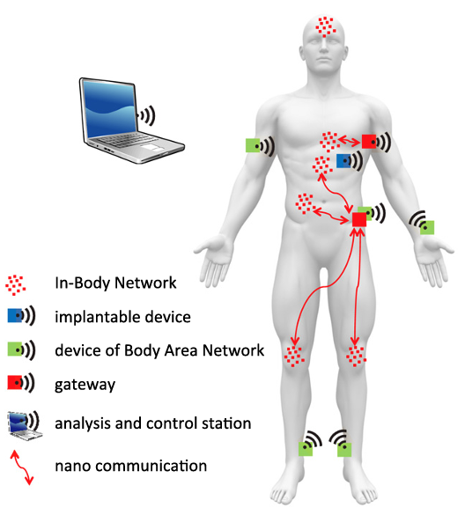
A possible architecture there would consist of one Body Area Network wirelessly connecting all (micro) devices which are located outside the body.
Within the body, there will be a number of nano device networks all operating in a certain area and specialized on certain functionalities and jobs.
Furthermore, there is one more powerful device which is able to analyse data from both network types and send commands to actuators also in both network types.
Finally, these networks will be interconnected through a gateway.

Slide 3
Privacy and security risks and solutions
The integration of Body Area Networks systems within body devices and nanomachines also creates a completely new level of security related challenges.
Such attacks may include
the theft of private data
the disruption of medical applications;
the targeted modification of communication links on the nano communication level or at the gateway
In order to achieve a certain level of security, IoNT systems need to rely on a broad mixture of security solutions:
Cryptographic primitives
Key management
Authentication and access control
Performance

Slide 4
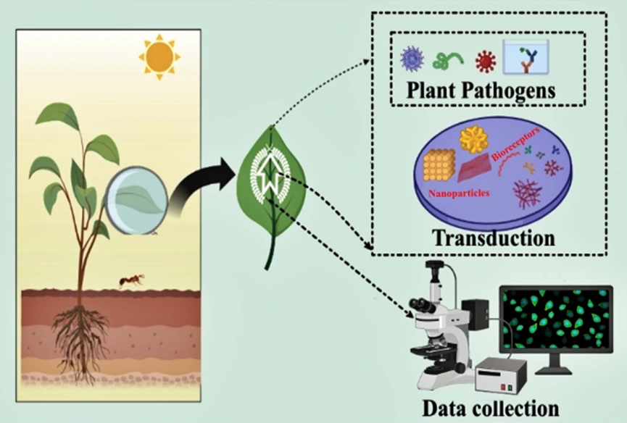
Application of IoNT in agriculture
Plant pathogens massively affect crop productivity and are one of the significant challenges in attaining sustainable development goals related to agriculture.
Biosensors generates an electrical signal by integrating a biological sensing element and physicochemical transducer when coming into contact with a target analyte or pathogen.

Slide 5
Plants that are under stress generally have a different "classification" than plants that are not under stress. This can be easily taken by using IoNT-integrated biosensors with the assistance of AI, drones, 5G communication, and machine algorithms.
These concerns, if given strategic consideration, will aid in the development of superior nanosensor products and their eventual incorporation into the agricultural ecosystem.

Slide 6
Future needs and prospects
Recent advancements in nano- and micro technologies have allowed the creation of plant-based biosensors that are extremely sensitive, fast, and selective.
There are some challenges that we have to overcome:
nanomaterials may be toxic
generation of e-waste due to the use of IoT
low detection time
Alternative for these challenges are:
toxicity can be reduced by functionalizing nanomaterials with biocompatible materials like P.E.G
green synthesis can be used in the fabrication of nanomaterials
use of the A.I. technique

