Slide 1

In-body and body area communication
Body Area Networks measure all kinds of body parameters from the outside.
Many more parameters are available inside the body, such as, for instance, blood and liver characteristics.
The vision of In-Body Networks is that nanomachines will patrol in the body, take measurements wherever necessary, and send collected data to the outside.
17

Slide 2
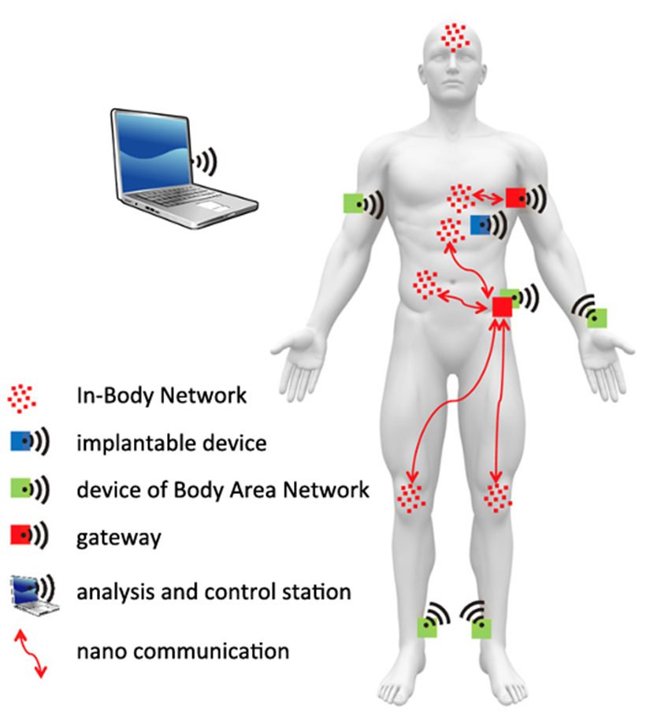
There will be a more powerful device which is able to analyze data from both network types and send commands to actuators also in both network types
The networks will be interconnected through a gateway
One Body Area Network wirelessly connecting all (micro) devices which are located outside the body
Within the body, there will be a number of nano device networks all operating in a certain area and specialized on certain functionalities and jobs
18

Slide 3

Privacy and security risks and solutions
The integration of Body Area Networks systems within body devices and nanomachines also creates a completely new level of security related challenges.
Attacks
Security solutions
theft of private data
disruption of medical applications;
targeted modification of communication links on the nano communication level or at the gateway
Cryptographic primitives
Key management
Authentication and access control
Performance

Slide 4
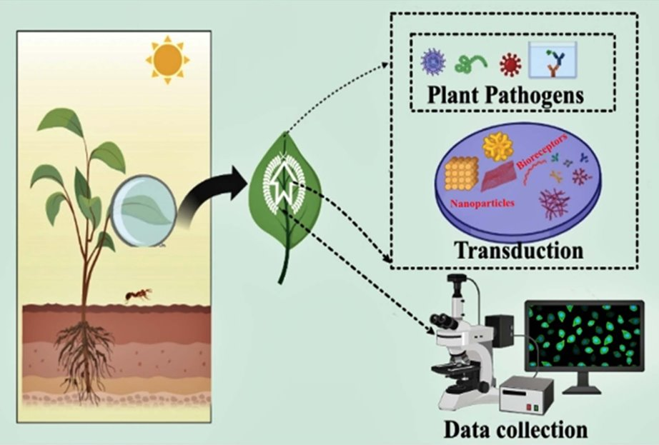
Application of IoNT in agriculture
Plant pathogens massively affect crop productivity and are one of the significant challenges in attaining sustainable development goals related to agriculture.
Biosensors generates an electrical signal by integrating a biological sensing element and physicochemical transducer when coming into contact with a target analyte or pathogen.​

Slide 5
Plants "classificated" by stress level can be easily taken by using IoNT-integrated biosensors with the assistance of AI, drones, 5G communication, and machine algorithms. These concerns will aid in the development of superior nanosensor products and their eventual incorporation into the agricultural ecosystem.

Slide 6
Future needs and prospects
Recent advancements in nano- and micro technologies have allowed the creation of plant-based biosensors that are extremely sensitive, fast, and selective.
Challenges | Alternative
Nanomaterials may be toxic | Toxicity can be reduced by functionalizing nanomaterials with biocompatible materials like P.E.G
Generation of e-waste | Green synthesis can be used in the fabrication of nanomaterials
Low detection time | Use of the A.I. technique

