Slide 1
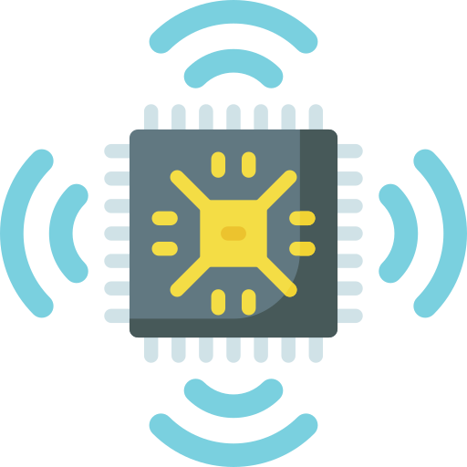
Internet of Nano Things
Daniele Borgna Luca Francesco Macera
Calogero Carlino

Slide 2
Definitions
Internet of Things: key technology that interconnects every digital device, allowing a machine-to-machine communication​
Internet of Nano-Things: The IoT on the nanoscale​
Internet of Everything: the concept that encapsulates different kinds of IoT such as IoNT, IoMT and more…​
IoE
IoT
IoNT
IoMT
…

Slide 3
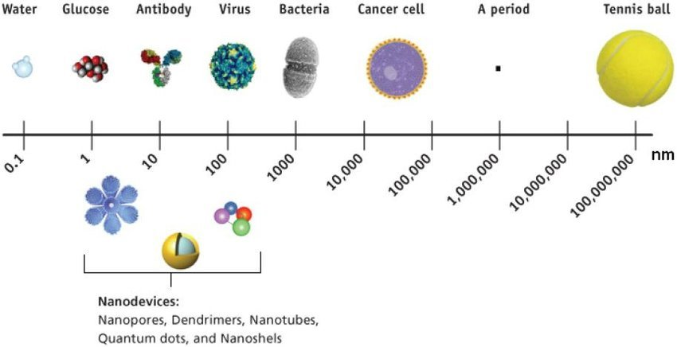
Definitions: nano-devices

Slide 4
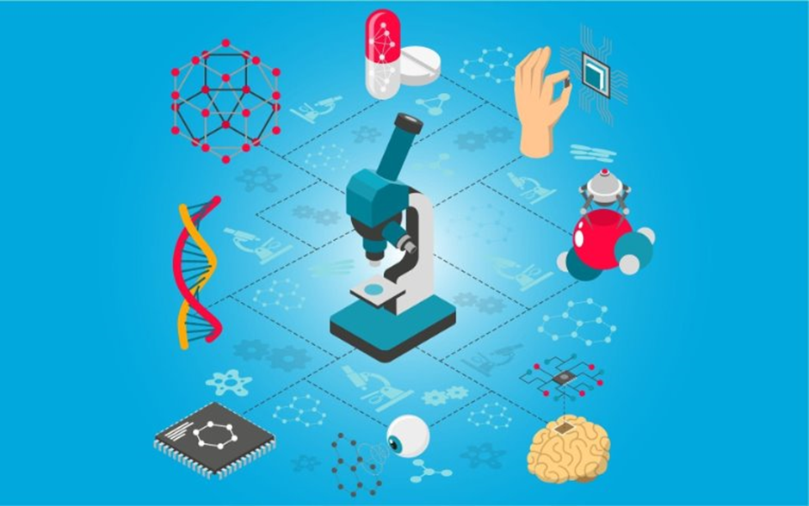
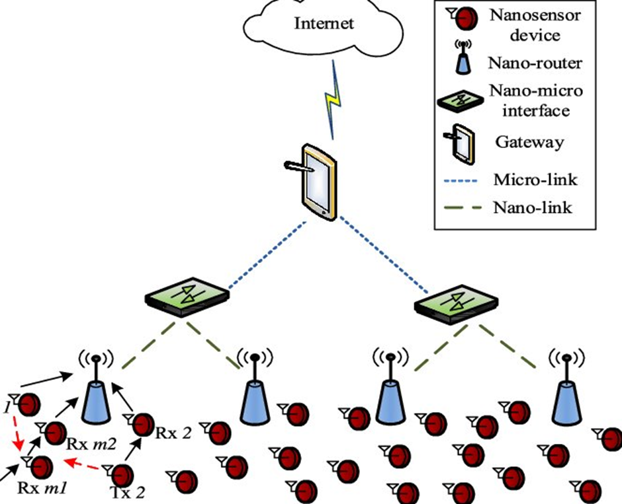
History of Nano-technology
In December 1959, Richard Feynman first presented the idea of nanotechnology.
The concept of the IoNT was developed by Ian F. Akyildiz and Josep Miguel Jornet from the Georgia Institute of Technology in 2010.

Slide 5
Benefits of IoNT
Enhanced functionality
Accuracy and precision
Energy efficiency
Performing a wide range of functions.
Measuring and monitoring at a higher level of accuracy.
Operating on very low levels of power.
Increased sensitivity
Miniaturization
Durability
Detecting subtle changes in the environment
Leading the development of less obtrusive implantable IoT devices.
Nanodevices are more resistant to damage than their larger counterparts.

Slide 6
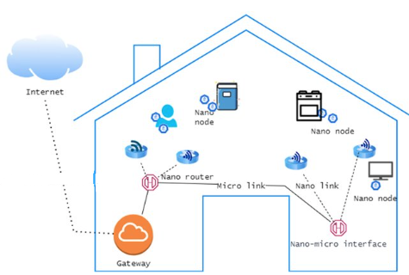
IoNT Architecture
Data processing and storage
Nano nodes
due to the large amount of data generated
Nanosensors and nanoactuators
Network infrastructure
Specific communication protocols
May include both traditional and specialized network technologies
Like NFC or nanowires

Slide 7
Security goals
Confidentiality
Availability
Avoiding the exposure of sensitive information to not authorized third parties.
A malicious user must never be able to interrupt or negatively impact the communication
Integrity
Authenticity
Data must not be altered in transit
The source of transmission should be reliable and should prevent attacks

Slide 8
Application fields of IoNT
Smart cities
Oil and Gas
Environmental monitoring
Manufacturing
Transportation
Energy
Military
Healthcare
Agriculture

Slide 9
Application fields of IoNT
Smart cities
Oil and Gas
Environmental monitoring
Manufacturing
Transportation
Energy
Military
Healthcare
Agriculture

Slide 10
Application fields of IoNT
Smart cities
Oil and Gas
Environmental monitoring
Manufacturing
Transportation
Energy
Military
Healthcare
Agriculture

Slide 11
Application fields of IoNT
Smart cities
Oil and Gas
Environmental monitoring
Manufacturing
Transportation
Energy
Military
Healthcare
Agriculture

Slide 12
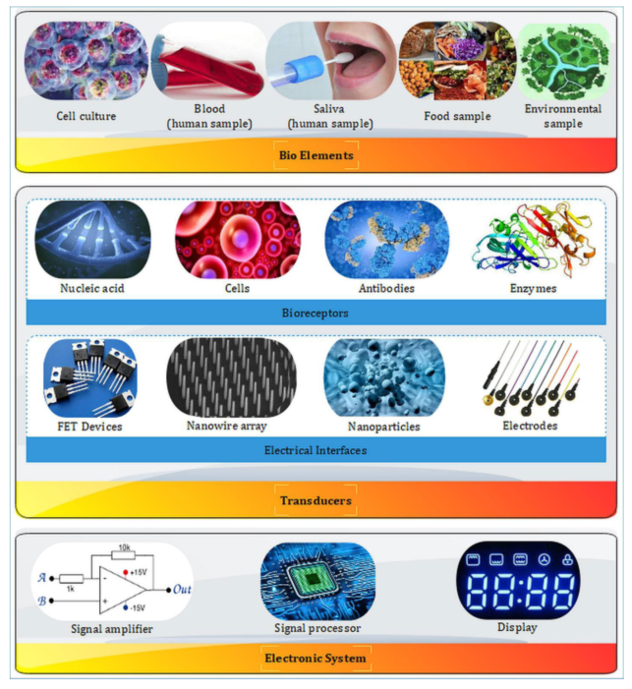
Applications of IoNT in healthcare Biosensors and Nano-biosensors
A biosensor is a device which incorporates active elements (enzymes or proteins) with physical transducers to generate measurable signals.
The mix of biosensors and nano-technology are nano-biosensors.

Slide 13
Applications of IoNT in healthcare Types of biosensors
Optical
Electrochemical
Electrical
Acoustic
Calorimetric
Mass sensitive
Biosensors
Electrochemical
Optical
Physical
Mass Sensitive
Calorimetric

Slide 14
Applications of IoNT in healthcare Detection and diagnosis
1
2
3
4
Counting blood cells
Measuring electrolytes
Detecting genetic diseases
Targeted drug delivery
Using chips to check the number of blood cells to analyze blood flow and pressure
A system for measuring sodium and potassium levels in critically ill patients
Programmable sensors used for carrying and deploy medicine in specific areas in the body
Like cardiovascular diseases of diabetes

Slide 15
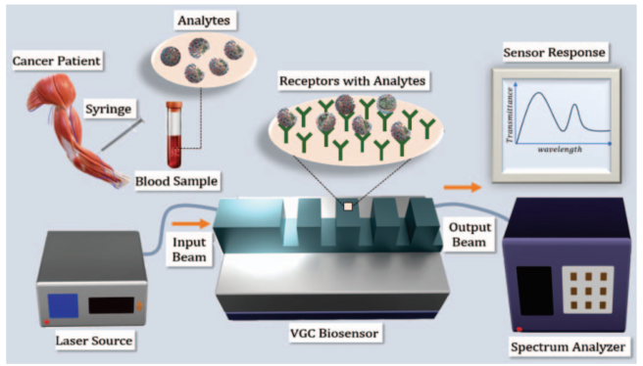
Applications of IoNT in healthcare Analysis and Research
Unhealthy and healthy cells can be detected and separated, based on the refraction index of each type of cell, using a special kind of machine called Vertical Grating Coupler (VGC).
https://ieeexplore.ieee.org/document/10621495

Slide 16
Applications of IoNT in healthcare Risks and Challenges
Usage concerns
Communication problems
The immune system may react negatively to these devices leading to an overall weakening for the patient.
High frequency radio waves can cause internal damage to tissues and organs.
Materials guidelines
Deployment issues
Long exposure to nano-materials can alter the normal behaviour of healthy cells leading to internal issues.
Implanting these devices in sensitive areas can be difficult and risky for the patient.

Slide 17

In-body and body area communication
Body Area Networks measure all kinds of body parameters from the outside.
Many more parameters are available inside the body, such as, for instance, blood and liver characteristics.
The vision of In-Body Networks is that nanomachines will patrol in the body, take measurements wherever necessary, and send collected data to the outside.
Notes:
Even better, if we consider actuators connected to the sensors, it will be possible that these machines immediately work on problems they detect within the body, such as cancer cells, arteriosclerosis, or HIV viruses.
Think, for instance, of an implanted drug pump, which could be instructed to dispense parts of its content when the IoNT considers it necessary, or of a heart pace maker which could be regulated in its frequency.

Slide 18
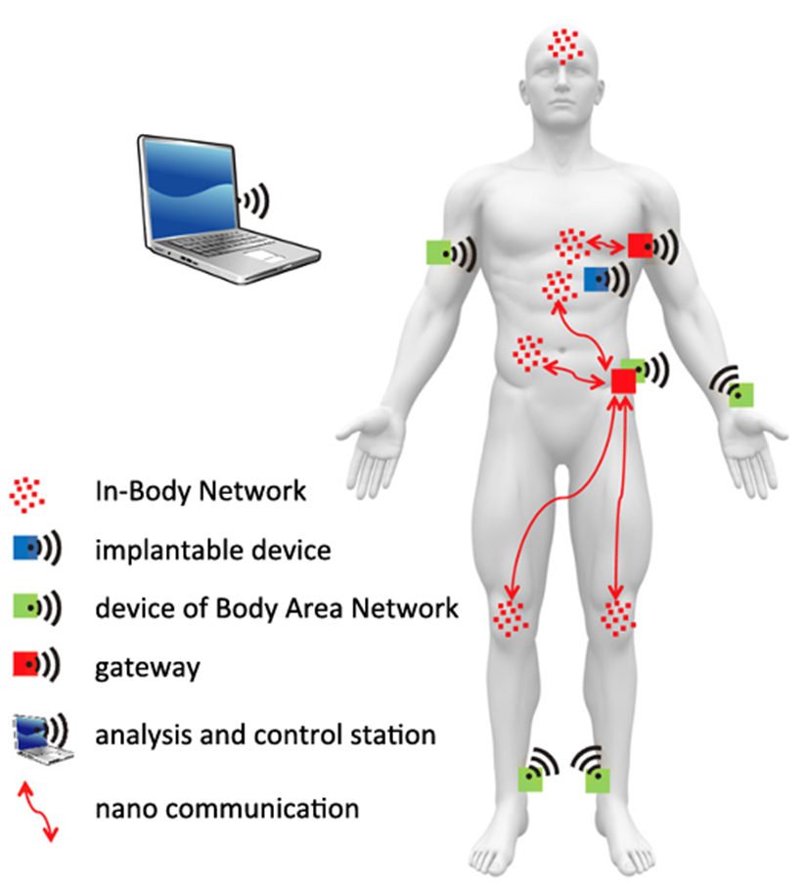
One Body Area Network wirelessly connecting all (micro) devices which are located outside the body
There will be a more powerful device which is able to analyze data from both network types and send commands to actuators also in both network types
The networks will be interconnected through a gateway
Within the body, there will be a number of nano device networks all operating in a certain area and specialized on certain functionalities and jobs

Slide 19

Privacy and security risks and solutions
The integration of Body Area Networks systems within body devices and nanomachines also creates a completely new level of security related challenges.
Attacks
Security solutions
theft of private data
disruption of medical applications;
targeted modification of communication links on the nano communication level or at the gateway
Cryptographic primitives
Key management
Authentication and access control
Performance
Notes:
Cryptographic primitives:
classical cryptographic solutions such as using the symmetric AES or the asymmetric RSA algorithms for Body Area Networks.
more lightweight solutions such as the biochemical cryptography for In-Body Nano Communication
Key management
The gateway will have to part of a (possibly larger) PKI system. Also, the type of keys used will strongly depend on the employed communication techniques.
- Authentication and access control
All messages to be forwarded by the gateway to the In-Body Nano Communication system need to be authenticated in order to prevent misuse.
- Performance
For sensor and body area networks, it has been shown that even rather fast cryptographic algorithms become limiting factors

Slide 20
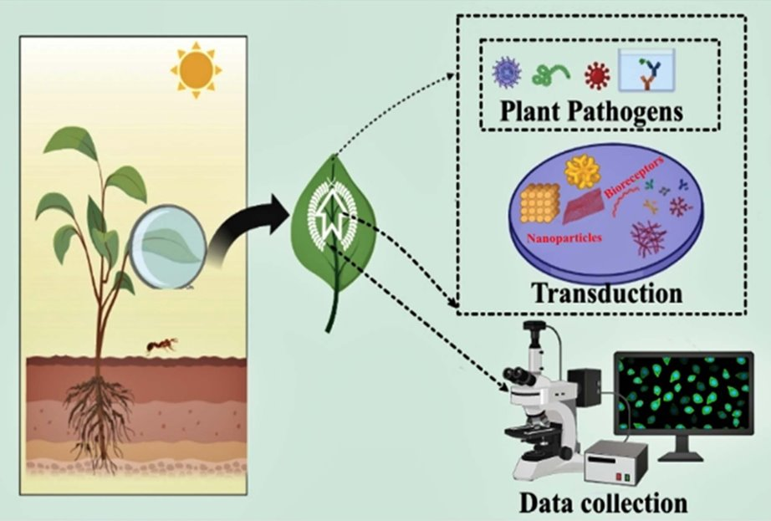
Application of IoNT in agriculture Intelligent Plant Pathogen-Diagnostic Biosensors
Plant pathogens massively affect crop productivity and are one of the significant challenges in attaining sustainable development goals related to agriculture.
Biosensors generates an electrical signal by integrating a biological sensing element and physicochemical transducer when coming into contact with a target analyte or pathogen.​
Notes:
The most conventional technique used for plant pathogen and resulting symptoms and disease diagnosis is their visual identification necessitating a practiced plant grower or pathologist. However, it is ineffective in detecting pathogens’ presence in the early infection phases when plant infections show no outward signs.
There also are three distinct molecular tests that have been used, but all of them are costly, time-consuming, and labour-intensive, hindering the early stage, cost-effective and rapid pathogen diagnosis necessary for diversified crops. ---------------------------------------------------------------- As a result, a transducer takes a biomolecular interaction and turns it into a digital signal.
An antibody, D.N.A., enzyme, tissue type, complete cell, etc., may all perform the function of a bioreceptor.
The bioreceptor’s specialized biochemical interaction gives the biosensor its recognition specificity.

Slide 21
Application of IoNT in agriculture Integration of modern age technology
Plants "classificated" by stress level can be easily taken by using IoNT-integrated biosensors with the assistance of AI, drones, 5G communication, and machine algorithms.
These concerns will aid in the development of superior nanosensor products and their eventual incorporation into the agricultural ecosystem.
Notes:
For example, Nasys, an Italian startup, developed a nanosensor based on metal oxides to measure air pollution.

Slide 22
Future needs and prospects
Recent advancements in nano- and micro technologies have allowed the creation of plant-based biosensors that are extremely sensitive, fast, and selective.
Challenges | Alternative
Nanomaterials may be toxic | Toxicity can be reduced by functionalizing nanomaterials with biocompatible materials like P.E.G
Generation of e-waste | Green synthesis can be used in the fabrication of nanomaterials
Low detection time | Use of the A.I. technique
Notes:
Technology mobilization will also benefit from the development of multi-entity detectable, broad-spectrum nanosensors.
Some have speculated that in the not-too-distant future, we may be able to create super "new nanomaterials" that will vastly increase the performance of biosensors.

Slide 23
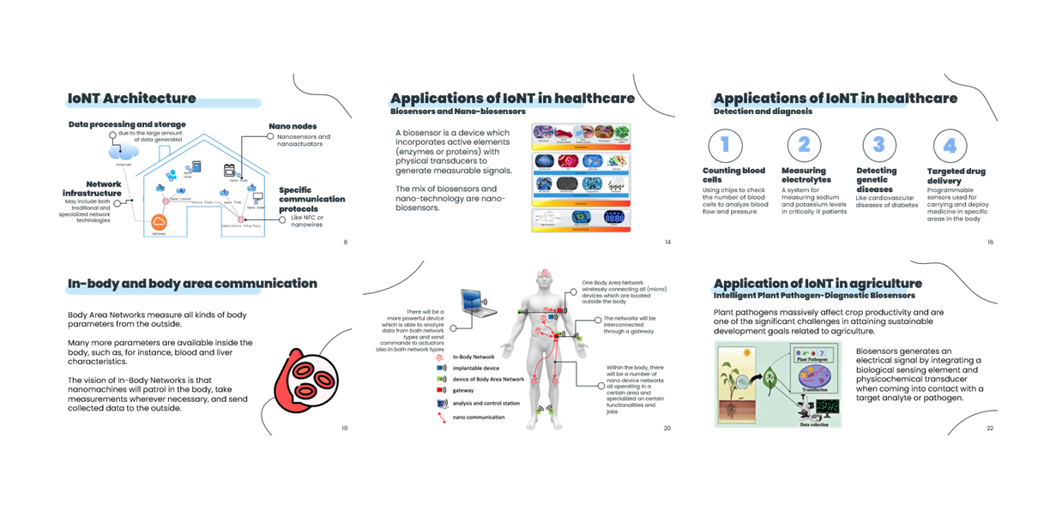
Final summary

Slide 24
References
[1] Internet of Nano-Things (IoNT): A Comprehensive Review from Architecture to Security and Privacy Challenges, https://www.mdpi.com/1424-8220/23/5/2807
[2] Internet of nanothings: Challenges & opportunities, https://ieeexplore.ieee.org/document/8363165
[3] Advancing Modern Healthcare With Nanotechnology, Nanobiosensors, and Internet of Nano Things: Taxonomies, Applications, Architecture, and Challenges, https://ieeexplore.ieee.org/abstract/document/9056855
[4] Vertical Grating Coupler Based Biosensor for Cancer Diagnostics,
https://ieeexplore.ieee.org/document/10621495
[5] A review on Internet of Things (IoT), Internet of Everything (IoE) and Internet of Nano Things (IoNT), https://ieeexplore.ieee.org/document/7317398
[6] The Internet of Bio-Nano Things — Smart Computing in the Human Body, https://ieeexplore.ieee.org/document/10595635
[7] A Paradigm of Internet-of-Nano-Things Inspired Intelligent Plant Pathogen-Diagnostic Biosensors, https://iopscience.iop.org/article/10.1149/2754-2726/ac92ed
[8] Connecting in-body nano communication with body area networks: Challenges and opportunities of the Internet of Nano Things, https://www.sciencedirect.com/science/article/abs/pii/S1878778915000071

