Slide 1
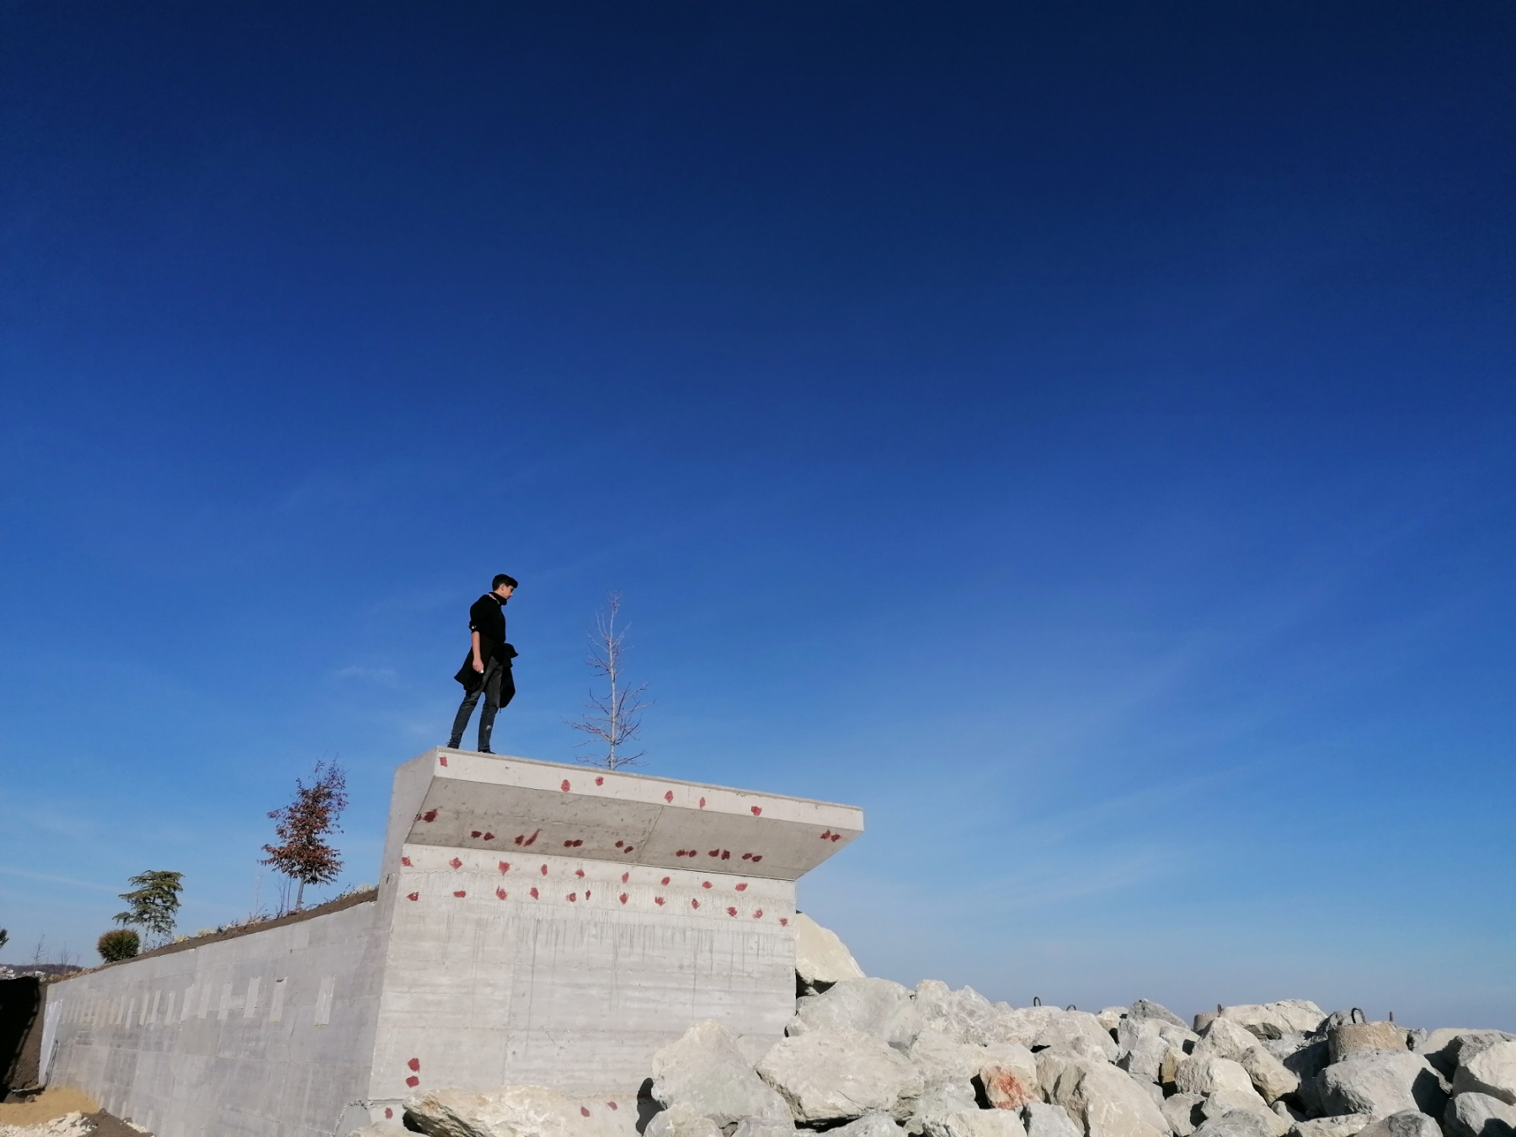
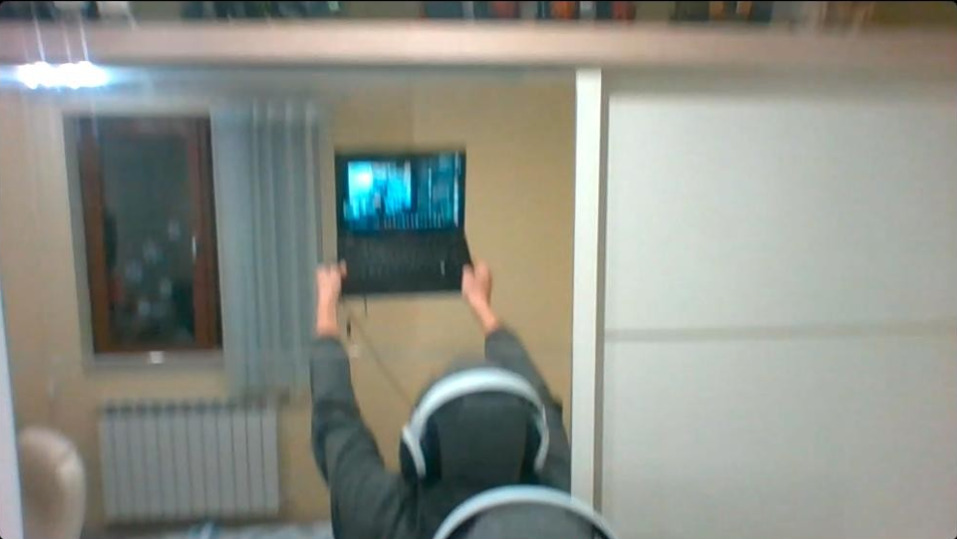
TUES FEST 2023
Team: DocHelp
Borimir
Ganchev
Radoslav
Cvetanov
Frontend
Backend

Slide 2
DocHelp
Web application
Improving the way doctors and patients communicate
Sharing medical records.
Search engine, which, based on entered symptoms, derives hypothetical diseases

Slide 3
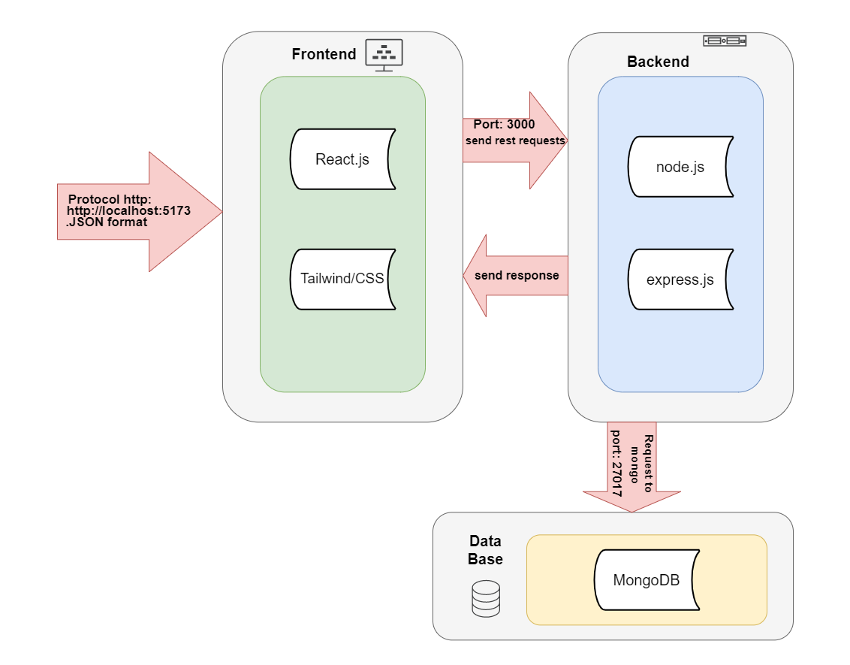
Software Architecture
Conception
Technologies
Firebase is used as a means of storing chat messages and handling user sessions.
Software tiers isolating backend, frontend, and database
Data Base for user management
Frontend
  React.js
  SCSS
Backend
  Node.js
  Firebase
Database
  MongoDB
  Firestore

Slide 4





Software Workflow
Step 2
Step 3
Step 4
Step 5
Step 1
Task allocation
Designing the Software
Developing the project
Idea
Testing
Brain Storming
Workflow agreed –Jira + GitHub
Software architecture
Design mockups
Individual work per area of expertise
Teamwork -Problems solved and bugs fixed
Putting the parts together
Teamwork iterations

Slide 5
Demo
DEMO
DEMO

Slide 6
/Thank you for your attention!
/Do you have any questions?

