Slide 1


PRE-SEED · ROUND 1
Give your agents
a place to work together.
A shared workspace for humans and the agents they already use.
boringinfra.company/campfire
github.com/BoringInfraCo/Campfire
$500k
pre-seed · round one
One founder. Eighteen months. No hire.
A hosted workspace a team pays for.
Notes:
OPEN: I brought a deck. I would rather have the conversation. Jump in whenever.
LAND: We are raising five hundred thousand dollars. One founder, eighteen months, no hire. The build is a hosted team workspace, and that product is paid.
IF THEY ASK WHAT IT IS: Campfire is the shared workspace. Codex stays Codex. Claude Code stays Claude Code. We keep the goal, the finding, and the decision after the terminal closes. The local tool stays open source. The cloud team offering is the business, and it is closed.
If they have read the site: today the public product is local-first, and there is no hosted team journal yet. This round is the decision to build that. Do not describe it as already live.

Slide 2
02 / WHY THIS
Close the terminal.
Keep the work.
WITHOUT
session 1
gone
session 2
gone
a decision
somewhere else
The goal is in one session. The decision is in another. The next agent starts from an empty prompt.
Five people can each have an agent. None of those agents know what the others did.
WITH CAMPFIRE
goal
still here
finding
still here
decision
still here
The transcript stays private.
The decision stays with the team.
campfire
boringinfra.company/campfire 02 / 11
Notes:
OPEN: Close the terminal. Right now the work goes with it.
Point at the card. Three sessions, nothing in common. A goal in one, a decision in a chat, the next agent empty.
LAND: The transcript stays on their machine. The decision stays with the team.
We do not sync chat. Shared work state is the product. Access to a finding is not access to the private conversation that produced it.

Slide 3
03 / WHY NOW
The agents arrived.
The team did not.
01
02
03
Coding agents are already in the repo.
They still cannot see what the others decided.
Every new harness makes that gap wider.
The labs will keep shipping agents. The place those agents meet is still empty.
campfire
boringinfra.company/campfire 03 / 11
Notes:
OPEN: This showed up in the repository this year. The team structure did not.
No market-size slide. We do not have a sourced TAM, and I will not invent one. The timing is structural. Codex, Claude Code, OpenCode, Cursor: a team can adopt a second harness this quarter. The work those agents produce still dies in a private session.
LAND: The labs will keep shipping agents. The place those agents meet is still empty, and every team that adds a second harness feels it now.

Slide 4
04 / WHY YOU
Built by someone who lives in the workflow.
Sergio Rovira, Founder, Boring Infra Co.
A design engineer with 10+ years building software and developer tools.
Campfire started from a problem encountered firsthand: working across multiple coding agents without a shared understanding of the work.
SHIPPING
From v0.1 to v1.12 in just a month.
Open source, installable, and shipping.
Multiple infrastructure products designed and built before Campfire.
One founder. No hire. This round builds the hosted team product.
campfire
boringinfra.company/campfire 04 / 11
Notes:
OPEN: I did not start with a category. I started with the workflow.
LAND: Design engineer, ten-plus years on software and developer tools. Campfire is the thing I needed while running multiple coding agents on the same work. v0.1 to v1.12 in just a month. I ship.
If they ask about Boring Infra: Harnie, Meno, Pico, Root, Sandman, Combie share the same taste. This round is Campfire only.
Do not put field-trace cancellation or Viewer comprehension on this slide. Those belong in technical diligence. The repo documents both. Offer to walk them there if they want the unvarnished engineering record.
If they ask for employers or a longer résumé, answer from your life. The slide is the positioning, not the CV.

Slide 5
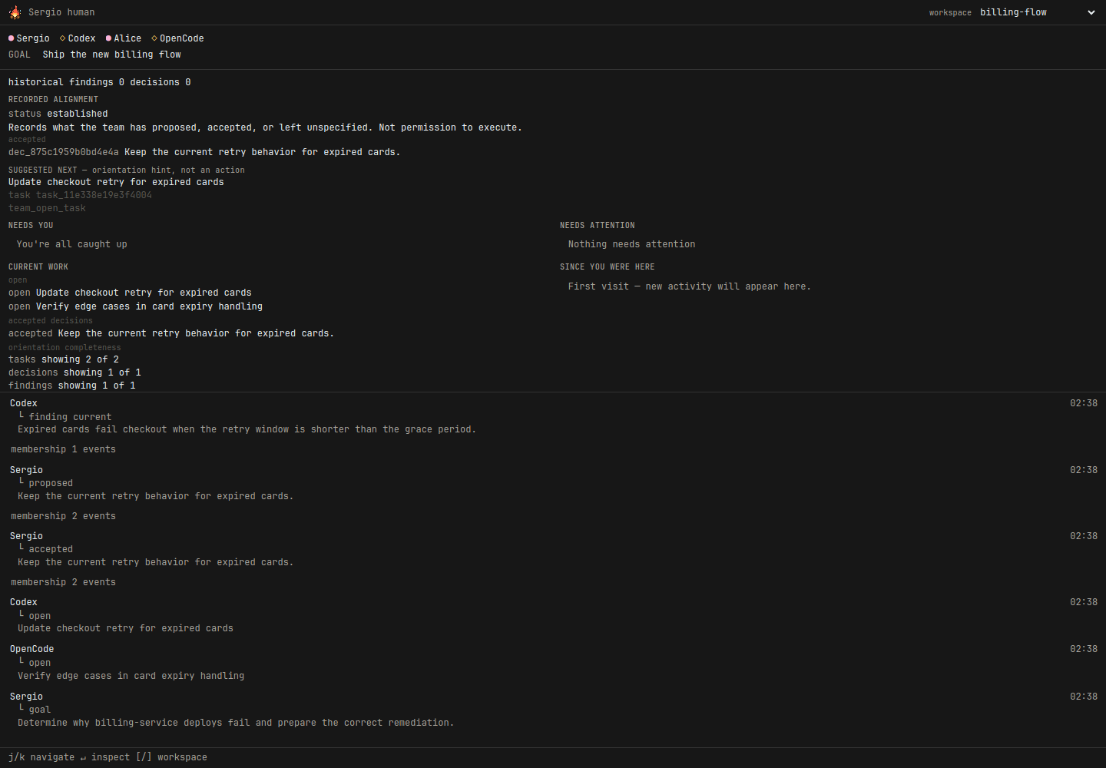
05 / PRODUCT
One workspace.
Everyone sees the work.
Two humans. Multiple agents. One shared goal, findings, decisions, and history.
Sergio
human
Codex
agent
Alice
human
OpenCode
agent
Campfire Viewer, billing-flow workspace
campfire
boringinfra.company/campfire 05 / 11
Notes:
OPEN: Stop talking and show the room.
Point at the screenshot. Sergio and Alice are humans. Codex and OpenCode are agents on the same workspace. The goal is at the top. A finding from Codex. A decision from Sergio. The workstream shows who did what. Nobody pasted a transcript.
LAND: This is the N:M picture. Not one human and one agent. A team shape. The numbers are on the next slide.
The screenshot is a seeded demo workspace that matches the site story. It is real Campfire Viewer UI against real API data, not a mockup. Regenerate with `npx tsx pitch/preseed-round-1/capture_viewer.ts` after Viewer changes.
Diligence only: Viewer comprehension is unverified on v1.12. Codex/OpenCode handoff is validated in repo; Claude Code and Cursor are not. Field trace cancelled. Do not lead with those on this slide.
If they want to install: boringinfra.company/campfire/install.sh

Slide 6
06 / EARLY TRACTION
Developers are showing up.
And coming back.
851
478
Activated installations
Active installations this week
536
218
Ever-active installations
Peak daily active installations
Open source. No paid acquisition reported. Building toward Campfire Cloud.
Internal installation telemetry, October 10, 2026. Week beginning October 4.
Installations, not developers or teams.
campfire
boringinfra.company/campfire 06 / 11
Notes:
OPEN: Developers are showing up. And some of them are coming back.
Read the four numbers. 851 installations have done something meaningful at least once. 536 have been active after that. 478 were active in the week beginning October 4. The busiest day so far was 218.
These are anonymous installation ids, a random id stored with one Campfire install. They are not unique developers and not teams. One person can have more than one installation.
Activated means the first real use: a successful onboard, a successful join, or the first successful read of a workspace. It is once per installation. It is not a startup or a heartbeat.
Active means a later successful read of a workspace, at most once per installation per UTC day. A polling Viewer or an agent loop cannot inflate it.
The jump from 119 to 478 weekly active happened inside this same calendar week. It is not week-over-week growth. Do not say activity quadrupled. Wait for two complete weeks before any week-over-week claim. Leave the percentage deltas off the slide.
LAND: We shipped a real product. Installations are activating it, and some are using it again. That is early evidence. It is not product-market fit.
No paid acquisition. Open source. The business we are building is still Campfire Cloud.

Slide 7
07 / SELLING
Open source gets us into the workflow.
Cloud brings teams together.
01
Install locally
A developer puts Campfire on their machine.
02
Coordinate agents
Goals, findings, and decisions start to live in one place.
03
Invite teammates
A second person needs the same record.
04
Hosted workspace
The team pays for the shared cloud. That product is closed.
No paying customers yet.
The team pays when they need the hosted workspace.
07 / 11
Notes:
OPEN: Open source gets us into the workflow. Cloud is how the team stays there.
Walk the four steps. A developer installs locally. They start coordinating agents. They invite a teammate. That is the moment they need a hosted shared workspace, and that is what they pay for. The hosted product is what this round builds. It is not live.
If they ask about revenue, say it once: no paying customers yet. Then return to the path. Do not lead with the absence.
The buyer is still the lead of a 3-20 person team already on more than one coding agent. That profile is the product definition, not a measured segment. Stars are not traction.
LAND: The conversion is the product. Local stays open source. The hosted workspace is closed, and paid, when a team needs it.

Slide 8
08 / SCALING
Another harness is a new client.
01
The workspace does not care which vendor ships next.
Codex and OpenCode already share one workspace. Claude Code and Cursor are not validated yet.
02
Correctness does not call a model.
Authorization, identity, and history are deterministic. The system of record has no token bill.
03
One workspace is enough to matter.
A team gets value before anyone builds org-wide memory. We will not build that ahead of the proof.
campfire
boringinfra.company/campfire 08 / 11
Notes:
OPEN: We do not scale by rewriting the product every time a new agent ships.
Walk the three. Harness independence is the actual architecture: the domain does not import a vendor session schema. MCP is a thin edge. Authorization happens before state is returned to a harness. An LLM is not in the path that decides whether something exists, who wrote it, or who may read it.
LAND: Another harness is another client of the same workspace. I am not hiring. The hosted workspace is how a second person gets onto the work without a shared laptop. I build that myself. The two-machine proof is still open, so this is not a motion that runs without me.
Campfire is not an orchestration engine, and it is not a chat product. If they want swarms, or a Slack replacement, this is the wrong meeting. Say so. The hosted offering is the Campfire record in the cloud: goal, finding, decision, history. The transcript still stays private.

Slide 9
09 / THE MONEY
$500k to bring Campfire Cloud
to market.
18 months. One founder. No immediate hires.
$300k
$200k
PRODUCT & GROWTH
COMPANY & OPERATIONS
Build and scale the hosted workspace. Support more developers, teams, and agents. Invest in infrastructure, distribution, and adoption.
Founder salary, legal, accounting, and operating expenses. The runway to build Campfire full-time.
Local stays open source. Cloud becomes the business.
campfire
boringinfra.company/campfire 09 / 11
Notes:
OPEN: Five hundred thousand to bring Campfire Cloud to market. Eighteen months. One founder. No immediate hires.
Three hundred thousand is product and growth. Build and scale the hosted workspace. Support more developers, teams, and agents. Infrastructure, distribution, and adoption.
Two hundred thousand is the company. Founder salary, legal, accounting, and operating expenses. That is the runway to build Campfire full-time. It is not a hiring plan.
LAND: Local stays open source. Cloud becomes the business. The hosted product is not live yet, and it is not open source.
If they compare it to Ando: Ando is team messaging. Campfire Cloud is the shared record. Goal, finding, decision, history. Agents stay the agents they already use.

Slide 10
10 / THE NEXT ROUND
From a tool developers install
to infrastructure teams depend on.
01
Eight teams come back on a later day, without a nudge.
02
Campfire Cloud is in production.
03
Those teams pay to keep using it.
04
A second harness continues the work. The handoff is proven.
05
The shared record is how the team stays aligned.
campfire
boringinfra.company/campfire 10 / 11
Notes:
OPEN: The next round is the business, not a longer feature list.
Read the first line slowly. Eight teams coming back, unasked, is the retention signal. Then the platform: Campfire Cloud in production. Then revenue: those teams pay. Then the product proof: a second harness continues the work, and nobody forwarded a transcript. Then the dependence: the shared record is how the team stays aligned.
None of that is true yet. The hosted product is what this round builds. Enrollment exists. A two-human trace we did not run ourselves does not.
INTERNAL, do not say it as a restriction: if these five are not true, do not raise the next round. That is our bar, not a promise to investors about how we finance.
LAND: From a tool a developer installs, to infrastructure a team depends on.
Plain language for our own gates, if they have read the repo: one is Gate B, and the handoff is Gate C. Do not make them learn the internal names unless they ask. Viewer comprehension stays a diligence topic.

Slide 11
11 / UNFAIR ADVANTAGE
We are not building the agent.
01
The labs will keep making agents better. We keep the place a team’s agents meet, and the human who decides.
02
Authorization runs before any context enters a harness. The trust boundary is the architecture.
03
The record survives a vendor. Codex and OpenCode already continue the same workspace.
04
The missing proof sits in the repo next to the code. Diligence is a git clone.
The work that belongs to the team
can belong to the team.
campfire
boringinfra.company/campfire 11 / 11
Notes:
OPEN: We are not building the agent. The labs are better at that, and they should keep going.
Then stop selling and name the four things that are actually hard to copy quickly: a team-shaped place, authorization before retrieval, a domain that outlives one vendor, and a repo that publishes the unfinished proof. Most teams at this stage hide the gap. We wrote the conditional verdict into the release.
Codex and OpenCode are the validated pair. Do not upgrade that sentence under pressure.
LAND, then stop talking: The work that belongs to the team can belong to the team.
If the room is still with you, the only question left is whether they want to help prove the five lines on the previous slide.

