Slide 1
Investment Advice Application
Boris Dudkin, Brian Wander, Adam Jimenez

Slide 2
User Stories / Executive Summary:
Very often people are making investment decisions driven by their risk tolerance, while disregarding their life circumstances. (Tolerance v. Capacity)
Our application aims to bridge the gap between the investors willingness and ability to take investment risks.
We conduct two sets of questionnaires, which is used to assess the client’s aptitude and tolerance for investment risk.
Two different portfolios on compiled based on these factors.
We hope to educate the client and allow them to make an informed decision by taking into account both the aptitude and attitude towards risk.

Slide 3
Application Flow
Sector / Industry / Investment Style mapping
Past Performance
Tickers
Market Data API ALPACA
Questionnaire 1 Risk Tolerance
Tolerance Score
Tolerance Risk Portfolio
Portfolios
Future Returns (Monte Carlo)
Capacity Score
Questionnaire 2 Risk Capacity
Capacity Risk Portfolio
Tickers
Sector / Industry / Investment Style mapping

Slide 4
Pulling Market Data / DB Queries:
Relevant market data is pulled via the Alpaca Market API and cached in the application for use later on.
The market data is cleansed removing any duplicated rows, missing values, and stock splits.
We compared the historical/current pricing to the Yahoo Market API to ensure there are no discrepancies.
Questionnaires, portfolio and sector/Industry/Investment style information stored in our database will be uploaded into the application via SQL queries.

Slide 5
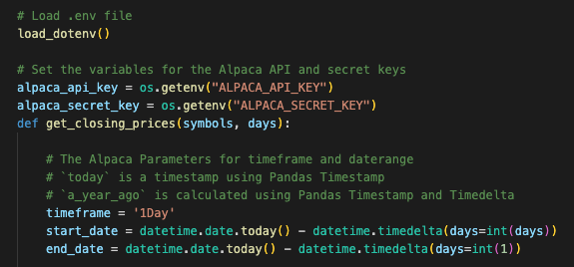

Slide 6
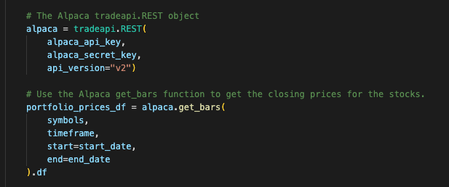

Slide 7
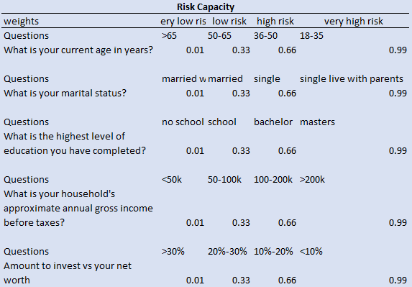
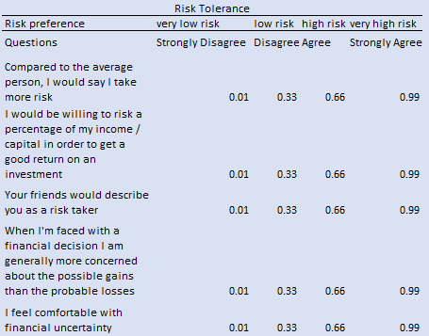
Two sets of questionnaire to assess the investor’s risk tolerance and risk aptitude. Each answer is assigned a weight and two risk scores are calculated:

Slide 8
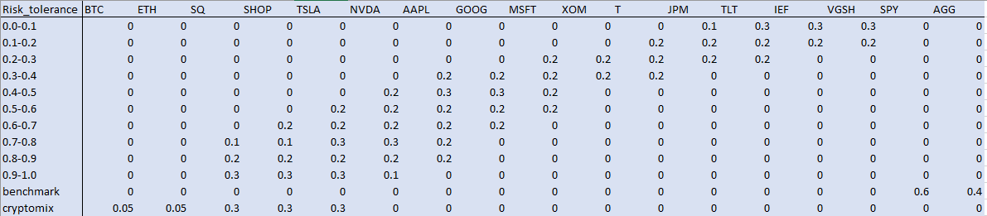
Based on two scores, risk tolerance and risk capacity portfolios are generated:

Slide 9
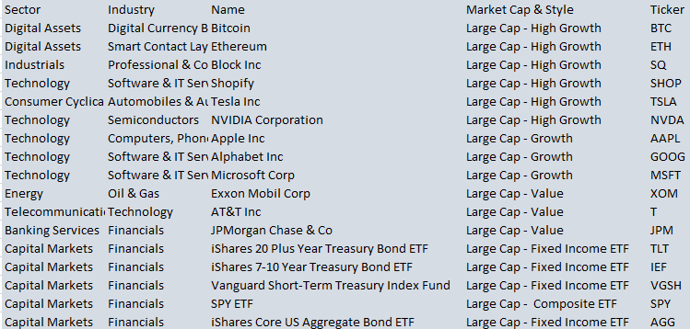
Sector, industry, investment style, and mapping table used to show portfolio breakdowns by one of those categories:

Slide 10
Historical Analysis:
The cleansed market data gathered by the Alpaca API is analyzed to assess past performance of each of the portfolios and their contents.
Cumulative returns and Sharpe-ratios are assessed over a three year time period.
The returns and ratios are gathered and plotted on figures to visualize the portfolio/asset performance for the investor.

Slide 11
Estimated Future Returns via Monte Carlo:
Based on the historical performance gathered by each of the assets in the four portfolios, a Monte Carlo simulation is run.
Each of the four portfolio’s estimated future returns are assessed using the 95% confidence interval gathered by the simulation.
The simulation is visualized via line plots and histograms representing the possible returns for the investor.

Slide 12
Next Steps
We are looking to improve the application in ways that will allow the investor greater insight on investment portfolio development and analysis:
Consideration is being taken to allow the investors create their own portfolios by selecting companies and allocating weights. The exiting functionality will be extended to those portfolios.
We would like to have a more diversified portfolios offering byaddong more securities to each portfolio (about 30 per portfolio) to be in line with the industry standards

Slide 13
Links
You can access our investment application here:
https://github.com/BorisDudkin/FinTech_Project_1_Investment_Advice

