Slide 1

IT Talents
Final Project
Work Plan 1.0
Sofia 11.4.2016

Slide 2
Creators:
Ivaylo Georgiev
&
Boris Gichev

Slide 3
What is Work Plan 1.0
Poject tracker based app
Using the Scrum workflow
Handaling multiple projects and tasks
Keeping track of the overall process
using logs and comments
Reporting tools for accessing

Slide 4
What did we used
Front end techonologies:
HTML 5
CSS
Bootstrap
JavaScript
jQuery
AJAX
JSP
JSTL

Slide 5
Back end techonologies:
Maven
Spring Framework
JavaMail API
Servlet 3.0
JFreeChart
JDBC
Gson
JUnit API
AWS
Database: MySQL

Slide 6
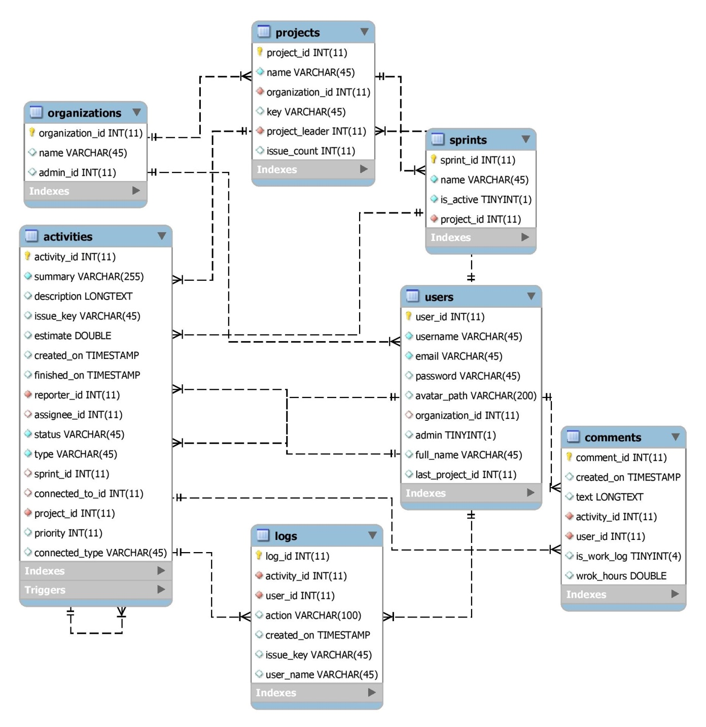
Design Database Diagram

Slide 7
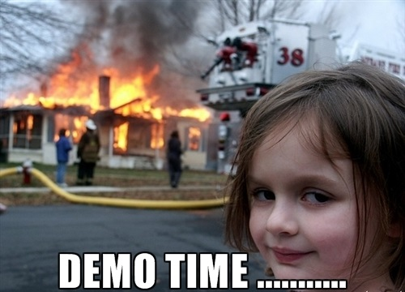
GO TO
WorkPlan

Slide 8
Upgrades for Work Plan 1.1:
More statistics
Integrating Kanban projects
Alerts for overdue issues
Payment integration
Improving the SEO rating

Slide 9
Thank you !

Slide 10
Time for questions!

