Slide 1
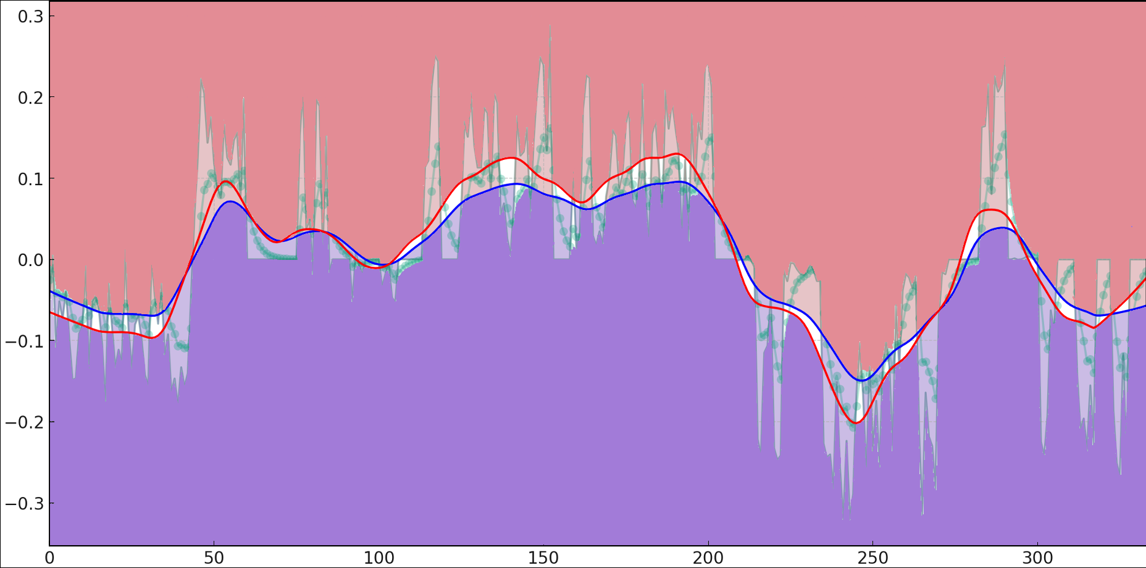
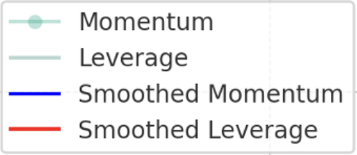
Predicted momentum of Match #1701—— Carlos Alcaraz vs. Novak Djokovic
SET1
SET2
SET3
SET4
SET5
Point

