Slide 1
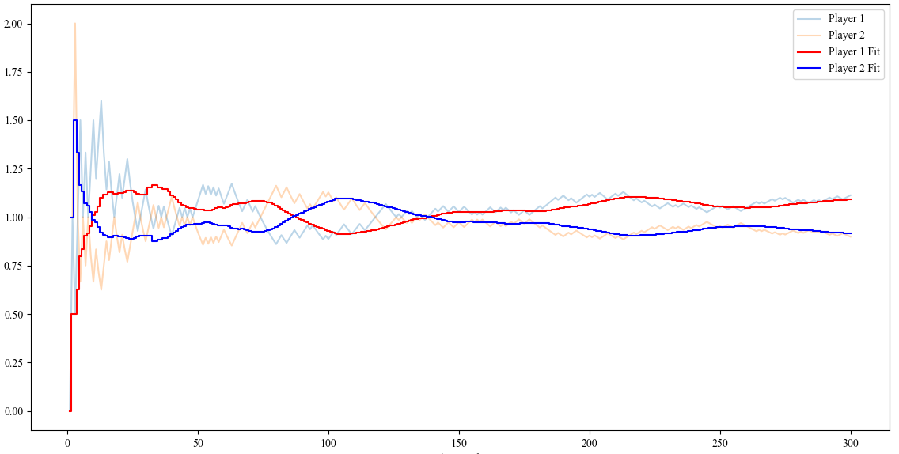
Match flow in #1301
Starting the gap
To-and-fro phase
Seal the victory
Carlos Alcaraz tied Nicolas Jarry’s score
Multi-Probability
Nicolas Jarry is ahead of Carlos Alcaraz
Nicolas Jarry back in lead
Scoring Index

