Slide 1

Prevail: Simple and Precise Static Analysis of Untrusted Linux Kernel Extensions
eBPF Programs
Elazar Gershuni, Noam Rinetzky, Mooly Sagiv (TAU) Leonid Ryzhyk, Nadav Amit, Nina Narodytska (VMWare Research) Jorge A. Navas (SRI International) Arie Gurfinkel (University of Waterloo)
Notes:
This work is about static analysis of kernel extensions, also known as eBPF programs
Hila:
* Don’t undersell
* (Jonathan van Geffen)
7 minutes for the problem domain
DSL like x86
Example before
No cBPF
Motivation: only packet filtering in the start, the rest at the end
Don’t talk about join
Supporting loops ”as well as current AI allows” – more than no-loop verifier
Kalev
Don’t undersell
More emphasis on our work
Explicit point where we say that we wrote a verifier
Problem - Existing solution –Our solution: SEPARATE slide
Mention the name: PREVAIL
Mention the library explicitly
”Example of a bad case”
Detailed empirical:
“Spurious“ in context
Precision: more details
Track: copy?
Explain desired behavior before introducing solution
Say: code in kernel can take control on everything

Slide 2
Static Analysis: Success Stories
Device drivers (Slam, Blast)
Avionics (Astrée, CGS)
OS kernel extensions
eBPF
Restricted class of programs
Safety is crucial
Particular properties
Verification is already mandatory
Programming for verifiability
Better analysis ➔ more programs
Notes:
If you look at successful applications of static analysis you will see that they share a common theme:
They typically focus on a restricted class of programs and a restricted set of properties that are crucial for the safety of the whole system.
This work is about a new application domain for static analysis, for which all of the above is true, along with an additional feature: here, verification allows people to do things they cannot do otherwise. And we know that people want to do those things, because there is already a verifier for eBPF programs inside the Linux kernel, and people are already writing code that must pass verification.
But the Linux verifier has important shortcoming; we present

Slide 3

PREVAIL: a new eBPF verifier
Simple
Scalable
Precise in practice
Improves functionality over existing verifier
Notes:
PREVAIL - a new eBPF verifier that is simple, scalable, precise enough to analyze existing programs and is better than the current verifier in several important factors.
But first, let’s talk about the domain – what are kernel extensions?

Slide 4

What are Kernel Extensions?
process
kernel
Packet filters
Security policies
Profiling
...
P
Filter

Slide 5
eBPF
r0
start | end
Context
Arithmetic
Load/Store
Jmp
Kernel API
r1
r2
Packet
r3
r4
Shared
…
r10
Stack
512 bytes

Slide 6
Running Example: Packet Filter
r2 = *(u32*)(r1 + 0)
r3 = r2 + 8
r4 = *(u32*)(r1 + 4)
if r3 > r4 exit 1
r5 = *(u64*)(r2)
if r5 = 0 exit 1
exit 0
r0
start | end
Context
r1
r2
Packet
r3
r4
Shared
…
r10
Stack

Slide 7
Execution model: Compilation
process
kernel
compiler
P
eBPF
x86
Notes:
Trust boundary is only crossed once, at load time

Slide 8
Execution model: Verification + Compilation
process
kernel
verifier
compiler
P
eBPF
x86
Notes:
Trust boundary is only crossed once, at load time

Slide 9
What to Verify?
Absence of memory errors
No leakage of kernel addresses
Termination
Notes:
What’s not to verify: functional correctness

Slide 10
current (Linux) Verifier
Path enumeration
Heuristic pruning
Intervals, bit values, identities
Looks for specific patterns
Notes:
Lacks formal foundations – particularly with respect to the heuristics.

Slide 11
Current (Linux) Verifier
No formal foundations
No loops
Exponential
r2 = packet_start
while r2 < packet_end
…
r2 ++
Notes:
Lacks formal foundations – particularly with respect to the heuristics.

Slide 12
Prevail
Based on abstract interpretation
Focus on safety properties
Loops
Cubic in theory
Linear in practice
Notes:
Bla blab.
Next I will show examples that guided the main design decisions of our verifier.

Slide 13


Modeling PACKET ACCESSES
Relational invariants
Code
Invariants
r2 = pkt_start
r3 = r2 + 8
r4 = pkt_end
if r3 > r4 exit 1
r5 = *(u64*)(r2)
$r2↦(pkt,0)$
$r3↦\left(pkt,8\right)$
$r4↦\left(pkt,?\right)$
$r3=r2+8$
$r4=end$
$r3≤r4$
$r2≤r4−8$
$0≤r2≤end−8$

Slide 14

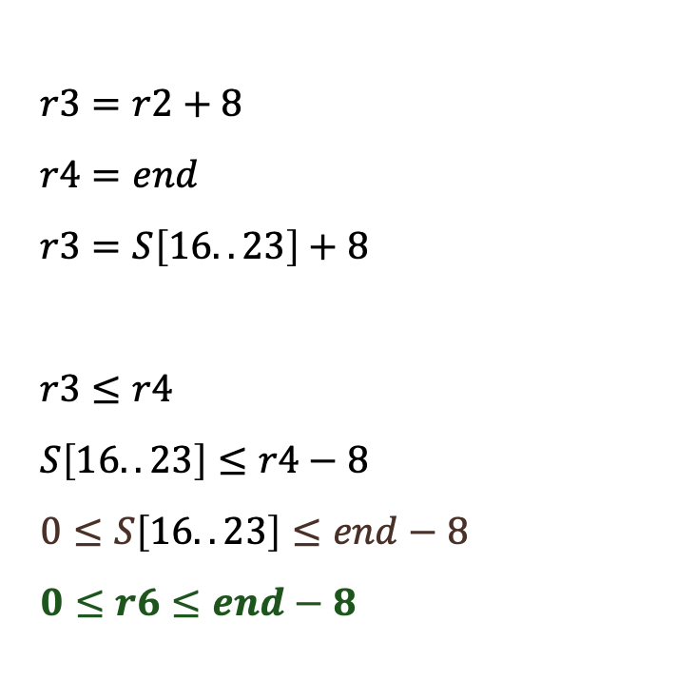
Modeling Register Spilling
Relational invariants
Code
Invariants
r2 = pkt_start
r3 = r2 + 8
r4 = pkt_end
*(stack+16) = r2
r2 = 0
if r3 > r4 exit 1
r6 = *(stack+16)
r5 = *(u64*)(r6)
$r2↦(pkt,0)$
$r3↦\left(pkt,8\right)$
$r4↦\left(pkt,?\right)$
$r2↦\left(num,0\right)$
$r3=r2+8$
$r4=end$
$r3=S\left[16..23\right]+8$
$r3≤r4$
$S\left[16..23\right]≤r4−8$
$0≤S\left[16..23\right]≤end−8$
$0≤r6≤end−8$

Slide 15
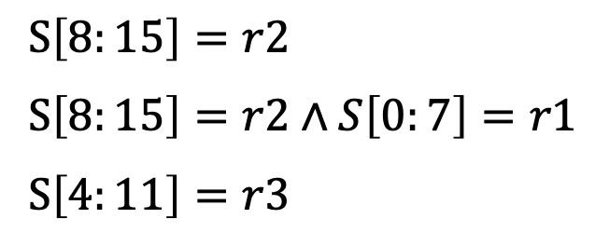
Memory Abstract Domain
Code
Invariants
*(stack + 8) = r2
*(stack + 0) = r1
*(stack + 4) = r3
$S\left[8:15\right]=r2$
$S\left[8:15\right]=r2∧S\left[0:7\right]=r1$
$S\left[4:11\right]=r3$
r10
S[0:7]
S[4:11]
S[8:15]
Stack
Notes:
Let’s Specifics about how we model register spilling

Slide 16
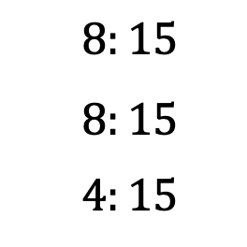
Memory Abstract Domain
Code
Invariants
Non-secret bytes
*(stack + 8) = r2
*(stack + 0) = r1
*(stack + 4) = r3
$S\left[8:15\right]=r2$
$S\left[8:15\right]=r2∧S\left[0:7\right]=r1$
$S\left[4:11\right]=r3$
$8:15$
$8:15$
$4:15$
r10
S[0:7]
S[4:11]
S[8:15]
Stack
Notes:
Let’s Specifics about how we model register spilling

Slide 17
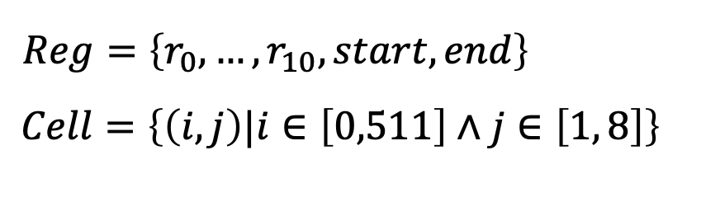
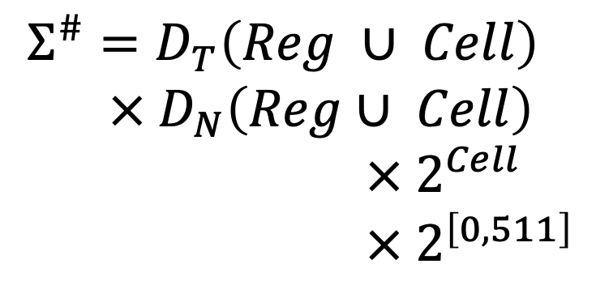
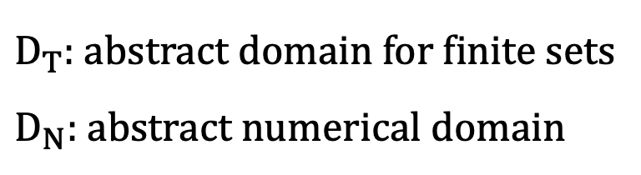
Parametric Abstract Domain
$Reg=\left\{r_{0},…,r_{10},start,end\right\}$ $Cell=\left\{\left(i,j\right)|i∈\left[0,511\right]∧j∈\left[1, 8\right]\right\}$
$D_{T}$: abstract domain for finite sets
$D_{N}$: abstract numerical domain
$Σ^{\#}=D_{T}\left(Reg ∪ Cell\right)$
$× D_{N}\left(Reg∪ Cell\right)$
$× 2^{Cell}$
$× 2^{\left[0,511\right]}$
// regions
// offsets
// spilled registers
// unclassified bytes

Slide 18
Evaluation
192 programs from real-world projects
Linux, Cilium, OpenVSwitch, Suricata
Number of instructions: 2-3500
All (currently) pass the Linux verifier

Slide 19

Numerical Domain Menu
Interval: $c_{1}≤V≤c_{2}$
Zone: $V_{1}−V_{2}≤K$
Octagon: ${±V}_{1}{±V}_{2}≤K$
Polyhedra: $Σ_{i}c_{i}V_{i}≤K$

Slide 20
Precision
Interval: 66% (128/192)
Zone, Octagon: 99% (191/192)
Polyhedra: 89% (170/192)
Generates large coefficients that cannot be represented in 64 bits

Slide 21

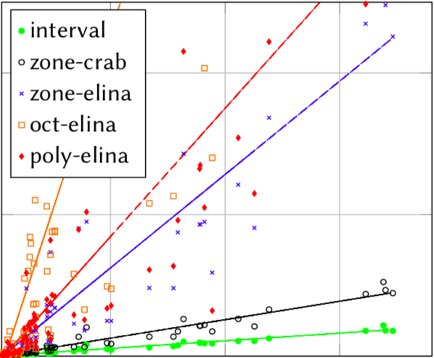

Runtime
sec
20
10
5
1000
2000
3000
Instructions

Slide 22
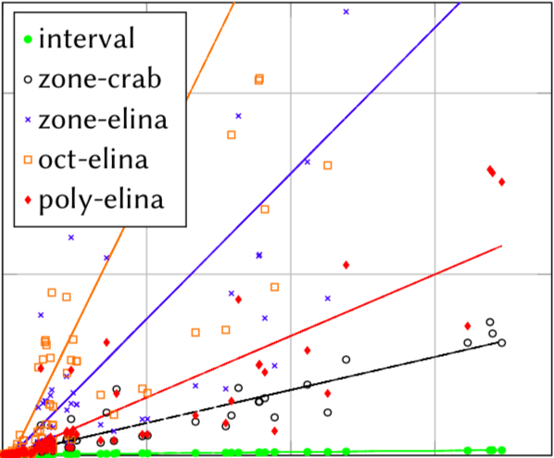
Memory
GB
4
3
2
1
1000
2000
3000
Instructions

Slide 23
Linux vs Prevail
Sec
Code:
strncmp(a,b,K)
strncmp(a,b,K)
15
10
Linux
5
Prevail
0
0
20
40
60
K

Slide 24
Conclusions
Verification of kernel extensions is in industrial use
Abstract interpretation is even better
An opportunity for the verification community

Slide 25
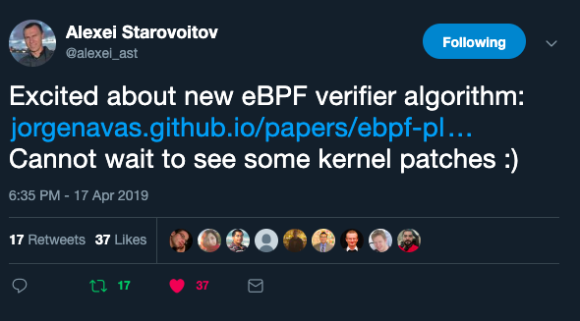

Formal Verification as an enabler
github.com/vbpf/ebpf-verifier

