Slide 1
Introducing Phaser.io
A JavaScript game engine for the browser

Slide 2
Background – Phaser.io
Website - http://phaser.io/
Developed by Richard Davey (@photonstorm)
Full featured game development engine based on Pixi.js rendering engine
For this tutorial we use Phaser 2.0.7 (Pixi 1.6.1)
We will develop the following game: http://boriskozo.github.io/phaser-tutorial/
No previous knowledge in game development is assumed
To follow the tutorial clone https://github.com/BorisKozo/phaser-tutorial and checkout the appropriate tags

Slide 3
Goals and Non-Goals
Goals
Show the main concepts of Game development (for a simple game)
Show the main entities of Phaser.io
Non-Goals
Show the correct code structure of the code in the game
Show good coding practices and style

Slide 4
Game Development - 101
Main Roles –
Game Designer – Something like the Functional Architect
Graphics – The person(s) that makes all the cool drawings and characters
Sound – The person(s) that makes all the cool sounds… Pew Pew
Programmer – The person who writes all the game logic

Slide 5
Game Development - 101
The game loop
Create
Update
Destroy
Render

Slide 6
Game Development - 101
The game loop
Preload
Create
Update
Destroy
Render

Slide 7
Game Development - 101
The game loop
A smooth game runs at 60 FPS – 16ms per loop
At 30 FPS you are still OK but below that there are noticeable jumps
Preload
Create
Update
Destroy
Render

Slide 8
Game Development - 101
Main Classes –
Game – The main container for all the game assets
State – A part of the game with its own game loop, logic such as a level, a menu, an intro screen, etc…
Phaser – The namespace class for all the Phaser.io elements

Slide 9
Game Development – Code Tag
Checkout Tag 1
Notes:
- Added a Level state with the main 4 functions
- Created a game object

Slide 10
The game world
Stage
World
Camera

Slide 11
The game world
Stage
World
Camera2
Camera1

Slide 12
The game world
150,300 – World Coordinates
0,0
X
Camera
Y

Slide 13
Game Entities - Sprite
A Sprite is anything intractable on the stage or a background. A ship, a shot, a cloud, a text, all are sprites
We create a Sprite using game.add.sprite function, the sprite is added to the state and the stage
We have to load the sprite image and create an alias for it using game.load.image before creating the sprite

Slide 14
Game Development – Code Tag
Checkout Tag 2
Notes:
- Added an image named player_ship in preload
- Added a player sprite

Slide 15
Game Entities - Input
Input is not event based. On each update we check if the relevant keys are pressed using Key.isDown property
The movement of the player depends on the actual elapsed time between calls to update because FPS may vary

Slide 16
Game Entities - Input
We limit the player motion by clamping its y coordinate to the camera viewport
Note: The top of the ship is (0,0) and the bottom is (0,height) because the anchor point is at the top left corner

Slide 17
Game Development – Code Tag
Checkout Tag 3
Notes:
- Added player motion in the update function
- Added clamping to camera

Slide 18
Game Entities - TileSprite
The TileSprite allows creation of a tile map out of single tiles
We create a long background of clouds and load it as a TileSprite
We move the tilePosition to create the motion effect (actually the background moves and all the rest stays static)

Slide 19
Game Concept - Parallax
Create the Parallax 3D effect by creating a semi transparent clouds layer, drawing it above the player and moving it faster than the original cloud background

Slide 20
Game Development – Code Tag
Checkout Tag 4
Notes:
Added back background of clouds
Added a forward semi transparent background of clouds that move faster (there is a bug and they actually move slower)

Slide 21
Game Entities – Group (SpriteGroup)
A group (collection) of sprites that share something in common
Same logical entity - Enemy ships
Parts of larger entity - Wheels, body, roof..
Allows manipulation on all the sprites in a group in a fast way – Move 10 pixels left
Allows recycling of sprites within a group
Creating a sprite in a group tries to resurrect a dead sprite

Slide 22
Game Entities – Phaser
Contains many helper classes
Math - A set of mathematical helper functions such as clamp, deg2rad etc…

Slide 23
Game Development – Code Tag
Checkout Tag 5
Notes:
Added enemies group
Added enemy spawn randomizer

Slide 24
Game Concept - Physics
Phaser supports five built in physics engines
Arcade, P2, Ninja, Box2D, Chipmunk
To know the difference see documentation
When using Physics the concepts are changed from static X,Y to velocities and forces.

Slide 25
Game Concept – World Bounds
We can tell Phaser to kill sprites that leave the world bounds. We do this by setting checkWorldBounds to true and setting outOfBoundsKill to true on the sprite.
Out of bounds checks happen each iteration but they are not expensive and we would do them anyway.

Slide 26
Game Development – Code Tag
Checkout Tag 6
Notes:
Added ARCADE physics
Added LAZERSSSS!

Slide 27
Game Concept – Collision
Most games need collision detection, the most popular types:
Geometric collision: Do two geometric shapes intersect?
Pyramid collision: Create a pyramid of geometries and test each pyramid level
Mask (pixel) collision: Test each pixel if it touches another pixel
Usually can be used in sequence because the former is cheaper than the later

Slide 28
Game Development – Code Tag
Checkout Tag 7
Notes:
Added ARCADE physics
Added LAZERSSSS!

Slide 29
Game Concept – HUD
We want elements to be on the player HUD. Some frameworks (e.g. Unity) provide special API for HUD elements.
Phaser doesn’t have special HUD API so we use regular sprites.

Slide 30
Game Entities – Text
We add a special sprite called Text which renders text to the canvas.
We can use any loaded font or create our own special font

Slide 31
Game Development – Code Tag
Checkout Tag 8
Notes:
Added ARCADE physics
Added LAZERSSSS!

Slide 32

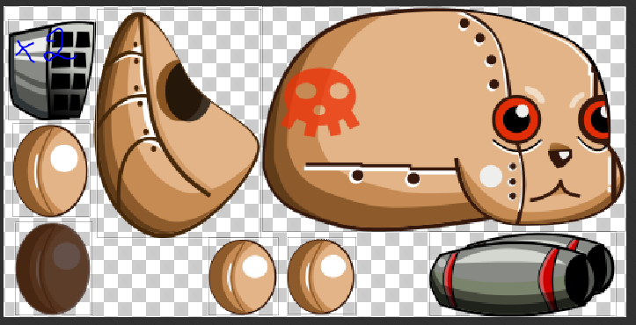
Game Concept – SpriteSheet and SpriteAtlas
An image file can contain a sequence of images that represents a sprite animation (or several animations). We combine the entire sequence into one entity called SpriteSheet
An image file can contain several images of different sprites. We need to ‘cut’ this image into sprites. This entity is called SpriteAtlas

Slide 33
Game Entities – SpriteSheet
We load the image into a SpriteSheet and define a name for each sequence of images (e.g. ‘walk’,’run’,’jump’)
When the appropriate time comes we play the sequence with a certain speed to create an animation

Slide 34
Game Concept – Anchor
We can set the anchor point of a sprite. This affects the drawing position and rotation of the sprite

Slide 35
Game Development – Code Tag
Checkout Tag 9
Notes:
Added ARCADE physics
Added LAZERSSSS!

Slide 36
Game Concept – Sound
We are using WebSound API to play sound. Each browser implements whatever it wants.
It seems most browsers support ogg format

Slide 37
Game Entities – Audio
We load a single file or several files into one sound alias
We add the sound to the game and when the time comes we play the sound

Slide 38
Game Development – Code Tag
Checkout Tag 10
Notes:
Added ARCADE physics
Added LAZERSSSS!

Slide 39
Game Concept – State
We control the game flow by changing states
Each change clears the game object but leaves the loaded assets so next load is faster
We transition from one state to another when level changes, when we show the end screen, etc…

Slide 40
Game Development – Code Tag
Checkout Tag 11
Notes:
Added ARCADE physics
Added LAZERSSSS!

Slide 41
Game Development – The End
Thank You!
Notes:
Added ARCADE physics
Added LAZERSSSS!

