Slide 1


Going Native With Kendo UI Mobile
Keith Burnell
Senior Sofware Engineer Skyline Technologies, Inc
@keburnell · DotNetDevDude.com

Slide 2
Little about me
Microsoft MVP: ASP.NET/IIS
Senior Software Engineer at Skyline Technologies
Been developing software for ~13 years
Primary focus on the Microsoft Web stack
Speaker (Local, Regional, National)
Author (MSDN, Pluralsight)

Slide 3
The plan
What is Kendo UI?
Kendo UI Overview
Kendo UI Mobile
Notes:
The agenda for our 60 minutes of excitement is as follows:
1. We’ll discuss exactly what Kendo UI is…so you guys no what your getting in to in case you just ducked into the closest room
2. Then I’ll give a high-level overview of what Kendo UI offers for tooling and capability
3. And then we’ll spent the remainder of our time covering Kendo UI Mobile

Slide 4



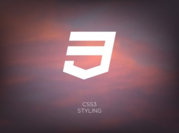
What is it?
JavaScript framework for building modern interactive web applications
Collection of script files and resources (styles, images, etc.)
Leverages
JavaScript
HTML5
CSS3
jQuery
Notes:
To start off lets answer the question “What is Kendo UI?” [CLICK]
Framework for building modern interactive web applications
Kendo UI is a JavaScript framework for building modern interactive web applications.
These days’ people expect rich fluent interactive web sites and in order to do that you must take advantage of client-side technologies and toolsets which Kendo UI Provides. [CLICK]
Collection of script files and resources (styles, images, etc)
From a bits and source code perspective Kendo UI is just like any other JavaScript toolset in that when you are done installing it what you end up with is a number of JavaScript files, Cascading Style Sheets and images added to your project. [CLICK]
Leverages
Kendo UI leverages the client-side technologies used today to make rich immersive web applications including:
JavaScript: JavaScript has been making a huge resurgence which is great because it allows you to do some fantastic fluent things with your web applications [CLICK]
HTML5: Latest revision of the HTML specification whose goal is to standardize the way developers code next generation online applications [CLICK]
CSS3: Latest version of the CSS specification that provides additional functionality for styling next generation responsive web applications…both HTML5 and CSS3 are works in progress but a lot of the functionality is already supported but most browsers. [CLICK]
jQuery: Extremely popular community driven JavaScript library that makes dealing with the DOM using selectors much easier in than in the past. [CLICK]

Slide 5
What’s in the box?
Rich UI Widgets
Mobile Application Framework
Client-side DataSource
MVVM Framework
Templating
Validation Framework
Animation & Drag-Drop
Notes:
Now that we know what Kendo UI is let’s talk about its feature set. CLICK
Kendo UI provides an extensive collection of rich UI widgets for both desktop and mobile browsers
Mobile application framework that handles a lot of goo needed when doing multi-platform mobile web development
Client-side DataSource that makes working with both local and remote data much easier
MVVM Framework for automatic two-way data synchronization
Templating engine for creating clean reusable HTML
Validation framework for providing client-side input validation
Animation and drag-drop for a true web 2.0 user experience

Slide 6
But, why?
All the tools in one package
Fast
Support
Notes:
But, Why?
At this point you may be asking yourself why Kendo UI? What is the benefit of using Kendo UI over the wide array of other tooling that is available
First of all Kendo UI provides all the tooling you need in one package
There is no longer a need to go out and download the ½ dozen or so library’s needed for modern web development
This not only makes for a more pleasant experience when setting up your development environment but it also allows the different parts of the toolset to work more efficiently together
Performance
has been developed from the ground up with performance in mind and no short cuts have been taken along the way, which has resulted in an extremely performant toolset
Support
Lastly it is a product of a very popular component vendor that offers top-notch support. Now don’t get me wrong the community support provided by other tool sets is awesome, but in the end you are at the mercy of the community to answer your question. Having professional support available for a product makes a huge difference in a lot of dev shops, especially in the corporate environment.
These are high level benefits of using KendoUI, we will cover more specific reasons throughout the presentation.

Slide 7





Browser Support
7.0 +
10.0 +
All versions
10.0 +
4.0 +
Notes:
Browser support is crucial when choosing any type of web tooling. There is nothing worse than finding the perfect tooling for the solution only to discover it is not supported on the majority of browsers you need to target.
A lot of diligence was put in to making sure that Kendo UI is able to run on the vast majority of browsers and browser versions.
Kendo UI is supported by:
IE: 7.0 and up
Firefox: 10.0 and up
Chrome: all versions
Opera: 10.0 and up
Safari: 4.0 and up
With the broad browser support that Kendo UI offers you can feel confident that just about everyone accessing your site will be able to get the full experience.

Slide 8
Get the bits
Download: http://www.kendoui.com
Unzip it
…/examples
Full source
Web interface
Widgets and framework components
Notes:
Downloading and installing Kendo UI is simple and straightforward.
You can download Kendo UI from the Kendo UI website kendoui.com
Because Kendo UI is a pure JavaScript tool set installation is as simple as unzipping what you downloaded.
Explore the Examples
There is an extensive set of examples that can be found in the \examples directory of the Kendo UI downlaod
Full source for all the examples is included [CLICK] along with an easy to navigate web interface for browsing the samples
Samples are included for all the UI widgets and the framework components as well

Slide 9
Kendo UI Mobile
Mobile development toolset
HTML5 powered (data-”dash”)
Native look, feel, and user experience
Kinetic scrolling
Automatic layout system
Application framework
Phone and tablet widgets
Notes:
So, what is Kendo UI Mobile?
[CLICK] At its core Kendo UI Mobile is a toolset that allow you to use HTML5 to build apps and sites targeted at mobile devices.
[CLICK] It uses the power of HTML 5 and the data dash attribute along with
[CLICK] Enhanced adaptive rendering to provide a native look, feel and user experience for iOS, Android, and Blackberry.
[CLICK] Scrolling performance is typically one place where a multi-targeted HTML5 mobile app falls short of a native app. Kendo UI mobile’s Kinetic Scrolling provides increased performance for smooth, natural, touch-friendly scrolling.
[CLICK] Kendo UI’s layout engine will automatically position common elements such as title and nav bars based on the orientation of the device.
[CLICK] Kendo UI Mobile also includes a complete application framework
[CLICK] and a collection of controls for mobile and tablet apps. We will spend the remainder of the module discussing these last two bullet points.

Slide 10
Mobile Framework
Application
Form
View
SplitView
Notes:
The first major component of Kendo UI Mobile that we’ll explore is the Mobile Framework.
It consists of the following pieces that we’ll cover in the upcoming slides
[CLICK] Application
[CLICK] Form
[CLICK] View
[CLICK] and SplitView

Slide 11
Application
Top of the stack
Initialization
App wide configuration
Layout
Navigation
View transitions
Status
var app = new kendo.mobile.Application($(document.body), {configuration});
Notes:
[CLICK] At the top of the Kendo UI Framework stack is the “Application”
[CLICK] An Application is declared and initialized using the “kendo.mobile.application” function.
The function accepts two parameters, both of which are optional.
[CLICK]The first parameter is the top level element that includes your mobile views. Typically this is the body tag of your page, but could be any other element.
[CLICK]The second parameter is the configuration object. We will cover what is configurable on the Application shortly.
The application is responsible for:
[CLICK] Application wide configuration.
[CLICK] Common layout
[CLICK] Handling navigation
[CLICK] and transitions between views
[CLICK] And for displaying the status for long running tasks

Slide 12
Application Structure
Single HTML page
One or more Kendo UI mobile views
Linked with Kendo UI navigational widgets
Notes:
A Kendo UI Mobile Application has the following structure
[CLICK] A single HTML page
[CLICK] Containing one for more mobile Views
[CLICK] that are linked with navigational widgets

Slide 13
Application Configuration
Application wide configuration
hideAddressBar
initial
layout
loading
platform
transition
var app = new kendo.mobile.Application($(document.body), {
hideAddressBar: true,
initial: "startView",
layout: "myCustomLayout",
loading: "I think I can. I think I can.",
platform: "blackberry",
transition: "slide"
}
);
Notes:
[CLICK] Application wide configuration is done by supplying a json-formatted object containing the configuration parameters and values to the Application constructor.
The following options are available for configuration:
[CLICK] Hide address bar is a Boolean that sets whether or not the mobile browsers address bar is hidden or not.
Hiding the address bar provides a much more native-like user experience.
Hide address bar is set to true by default
[CLICK] “initial” allows you to define which mobile view should be displayed when the application starts.
You set initial to id of a view
If initial is not set the first view defined in the application will be displayed as the initial view
[CLICK] You can assign the default Application Layout by setting the “layout” property in the application configuration to the ID of element that defines your layout. We will discuss creating layouts later on in the module.
[CLICK] The applications “loading” property allows you to define the text displayed in the loading popup. You can set the value to false to disable the loading popup for the entire application. By default the word “loading” is displayed in the popup. We’ll cover the loading popup in more detail later in the module.
[CLICK] If you ever wanted to only render the application with the look and feel of a single mobile platform you could do that by setting the Application’s “platform” property. Valid settings for the platform are “ios”, “android”, and “blackberry”
[CLICK] The transition property allows you define which one of the built in transitions will be used when transitioning from one view to another. By default this property is not set which means transitions will occur like a typical web browser transition.

Slide 14
Mobile Layout
Share common header and footer
Define
Assign
<!-- Layout -->
<div data-role="layout" data-id="myLayout">
<div data-role="header">
</div>
<div data-role="footer">
</div>
</div>
<!-- View -->
<div data-role="view" data-title="Home" data-layout="myLayout">
<!-- View Content -->
</div>
Notes:
[CLICK] A mobile layout is used to define headers and footers that can be shared among multiple views
[CLICK] You create a layout by
[CLICK] defining an html container element, giving it a unique data dash id and assigning it the data dash role of “layout”
[CLICK] Then you define an HTML element with data dash role of Header to hold the header content
[CLICK] And an HTML element with data dash role of Footer to hold the footer content
The only markup that will be rendered as part of the Layout is the content that resides in the header and footer elements. Any content placed outside those two elements will be ignored when the Layout is applied.
[CLICK] In order to assign a Layout to a View you set the data dash layout attribute of the View to the Id of the layout
If you plan on using the same Layout for all or most of your views you can assign the default layout globally by setting the “layout” property when configuration your Kendo UI Mobile Application

Slide 15
Navigation
Local
External
<a href="#page2" data-role="button" >Next Page</a>
<a href="http://kendoui.com/" data-rel="external" >Visit KendoUI</a>
Notes:
[CLICK] Navigation between views in the application is done using any of the Kendo UI navigational widgets.
[CLICK] Here I have an anchor tag that I am assigning data dash role of button, making it a Kendo UI button widget.
To have it navigate to a view within my application I set href to the name of the view I want to navigate to, prefixed with the hash character
[CLICK] By default all navigational widgets attempt to navigate to locals views.
[CLICK] In order to navigate to a location outside the application you need to override this default behavior by setting the data dash rel to “external”

Slide 16
View Transitions
Animation when moving from one view to another
Defined on View, navigational widget…or at the app level
Slide, Zoom, Fade, and Overlay
Configure direction (slide, overlay), and reversible (all)
<div data-role="view" id="search" data-transition="slide" >
</div>
<a href="#search" data-role="button" data-transition="fade" >Search</a>
Notes:
[CLICK] View Transitions refer to the animation that is used when moving from view to another.
Animated view transitions have become a staple of native mobile applications and are now expected by users for true native user experience.
In a Kendo UI Mobile application View transitions can be configured 3 ways
[CLICK] The first way is to set it directly on the view
[CLICK] The second way is to configure in on the navigational widget.
And the third way, which we already covered, is to configure it application wide by configuring the “transition” property of the Kendo Mobile application during initialization.
If a situation is encountered where it is configured in multiple cases the default transition set during application initialization has lowest priority and the transition set on in the navigational widget has highest priority.
My recommendation is to set at the app level and override using one of the techniques when necessary and stick with the same technique throughout the app.
[CLICK] There are 4 transition animations available: Slide, Zoom, Fade, and Overlay
[CLICK] For slide and overlay you can configure the direction at which the animation occurs.
Slide can go either left or right
Overlay can up, down, left and right
For both the default direction is left
And all animations can be played in reverse

Slide 17
Progress/Status
Built-in loading indicator
Styled per platform
<script>
$(function () {
$("#longProcess").bind('click', function () {
app.showLoading();
longRunningProcess();
app.hideLoading();
});
});
</script>
<script>
window.app = new kendo.mobile.Application(document.body);
</script>
Notes:
[CLICK] The Kendo UI Mobile application has a built in loading indicator
[CLICK] That like the rest of the Kendo UI Mobile elements it is styled per platform [CLICK]
Here is an example of using the Loading indictor.
I am binding the ‘click’ event of an element to a function that
[CLICK] Calls the showloading method of the KendoUI Mobile application that is defined and initialized at the bottom
[CLICK] Then it makes a synchronous call to a long running process
[CLICK] And finally it hides the loading pop up by calling “hideLoading”

Slide 18

Demo: Kendo UI Mobile Application
Notes:
[CLICK] The Kendo UI Mobile application has a built in loading indicator
[CLICK] That like the rest of the Kendo UI Mobile elements it is styled per platform [CLICK]
Here is an example of using the Loading indictor.
I am binding the ‘click’ event of an element to a function that
[CLICK] Calls the showloading method of the KendoUI Mobile application that is defined and initialized at the bottom
[CLICK] Then it makes a synchronous call to a long running process
[CLICK] And finally it hides the loading pop up by calling “hideLoading”

Slide 19
Form
Automatic platform specific styling of form elements
Uses new HTML5 input types
Supported inputs
- text
password
search
url
email
number
tel
file
date
time
month
Notes:
[CLICK] Kendo UI Mobile Framework provides automatic platform specific styling for form input elements when placed inside a Kendo UI Mobile View.
[CLICK] Takes advantage of the new input types introduced in HTML5.
[CLICK] The following input types are supported
Let’s do a demo to illustrate some of the form elements

Slide 20
Demo: Mobile Form
Notes:
*** OPTION FOR SKIP IF RUSHED FOR TIME!
In this demo we will take a look at the Kendo UI Mobile platform specific styling of form input elements
I’m starting with a single view and a layout with a header and then a script to initialize everything as a new “kendo.mobile.application”
(k521) I’ll start by creating a number input by declaring a new html input and assigning it a type of number
Save and run.
By default I have an iOS styled numeric input
And if I switch to my user agent to Android I get an Android styled numeric input
Here is where we hit a limitation of using the browser and user agent switching to test our mobile apps. We don’t get to see the on screen keyboard.
So I am going to switch over to the official Android emulator because I am not running on a mac so I can’t use the iPhone emulator, to demonstrate a couple of things
The first thing you will notice that on an actual device you don’t get the up and down spinner buttons…which makes sense because there is no way you would be able to use them on a small screened device
Next if I click inside the number input field you’ll notice that on screen keyboard is set for numeric input. That’s not Kendo UI doing that, that is then HTML5 input types that is doing that.
Next let’s take a look at implementing a DropDown
(k522) So here I have a select html element with its associated options.
If I save this and pull it up in the browser you’ll see I get an iOS styled display but when I click on it I get a standard web drop down. This is another example where I need to have a full blown emulator/simulator to see the actual display.
So I’ll switch over to the Android emulator and pull it up and you’ll see that when I click on the input I get a full blown Android select list.

Slide 21
View
Represents a screen
HTML element attributed with data role of view
<div data-role="view">
<!-- content -->
</div>
Notes:
[CLICK] The View represents a single screen
[CLICK] The Kendo UI Mobile Application framework automatically instantiates a mobile view for any html element attributed with a data dash role of view.
By default the view will be stretched to fill the entire Application element and any markup placed inside the view element will be rendered as the view content.
Along with content a View may also have a header and footer, but unless your app consists of just a single view I would suggest using a Mobile Layout to define your header and footer.

Slide 22
Remote View
Load view remotely via AJAX
Only content within the first View element is rendered
<div data-role="view">
<a href="remoteView.html" data-role="button">Remote View</a>
</div>
<!-- remoteView.html -->
<div data-role="view" data-init="initRemoteView" >
<a href="#someLocalView" id="link">Link</a>
</div>
<!-- script in consuming view -->
<script>
function initRemoveView(e) {
e.view.element.find("#link").kendoMobileButton();
}
</script>
Notes:
[CLICK] The Kendo Mobile Application can also load views remotely with AJAX.
[CLICK] If a navigational widget’s “href” value does not start with the “hash” symbol it is considered to be a remote view and in turn an AJAX request to the provided URL is made
[CLICK]Only content that exists within the first element in the remote view with a data-dash role of “view” will be rendered.
[CLICK] This means that anything you reference in the head of the html document will not be available when the view is rendered remotely and same holds true for any scripts as well.
Additional scripting and widget initialization can be done in the initialization of the remote view.
You can create a function on the consuming view that will do the initialization
And you can hookup that function by setting the data dash init attribute to the functions name on the remote view.
Let’s take a look at a demo to illustrate the Kendo UI Mobile View

Slide 23
Demo: View
Notes:
*** OPTION FOR SKIP IF RUSHED FOR TIME!
This one requires IIS
In this demo we will take a look at the Kendo UI Mobile View
I’m starting with a layout that has a header and then a script to initialize everything as a new “kendo.mobile.application”
(k531) I’ll start by creating a view. Like we’ve covered a view is just an HTML container element with a data dash role of view. Here I am also setting the ID and title.
We can save this and pull it up and see we have a mobile view with our header.
Now I want to implement a remote view
(Pull up Remote.html) I have a remote view that is just a simple view no other markup…for remote views only markup inside the container with a role of view is rendered.
Now I can go back to my page and add a navigational widget to navigate to the remote view.
(k532) Because my href for this navigation widget does not start with the has character it will load the view remotely using AJAX
Save and pull it up (have to fake this)

Slide 24
Split View
Tablet specific view
Consists of two or more pane widgets
Should not be nested in a view
Notes:
[CLICK] The split view is a tablet specific view
[CLICK] That consists of 2 or more mobile pane widgets.
Mobile pane widgets
[CLICK] Unlike most widgets, Split View should not be nested in a View. It should be placed in the root of the Mobile Application element.
Let’s do a demo to get a better understanding of a SplitView

Slide 25
Demo: Split View
Notes:
*** OPTION FOR SKIP IF RUSHED FOR TIME!
In this demo we will take a look at the Kendo UI Mobile SplitView
I’m starting with the Kendo UI Mobile scripts and styles registered in the head and a script to initialize everything as a new “kendo.mobile.application”
(k541) I’ll start by creating the shell of my SplitView which is HTML container element with the data dash role of “splitview”
A split view contains two pane’s
A narrower left pane
And a wider main pane
Each pane currently just contains a layout defining the Pane’s headers.
Now I will add a view to each of my two Panes
(k542)The left pane gets a view with an Id of “leftPaneView”
(k543) and the main pane gets a view the Id of “mainPaneView”
At this point I can save this and pull it up and we’ll see that we get an iOS styled split view
Let’s wire this up to some data for real-world experience
First I need some data.
(k544) I’ve created a couple kendo data sources, one with car headers and the other with car details.
Next I want to get my left pane to display a list of car headers so that I can select one and have the detail for that car be displayed in my main pane
(k545) First inside my left pane view I’ll create a list view and bind it to the “carHeaders” data source.
(k546) Then I’ll create a Kendo UI template that will populate my list view. If you aren’t familiar with the Kendo UI Data Source and the Kendo UI Templates then make sure you check out the Framework Module of this course.
My template for now will just display the name of my car
And then I need to assign the data template to the list view I created by setting “data-template” to “headersTemplate”
Now I can run this and you’ll see that I’ve made some progress and I now have a list of items displaying in my left pane.
Next I need to get the interaction between my left pane and my main pane.
(k547) I’ll start that process by creating my data template for what will be displayed in the Main pane.
My template consists of some spans that display the
Brake Horsepower
Top Speed
Zero to Sixty
And an image of the car
(k548) Next I’ll add the list view to the Main Panel View.
The list view has its data source set to the carDetails data source and its data template set to the details template we just created.
Now I need a way to have the main pane updated when an item is selected in the left pane.
I do that by changing the left pane’s data template to include a navigational widget.
(k549) I’ve updated the template to include an anchor tag with the href set to the MainPanelView and I am passing the selected headerId to the view.
I am also saying that when the mainPanelView is pulled up it should be rendered in the mainPane and I do that by setting data dash target to “mainPane”
Save this and pull it up in the browser and you’ll notice that the mane pane is already displaying data and that is not what we want.
In order to fix that we first need to write some code to filter that data source.
(k45a) I’ve created a function to filter the carsDetails datasource on the selected headerId
In order to get that function called we can use the data dash show attribute. What this attribute does is call the assigned function every time the view is rendered and since we are re-rendering the view on every click of an item this is exactly what we want.
data-show=”filterDetails” on the main panel view.
Save and run
You’ll notice that when we first pull up our app we don’t have anything in the mane pane…so that’s a good start.
And when we select an item its associated details are displayed in the main pain.

Slide 26
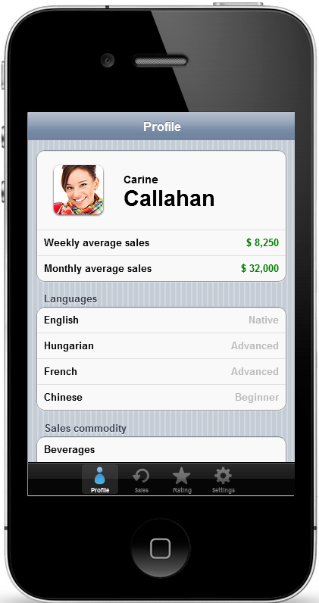
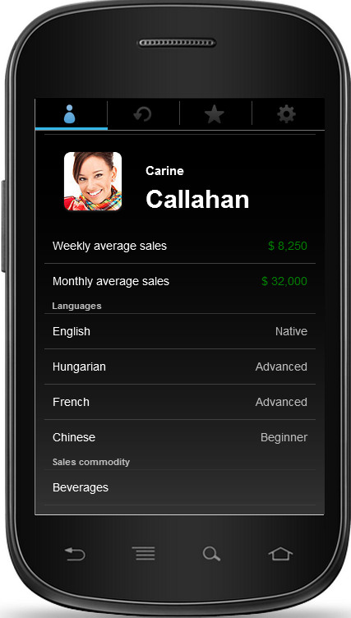
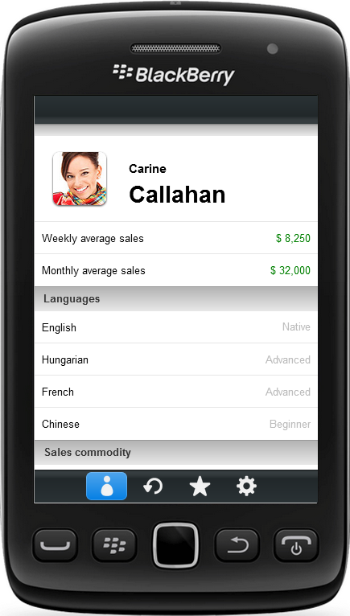
Widgets!?
Controls that mimic native UI/UX
HTML5
Platform specific look and feel
Notes:
Now that we know all about the Kendo UI Mobile framework let’s talk about the Mobile Widgets
After discussing Mobile Widgets we will do a demo where I am going to assume you already watched the Web Widgets module, so if you haven’t watched that yet you may want to do so now.
[CLICK] Mobile widgets are a collection of controls that allow you to easily replicate a native user interface and user experience
[CLICK] They are HTML5 controls
[CLICK] that adaptively render to provide platform specific styling and interaction.
[CLICK] Here is an example of the TabStrip widget
This is the same markup in every device and not only is the style of the widget platform specific
But notice on the second device, which is an Android device, that the tab strip is located at the top which is typical placement in Android
We have adaptive rendering doing the platform specific styling and then we have the Mobile Application Framework Layout functionality dynamically setting the location based on the platform.
All of this for a true native experience on all 3 platforms from a single HTML code base.

Slide 27
List O’ Widgets
Action Sheet
Button
ButtonGroup
ListView
ModalView
Navbar
PopOver (tablet only)
Scroller
ScrollView
Switch
TabStrip
Notes:
Let’s look at the widgets that are currently available in Kendo UI Mobile
[CLICK] ActionSheet
The ActionSheet widget displays a set of choices related to a user initiated task
Think of this as a context menu, I click a button or select something and I am presented with options in a modal fashion
[CLICK] Button
Button navigates to a view or can also execute a custom callback
We’ve worked with the button in a few of our previous demos
[CLICK] You can also create a group of buttons using the ButtonGroup
These are typically used to create tab-like interface
[CLICK] ListView
The ListView widget is used to display a flat list of items
We used a ListView in our SplitView demo to display the car headers in the left pane
[CLICK] The ModalView is a modal window that is contained to a specific task
You’ll typically encounter a modal window when being prompted for credentials on a mobile device
[CLICK] NavBar is used to display an application navigation bar
Typically a navbar contains the view title and optionally 1 or 2 navigational widgets.
We have used the nav bar in all of our demos
[CLICK] PopOver is a tablet specific control that contains one or more views and typically “pops over” the current content
[CLICK] The scroller widget enables kinetic scrolling for the contents of the HTML element
[CLICK] The ScrollView is used to scroll content horizontally…a typical application of this is a photo gallery.
[CLICK] Switch is used to allow selection of two exclusive choices.
You can see this control in use in just about “settings” page to turn things on and off
[CLICK] And finally the TabStrip which showed in the previous slide is used to display an application-wide group of navigation buttons
Let’s write some code and implement a few of these controls.

Slide 28
Demo: Widgets
Notes:
In this demo we’ll implement some of the Kendo UI Mobile widgets.
I am starting with an HTML page that
Has the Kendo UI Mobile scripts and stylesheets referenced in the head
It has a mobile view and layout with navbar defined displaying the view title
And finally the entire contents of the body is initialized as a Kendo UI Mobile Application
To start I want to add a TabStrip to allow me to navigate to different views in my application and by convention a TabStrip belongs in the footer
(k551) I have created a div with data dash role of footer
and inside of it I have created another div, this one has a data dash role of Tab Strip, meaning it will be initialized as a Tab Strip widget
Inside the tab strip element I have declared 3 anchor tags and given each one an href and an icon using the data dash icon attribute. There are a bunch of default icons that ship with Kendo UI Mobile. They are located in the styles/images directory of the Kendo UI download
Save and run
Now I have mobile tab strip with iOS styling and if I switch my user agent to Android you’ll see I have an Android version on the top where it is supposed to be.
Next let’s add a list view to our main view
The first thing I need is data
(k552) We’ll be using the car data we’ve used in all our demos so far and I am creating a kendo.data.datasource with the data
Next I need to create a data template for my listview to bind to
(k553) My template consists of an unordered list with a single list item that has data icon and displays the make and model of the car
Now I need to add the list view and bind it to the data source and template we created
(k554) I declare an unordered list
Give it a data dash role of list view
set the type to group which allows me to click the items
Set the data source to our cars datasource we created earlier
And set the template to the cars list template
Save and run
We now have slick mobile list view in iOS and I can switch over to Android and see the android styled list view as well
Now I’ll implement the pictures view
(k555) I’ll start by creating the view, which is just a div with a role of view and I’m setting title
And if we look down at the implementation of our tabstrip in the footer we can make sure that our href is pointing to the new view which it is
So now we can pull this up and we can now navigate between our Main view and the pictures view

Slide 29
What Did We Learn?
Application
Views
Form
SplitView
Widgets
Notes:
That wraps the module so let’s summarize what we’ve covered
First we covered the Kendo UI mobile application and all the features it provides to enable development of native-like applications across the 3 major mobile platforms using HTML
Next we talked about vMobile views and you can load both locally and remotely and navigate between them
We looked at how Kendo UI leverages the new input elements introduced in HTML5 to create native input elements for iOS, Android, and Blackberry
We looked at the very cool SplitView for doing tablet applications
And we wrapped up by covering the mobile widgets
Through all of those things we’ve seen the power and flexibility that Kendo UI mobile offers for creating html mobile applications with true native look and feel across the 3 major platforms.
In the next module we’ll cover the Kendo UI HTML Helpers for ASP.NET MVC.

Slide 30











Slide 31
Thank You!
github.com/KBurnell/GoingNativeWithKendoUIMobile
Rate the session: http://bit.ly/N9xAjU
Find me:
Twitter: @KeBurnell
Blog: DotNetDevDude.com
E-Mail: KBurnell@SkylineTechnologies.com
Interested in working for/with an awesome organization?
Talk to me or stop by the Skyline Technologies booth
Notes:
That wraps the module so let’s summarize what we’ve covered
First we covered the Kendo UI mobile application and all the features it provides to enable development of native-like applications across the 3 major mobile platforms using HTML
Next we talked about vMobile views and you can load both locally and remotely and navigate between them
We looked at how Kendo UI leverages the new input elements introduced in HTML5 to create native input elements for iOS, Android, and Blackberry
We looked at the very cool SplitView for doing tablet applications
And we wrapped up by covering the mobile widgets
Through all of those things we’ve seen the power and flexibility that Kendo UI mobile offers for creating html mobile applications with true native look and feel across the 3 major platforms.
In the next module we’ll cover the Kendo UI HTML Helpers for ASP.NET MVC.

