Slide 1
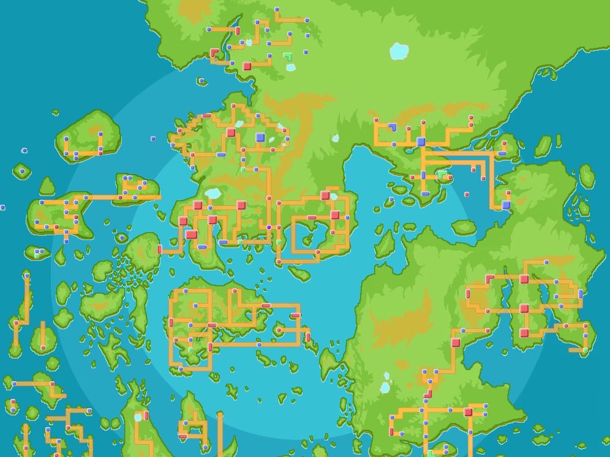
Visualizing
Path-Finding
Algorithms
Boris Nikulin
Qian Zhu
Marina Mizar

Slide 2
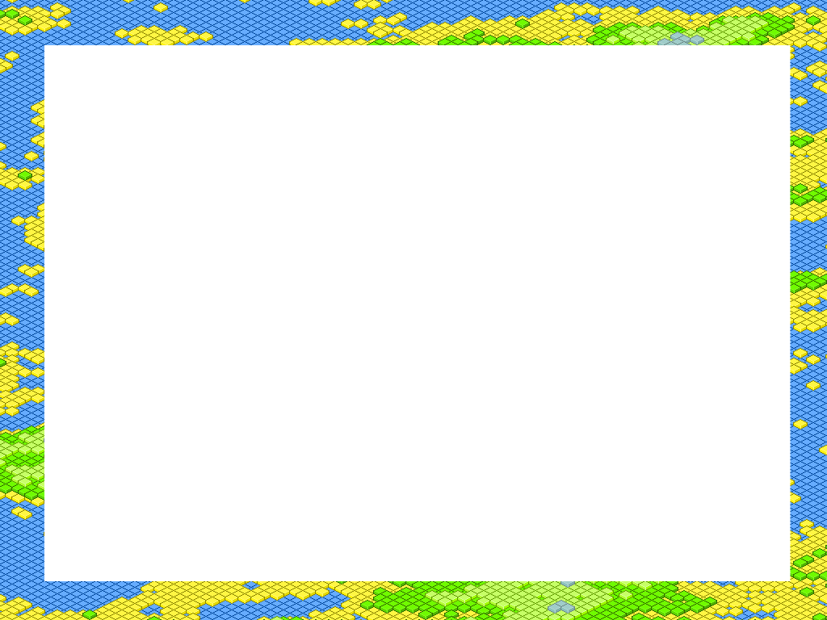
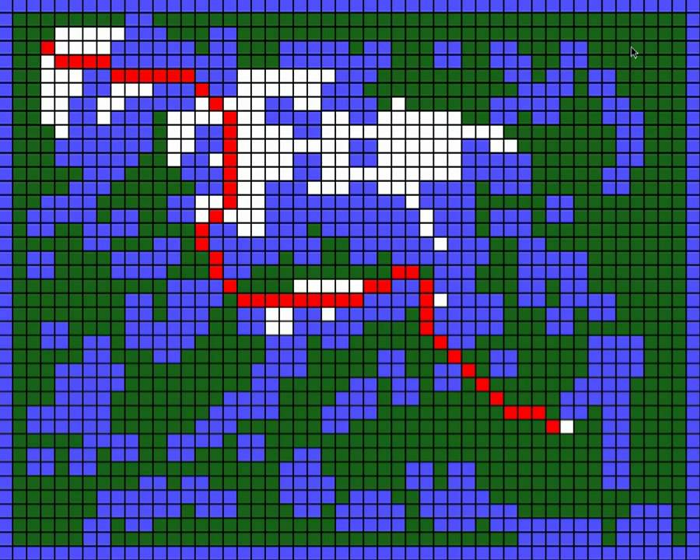
Purpose: Path-finding Visualization/Education Tool
Differentiate steps of the path-finding algorithm (visited vs. queued vertices, etc.) using color coding
Make the visualization interactive by allowing users to change the start/end points & choose from various graphs

Slide 3
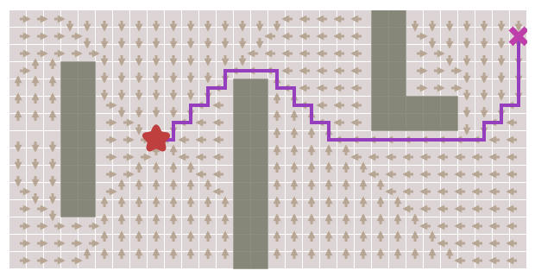
Allow users to dynamically switch between path-finding algorithms to compare amount of vertices evaluated & efficiency of paths found
Variety of background images/themes to demonstrate the many real-world applications of path-finding (video game AI, city planning, shipping/business routes, and more..!)
Target audience for application:
Middle school to college-age students interested in applied computer science

Slide 4
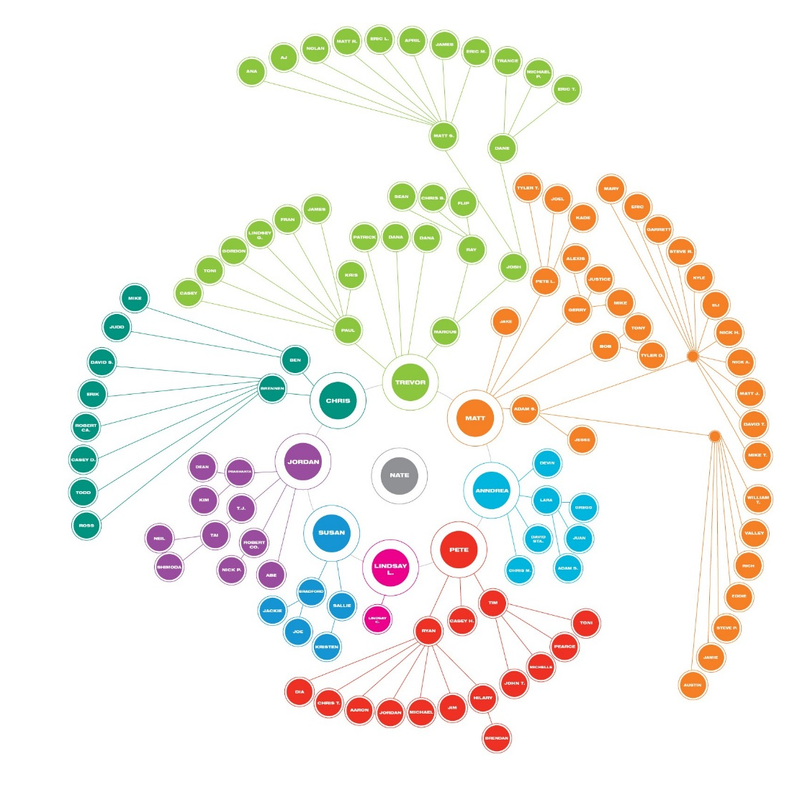
Data Structure: Graph
Edge: Component class
Vertex: Generic type
Type: Undirected, weighted
Adjacencies: Stored in HashMap (key = vertex, value = linked list of edges)
Separate GraphUtility class reads vertex data & relationships from text file & inserts vertices and edges

Slide 5
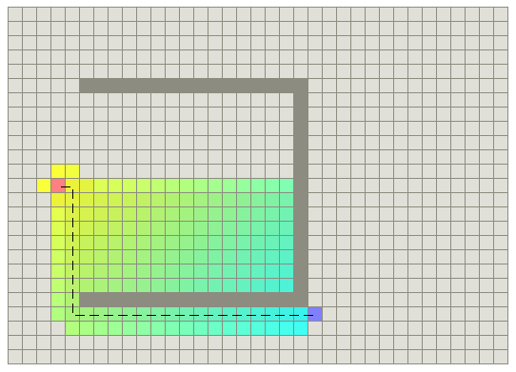
Algorithm: A* (“A-Star”)
Combines components of Greedy Best-First (seeks vertices that have coordinates closest to goal) and Dijkstra’s (favors vertices that are have shortest path from start)
Makes use of a frontier (PriorityQueue of vertices) and a heuristic (equation that calculates a priority value for each vertex depending on its distance from start & goal mentioned above)

Slide 6
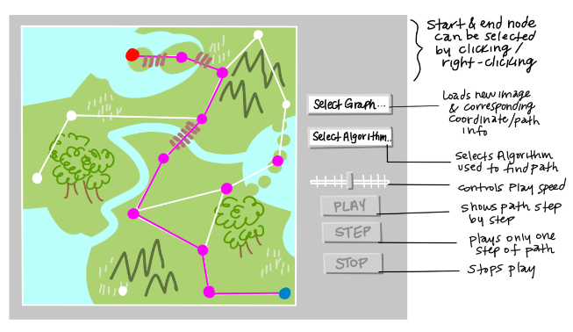
Application: Pathfinding Visualizer
Our goal was to design an application that would animate each step of a path-finding algorithm on a given map, with specified start and end points

Slide 7
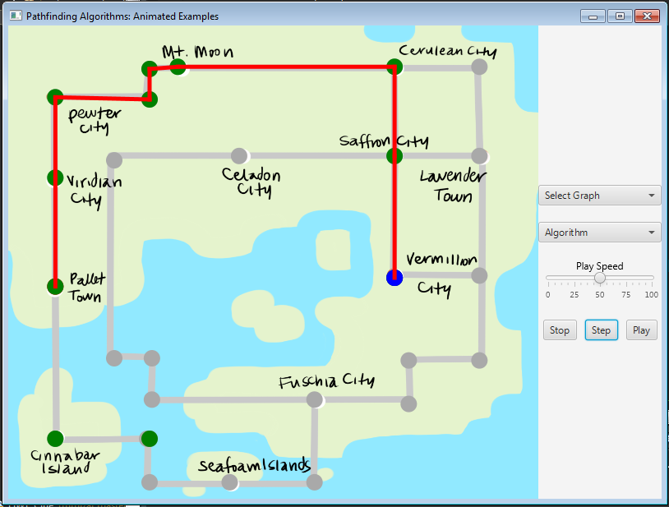
Application: Pathfinding Visualizer
Green vertices: Possible path points explored (via the PriorityQueue)
Blue vertex: Goal
Grey lines: all possible edges
Red lines: Shortest path via A* algorithm

Slide 8
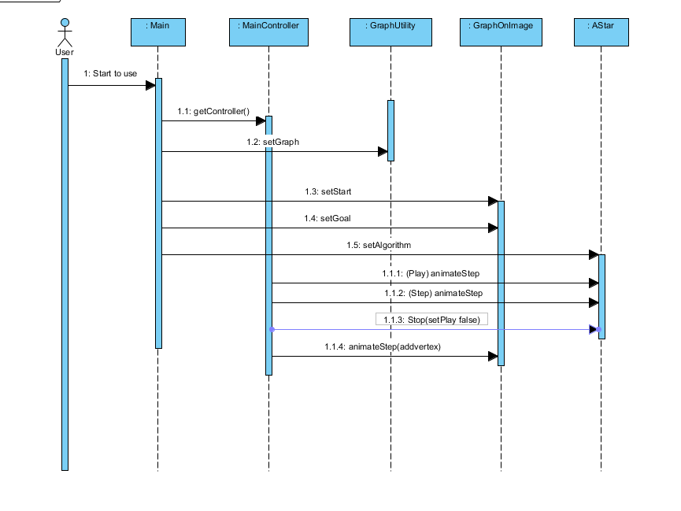
Used a Model-Controller-View design pattern to create application:
Model: Data structure & components, algorithm, utility class
Controller: Event listeners for app controls (play, stop)
View: JavaFX classes & FXML files that build & change visuals
Documentation: Sequence Diagram

Slide 9
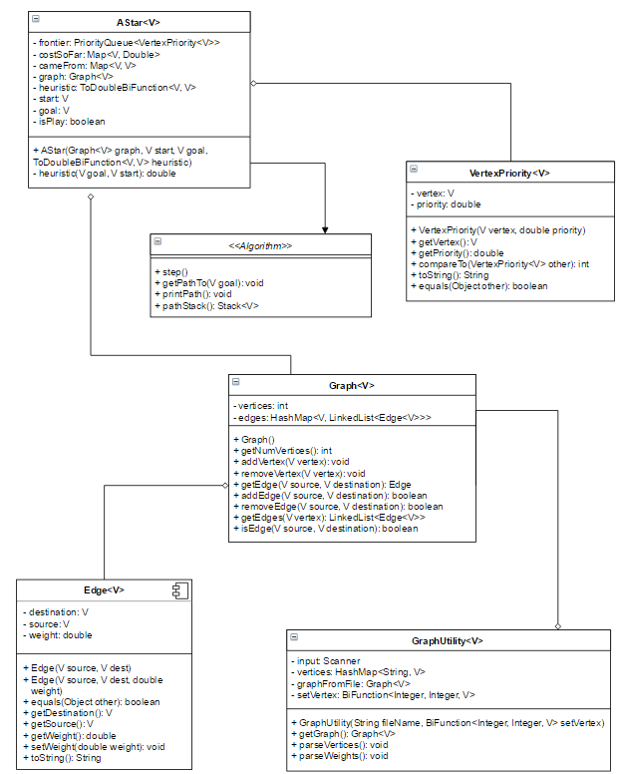
Documentation: UML Diagram
Kept model classes generic to allow for different kinds of graphs/data networks
Used Graph<Point2D> for Controller/View class visualization purposes
Used functional interfaces and anonymous classes to accommodate different data types

Slide 10
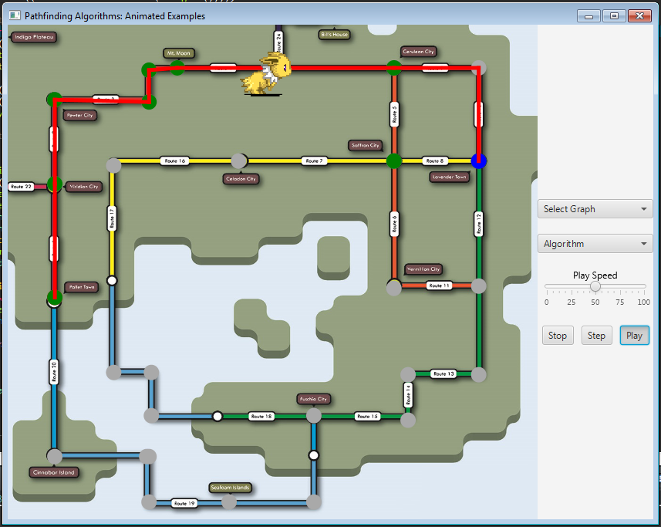
Choose between various path-finding algorithms (currently only option is A*)
Choose between multiple maps/images/themes (currently one) or have user input their own file
Dynamically change start and/or end-points, recalculate/redraw path in response
Features to Add:
More sophisticated animations & CSS styling of visual elements

Slide 11
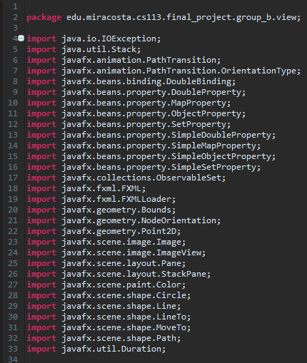
Project Challenges
Keeping model classes generic & flexible
Making sure the Model, Control, and View portions were all discrete & yet cooperative units
Deciding what to include in the Sequence/UML Diagrams, how much to pseudocode/plan, etc.
Binding visual components to objects, maintaining item’s spatial relationships to one another…

Slide 12
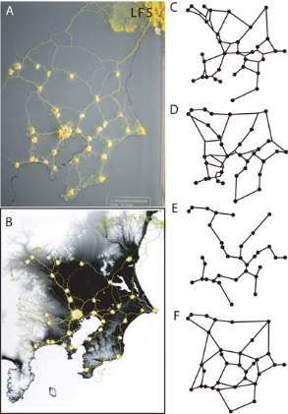
What We Learned/Future Topics to Explore:
GUIs: More opportunities to experiment with JavaFX’s extensive library of visual/animation properties, FXML & SceneBuilder
Functional vs. Object-Oriented programming: what useful techniques can be adapted from other paradigms (lambda expressions, passing functions as parameters)
Planning: What is the best way to approach designing the M-C-V project, creating & merging new version branches, learning & using new material & concepts

