Slide 1




Network-software interfaces
Boris Pismenny | Adam Morrison | Dan Tsafrir
 | Tel-Aviv University | Technion
Boris Pismenny, Haggai Eran, Aviad Yehezkel, Liran Liss, Adam Morrison, and Dan Tsafrir
Notes:
tutorial on how NICs and accelerators being integrated into the OS and software.

Slide 2
Overview
Technology trends
Existing approaches
Software interfaces
Hardware interfaces
Future

Slide 3
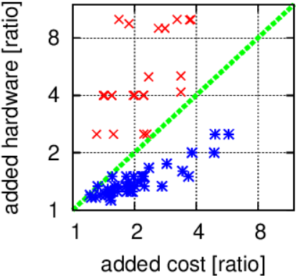

Trend: NICs are cheaper than CPUs
2x CPU cores—4x price
4x NIC speed—only 2x price
Paravirtual remote I/O by Kuperman et al., ASPLOS’16
Notes:
I’d like to start from talking about NIC and CPU prices and I’m going to show that NIC upgrades are cheaper than CPU upgrades.
The following figure shows this trend by comparing the ratio of added hardware to the added cost. Every point represents a pair of CPUs in blue or a pair of NICs in red that differ only in one parameter other than price. For CPUs, the pair differs in the number of cores and the price, and for NICs, the pair differs in the network speed and the price. For example, (click) the blue point at (4,2) represents a pair of CPUs such that it is possible to double the number of cores by quadrupling the price. On the other hand, (click) the red point in (2,4) shows that it is possible to quadruple NIC speed by only doubling the cost. Since all the points above the break-even line are NICs and all the points below it are CPUs, we conclude that it is more profitable to invest in improving NIC speeds than in improving the number of CPU cores. Moreover, CPUs are the most expensive component in servers. So, we would like to find ways to help CPUs manage with the growing speed of NICs.
90s

Slide 4
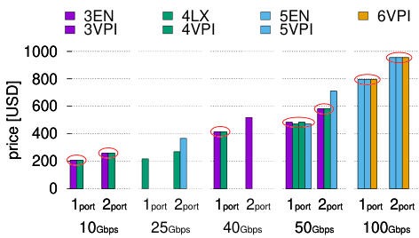

Trend: NIC offloads are $≈$free
Same price different offloads
Gen. | Year | Added offloads
3 | 2011 | First Ethernet driver Segmentation Checksum
4 | 2014 | I/O page faults (ASPLOS’17)
5 | 2016 | Multipacket descriptors (OSDI’23) NVMe emulation UDP segmentation offload
6 | 2019 | AES-XTS encryption offload
Autonomous NIC offloads by Pismenny et al. , ASPLOS’21 best paper
Notes:
Not only is it more cost effective to upgrades NICs instead of servers, but NIC offloads are often practically free, and this is what we show next.
The following table presents 4 generations of Mellanox ConnectX NICs between 2011 and 2019 (CX3 to CX6), each generation adds new offloads that improve performance (ODP, Enso, XTS). <Click> Now if we look at the prices of these NICs, then we can observe an interesting phenomena where in many cases what determines the price is not the NIC’s generation and its offloads but rather the number of NIC ports and their speed. So we conclude that offloads are often added for free.

Slide 5
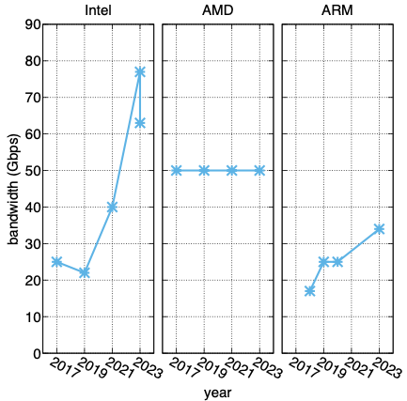
Trend: per-core bandwidth to saturate I/O
Notes:
Mention: TCP baremetal is 25Gbps, and VM is 10Gbps, DPDK is higher.
Message: offload when we can and otherwise make CPUs more efficient
So, what’s the takeaway from this analysis?
1) Don’t go through memory, even zero-copy isn’t good enough since the I/O device reads/writes to memory. DCA is a possible solution.
2) CPUs struggle to saturate line-rate and I/O offloads are necessary.
TODO: do side-by-side slides and write the takeaways

Slide 6

Existing software interface optimizations
Batching
Zerocopy
Memory BW bottlenecks
Living alongside memory BW bottlenecks
Solving memory BW bottlenecks
Unmodified socket application Only kernel/hypervisor changes
App rewrite

Slide 7
Batching
User/Kernel and VM/hypervisor
TCP CORK and Nagle’s algorithm
Jumbo frames (1.5KB → 9KB)
Segmentation and aggregation offloads (64KB → 185KB)
Doorbell, desciptor, completion batching
Interrupt batching
Adaptive NIC Interrupt coalescing
Optimizing Storage Performance with Calibrated Interrupts (OSDI’21)
Notes:
Batching is a very basic and straightforward technique to improve throughput at the cost of latency. I think that Nagle’s algorithm demonstrates this really well… Jambo packets can be used in closed networks to send more data using each packets. Segmentation and aggregation offloads provide similar benefits to Jumbo even when the MTU is smaller. They do this by sending
Cork is when a packet is being sent by the NIC to the network, so TCP can aggregate more data of the same flow being sent by the app.
Segmentation up to 64KB (max ipv4 datagram), today segmentation up to 256KB (BIG_TCP)
Segmentation and aggregation need checksum offload
Driver software and hardware use batching too: for doorbell, descriptor and completion batching.
Interrupts: send them when needed based on application-layer information
Still evolving: latency/throughput tension creates a tra

Slide 8
Zerocopy (TCP)
recvmsg (page remapping)
sendmsg (MSG_ZEROCOPY)
io_uring

Slide 9


Kernel TLS
Baseline
App
data
$⇐$encrypt
TLS
H | enc(data) | T
user
kernel
$⇐$copy
TCP/IP
H | H | enc(data) | T
NIC
H | H | enc(data) | T
TCP header
TLS message header/trailer

Slide 10

Kernel TLS
Baseline
Kernel TLS
App
data
data
user
kernel
$⇐$encrypt
$⇐$encrypt+copy
TLS
H | enc(data) | T
H | enc(data) | T
user
kernel
$⇐$copy
TCP/IP
H | H | enc(data) | T
H | H | enc(data) | T
NIC
H | H | enc(data) | T
H | H | enc(data) | T
TCP header
TLS message header/trailer

Slide 11
Zerocopy (TCP)
Recvmsg (page remapping)
Sendmsg (MSG_ZEROCOPY)
Io_uring
Kernel TLS
In-app copies
zIO: Accelerating IO-Intensive Applications with Transparent Zero-Copy IO (OSDI’22)
Serialization using scatter-gather
Cornflakes: Zero-Copy Serialization for Microsecond-Scale Networking (SOSP’23)
Accelerator device memory
GPUnet (OSDI’14)
High-throughput and Flexible Host Networking for Accelerated Computing (OSDI’24)

Slide 12


Zerocopy receive is sub-optimal
Zerocopy receive struggles to fill contiguous application buffers
1MiB image
4KiB chunk 1
4KiB chunk 1
4KiB chunk 2
4KiB chunk N
4KiB chunk 1
4KiB chunk 1
4KiB chunk 1
Rx
Notes:
Suppose we want to fill a 1MiB buffer with some input, say an image. We use zerocopy, and for example with io_uring, (click) we point Rx ring descriptors to buffers the together compose the 1MiB. Ideally, data arrives in-order and fills the 1MiB image as expected (click). But, if data arrives out-of-order or retransmissions happen (click), then we need to fallback to copying or to use an accessor function that can find the location of each byte of our image.

Slide 13
Possible solution: direct data placement (DDP)
Write arbitrary long data only in its correct destination
RDMA
TCP?
Yes, using Autonomous NIC offloads

Slide 14
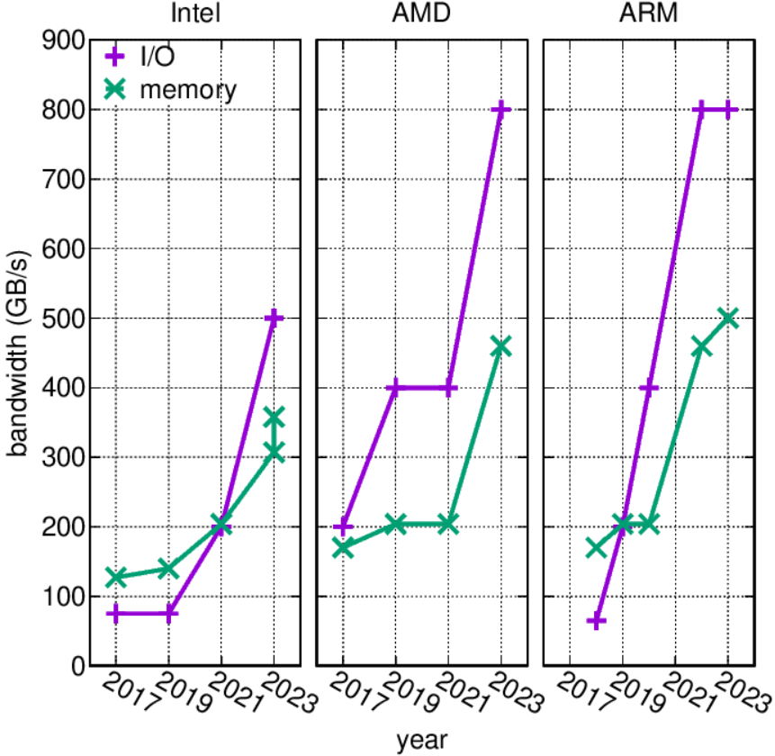
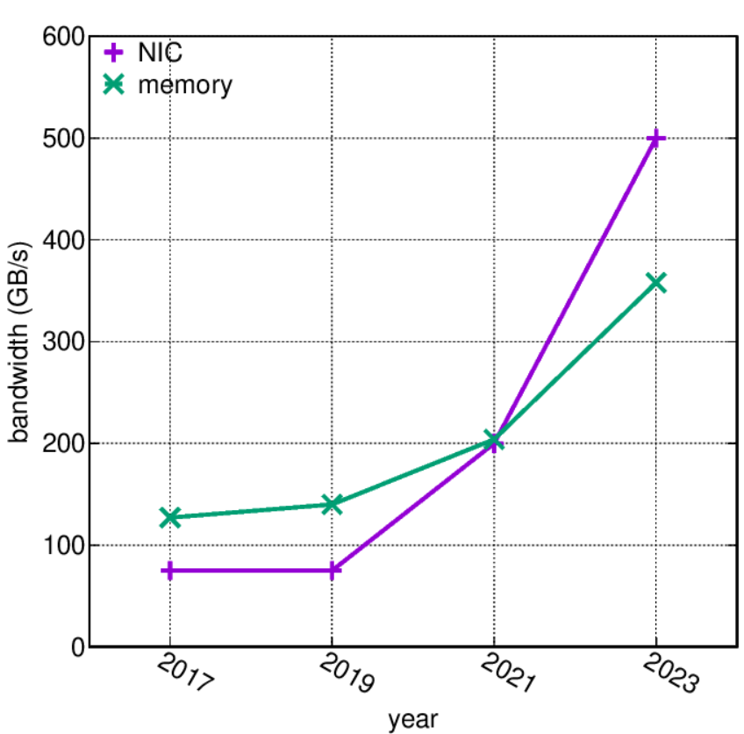
Trend: I/O > memory BW
Notes:
But zero-copy is kind of a dead-end, because as the following figure shows, if we want to fully saturate server I/O then we can’t even DMA data to memory, and this also further motivates the need for clever I/O acceleration.

Slide 15
Living alongside memory BW bottlenecks
Caladan: Mitigating Interference at Microsecond Timescales (OSDI’20)
Identify high memory bandwidth
Backpressure compute: reallocate cores
Host Congestion Control (SIGCOMM’23)
Identify high memory bandwidth
Backpressure network: TCP explicit congestion notifications
Backpressure compute: reduce core memory bandwidth using Intel MBA

Slide 16
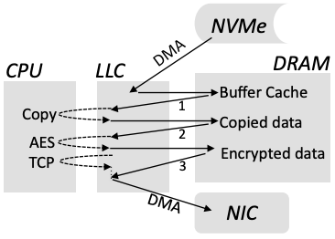
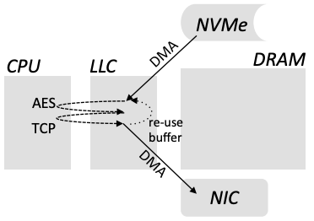
Solving memory BW bottlenecks using DCA
Direct Cache Access for High Bandwidth Network I/O (ISCA’05)
DMA to/from CPU LLC (Intel DDIO)
Disk|Crypt|Net: rethinking the stack for high-performance video streaming (SIGCOMM’17)
Sendfile over TLS; keep working-set in LLC

Slide 17
Existing hardware interface optimizations
Multicore
Virtualization
Packet layer
Transport layer
Application layer
Notes:
15m

Slide 18



Multicore and multiqueue transmit
Goal: schedule packet transmission from multiple cores fairly and efficiently
Single centralized queue – bottleneck
Hash based queue selection – imbalance
Large batches of packets – imbalance
load-aware hash function
hash function
64B pkt
centralized scheduler
1.5KB pkt

Slide 19
Multicore and multiqueue transmit
Goal: schedule packet transmission from multiple cores fairly and efficiently
Single centralized queue – bottleneck
Hash based queue selection – imbalance
Large batches of packets – imbalance
Titan: Fair Packet Scheduling for Commodity Multiqueue NICs (ATC’17)
Dynamic batching and select queue based on load
Loom: Flexible and Efficient NIC Packet Scheduling (NSDI’19)
Offload hierarchical packet scheduler to NIC

Slide 20
Multicore and multiqueue receive
Goal: spread incoming packets evenly to cores
Dispatcher core – bottleneck
Shenango: Achieving High CPU Efficiency for Latency-sensitive Datacenter Workloads (NSDI’19)
RSS hash or steer to a specific core – imbalance
hash function
centralized dispatcher

Slide 21
Multicore and multiqueue receive
Goal: spread incoming packets evenly to cores
Dispatcher core – bottleneck
Shenango: Achieving High CPU Efficiency for Latency-sensitive Datacenter Workloads (NSDI’19)
RSS hash or steer to a specific core – imbalance
Hardware load-balancing based on load – mandates transport offload
RPCValet: NI-Driven, Tail-Aware Balancing of us-Scale RPCs (ASPLOS’19)
The NeBuLa RPC-Optimized Architecture (ISCA’20)
RingLeader: Efficiently Offloading Intra-Server Orchestration to NICs (NSDI’23)

Slide 22
Multicore Rx memory consumption problem
Queue
Per-core
Per-VM
Per-app
Per-priority
Queue depth
Increases with speed

Slide 23
Trend: LLC size
Size (MB)
LLC
23

Slide 24
Trend: NIC Rx size > LLC size
Size (MB)
4x
LLC
per-core ring

Slide 25
Trend: NIC Rx size > LLC size
78x
Size (MB)
max rings
LLC
per-core ring

Slide 26
Multicore Rx memory consumption solutions
ShRing: Networking with Shared Receive Rings (OSDI’23)
Share an Rx ring between independent cores with synchronization on buffer reposting

Slide 27

ShRing: Networking with Shared Receive Rings (OSDI’23)
NIC
memory
core 1
completion ring 1
.
.
shared receive ring
.
.
.
.
.
Packet
D
.
.
core N
D
D
D
completion ring N
Packet
Packet
D
D

Slide 28
Multicore Rx memory consumption solutions
ShRing: Networking with Shared Receive Rings (OSDI’23)
Share an Rx ring between independent cores with synchronization on buffer reposting
Disentangling the Dual Role of NIC Receive Rings (under submission)
New Rx ring design obviates the need for synchronization
Making Kernel Bypass Practical for the Cloud with Junction (NSDI’24)
Share an Rx ring between cores using a coordinator core to repost buffers
Intel ENQCMD
Software writes descriptors and hardware handles conflicts

Slide 29
Virtualization
Paravirtualization → SRIOV
Inerposition problem
Pinned VM memory
Live migration
→ inter-VM switch offload
→ Page Fault Support for Network Controllers (ASPLOS’17)
→ SRIOV live migration
VM 1
VM N
VM 1
VM N
virtio
virtio
VF driver
VF driver
VXLAN
metering
conntrack
Hypervisor
Hypervisor
inter-VM switch
firwall
NIC driver
encryption
NAT
NIC driver
VXLAN
metering
Physical NIC
conntrack
inter-VM switch
firwall
Phyiscal NIC
encryption
NAT

Slide 30
Network functions (NFs)
Inter-VM switch offload + hairpin = NF offload
Eliminates all host overheads: CPU, memory, and PCIe
Struggles to scale with flows
Limited programmability
DPDK
Memory bandwidth bottleneck
The Benefits of General-Purpose On-NIC Memory (ASPLOS’22)
Store packet payload in ASIC NIC memory to save PCIe and host memory traffic

Slide 31
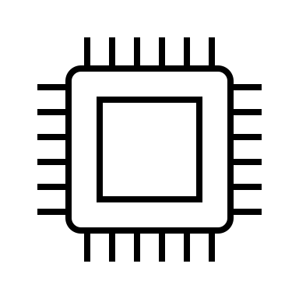
The benefits of General Purpose on-NIC memory (ASPLOS’22)
Leave data on NIC memory (nicmem)
Copy only metadata
PCIe
NIC
CPU
srcMAC
dstMAC
newSrcMAC newDstMAC
srcIP=172.16.1.100 dstIP= 172.16.2.1
… data
…
Notes:
Our main idea is to eliminate the cost of moving data by leaving it on-NIC memory. Meanwhile, we pass only message metadata to the host for processing. By doing this, we avoid the costs associated we data movers.

Slide 32
Network functions (NFs)
Inter-VM switch offload + hairpin = NF offload
Eliminates all host overheads: CPU, memory, and PCIe
Struggles to scale with flows
Limited programmability
DPDK
Memory bandwidth bottleneck
The Benefits of General-Purpose On-NIC Memory (ASPLOS’22)
Store packet payload in ASIC NIC memory to reduce PCIe and host memory traffic
Enso: A Streaming Interface for NIC-Application Communication (OSDI’23 best paper)
Streaming Rx descriptor and batched notifications to reduce PCIe traffic

Slide 33
Enso: A Streaming Interface for NIC-Application Communication (OSDI’23 best paper)
Streaming Rx descriptor
Batched notifications
Map Tx and Rx to same memory to avoid copying
NIC
RX/TX
PKT 1
PKT 2
PKT 3
PKT 4
RX
CPU

Slide 34
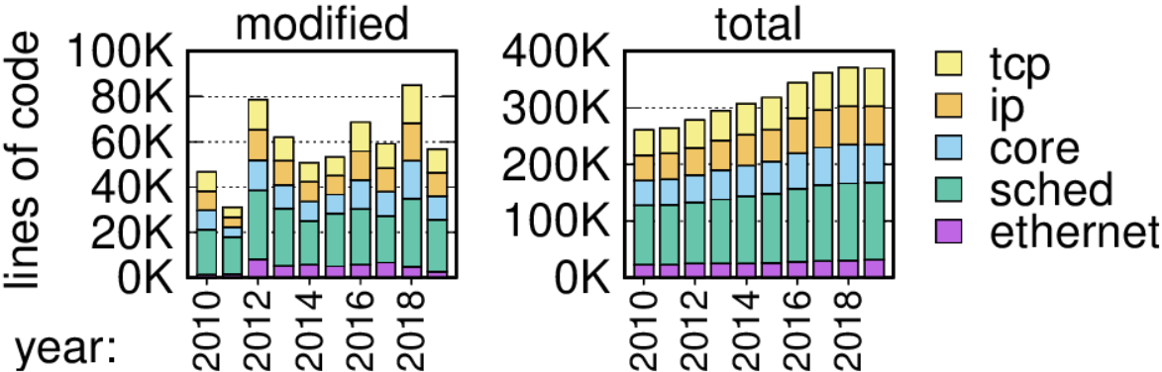
Transport offloads
Dependent NIC offloads (TCP offload engines)
TCP offload is a dumb idea whose time has come (HotOS’03)
Complex, evolving, security sensitive, niche

Slide 35
Transport offloads
Dependent NIC offloads (TCP offload engines)
AccelTCP: Accelerating Network Applications with Stateful TCP Offloading (NSDI’20)
Goal: offload only connection setup/teardown and splicing
End result: full TOE
splice()
TCP
NIC
connection 1
connection 2

Slide 36
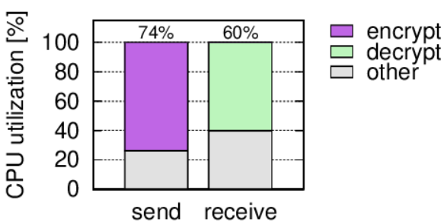
Transport offloads
Dependent NIC offloads (TCP offload engines)
AccelTCP: Accelerating Network Applications with Stateful TCP Offloading (NSDI’20)
Goal: offload only connection setup/teardown and splicing
End result: full TOE
Why do we want TOEs?
Accelerate application computation

Slide 37
Transport offloads
Dependent NIC offloads (TCP offload engines)
AccelTCP: Accelerating Network Applications with Stateful TCP Offloading (NSDI’20)
Goal: offload only connection setup/teardown and splicing
End result: full TOE
Why do we want TOEs?
Accelerate application computation
Can we accelerate app computation without offloading TCP?
Yes! Autonomous NIC offloads (ASPLOS’21 best paper)

Slide 38



Autonomous NIC offload: TLS
Kernel TLS
Autonomous TLS offload
App
data
data
user
kernel
user
kernel
$⇐$encrypt+copy
$⇐$copy
TLS
H | enc(data) | T
H | data | 0
TCP/IP
H | H | enc(data) | T
H | H | data | 0
$⇐$encrypt
NIC
H | H | enc(data) | T
H | H | enc(data) | T
TCP header
TLS message header/trailer

Slide 39



When computation is autonomously offloadable?
Can be computed incrementally
Byte-granular input
Size preserving output
Many computations fit this requirement
Autonomous TLS offload
data
App
user
kernel
$⇐$copy
H | data | 0
TLS
direct data placement
pattern matching
deserialization
encryption
decryption
digest
H | H | data | 0
TCP/IP
$⇐$encrypt
H | H | enc(data) | T
NIC

Slide 40
When L5P is autonomously offloadable?
The protocol message header must contain:
Message length field
Plaintext magic pattern (version/opcode)
Many protocols fit this requirement
Autonomous TLS offload
data
App
user
kernel
$⇐$copy
H | data | 0
TLS
http/2
memcached
iscsi
smb
thrift
grpc
nbd
H | H | data | 0
TCP/IP
$⇐$encrypt
H | H | enc(data) | T
NIC

Slide 41
Conclusion
Technology trends create an opportunity to rethink host networking
CPUs are slow and expensive whereas NICs are fast and cheap
Memory is a key bottleneck for both CPUs and NICs
Use NICs to offload when possible and otherwise make CPUs more efficient
Notes:
We saw several technology trends that I believe are going to remain true for the next few years. These trends present an opportunity to rethink various aspects of the network stack, and we saw several examples of works that do that and the tradeoffs involved. We also discussed some emerging technologies and use-cases that present new opportunities. Two key trends are: (1) CPUs are expensive and slow whereas NIC speeds outpace CPU network processing speeds and their relative price is cheaper; and (2) memory is a key bottleneck for CPU and I/O. Based on these trends, I think that we should offload when we can, and otherwise make CPUs more efficient. My work follows this approach.

