Slide 1




ShRing: networking with Shared Receive Rings
#
‡
^
§
Boris Pismenny #§ | Adam Morrison ‡ | Dan Tsafrir #^
Boris Pismenny, Liran Liss, Adam Morrison, and Dan Tsafrir
Notes:
Hello, my name is Boris Pismenny, and I’ll be presenting “shRing: networking with shared receive rings". This work is a collaboration with my advisors Adam Morrison and Dan Tsafrir.
20s

Slide 2
A day in a life of a packet
NIC
memory
CPU core
head
.
.
.
receive ring
batch
Packet
D
Packet
D
Notes:
Software and NICs interact via logically cyclic arrays called rings….
Note that all buffers in the ring must be processed before any of them is reused.
Software and NICs interact via logically cyclic arrays called rings. <click> When a packet arrives from the wire, <click> the NIC DMA writes it in a buffer pointed by an entry of the receive ring. <click> The NIC then marks the entry as “done”, indicating to software that it is ready for processing. <click> Multiple packets can arrive until software checks the ring for packets, and they are all stored in sequence. Software checks for packets starting from the head entry marked in bold. <click> Software reads a batch of these packets, <click> clears the corresponding done flags, <click> and replaces packet buffers with new ones. <click> Then, software moves the ring’s head indicating to NIC hardware that ring entries can be reused. <click> Finally, software proceeds to process received packets.
Note that all buffers in the ring must be processed before any of them can be reused.

Slide 3
A day in a life of a packet
NIC
memory
CPU core
.
.
.
…
receive ring
1
1.5KiB
0
1023
1.5KiB
Notes:
By default, <click> receive rings have 1024 entries and <click> each entry’s buffer is large enough to receive the maximum transmittable unit, which is about 1.5KB.

Slide 4
A day in a life of a packet
NIC
memory
CPU core
working set per core $≈$ 1.5 MiB
.
.
…
.
receive ring
1
1.5KiB
0
1023
1.5KiB
Notes:
So, in total the I/O working set is at least 1.5MB per core.

Slide 5
A day in a life of a packet
.
.
receive ring 1
core 1
NIC
.
.
.
.
.
.
.
.
.
receive ring N
core N
.
memory
.
.
.
receive ring
Notes:
(RSS) For scalability, today’s multicore CPUs use a ring per core, and the NIC distributes packets between cores using an RSS hash on packet headers. Hence, when running network intensive processing on N cores, the total working set consists of all receive ring buffers of N cores put together.

Slide 6
A day in a life of a packet
.
.
receive ring 1
core 1
NIC
.
Problem: working set $≈$ N $×$ 1.5 MiB > LLC
.
.
.
.
.
.
.
.
receive ring N
core N
.
memory
.
.
.
receive ring
Notes:
(DDIO) Namely, the working set is N times 1.5MB, which today is often greater than the LLC of Intel CPUs. This is important because, as we will show later, working sets greater than the LLC degrade performance when NICs have direct access to the LLC, such as with Intel DDIO.

Slide 7
Our proposal: ShRing
core 1
NIC
shared receive ring
.
.
.
.
.
.
core N
memory
.
.
.
receive ring
Notes:
In this work, we propose to replace per-core receive rings with a shared receive ring, which we call shRing.

Slide 8
Our proposal: ShRing
core 1
NIC
shared receive ring
.
Solution: shared receive ring $≈$ 1.5 MiB < LLC
.
.
.
.
.
core N
memory
.
.
.
receive ring
Notes:
With a shared ring, the working set is only 1.5MB, which fits in the LLC.

Slide 9
Our proposal: ShRing
core 1
NIC
shared receive ring
.
Helps when: LLC contention > synchronization
.
.
.
.
.
core N
memory
.
.
.
receive ring
Notes:
ShRing helps apps when the the impact of LLC contention caused by I/O outweighs the overhead of synchronization.

Slide 10
Cons of big rings
Memory bandwidth (GB/s)
DDIO
(20% of LLC)
LLC
DRAM
1024
ring size (entries)
Notes:
Next, to show the cost of a large working set, we run an experiment with a synthetic network function that receives packets, accesses memory twice per packet, performs routing and sends packets out to the wire. We run this NF on all CPU cores, and we load it with 200Gbps using an open loop load generator. The following figure shows memory bandwidth in GB/s as a function of ring size. We see that rings smaller than 128, <click> whose working set fits into the DDIO portion of the LLC, have less than 20GB/s memory bandwidth. Next, we see that rings smaller than 512, <click> which fit in the LLC but not in DDIO’s portion of the LLC have less than 40GB/s memory bandwidth. Finally, with rings of 1024 entries, which is the default size, or larger, the working set exceeds the LLC, and all data goes through DRAM.
So smaller rings, cause a smaller working set, which improves memory bandwidth. But, membw is a secondary metric---what about throughput and latency?

Slide 11
Cons of big rings
Throughput (Gbps)
DDIO
(20% of LLC)
LLC
DRAM
1024
ring size (entries)
Notes:
When looking at the throughput of the same experiment. We can see that small rings reach line-rate speeds of 200Gbps. Larger rings, whose working set size exceeds DDIO, have up to 20% lower throughput. This is caused by high membw, which slows down both NIC and CPU memory accesses.

Slide 12
Cons of big rings
Latency (µs)
DDIO
(20% of LLC)
LLC
DRAM
1024
ring size (entries)
Notes:
Because working sets that fit in DDIO achieve line rate throughput, they have the lowest latency of about 100us. But, the latency of larger working sets increases proportionally to ring size. This happens because the rings of NFs that fail to meet line rate fill up with packets, and as a result the latency experienced by each packet is the sum of the latencies of processing all packets in the ring.

Slide 13
Smaller default is impractical
The default is 1024 ring entries
Can we just use small rings?
ResQ: Enabling SLOs in network function virtualization (NSDI`18)
Notes:
Since the default ring size today is 1024 entries, and we saw that smaller rings improve performance. Should we just use small rings to solve this problem? We find that small rings are impractical as we show next.

Slide 14
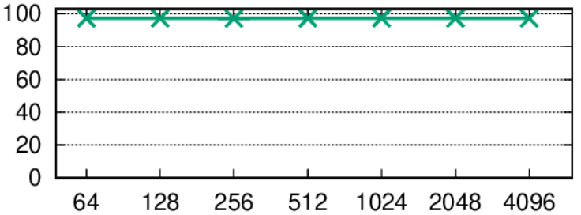

Smaller default is impractical
multicore
DPDK
l3fwd no-drop throughput
(Gbps)
1024
ring size (entries)
Notes:
Next, we run DPDK’s l3fwd app and measure the maximum throughput without packet loss for various ring sizes. When we run this experiment with traffic spread among multiple cores, we see that we can reach line rate with any ring size.

Slide 15
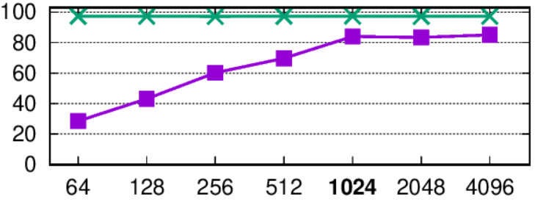

Smaller default is impractical
multicore
DPDK l3fwd no-drop throughput
(Gbps)
default (1024) ring per core works best
single core
1024
ring size (entries)
Notes:
But, when we repeat this experiment with a single core, we find that rings smaller than the default degrade performance, while rings larger than the default do not improve it. <click> This suggests that the default ring size should be maintained.

Slide 16
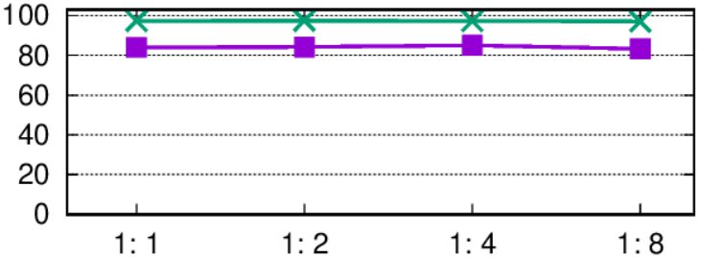
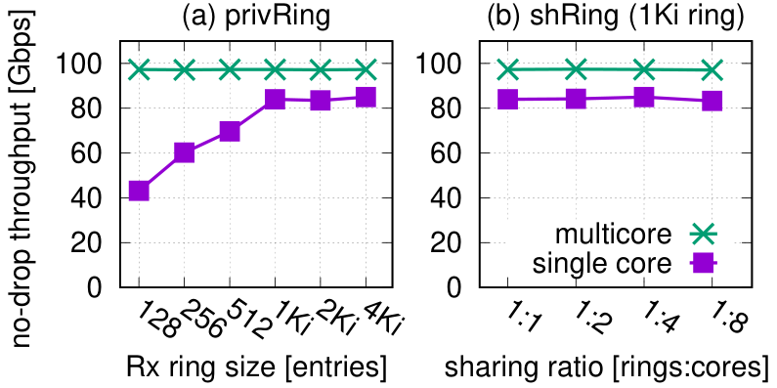
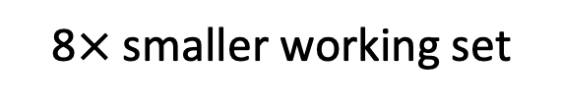
Sharing default sized ring
multicore
single core
DPDK
l3fwd no-drop throughput
(Gbps)
default (1024) ring per core
8$×$ smaller working set
Notes:
We ask ourserlves whether sharing the default sized ring would solve the problem we observe with no-drop throughput?
So we repeat the same experiment with a shared default sized ring, and we consider both single core and multicore performance. The leftmost points <click> correspond to the default ring size per core, which we saw in the previous slide. As we move to the right, the number of cores sharing each default sized ring increases with no loss in performance <click> while at the same time the working set size is reduced by up to 8 times.
So, now that we’ve motivated the need for sharing rings, let’s discuss how we share a ring.

Slide 17

Naive ring sharing
NIC
memory
core 1
.
.
shared receive ring
.
.
.
.
Packet
D
core N
Packet
D
D
Packet
Notes:
The naïve approach to share a ring uses a lock to serialize access to the shared ring. <click> When packets arrive from the network, all are placed in the shared ring. Cores contend on the shared ring’s lock, <click> and once a core acquires the lock, <click> it reads a batch of packets, <click> clears the done flags, <click> replaces packet buffers, <click> advances the ring’s head, <click> releases the lock, <click> and processes the packets. <click> Then, another core acquires the lock and performs the same operations.

Slide 18
Naive ring sharing
core 1
NIC
memory
.
.
Problem: serialized ring polling
.
shared receive ring
.
.
.
core N
Notes:
The problem with this approach is serialized ring polling and packet processing.

Slide 19
Naive ring sharing
core 1
NIC
memory
.
.
Solution: separate polling from the shared ring
.
shared receive ring
.
.
.
core N
Notes:
We solve this by separating polling from the shared ring

Slide 20
Shared ring with completion rings
NIC
memory
core 1
completion ring 1
.
.
shared receive ring
.
.
.
.
.
Packet
D
.
.
core N
Packet
completion ring N
Packet
D
D
Notes:
So instead of polling for packets on the shared receive ring, cores poll for packets on a per core completion ring. <click> When packets arrive from the wire, the NIC DMA writes packets in shared receive ring buffers and sets done flags in completion rings selected according to the RSS hash of packet headers. Cores poll in parallel on their coresponding completion rings for packets, <click> read a batch of packets, <click> clear the done flags in their completion rings, <click> advance the completion ring's head, <click> and replace the consumed shared ring buffers. <click> But, synchronization is still necessary to advance the shared ring’s head. <click> So, one of the cores will acquire a lock. <click> Meanwhile, others make progress. <click> Finally, the core with the lock will advance the head, <click> release the lock, <click> and complete packet processing.

Slide 21
Shared ring with completion rings
NIC
memory
core 1
completion ring 1
.
.
Completion rings → parallel polling
.
shared receive ring
.
.
.
.
.
.
core N
completion ring N
Notes:
In conclusion, completion rings enable parallel polling and packet processing.

Slide 22

Problem: out-of-order head update
NIC
memory
core 1
completion ring 1
.
.
shared receive ring
.
.
.
.
.
Packet
D
.
.
core N
completion ring N
Packet
Packet
D
D
Notes:
But, since completion rings enable cores to process packets in parallel, packets may be processed out-of-order, and sometimes a core cannot advance the head even though it reposted its buffers. For example, <click> when packets arrive from the wire, <click> and core 1 makes progress while core N is busy with other tasks. <click> Then, core 1 will try to advance the head before core N read its packets, <click> which cannot be allowed as it will let the NIC override the packets of core N. Hence, core 1 must leave the head as-is <click>. <click> Later, core N will examine its completion ring, and make progress. But, since core N is unaware of the packet processed by core 1, <click> its update to the head will be one entry short, and the resulting head position will become stale <click>.

Slide 23
Solution: in-order head update
NIC
memory
core 1
completion ring 1
.
.
shared receive ring
.
.
.
.
.
Packet
D
.
.
core N
D
D
D
completion ring N
Packet
Packet
D
D
Notes:
To solve this problem and make head advance correctly, we need to track processed entries in the shared ring as we show next. Following the previous example, <click> when packets arrive from the network, and core 1 makes progress while core N is busy. <click> Then, core 1 will try to advance the head before core N read its packets, <click> which is forbidden. So, instead, core 1 will mark the shared ring entry as done <click>, and <click> finish its packet processing. <click> Later, core N examines its completion ring and makes progress. It will also mark processed entries in the shared ring as done <click>. Then, core N will identify the sequence of entries marked as done starting from the head, clear the done flags <click>, advance head correctly <click>, and complete its packet processing <click>.

Slide 24
Pathological conditions
No isolation between shared ring users
Shared ring can be halted by one persistently slow core
Slow processing
Traffic overload
Notes:
While using shared rings, we found that besides the cost of synchronization on the lock, shared rings can degrade performance due to the lack of isolation between cores. This can happen if, for example, a core is persistently slow, either due to excess traffic or due to processing overload. We call these pathological conditions.

Slide 25

Pathologically long processing
NIC
memory
core 1
completion ring 1
Packet
.
.
shared receive ring
.
.
.
Packet
.
Packet
Packet
.
Packet
D
.
.
core N
D
completion ring N
Packet
Packet
D
D
Notes:
To demonstrate pathologically long processing conditions, we use our previous example. <click> Packets arrive from the wire, <click> and core 1 makes progress while core N is busy. <click> This time, core N remains busy <click>, causing the ring to fill up with packets that are not getting processed <click>, until eventually, <click> new packets will be dropped due to lack of space.

Slide 26
ShRing is therefore dynamic
Enable shRing only when it helps
High cache contention due to I/O
Disable shRing when it hurts
Core load is persistently extreme compared to rest
Notes:
To addres pathological conditions, we switch between shared and private per core rings dynamically. We enable shRing when it helps, that is when cache contenion is high as measured by Intel PCM. We also disable shRing when it hurts, that is when there is a core whose load is persistently extreme compared to the rest.

Slide 27

Implementation
NVIDIA ConnectX-5
Minor firmware change
Now generally available
ShRing is transparent to app
DPDK mlx5 driver config
$≈$2200 lines of code
Mostly in the driver
Notes:
We implement shRing on NVIDIA CX-5 using minor FW changes that are now generally available. Our implementation is 2200 LOC, mostly in DPDK’s driver layer. This allows apps to enable shRing without changes to application logic.

Slide 28
Layer-3 load balancer performance
+20%
+20%
Throughput (Gbps)
Notes:
To evaluate the performance of shRing on a real application we use a stateful load balancer network function, which rewrites packet headers to spread load among 16 servers. We run the load balancer on all cores and load it with 200Gbps. We compare between a default sized private ring per core, small private rings that fit in DDIO but will cause loss if traffic is bursty, and a ring shared by 8 cores. <click> The working set of private rings doesn’t fit in DDIO, and hence its throughput is low. <click> Small private rings and ShRing fit in DDIO and hence they reach line rate, improving throughput by 20%.

Slide 29
Layer-3 load balancer performance
Latency
(µs)
-92%
-91%
Notes:
When looking at latency, we see that default private rings, which do not reach linerate, have latency of about 1ms, while small private rings and shRing latency is closer to 100us.

Slide 30
Pathological processing skew
shRing/8
dynamic shRing/8
privRing
Throughput (Gbps)
Overhead on target core (mem refs per packet)
Notes:
Next, we look at the performance under pathological processing skew. To that end, we run a synthetic NF on all CPU cores. Each core accesses memory twice per packet except one core, which we call the target core. On the target core, we vary the number of memory accesses between 0 and 300. We load our app with 200Gbps that is spread evenly among all cores except the target core which receives only 1% of all traffic. In the figure, we plot the throughput of our app as a function of the number of memory accesses on the target core. <click> With private rings, the app cannot achieve line rate because its working set is too big, and it performs similarly regardless of the load on the target core. This is expected because 99% of all traffic is being processed by cores other than the target core. <click> In contrast, shRing achieves linerate when the overhead on the target core is low. But, when the load on the target core exceeds 100 memory accesses per packet, shRing performance starts dropping, this happens because the slow target core prevents other cores from making progress. <click> Dynamic shRing solves this problem by identifying the persistently slow core and switching to private rings.
Synthetic NF running on all cores
200Gbps load
Target core processing varies between 0—300 mem accesses
Dynamic shring switches to base upon pathological imbalance
Synthetic workload: 2 memory accesses per packet

Slide 31
Conclusions
Too many receive ring buffers degrade performance
Small rings cannot address this problem
Sharing buffers alleviates this despite synchronization overhead
Notes:
In conclusion, too many receive ring buffers degrade app performance, using small rings cannot address this problem. We show that sharing ring buffers solves the problem despite the synchronization overhead.

