Slide 1

NVMeTCP Offload
Implementation and Performance Gains
Shai Malin, Aurelien Aptel
Boris Pismenny, Yoray Zack, Ben Ben-Ishay and Or Gerlitz

Slide 2
Agenda
The motivation for the NVMeTCP offload
The challenge
The offload design and implementation
Performance
Debug lessons

Slide 3
The Offload Opportunities
NVMeTCP PDU
Header
Receive side zero-copy
The data arrives as TCP stream and needs to be copied into the destination buffers.
Receive side data CRC validation
Transmit side data CRC calculation
Data
CRC

Slide 4
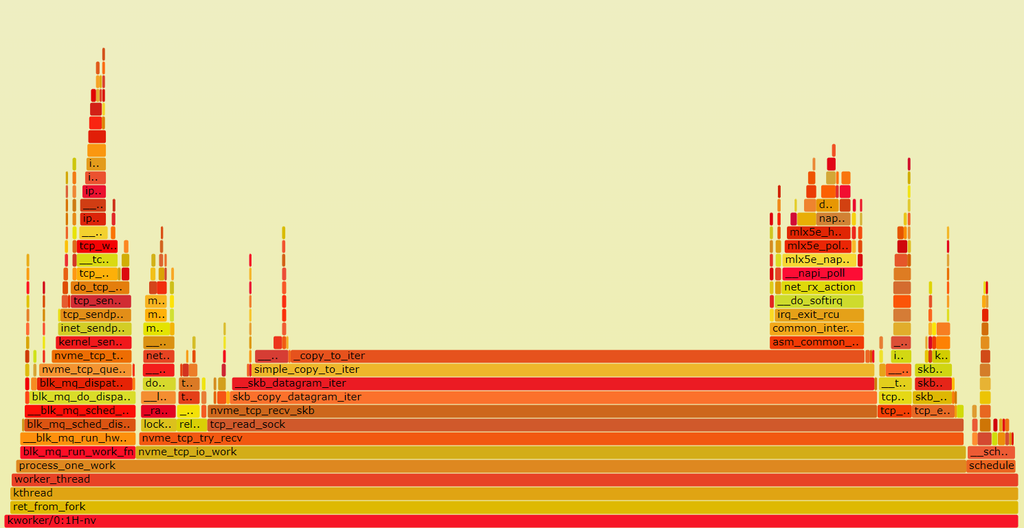
The Motivation
fio --bs=128k --rw=randread --ioengine=libaio --bs=[x] iodepth=128 --numjobs=1 | Without data digest
Notes:
128K IOs, 1 queue, 128qd, no offload, with digest

Slide 5
The Motivation
Saving the Data Copy:
Rx Data Copy
fio --bs=128k --rw=randread --ioengine=libaio --bs=[x] iodepth=128 --numjobs=1 | Without data digest
Notes:
128K IOs, 1 queue, 128qd, no offload, with digest

Slide 6
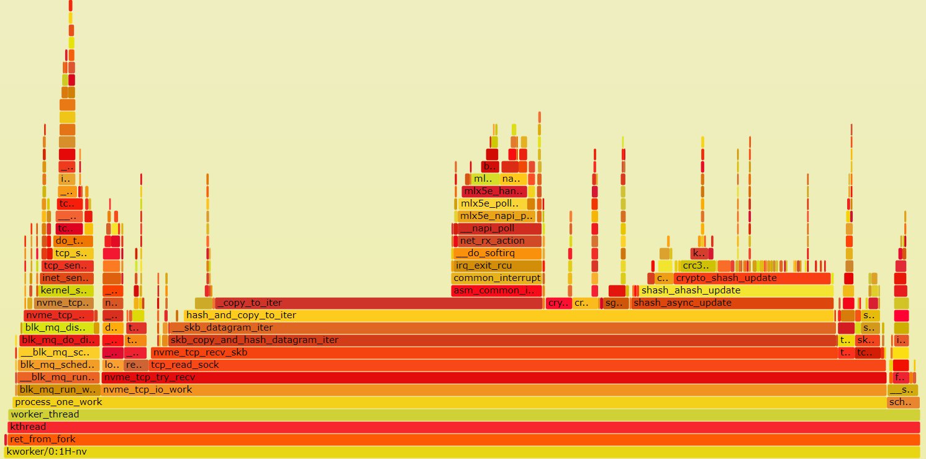
The Motivation
Saving the Data Copy and the CRC Calculation:
Rx CRC Validation
Rx Data Copy
fio --bs=128k --rw=randread --ioengine=libaio --bs=[x] iodepth=128 --numjobs=1 | With data digest
Notes:
128K IOs, 1 queue, 128qd, no offload, with digest

Slide 7
The Challenge

Slide 8
NVMeTCP PDU vs TCP Segments
NVMeTCP PDU #1
PDU hdr
PDU data
DD
TCP Segment #1
TCP Segment #2
TCP Segment #3
TCP hdr
PDU hdr
PDU data
TCP hdr
PDU data
TCP hdr
PDU data
DD

Slide 9
NVMeTCP PDU vs TCP Segments
NVMeTCP PDU #1
PDU hdr
PDU data
DD
TCP Segment #1
TCP Segment #2
TCP Segment #3
TCP hdr
PDU hdr
PDU data
TCP hdr
PDU data
TCP hdr
PDU data
DD
TCP Segment
TCP hdr
PDU hdr
PDU data
DD
PDU hdr
PDU data
DD

Slide 10
The Challenge
TCP receives data in anonymous unaligned buffers.
PDU out of order is allowed – the remote side is allowed to reorder the transmitted PDUs.
-> Generic receive zero-copy will not work.
This requires to track the TCP stream and distinguish the
NVMeTCP PDU based on the PDU header CCCID and PLEN.
CCCID – Command Capsule CID
PLEN – Total length of the PDU
PDU hdr
CCCID
PLEN

Slide 11
The Offload Design

Slide 12
The Offload Rx Design (in-order)
Identify the TCP connection based on a 5-tuple steering rule.
Track the TCP stream and identify the NVMeTCP PDUs in the stream based on PDU headers which include command identifier (CCCID) and PDU length (PLEN).
In case of Data PDU:
DDP (Direct Data Placement) – Place the PDU data directly into the end-buffer in the relevant offset which is based on the TCP sequence.
CRC Offload - Calculate the start/continuation of the data digest and verify the result at the end of the PDU.
1
2
3
4
5
PDU Header
PDU Data
Data Digest
PDU 1
DDP+CRC Offload
PDU 2
DDP+CRC Offload

Slide 13
The Driver SKB Build
NIC driver builds SKBs of packets:
Packet headers from receive ring
Storage protocol header from receive ring
Payload from destination buffers
Storage protocol skips copy
If (src addr == dst addr)
skb_shinfo(skb)
Application buffers
previous packets
PDU data (part 1)
Receive
ring
Ethernet / IP / TCP / NVMeTCP
Received
TCP packet
-
NVMe IO
(CID=X)
PDU data (part 2)
offload
more packets
PDU data (part 3)

Slide 14
The Offload Rx Design (out-of-order)
Based on the PDU header DATAL, the HW can anticipate which TCP sequence range is within the current PDU.
If the missing TCP packet is in the middle of the PDU, the HW will continue the direct data placement of the following packets.
In this case the PDU data digest will be calculated by software.
1
2
3
4
5
PDU Header
PDU Data
Data Digest
PDU 1
PDU 2

Slide 15
The Offload Rx Design (out-of-order)
Based on the PDU header DATAL, the HW can anticipate which TCP sequence range is within the current PDU.
If the missing TCP packet is in the middle of the PDU, the HW will continue the direct data placement of the following packets.
In this case the PDU data digest will be calculated by software.
When the missing packet will arrive (out-of-order), the HW will bypass the offload flow.
1
2
3
4
5
PDU Header
PDU Data
Data Digest
PDU 1
DDP + CRC Offload
PDU 2
Partial DDP,
No CRC Offload
*For more detail -> Netdev 0x15 Autonomous NVMe-TCP Offload
Notes:
Packet 4 is dropped.

Slide 16
The Offload Rx Design (out-of-order)
If the missing TCP packet includes a PDU header:
The HW will pause the offloading and in the next following packets, the HW will compare the start of the packet with the magic pattern as optimistic approach, and in case of a match, the HW will send a resync request to the software.

Slide 17
The Offload Rx Design (out-of-order)
If the missing TCP packet includes a PDU header:
The HW will pause the offloading and in the next following packets, the HW will compare the start of the packet with the magic pattern as optimistic approach, and in case of a match, the HW will send a resync request to the software.
Magic pattern match
The HW will send a resync request to the SW
1
2
3
4
5
PDU Header
PDU Data
Data Digest
PDU 1
PDU 2
PDU 3
PDU 4
Notes:
Packet 2 is dropped.

Slide 18
The Offload Rx Design (out-of-order)
If the missing TCP packet includes a PDU header:
The HW will pause the offloading and in the next following packets, the HW will compare the start of the packet with the magic pattern as optimistic approach, and in case of a match, the HW will send a resync request to the software.
The HW will continue to track the incoming stream, without performing the DDP, while it is waiting for the resync response.
Magic pattern match
The HW will send a resync request to the SW
1
2
3
4
5
PDU Header
PDU Data
Data Digest
PDU 1
PDU 2
PDU 3
PDU 4
Notes:
Packet 2 is dropped.

Slide 19
The Offload Rx Design (out-of-order)
If the missing TCP packet includes a PDU header:
The HW will pause the offloading and in the next following packets, the HW will compare the start of the packet with the magic pattern as optimistic approach, and in case of a match, the HW will send a resync request to the software.
The HW will continue to track the incoming stream, without performing the DDP, while it is waiting for the resync response.
Once the software resyncs the HW with the new state (confirmation of the magic pattern), the offload will continue.
Resync response (confirmation)
1
2
3
4
5
PDU Header
PDU Data
Data Digest
PDU 1
DDP + CRC Offload
PDU 2
No DDP,
No CRC Offload
PDU 3
No DDP,
No CRC Offload
PDU 4
DDP + CRC Offload
Notes:
Packet 2 is dropped.

Slide 20
The Offload Rx Design (out-of-order)
If the missing TCP packet includes a PDU header:
The HW will pause the offloading and in the next following packets, the HW will compare the start of the packet with the magic pattern as optimistic approach, and in case of a match, the HW will send a resync request to the software.
The HW will continue to track the incoming stream, without performing the DDP, while it is waiting for the resync response.
Once the software resyncs the HW with the new state (confirmation of the magic pattern), the offload will continue.
The resync does not terminate the offload or stop the Rx from receiving the incoming packets.
*For more detail -> Netdev 0x15 Autonomous NVMe-TCP Offload

Slide 21
The Offload Tx Design
Instead of computing the NVMeTCP PDU data digest by the software layer, the driver marks packets for data digest offload based on the socket the packet is attached to.
The HW identifies the packet as requiring data digest offload handling and performs data digest calculation of the PDU data. It replaces the PDU data digest and TCP checksum with correct values.
Both the device and the driver maintain expected TCP sequence values in order to handle retransmissions.
Retransmission of a packet in the middle of the PDU will not require to be handled by the offload IO path.
If the retransmission includes the PDU data digest, the software will resend the entire PDU to the HW, which will calculate the data digest but will send to the wire only last segment which includes the data digest.
*For more detail -> Netdev 0x15 Autonomous NVMe-TCP Offload

Slide 22
The Offload Flows
The offload (DDP and CRC offload) is a net-device capability. When creating a new NVMeTCP queue, the offload will be enabled if the module param ulp_offload is set and if netdev->features & NETIF_F_HW_ULP_DDP.
The offload for IO queues is initialized after the handshake of the NVMe-TCP protocol is finished by calling nvme_tcp_offload_socket(). This operation sets all relevant hardware contexts in the hardware.
On the IO path, per IO:
The NVMeTCP layer will call nvme_tcp_setup_ddp() to map the IO buffer and to configure the HW for the specific IO (CCCID, buffer). This flow is opportunistic in order to avoid the waiting for the HW completions.
Once the IO has completed by the NVMeTCP layer, but before posting the completion to the upper layer, the nvme_tcp_teardown_ddp() will invalidate the HW buffer.
The resynchronization flow:
Resync request from the device HW to the SW, regarding a possible location of a PDU header.
Resync response from the NVMe-TCP driver to the device HW.

Slide 23
SKB changes
In order the allow the design, 2 New SKB bits skb->ulp_ddp and skb->ulp_crc
Used similarly to TLS’s skb->decrypted
On transmit skb->ulp_crc indicates to the HW that CRC offload is expected
On receive skb->ulp_crc indicates to the driver that no CRC errors in the packets’ payload
skb->ulp_crc==0 triggers software PDU CRC calculation
On receive skb->ulp_ddp indicates to avoid skb_condense which copies data from destination buffer back to SKB.

Slide 24
Enablement
In order to enable the NVMeTCP offload: ethtool -K <device> ulp-ddp-offload on
modprobe nvme-tcp ulp_offload=1
Following the enablement, all the NVMeTCP queues/sockets which are running on the device are offloaded.

Slide 25
DDP and Rx CRC Offload Performance Results on ConnectX 7

Slide 26
The Tests Config
Servers:
Host server: Intel(R) Xeon(R) Platinum 8380 CPU @ 2.30GHz| Kernel: 5.19.0 | HW: ConnectX-7 2x200
Target server Intel(R) Xeon(R) Platinum 8380 CPU @ 2.30GHz | Kernel: 5.19.0 | HW: ConnectX-7 2x200
Target backend: null-device
Topology and Networking:
Back-to-back connectivity, 1x200 Gbps
ipv4, 1500 MSS
Tuning:
Host server offload: not needed.
Host server non-offload (“SW”): aRFS, num combined queues = num fio jobs
Target server (“SW”): aRFS, num combined queues = num fio jobs
Workload:
fio: num fio jobs = fio cpu allowed

Slide 27
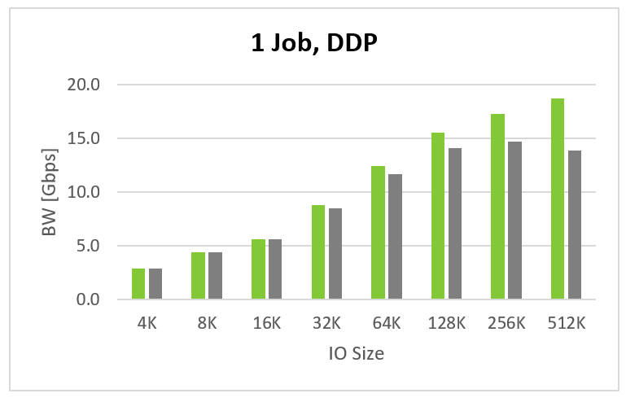
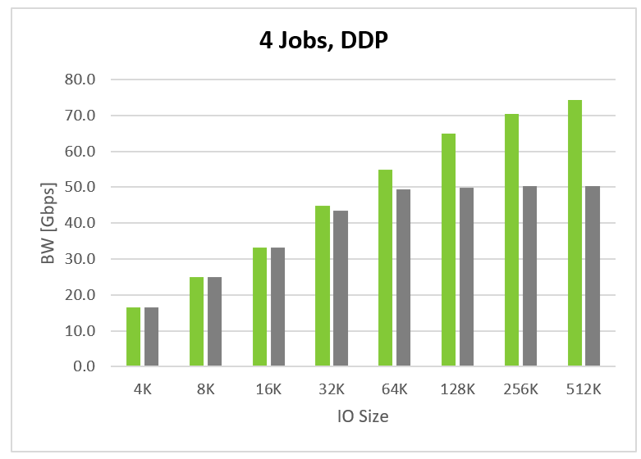
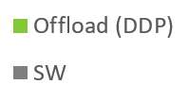
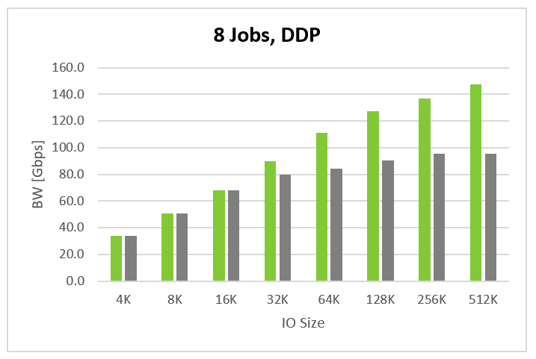
DDP vs SW – Bandwidth Comparison
Up to 35% higher BW
Up to 48% higher BW
Up to 55% higher BW
fio
--rw=randread --ioengine=libaio
--bs=[x] iodepth=128 --numjobs=[x]

Slide 28
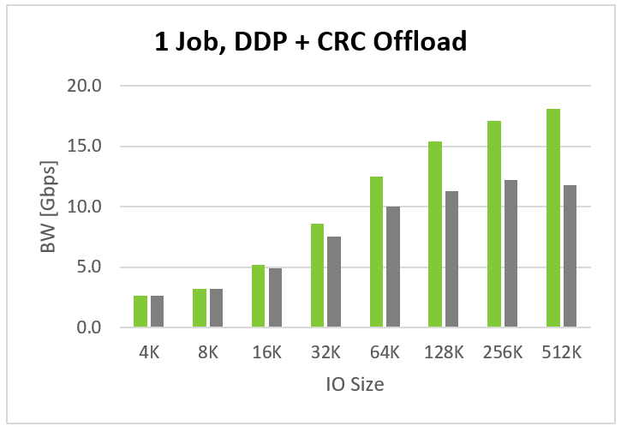
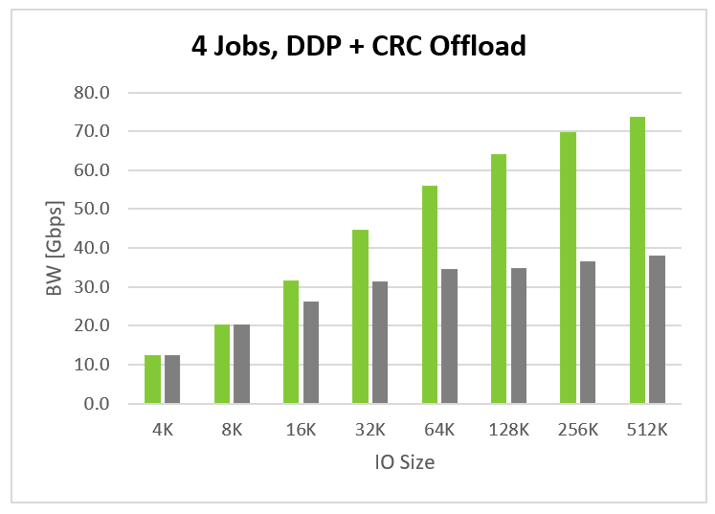
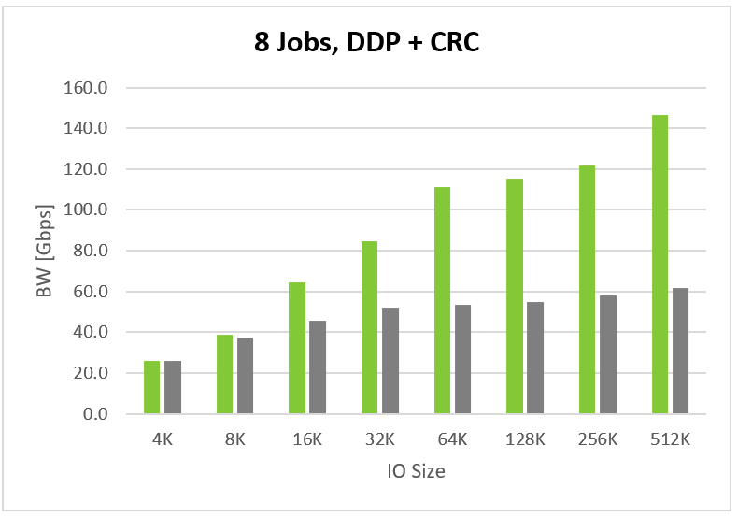
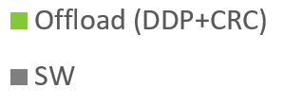
DDP (+ CRC Offload) vs SW (+ SW CRC) – Bandwidth Comparison
Up to 53% higher BW
Up to 85% higher BW
Up to 138% higher BW
fio
--rw=randread --ioengine=libaio
--bs=[x] iodepth=128 --numjobs=[x]

Slide 29
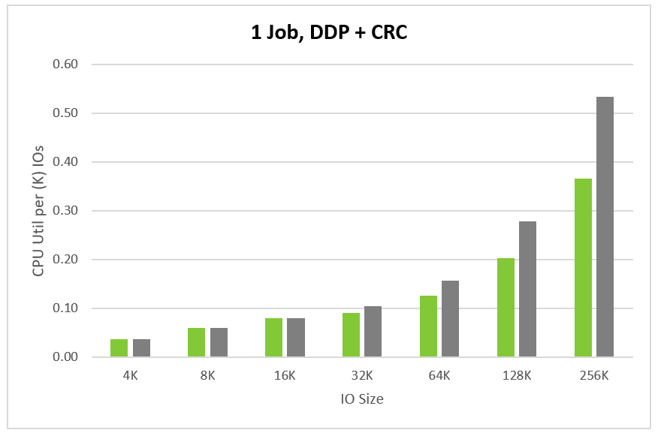
DDP (+ CRC Offload) vs SW (+ SW CRC) – The CPU Cost Comparison
The comparison of the CPU utilization, normalized per 1000 IOs
The offload shows consistent advantage
fio
--rw=randread --ioengine=libaio
--bs=[x] iodepth=128 --numjobs=1

Slide 30
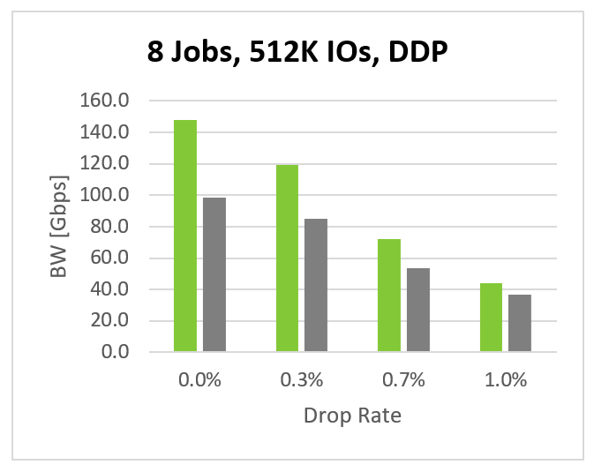
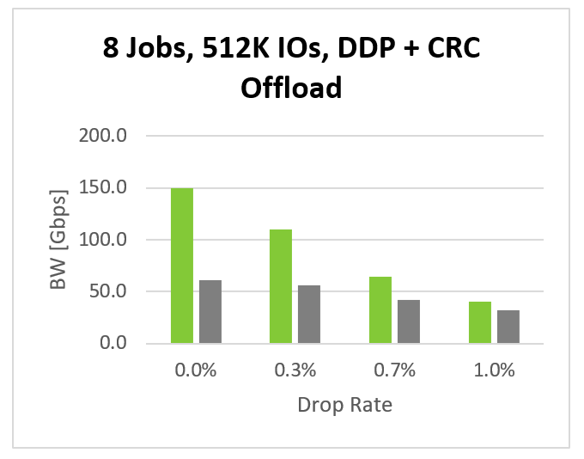
Network Congestion
The network congestion was simulated using:
tc qdisc add dev eth0 root netem loss []%
The offload shows consistent advantage
fio
--rw=randread --ioengine=libaio
--bs=512k iodepth=128 --numjobs=8

Slide 31
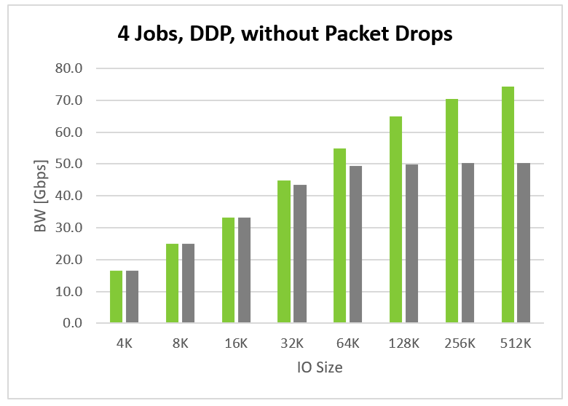
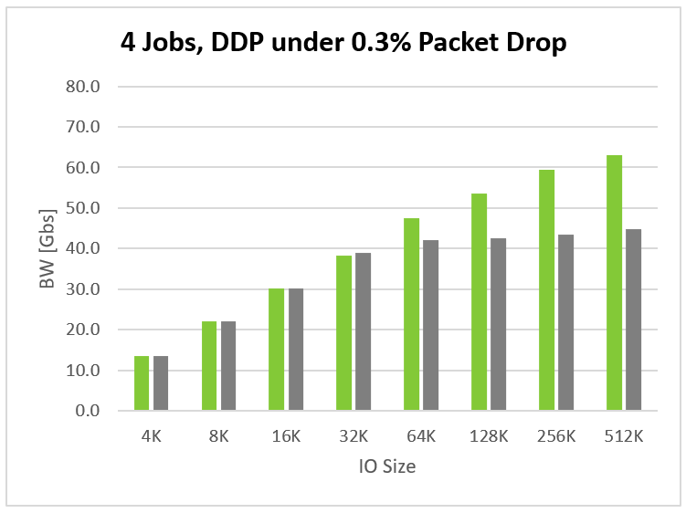
DDP vs SW – Bandwidth Comparison Under Congestion
The network congestion was simulated using:
tc qdisc add dev eth0 root netem loss 0.3%
The offload shows consistent advantage
The overall performance is lower (as expected)
fio
--rw=randread --ioengine=libaio
--bs=[x] iodepth=128 --numjobs=4

Slide 32
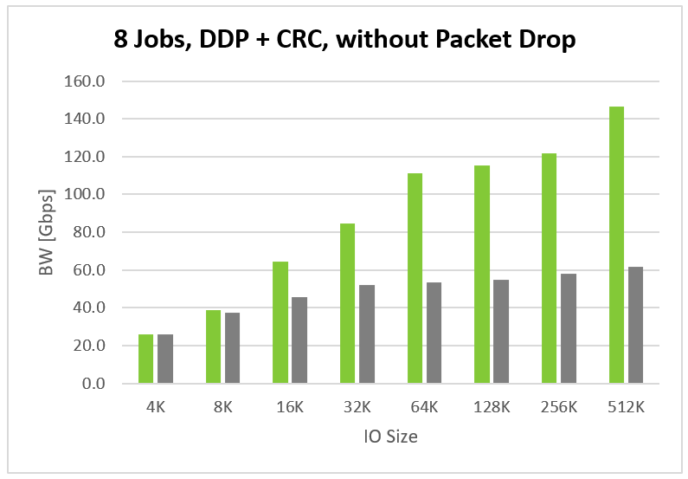
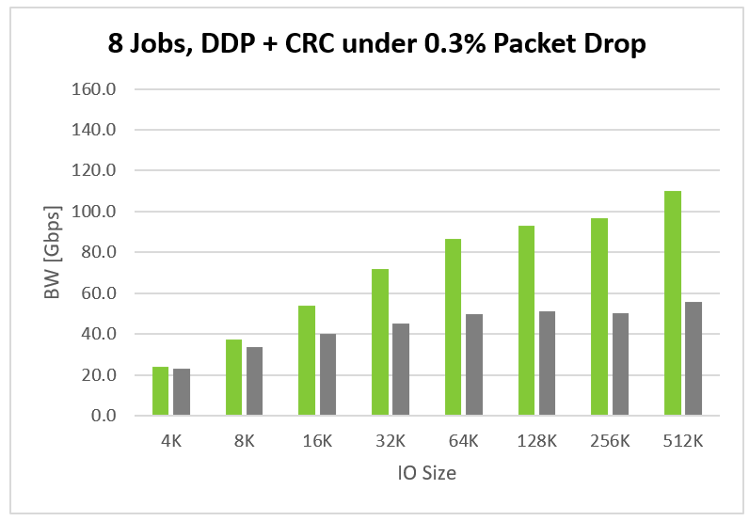
DDP (+ CRC Offload) vs SW (+ SW CRC) – Bandwidth Comparison Under Congestion
The network congestion was simulated using:
tc qdisc add dev eth0 root netem loss 0.3%
The overall performance is lower (as expected)
The offload shows consistent advantage
fio
--rw=randread --ioengine=libaio
--bs=[x] iodepth=128 --numjobs=8

Slide 33
Lessons

Slide 34
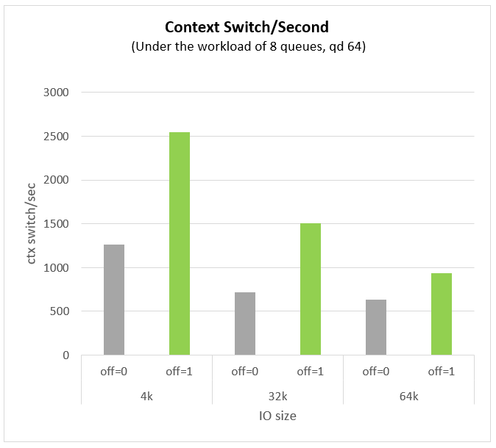
Context Switches are Expensive
A lot of interruptions resulted in a lot of scheduling and context switching:
This resulted in a significant overhead.
Fixed by disabling the notification of UMR completion.
Because the offload is opportunistic, it doesn’t have to wait for the completion.
Useful tools to for analysis and debugging:
Perf(1)
flamegraphs
perf record -a -g -F 99 -o data.perf -- fio –bs=64k …
perf script -i data.perf > data.txt
./stackcollapse-perf.pl data.txt > collapsed.txt
./flamegraph.pl --title "fio flamegraph" collapsed.txt > graph.svg

Slide 35
GRO Impacts Performances a Lot
GRO is an optimization to coalesce multiple packets together while receiving.
The initial method used to track the DDP and CRC offload in SKB affected GRO.
GRO should only group packets which have their CRC computed.
Initial design used the same bit to track CRC computation and Direct Data placement.
Packets group would be flushed early and resulted in more processing (worse performance than non-offloaded).
Fixed by tracking CRC and DDP independently so as to not split packets early in GRO.
Useful tools for analysis and debugging
Tracked average received packet size via tcpdump and wireshark:
tcpdump -i $iface -Q in -s 64 -c 2000 -w net.cap
tshark -r net.cap -q -z 'io,stat,0,MIN(frame.len),MAX(frame.len),AVG(frame.len)frame.len'

Slide 36
Upstream status

Slide 37
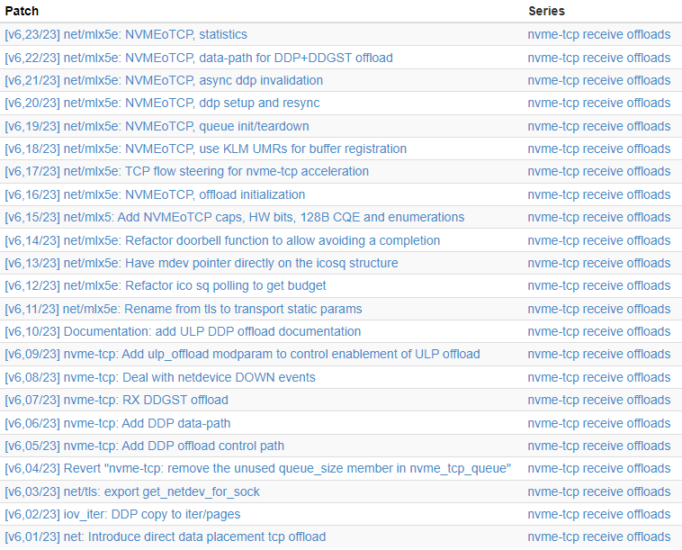
Upstream status
nvme-tcp-receive offload v6 sent last week to:
net-next
linux-nvme

Slide 38
Questions
Notes:
Questions

