Slide 1
Sign
Exponent
Mantissa
31
30
23
22
0
FP32
15
14
10
9
0
FP16
Data type | exponent | mantissa
zero | 0 | 0
Inf | All 1 | 0
NaN | All 1 | None zero
subnorm | 0 | None zero

Slide 2
sign a
exp a
mant a
sign b
exp b
mant b
Calculate
+
overflow
˟
Normalize
+
1
>>
0
1
1
0
sign out
exp out
mant out

Slide 3





















24 bit
$$a$$
$$a_{1}$$
$$a_{2}$$
$$a_{3}$$
$$˟$$
$$b$$
$$b_{1}$$
$$b_{2}$$
$$b_{3}$$
$$a_{1}$$
$$a_{2}$$
$$a_{3}$$
$$b_{3}$$
$$b_{3}$$
$$b_{3}$$
$$b_{3}$$
$$a_{1}$$
$$a_{2}$$
$$a_{3}$$
$$b_{2}$$
$$b_{2}$$
$$b_{2}$$
$$a_{1}$$
$$a_{2}$$
$$a_{3}$$
$$+$$
$$b_{1}$$
$$b_{1}$$
$$b_{1}$$
$$out$$
48 bit

Slide 4
CALC
SHIFT
cnt < mult_times
valid=1
cnt < mult_times
IDLE
ACCU
valid=0
cnt > mult_times
cnt > mult_times
DONE
NORM

Slide 5
Port name | Type | Width | Description
clk | input | 1 | Clock
rst_n | input | 1 | Reset, 0 active
data_type | input | 1 | Input data type, 1 means FP32, 0 means FP16
enter | input | 1 | Start calculation
ce | input | 1 | Clear all inputs
in1_row | input | 4 | Row signal of the first input, connected to the 4*4 input pad in Rabbit
in1_col | input | 4 | Collum signal of the first input, connected to the 4*4 input pad in Rabbit
in2_row | input | 4 | Row signal of the second input, connected to the 4*4 input pad in Rabbit
in2_col | input | 4 | Collum signal of the second input, connected to the 4*4 input pad in Rabbit
disp1_seg | output | 7 | Segment signal of first input, connected to 7-segment display component
disp1_sel | output | 8 | Segment select signal of first input
disp2_seg | output | 7 | Segment signal of second input
disp2_sel | output | 8 | Segment select signal of second input
out_seg | output | 7 | Segment signal of output
out_sel | output | 8 | Segment select signal of output
ready | output | 1 | Set 1 when the calculation is done
overflow | output | 1 | Overflow happens
error | output | 1 | Error happens
Port name | Type | Width | Description
clk | input | 1 | Clock
rst_n | input | 1 | Reset, 0 active
data_type | input | 1 | Input data type, 1 means FP32, 0 means FP16
valid | input | 1 | New data comes, next clock calculation starts
in1_32 | input | 32 | Input1 when mode is FP32
in2_32 | input | 32 | Input2 when mode is FP32
in1_16 | input | 16 | Input1 when mode is FP16
in2_16 | input | 16 | Input2 when mode is FP16
out_32 | input | 32 | FP32 output, 0 when mode is FP16
out_16 | output | 16 | FP16 output, 0 when mode is FP32
ready | output | 1 | Set 1 when the calculation is done
overflow | output | 1 | Overflow happens
error | output | 1 | Error happens
in1_disp | output | 32 | Signal for input display
in2_disp | output | 32 | Signal for input display

Slide 6
Port name | Type | Width | Description
In1 | input | 8 | Input1
In2 | input | 8 | Input2
sum | output | 9 | Output with carry bit
Port name | Type | Width | Description
clk | input | 1 | Clock
rst_n | input | 1 | Reset, 0 active
valid | input | 1 | New data comes, next clock calculation starts
mode | input | 1 | Input data type, deciding which bit indicates normalization
in1 | input | 24 | Input1
in2 | input | 24 | Input2
product | output | 23 | Product of two inputs, without the implicit 1 or 0
normalize | output | 1 | Product is larger than 2, exponent needs to add 1
more_than_1 | output | 1 | Product is more than 1 while exp is 0, transfer subnormal to normal number by setting exp as 9’b1(-126)
ready | output | 1 | 1 when calculation is finished
Port name | Type | Width | Description
In1 | input | 8 | Input1
In2 | input | 8 | Input2
product | output | 16 | Complete product

Slide 7
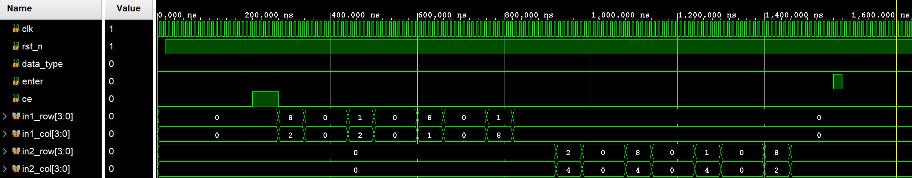
3
E
4
C
0
2
D
3

Slide 8
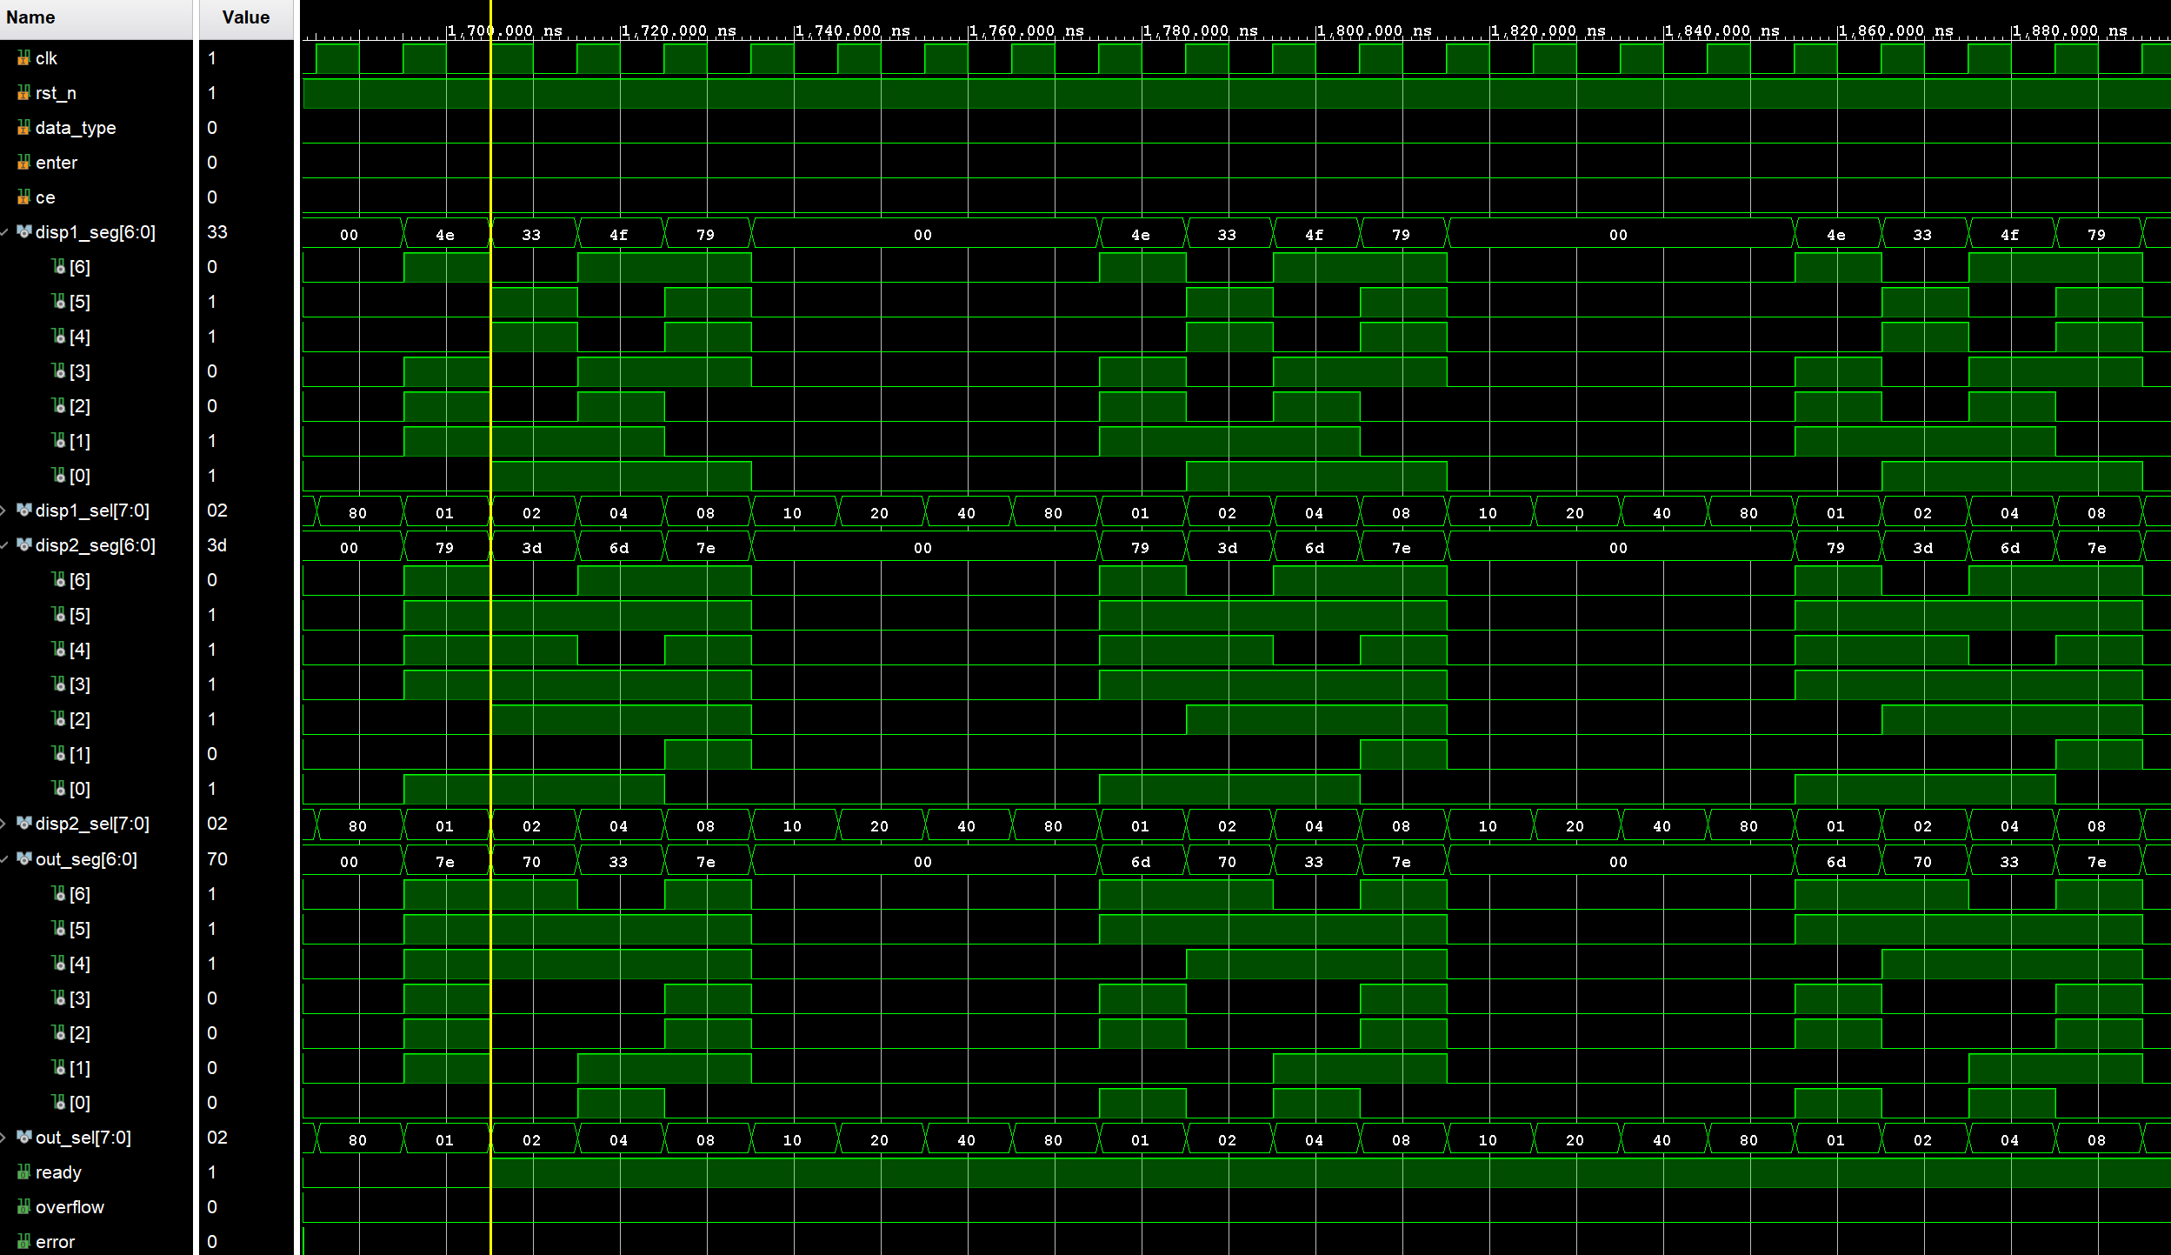
C
4
E
3
3
D
2
0
2
7
4
0
Calculation Finish

