Slide 1

Who are we?
Борислав Топалов Петър Томов
32 години 21 години
София Пловдив
Java Script IT Talents Season 14

Slide 2







About Our Project
In our site you can sell your vehicle fast and easy.
For this purpose we have used different technologies...

Slide 3

What functionalities our site contains
Register / Delete Account
Login / Logout
Edit Account
Search / View Without Logged User
Add New Ads, When You Have An Account
Make Your Ads Inactive/Active
Delete Your Ads
Add/Remove Other Ads To / From Notebook

Slide 4
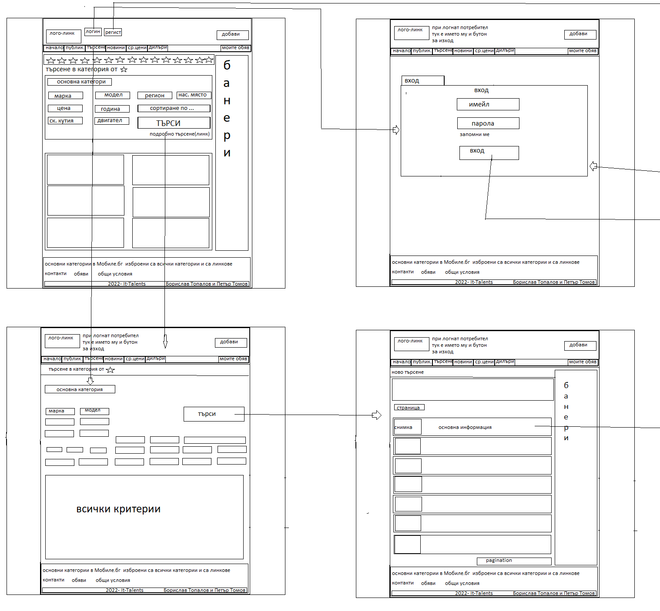
The Present Situation

Slide 5
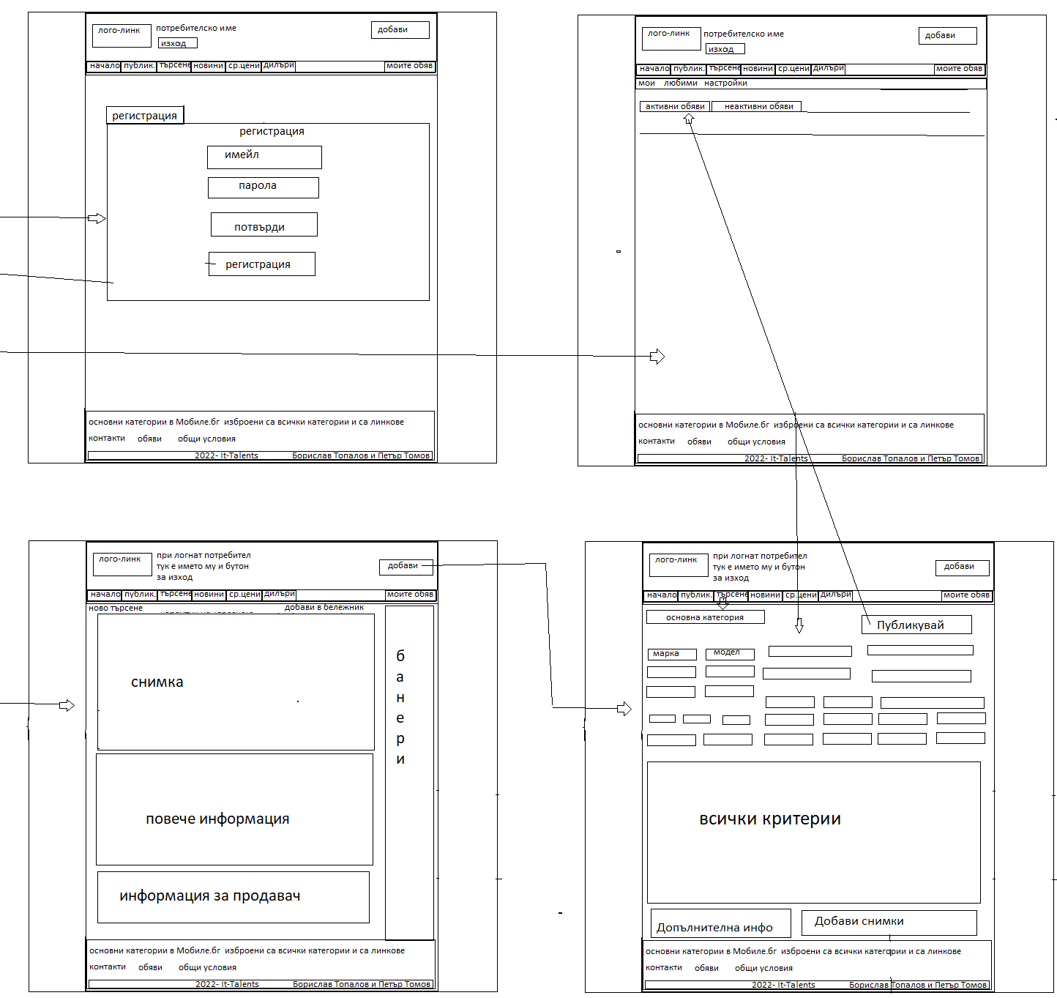
Development up to present

Slide 6
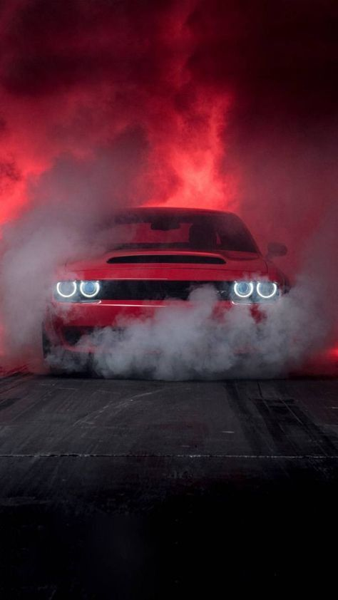

Now it's time for Show :)

Slide 7
Thank You For The Attention.
If You Have Any Questions, … :)

