Slide 1


K.RAMAKRISHNAN COLLEGE OF ENGINEERING
(AUTONOMOUS), TRICHY
TITLE: SMART TRAFFIC management
PRESENTED BY SUPERVISOR
BORJIYA AALSAN T Mr.V.KUMARARAJA, M.E., (PhD),
8115U23EC017 AP/CSE.
6/12/24

Slide 2

PRESENTATION OVERVIEW
Introduction
Objective
Problem Statement
Java Concepts
5. Modules Used
6. Architecture of the proposed system
7. Merits and Demerits
8. Program Execution and Output
9. Queries
6/12/24

Slide 3
INTRODUCTION
The Real-Time Traffic Light Controller simulates a dynamic traffic signal system that adapts to real-time traffic conditions.
It features adjustable light durations based on traffic density and an emergency mode for prioritizing green lights during critical situations.
Built using Java and AWT, the application includes a user-friendly GUI, real-time countdown timers, and responsive event handling.
6/12/24

Slide 4
OBJECTIVE
Optimize Traffic Flow: Implement a traffic light system that dynamically adjusts light durations based on real-time traffic density.
Enhance Traffic Efficiency: Reduce congestion and waiting times by prioritizing traffic based on current conditions.
Emergency Management: Provide an emergency mode to extend green light durations for emergency vehicles or critical situations.
User-Friendly Simulation: Create an intuitive graphical interface for users to interact with and visualize traffic management.
Adaptability and Automation: Develop a system capable of real-time adjustments using Java's scheduling and event-handling features.
6/12/24

Slide 5
PROBLEM STATEMENT
Design a dynamic traffic light control system that adapts to real-time traffic conditions to reduce congestion and enhance road efficiency.
6/12/24

Slide 6
JAVA CONCEPTS
AWT (Abstract Window Toolkit): Used to create the graphical user interface, including windows, buttons, and custom panels for the traffic light system.
Event Handling: Implemented to manage user actions like button clicks and window events for interactive functionality.
Timers and Multithreading: Used to handle real-time countdown updates and ensure smooth simulation of traffic light transitions.
6/12/24

Slide 7
MODULES USED
java.awt: Provides the classes for creating the graphical user interface (GUI) components, such as Frame, Button, Panel, and Graphics.
java.awt.event: Used for handling user interactions, such as button clicks and window events, through classes like ActionListener and WindowAdapter.
java.util: Contains the Timer and TimerTask classes, which are used to schedule and execute periodic tasks, such as updating the countdown timer for the traffic lights.
6/12/24

Slide 8
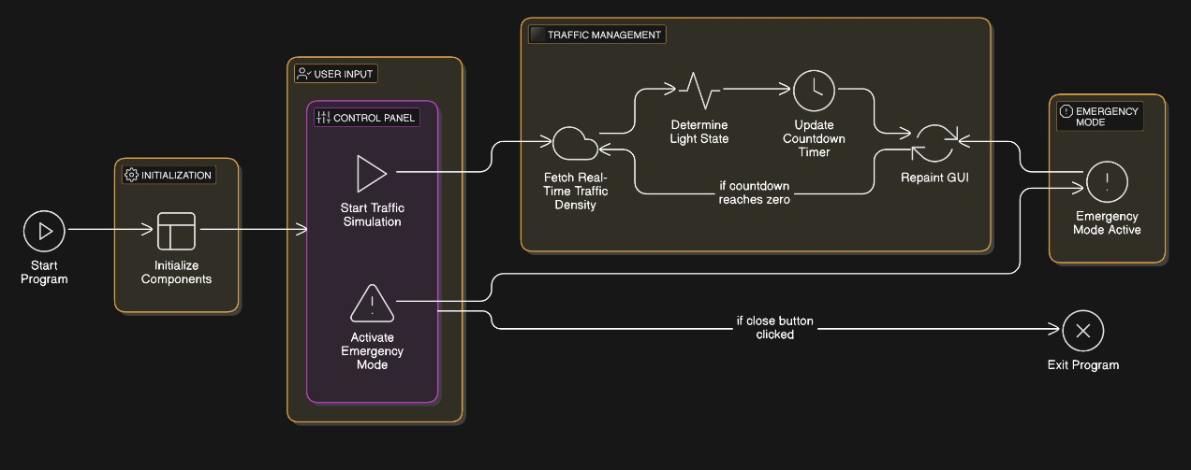
ARCHITECTURE OF PROPOSED SYSTEM
6/12/24

Slide 9
MERITS AND DEMERITS
Merits:
Efficient Traffic Management:
  The system adjusts traffic light timings based on real-time traffic density, ensuring optimal flow of traffic and reducing congestion, especially during peak hours.
Emergency Mode Support:
  The system can activate emergency mode, extending green light duration to allow emergency vehicles to pass, thus improving response time during critical situations.
Demertis:
1.Dependence on Real-Time Data:
The system's effectiveness heavily relies on the accuracy of rea-time traffic data, which may not always be available or reliable if sensors or APIs fail.
2.System Complexity:
The system can become complex to maintain and scale, especially if more features or data sources (e.g., cameras, sensors) need to be integrated.
6/12/24

Slide 10
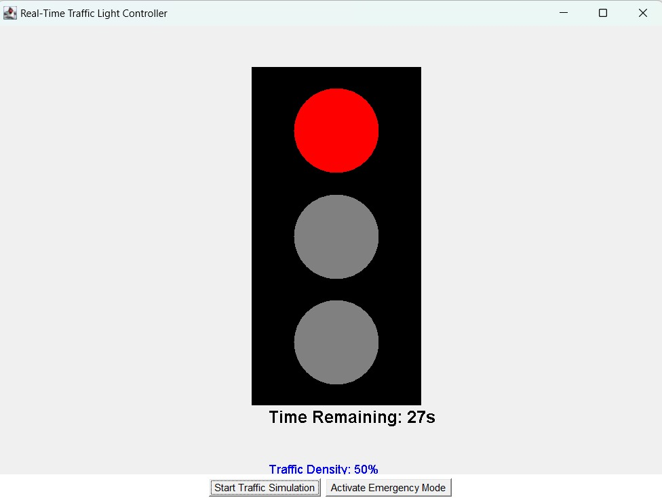
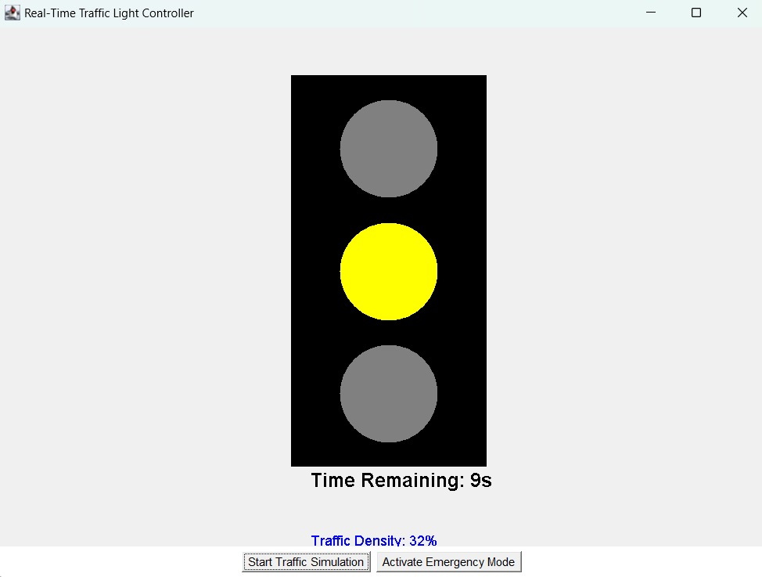
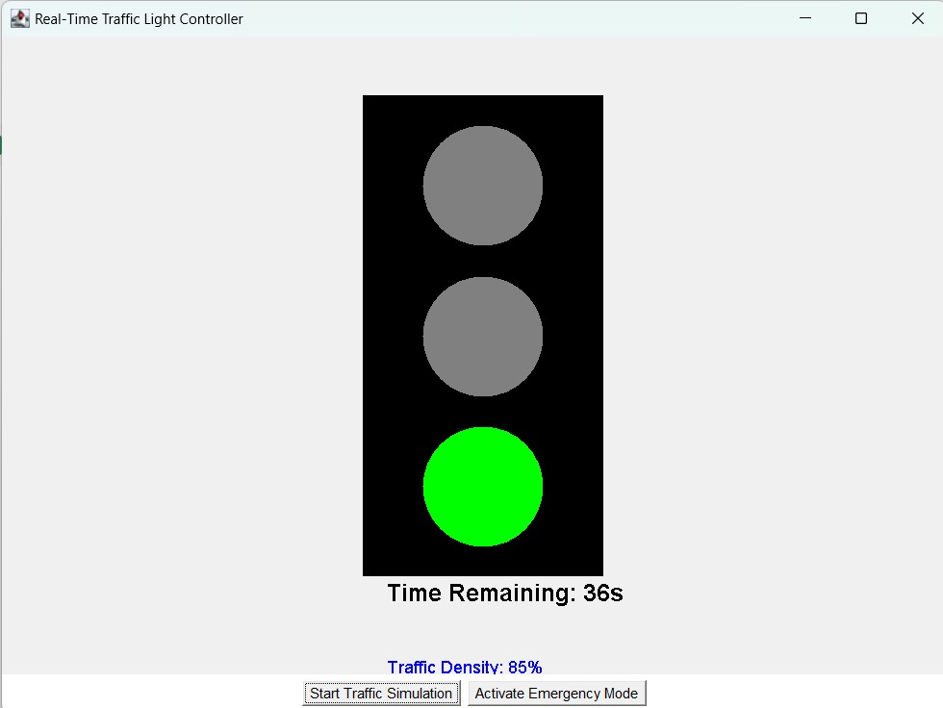
PROGRAM EXECUTION AND OUTPUT
TRAFFIC LIGHT SIMULATION
6/12/24

Slide 11
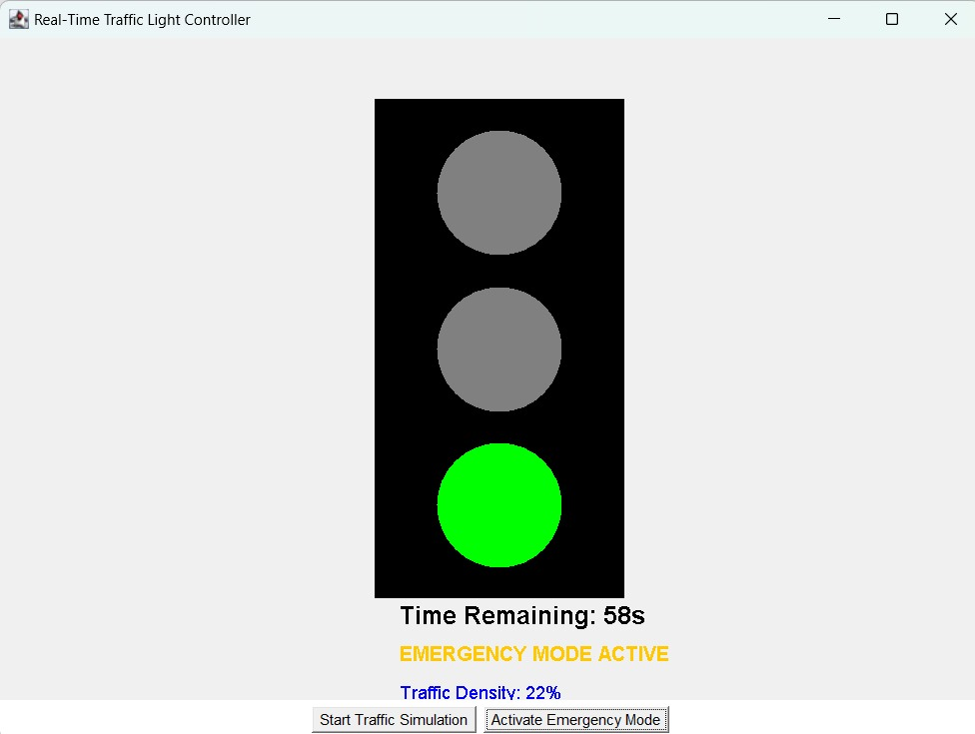
PROGRAM EXECUTION AND OUTPUT
Emergency Mode
6/12/24

Slide 12

6/12/24

