Slide 1

Department of ECE
Analog electronic Circuit Design (24ec2104)
Topic:
Linear Applications-1 (adder, subtractor,
integrator, differentiator)

Slide 2
Session Content
Adder
Subtractor
Integrator Amplifier
Applications of Integrators
Differentiator Amplifier
Applications of Differentiators
Summary
Example Problems

Slide 3



AIM OF THE SESSION
The aim of this session is to emphasise the importance of Operational Amplifier and to understand the fundamental principles of linear applications of Op-Amp, including adder, subtractor, integrator, and differentiator.
INSTRUCTIONAL OBJECTIVES
This Session is designed to:
  Specify the importance/necessity of the Operational Amplifier (Op-Amp) Applications.
  Describe the function of each block of the Op-Amp applications.
  Understand the schematic symbol of the different mathematical functions.
LEARNING OUTCOMES
At the end of this session, you should be able to:
  Explain the application of Op-Amp for various applications.
  Summarize the functioning of different applications and use.
  Identify the Pin configuration and importance of IC741 for various application.

Slide 4
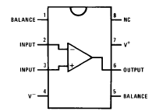
Introduction
Op-amps (amplifiers/buffers in general) are drawn as a triangle in a circuit schematic
There are two inputs - inverting and non-inverting, one output and power connections (note no explicit ground).
The ideal Op-amp consists infinite voltage gain, infinite input impedance, zero output impedance ,infinitely fast(infinite bandwidth).
divot on pin-1 end
V⁺
2
−
7
inverting input
6
non-inverting input
+
3
4
output
V⁻

Slide 5
Linear Applications of op-amp
Summing Amplifier: An op-amp circuit that can combine multiple input signals into a single output signal that is the weighted sum of the inputs.
Subtractor: An op-amp circuit that is specifically designed to subtract one input voltage from another.
Differential Amplifier: An op-amp circuit that amplifies the difference between two input signals while rejecting any signals that are common to both inputs.

Slide 6
Adder
Now neg. terminal held at V_{in}
  so current through R₁ is I_{f} = V_{in}/R₁ (to left, into ground)
This current cannot come from Op-Amp input
  so comes through R₂ (delivered from Op-Amp output)
  voltage drop across R₂ is I_{f}R₂ = V_{in}×(R₂/R₁)
  so that output is higher than neg. input terminal by V_{in}×(R₂/R₁)
  V_{out} = V_{in} + V_{in}×(R₂/R₁) = V_{in}×(1 + R₂/R₁)
  thus gain is (1 + R₂/R₁), and is positive
Current is sourced from op-amp output in this example
R₁
R_{F}
V₁
−
R₂
V₂
V_{out}
+

Slide 7
Subtractor
The non-inverting input is a simple voltage divider:
  V_{node} = V⁺R₂/(R₁ + R₂)
So I_{f} = (V⁻ − V_{node})/R₁
  V_{out} = V_{node} − I_{f}R₂ = V⁺(1 + R₂/R₁)(R₂/(R₁ + R₂)) − V⁻(R₂/R₁)
  so V_{out} = (R₂/R₁)(V⁺ − V⁻)
  therefore we difference V⁺ and V⁻
R₂
R₁
V⁻
−
V_{out}
V⁺
+
R₁
R₂

Slide 8

Integrator Amplifier
I_{f} = V_{in}/R, so C·dV_{cap}/dt = V_{in}/R
  and since left side of capacitor is at virtual ground:
  −dV_{out}/dt = V_{in}/RC
  so
  and therefore we have an integrator (low pass)
C
R
V_{in}
−
V_{out}
+

Slide 9
Practical Integrator Amplifier
The gain of an integrator at low frequency can be limited to avoid saturation by introducing a feedback resistance(Rf) in shunt with feedback capacitance(Cf).
The resistor Rf limits the low frequency gain to – Rf/R
C

Slide 10
Applications of Integrators
Signal Integration in Analog Computation: Integrators can perform mathematical integration of input signals
Waveform Generation: Integrators convert square waves into triangular waves.
Analog Filters: Integrators act as low-pass filters by allowing low-frequency signals to pass while attenuating high-frequency signals.
Phase Locked Loop Circuits: Integrators are used to generate a voltage proportional to the phase difference between input and reference signals.

Slide 11
Differentiator Amplifier
For a capacitor, Q = CV, so I_{cap} = dQ/dt = C·dV/dt
  Thus V_{out} = −I_{cap}R = −RC·dV/dt
So we have a differentiator, or high-pass filter
  if signal is V₀sinωt, V_{out} = −V₀RCωcosωt
  the ω-dependence means higher frequencies
  amplified more
R
C
V_{in}
−
V_{out}
+

Slide 12
Applications of Differentiators
Edge Detection in Signal Processing: Differentiators can detect the edges or transitions in digital signals.
Frequency Modulation (FM) Demodulation: Differentiators can convert frequency variations into amplitude variations.
Waveform Generation: Differentiators can convert square waves into spike or pulse waveforms.
High-Pass Filter: Differentiators act as high-pass filters by allowing high-frequency signals to pass while attenuating low-frequency signals.

Slide 13
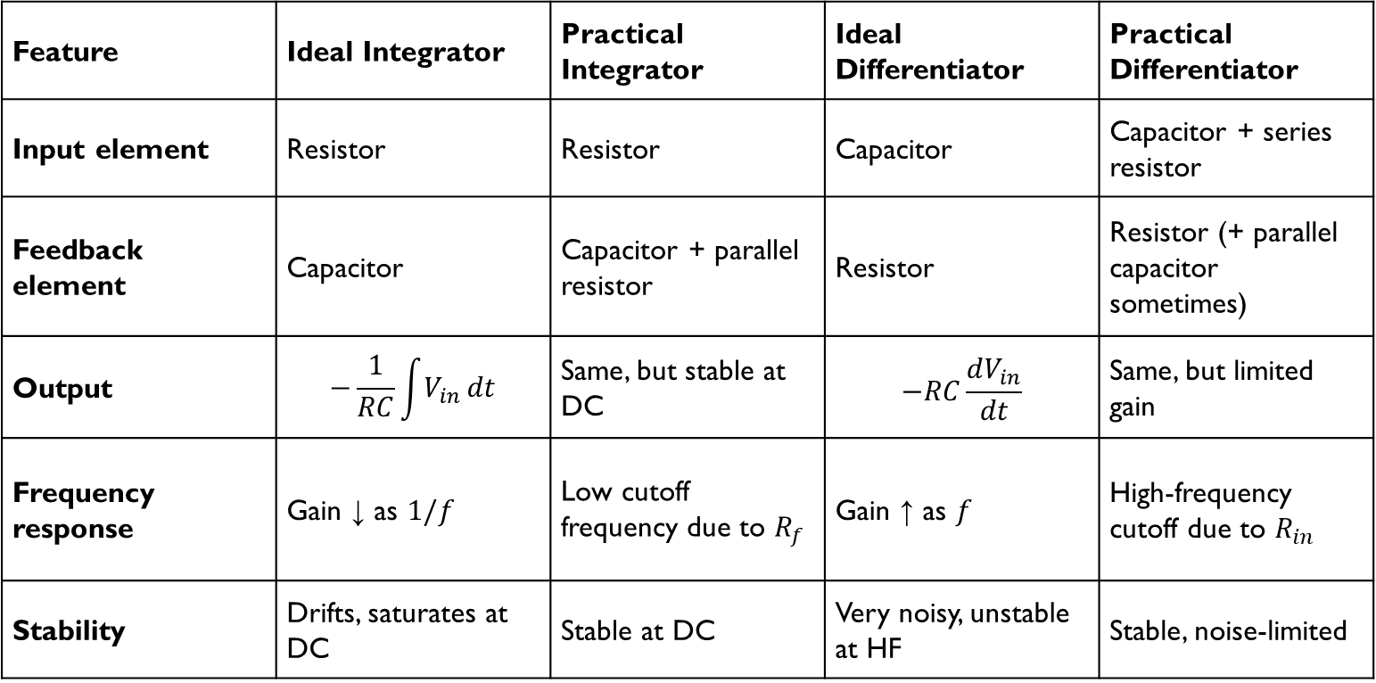
Feature | Ideal Integrator | Practical Integrator | Ideal Differentiator | Practical Differentiator
Input element | Resistor | Resistor | Capacitor | Capacitor + series resistor
Feedback element | Capacitor | Capacitor + parallel resistor | Resistor | Resistor (+ parallel capacitor sometimes)
Output | $$−\frac{1}{RC}\int{V_{in}}dt$$ | Same, but stable at DC | $$−RC\frac{dV_{in}}{dt}$$ | Same, but limited gain
Frequency response | Gain ↓ as $1/f$ | Low cutoff frequency due to $R_{f}$ | Gain ↑ as $f$ | High-frequency cutoff due to $R_{in}$
Stability | Drifts, saturates at DC | Stable at DC | Very noisy, unstable at HF | Stable, noise-limited

Slide 14

SUMMARY
The aim of this session is to emphasize the importance of Operational Amplifiers (Op-Amps) and to understand the fundamental principles of linear applications of Op-Amps. The key applications discussed include:
- Adder: An Op-Amp circuit that sums multiple input signals.
- Subtractor: An Op-Amp circuit that subtracts one input signal from another.
- Integrator: An Op-Amp circuit that performs mathematical integration of the input signal, producing an output that is proportional to the integral of the input signal.
- Differentiator: An Op-Amp circuit that performs mathematical differentiation of the input signal, producing an output that is proportional to the rate of change of the input signal.
The session aims to provide a comprehensive understanding of how these linear applications of Op-Amps function and their significance in various electronic circuits.

Slide 15
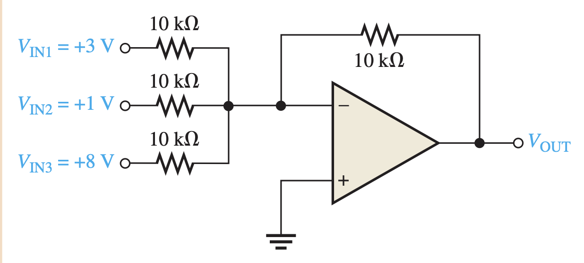
Example Problem - 1
Problem: Determine the output voltage.
Solution:

Slide 16
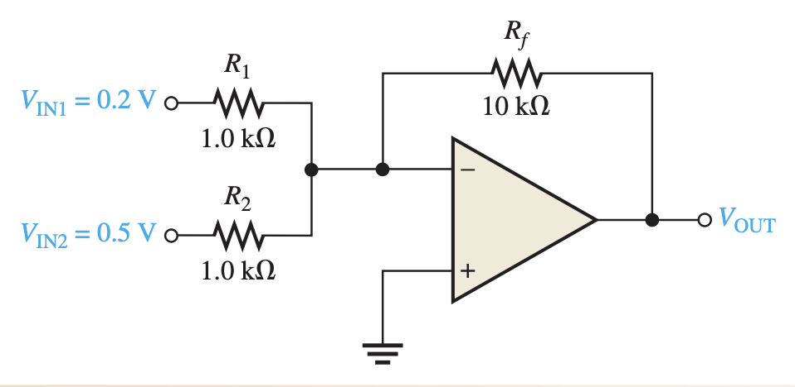
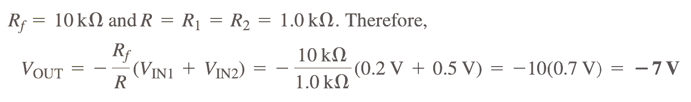
Example Problem - II
Problem: Determine the output voltage for the summing amplifier.
Solution:

Slide 17
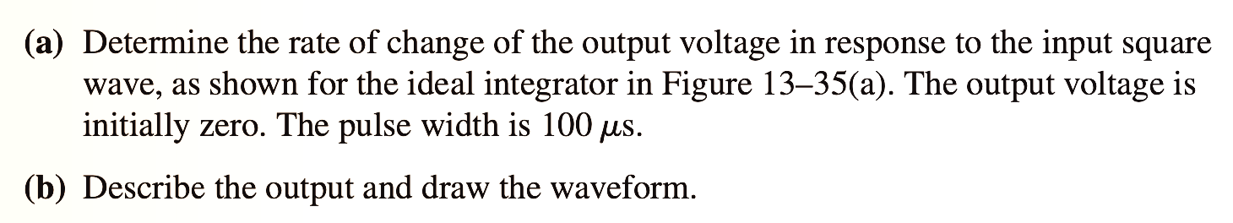
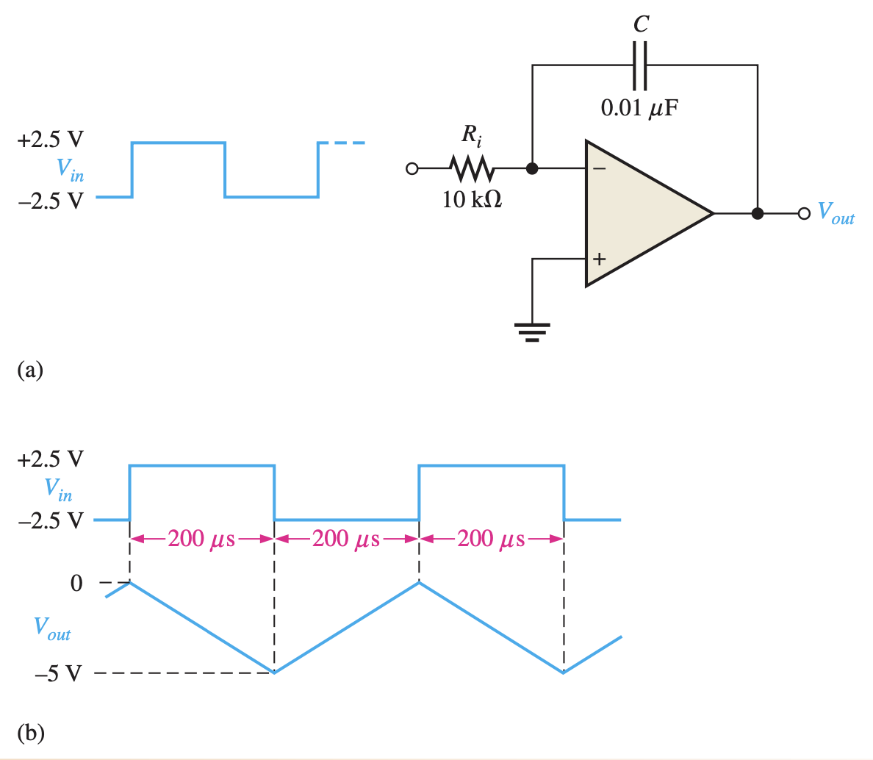
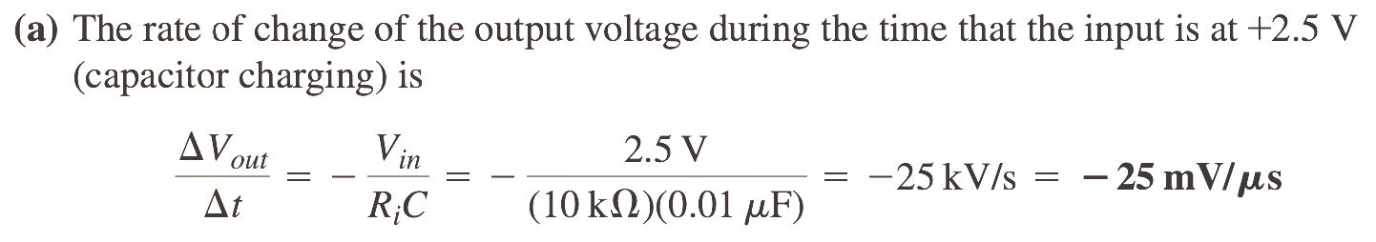
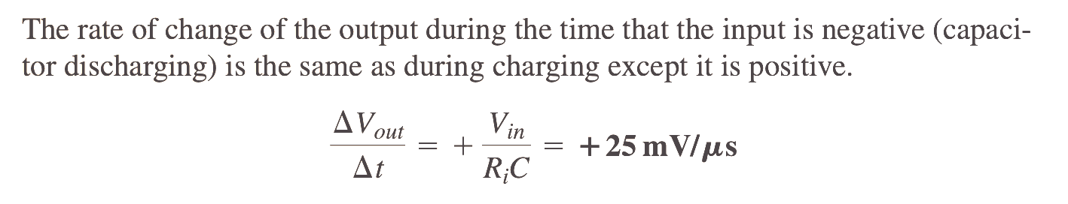
Example Problem - III
Problem:
Solution:

Slide 18
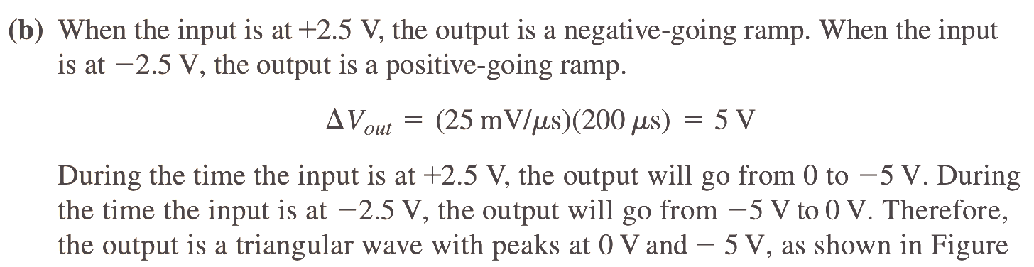
Example Problem - III
Solution:

Slide 19
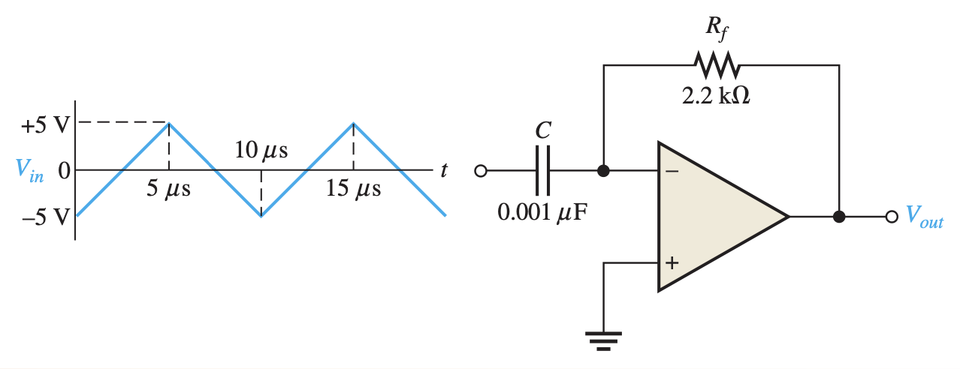
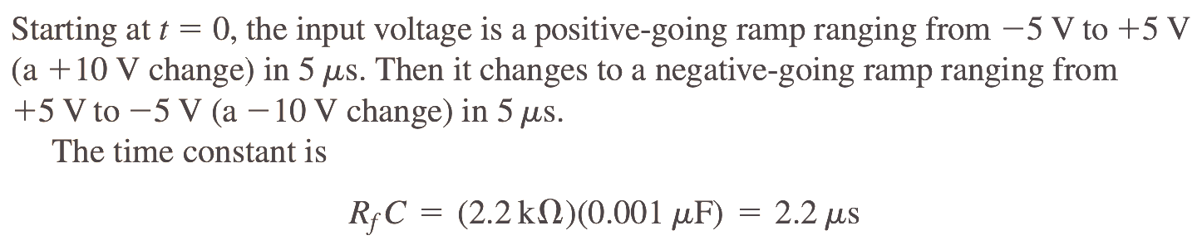
Example Problem - IV
Problem: Determine the output voltage of the ideal op-amp differentiator in Figure for the triangular-wave input shown.
Solution:

Slide 20
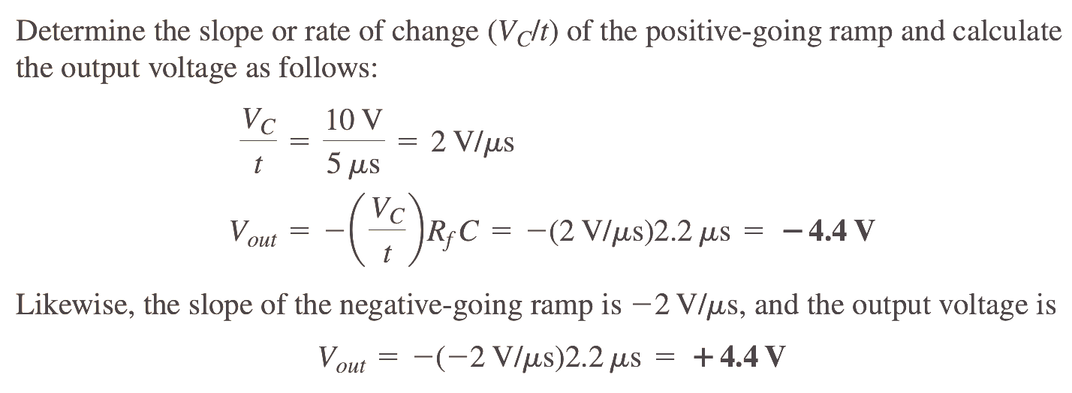
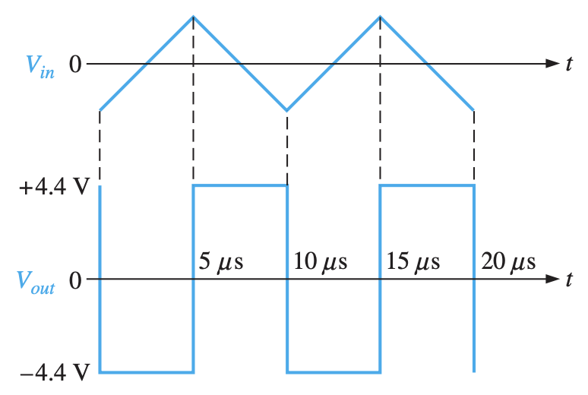
Example Problem - IV
Solution:

Slide 21
SELF-ASSESSMENT QUESTIONS
What is the primary function of an Operational Amplifier (Op-Amp)?
To amplify voltage signals
To store energy
To convert AC to DC
To act as a power supply
In an Op-Amp Adder circuit, the output voltage is:
The difference of input voltages
The sum of input voltages
The product of input voltages
The quotient of input voltages

Slide 22
SELF-ASSESSMENT QUESTIONS
3. The output of a Differentiator circuit is proportional to:
The sum of the input signal
The integral of the input signal
The rate of change of the input signal
The difference between two input signals
4. Which component is typically used in the feedback loop of an Op-Amp Integrator circuit?
Resistor
Capacitor
Inductor
Diode

Slide 23
ANSWERS
a
b
c
b

Slide 24
TERMINAL QUESTIONS
Explain how an adder circuit operational amplifier works.
Explain Op-Amp integrator circuit setup and operation.
What are the main circuit configuration and output differences between an Op-Amp subtractor and an adder?
How does an operational amplifier-based differentiator circuit work? What does the input signal change rate mean here?
Explain how capacitors and resistors affect integrator and differentiator Op-Amp feedback loops. How do they effect circuit output and performance?

Slide 25
REFERENCES FOR FURTHER LEARNING OF THE SESSION
Reference Books:
1. Op-Amps and Linear Integrated Circuit; 4th Ed., Gayakwad, Ramakant A.
Sites and Web links:
https://electronicsforyou.in/introduction-to-op-amp
https://www.youtube.com/watch?v=7B_aMPIIKRI

Slide 26
THANK YOU
Team – ANALOG ELECTRONIC CIRCUIT DESIGN

