Slide 1

Department of ECE
Analog electronic Circuit Design (24ec2104)
Topic:
Linear Applications-2 (comparator, Smith Trigger, instrumentation amplifier)

Slide 2
Session Content
Aim – Objectives – Outcomes
Introduction
Comparator
Schmitt Trigger
Applications of Schmitt Trigger
Instrumentation Amplifier
Advantages of Instrumentation Amplifier
Applications of Instrumentation Amplifier
Summary
Example Problems
Self Assessment Questions
Terminal Questions
References

Slide 3



AIM OF THE SESSION
The aim of this session is to emphasize the significance of operational amplifiers and to understand the fundamentals of their linear applications, including comparators, Schmitt triggers, and instrumentation amplifiers.
INSTRUCTIONAL OBJECTIVES
This Session is designed to:
  Specify the importance/necessity of the Operational Amplifier (Op-Amp) Applications.
  Describe the function of each block of the Op-Amp applications.
  Understand the schematic symbol of the different mathematical functions.
LEARNING OUTCOMES
At the end of this session, you should be able to:
  Explain the application of Op-Amp for various applications.
  Summarize the functioning of different applications and use.
  Identify the Pin configuration and importance of IC741 for various applications.

Slide 4
INTRODUCTION
Comparators compare two voltages and switch their output to indicate which input is higher.
Used in devices where it is necessary to measure and compare voltages, such as in zero-crossing detectors, level shifters, and analog-to-digital converters.
The output of the comparator is either high or low, depending on whether the positive input voltage is higher or lower than the negative input voltage.
Schmitt Trigger is a type of comparator with hysteresis, providing a cleaner and more stable output signal by introducing two different threshold voltage levels for switching.
Widely used to eliminate noise in digital circuits, signal conditioning, and switch debouncing.
The Schmitt Trigger switches its output state when the input crosses the upper or lower threshold, creating a stable and noise-resistant output.
Instrumentation amplifiers amplify small differential signals while rejecting large common-mode voltages.
Common in precision data acquisition, medical instrumentation, and sensor signal conditioning due to their high input impedance, low offset voltage, and high CMRR (Common Mode Rejection Ratio).
Typically uses multiple op-amps in its configuration to ensure accurate and stable amplification of the differential signal.

Slide 5
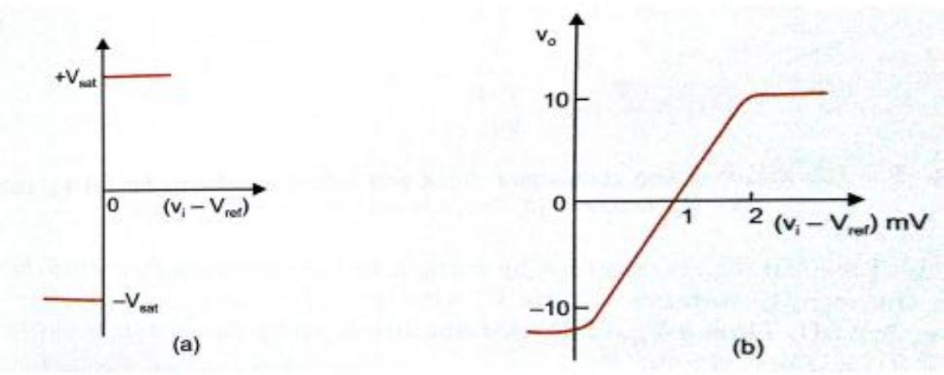
Comparator
    Comparator is a circuit which compares a signal voltage applied at one input of an OPAMP with a known reference voltage at the other input.
    It is basically an open loop OPAMP with output ±𝑣_{𝑠𝑎𝑡} = 𝑣_{𝑐𝑐}

Slide 6
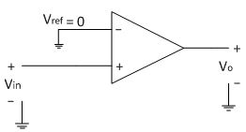
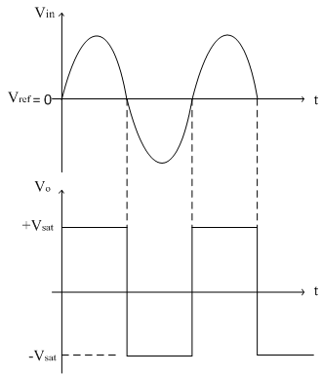
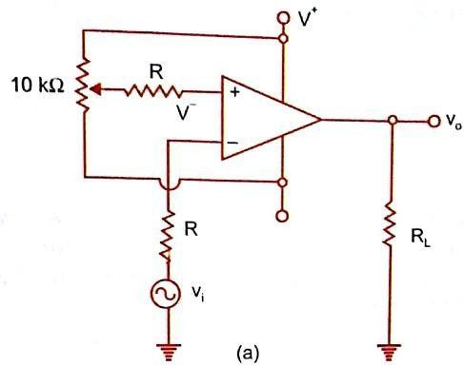
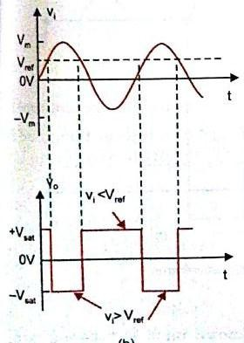
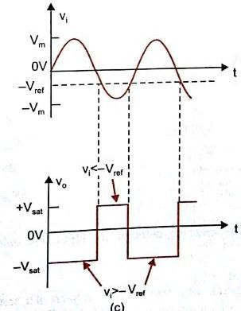
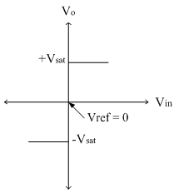
    Non-inverting comparator
Comparator[contd..]
    Inverting comparator

Slide 7
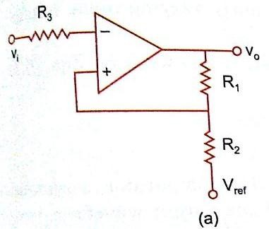
Schmitt Trigger
Schmitt trigger is one of the important application of comparator.
A inverting comparator with positive feedback is called as Schmitt trigger.
The circuit converts any irregular shaped input wave to square wave.
The input voltage is applied to the (-) input terminal and feedback voltage to the (+) input terminal.
The input voltage vi triggers the output voltage vo every time it exceeds certain voltage levels.
These voltage levels are called upped threshold voltage(VUT) and lower threshold voltage(V LT).
The hysteresis width is the difference between these two threshold voltage i.e VUT –VLT

Slide 8
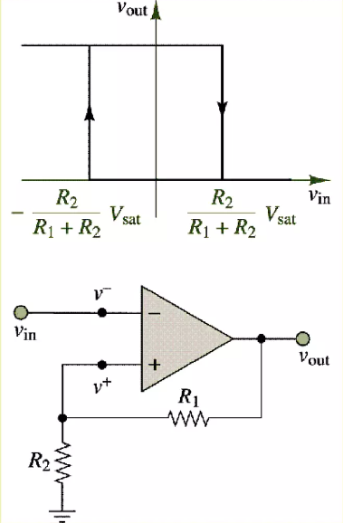
Transfer characteristic of Schmitt trigger
One of the effective ways to improve the performance of the comparator is by introducing positive feedback.
Positive feedback can increase switching speed of the comparator and provide noise.
If it is desired to switch about a voltage other than zero, a reference voltage can also be connected to the non-inverting terminal.

Slide 9
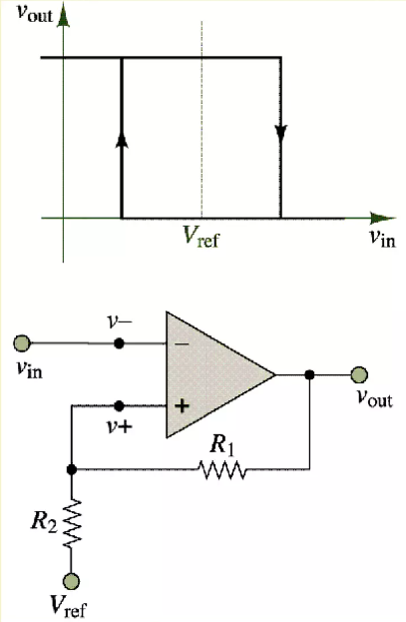
Switching levels for the Schmitt trigGer
Vin > R2/(R2+R1) Vsat + Vref R1/(R2+R1)
Positive-going transition
Vin < - R2/(R2+R1) Vsat + Vref R1/(R2+R1)
Negative-going transition

Slide 10
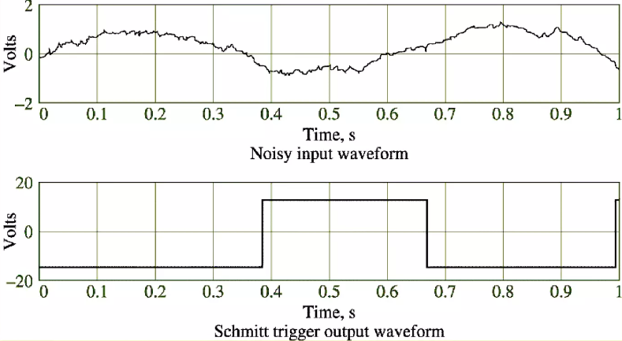
In effect, the Schmitt trigger provides a noise rejection range equal to ± Vsat[R2/(R2+R1)] within which the comparator cannot switch
Thus if the noise amplitude is contained within this range, the Schmitt trigger will prevent multiple triggering

Slide 11
Applications of Schmitt Trigger
  Noise Immunity: Convert noisy analog signals into clean digital signals.
  Debouncing mechanical switches to eliminate noise and false triggering in digital circuits.
  Waveform Generation: Generate square waves from a sinusoidal input.
  Used in function generators and pulse-width modulation (PWM) circuits.
  Signal Conditioning: Condition analog signals before further digital processing.
  Shape sensor outputs into precise digital pulses in measurement systems.
  Oscillators: Create stable oscillations for clock generation.
  Relaxation oscillators for timing and control applications in microcontrollers and other digital systems.
  Comparators: Provide precise threshold detection.
  Voltage level detectors in power supply circuits to monitor battery levels.

Slide 12
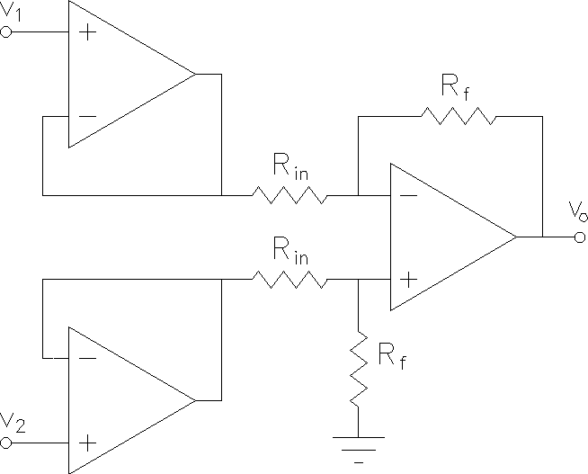
Instrumentation Amplifier
In a number of industrial and consumer applications, the measurement of physical quantities is usually done with the help of transducers.
The output of transducer has to be amplified so that it can drive the indicator or display system.
This function is performed by an instrumentation amplifier.
Features of instrumentation Amplifier
  High gain accuracy
  High CMRR
  High gain stability with low temperature co-efficient
  Low dc offset
  Low output impedance

Slide 13
Instrumentation Amplifier [contd…]
The Instrumentation amplifier is used to amplify very low signals, rejecting noise and interference signals.
Eg.: Heartbeats, Blood Pressure, Earthquakes,… so on.
The characteristics of a good instrumentation amplifier are:
  Inputs to the instrumentation amplifiers will have very low signal energy. Therefore, the instrumentation amplifier should have high gain and should be accurate.
  The gain should be easily adjustable using a single control.
  It must have High Input Impedance and Low Output Impedance to prevent loading.
  The Instrumentation amplifier should have High CMRR since the transducer output will usually contain common mode signals such as noise when transmitted over long wires.
  It must also have a High Slew Rate to handle sharp rise times of events and provide a maximum undistorted output voltage swing.

Slide 14
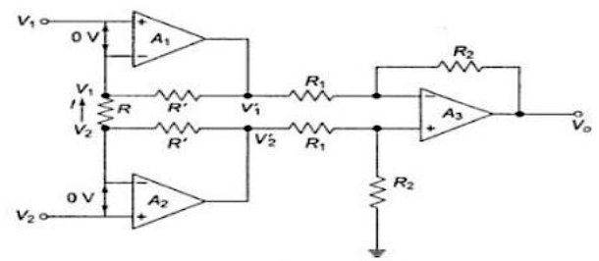
Instrumentation Amplifier[contd…]
Figure shows the improved instrumentation amplifier using three op-amp. The output Vo is given by 𝑉𝑜 = 𝑅2 𝑅1 [𝑉1 − 𝑉2] Voltage at the + input terminal of op-amp A3 is 𝑅2𝑉1 ´ 𝑅1 + 𝑅2
Using superposition Theorem 𝑉𝑜 = − 𝑅2 𝑅1 (𝑉1 ´ − 𝑉2 ´ ) − − − −(1)
Since no current flows into op-amp, the current I flowing(upwards) in R is 𝐼 = 𝑉1 − 𝑉2 𝑅 And passes through the resistor
R’ 𝑉1 ´ = 𝑅 ´ 𝐼 + 𝑉1 𝑉1 ´ = 𝑅 𝑅 ´ (𝑉1 − 𝑉2 ) + 𝑉1 − − − − − (2)
𝑉2 ´ = 𝑅 ´ 𝐼 + 𝑉2
𝑉2 ´ = − 𝑅 𝑅 ´ (𝑉1 − 𝑉2 ) + 𝑉2 − − − − − (3)
Sub (2) & (3) in (1)
𝑉𝑜 = − 𝑅2 𝑅1 [(1 + 2𝑅 ´ 𝑅 ) (𝑉1 − 𝑉2 )]

Slide 15
Advantages of Instrumentation Amplifier
The advantages of the instrumentation amplifier include the following:
  The gain of a three op-amp instrumentation amplifier circuit can be easily varied by adjusting the value of only one resistor Rgain.
  The gain of the amplifier depends only on the external resistors used.
  The input impedance is very high due to the emitter follower configurations of amplifiers 1 and 2.
  The output impedance of the instrumentation amplifier is very low due to the difference amplifier 3.
  The CMRR of the op-amp 3 is very high and almost all of the common mode signal will be rejected.

Slide 16
Applications of Instrumentation Amplifier
  The applications of the instrumentation amplifier include the following:
  These amplifiers mainly involve where the accuracy of high differential gain is required, strength must be preserved in noisy surroundings, as well as where huge common-mode signals are there. Some of the applications are
  Instrumentation amplifiers are used in data acquisition from small o/p transducers like thermocouples, strain gauges, measurements of Wheatstone bridge, etc.
  These amplifiers are used in navigation, medical, radar, etc.
  These amplifiers are used to enhance the S/N ratio (signal to noise) in audio applications like audio signals with low amplitude.
  These amplifiers are used for imaging as well as video data acquisition in the conditioning of high-speed signal.
  These amplifiers are used in RF cable systems for amplification of the high-frequency signal.

Slide 17

SUMMARY
Importance of operational amplifiers (Op-Amps) in electronic systems.
Fundamentals of linear applications of Op-Amps.
Key circuits discussed: comparators, Schmitt triggers, and instrumentation amplifiers.
Tlinear applications play crucial roles in various electronic systems by enabling precise voltage comparisons, noise reduction, and accurate signal amplification, making them essential components in both analog and digital electronics.

Slide 18
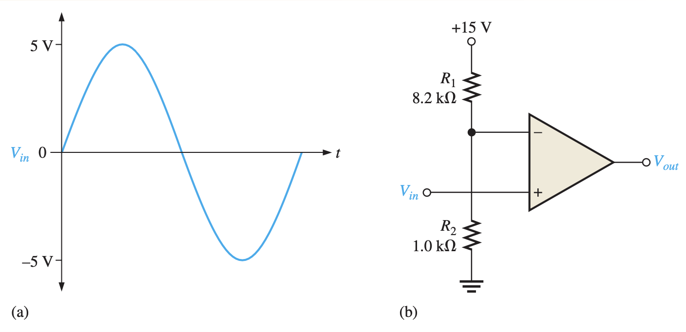
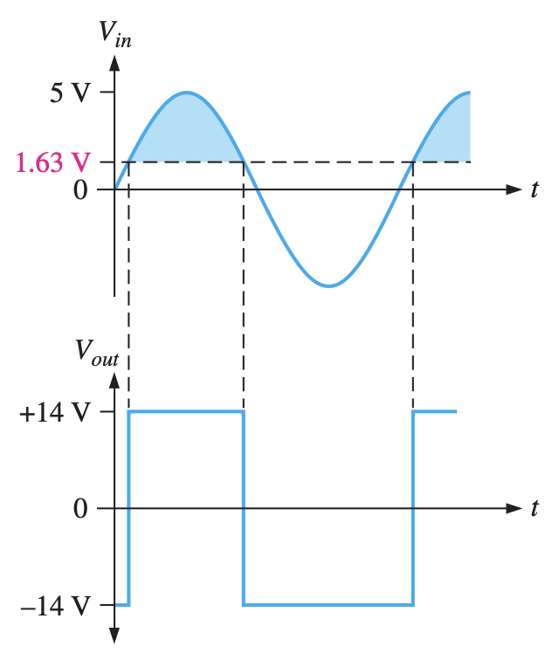
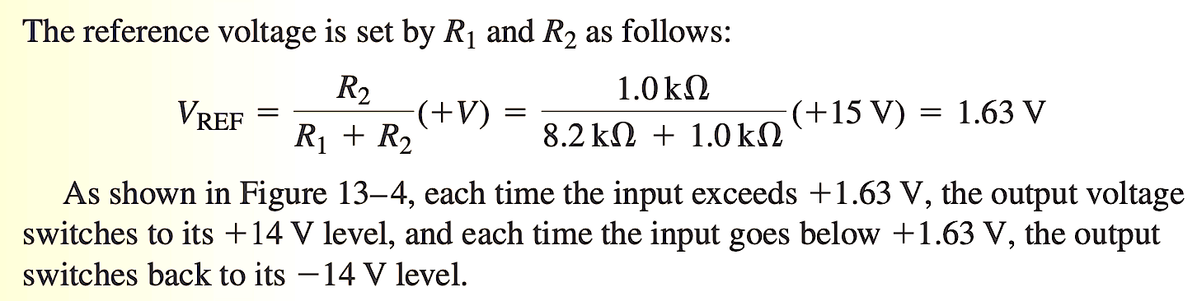
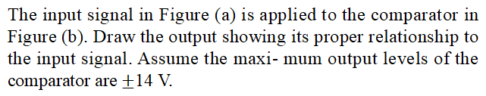
Example Problem - 1
Problem:
The input signal in Figure (a) is applied to the comparator in Figure (b). Draw the output showing its proper relationship to the input signal. Assume the maxi- mum output levels of the comparator are $±$14 V.
Solution:

Slide 19
SELF-ASSESSMENT QUESTIONS
What is the primary application of a comparator?
Voltage amplification
Digital-to-analog conversion
Signal filtering
Signal comparison
Which statement best describes the output behavior of an ideal comparator?
The output transitions instantly between high and low states
The output changes gradually with input changes
The output is always at a fixed voltage level
The output is unaffected by input changes

Slide 20
SELF-ASSESSMENT QUESTIONS
In what application would a Schmitt trigger be most useful?
Audio amplification
Signal filtering
Switch debouncing
Voltage regulation
What is the main purpose of a Schmitt trigger?
To amplify signals
To provide hysteresis in signal processing
To generate sinusoidal waves
To filter out noise from signals

Slide 21
SELF-ASSESSMENT QUESTIONS
3. What is the primary advantage of an instrumentation amplifier over a regular operational amplifier?
Higher gain
Lower cost
Higher input impedance
Greater accuracy in differential amplification
4. In what application would an instrumentation amplifier be most suitable?
Audio amplification
Temperature sensing
Power generation
Signal conditioning for sensors

Slide 22
ANSWERS
d
a
b
C
d
d

Slide 23
TERMINAL QUESTIONS
Describe the characteristics of an ideal comparator. What are the key parameters to consider when selecting a comparator for a specific application?
What is hysteresis, and how does it apply to Schmitt triggers? Explain with the help of a diagram.
Define an instrumentation amplifier and discuss its primary features and advantages over traditional operational amplifiers.
Explain the configuration and working principle of an instrumentation amplifier. How does it achieve high common-mode rejection ratio (CMRR) and gain accuracy?

Slide 24
REFERENCES FOR FURTHER LEARNING OF THE SESSION
Reference Books:
1. Op-Amps and Linear Integrated Circuit; 4th Ed., Gayakwad, Ramakant A.
Sites and Web links:
1. https://electronicsforyou.in/introduction-to-op-amp

Slide 25
THANK YOU
Team – ANALOG ELECTRONIC CIRCUIT DESIGN

