Slide 1

Department of ECE
Analog electronic Circuit Design (24ec2104)
Topic:
Active Filters-1I

Slide 2
Session Content
Aim – Objectives – Outcomes
Introduction
Active High Pass Filter
First Order High Pass Filter
First Order Low Pass Butterworth Filter
Summary
Example Problems
Self Assessment Questions
Terminal Questions
References

Slide 3



AIM OF THE SESSION
The aim of this session is to emphasize the significance of Operational Amplifier and to understand the basics of most important applications of Op-Amp such as, active filters.
INSTRUCTIONAL OBJECTIVES
This Session is designed to:
  Specify the importance/necessity of the active filters using Op-Amp.
  Describe the function of block diagram of active filters.
  Understand the schematic symbol of the active filters.
LEARNING OUTCOMES
At the end of this session, you should be able to:
  Explain the application of Op-Amp for active filters.
  Summarize the functioning of active filters applications.
  Identify the Pin configuration and importance of IC741 for active filters operation.

Slide 4
INTRODUCTION
Active filters can provide amplification of the signal.
Unlike passive filters, active filters do not require inductors, which can be bulky and expensive.
Easier to adjust and fine-tune compared to passive filters.
Improved performance characteristics like higher input impedance and lower output impedance.
Used in equalizers, audio crossover networks, and noise reduction systems.
Employed in signal conditioning, modulation, and demodulation circuits.
Used in various measurement and data acquisition systems to filter out unwanted noise and signals.

Slide 5
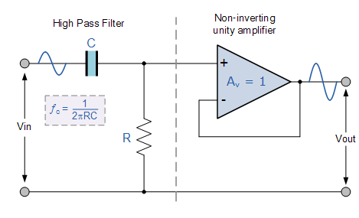
Active High Pass Filter
An Active High Pass Filter can be created by combining a passive RC filter network with an operational amplifier to produce a high pass filter with amplification
The basic operation of an Active High Pass Filter (HPF) is the same as for its equivalent RC passive high pass filter circuit, except this time the circuit has an operational amplifier or included within its design providing amplification and gain control.
Like the previous active low pass filter circuit, the simplest form of an active high pass filter is to connect a standard inverting or non-inverting operational amplifier to the basic RC high pass passive filter circuit as shown.

Slide 6
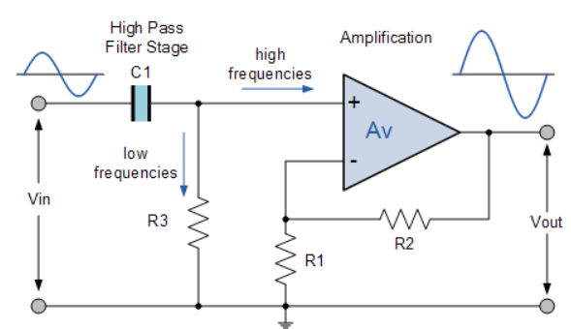
First Order High Pass Filter
A first-order (single-pole) Active High Pass Filter attenuates low frequencies and passes high frequency signals.
It consists simply of a passive filter section followed by a non-inverting operational amplifier.
The frequency response of the circuit is the same as that of the passive filter, except that the amplitude of the signal is increased by the gain of the amplifier and for a non-inverting amplifier the value of the pass band voltage gain is given as 1 + R2/R1, the same as for the low pass filter circuit.

Slide 7
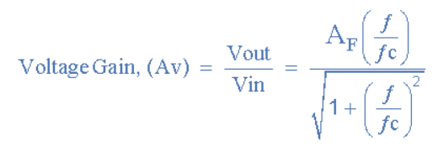
First Order High Pass Filter
This first-order high pass filter, consists simply of a passive filter followed by a non-inverting amplifier. The frequency response of the circuit is the same as that of the passive filter, except that the amplitude of the signal is increased by the gain of the amplifier.
For a non-inverting amplifier circuit, the magnitude of the voltage gain for the filter is given as a function of the feedback resistor ( R2 ) divided by its corresponding input resistor ( R1 ) value and is given as:

Slide 8



The operation of a high pass active filter can be verified from the frequency gain equation above as:
At very low frequencies, ƒ < ƒc
At the cut-off frequency, ƒ = ƒc
At very high frequencies, ƒ > ƒc

Slide 9
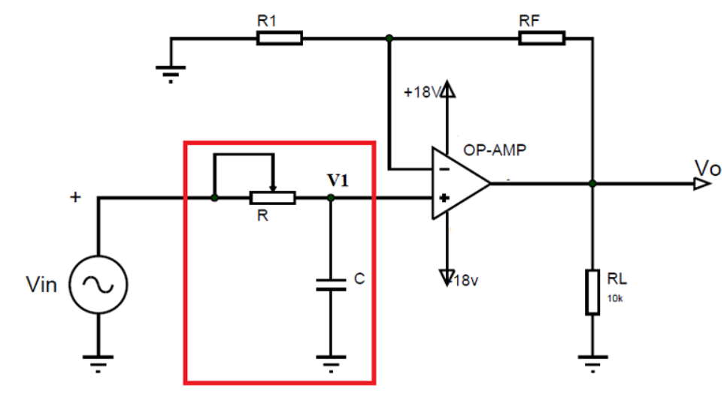
First Order Low Pass Butterworth Filter
The figure shows the circuit model of the first-order low pass Butter worth filter
In the circuit we have:
  Voltage ‘Vin’ as an input voltage signal which is analog in nature.
  Voltage ‘Vo’ is the output voltage of the operational amplifier.
  Resistors ‘RF’ and ‘R1’ are the negative feedback resistors of the operational amplifier.
  There is a single R-C network (marked in the red square) present in the circuit hence the filter is a first-order low pass filter
  ‘RL’ is the load resistance connected at the op-amp output.

Slide 10
First Order Low Pass Butterworth Filter
If we use the voltage divider rule at point ‘V1’then we can get the voltage across the capacitor as,
V1 = [ -jXc / (R-jXc) ] Vin Here –jXc = 1/2ᴫfc
After substitution this equation we will have something like below
V1 = Vin / (1+j2ᴫfRC)
Now the op-amp here used in negative feedback configuration and for such a case the output voltage equation is given as,
V0 = ( 1 + RF / R1 ) V1 .
If we submit V1 equation into Vo we will have,
V0 = (1 + RF / R1) [Vin / (1 + j2ᴫfRC) ]
After rewriting this equation we can have,
V_{o}/V_{in}= AF / ( 1 + j(f/fL) )

Slide 11
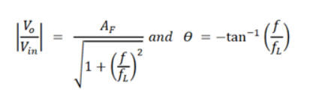
First Order Low Pass Butterworth Filter
We have, V_{o}/V_{in} = AF / ( 1 + j(f/fL) )
In this equation,
V_{o}/V_{in} = gain of the filter as a function of frequency
= (1+RF / R1) = passband gain of the filter
f = frequency of the input signal
f_{L} = 1 / 2ᴫRC = cutoff frequency of the filter.
We can use this equation to choose appropriate resistor and capacitor values to select the cutoff frequency of the circuit.
If we convert the above equation into a polar form we will have,

Slide 12
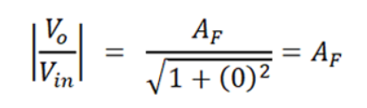

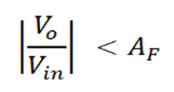
Case 1: f<<fL. So let us consider input frequency is very less than the cutoff frequency of the filter then,
Case 2: f = fL. If the input frequency is equal to the cutoff frequency of the filter then,
Case3: f >fL. If the input frequency is higher than the cutoff frequency of the filter then,

Slide 13
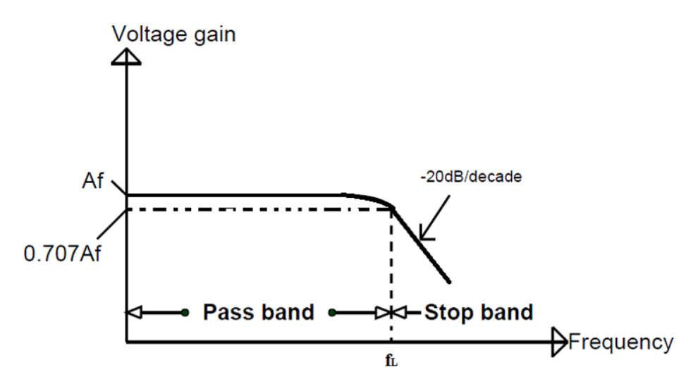
The frequency response of the above circuit:
The gain of the filter will be the same as op-amp gain until the input signal frequency is less than the cutoff frequency.
But once the input signal frequency reaches cutoff frequency the gain marginally decreases as seen in case two.
And as the input signal frequency increases even further the gain gradually decreases until it reaches zero.
So the low pass Butterworth filter allows the input signal to appear at the output until the frequency of the input signal is lower than the cutoff frequency.

Slide 14

SUMMARY
Active filters offer precise frequency selectivity by allowing specific bands of frequencies to pass while attenuating others.
Active high pass filters pass high-frequency components, while active low pass filters pass low-frequency components.
Active band pass filters allow a specific band of frequencies to pass through, while active band stop filters reject a particular band of frequencies.
Active filters find extensive use in various electronic systems requiring frequency-selective signal processing.
Common applications include audio equalization, signal conditioning, noise cancellation, interference rejection, and notch filtering.

Slide 15
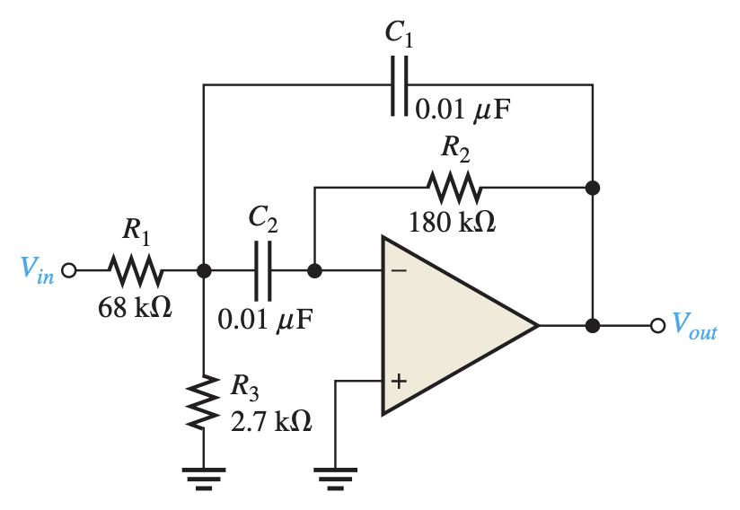
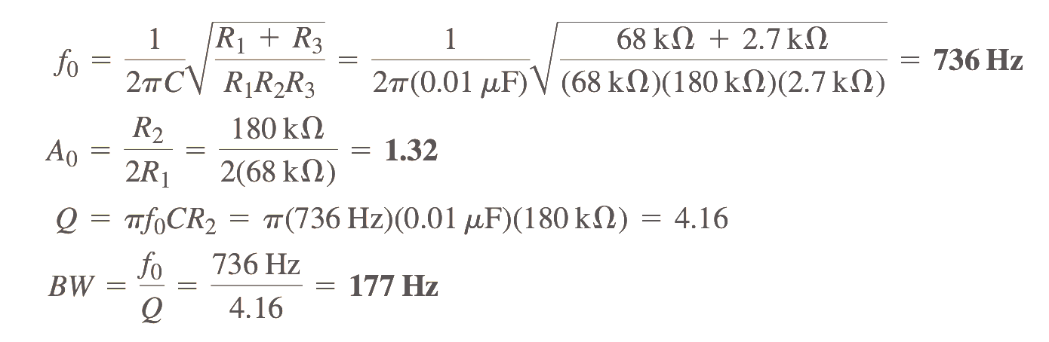
Example Problem
Problem:
Determine the center frequency, maximum gain, and bandwidth for the filter,
Solution:

Slide 16
SELF-ASSESSMENT QUESTIONS
What is the primary function of an active band stop filter?
A. Pass a specific band of frequencies
Reject a specific band of frequencies
Amplify all frequencies equally
Attenuate all frequencies equally
In an active high pass filter, where is the non-inverting terminal of the op-amp typically connected?
Input signal source
Output of a passive high pass filter
Ground
Output of a passive low pass filter

Slide 17
SELF-ASSESSMENT QUESTIONS
3. What parameter can be adjusted to control the gain of an active filter?
Capacitance
Resistance
Inductance
Frequency
4. What is the primary advantage of active filters in noise cancellation and interference rejection applications?
Automotive engineering
Telecommunications
Environmental science
Medical instrumentation

Slide 18
ANSWERS
b
b
b
b

Slide 19
TERMINAL QUESTIONS
Define an active filter and explain how it differs from a passive filter.
Discuss the principle of frequency selectivity in active filters and how it is achieved.
Compare and contrast the operation of active high pass, low pass, band pass, and band stop filters.
Explain the role of operational amplifiers (op-amps) in active filter circuits.
Describe the design considerations for selecting component values in an active filter circuit.

Slide 20
REFERENCES FOR FURTHER LEARNING OF THE SESSION
Reference Books:
1. Op-Amps and Linear Integrated Circuit; 4th Ed., Gayakwad, Ramakant A.
Sites and Web links:
1. https://electronicsforyou.in/introduction-to-op-amp

Slide 21
THANK YOU
Team – ANALOG ELECTRONIC CIRCUIT DESIGN

