Slide 1

AY-2025-2026
ODD SEM
Department of ECE
Analog electronic Circuit Design
24ec2104
Topic:
BJT Q-POINT
Session - 03

Slide 2
Session content
Open circuit voltage
Short circuit current
Load line
Operating point

Slide 3



AIM OF THE SESSION
To demonstrate operating point of BJT
INSTRUCTIONAL OBJECTIVES
This Session is designed to:
  Demonstrate open circuit voltage
  Demonstrate circuit current
  Demonstrate Load line of BJT.
  Identify operating point of BJT for changing current gains.
LEARNING OUTCOMES
At the end of this session, you should be able to:
  Plot open circuit voltage
  Plot short circuit current
  Determine Load line of BJT.
  Identify operating point of BJT for changing current gains.

Slide 4
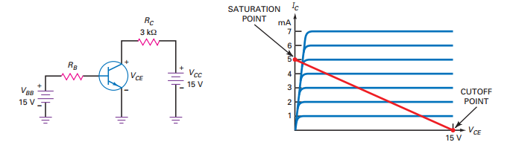
BJt placed in a circuit
In order for a transistor to function as an amplifier or a switch, it must fi rst have its dc circuit conditions set properly. This is referred to as properly biasing the transistor.
Fig. 3.1. depicts a situation where BJT with given output characteristics is placed in a circuit with given voltages and resistors.
Further step is to determine which are the worst case voltage and current that BJT shall carry in the given circuit.
Finally to obtain a common point which satisfy the operating characteristics and circuit conditions.
Fig. 3.1. BJT placed in a circuit with fixed conditions, identifying circuit conditions and operating characteristics

Slide 5
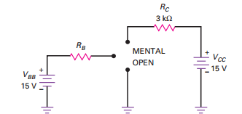
Open Circuit Voltage
To determine which are the worst case voltage and current that BJT shall carry in the given circuit.
First, open circuit the BJT terminals and find the voltage across collector-emitter terminals
For the given circuit conditions, the open circuit voltage across C-E terminals V_{CEcutoff} = 15 V
Fig. 3.2. BJT placed in a circuit with fixed conditions, identifying open circuit voltage

Slide 6
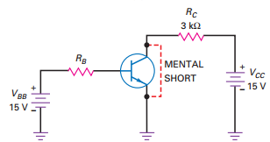
Short circuit current
To determine which are the worst case voltage and current that BJT shall carry in the given circuit.
Next, short circuit the BJT C-E terminals and find the current through the short circuit.
For the given circuit conditions, the short circuit current through C-E terminals I_{Csat} = 15V/3 kΩ = 9mA
Fig. 3.3. BJT placed in a circuit with fixed conditions, identifying short circuit current

Slide 7
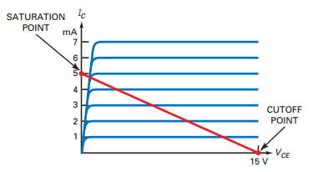
Load line
Now, the voltage across C-E terminals and current through C-E terminals can take the values only on the line joining the V_{CEcutoff} and I_{Csat} , owing to the given output circuit.
This line joining these two parameters is termed as Load line
Fig. 3.4. BJT placed in a circuit with fixed conditions, identifying circuit conditions and operating characteristics

Slide 8
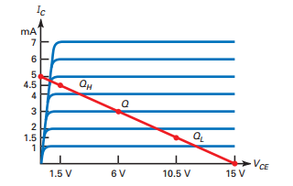
Operating point (Q-point)
The voltage across C-E terminals and current through C-E terminals can take the values only on the line joining the V_{CEcutoff} and I_{Csat} , owing to the given output circuit.
This line joining these two parameters is termed as Load line.
Output characteristics are controlled by current gain and input current.
The intersection of load line and output characteristics is the only points where both device operation and circuit operation are feasible.
This is termed as operating point or Q-point
Fig. 3.5. BJT placed in a circuit with fixed conditions, identifying operating point

Slide 9
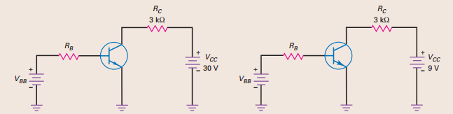
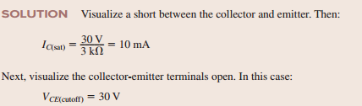
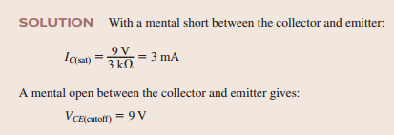
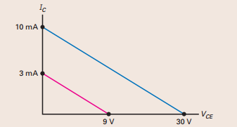
Example Problems
3.1 Draw the load lines for circuits shown in Fig. 3.6.
Solution:
Fig. 3.6. BJT placed in circuits with voltage and current limiter resistances

Slide 10
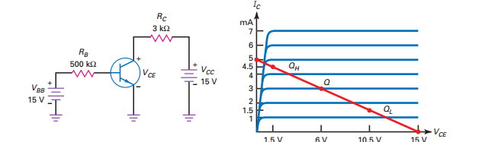
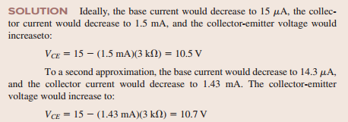
Example Problems
3.2 For the ideal BJT shown in Fig. 3.7 having β_{DC} of 100, determine Q-point and if base resistance changes to 1 MΩ determine the new Q-Point.
Solution:
Fig. 3.7. CE Configured BJT biased with external voltages

Slide 11

SELF-ASSESSMENT QUESTIONS
Load line is drawn between
V_{OC} and I_{SC}
I_{OC} and V_{SC}
V_{SC} and V_{OC}
I_{SC} and I_{OC}
What is the Quiescent collector current I_{C} for BJT in active region
β I_{B}
< β I_{B}
Zero

Slide 12
SELF-ASSESSMENT QUESTIONS
3. Which mode does BJT Q-point to be biased for amplification
Saturation
Active
Cut-off
4. Operating point is the intersection of load line and device characteristics.
False
True

Slide 13
ANSWERS
A
A
B
B

Slide 14
TERMINAL QUESTIONS
Describe open circuit voltage across a circuit element at load terminals.
Discuss short circuit current in a circuit element
Draw the load line of BJT for given circuit.
Draw output characteristics of BJT for various input base current values.
Draw the load lines for varying resistance in output loop of BJT.
Identify the Q-point of BJT for given circuit.

Slide 15
REFERENCES FOR FURTHER LEARNING OF THE SESSION
Reference Books:
Albert Malvino, David Bate, “Electronic Principles”
Robert L. Boylestad and Louis Nashelsky - “Electronic Devices and Circuit Theory”

Slide 16
THANK YOU
Team – Analog electronic Circuit Design
Prepared by – Mr. S. Ravi Teja

