Slide 1


Department of ECE
COURSE:
Processors and Controllers
COURSE CODE:24EC2106
Topic:
CO 2- 8051

Slide 2
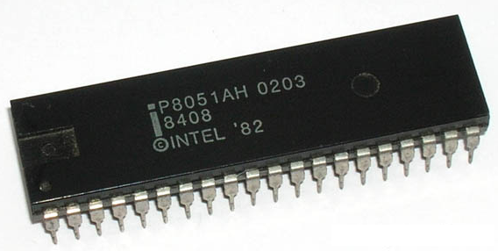
Microcontroller
8051

Slide 3
The necessary tools for a microprocessor/controller
Data Bus
CPU
General-Purpose Micro-processor
Serial
COM
Port
RAM
ROM
I/O Port
Timer
Address Bus
General-Purpose Microprocessor System
CPU
RAM
ROM
Serial COM Port
I/O Port
Timer
Microcontroller
Example：Motorola’s 6811, Intel’s 8051, Zilog’s Z8 and PIC 16X

Slide 4
Block Diagram of 8051
External interrupts
On-chip ROM for program code
Timer/Counter
Interrupt Control
On-chip RAM
Timer 1
Counter Inputs
Timer 0
CPU
Bus Control
Serial Port
4 I/O Ports
OSC
P0 P1 P2 P3
TxD RxD
Address/Data

Slide 5
Features of 8051 Microcontroller
An 8051 microcontroller comes bundled with the following features −
4KB bytes on-chip program memory (ROM)
128 bytes on-chip data memory (RAM)
Four register banks
128 user defined software flags
8-bit bidirectional data bus
16-bit unidirectional address bus
32 general purpose registers each of 8-bit
16 bit Timers (usually 2, but may have more or less)
Three internal and two external Interrupts
Four 8-bit ports,(short model have two 8-bit ports)
16-bit program counter and data pointer
8051 may also have a number of special features such as UARTs, ADC, Op-amp, etc.

Slide 6
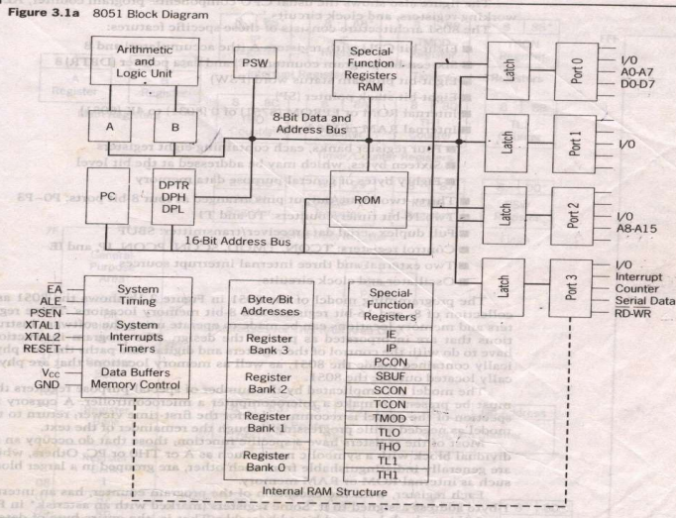
Architecture of 8051

Slide 7
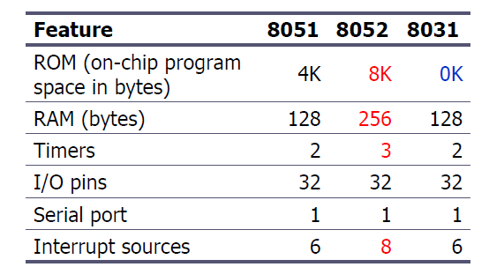
Comparison of the 8051 Family Members
Notes:
versatility 多用途的: any number of applications for PC

Slide 8
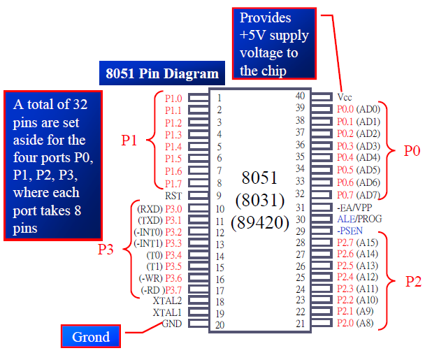
Pin Description of the 8051

Slide 9
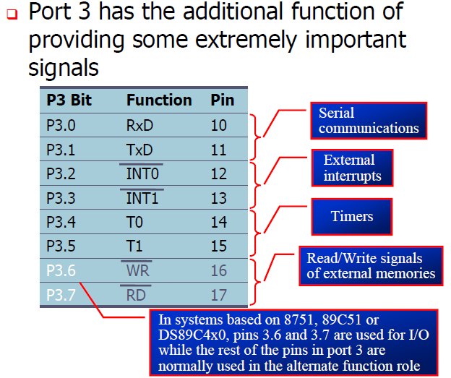
Port 3 Alternate Functions

Slide 10
RESET Value of Some 8051 Registers:
Register
Reset Value
PC
0000
ACC
00
B
00
PSW
00
SP
07
DPTR
0000
RAM are all zero.

Slide 11
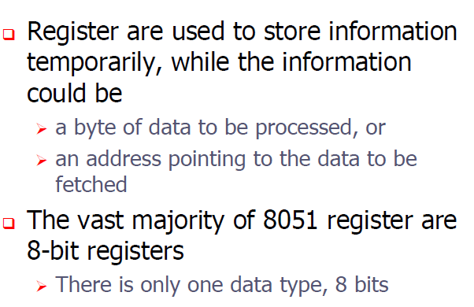
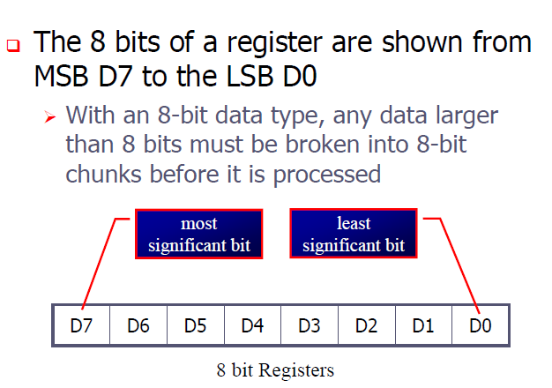
Registers

Slide 12
RAM memory space allocation in the 8051
7FH
Scratch pad RAM
30H
2FH
Bit-Addressable RAM
20H
1FH
Register Bank 3
18H
17H
Register Bank 2
10H
0FH
(Stack) Register Bank 1
08H
07H
Register Bank 0
00H

Slide 13
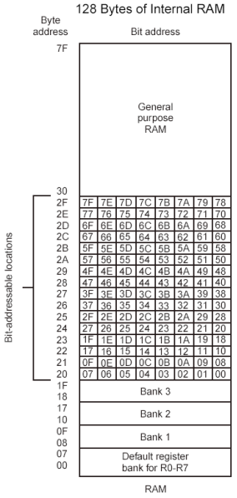

Slide 14
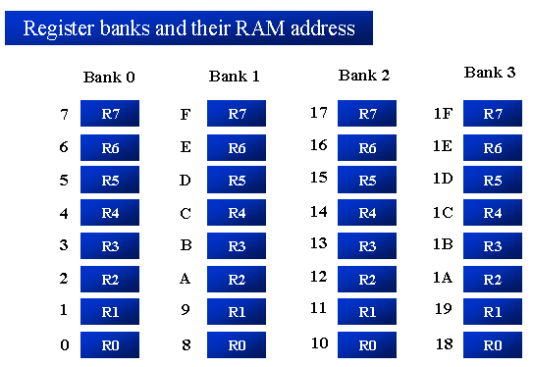

Slide 15
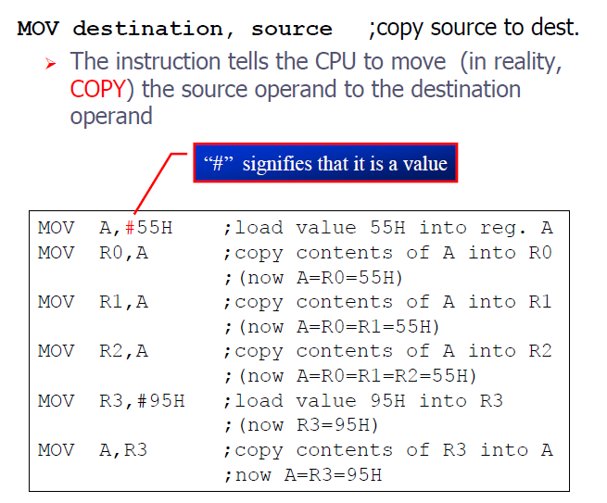

Slide 16
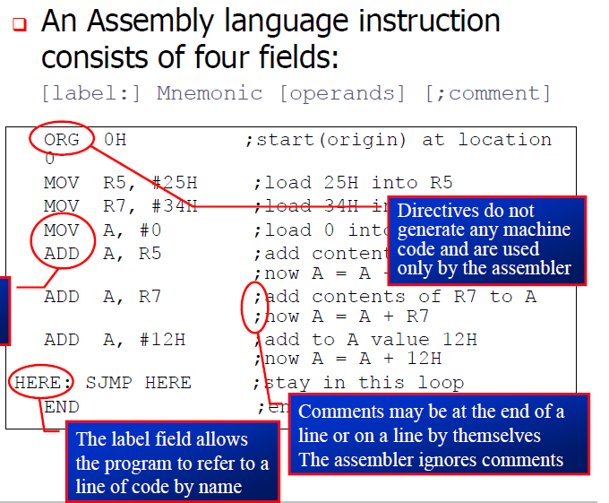


Slide 17
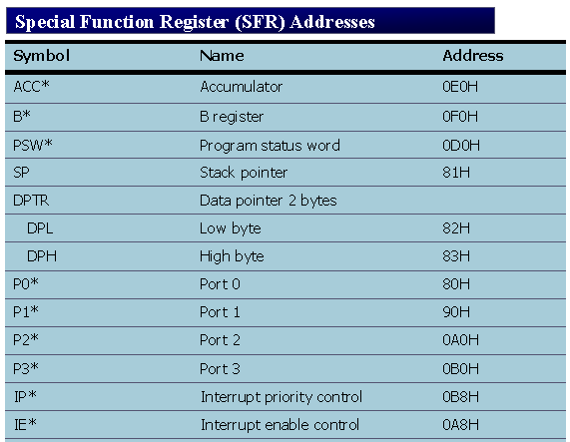

Slide 18
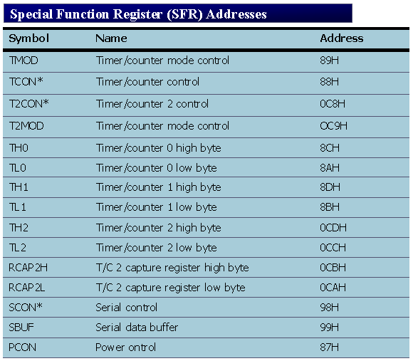

Slide 19
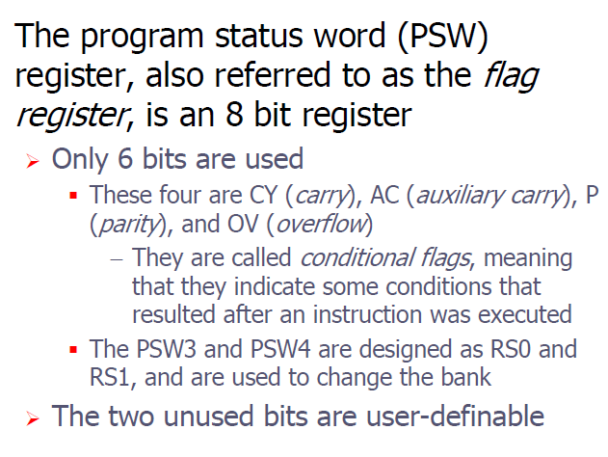
8051 Flag bits and the PSW register

Slide 20
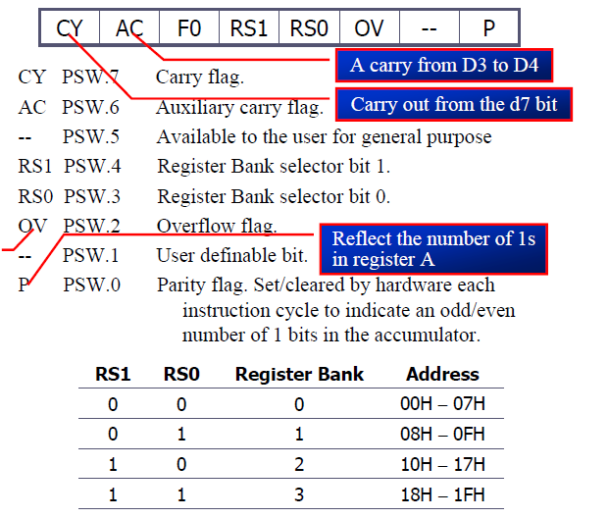
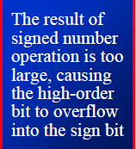
8051 Flag bits and the PSW register

Slide 21
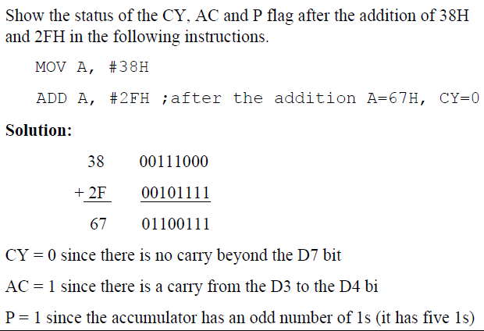
8051 Flag bits and the PSW register

Slide 22
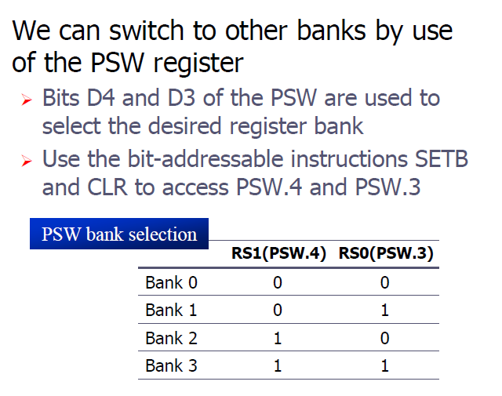
8051 PSW BANK SELECTION

Slide 23



8051 PSW BANK SELECTION

Slide 24
Stack in the 8051
The register used to access the stack is called SP (stack pointer) register.
The stack pointer in the 8051 is only 8 bits wide, which means that it can take value 00 to FFH. When 8051 powered up, the SP register contains value 07.
7FH
Scratch pad RAM
30H
2FH
Bit-Addressable RAM
20H
1FH
Register Bank 3
18H
17H
Register Bank 2
10H
0FH
(Stack) Register Bank 1
08H
07H
Register Bank 0
00H

Slide 25
Example of STACK operation:
MOV R6,#25H
MOV R1,#12H
MOV R4,#0F3H
PUSH 6
PUSH 1
PUSH 4
0BH
0BH
0BH
0BH
0AH
0AH
0AH
0AH
F3
09H
09H
09H
12
09H
12
08H
08H
25
08H
25
08H
25
Start SP=07H
SP=08H
SP=09H
SP=0AH

Slide 26
8051- Addressing Modes
Immediate
Register
Direct
Register Indirect
Indexed

Slide 27
Immediate Addressing Mode
MOV A,#65H
MOV A,#’A’
MOV R6,#65H
MOV DPTR,#2343H
MOV P1,#65H

Slide 28
Register Addressing Mode
MOV Rn, A ;n=0,..,7
ADD A, Rn
MOV DPL, R6
MOV DPTR, A
MOV Rm, Rn

Slide 29
Direct Addressing Mode
Although the entire of 128 bytes of RAM can be accessed using direct addressing mode, it is most often used to access RAM loc. 30 – 7FH.
MOV R0, 40H
MOV 56H, A
MOV A, 4 ; ≡ MOV A, R4
MOV 6, 2 ; copy R2 to R6
; MOV R6,R2 is invalid !
SFR register and their address
MOV 0E0H, #66H ; ≡ MOV A,#66H
MOV 0F0H, R2 ; ≡ MOV B, R2
MOV 80H,A ; ≡ MOV P1,A

Slide 30
Register Indirect Addressing Mode
In this mode, register is used as a pointer to the data.
MOV A,@Ri ; move content of RAM loc. Where address is held by Ri into A
( i=0 or 1 )
MOV @R1,B
In other word, the content of register R0 or R1 is sources or target in MOV, ADD and SUBB instructions.
Example: Write a program to copy a block of 10 bytes from RAM location starting at 40H to RAM location starting at 60H.
Solution:
MOV R0,#40H ; source pointer
MOV R1,#60H ; destination pointer
MOV R2,#10 ; counter
BACK: MOV A,@R0
MOV @R1,A
INC R0
INC R1
DJNZ R2,BACK

Slide 31
Indexed Addressing Mode And On-Chip ROM Access
This mode is widely used in accessing data elements of look-up table entries located in the program (code) space ROM at the 8051
MOVC A,@A+DPTR
A= content of address A +DPTR from ROM
Note:
Because the data elements are stored in the program (code ) space ROM of the 8051, it uses the instruction MOVC instead of MOV. The “C” means code.

Slide 32
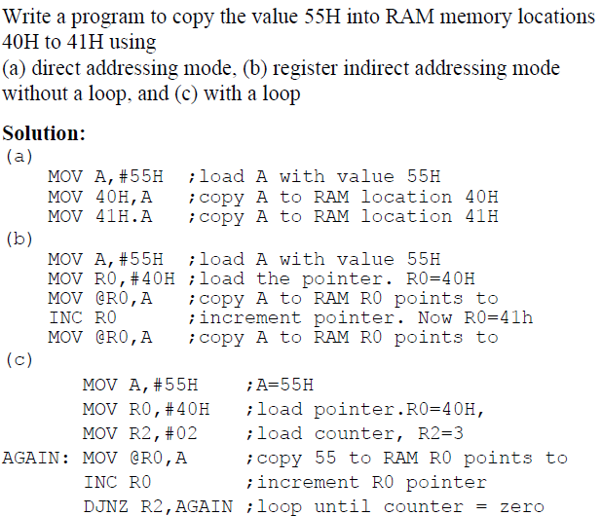
Example Programs

Slide 33
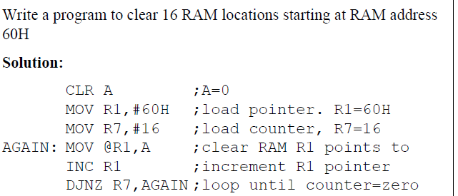
Example Programs

Slide 34
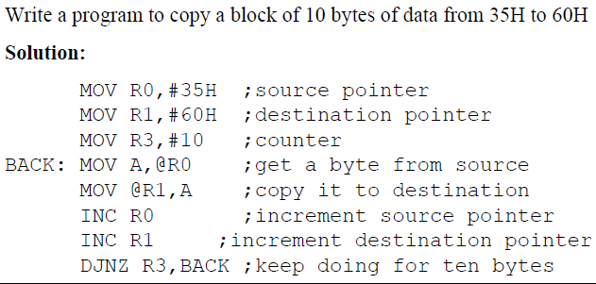
Example Programs

Slide 35
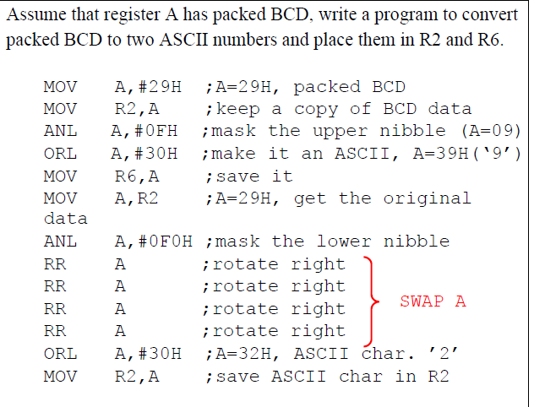
Example Programs

Slide 36
8051- INSTRUCTION SET
Data transfer instructions.
Arithmetic instructions.
Logical instructions.
Logical instructions with bits.
Branch instructions.

Slide 37
Data transfer instructions:
MOV A,Rn
MOV A, Direct
MOV A,@Ri
MOV A,#Data
MOV Rn,A
MOV Rn,Direct
MOV Rn,#Data
MOV Direct,A
MOV Direct, Rn
MOV Direct, Direct
MOV Direct,@Ri
MOV Direct,#Data
MOV @Ri,A
MOV @Ri,Direct
MOV @Ri,#Data
MOV DPTR,#Data16
MOVX A,@Ri
MOVX A,@DPTR

Slide 38
Data transfer instructions:
PUSH Direct
POP Direct
XCH A,Rn
XCH A, Direct
XCH A,@Ri
XCHD A,@Ri
MOVX @Ri,A
MOV @DPTR,A

Slide 39
Arithmetic instructions:
ADD A,Rn
ADD A,Direct
ADD A,@Ri
ADD A,#Data
ADDC A,Rn
SUBB A, Direct
SUBB A,@Ri
SUBB A,#Data
INC A
INC Rn
INC Direct
INC @Ri
DEC A
DEC Rn
ADDC A, Direct
ADDC A,@Ri
ADDC A,#Data
SUBB A,Rn

Slide 40
Arithmetic instructions:
DEC Direct
DEC @Ri
INC DPTR
MUL AB
DIV AB
DA A

Slide 41
Logical instructions:
ANL A,Rn
ANL A,Direct
ANL A,@Ri
ANL A,#Data
ANL Direct,A
ANL Direct,#Data
ORL A,Rn
ORL A,Direct
ORL A,@Ri
ORL A,#Data
ORL Direct,A
ORL Direct,#Data
XRL A,Rn
XRL A,Direct
XRL A,@Ri
XRL A,#Data
XRL Direct,A
XRL Direct,#Data

Slide 42
Logical instructions:
CLR A
CPL A
RL A
RLC A
RR A
RRC A
SWAP A

Slide 43
Boolean Variable Manipulation instructions:
CLR C
CLR bit
SETB C
SETB bit
CPL C
CPL bit
ANL C,bit
ANL C,/bit
ORL C,bit
ORL C,/bit
MOV C,bit
MOV bit,C
JC rel
JNC rel
JB bit,rel
JNB bit,rel
JBC bit,rel

Slide 44
Program branching instructions:
ACALL addr11
LCALL addr16
RET
RETI
AJMP addr11
LJMP addr16
SJMP rel
JMP @A+DPTR
JZ rel
JNZ rel
CJNE A,direct,rel
CJNE A,#data,rel
CJNE Rn,#data,rel
CJNE @Ri,#data,rel
DJNZ Rn,rel
DJNZ direct,rel
NOP

Slide 45
MUL & DIV
MUL AB ;B|A = A*B
MOV A,#25H
MOV B,#65H
MUL AB ;25H*65H=0E99
;B=0EH, A=99H
DIV AB ;A = A/B, B = A mod B
MOV A,#25H
MOV B,#10H
DIV AB ;A=2, B=5

Slide 46
Rotate
EXAMPLE:
RR:
RRC:
RL:
RLC:
C
C

Slide 47
8051 INSTRUCTION SET
ACALL: Absolute Call
ADD, ADDC: Add Acc. (With Carry)
AJMP: Absolute Jump
ANL: Bitwise AND
CJNE: Compare & Jump if Not Equal
CLR: Clear Register
CPL: Complement Register
DA: Decimal Adjust
DEC: Decrement Register
DIV: Divide Accumulator by B
DJNZ: Dec. Reg. & Jump if Not Zero
INC: Increment Register
JB: Jump if Bit Set
JBC: Jump if Bit Set and Clear Bit
JC: Jump if Carry Set
JMP: Jump to Address
JNB: Jump if Bit Not Set
JNC: Jump if Carry Not Set
JNZ: Jump if Acc. Not Zero
JZ: Jump if Accumulator Zero
LCALL: Long Call
LJMP: Long Jump
MOV: Move Memory
MOVC: Move Code Memory
MOVX: Move Extended Memory
MUL: Multiply Accumulator by B
NOP: No Operation
ORL: Bitwise OR
POP: Pop Value From Stack
PUSH: Push Value Onto Stack
RET: Return From Subroutine
RETI: Return From Interrupt
RL: Rotate Accumulator Left
RLC: Rotate Acc. Left Through Carry
RR: Rotate Accumulator Right
RRC: Rotate Acc. Right Through Carry
SETB: Set Bit
SJMP: Short Jump
SUBB: Sub. From Acc. With Borrow
SWAP: Swap Accumulator Nibbles
XCH: Exchange Bytes
XCHD: Exchange Digits
XRL: Bitwise Exclusive OR
Undefined: Undefined Instruction

Slide 48
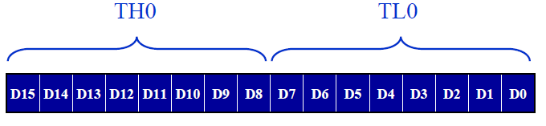
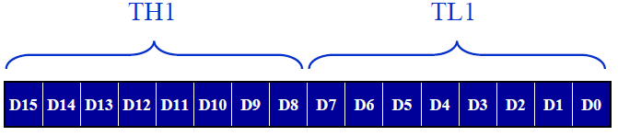
TIMERS
The 8051 has two timers:
TIMER 0
TIMER 1
TIMER 0
TIMER 1

Slide 49
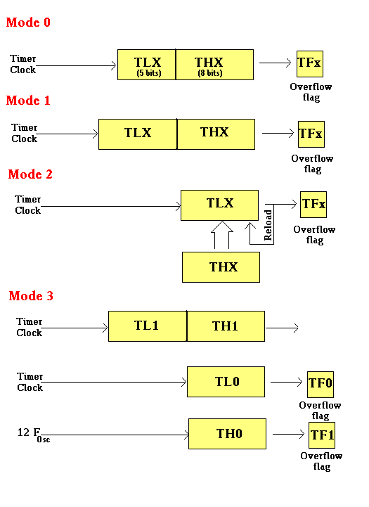

Slide 50
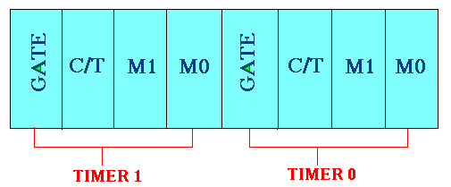
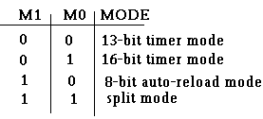
TMOD Register
Gate : When set, timer only runs while INT(0,1) is high.
C/T : Counter/Timer select bit.
M1 : Mode bit 1.
M0 : Mode bit 0.

Slide 51
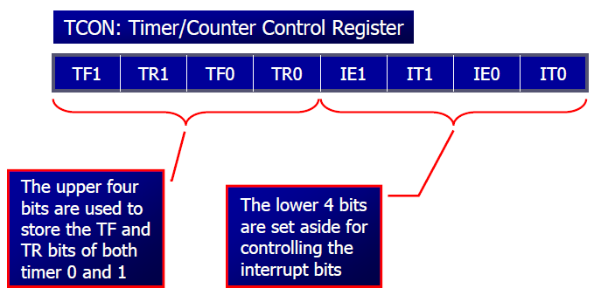
TCON Register (BIT ADRESSABLE REG)
TCON.7 - TF1: Timer 1 overflow flag.
TCON.6 - TR1: Timer 1 run control bit.
TCON.5 - TF0: Timer 0 overflag.
TCON.4 - TR0: Timer 0 run control bit.
TCON.3 - IE1: External interrupt 1 edge flag.
TCON.2 - IT1: External interrupt 1 type flag.
TCON.1 - IE0: External interrupt 0 edge flag.
TCON.0 - IT0: External interrupt 0 type flag.

Slide 52
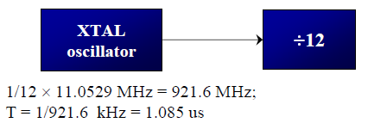

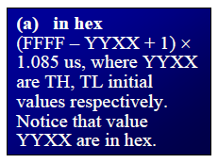
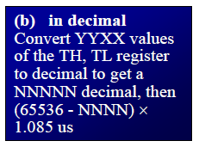
Concept of timer

Slide 53
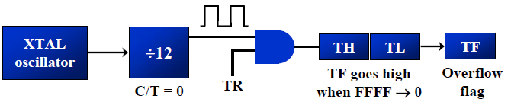
Mode 1 Programming
Load the TMOD value register indicating which timer (Timer0 or Timer1) is to be used and which timer mode is selected.
Load registers TL & TH with initial count values.
Start the timer
Keep monitoring the timer flag(TF)
Stop the timer.
Clear TF for next round .
Go back to step 2 to load TH & TL again
NOTE: MODE 0 is exactly like mode-1 except that it is 13-bit timer instead 16-bit. The 13-bit timer/counter can hold values between 0000H to 1FFFH in TH-TL.

Slide 54
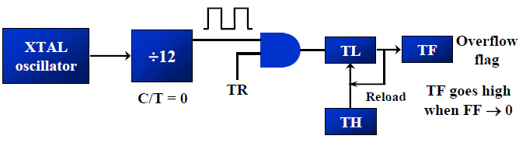
Mode 2 Programming
Load the TMOD value register indicating which timer (Timer0 or Timer1)is to be used, and select the timer mode (mode-2).
Load the TH register with the initial count value.
Start the timer.
Keep monitoring TF timer flag
After it becomes “1” then clear the TF flag
Go back to step 4 , since mode 2 is auto - reload

Slide 55
Example program for Mode1
ORG 0H
MOV TMOD,#00000001B
BACK: MOV TL0,#0F0H
MOV TH0,#0FFH
CPL P1.0
ACALL DELAY
SJMP BACK
DELAY:SETB TR0
HERE: JNB TF0, HERE
CLR TR0
CLR TF0
RET
END

Slide 56
Example program for Mode2
ORG 0H
MOV TMOD,#00100000B
MOV TH1, #05H
SETB TR1
HERE: JNB TF1, HERE
CPL P2.0
CLR TF1
SJMP HERE
END

