Slide 1
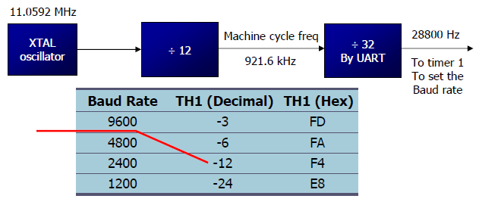
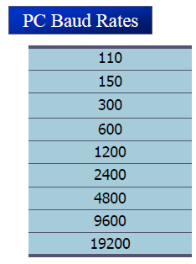


Serial Communication

Slide 2
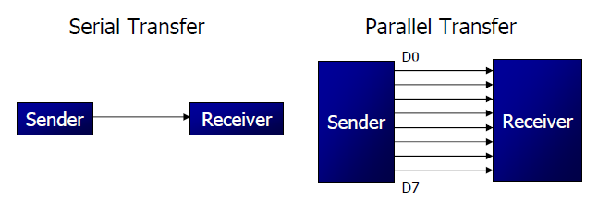
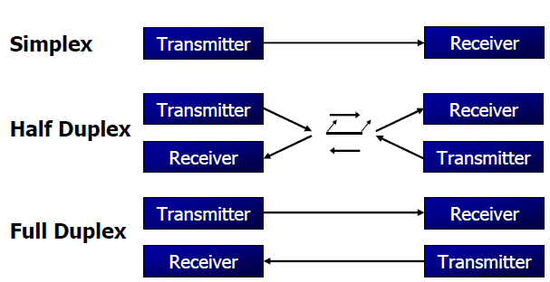
Serial vs. parallel Communication

Slide 3
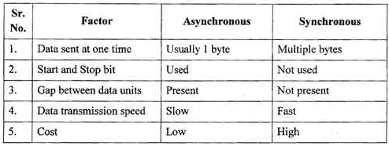
Synchronous vs. Asynchronous
Serial data communication uses two methods
Synchronous
Asynchronous
There are special IC chips made by many manufacturers for serial communications.
UART- universal asynchronous receiver-transmitter.
USART- universal synchronous - asynchronous receiver-transmitter

Slide 4
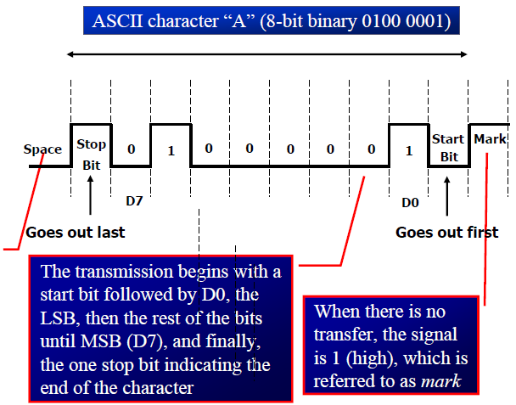

Framing (Asynchronous )

Slide 5
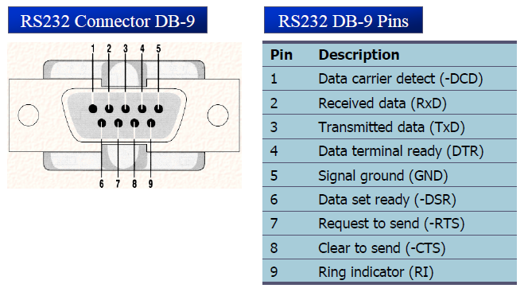

Slide 6
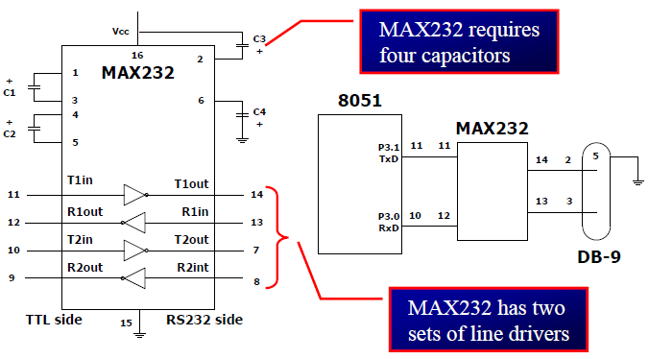

Slide 7
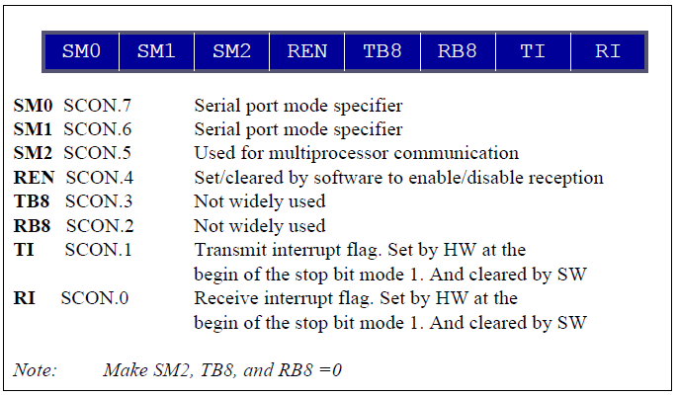
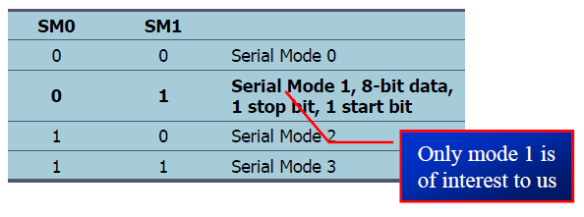
SCON register

Slide 8

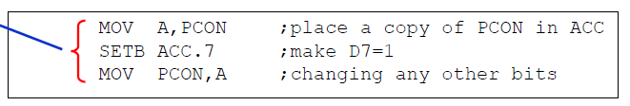
There are two ways to increase the baud rate of data transfer in 8051.
1. Use a higher frequency crystal.
2. Change a D7-bit to 1 in the PCON register
PCON Register: ( Byte addressable)
Doubling the baud rate

Slide 9
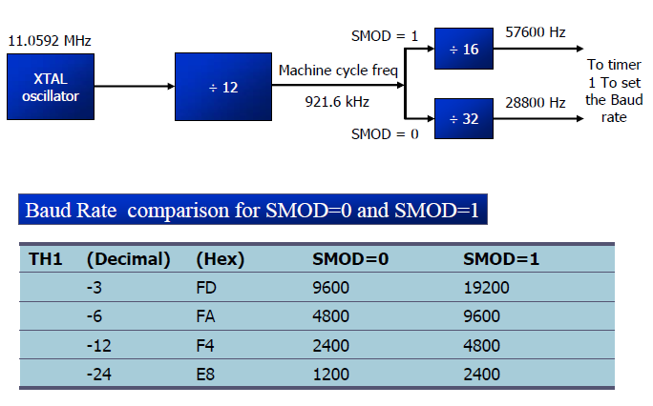

Slide 10
Programming 8051 to transfer data serially
In programming 8051 to transfer character bytes serially, the following steps must be taken
The TMOD register is loaded with the value 20H , indicating the use of Timer 1 in mode 2(8-bit auto reload) to set the baud rate
The TH1 is loaded with one of the values to set the baud rate for serial data transfer( assuming XTAL= 11.0592 MHz).
The SCON register is loaded with the value 50H indicating serial mode 1, where an 8-bit data is framed with start & stop bits.
TR1 is SET to 1 to start Timer 1.
TI is cleared when transmission is complete.
The character byte to be transferred serially is written into SBUF register.
TI is monitored for transmission .
To transfer the next character go to step 5

Slide 11
Example Program for Serial Communication
      ORG 0H
      MOV TMOD,#00100000B------(20H)
      MOV TH1,#-3
      MOV SCON,#01010000B-------(50H)
      SETB TR1
      AGAIN:MOV A,# ” “
      ACALL TRANSFER
      MOV A,# ”K“
      ACALL TRANSFER
      MOV A,# ”L“
      ACALL TRANSFER
      MOV A,# ”U“ TRANSFER: MOV SBUF,A
      ACALL TRANSFER HERE: JNB TI, HERE
      MOV A,# ” “ CLR TI
      ACALL TRANSFER RET
      SJMP AGAIN
      END

Slide 12
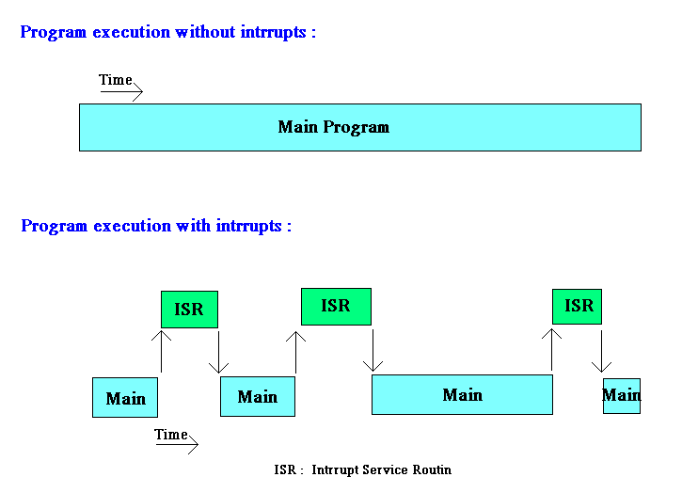
Interrupts

Slide 13
Concept behind Interrupt
An interrupt is an external or internal event that interrupts the microcontroller to inform it that a device needs its service
Upon activation of an interrupt, the microcontroller goes through the following steps
1. It finishes the instruction it is executing and saves the address of the next instruction (PC) on the stack
2. It also saves the current status of all the interrupts internally (i.e.: not on the stack)
3. It jumps to a fixed location in memory, called the interrupt vector table, that holds the address of the ISR
4. The microcontroller gets the address of the ISR from the interrupt vector table and jumps to it
5. Upon executing the RETI instruction, the microcontroller returns to the place where it was interrupted

Slide 14
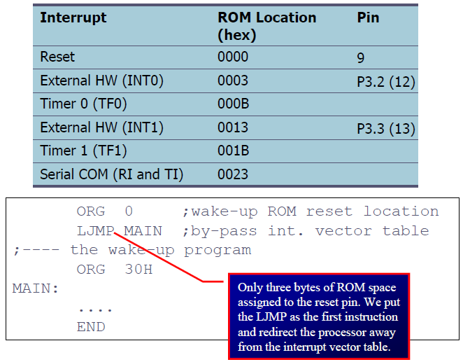
Interrupts & Interrupt vectors:

Slide 15
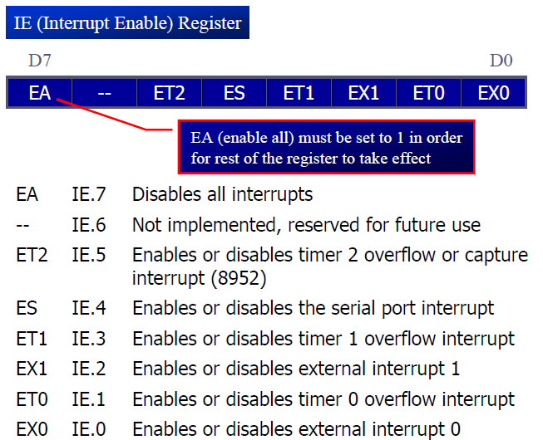
Interrupt Enable Register

Slide 16
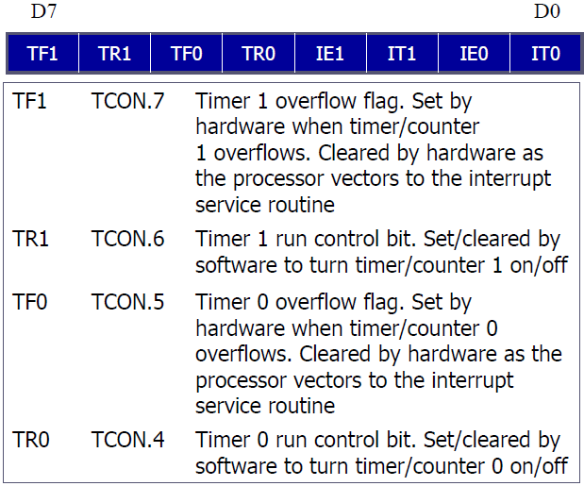
TCON REGISTER

Slide 17
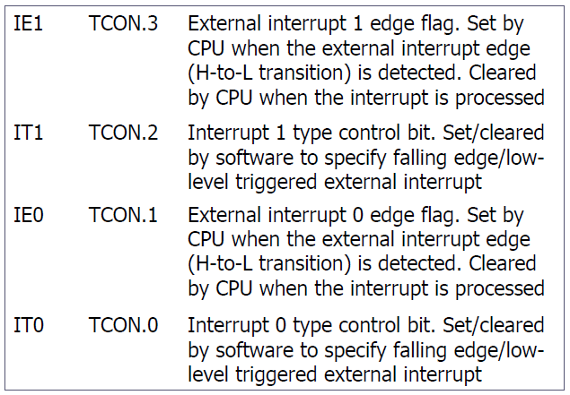

Slide 18
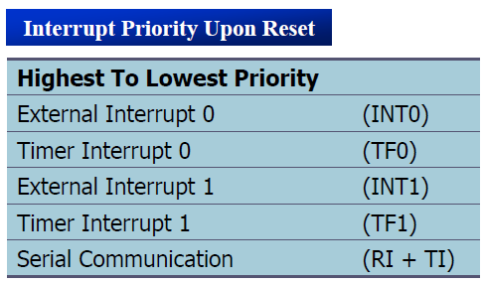

Slide 19
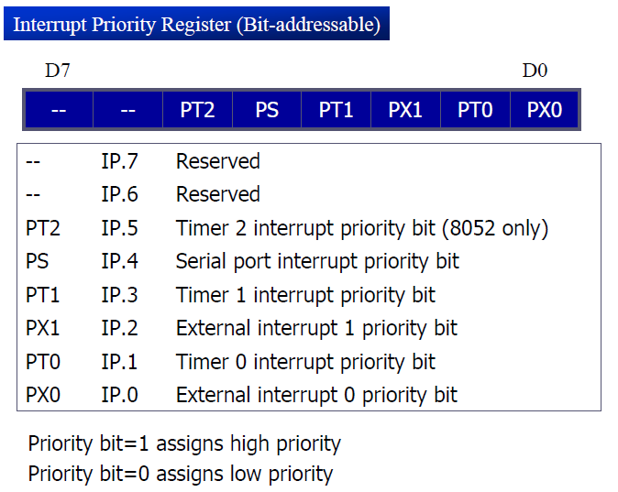
Interrupt Priority register

Slide 20
Write a program that continuously get 8-bit data from P0 and sends it to P1 while simultaneously creating a square wave of 200 μs period on pin P2.1. Use timer 0 to create the square wave. Assume that XTAL = 11.0592 MHz.
ORG 0000H
LJMP MAIN
ORG 000BH
CPL P2.1
RETI
ORG 0030H
MAIN: MOV TMOD,#02H
MOV P0,#0FFH
MOV TH0,#-92 (TH0=A4H)
MOV IE,#82H
SETB TR0
BACK: MOV A,P0
MOV P1,A
SJMP BACK
END
EXAMPLE PROGRAMS

Slide 21
Write a program to generate a square wave if 50Hz frequency on pin P1.2. Assume that XTAL=11.0592MHz
ORG 0
LJMP MAIN
ORG 000BH
CPL P1.2
MOV TL0,#00
MOV TH0,#0DCH
RETI
ORG 30H
MAIN: MOV TM0D,#00000001B
MOV TL0,#00
MOV TH0,#0DCH
MOV IE,#82H
SETB TR0
HERE: SJMP HERE
END
EXAMPLE PROGRAMS

Slide 22
LCD Interfacing (16X2)
V_{ss} V_{cc} V_{EE} RS R/W EN DB0 ---------------------------------------------DB₇ + -
LCD
1 2 3 4 5 6 7 8 9 10 11 12 13 14 15 16

Slide 23

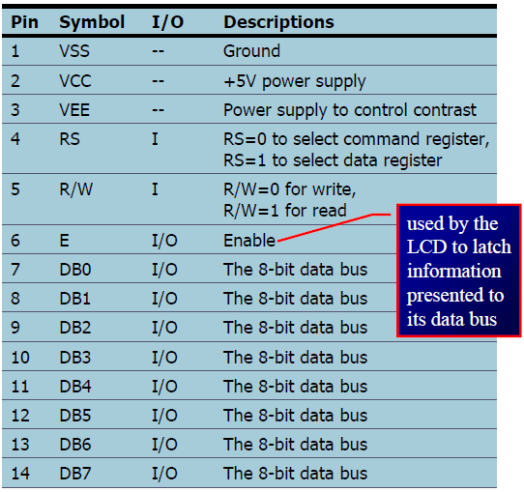
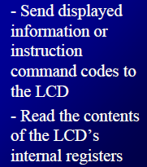


Slide 24

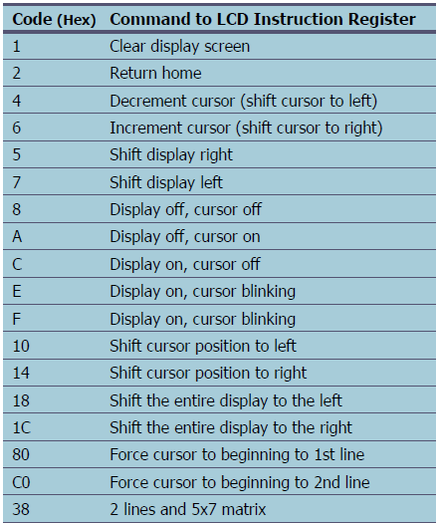

Slide 25
Addresses of 16x2 LCD
80 | 81 | 82 | 83 | 84 | 85 | 86 | 87 | 88 | 89 | 8A | 8B | 8C | 8D | 8E | 8F
C0 | C1 | C2 | C3 | C4 | C5 | C6 | C7 | C8 | C9 | CA | CB | CC | CD | CE | CF

Slide 26
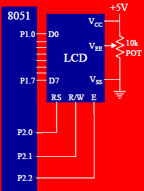

LCD INTERFACING TO 8051

Slide 27
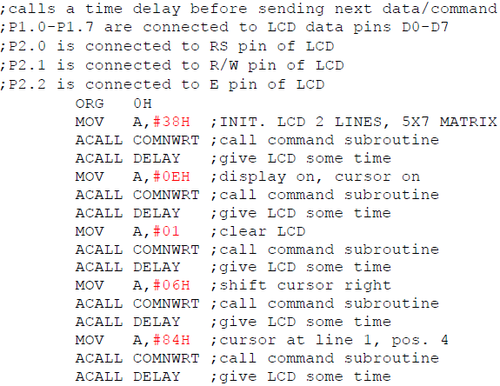
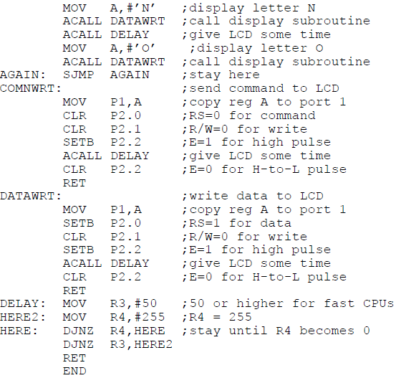
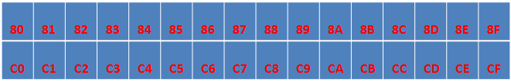

Slide 28
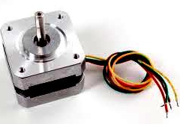
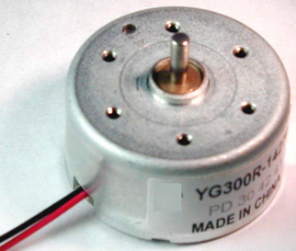
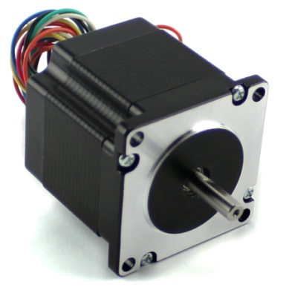
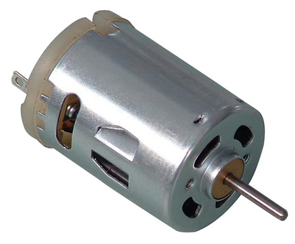
STEPPER MOTOR INTERFACING
A Stepper motor is a widely used device that translates electrical pulses into mechanical movement.
In applications such as disk drives, dot matrix printers & robotics, the stepper motor is used for position control
Stepper motors commonly have a permanent magnet ‘rotor’( also called shaft) surrounded by a ‘stator’.

Slide 29
Driving Stepper motor
Normal 4 Step Sequence
Wave Drive 4 step sequence
CLOCKWISE | STEP | WINDING A | WINDING B | WINDING C | WINDING D | COUNTER CLOCKWISE
 | 1 | 1 | 1 | 0 | 0
 | 2 | 0 | 1 | 1 | 0
 | 3 | 0 | 0 | 1 | 1
 | 4 | 1 | 0 | 0 | 1
CLOCKWISE | STEP | WINDING A | WINDING B | WINDING C | WINDING D | COUNTER CLOCKWISE
 | 1 | 1 | 0 | 0 | 0
 | 2 | 0 | 1 | 0 | 0
 | 3 | 0 | 0 | 1 | 0
 | 4 | 0 | 0 | 0 | 1

Slide 30
Driving Stepper motor
Half step 8-step sequence
CLOCKWISE | STEP | WINDING A | WINDING B | WINDING C | WINDING D | COUNTER CLOCKWISE
 | 1 | 1 | 0 | 0 | 0
 | 2 | 1 | 1 | 0 | 0
 | 3 | 0 | 1 | 0 | 0
 | 4 | 0 | 1 | 1 | 0
 | 5 | 0 | 0 | 1 | 0
 | 6 | 0 | 0 | 1 | 1
 | 7 | 0 | 0 | 0 | 1
 | 8 | 1 | 0 | 0 | 1

Slide 31
Stepper Motor Program
Assuming two stepper motors are interfaced to 8051 with ULN2803 drivers.
Program for normal 4-step sequence ( clock wise )
ORG 0H
BACK: MOV A,#0CCH
MOV P1,A
ACALL DELAY
DELAY:
MOV A,#66H MOV R0,#0FFH
MOV P1,A LOOP2: MOV R1,#80H
ACALL DELAY LOOP1: DJNZ R1,LOOP1
MOV A,#33H DJNZ R0,LOOP2
MOV P1,A RET
ACALL DELAY
MOV A,#99H
MOV P1,A
ACALL DELAY
SJMP BACK
END

Slide 32
Stepper Motor Program
Assuming two stepper motors are interfaced to 8051 with ULN2803 drivers.
Program for wave drive 4-step sequence ( clock wise )
ORG 0H
BACK: MOV A,#88H
MOV P1,A
ACALL DELAY DELAY:
MOV A,#44H MOV R0,#0FFH
MOV P1,A LOOP2: MOV R1,#80H
ACALL DELAY LOOP1: DJNZ R1,LOOP1
MOV A,#22H DJNZ R0,LOOP2
MOV P1,A RET
ACALL DELAY
MOV A,#11H
MOV P1,A
ACALL DELAY
SJMP BACK
END

Slide 33
Stepper Motor Program
Assuming two stepper motors are interfaced to 8051 with ULN2803 drivers.
Program for half step 8-step sequence ( clock wise )
ORG 0H
BACK: MOV A,#88H MOV A,#22H
MOV P1,A MOV P1,A
ACALL DELAY ACALL DELAY DELAY:
MOV A,#0CCH MOV A,#33H MOV R0,#0FFH
MOV P1,A MOV P1,A LOOP2: MOV R1,#80H
ACALL DELAY ACALL DELAY LOOP1: DJNZ R1,LOOP1
MOV A,#44H MOV A,#11H DJNZ R0,LOOP2
MOV P1,A MOV P1,A RET
ACALL DELAY ACALL DELAY
MOV A,#66H MOV A,#99H
MOV P1,A MOV P1,A
ACALL DELAY ACALL DELAY
SJMP BACK
END

Slide 34
ADC(0804) INTERFACING
ADCs( Analog-to-Digital Converters) are among the most widely used devices for data acquisition.
A Physical quantity, like temperature, pressure, humidity, and velocity, etc., is converted to electrical ( Voltage , current) signals using a device called a transducer or sensor.
We need ADCs to translate the analog signals to digital numbers, so that the microprocessor/microcontroller can read the data for further implement.

Slide 35
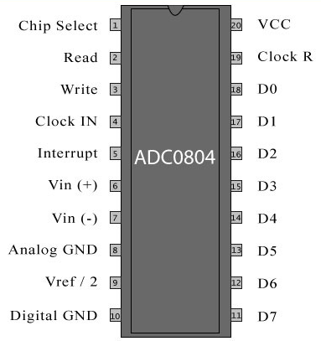
ADC 0804

Slide 36
Important Points on ADC 0804
V_{cc} It works with +5 volts and has a resolution of 8 bits.
Conversion time is another major factor in judging an ADC.
a. Conversion time is defined as the time it takes the ADC to convert the analog input to a digital (Binary) number.
b. In ADC804 conversion time varies depending on the
clocking signals applied to CLK R and CLK IN pins, but it
cannot be faster than 110 μs

Slide 37

3. CLK IN and CLK R
a. CLK IN is an input pin connected to an external clock source
b. To use the internal clock generator (also called self-
clocking), CLK IN and CLK R pins are connected to a
capacitor and a resistor, and the clock frequency is
determined by
Typical values are R = 10K ohms and C = 150 pF.
We get f = 606 kHz and the conversion time is 110 μs.

Slide 38
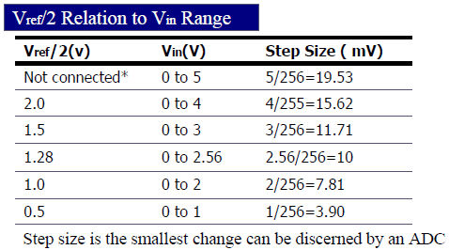
4. V_{Ref}/2: It is used for the reference voltage
If this pin is open (not connected), the analog input voltage is in the range of 0 to 5 volts (the same as the Vcc pin)
If the analog input range needs to be 0 to 4 volts, V_{Ref}/2 is connected to 2 volts

Slide 39
5. Analog ground and digital ground
Analog ground is connected to the ground of the analog Vin.
Digital ground is connected to the ground of the Vcc pin.
6. CS( Chip Select)
Chip select is an active low input used to activate the ADC0804 chip.
7. RD(Read)
This is an input signal and is active low. The ADC converts the analog input to its binary equivalent and holds it in an internal register. RD is used to get the converted data out of the ADC0804 chip. When CS=0, if a high-to-low pulse is applied to the RD pin, the 8-bit digital output can be read from D0-D7. The RD pin is also referred to as Output Enable(OE).

Slide 40
8. WR( Write , a better name might be “start of Conversion”)
This is an active low input used to inform the ADC0804 to start the conversion process. If CS=0, when WR makes a low-to-high transition, the ADC0804 starts converting the analog input value of V_{in} to an 8-bit digital number
9. INTR( Interrupt, a better name might be “End of Conversion”)
This is an output pin and is active low. It is normally high pin and when the conversion is completed, it goes low to signal the CPU that the converted data is ready to be picked up. After INTR goes low, we make CS=0 and send a high- to- low pulse to the RD pin to get the next analog data to be converted.

Slide 41
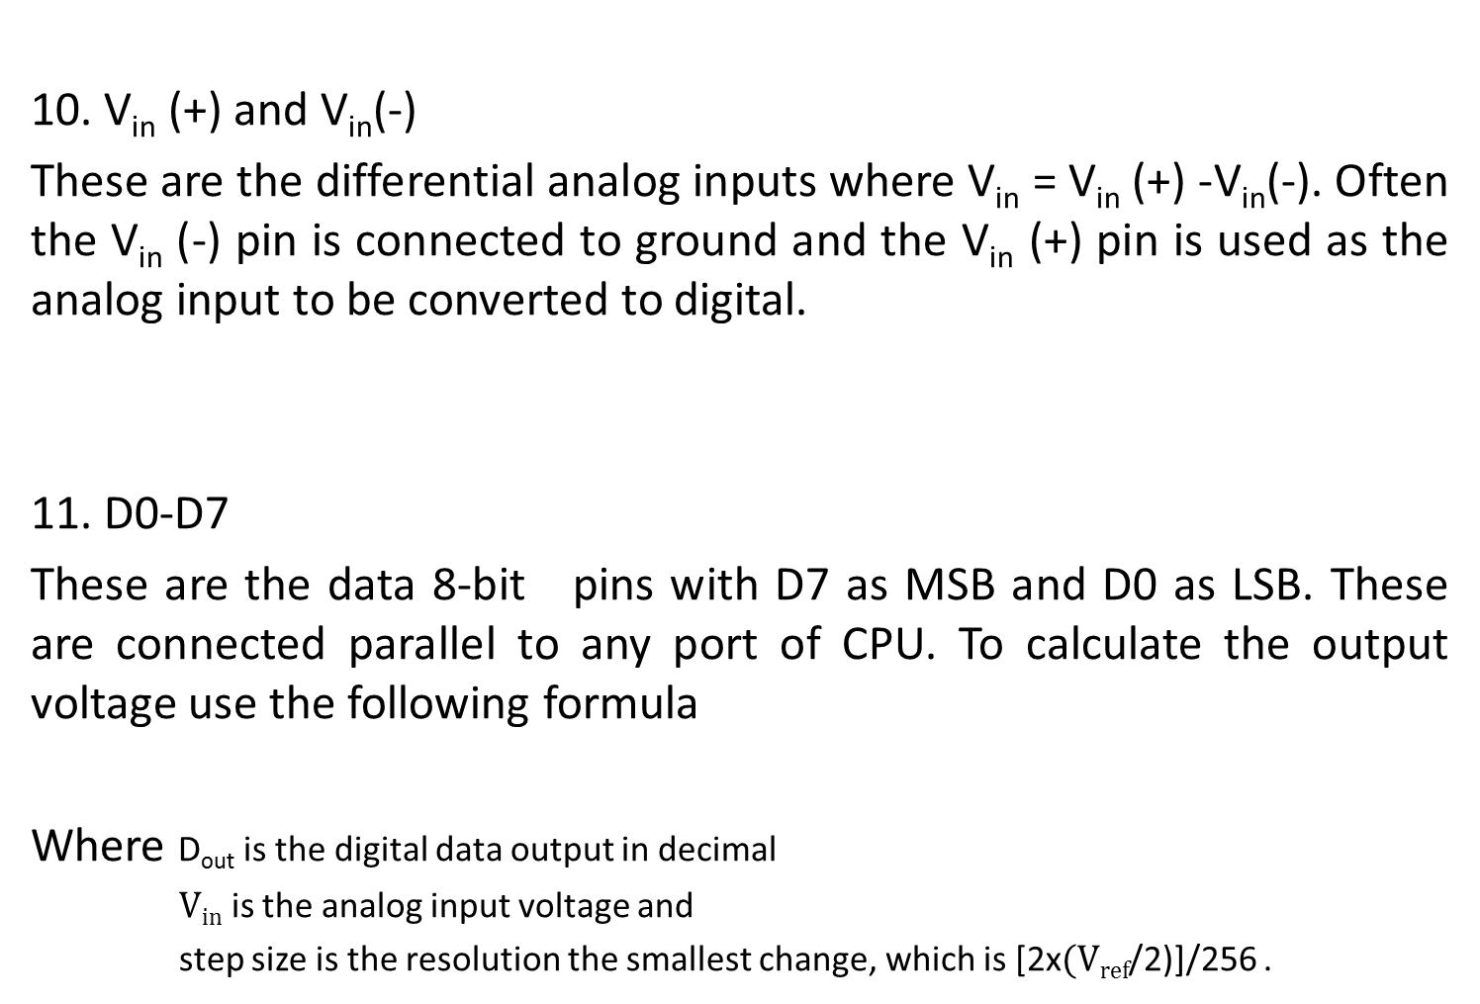


Slide 42
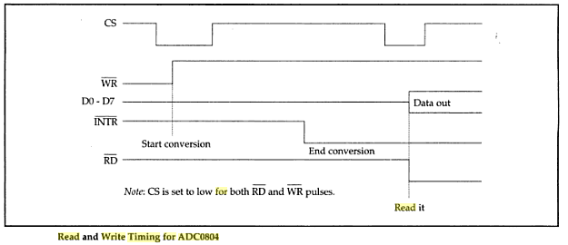
Timing diagram of ADC 0804

Slide 43
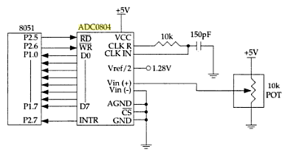
Interfacing circuit of ADC0804

Slide 44
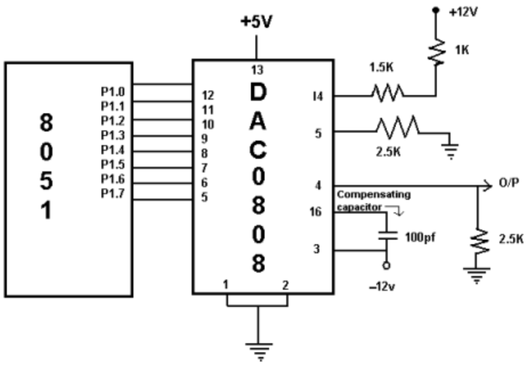
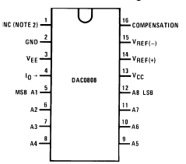
DAC(0808) INTERFACING

Slide 45
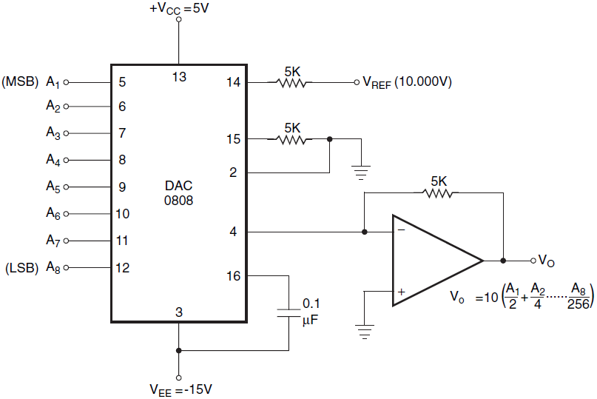
Interfacing Circuit of DAC 0808

Slide 46
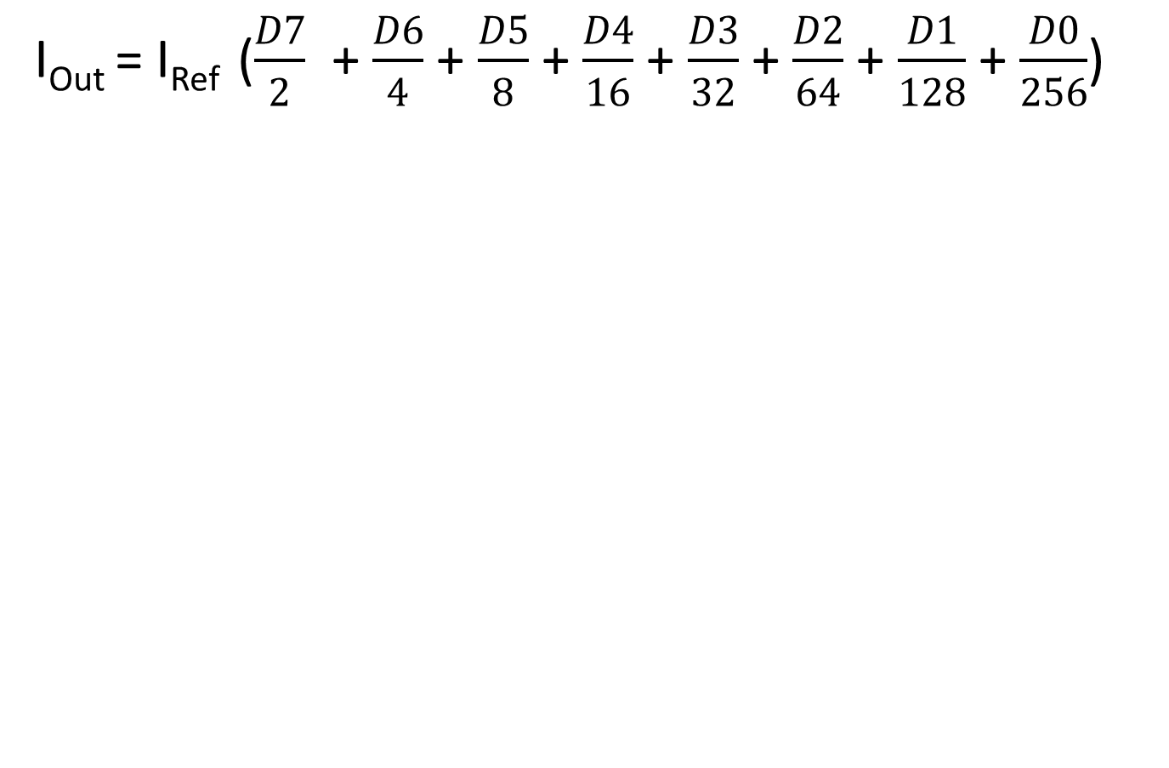
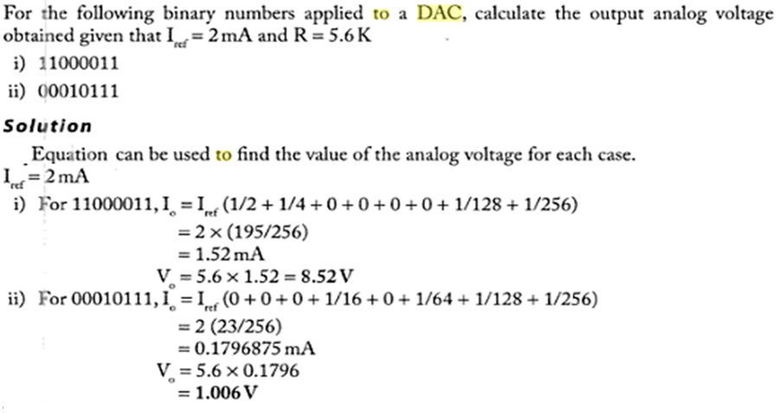

Slide 47
Specifications related to DAC
Resolution: It can be defined as a smallest change in the output corresponding to an input change by one LSB.
Accuracy: This is the measure of the difference between the actual output voltage & the expected output voltage.
Full scale output voltage: This is the output voltage when binary input has the highest value. For ex: 8-bit 5V DAC have max voltage 5V-19.5mv= 4.9805V.

Slide 48
Generating Staircase waveform
      ORG 0H
      START: CLR A
      AGAIN: MOV P1,A ;Send data to DAC
      INC A ;count from 0h to FFh
      ACALL DELAY ;Let DAC recover
      CJNE A,#0FFH,GO
      SJMP START
      GO: SJMP AGAIN
      DELAY: MOV R0,#0FFH
      LOOP: DJNZ R0,LOOP
      RET
      END

Slide 49
Generating Triangular waveform
      ORG 0H
      START0to1: CLR A
      AGAIN1: MOV P1,A ;Send data to DAC
      INC A ;count from 0h to FFh
      ACALL DELAY ;Let DAC recover
      CJNE A,#0FFH,GO1
      SJMP START1to0
      GO1: SJMP AGAIN1
      START1to0: MOV P1,A
      DEC A
      ACALL DELAY
      CJNE A,#00H,GO2 DELAY: MOV R0,#0FFH
      SJMP START0to1 LOOP: DJNZ R0,LOOP
      GO2: SJMP START1to0 RET
      END

Slide 50
Generating Sine waveform
To generate a sine wave , we first need a table whose values represent the magnitude of the sine of angles between 0^{0 &} 360⁰ The values for the sine function vary from -1.0 to +1.0 for 0^{0 &} 360⁰ angles. Therefore, the table values are integer numbers representing the voltage magnitude for the sine of theta (θ). To generate sine wave we assume the full scale voltage of 10V for DAC output. Full scale output of the DAC is achieved when all the data inputs of the DAC are high. Therefore, to achieve the full scale 10V output, we use the following equation.
V_{Out} = 5V + ( 5 X Sin θ)

Slide 51
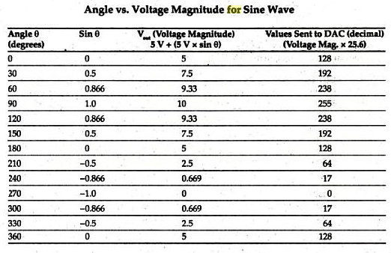

Slide 52
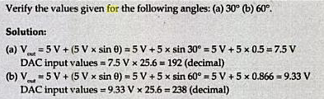
Example

Slide 53
Program
ORG 0H
MOV DPTR,#TABLE
MOV R2,#COUNT
BACK: CLR A
MOVC A,@A+DPTR
MOV P1,A
INC DPTR
DJNZ R2,BACK
SJMP AGAIN
ORG 0300H
TABLE: DB 128,192,238,255,238,192,128,64,17,0,17,64,128

Slide 54
Representation of Sine waveform
Volts
10
9
8
7
6
5
4
3
2
1
0 30 60 90 120 150 180 210 240 270 300 330 360 Degrees

