Slide 1

ARTIFICIAL INTELLIGENCE
&
MACHINE LEARNING
SESSION NO : 20
Feature selection methods (mutual information, information gain, Fisher score).

Slide 2
Feature Selection Methods
In data science many times we encounter vast of features present in a dataset.
But it is not necessary all features contribute equally in prediction that's where feature selection comes.
It involves selecting a subset of relevant features from the original feature set to reduce the feature space while improving the model’s performance by reducing computational power.

Slide 3
Feature Selection Methods
1. Filter Methods
Filter methods evaluate each feature independently with target variable.
Feature with high correlation with target variable are selected as it means this feature has some relation and can help us in making predictions.
These methods are used in the preprocessing phase to remove irrelevant or redundant features based on statistical tests (correlation) or other criteria.

Slide 4
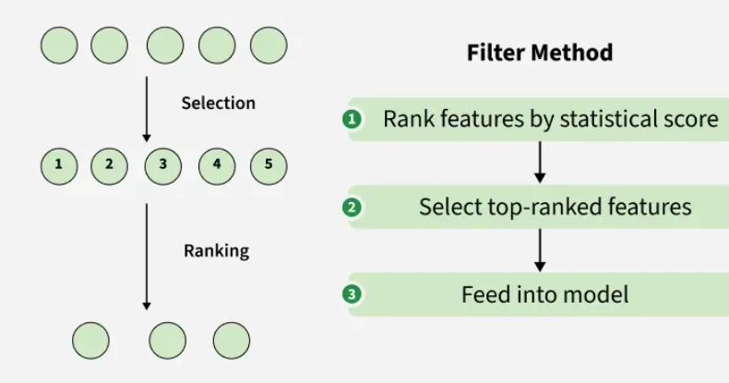
Filter Methods

Slide 5
Feature Selection Methods
Some techniques used are:
Information Gain
Chi-square test
Fisher’s Score
Pearson’s Correlation Coefficient
Variance Threshold
Mean Absolute Difference:
Dispersion ratio

Slide 6
Attribute Selection Measure: Information Gain
Select the attribute with the highest information gain
Let p_{i} be the probability that an arbitrary tuple in D belongs to class C_{i}, estimated by |C_{i, D}|/|D|
Expected information (entropy) needed to classify a tuple in D:
Information needed (after using A to split D into v partitions) to classify D:
Information gained by branching on attribute A
Notes:
I : the expected information needed to classify a given sample
E (entropy) : expected information based on the partitioning into subsets by A

Slide 7
Attribute Selection: Information Gain
Class P: buys_computer = “yes”
Class N: buys_computer = “no”
means “age <=30” has 5 out of 14 samples, with 2 yes’es and 3 no’s. Hence
Similarly,

Slide 8
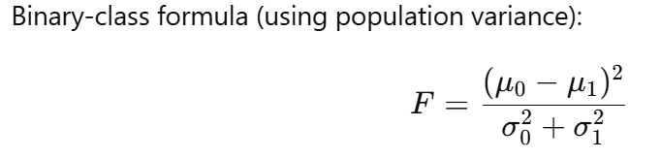
Fisher Score
The Fisher Score is a simple used to select important features for classification tasks. It works by comparing how much a feature varies between different classes versus how much it varies within the same class. Features that show big differences between classes, but are consistent within each class, are considered useful for classification.

Slide 9
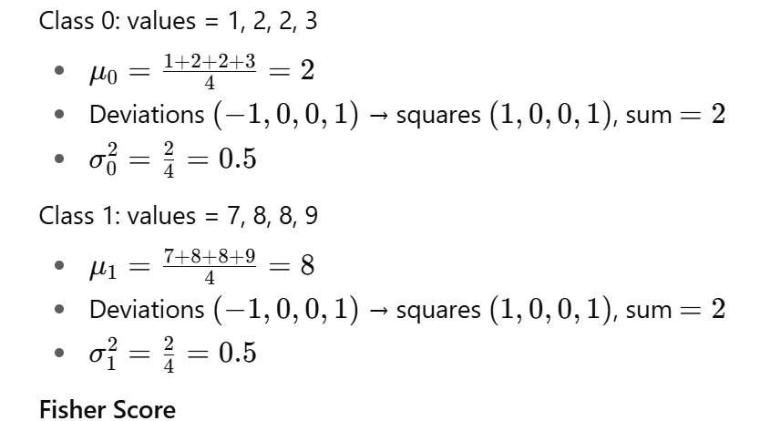
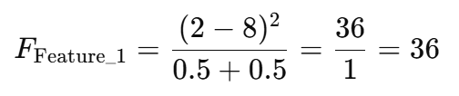
Fisher Score
Feature 1
Sample | Feature_1 | Feature_2 | Class
S1 | 1 | 4 | 0
S2 | 2 | 5 | 0
S3 | 2 | 5 | 0
S4 | 3 | 6 | 0
S5 | 7 | 5 | 1
S6 | 8 | 5 | 1
S7 | 8 | 6 | 1
S8 | 9 | 6 | 1

Slide 10
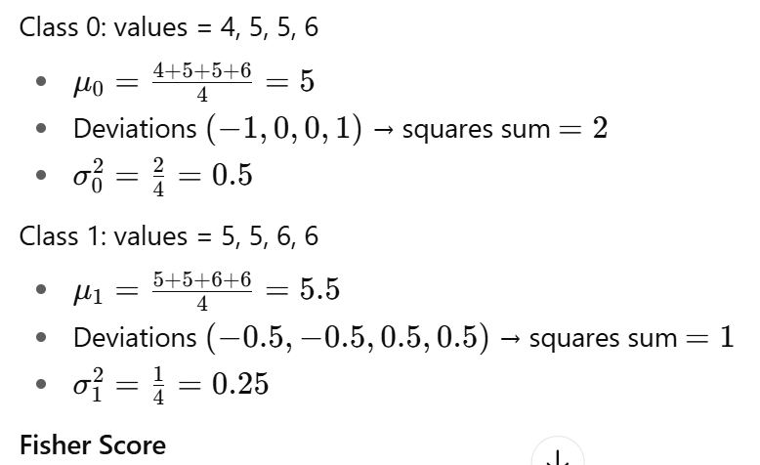
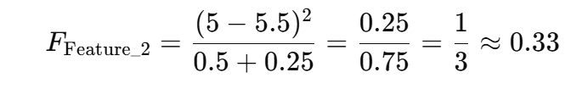
Fisher Score
Feature 2
Sample | Feature_1 | Feature_2 | Class
S1 | 1 | 4 | 0
S2 | 2 | 5 | 0
S3 | 2 | 5 | 0
S4 | 3 | 6 | 0
S5 | 7 | 5 | 1
S6 | 8 | 5 | 1
S7 | 8 | 6 | 1
S8 | 9 | 6 | 1

Slide 11
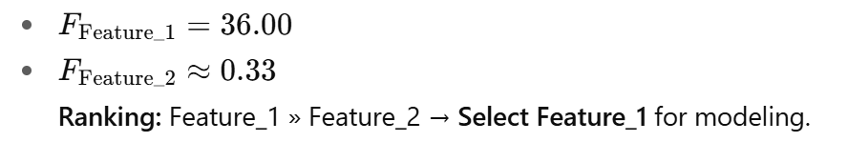
Fisher Score

Slide 12
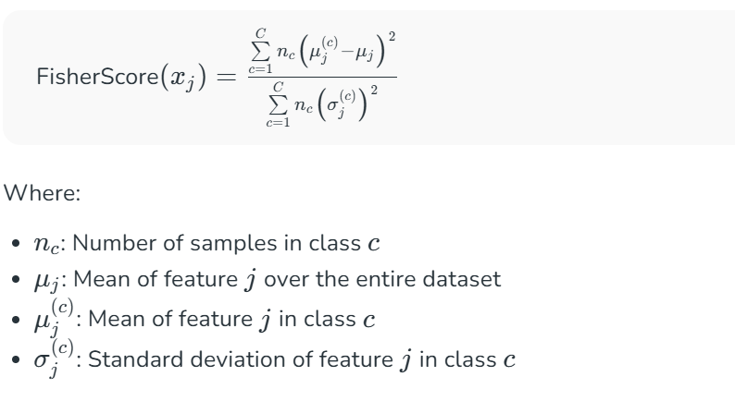
Fisher Score
For multi classes

Slide 13
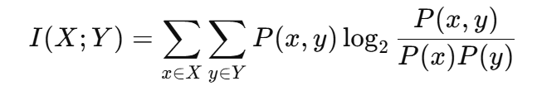
Mutual Information
Mutual information(MI)between two random variables is a non-negative value,which measures the dependency between the variables .It is equal to zero if and only if two random variables are independent ,and higher values mean higher dependency
In short, it is the amount of information one variable gives about the other.

Slide 14
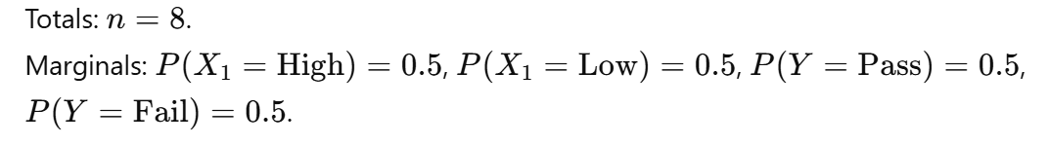
Mutual Information
ID | F1 | F2 | YY
1 | High | A | Pass
2 | High | A | Pass
3 | High | B | Pass
4 | High | B | Fail
5 | Low | A | Fail
6 | Low | A | Fail
7 | Low | B | Fail
8 | Low | B | Pass

Slide 15
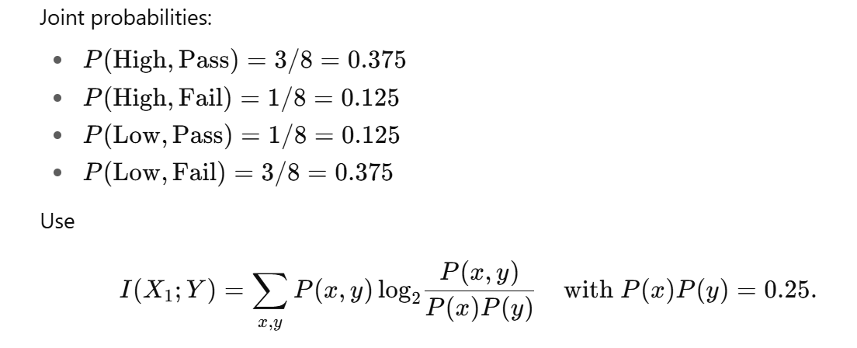
Mutual Information
MI of X1 with YY
ID | F1 | F2 | YY
1 | High | A | Pass
2 | High | A | Pass
3 | High | B | Pass
4 | High | B | Fail
5 | Low | A | Fail
6 | Low | A | Fail
7 | Low | B | Fail
8 | Low | B | Pass

Slide 16
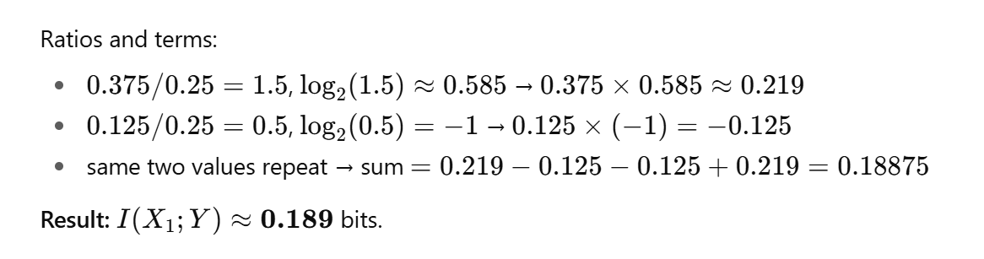
Mutual Information
MI of X1 with YY
ID | F1 | F2 | YY
1 | High | A | Pass
2 | High | A | Pass
3 | High | B | Pass
4 | High | B | Fail
5 | Low | A | Fail
6 | Low | A | Fail
7 | Low | B | Fail
8 | Low | B | Pass

Slide 17
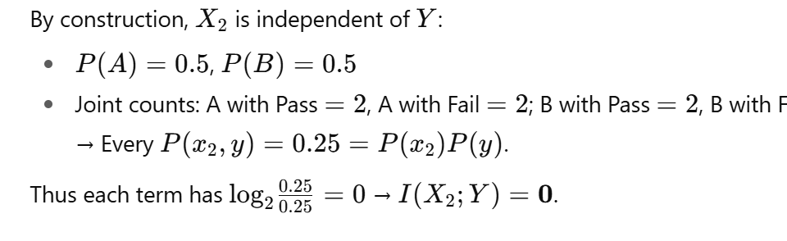
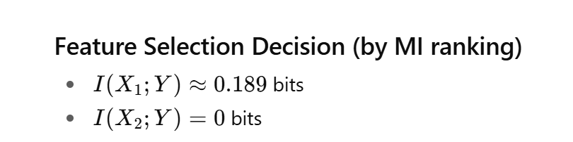
Mutual Information
MI of X2 with YY
ID | F1 | F2 | YY
1 | High | A | Pass
2 | High | A | Pass
3 | High | B | Pass
4 | High | B | Fail
5 | Low | A | Fail
6 | Low | A | Fail
7 | Low | B | Fail
8 | Low | B | Pass

Slide 18
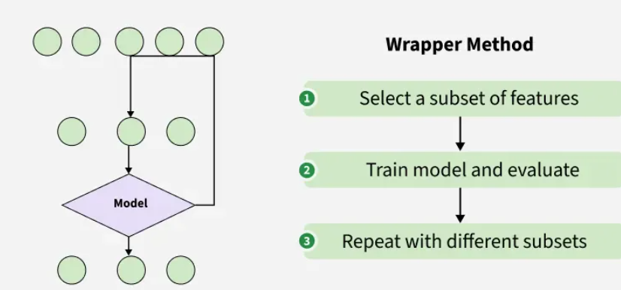
Wrapper methods
Wrapper methods are also referred as greedy algorithms that train algorithm. They use different combination of features and compute relation between these subset features and target variable and based on conclusion addition and removal of features are done.

Slide 19
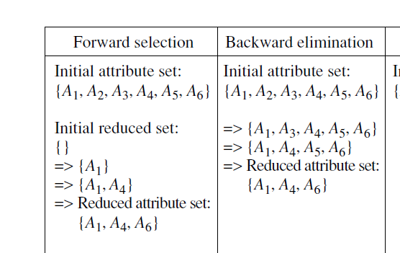
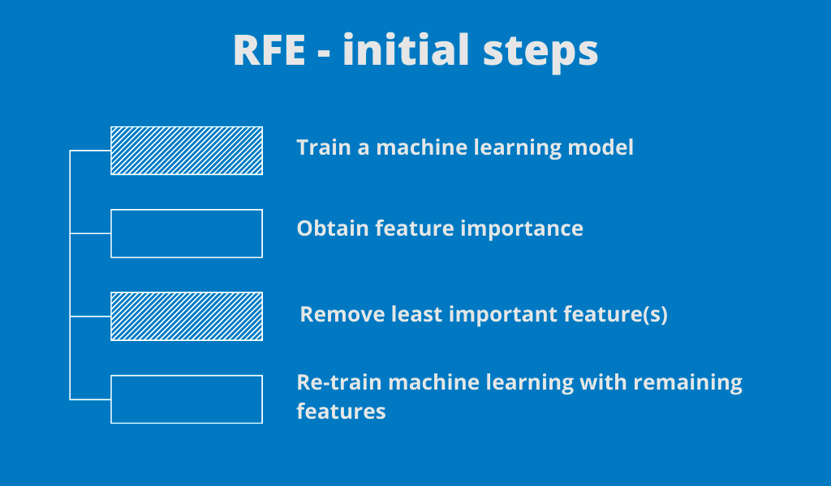
Wrapper methods
Forward selection
Backward elimination
Recursive elimination

Slide 20

THANK YOU

