Slide 1

Department of ECE
Analog electronic Circuit Design (24ec2104)
Topic:
Active Filters-1

Slide 2
Session Content
Aim – Objectives – Outcomes
Introduction
Filters
Active Filters
Low Pass Filters
Summary
Example Problems
Self Assessment Questions
Terminal Questions
References

Slide 3



AIM OF THE SESSION
The aim of this session is to emphasize the significance of Operational Amplifier and to understand the basics of most important applications of Op-Amp such as, active filters.
INSTRUCTIONAL OBJECTIVES
This Session is designed to:
  Specify the importance/necessity of the active filters using Op-Amp.
  Describe the function of block diagram of active filters.
  Understand the schematic symbol of the active filters.
LEARNING OUTCOMES
At the end of this session, you should be able to:
  Explain the application of Op-Amp for active filters.
  Summarize the functioning of active filters applications.
  Identify the Pin configuration and importance of IC741 for active filters operation.

Slide 4
INTRODUCTION
Active filters are frequency-selective circuits that use active components, such as operational amplifiers (op-amps), along with passive components like resistors and capacitors to filter specific frequency ranges.
Typically operational amplifiers (op-amps) are used to amplify signals and provide the necessary gain.
Resistors and capacitors are used to determine the frequency response of the filter.
Low Pass Filter (LPF): Passes low-frequency signals while attenuating high-frequency signals.
High Pass Filter (HPF): Passes high-frequency signals while attenuating low-frequency signals.
Band Pass Filter (BPF): Passes a specific band of frequencies while attenuating frequencies outside this band.
Band Stop Filter (BSF) or Notch Filter: Attenuates a specific band of frequencies while passing frequencies outside this band.

Slide 5
Filters
Filter is a frequency selective circuit that passes signal of specified band of frequencies and attenuates the signals of frequencies outside the band.
Types of Filters
  Active Filter
  Passive Filter
Passive Filters
  Passive filters works well for high frequencies. But at audio frequencies, the inductors become problematic, as they become large, heavy and expensive.
  For low frequency applications, more number of turns of wire must be used which in turn adds to the series resistance degrading inductor’s performance i.e, low Q, resulting in high power dissipation.

Slide 6
Active Filters
Active filters used op-amp as the active element and resistors and capacitors as passive elements.
Some commonly used active filters
  Low pass filter
  High pass filter
  Band pass filter
  Band reject filter

Slide 7
Active filters use op-amp(s) and RC components.
Advantages over passive filters :
  Op-amp(s) provide gain and overcome circuit losses
  Increase input impedance to minimize circuit loading
  Higher output power
  Sharp cut-off characteristics can be produced simply and efficiently without bulky inductors.

Slide 8
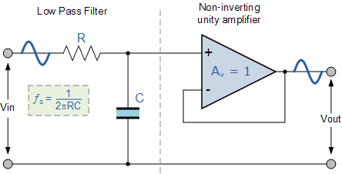
Active Low Pass Filter
The most common and easily understood active filter is the Active Low Pass Filter. Its principle of operation and frequency response is exactly the same as those for the previously seen passive filter, the only difference this time is that it uses an op-amp for amplification and gain control. The simplest form of a low pass active filter is to connect an inverting or non-inverting amplifier, the same as those discussed in the Op-amp tutorial, to the basic RC low pass filter circuit as shown.
First Order Low Pass Filter
This first-order low pass active filter, consists simply of a passive RC filter stage providing a low frequency path to the input of a non-inverting operational amplifier. The amplifier is configured as a voltage-follower (Buffer) giving it a DC gain of one, Av = +1 or unity gain as opposed to the previous passive RC filter which has a DC gain of less than unity.
The advantage of this configuration is that the op-amps high input impedance prevents excessive loading on the filters output while its low output impedance prevents the filters cut-off frequency point from being affected by changes in the impedance of the load.

Slide 9
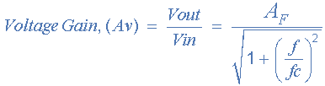
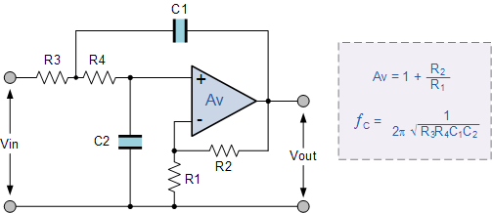
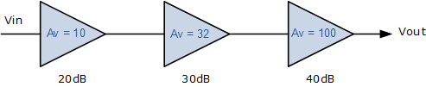
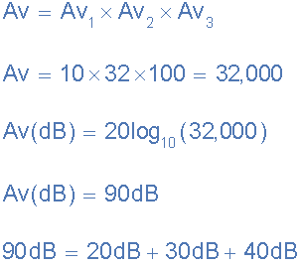
Second Order Low Pass Filter
When cascading together filter circuits to form higher-order filters, the overall gain of the filter is equal to the product of each stage.
For example, the gain of one stage may be 10 and the gain of the second stage may be 32 and the gain of a third stage may be 100. Then the overall gain will be 32,000, (10 x 32 x 100) as shown below.

Slide 10
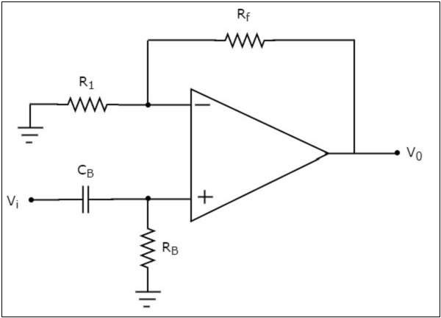
Active High Pass Filter
If an active filter allows (passes) only high frequency components and rejects (blocks) all other low frequency components, then it is called an active high pass filter.
The circuit diagram of an active high pass filter is shown in the following figure −
We know that the electric network, which is connected to the non-inverting terminal of an op-amp is a passive high pass filter. So, the input of a non-inverting terminal of op amp is the output of passive high pass filter.
Now, the above circuit resembles a non-inverting amplifier. It is having the output of a passive high pass filter as an input to non-inverting terminal of op-amp. Hence, it produces an output, which is (1+RfR1)(1+𝑅𝑓𝑅1) times the input present at its non-inverting terminal.
We can choose the values of Rf𝑅𝑓 and R1𝑅1 suitably in order to obtain the desired gain at the output.

Slide 11
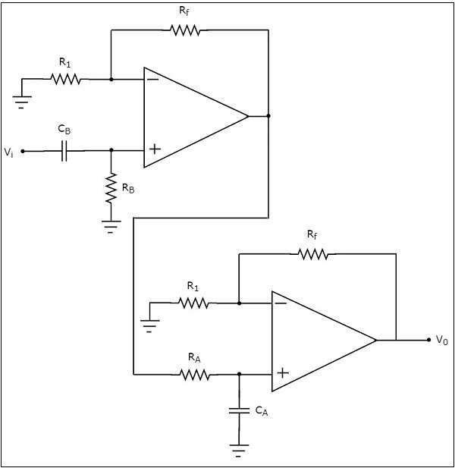
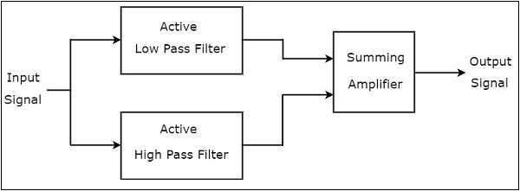
Active Band Pass Filter
If an active filter allows (passes) only one band of frequencies, then it is called as an active band pass filter. In general, this frequency band lies between low frequency range and high frequency range. So, active band pass filter rejects (blocks) both low and high frequency components.
The output of the active high pass filter is applied as an input of the active low pass filter. That means, both active high pass filter and active low pass filter are cascaded in order to obtain the output in such a way that it contains only a particular band of frequencies.
Active Band Stop Filter
If an active filter rejects (blocks) a particular band of frequencies, then it is called as an active band stop filter. In general, this frequency band lies between low frequency range and high frequency range. So, active band stop filter allows (passes) both low and high frequency components.

Slide 12
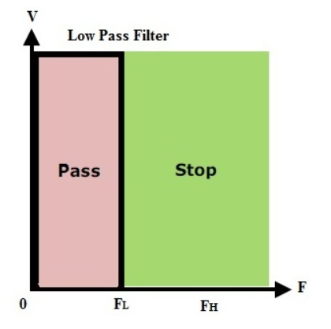
Low Pass Filters
Low pass filter is a filter which passes all frequencies from DC to upper cut-off frequency fH and rejects any signals above this frequency
In ideal case, the frequency response curve drops at the cut-off frequency. Practically the signal will not drop suddenly but drops gradually from transition region to the stop band region.
Cut-off frequency means the point where the response drops -3 dB or 70.7% from the pass band. Transition region means the area where falloff occurs.
The ideal response is shown:

Slide 13
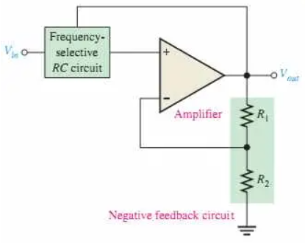
Active Filter
An active filter is a type of filter that includes one or more active circuit components such as a transistor or an operational amplifier (Op-Amp).
They derive their energy from an external source of energy and use it to increase or amplify the signal output.
Operational amplifiers adjust the filter’s output by narrowing or widening the bandwidth, creating a selective response to frequencies.
An Op-Amp has a high input impedance, a low output impedance and a voltage gain within its feedback loop arising from the mixture of the resistor.
Active filters, when used with careful circuit design, generate excellent performance features, very good precision with a steep roll-off and low noise.

Slide 14
Active Low Pass Filter
An Active Low Pass Filter only allows low-frequency signals to pass while blocking high frequencies, utilizing an Op-Amp that converts high impedance inputs to low impedance outputs.
The performance of the amplifier plays a very important factor when designing an active low pass filter.
There are two primary kinds of active low-pass filters namely switched capacitor type and continuous capacitor type.
The filters are available from first-order until the eighth order of design.
The circuit’s frequency response mirrors that of a passive RC filter, but with a passband voltage gain that boosts the output signal’s amplitude.
The passband begins from 0Hz or DC for a low pass filter and continues at -3dB to the designated cut-off point. Signals are attenuated beyond the cut off frequency. Active low pass filters are grouped according to the order of the filter. We will discuss 1st & 2nd order active low pass filters.

Slide 15
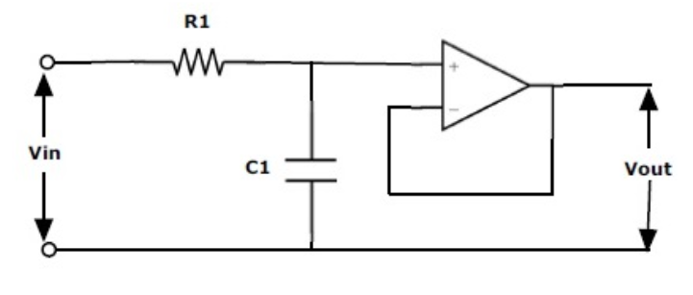
Active Low Pass Filter: The attenuation of the signal i.e. the amplitude of the output signal is lesser than amplitude of the input signal in the passive circuit. In order to overcome this disadvantage of passive filter, active filter is designed. A Passive Low Pass Filter connected to either inverting or non-inverting op-amp gives us a simple Active Low Pass Filter.
First order active filter is formed by a single op-amp with RC circuit. A simple RC Passive Filter connected to the non-inverting terminal of an operational amplifier is shown below.

Slide 16
Second Order Low Pass Filter
When cascading together filter circuits to form higher-order filters, the overall gain of the filter is equal to the product of each stage.
For example, the gain of one stage may be 10 and the gain of the second stage may be 32 and the gain of a third stage may be 100. Then the overall gain will be 32,000, (10 x 32 x 100) as shown below.

Slide 17

SUMMARY
Active filters are frequency-selective circuits that utilize active components such as operational amplifiers (op-amps) to achieve desired filtering characteristics.
They offer advantages like flexibility, precision, and ease of design compared to passive filters.
Active Filters: Employ op-amps and other active components for filtering.
Passive Filters: Rely solely on passive components like resistors, capacitors, and inductors.

Slide 18
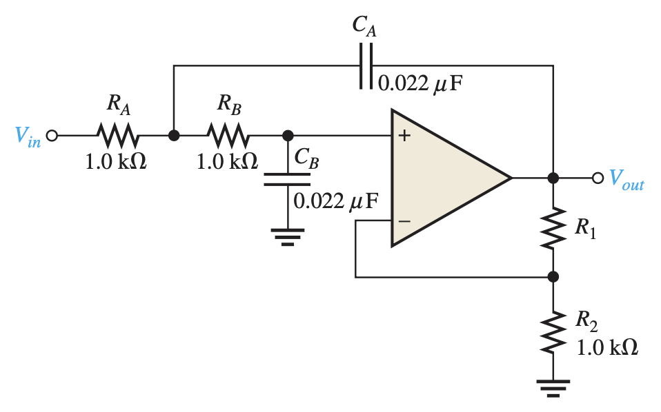
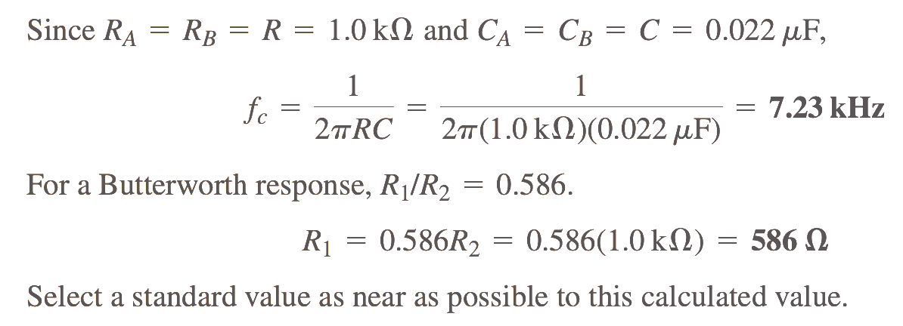
Example Problem
Problem:
Determine the critical frequency of the Sallen-Key low-pass filter in Figure, and set the value of R1 for an approximate Butterworth response.
Solution:

Slide 19
SELF-ASSESSMENT QUESTIONS
Active filters utilize:
Only passive components (resistors, capacitors, inductors).
Only active components (transistors, op-amps).
A combination of active and passive components.
None of the above.
Which of the following is NOT a basic type of passive filter?
Low-pass filter
Band-reject filter
All-pass filter
High-impedance filter

Slide 20
SELF-ASSESSMENT QUESTIONS
3. The cutoff frequency of a filter separates the:
Passband from the stopband.
DC component from the AC component.
High frequencies from the low frequencies.
All of the above.
4. To design a passive filter with a specific cutoff frequency, you would primarily adjust the values of:
Resistors only.
Capacitors only.
Inductors only.
Any combination of resistors, capacitors, and inductors.

Slide 21
ANSWERS
c
d
a
d

Slide 22
TERMINAL QUESTIONS
Describe the basic principle of operation of active filters and how they differ from passive filters.
Discuss the key advantages of using active filters in electronic circuits, including flexibility, precision, and ease of design.
Provide examples of real-world applications where active filters excel and explain how their active components contribute to their effectiveness.

Slide 23
REFERENCES FOR FURTHER LEARNING OF THE SESSION
Reference Books:
1. Op-Amps and Linear Integrated Circuit; 4th Ed., Gayakwad, Ramakant A.
Sites and Web links:
1. https://electronicsforyou.in/introduction-to-op-amp

Slide 24
THANK YOU
Team – ANALOG ELECTRONIC CIRCUIT DESIGN

