Slide 1

AY-2025-2026
ODD SEM
Department of ECE
Analog electronic Circuit Design
23ec2104
Topic:
Design of BJT amplifier
Session - 10

Slide 2
Session content
Design of BJT amplifier

Slide 3



AIM OF THE SESSION
To understand the principles and steps involved in designing BJT amplifiers, and to apply design techniques to achieve desired amplifier specifications such as gain, bandwidth, and stability.
INSTRUCTIONAL OBJECTIVES
The Session is designed to:
Explain the general approach for designing a BJT amplifier.
Select appropriate biasing techniques to ensure proper Q-point operation.
Design small-signal equivalent models for amplifier analysis.
LEARNING OUTCOMES
At the end of this session, learners will be able to:
Design a BJT amplifier circuit to meet specified requirements.
Determine suitable biasing components for thermal and operating point stability.

Slide 4
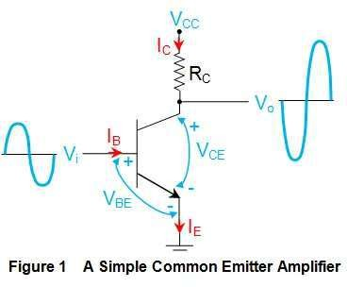
CE Amplifier Circuit
Collector terminal terminal) is connected
(output
to
supply voltage V_{CC} through the collector resistor R_{C}.
Base terminal is provided with the AC signal which needs to be amplified.
Emitter terminal is grounded
(hence also referred Grounded configuration).
to as Emitter

Slide 5
CE Amplifier Circuit
In this kind of arrangement, as the input voltage V_{i} increases, the base current I_{B} also increases which in turn increases the collector current I_{C}.
This causes an increase in the voltage drop across the collector resistor, R_{C} which results in a decreased output voltage V₀ as emphasized by the following relationship

Slide 6
CE Amplifier Circuit
Similarly as the input voltage goes on decreasing, I_{B} and hence I_{C} decrease, due to which the voltage drop across R_{C} also decreases thereby increasing the output voltage.
This indicates that for the positive half- cycle of the input waveform, one would get amplified negative half-cycle while for the negative input pulse, the output would be a amplified positive pulse. Hence there exists a phase-shift of 180º between the input and the output waveforms of the common emitter amplifier for which it is also referred to as Inverting Amplifier.

Slide 7
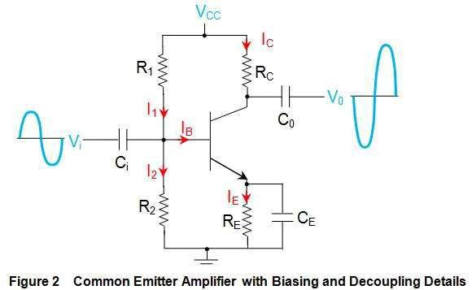
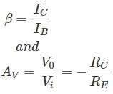

CE Amplifier Circuit
R1 and R2-Voltage Divider Bias
Ci and Co-Coupling Capacitor for blocks any DC Components and passes AC Signal for Amplification
Rc for Controlling Ic and
Provide Output Voltage.
RE provides biasing
stabilization.
CE
path
signal.
provides low reactance
to the amplified AC

Slide 8
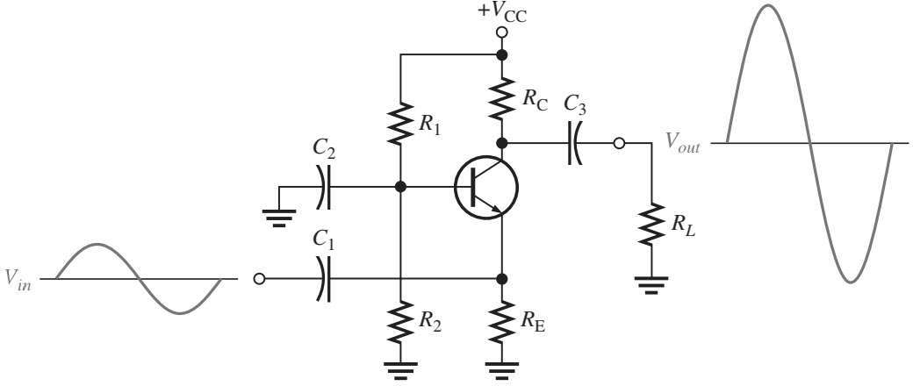
CB Amplifier Circuit

Slide 9
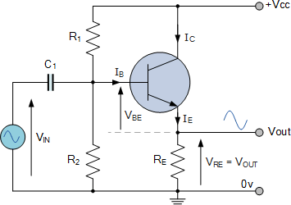
CC Amplifier Circuit(Emitter Follower)

Slide 10
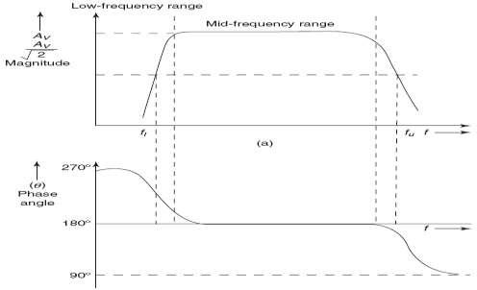
FREQUENCY RESPONSE FOR CE AMPLIFIER WITH AND WITHOUTSOURCE IMPEDANCE
At different frequencies of the input signal, the performance of the device is different. The analysis till now has been limited to the mid-frequency spectrum. Frequency response of an amplifier refers to the variation of the magnitude and phase of the amplifier with frequency.
Gain vs. frequency for a CE amplifier
Phase angle vs. frequency for a CE amplifier

Slide 11
Comparison of BJT Amplifier
Characteristics | CE Amplifier | CB Amplifier | CC amplifier (Emitter Follower)
Current Gain | High | Less Than Unity | High
Voltage Gain | High | High | Less Than Unity
Input Resistance | Medium | Lowest | Highest
Output Resistance | Moderately High | Highest | Lowest
Phase Shift between Input and Output | 180 ° | 0° | 0°
Application | For Audio Frequency Applications | For High Frequency Applications | For Impedance Matching

Slide 12
