Slide 1

AY-2025-2026
ODD SEM
Department of ECE
Analog electronic Circuit Design
23ec2104
Topic:
BJT Characteristics
Session - 02

Slide 2
Session content
CE CONFIGURATION
INPUT CHARACTERISTICS
OUTPUT CHARACTERISTICS
REGIONS OF BJT OPERATION

Slide 3



AIM OF THE SESSION
To demonstrate characteristics of BJT
INSTRUCTIONAL OBJECTIVES
This Session is designed to:
  Plot input characteristics of BJT
  Plot output characteristics of BJT
  Understand operating modes of BJT
LEARNING OUTCOMES
At the end of this session, you should be able to:
  Demonstrate input characteristics
  Demonstrate input characteristics
  Identify various modes of operation of BJT

Slide 4
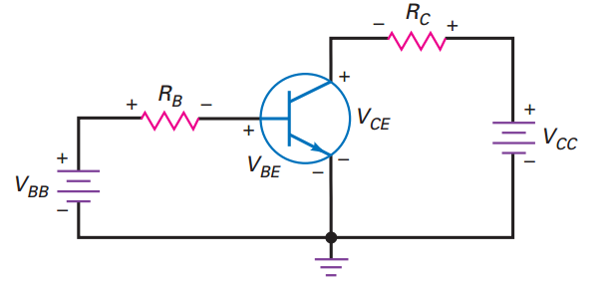
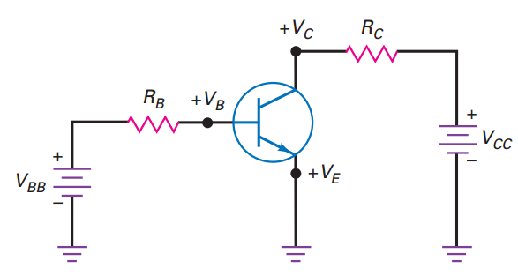
Common Emitter configuration
Fig. 2.1. depict the BJT configured for common emitter mode operation
Input voltage is applied across B-E junction with limiter resistance R_{B.}
Output loop consists of variable voltage V_{CC,} current limiter R_{C} and output voltage of the BJT across collector and emitter, V_{CE} For easiness to identify input loop and output loop the ground terminal is separated as shown in Fig. 2.2.
Fig. 2.1. CE configured BJT supplied with variable external voltages
Fig. 2.2. separation of ground terminal for ease of identification of input and output loops

Slide 5
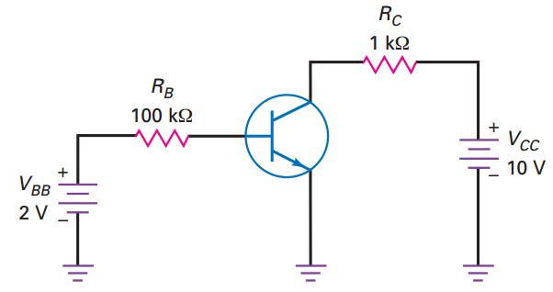
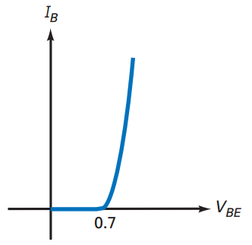
The Base Curve / Input Characteristics
Graph I_{B} versus V_{BE}
Like ordinary diode
Ohm’s law to Base loop
Ideal diode V_{BE} = 0 and second app. V_{BE} = 0.7 V
Fig. 2.3. Circuit operation to plot input characteristics
Fig. 2.4. Input characteristics of CE configured BJT

Slide 6
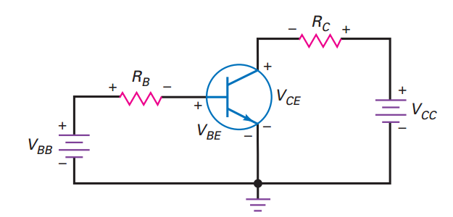
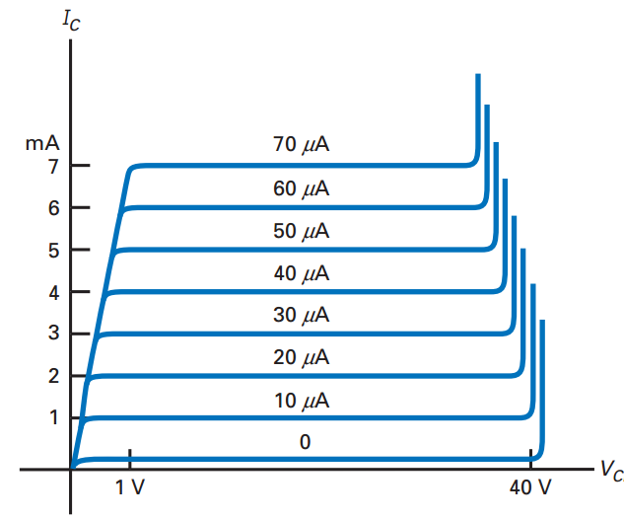
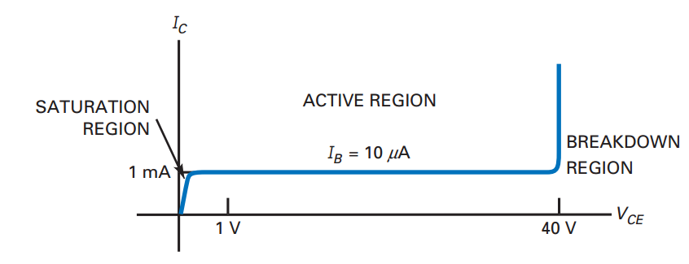
Collector Curve / output Characteristics
Graph I_{C} versus V_{CE}
Ohm’s low to Collector loop
Fixed value of based current, vary V_{CC} and measure I_{C} and V_{CE}
Fig. 2.5. Circuit operation to plot output characteristics
Fig. 2.7. Output characteristics of CE configured BJT for
Various values of input base current
Fig. 2.6. Output characteristics of CE configured BJT for fixed base current

Slide 7
Analogy with Transistor in Active
Region: Fluid-jet operated Valve
In active region this stopper does not really have
noticeable effect on the flow rate
Emitter Base Junction – FB
Collector Base Junction – RB
Fig. 2.8. Analogy of fluid jet operation to active region of BJT

Slide 8
Analogy with Transistor Cutoff
Fluid-jet operated Valve
Emitter Base Junction – RB
Collector Base Junction – RB
Fig. 2.9. Analogy of fluid jet operation to saturation region of BJT

Slide 9
Analogy with Transistor Saturation
Fluid-jet operated Valve
The valve is wide open; changing valve position a little bit
does not have much influence on the flow rate.
E-B Junction – FB
C-B Junction – FB
Fig. 2.10. Analogy of fluid jet operation to cut-off region of BJT

Slide 10
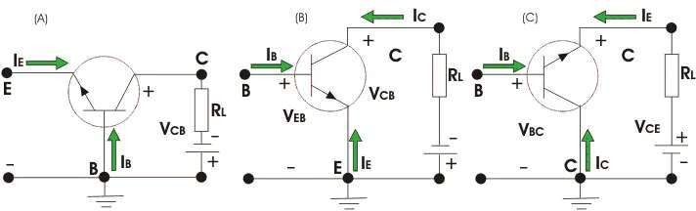
BJT

Slide 11
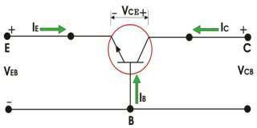
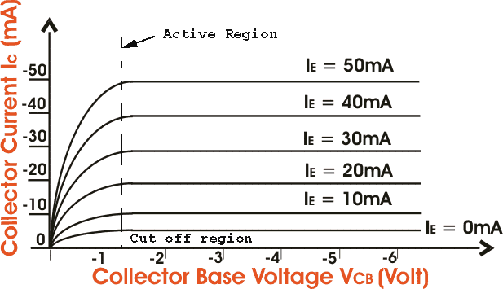
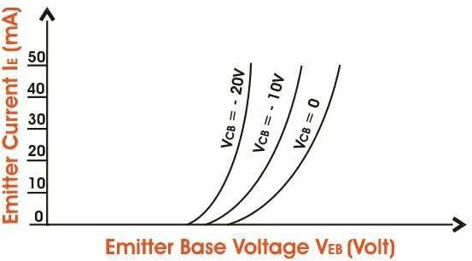
BJT
Common Base Characteristics Input Characteristics
Output Characteristics

Slide 12
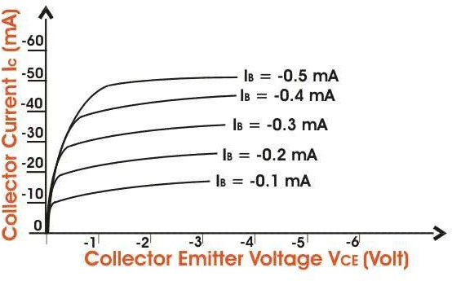
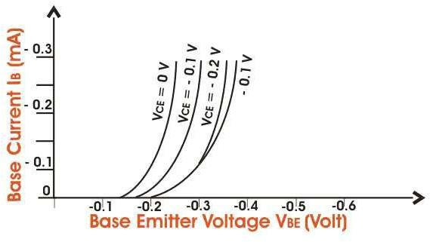
BJT
Common Emitter Characteristics Input Characteristics
Output Characteristics

Slide 13
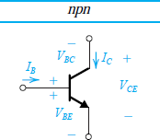
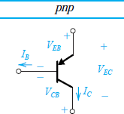
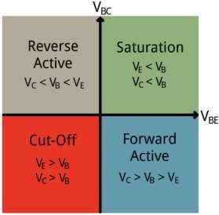
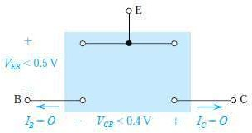

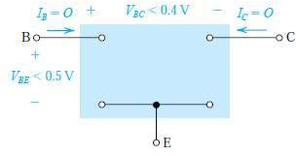
BJT Circuits at DC
Conditions and Models for the Operation of the BJT in Various Modes
Only DC Voltages are applied
Vbe=0.7 V and Vce=0.2 V

Slide 14
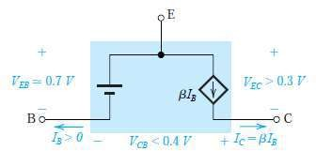
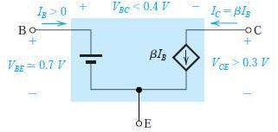

BJT Circuits at DC
Conditions and Models for the Operation of the BJT in Various Modes
Only DC Voltages are applied
Vbe=0.7 V and Vce=0.2 V

Slide 15

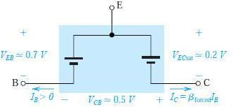

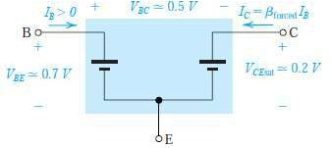
BJT Circuits at DC
Conditions and Models for the Operation of the BJT in Various Modes
Only DC Voltages are applied
Vbe=0.7 V and Vce=0.2 V

Slide 16
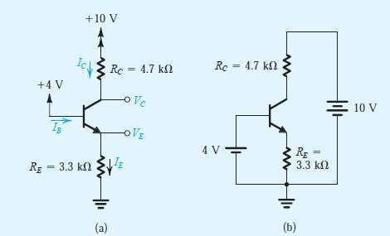
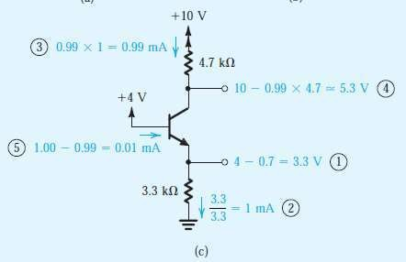
BJT Circuits at DC-Active Mode(Problems)
Example, β is specified to be 100.

Slide 17
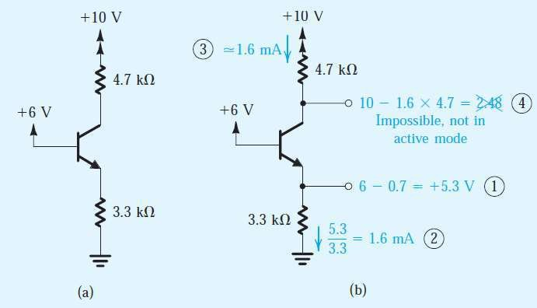
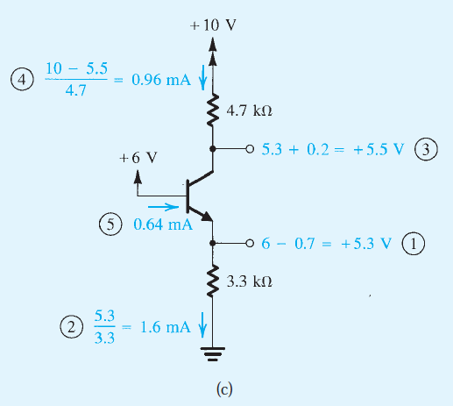
BJT Circuits at DC-Saturation Mode(Problems)
Example, β is specified to be ATLEAST OF 50.

Slide 18
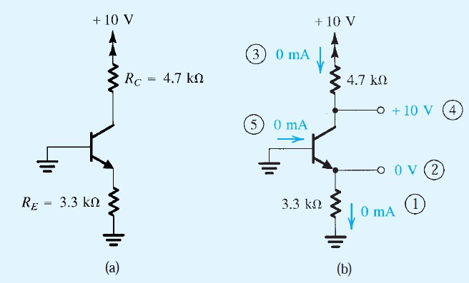
BJT Circuits at DC-Cutoff Mode(Problems)
Example

Slide 19
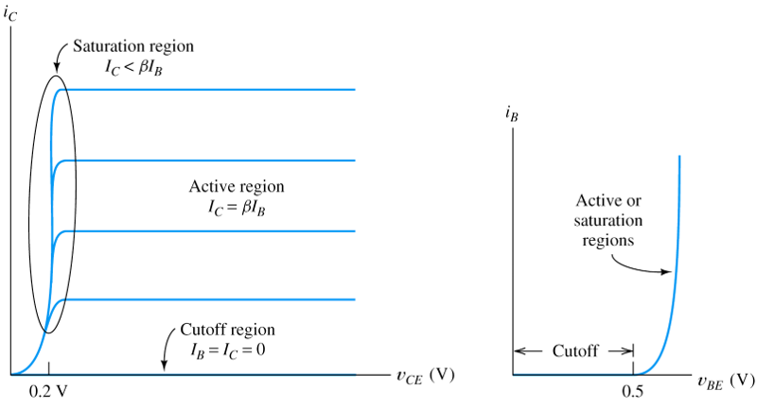
BJT operating regions
With the analogy discussed, the operation of BJT is driven in to any of the three regions with base current value.
For this reason, BJT is termed as current controlled current source.
BJT acts as controlled switch when continuously operated in cut off and saturation regions
BJT acts as an amplifier when driven in to active region
Fig. 2.11. Output and input characteristics of CE configured depicting possible operating regions
of BJT (active, saturation, cutoff)

Slide 20
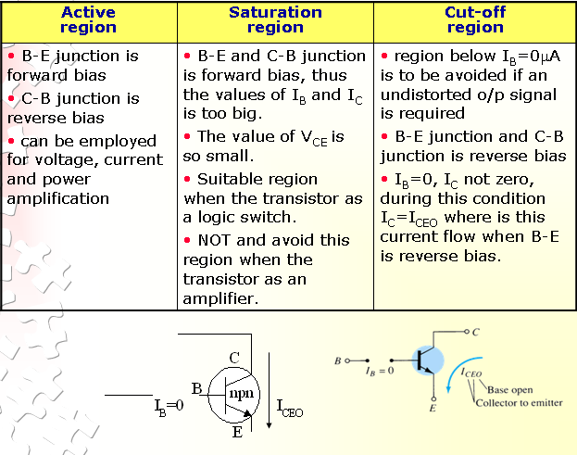
SuMMARY

Slide 21
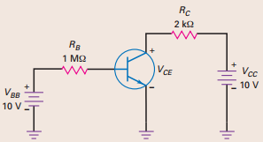
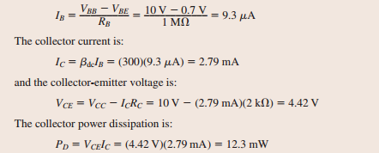
Example Problems
2.1 BJT shown in Fig. 2.12 has β_{DC} of 300. Calculate I_{B}, I_{C,} V_{CE} and P_{D}.
Solution:
Fig. 2.12. CE Configured BJT biased with external voltages

Slide 22
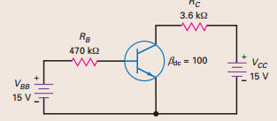
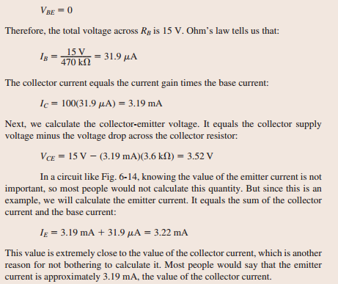
Example Problems
2.2 For the ideal BJT shown in Fig. 2.13 has β_{DC} of 100. Determine V_{CE}
Solution:
Fig. 2.13. CE Configured BJT biased with external voltages

Slide 23

SELF-ASSESSMENT QUESTIONS
BJT is modelled as
Voltage controlled voltage source
Current controlled voltage source
Current controlled current source
Voltage controlled current source
What is the current in BJT in cut-off region
β I_{B}
< β I_{B}
Zero

Slide 24
SELF-ASSESSMENT QUESTIONS
3. Which mode does BJT operate if B-E and B-C junctions are forward biased?
Saturation
Active
Cut-off
4. Which parameter shall be constant to plot input characteristics?
V_{CE}
V_{BE}
I_{C}
I_{B}

Slide 25
ANSWERS
C
C
A
A

Slide 26
TERMINAL QUESTIONS
Describe how to configure BJT in common emitter mode operation.
Discuss the input characteristics of BJT.
Discuss the output characteristics of BJT.
Draw output characteristics of BJT for various input base current values.
Derive the analogy between electron flow in BJT and jet flow in valve operated tube.
Identify the regions of operation of BJT

Slide 27
REFERENCES FOR FURTHER LEARNING OF THE SESSION
Reference Books:
Albert Malvino, David Bate, “Electronic Principles”
Robert L. Boylestad and Louis Nashelsky - “Electronic Devices and Circuit Theory”

Slide 28
THANK YOU
Team – Analog electronic Circuit Design
Prepared by – Mr. S. Ravi Teja

