Slide 1

AY-2025-2026
ODD SEM
Department of ECE
Analog electronic Circuit Design
24ec2104
Topic:
Voltage divider bias
Session - 05

Slide 2
Session content
Voltage Divider Bias Circuit
Equivalent Circuit
Analysis
Design of Bias

Slide 3



AIM OF THE SESSION
To demonstrate Biasing of BJT using Voltage Divider Bias
INSTRUCTIONAL OBJECTIVES
This Session is designed to:
  Demonstrate Voltage divider bias for BJT
  Select bias components
LEARNING OUTCOMES
At the end of this session, you should be able to:
  Describe voltage divider biasing circuit
  Design component values for desired operating point

Slide 4
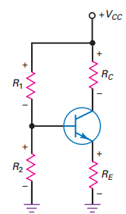
VOLTAGE DIVIDER BIAS
V_{CC}, R₁, R₂, and R_{C} control the saturation current and the cutoff voltage. A change in any of these quantities will change I_{C(sat)} and/or V_{CE(cutoff)}.
Once the designer has established the values of the foregoing variables, the emitter resistance is varied to set the Q point at any position along the load line.
If R_{E} is too large, the Q point moves into the cutoff point. If R_{E} is too small, the Q point moves into saturation. Usually designers set the Q point at the middle of the load line.
When we examine transistor amplifiers, the dc load line Q point will be adjusted from the middle of the dc load line to achieve maximum output signal.
Fig. 5.1. Voltage divider bias for BJT

Slide 5
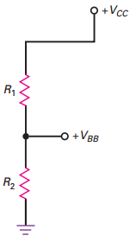

Thevenin's voltage at input terminals
Open the load terminals to obtain equivalent as shown in Fig. 5.2.
Now, Determine the open circuit voltage.
Applying series voltage division rule
Fig. 5.2. Voltage divider bias for BJT – Equivalent Thevenin’s voltage across base-ground terminals

Slide 6
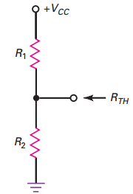
Thevenin's resistance at input terminal
Consider the terminals as shown in Fig. 5.3.
Now, Determine the Resistance seen through the terminal.
While finding equivalent resistance the idel voltage sources are short circuited. Therefore
R_{TH} = R₁ // R₂
Fig. 5.3. Voltage divider bias for BJT – Equivalent Thevenin’s Resistance across base-ground terminals

Slide 7
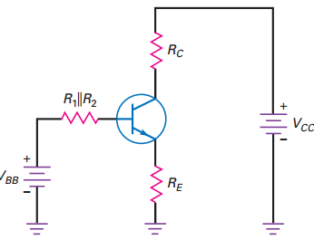
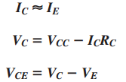

Analysis
Circuit Equations
Applying KVL in the input loop:
V_{BB} = I_{B} R_{TH} + V_{BE} + I_{E} R_{E}
Now, I_{B}= I_{E}/β_{DC}
Therefore,
Applying KVL in the output loop:
Fig. 5.4. Voltage divider bias for BJT – Equivalent circuit with Thevenin’s equivalent in input loop

Slide 8
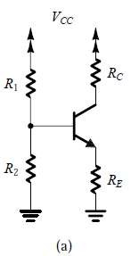
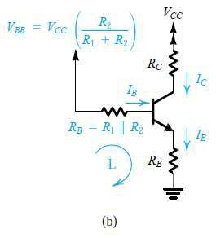
Self Bias/Voltage Divider Bias
The arrangement most commonly used for biasing a discrete-circuit transistor amplifier if only a single power supply is available.
The technique consists of supplying the base of the transistor with a fraction of the supply voltage VCC through the voltage divider R1, R2.
In addition, a resistor RE is connected to the
Classical biasing for BJTs using a single power supply: (a) circuit;
(b) circuit with the voltage divider supplying the base replaced with its Thévenin equivalent.
emitter.

Slide 9
Self Bias/Voltage Divider Bias
⎛
R
⎞
V =
2
⎟
V CC ⎜
BB
⎜
R R
⎟
⎝
+
2 ⎠
1
⎛ _{R1R} ⎞
R
₌ ⎜ 2 ⎟
⎜ _{R + R} ⎟
B
⎝
1
2 ⎠
Classical biasing for BJTs using a single power supply: (a) circuit;
(b) circuit with the voltage divider supplying the base replaced with its Thévenin equivalent.

Slide 10
Self Bias/Voltage Divider Bias
The current IE determined by
can be
writing a
Kirchhoff loop equation for the base–emitter– ground loop, labeled L, and substituting
I_{E}
β +1
I =
B
= I_{B}R_{B} +_{V BE} + I_{E}R_{E}
^{V}BB
₌ ⎛ I_{E} ⎞_{R}
V
+ + I R
BB
⎜ β +1⎟
⎝ ⎠
B
V BE
E E
₌ V BB ⁻V BE
Classical biasing for BJTs using a single power supply: (a) circuit; I
(b) circuit with the voltage divider supplying the base replaced
with its Thévenin equivalent.
E
₊ R_{B}
R
E
β +1

Slide 11
Self Bias/Voltage Divider Bias
V_{BB} = V_{BE} + I_{B}R_{B} + I_{E}R_{E}
^{V}BE ^{V}BE
= V_{BB} - I_{B}R_{B} − (I_{B} + I_{C} )R _{E}
= V_{BB} - I_{B} (R _{B} + R_{E} ) − I_{C}R_{E}
^{V}CE
= V_{CC} - I_{C}R_{C} − I_{E}R_{E}
Classical biasing for BJTs using a single power supply: (a) circuit;
(b) circuit with the voltage divider supplying the base replaced with its Thévenin equivalent.

Slide 12
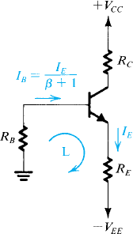
Self Bias/Voltage Divider Bias
Biasing the BJT using two power supplies. Resistor RB is needed only if the signal is to be capacitively coupled to the base.
Otherwise, the base can be connected directly to ground, or to a grounded signal source, resulting in almost total β -independence of the bias current.
₌ V EE ⁻V BE
I
E
R
R_{E} + _{β}
B
+1

Slide 13
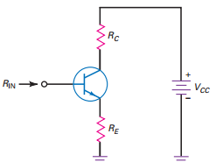
DESIGN OF VOLTAGE DIVIDER BIAS
The circuit is biased for VCE to be at a midpoint value with a specified collector current. Start by making the emitter voltage approximately one-tenth of the supply voltage:
Design for a stiff voltage divider using the 100 :1 rule:
V_{E} = 0.1 V_{CC}
calculate the value of R_{E} to set up the specified collector current
R_{E} = V_{E}/I_{E}
Since the Q point needs to be at approximately the middle of the dc load
line, about 0.5V_{CC} appears across the collector-emitter terminals. The remaining
0.4 V_{CC} appears across the collector resistor; therefore:
Fig. 5.5. Input Resistance seen by source terminals
R_{TH} <= 0.01 β_{dc} R_{E} Usually, R₂ is very small, therefore
R_{C} = 4 R_{E}
R₂ <= 0.01 β_{dc} R_{E} and R₁ = (V₁/V₂)R₂

Slide 14
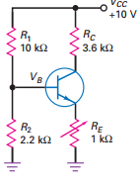
Example Problems
5.1 Calculate the Q-point for voltage divider bias as shown in Fig. 5.6 for R_{E}= 1 kΩ, and 2.2 kΩ, and 510 Ω Consider β_{DC} of BJT to be 100.
Solution:
Considering I_{E} ~ I_{C} and
Now, I_{E} = 1.08 mA
And V_{E} = I_{E}R_{E} = 1.08 mA * 1 kΩ = 1.08 V
V_{CE} = V_{CC}- I_{C}R_{C}-V_{E} = 10-(1.08 mA * 3.6 kΩ)-1.08 =5.032 V
Similarly, for R_{E}= 2.2 kΩ, the Q-point is ( 7.12 V,0.495 mA). It is observed that Q-point is moved down on load line.
And for R_{E}= 2.2 kΩ, the Q-point is ( 1.45 V, 2.08 mA). It is observed that Q-point is moved up on load line.
Fig. 5.6. Voltage Divider Bias

Slide 15
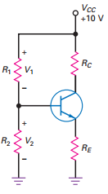

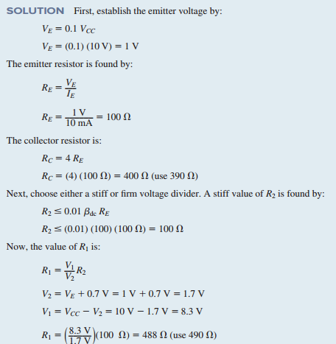
Example Problems
5.2. Design voltage divider bias for circuit shown in Fig. 5.7 to meet the following specifications
Fig. 5.7. Voltage divider for BJT

Slide 16

SELF-ASSESSMENT QUESTIONS
Which Bias is suitable for Amplifier?
Emitter Bias
Base Bias
Collector feedback Bias
Voltage divider bias
Which of the following bias is less effected by Beta variation?
Voltage divider bias
Collector feedback bias

Slide 17
SELF-ASSESSMENT QUESTIONS
3. Which of the following is usual design for operating point voltge?
0.8 V_{CC}
0.2 V_{CC}
0.5 V_{CC}
0.1 V_{CC}
4. Operating point of the BJT does not depend on Current Gain
False
True

Slide 18
ANSWERS
D
A
C
A

Slide 19
TERMINAL QUESTIONS
Describe the operation of Voltage Divider bias. Sketch circuit and obtain operating point.
Describe the equivalent input loop circuit for voltage divider bias.
Obtain the input and output circuit equations for voltage divider bias.
Identify the circuit requirements to design voltage divider bias.
Develop the design steps to bias BJT in to middle point of load line using voltage divider bias.

Slide 20
REFERENCES FOR FURTHER LEARNING OF THE SESSION
Reference Books:
Albert Malvino, David Bate, “Electronic Principles”
Robert L. Boylestad and Louis Nashelsky - “Electronic Devices and Circuit Theory”

Slide 21
THANK YOU
Team – Analog electronic Circuit Design
Prepared by – Mr. S. Ravi Teja

