Slide 1

AY-2025-2026
ODD SEM
Department of ECE
Analog electronic Circuit Design
23ec2104
Topic:
Hybrid Model for BJT Configurations-CE
Session - 08

Slide 2
Session content
Hybrid Model for BJT Configurations-CE

Slide 3



AIM OF THE SESSION
To analyze and understand the Hybrid-π model for the Common Emitter (CE) configuration of a BJT and apply it in small-signal amplifier circuit analysis.
INSTRUCTIONAL OBJECTIVES
The Session is designed to:
Explain the concept of the Hybrid-π model for BJTs.
Identify the key elements of the Hybrid-π equivalent circuit.
Describe the role of each parameter (rπ, gm, ro) in CE configuration.
Apply the model to analyze small-signal behavior of CE amplifiers.
LEARNING OUTCOMES
At the end of this session, learners will be able to:
Construct the Hybrid-π equivalent circuit for a given BJT CE configuration.
Use the model to calculate small-signal parameters and performance metrics.
Understand how the base-emitter resistance (rπ) and transconductance (gm) influence signal gain.

Slide 4
Basic BJT Amplifier Configurations
Common-Emitter (CE) amplifier with emitter resistance
Common-Base (CB) amplifier
without and
Common-Collector (CC) amplifier or Emitter Follower

Slide 5
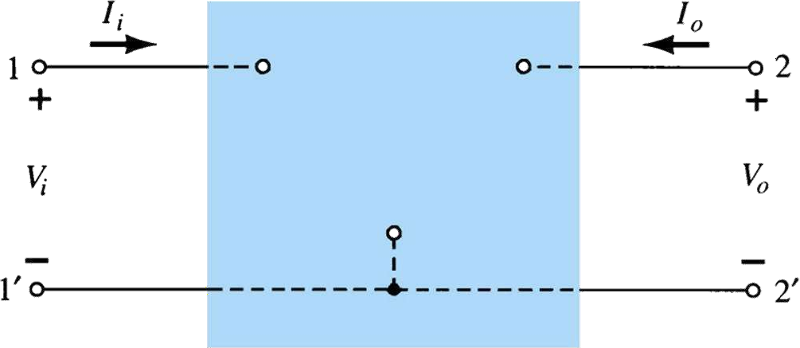
Hybrid Equivalent Model
V_{i} = Input
V_{o} = Output
Voltage Voltage
Port 1
(or)
Input Port
Port 2
(or)
Output Port
I = Input
Current Current
i
I_{o} = Output
Two -Port Network

Slide 6
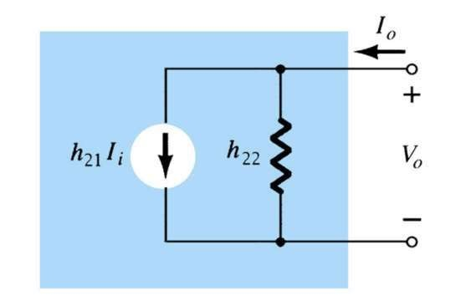
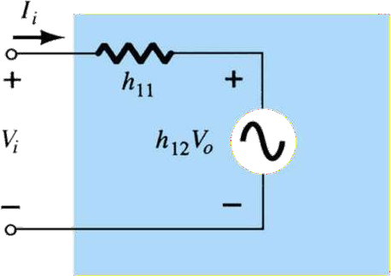
Determination of Hybrid Parameters
V_{i} = h₁₁I_{i} + h₁₂V_{o}
I_{O} = h₂₁I_{i} + h₂₂V_{o}

Slide 7
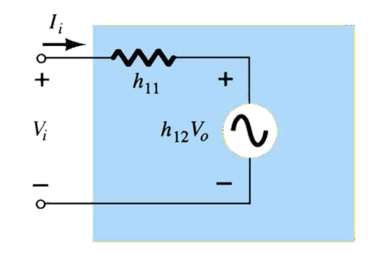
Determination of Hybrid Parameters
h₁₁ - Ω and h₂₂ – mhos h12, h21 – Dimension Less.
V_{i} = h₁₁I_{i} + h₁₂V_{o}
₌ V_{i}
h
= Input Impedance with output part short circuited( Ω)
11
I
i
V_{o} =0V
₌ V_{i}
h
= ReverseVoltage Transfer Ratio with input part open circuited
12
V
o
I_{i} =0V

Slide 8
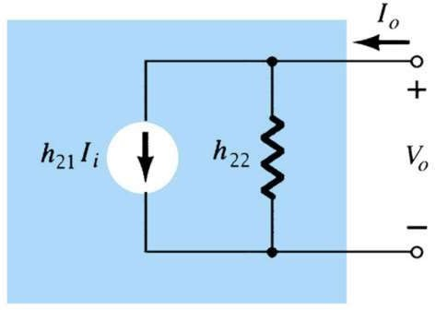
Determination of Hybrid Parameters
h₁₁ - Ω and h₂₂ – mhos
h12, h21 – Dimension Less.
I = h
I + h V
O
21 i
22 o
₌ I_{o}
h
= Forward Current Gain with output part short circuited
21
I
i
V_{o} =0V
₌ I_{o}
h
= Output Adm ittance with input part open circuited( mhos)
22
V
o
I_{i} =0A

Slide 9
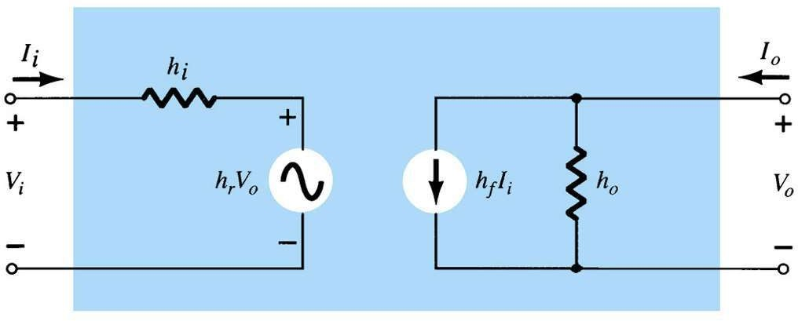
General h-Parameters for any Transistor Configuration
V_{i} = h_{i} I_{i} + h_{r} V_{o} I₂ = h_{f} I_{i} + h₀ V_{o}
hi = Input Resistance(Vi/Ii)
hr = Reverse Transfer Voltage Ratio (Vi/Vo) hf = Forward Transfer Current Ratio (Io/Ii) ho = Output Conductance(Io/Vo)

Slide 10
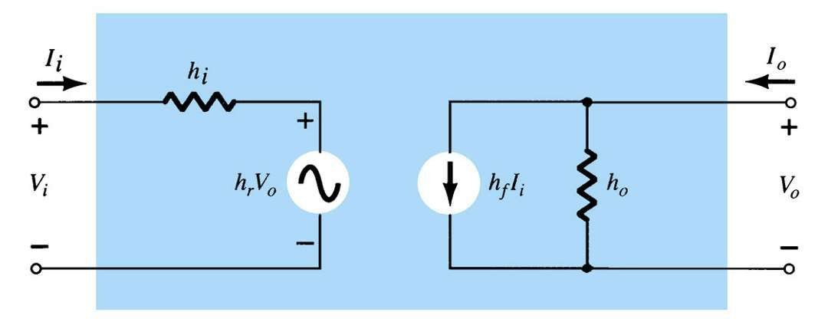
General h-Parameters for any Transistor Configuration
₌ I_{o}
h
f
I
i
V_{o} =0V
V_{i} = h_{i} I_{i} + h_{r} V_{o} I_{o} = h_{f} I_{i} + h₀ V_{o}
V
V
₌ I_{o}
V
h =
i
h =
i
h
i
I
r
V
o
i
V_{o} =0V
o
I_{i} =0 A
o
I_{i} =0 A

Slide 11
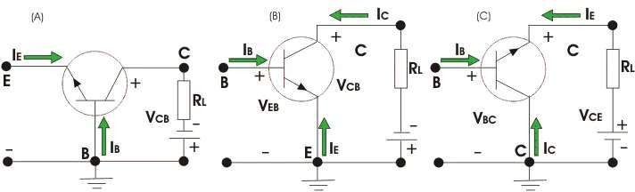
Three Basic Configurations of BJT Amplifier

Slide 12
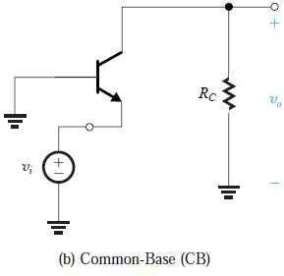
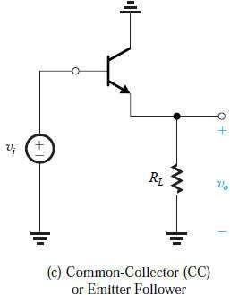
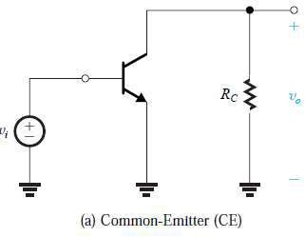
Three Basic Configurations of BJT Amplifier

Slide 13
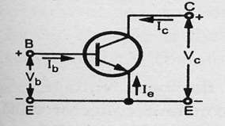
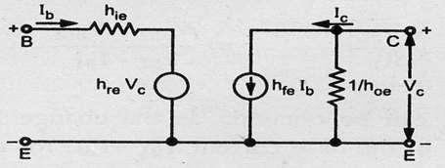
Hybrid Model for BJT Configurations-CE
v
h_{ie} = ^{b}
v
h _{re} = ^{b}
v_{b} = h_{ie}i_{b} + h_{re}v_{c}
i_{c} = h_{fe}i_{b} + h_{oe}v_{c}
i_{b}
v_{c}
V =0V
i_{b} =0 A
c
₌ i_{c}
₌ i_{c}
h
h
fe
i
oe
v
b
V_{c} =0V
^{c} i_{b} =0 A

Slide 14
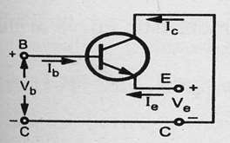
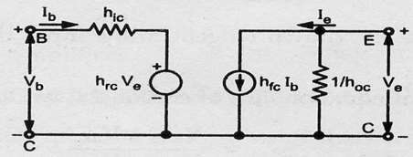
Hybrid Model for BJT Configurations-CC
v
h_{ic} = ^{b}
v
h _{rc} = ^{b}
v_{b} = h_{ic}i_{b} + h_{rc}v_{e}
i_{e} = h_{fc}i_{b} + h_{oc}v_{e}
i_{b}
v_{e}
V_{e} =0V
i =0 A
b
₌ i_{e}
₌ i_{e}
h
h
fc
i
oe
v
b
V_{e} =0V
^{e} i_{b} =0 A

Slide 15
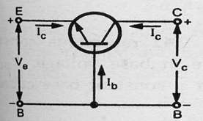
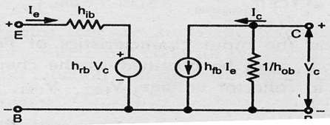
Hybrid Model for BJT Configurations-CB
v_{e} = h_{ib}i_{e} + h_{rb}v_{c}
i_{c} = h_{fb}i_{e} + h_{ob}v_{c}
₌ v_{e}
₌ v_{e}
h
h
ib
i
rb
v
c
V_{c} =0V
^{c} i_{e} =0 A
₌ i_{c}
₌ i_{c}
h
h
fb
i
ob
v
e
V_{c} =0V
^{c} i_{e} =0 A

Slide 16
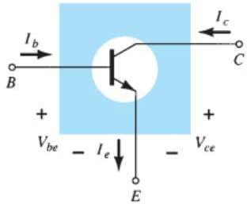
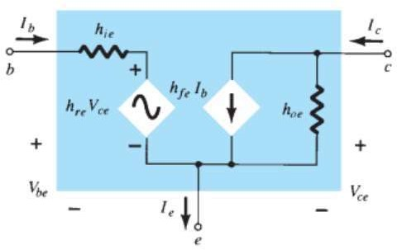
Hybrid Model for BJT Configurations-CE

Slide 17
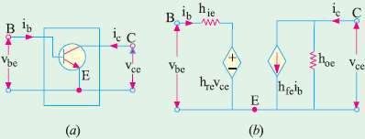

Hybrid Model for BJT Configurations-CE

Slide 18
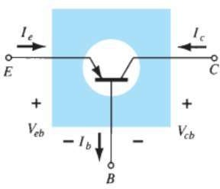
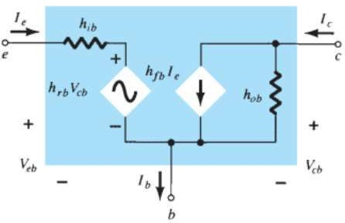
Hybrid Model for BJT Configurations-CB

Slide 19
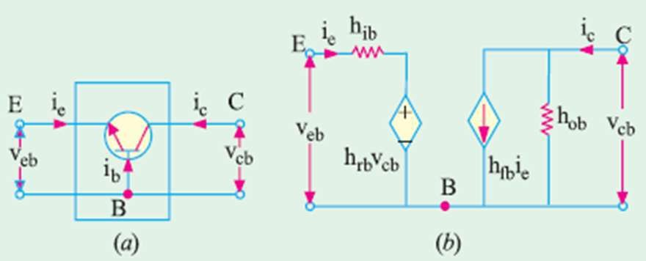

Hybrid Model for BJT Configurations-CB

Slide 20
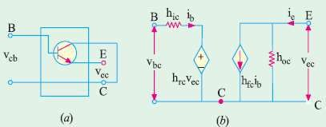

Hybrid Model for BJT Configurations-CC

Slide 21
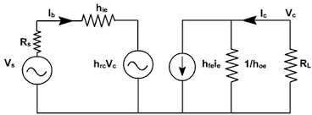
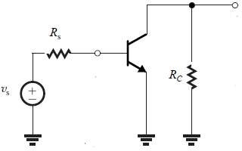
CE Amplifier Without Emitter Resistance
(Using Hybrid Model)
Determine :
Current Gain or Current Amplification A_{i}
Input Resistance R_{i}
Voltage Gain or Voltage Amplification A_{v}
Output Admittance Y₀
Output Resistance R_{o}

Slide 22
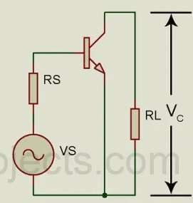
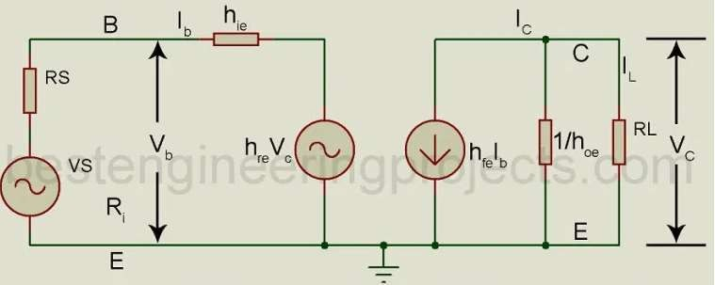
CE Amplifier Without Emitter Resistance
(Using Hybrid Model)
Determine :
Current Gain or Current Amplification A_{i}
Input Resistance R_{i}
Voltage Gain or Voltage Amplification A_{v}
Output Admittance Y₀
Output Resistance R_{o}

Slide 23
CE Amplifier Without Emitter Resistance
(Using Hybrid Model)_{i}
i
A_{i} = ^{L} = −
c
ib ib
ic ⁼ hfeib ⁺ hoe vc
vc ⁼ iL RL ⁼ ⁻ic RL
ic ⁼ hfeib ⁺ hoe ⁽⁻ ic RL ⁾
Current Gain or Current Amplification:
Current gain is defined as the ratio of the load current I_{L} to the input current I_{b}.
(1+
)=
i
h R
h i
c
oe L
fe b
h fe
¹⁺hoe RL
i
A
=
c
=−
i
i
b

Slide 24
CE Amplifier Without Emitter Resistance
(Using Hybrid Model)
Input Resistance R_{i}
v
R =
b
i
i
b
vb ⁼ hie ib ⁺ hre vc
i i
But, A = −
ic
i i_{b}
vc ⁼ iL RL ⁼ ⁻ic RL ⁼ Ai ib RL
c
⇒ = −A
i
b
vb ⁼ hie ib ⁺ hre ⁽Ai ib RL⁾
v
( +
)
⇒
R
=
=
h h A R
vb
ib hie
hre Ai RL
b
+
=
ib
i
ie re i L

Slide 25
CE Amplifier Without Emitter Resistance
(Using Hybrid Model)
Voltage Gain A_{v}
₌ vc
A
v
v
b
i i
But, A = −
ic
i i_{b}
vc ⁼ iL RL ⁼ ⁻ic RL ⁼ Ai ib RL
c
⇒ = −A
i
b
1 ₌ ib
v A i R A R
⇒
A
=
c
= =
i b L i L
v
v v
Ri
R_{i}
vb
b b

Slide 26
CE Amplifier Without Emitter Resistance
(Using Hybrid Model)
Output Admittance Y_{o}
i
Y =
c
o
v
c
ic ⁼ hfeib ⁺ hoe vc
Dividing By V_{c}
i_{c =} hfeib
vc vc
₊ hoe vc ⇒ ic ₌ hfeib
vc vc vc
⇒ ib ₌ ₋ hre
⁺ hoe
vc
Rs ⁺ hie
v =0,R i +h i + h v = 0
s s b
b re c
ie
h fe^{h}
(R +h )i =−h v
⇒ _{Y 0} = _{hoe} −
1
re
and
R
=
s ie b
re c
R ⁺ h
0
Y 0
s
ie

Slide 27
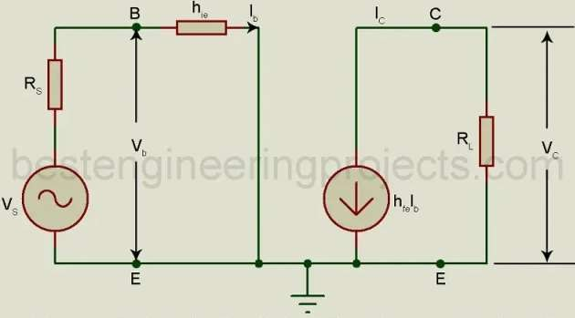
CE Amplifier Without Emitter Resistance
(Using Approximate Hybrid Model)
h
vb
i
fe
R
=
=
h
+
hre Ai R
Ai
=
c
=−
i
i
ie
L
i
b
¹⁺hoe RL
b
Neglecting
⇒Ri
=
hie
i i
Ai
=
=−
h
c
fe
_{hoe} = 0, and _{hre} = 0
b

Slide 28
(Using Approximate Hybrid Model)
CE Amplifier Without Emitter Resistance
A R A R
h
h
Y
h
fe
and _{R} = ¹
⇒
A
=
i L
=
i L
⇒
=
−
re
0
R ⁺ h Y 0
v
Ri h
oe
0
s ie
ie
⇒ _{Y} = 0and _{R} = ¹ = ∞
0 0
Y
0

