Slide 1

AY-2025-2026
ODD SEM
Department of ECE
Analog electronic Circuit Design
23ec2104
Topic:
Hybrid Model for BJT Configurations-CE, CB,CC
Session - 09

Slide 2
Session content
Hybrid Model for BJT Configurations-CE, CB, CC

Slide 3



AIM OF THE SESSION
To analyze and understand the Hybrid-π model for the Common Emitter (CE), CB, CC configuration of a BJT and apply it in small-signal amplifier circuit analysis.
INSTRUCTIONAL OBJECTIVES
The Session is designed to:
Explain the concept of the Hybrid-π model for BJTs.
Identify the key elements of the Hybrid-π equivalent circuit.
Describe the role of each parameter (rπ, gm, ro) in CE,CB, CC configuration.
Apply the model to analyze small-signal behavior of CE, CB, CCamplifiers.
LEARNING OUTCOMES
At the end of this session, learners will be able to:
Construct the Hybrid-π equivalent circuit for a given BJT CE, CB,CC configuration.
Use the model to calculate small-signal parameters and performance metrics.
Understand how the base-emitter resistance (rπ) and transconductance (gm) influence signal gain.

Slide 4
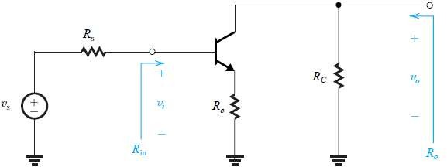
CE Amplifier With Emitter Resistance

Slide 5
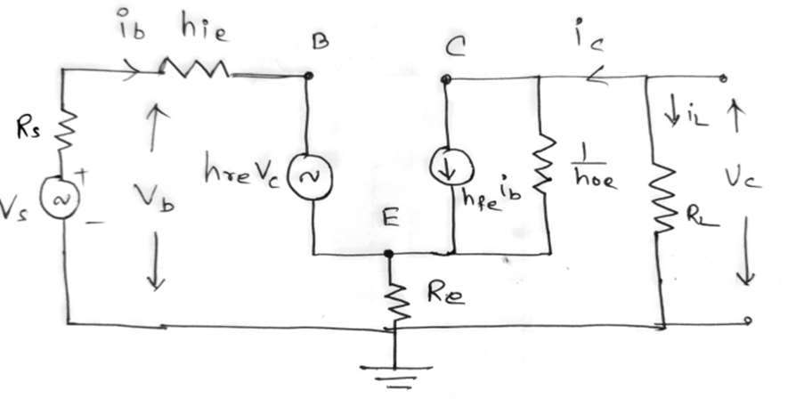
CE Amplifier With Emitter Resistance
(Using Hybrid Model)

Slide 6
CE Amplifier With Emitter Resistance
(Using Hybrid Model)
h fe
hoe Re^{−h} fe
_{A} = −
A
=
i
1+ (R +R
)
i
1+h
R
h
oe e
oe
L
L
vb
_{Ri} = _{hie} + _{hre Ai} (_{RL} + _{Re})+ _{Re} (1− _{Ai} )− _{Re}h_{re}
R
=
=
h h A R
+
i
i
ie
re i L
b
A R
A R
A
=
i L
A
=
i L
Ri
v
R
v
i
h
h
1+h_{fe} (_{Rs} + _{hie})(1+ _{hoe Re} )
_{R0} = _{hoe} + _{hoe Re} and _{Y 0} =
1
Y h
fe
R
1
= −
re
and
=
R0
0
oe
R ⁺ h
0
Y 0
s
ie

Slide 7
Hybrid model
Approximate Hybrid model
h fe
_{A} = −
Ai ⁼ ⁻h fe
i
1+h
R
oe
L
vb
Ri ⁼ hie ⁺ ⁽1+hfe⁾Re
R
=
=
h h A R
+
i
i
ie
re i L
b
A R
A R
−hfe RL
A
=
i L
A
=
i L
=
+ ( )
v
R
v
R h 1+h R
i
i ie fe e
h
h
Y h
fe
R
1
_{Y 0} = 0, and _{R0} = ∞
= −
re
and
=
0
oe
R ⁺ h
0
Y 0
s
ie

Slide 8
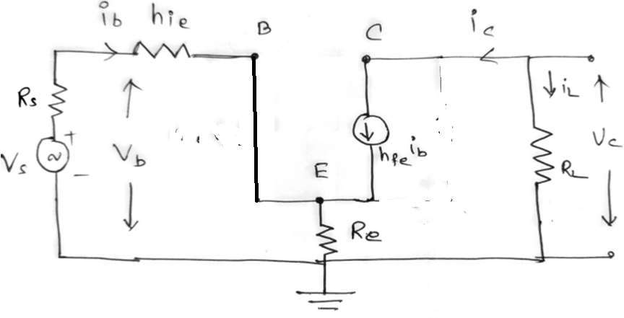
CE Amplifier With Emitter Resistance
(Using Approximate Hybrid Model)

Slide 9
CE Amplifier With Emitter Resistance
(Using Approximate Hybrid Model)
hoe Re^{−h} fe
Ai ⁼ ⁻h fe
A
=
i
1+ (R + )
h
R
oe
L
e
= + ( + )+ (1− )−
h
Ri ⁼ hie ⁺ ⁽1+hfe⁾Re
R h h A R R R A
i R
i
ie
re i L
e e
e
re
A R
A R
−hfe RL
A
=
i
L
A
=
i L
=
+ ( )
Ri
v
R h 1+h R
v
i ie fe e
1+h
( )(
)
R h h R
_{Y 0} = 0, and _{R0} = ∞
+ 1+
1
R
=
fe
+
s
ie
oe e
and
Y
=
0
h
h R
0
R
oe
oe e
0

Slide 10
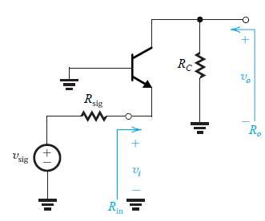
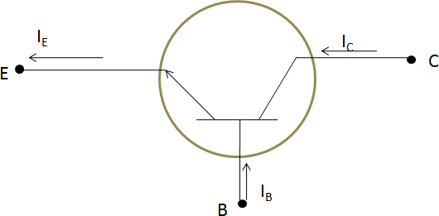
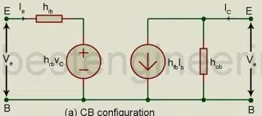
CB Amplifier(Using Hybrid Model)

Slide 11
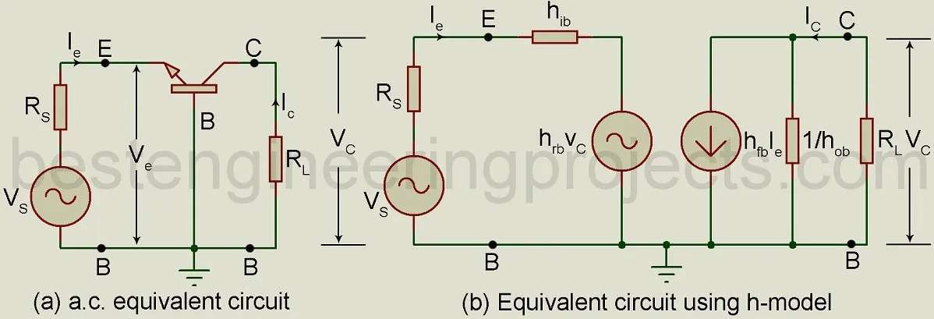
CB Amplifier(Using Hybrid Model)

Slide 12
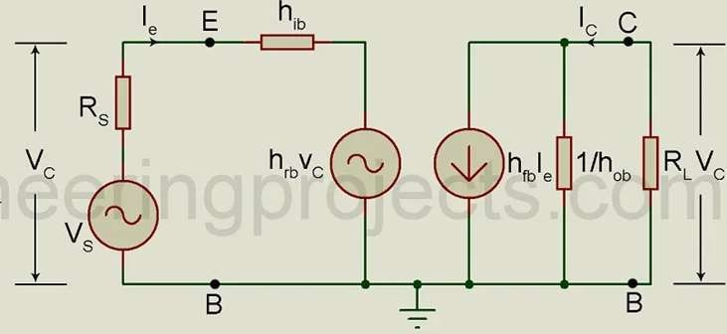
CB Amplifier (Using Hybrid Model)
i i
i i
A =
L
= −
c
i
e
e
ic ⁼ hfbie ⁺ hob vc
vc ⁼ iL RL ⁼ ⁻ic RL
ic ⁼ hfbie ⁺ hob ⁽⁻ ic RL ⁾
h fb
¹⁺hob RL
i i
_{ic} (1+ )=
Ai
=
c
=−
hob RL hfbie
e

Slide 13
CB Amplifier (Using Hybrid Model)
v
R =
e
i
i
e
ve ⁼ hib ie ⁺ hrb vc
But, A_{i} = − ^{ic} ⇒ _{i} = −A_{i i}
c e
vc ⁼ iL RL ⁼ ⁻ic RL ⁼ Ai ie RL
ie
ve ⁼ hib ie ⁺ hrb ⁽Ai ie RL⁾
v
⇒
R
=
=
h h A R
(
)
e
+
v ⁼ i h
⁺ hrb Ai RL
i
i
ib rb i L
e e ib
e

Slide 14
₌ vc
CB Amplifier (Using Hybrid Model)
A
v
v
e
i i
But, A = −
ic
i i_{e}
vc ⁼ iL RL ⁼ ⁻ic RL ⁼ Ai ie RL
c
⇒ = −A
i
e
1 ₌ i_{e}
v A i R A R
⇒
A
=
c
= =
i e L i L
ve
v
v v
Ri
R_{i}
e
e

Slide 15
CB Amplifier (Using Hybrid Model)
Output Admittance Y_{o}
i
Y =
c
o
v
c
ic ⁼ hfbie ⁺ hob vc
Dividing By V_{c}
i_{c =} hfbie
vc vc
₊ hob vc ⇒ ic ₌ hfbie
vc vc vc
⇒ ie ₌ ₋ hrb
⁺ hob
vc
Rs ⁺ hib
v =0,R i +h i + h v = 0
s s e
e rb c
ib
h fb^{h}
(R +h )i =−h v
⇒ _{Y} = _{h} −
1
rb
and
R
=
s ib e
rb c
0
ob
R ⁺ h
0
Y 0
s
ib

Slide 16
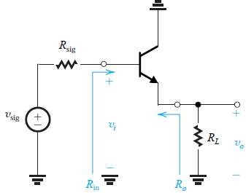
CC Amplifier(Using Hybrid Model)

Slide 17
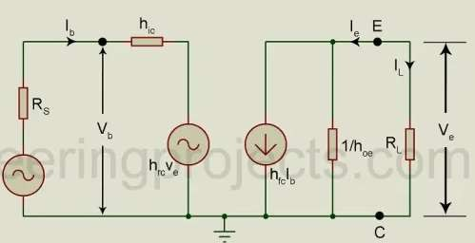
CB Amplifier(Using Hybrid Model)

Slide 18
CB Amplifier (Using Hybrid Model)
i i
i i
A =
L
= −
e
i
b b
ie ⁼ hfcib ⁺ hoc ve
vc ⁼ iL RL ⁼ ⁻ie RL
ie ⁼ hfcib ⁺ hoc ⁽⁻ ie RL ⁾
ie ⁽¹⁺ hoc RL ⁾⁼ hfcib
h fc
¹⁺hoc RL
i i
Ai
=
e
=−
b

Slide 19
CB Amplifier (Using Hybrid Model)
v
R =
b
i
i
b
vb ⁼ hic ib ⁺ hrc ve
But, A_{i} = − ^{ie} ⇒ _{i} = −A_{i i}
e b
ve ⁼ iL RL ⁼ ⁻ie RL ⁼ Ai ib RL
ib
vb ⁼ hic ib ⁺ hrc ⁽Ai ib RL⁾
v
⇒
R
=
=
h h A R
(
)
b
+
v ⁼ i h
⁺ hrc Ai RL
i
i
ic rc i L
b b ic
b

Slide 20
₌ ve
CB Amplifier (Using Hybrid Model)
A
v
v
b
i
But, A = −
ie
i i_{b}
e
⇒ = −A
i
i
b
ve ⁼ iL RL ⁼ ⁻ie RL ⁼ Ai ib RL
1 ₌ i_{b}
v Ai i R A R
⇒
A
=
e
= =
b L
i L
vb
v
v v
Ri
R_{i}
b b

Slide 21
CB Amplifier (Using Hybrid Model)
Output Admittance Y_{o}
i
Y =
e
o
v
e
ie ⁼ hfcib ⁺ hoc ve
Dividing By V_{e}
i_{e =} hfcib
ve ve
₊ hob ve ⇒ ie ₌ hfcib
ve ve ve
⇒ ib ₌ ₋ hrc
⁺ hoc
ve
Rs ⁺ hic
v =0,R i +h i + h v = 0
s s b
b rc e
ic
h fc^{h}
(R +h )i =−h v
⇒ _{Y 0} = _{hoc} −
1
rc
and
R
=
s ic b
rc e
R ⁺ h
0
Y 0
s
ic

Slide 22
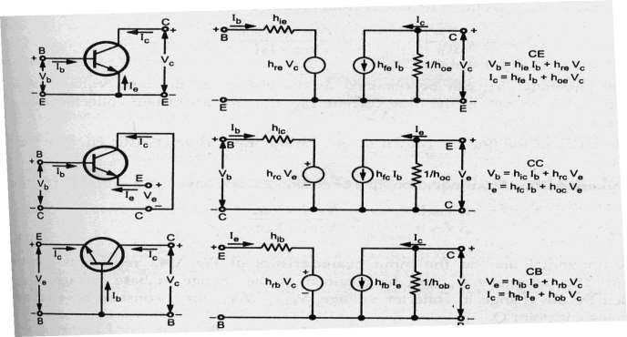
Hybrid Model and Equations for the transistor in three different configurations are are given below.

Slide 23
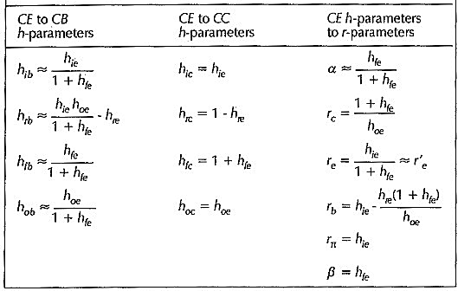
Conversion Formulae for Hybrid Parameters

Slide 24
