Slide 1


Department of ECE
ASIC & FPGA Design
23ec2230F
Topic:
Programmable ASIC I/O Cells

Slide 2
Programmable ASIC I/O Cells SESSION INTRODUCTION
In modern Application-Specific Integrated Circuits (ASICs), programmable I/O (Input/Output) cells play a vital role in providing flexibility, configurability, and performance optimization at the interface between the core logic and the external environment. These cells form the boundary between the internal logic circuitry and the off-chip signals, ensuring reliable communication while protecting the internal circuits from electrical variations or noise.
Programmable I/O cells are designed to support multiple electrical standards, voltage levels, and drive strengths, making a single ASIC design adaptable to various system requirements. Through programmable control, designers can configure parameters such as input thresholds, output slew rate, impedance, and pull-up/pull-down resistors. This allows the same silicon implementation to operate across different boards or systems without hardware modification.

Slide 3
Furthermore, programmable I/O structures enhance testability and signal integrity, often integrating ESD protection, boundary scan (JTAG) support, and mode selection logic. In high-performance ASICs, these I/O cells can also be configured for bi-directional operation, differential signaling (LVDS), or low-power modes, depending on system needs.
Overall, programmable I/O cells provide the essential interface adaptability that enables ASICs to maintain functional compatibility, electrical robustness, and design scalability in diverse application environments.

Slide 4
DC Input: Programmable ASIC I/O Cells
When configured as a DC input, the programmable ASIC I/O cell functions primarily as an interface for receiving static or slowly varying logic signals from external sources into the ASIC core. The input circuitry must accurately interpret incoming voltage levels while maintaining signal integrity and protecting the internal transistors from electrical stress.
A DC input I/O cell typically includes the following key components:
Input Buffer / Receiver:
ESD Protection Network:
Programmable Input Features:

Slide 5
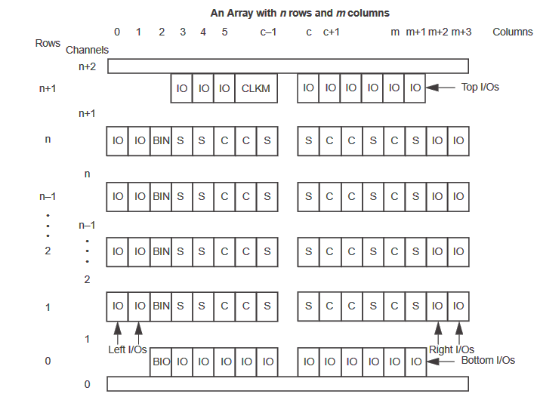
Generalized Floor Plan of ACT 3 Device

Slide 6
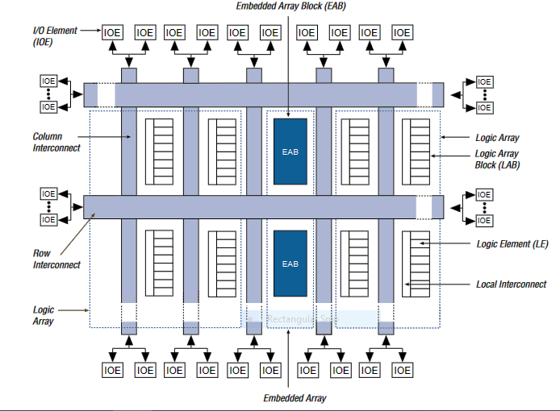
FLEX 10K Device Block Diagram

Slide 7
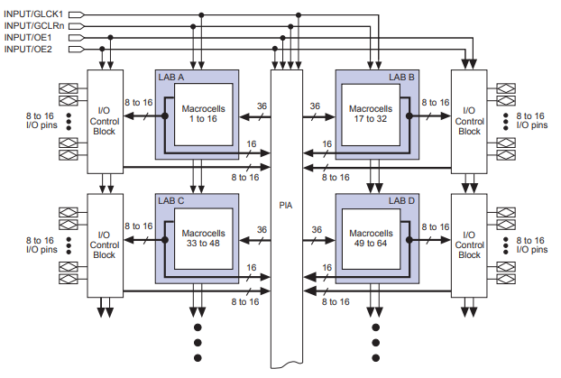
SESSION DESCRIPTION

Slide 8
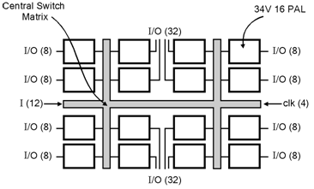
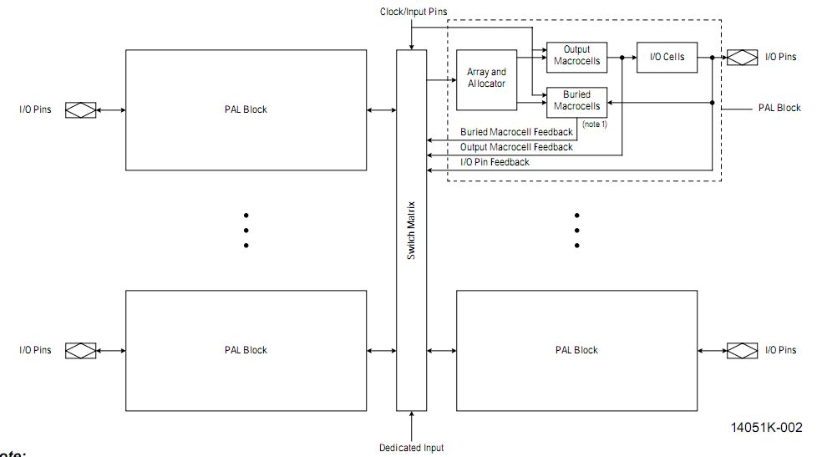
SESSION DESCRIPTION
MACH 1 devices

Slide 9
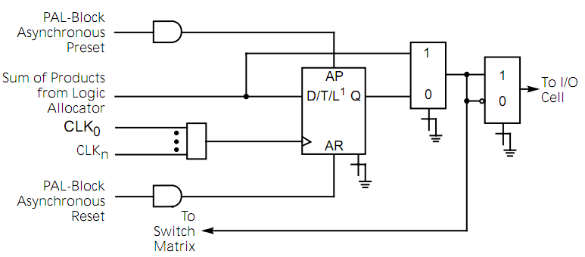
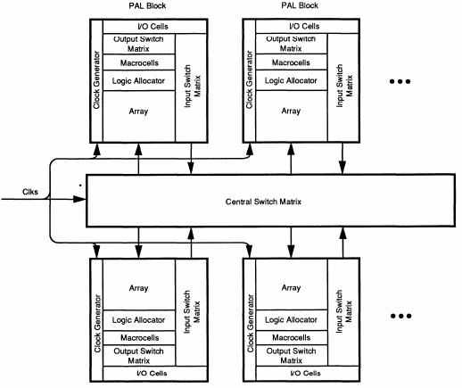
SESSION DESCRIPTION (Cont..)
MACH 2 devices
MACH 3 Block Diagram

Slide 10
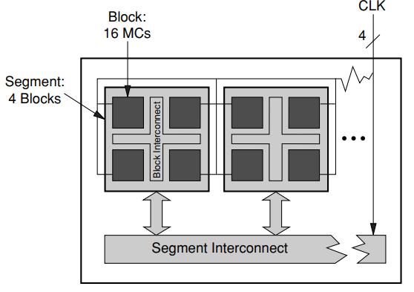
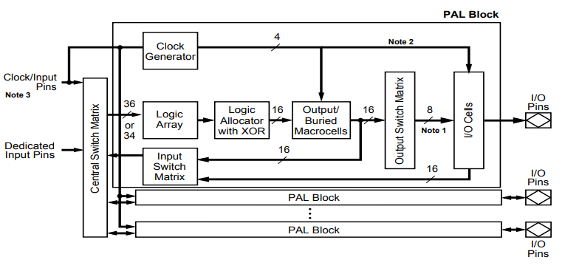
SESSION DESCRIPTION (Cont..)
MACH 4 Block Diagram
MACH 5 Block Diagram

Slide 11
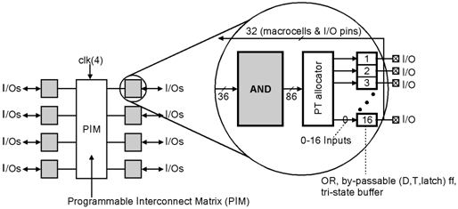
SESSION DESCRIPTION
FLASH370

Slide 12
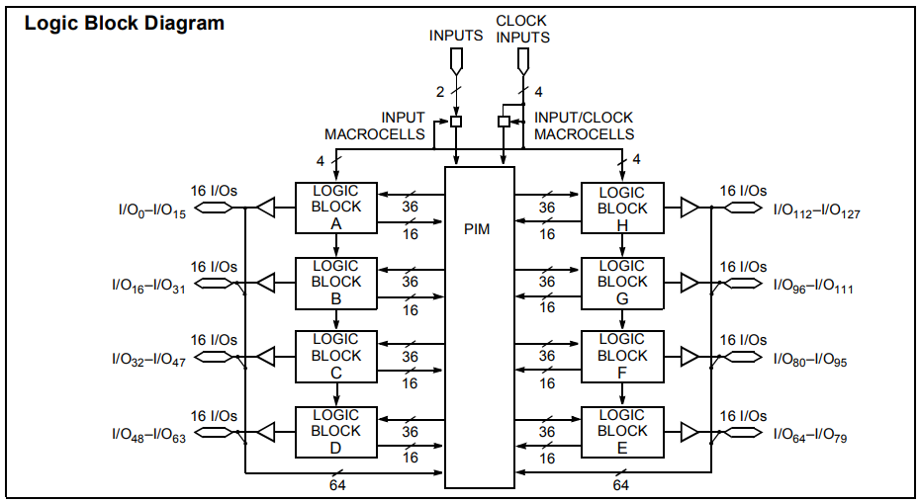
SESSION DESCRIPTION (Cont..)

Slide 13
SUMMARY
Stated another way, the FLASH370 features: • no fanout delays • no expander delays • no dedicated vs. I/O pin delays • no additional delay through PIM • no penalty for using 0–16 product terms • no added delay for steering product terms • no added delay for sharing product terms • no routing delays • no output bypass delays The simple timing model of the FLASH370 family eliminates unexpected performance penalties.

Slide 14
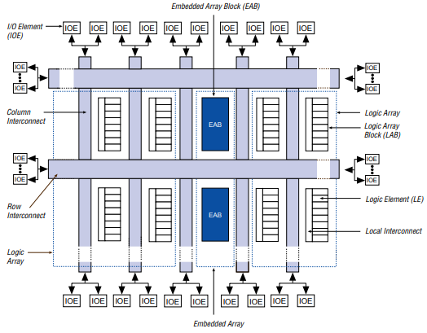
SESSION DESCRIPTION

Slide 15
THANK YOU
Team – ASIC & FPGA Design

