Slide 1

AY-2025-2026
ODD SEM
Department of ECE
ASIC & fpga dESIGN
22EC2237F
Topic:
Introduction to ASICs
Session - 1

Slide 2



AIM OF THE SESSION
To provide an in-depth understanding of ASICs, their classifications, design flow, critical cell types used in ASIC implementation, and the economic trade-offs associated with ASIC development.
INSTRUCTIONAL OBJECTIVES
This Session is designed to:
Define ASICs and classify them into Full-Custom, Semi-Custom, and Programmable types.
Describe and analyze the standard ASIC design flow from specification to GDSII.
Explain the role of standard cell libraries and discuss in detail combinational, sequential, datapath, and I/O cells.
Understand the economic considerations in ASIC production including NRE and unit cost.
Present a case study to contextualize ASIC usage in a practical scenario..
LEARNING OUTCOMES
At the end of this session, you should be able to:
Classify and differentiate between various ASIC types (Full-Custom, Semi-Custom, Programmable) based on architecture, design complexity, and application domain.
Demonstrate a comprehensive understanding of the ASIC design flow and accurately describe each step from specification to tape-out.
Analyze and interpret the roles of different logic cells (combinational, sequential, datapath, and I/O) within ASIC cell libraries and evaluate their impact on timing and area constraints.

Slide 3
Contents
Introduction to ASICs
Types of ASICs
ASIC Design Flow
Case Study
Economics of ASICs
ASIC Cell Libraries
Combinational Logic Cells
Sequential Logic Cells
Data Path Logic Cells
I/O Cells

Slide 4

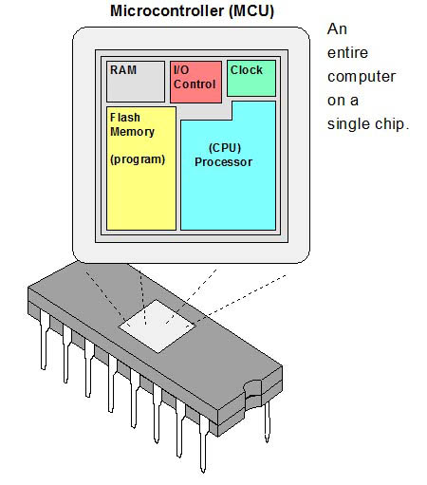
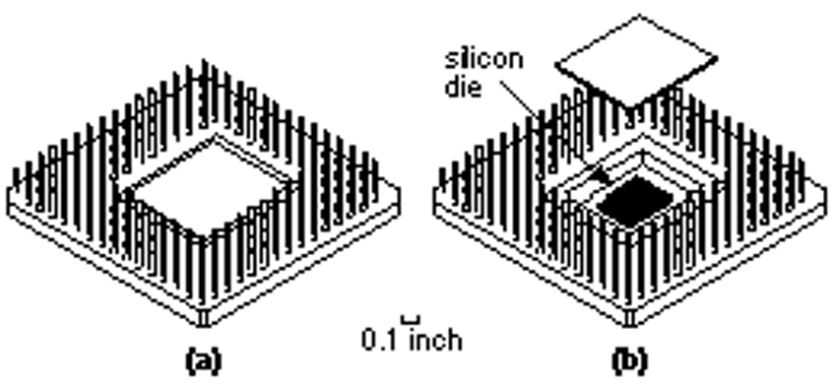
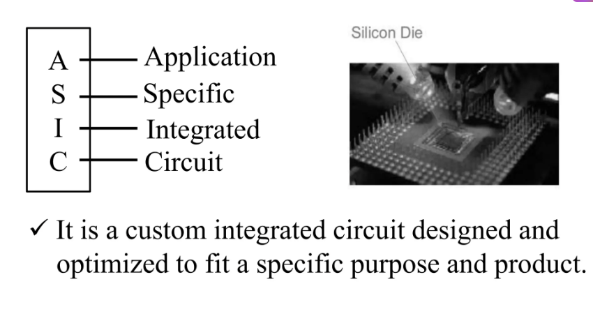
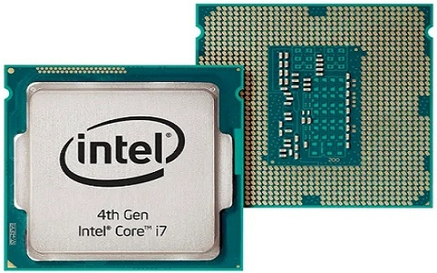
INTRODUCTION to ASICs
A
S
I
C
Application
Examples of ICs that are ASICs:
A chip for a toy bear that talks.
A chip for a satellite.
A chip designed to handle the interface between memory and a microprocessor for a workstation CPU.
A chip containing a microprocessor as a cell together with other logic.
Specific
Integrated
Circuit
It is a custom integrated circuit designed and optimized to fit a specific purpose and product.
Fig.2 : An Integrated Cirucit (IC) (a) A pin grid array (PGA) package (b) The silicon die or chip is under the package lid.
Fig.1 : Silicon Die

Slide 5
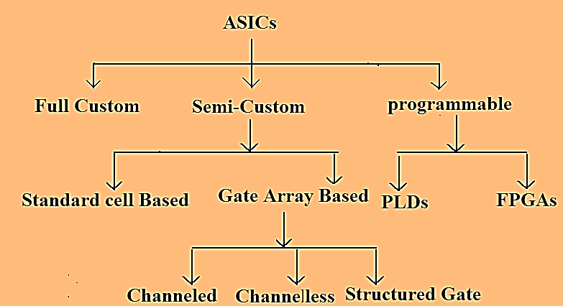
Types of ASICs
Full Custom ASICs
All mask layers are customized in a full-custom ASIC
Generally, the designer lays out all cells by hand
Some automatic placement and routing may be done
Critical (timing) paths are usually laid out completely by hand
Full-custom design offers the highest performance and lowest part cost (smallest die size) for a given design.
The disadvantages of full-custom design include increased design time, complexity, design expense, and highest risk
So, as shown in the slide the ASICs are broadly classified into three types.
I. Full-Custom ASICs
II. Semi-custom ASICs
III. Programmable ASICs

Slide 6
Types of ASICs
Full Custom ASICs
Semi Custom ASICs
Microprocessors (strategic silicon) were exclusively full-custom, but designers are increasingly turning to semicustom ASIC techniques in this area as well.
Other examples of full-custom ICs or ASICs are requirements for high-voltage (automobile), analog/digital (communications), sensors and actuators, and memory (DRAM).
ASICs , for which all of the logic cells are predesigned and some (possibly all) of the mask layers are customized are called semi custom ASICs.
Using the predesigned cells from a cell library makes the design , much easier.
There are two types of semicustom ASICs
(i) Standard-cell–based ASICs
(ii)Gate-array–based ASICs.

Slide 7
Types of ASICs
Standard-Cell Based ASICs
A cell-based ASIC (cell-based IC, or CBIC pronounced sea-bick) uses predesigned logic cells (AND gates, OR gates, multiplexers, and flip-flops, for example) known as standard cells.
One can apply the term CBIC to any IC that uses cells, but it is generally accepted that a cell-based ASIC or CBIC means a standard-cell based ASIC.
The standard-cell areas (also called flexible blocks) in a CBIC are built of rows of standard cells like a wall built of bricks. The standard-cell areas may be used in combination with microcontrollers or even microprocessors, known as mega cells. Mega cells are also called mega functions, full-custom blocks, system-level macros (SLMs), fixed blocks, cores, or Functional Standard Blocks (FSBs).

Slide 8
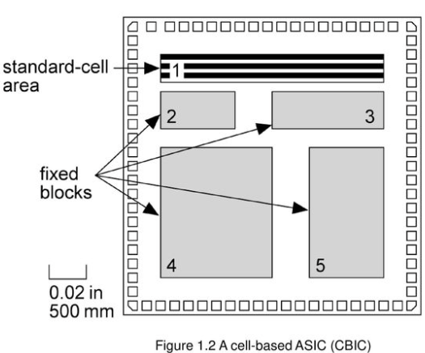
Types of ASICs
Standard-Cell Based ASICs
A cell-based ASIC (CBIC) die with a single standard-cell are (a flexible block) together with four fixed blocks.
The ASIC designer defines only the placement of the standard cells and the interconnect in a CBIC. However, the standard cells can be placed anywhere on the silicon; this means that all the mask layers of a CBIC are customized and are unique to a particular customer.
The advantage of CBICs is that designers save time, money, and reduce risk by using a predesigned, pretested, and pre characterized standard-cell library.
In addition each standard cell can be optimized individually. During the design of the cell library each and every transistor in every standard cell can be chosen to maximize speed or minimize area .
The disadvantages are the time or expense of designing or buying the standard-cell library and the time needed to fabricate all layers of the ASIC for each new design.

Slide 9
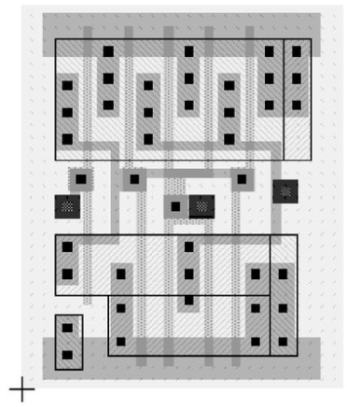
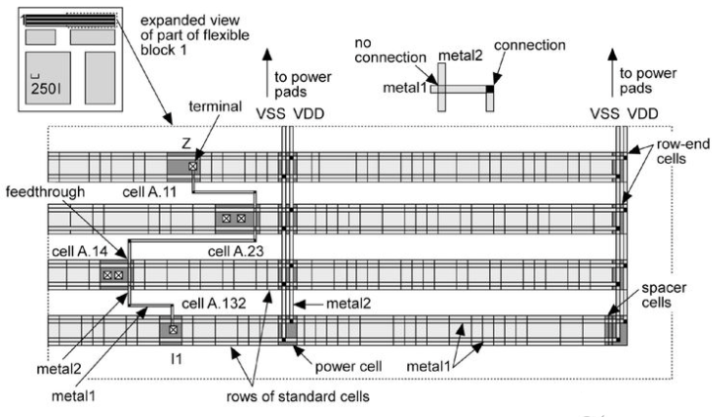
Types of ASICs
Fig. Layout of Standard-Cell
Fig. Routing the CBIC

Slide 10
Types of ASICs
Gate-Array-Based ASICs
In a Gate-Array-Based ASIC, the transistors are predefined on the silicon wafer.
The predefined pattern of transistors is called the base array.
The smallest element that is replicated to make the base array is called the base or primitive cell.
The top-level interconnect between the transistors is defined by the designer in custom masks-Masked Gate Array (MGA).
Design is performed by connecting predesigned and characterized logic cells from a library (macros).
After validation, automatic placement and routing are typically used to convert the macro-based design into a layout on the ASIC using primitive cells.
Types of MGAs:
(i) Channeled Gate Array (ii) Channel less Gate Array (iii) Structured Gate Array

Slide 11
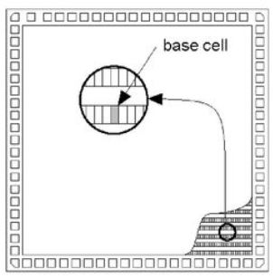
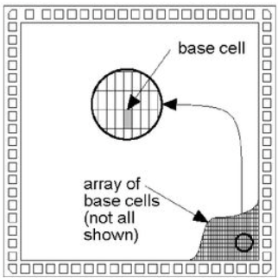
Types of ASICs
Gate-Array-Based ASICs
Channel Gate Array
Only the interconnect is customized.
The interconnect uses predefined spaces between rows of base cells.
Manufacturing lead time is between two days and two weeks.
Channel less Gate Array
There are no predefined areas set aside for routing-routing is over the top of the gate-array devices.
Achievable logic density is higher than for channeled gate arrays.
Manufacturing lead time is between two days and two weeks.
Fig. Channel Gate-Array die
Fig. Sea-Of-Gates (SOG) array die

Slide 12
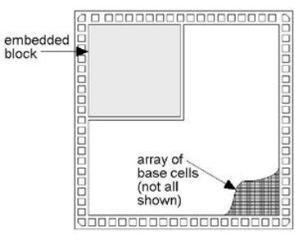
Types of ASICs
Gate-Array-Based ASICs
Structured Gate Array
Only the interconnect is customized.
Custom blocks (the same for each design) can be embedded.
These can be complete blocks such as a processor or memory array or An array of different base cells better suited to implementing a specific function.
Manufacturing lead time is between two days and two weeks.
Fig. Gate array die with embedded block

Slide 13
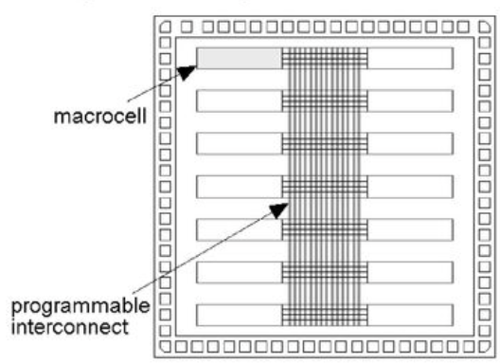
Types of ASICs
Gate-Array-Based ASICs
Programmable Logic Devices
No customized mask layers or logic cells
Fast design turnaround
A single large block of programmable interconnect
Erasable PLD (EPLD)
Mask-programmed PLD
A matrix of logic macro cells that usually consist of programmable array logic followed by a flip-flop or latch.
Fig. Programmable logic device die

Slide 14
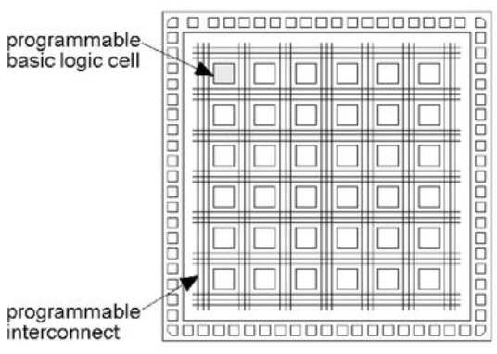
Types of ASICs
Gate-Array-Based ASICs
Field Programmable Gate Array
None of the mask layers are customized.
A method for programming the basic logic cells and the interconnect.
The core is a regular array of programmable basic logic cells that can implement combinational as well as sequential logic (flip-flops)
A matrix of programmable interconnect surrounds the basic logic cells.
Programmable I/O cells surround the core.
Design turnaround is a few hours
Fig. Field Programmable Gate Array (FPGA) die

Slide 15
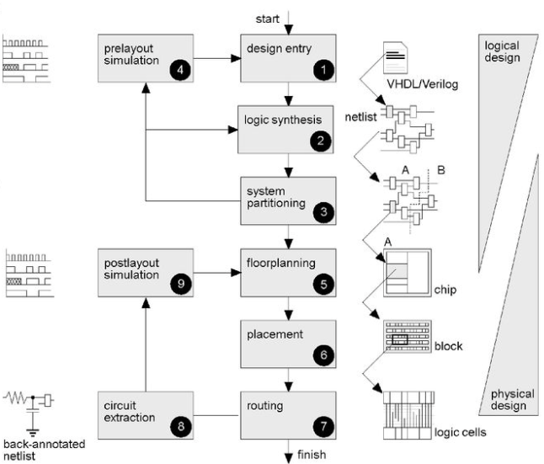
ASIC Design Flow
Design entry – Using a hardware description language (HDL) or schematic entry
Logic synthesis – Produces a netlist – logic cells and their connections
System partitioning – Divide a large system into ASIC-sized pieces
Pre layout simulation – Check to see if the design functions correctly
Floor planning – Arrange the blocks of the netlist on the chip
Placement – Decide the locations of cells in a block
Routing – Make the connections between cells and blocks
Extraction – Determine the resistance and capacitance of the interconnect
Post layout simulation – Check to see if the design still works with the added loads of the interconnect
Fig. ASIC Design Flow

Slide 16
Case Study
Case Study – ASIC in Wearable Health Monitoring Device
Application Context: Development of a low-power, real-time ECG monitoring chip for a wearable health device (e.g., smart band or patch).
Design Goal:
Continuous monitoring of ECG signals
Ultra-low power operation for multi-day battery life
Compact form factor
On-chip signal filtering and compression
ASIC Solution Features:
Technology Node: 65nm CMOS LP
Analog Front End (AFE):
Integrated instrumentation amplifier
Low-noise ADC with 10-bit resolution
Hardware bandpass filtering for noise reduction
Digital Signal Processing Block:
QRS detection implemented using optimized FSM
R-R interval calculation
Lossless compression module (Huffman encoding)
Power Management:
Dynamic voltage scaling
Power gating for idle logic
I/O Interface:
SPI slave for data transfer to MCU or wireless transceiver
Design Flow Highlights:
RTL design and behavioral verification in Verilog
Floorplanning with area constraint < 2 mm²
Clock tree synthesis to minimize skew in DSP block
Post-layout simulation with extracted parasitics for power estimation
Final GDSII taped out using TSMC 65nm LP process
Results:
Total Power Consumption: ~120 µW at 1V supply
Throughput: 1 ECG sample processed every 2 ms
Silicon Area: 1.6 mm² including ESD pads
Battery Life Impact: Extended device operation to >5 days on 50 mAh battery
Conclusion:
This ASIC enabled high-precision, energy-efficient ECG monitoring for wearables, outperforming equivalent FPGA or microcontroller-based implementations in terms of power, size, and integration.

Slide 17
Economics of ASICs
Cost Components
Fixed Costs (NRE):
Design tools, mask generation, simulation, test programs
Range: $10K–$300K+
Variable Costs (Per Unit):
Fabrication, packaging, testing
Decreases with higher volume
MGAs and CBICs become cost-effective at higher volumes due to amortized NRE.
Time-to-Market vs. Volume Tradeoff
FPGAs: Faster development, higher unit cost → ideal for prototypes & low volume
CBICs/MGAs: Slower dev time, low unit cost → suited for high-volume production
ASIC Type | Fixed Cost | Unit Cost | Breakeven Volume
FPGA | $21,800 | $39 | -
MGA | $86,000 | $10 | ~2,000 units
CBIC | $146,000 | $8 | ~4,000 units

Slide 18
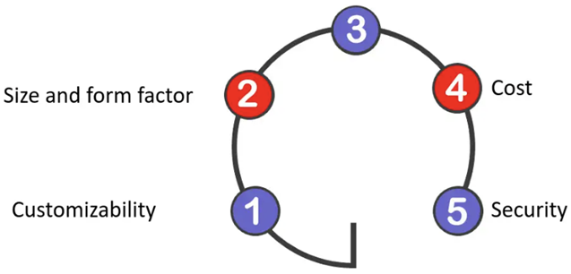
ASIC cell library
The logic cells such as AND, OR, XOR, NOR, NAND, multiplexers and Flip-Flops are predesigned by designers using different configuration, standardized and stored in the form of a library.
Cell libraries are fixed set of well-characterized logic blocks.
Each cell in an ASIC cell library must contain:
A physical layout
A behavioral model
A Verilog/VHDL model
A detailed timing model
A test strategy
A circuit schematic
A cell icon
A wire load mode
A routing model
Performance
Advantages
of using
ASIC
Characterization Parameters
Delay & Transition Time (under various input slew/load)
Power Consumption (dynamic + leakage)
Drive Strength Variants (e.g., INVX1, INVX4)
Setup/Hold Times (for sequential cells)
Area Footprint (height fixed for row alignment)
Advantages
Facilitates consistent logic synthesis and physical design
Speeds up time-to-market through reuse
Supports multi-corner multi-mode (MCMM) optimization
Enables integration with DFT, P&R, STA, and IR-drop tools

Slide 19
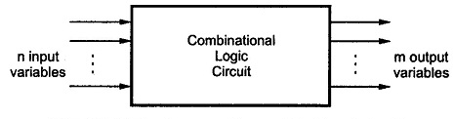
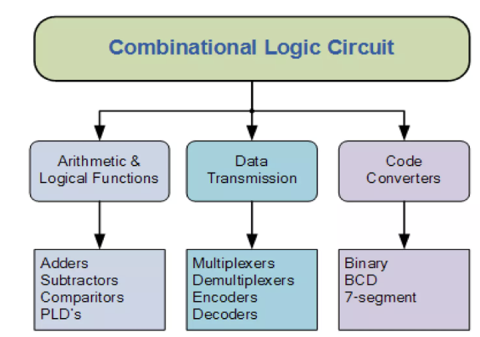
Combinational Logic Cells
A Combinational Circuit is a combination of Logic gates, the output depends upon the current value of the inputs.
Examples of Combinational Circuits
Addition:
Half Adder (HA).
Full Adder (FA).
BCD(Decimal) Adder.
Multiplication:
Binary Multipliers.
Subtraction:
Half Subtractor.
Full Subtractor.
Comparator:
Magnitude Comparator.
Fig. Block diagram of a Combinational Circuit
Characteristics:
The output of combinational circuit at any instant of time, depends only on the levels present at input terminals.
The combinational circuit do not use any memory. The previous state of input does not have any effect on the present state of the circuit.
A combinational circuit can have an n number of inputs and m number of outputs.
Classification of Combinational Logic

Slide 20
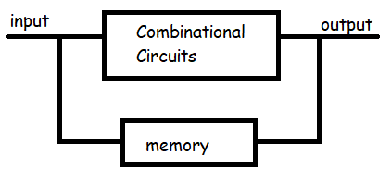
Sequential Logic Cells
A sequential logic circuit is a type of digital circuit whose output depends not only on the current input but also on the sequence of past inputs.
Characteristics:
Clock-Driven – Operate based on a clock signal to synchronize state transitions.
Stores State – Use flip-flops or latches to retain previous input values.
Output Depends on Inputs + State – Outputs are a function of both current inputs and stored states.
Timing Constraints – Require careful handling of setup time, hold time, and clock skew during ASIC timing analysis.
Used in Control and Data Path Logic – Essential for implementing FSMs, registers, pipelines, and protocol controllers in ASICs.
Fig. Block diagram of a Sequential Circuit
Applications:
Examples of Combinational Circuits
Finite State Machines (FSMs)
Pipelined Data Paths
Counters and Timers
Registers and Buffers
Flip-flops
Counters
Registers
State Machines

Slide 21
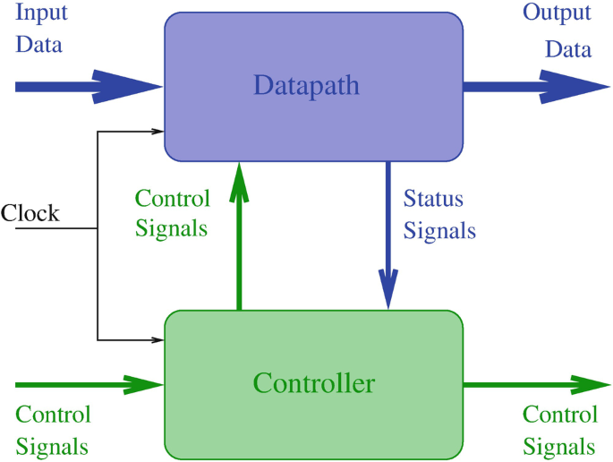
Data Path Logic Cells
Examples
Datapath Logic Cells are specialized standard cells designed to implement arithmetic and logical operations on multi-bit data buses in ASICs.
They are optimized for speed, area, and bit-wise uniformity, and often used in pipelined or register-transfer logic.
Adders
Multipliers
Subtractors
Shifters
Comparators
Arithmetic Logic Units
Accumulators
Characteristics
Designed in bit-slice architecture for easy scaling to multi-bit operations.
Optimized for high speed and throughput in arithmetic and logic processing.
Area-efficient layout with regular, modular structure for better silicon utilization.
Supports pipelining, making it ideal for high-performance, data-heavy ASIC designs.
Applications
Digital Signal Processing (DSP)
Microprocessors / Controllers
Image and Video Processing
Cryptographic Engines
Networking ASICs
Fig. Block diagram of a Data Path Logic Cell

Slide 22
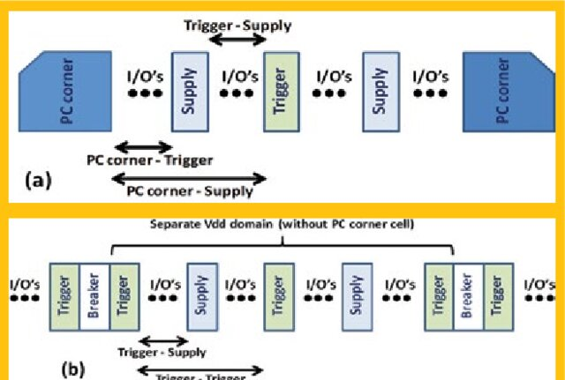
I/O Cells
I/O (Input/Output) cells are special logic cells in an ASIC that interface the internal core logic to the outside world via chip/package pins.
They ensure signal compatibility, electrical protection, and driving capability between internal signals and external devices.
Characteristics
Connect internal ASIC signals to chip pins or pads.
Support multiple voltage and I/O standards (e.g., CMOS, LVTTL, LVCMOS).
Include protection circuitry like ESD and over-voltage clamps.
Offer customizable drive strength, slew rate control, and impedance matching.
Placed around the periphery of the chip (in pad rings or frames).
Examples
Input Cells – Receive signals from external sources.
Output Cells – Drive signals out from the chip.
Bidirectional I/O Cells – Can act as input or output depending on control logic.
ESD Protection Cells – Protect internal circuits from electrostatic discharge.
Analog I/O Pads – For interfacing with analog signals (e.g., ADC/DAC).
Applications
Interface with external components (memory, processors, sensors).
Support communication protocols (SPI, I²C, UART, USB, Ethernet).
Provide power and ground connections.
Connect clock, reset, and async signals.
Enable test access (e.g., JTAG, scan chains).
Fig. Block diagram of I/O Cells

Slide 23
Summary
ASICs (Application Specific Integrated Circuits) are custom-designed chips tailored for specific applications, offering optimized performance, power efficiency, and area savings compared to general-purpose ICs.
ASICs are broadly categorized into Full-Custom, Semi-Custom, and Programmable types, each with trade-offs in cost, flexibility, and performance.
The ASIC design flow covers all stages from specification, design entry, synthesis, simulation, floorplanning, placement, routing, to tape-out and fabrication.
Standard cell libraries provide well-characterized, reusable building blocks including combinational, sequential, datapath, and I/O cells.
A case study in wearable ECG monitoring demonstrated ASIC advantages in power, area, and integration compared to FPGAs or microcontrollers.
Economic considerations such as NRE (non-recurring engineering cost), volume, and unit cost are essential in determining ASIC feasibility.

Slide 24

SELF-ASSESSMENT QUESTIONS
Which of the following is not a type of ASIC?
A. Standard Processor ASIC
B. Semi-Custom ASIC C. Full-Custom ASIC D. Programmable ASIC
The output of a combinational logic circuit depends on:
Clock
Previous state
None of the above
Current inputs

Slide 25
SELF-ASSESSMENT QUESTIONS
3. A flip-flop is classified as which type of logic cell?
A. Combinational B. Sequential C. Data path D. I/O
4. Which logic cells are responsible for arithmetic operations in an ASIC?
A. Combinational Cells B. Sequential Cells C. Datapath Cells D. Control Cells

Slide 26
SELF-ASSESSMENT QUESTIONS
5. I/O cells are placed:
A. Inside the core logic B. In the standard cell region C. Around the periphery of the chip D. At the top-left corner

Slide 27
ANSWERS
A
D
C
C
C

Slide 28
TERMINAL QUESTIONS
Explain the difference between Full-Custom and Semi-Custom ASICs with suitable examples.
Describe the complete ASIC design flow and the purpose of each stage.
Discuss the roles and differences between combinational, sequential, datapath, and I/O logic cells.
Analyze the trade-offs between using ASICs vs. FPGAs in terms of economics and application scope.
Based on the case study, what key design strategies helped reduce power consumption in the ECG monitoring ASIC?

Slide 29
REFERENCES FOR FURTHER LEARNING OF THE SESSION
References of books, sites, links
Michael John Sebastian Smith, “Application Specific Integrated Circuits”, Pearson Education,2001.
Debaprasad Das, “VLSI Design”. 3. Neil H. E. Weste and K. Eshraghian, Principles of CMOS VLSI Design, 2nd Edition, Addison Wesley.
Bob Zeidman, “Designing with FPGAs and CPLDs”.
Stephen Brown and ZvonkoVranesic “Fundamentals of Digital Logic with Verilog Design”.
Pak K. Chan, Samiha Mourad,“Digital Design Using Field Programmable Gate Array”.

Slide 30
THANK YOU
Team – LOW POWER VLSI Design

