Slide 1
PROGRAMMABLE ASICS
22EC2237F – ASIC AND FPGA DESIGN
CO2

Slide 2
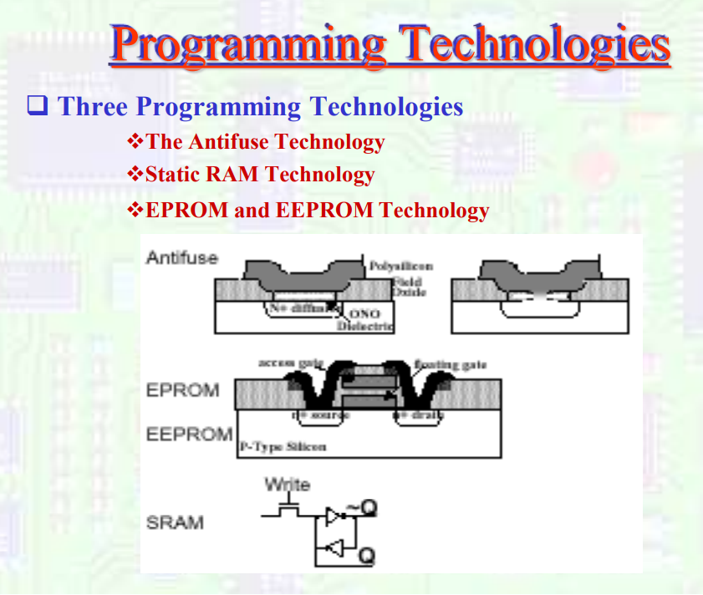

Slide 3

The Antifuse
Programmable switches are used for connections of wire segments in a FPLD. A FPLD may contain hundreds of thousands programmable switches.
Programming technologies may be permanent or non-permanent.
For commercial FPGAs, the main switch technologies are antifuses (e.g. Actel) and Static RAM cells (e.g. Xilinx).
For commercial CPLDs (e.g. Altera MAX), the main switch technologies are Erasable Programmable ROM (EPROM) transistors and Electrically Erasable PROM (EEPROM) transistors.

Slide 4

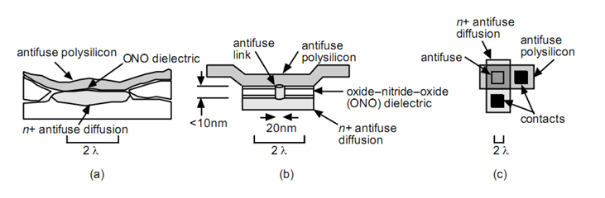
The Antifuse
An antifuse is a one-time programmable element used primarily in FPGAs and programmable logic devices. It initially acts as an open circuit and forms a permanent conductive connection when programmed. The structure of an antifuse consists of a thin oxide–nitride–oxide (ONO) dielectric layer sandwiched between an upper antifuse polysilicon electrode and a lower n⁺ diffusion region in the silicon substrate. During normal operation, the ONO dielectric prevents current flow between these two regions. However, when a high programming voltage is applied across the antifuse, the dielectric layer breaks down, creating a permanent, low-resistance conductive path known as an antifuse link. This process forms a metal-like connection that cannot be reversed, making the antifuse a non-volatile and tamper-resistant element. Antifuse cells are designed with precise dimensions, typically around 2λ pitch, with dielectric thickness less than 10 nm and contact widths around 20 nm, allowing for compact integration. The antifuse’s robust structure and permanent nature make it ideal for applications requiring high security, reliability, and resistance to radiation.
Application-Specific Integrated Circuit and Field Programmable Gate Array Design
******

Slide 5
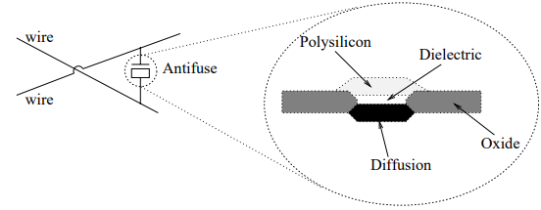
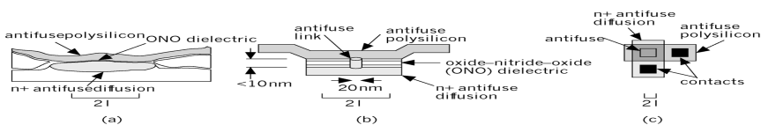
SESSION DESCRIPTION
Basic Antifuse Structure
An Actel antifuse. (a) A cross section. (b) A simplified drawing. (c) From above, an antifuse is approximately the same size as a contact.

Slide 6
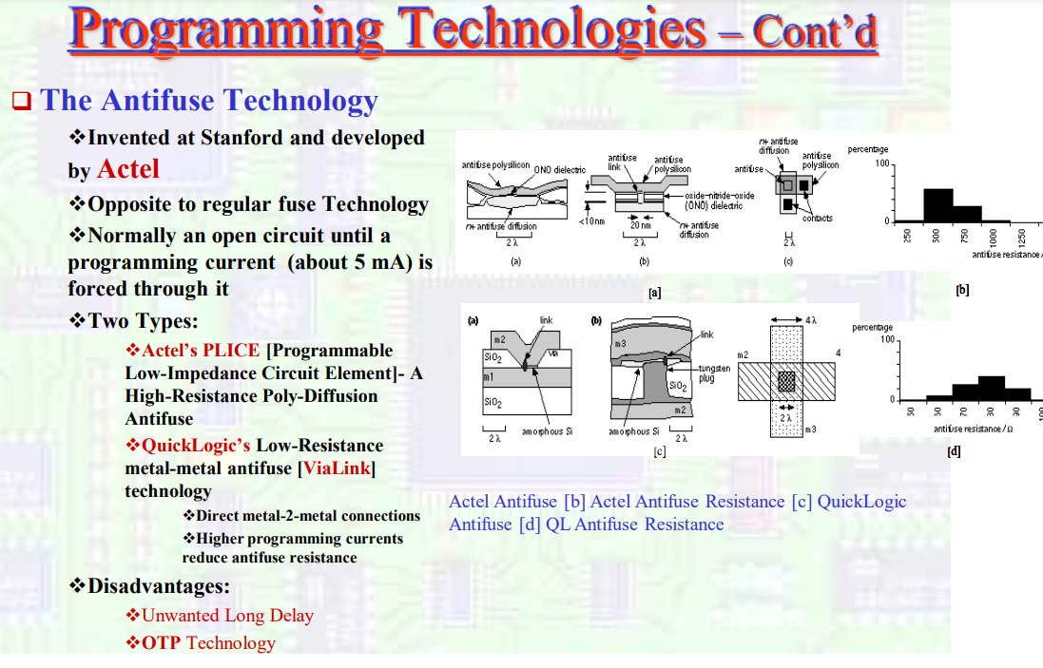

Slide 7
SESSION DESCRIPTION (Cont..)
Programming Techniques in Configurable ICs
Ploy-Diffusion Antifuse
Metal-Metal Antifuse
SRAM-Based Programming Technique
EPROM-based Programming Technique
EEPROM-based Programming Technique

Slide 8
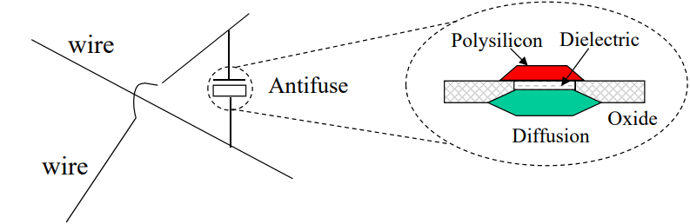
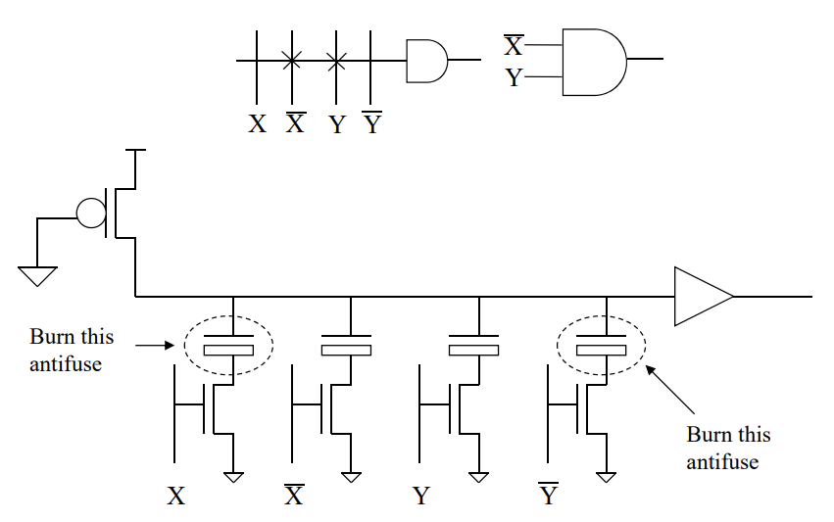
SESSION DESCRIPTION (Cont..)
Poly-Diffusion Antifuse
Antifuse Techniques in PAL & PLA
Implementation of wired-AND gate

Slide 9
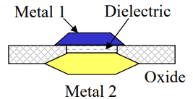
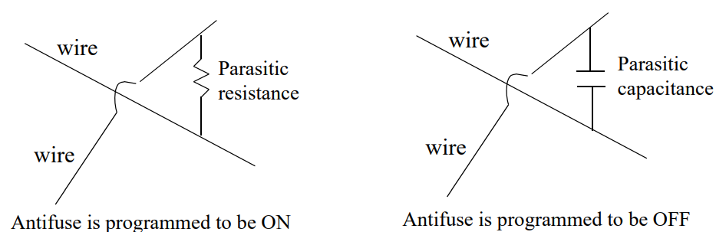
SESSION DESCRIPTION (Cont..)
Metal-Metal Antifuse
Cross section of a metal-metal antifuse
Parasitic effects of antifuse

Slide 10
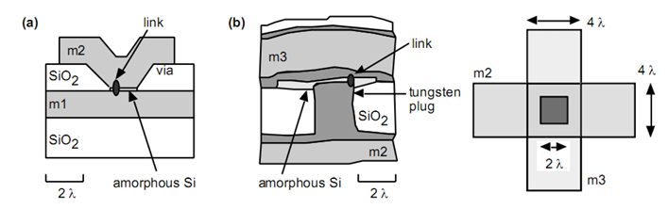
Metal-Metal Antifuse
A metal-to-metal antifuse is a type of antifuse in which the conductive link is formed directly between two metal layers, typically separated by a thin insulating dielectric. Unlike conventional polysilicon-to-diffusion antifuses, metal-metal antifuses are implemented entirely within the interconnect layers of an integrated circuit, allowing for higher density and simpler integration in modern VLSI processes. Initially, the two metal layers are isolated by a thin dielectric material, such as silicon dioxide or other high-k dielectrics. When a programming voltage is applied (usually a high voltage pulse), the dielectric breaks down due to the intense electric field, causing a permanent conductive bridge to form between the two metal layers. This bridge typically consists of melted or electromigrated metal from the adjacent layers, resulting in a low-resistance, non-volatile connection.
Application-Specific Integrated Circuit and Field Programmable Gate Array Design
******

Slide 11
SUMMARY
Antifuses are widely used to permanently program integrated circuits (ICs).
Certain programmable logic devices (PLDs), such as structured ASICs, use fuse technology to configure logic circuits and create a customized design from a standard IC design.
Antifuse PLDs are one time programmable in contrast to other PLDs that are SRAM-based and which may be reprogrammed to fix logic bugs or add new functions.
Antifuse PLDs have advantages over SRAM based PLDs in that like ASICs, they do not need to be configured each time power is applied.

Slide 12
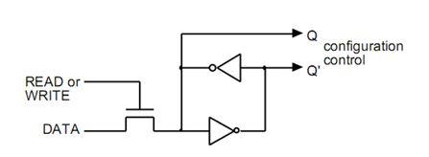
Static RAM [Xilinx SRAM]
Static Random Access Memory (SRAM) is a type of volatile memory that retains data as long as power is supplied. The given diagram shows a basic SRAM cell used in applications such as FPGA configuration and cache memory. This cell consists of two cross-coupled inverters forming a bistable latch, which can hold a single bit of data.
The outputs of the latch, labeled Q and Q̅, are always complementary and are used to control configuration logic.
A control line labeled READ or WRITE is used to enable access to the cell, and a DATA line provides input during a write operation or outputs stored data during a read operation. In the write mode, the control line is activated, and the data present on the DATA line is latched into the cell.
The cross-coupled inverters maintain the stored value as long as power is applied. During a read operation, the stored value is made available at the Q output. SRAM is known for its fast access times, making it ideal for high-speed applications. However, it requires more transistors per bit (typically six), resulting in lower density and higher area consumption compared to other memory types. SRAM is rewritable and widely used in FPGAs, CPU caches, and high-speed memory buffers.

Slide 13
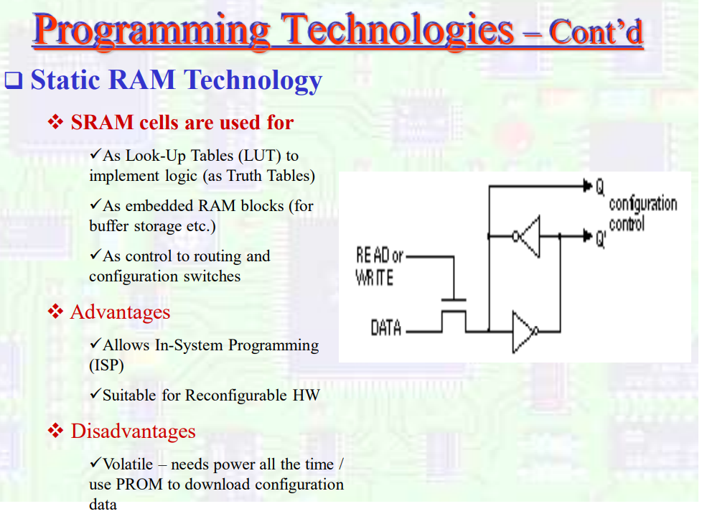

Slide 14
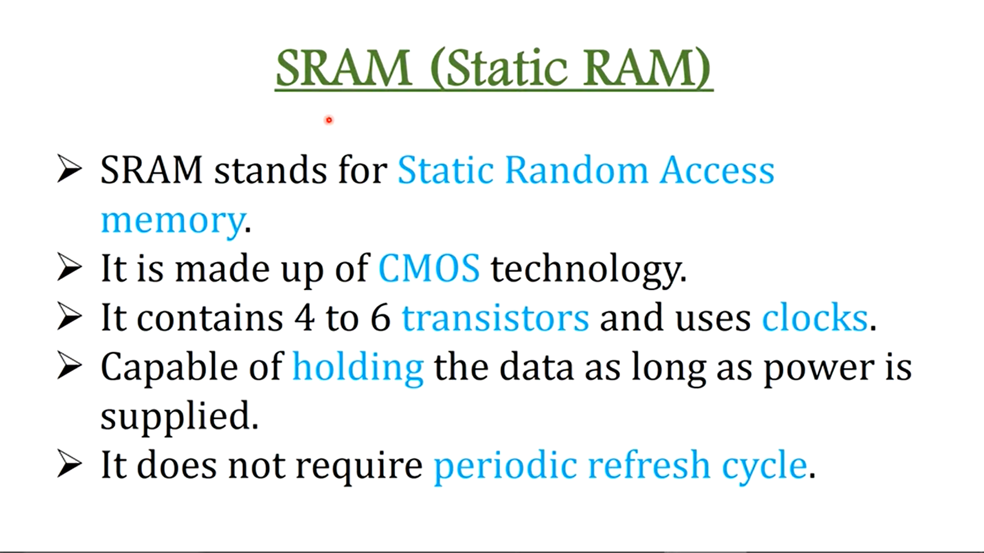

Slide 15
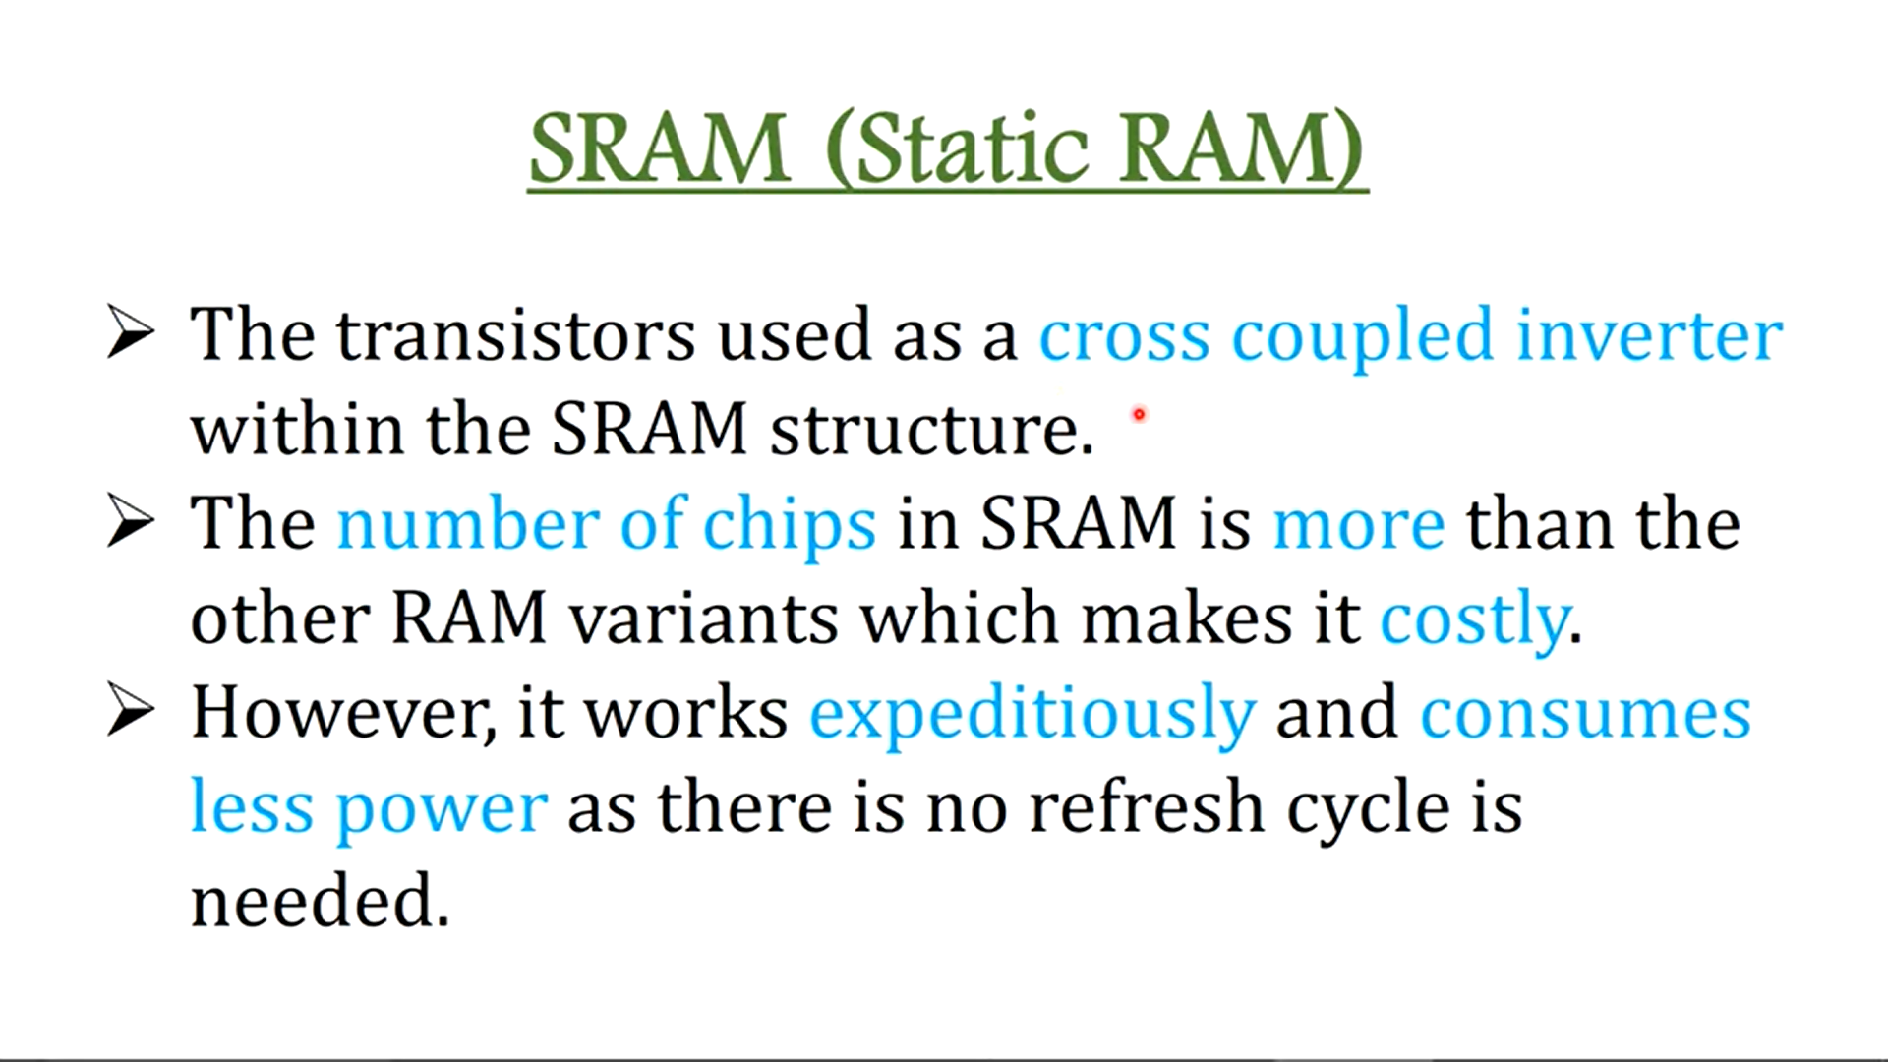

Slide 16
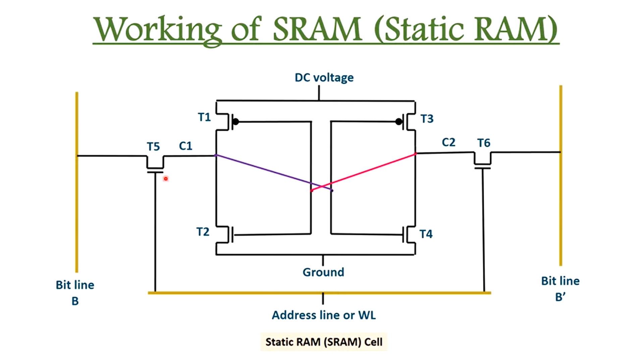

Slide 17
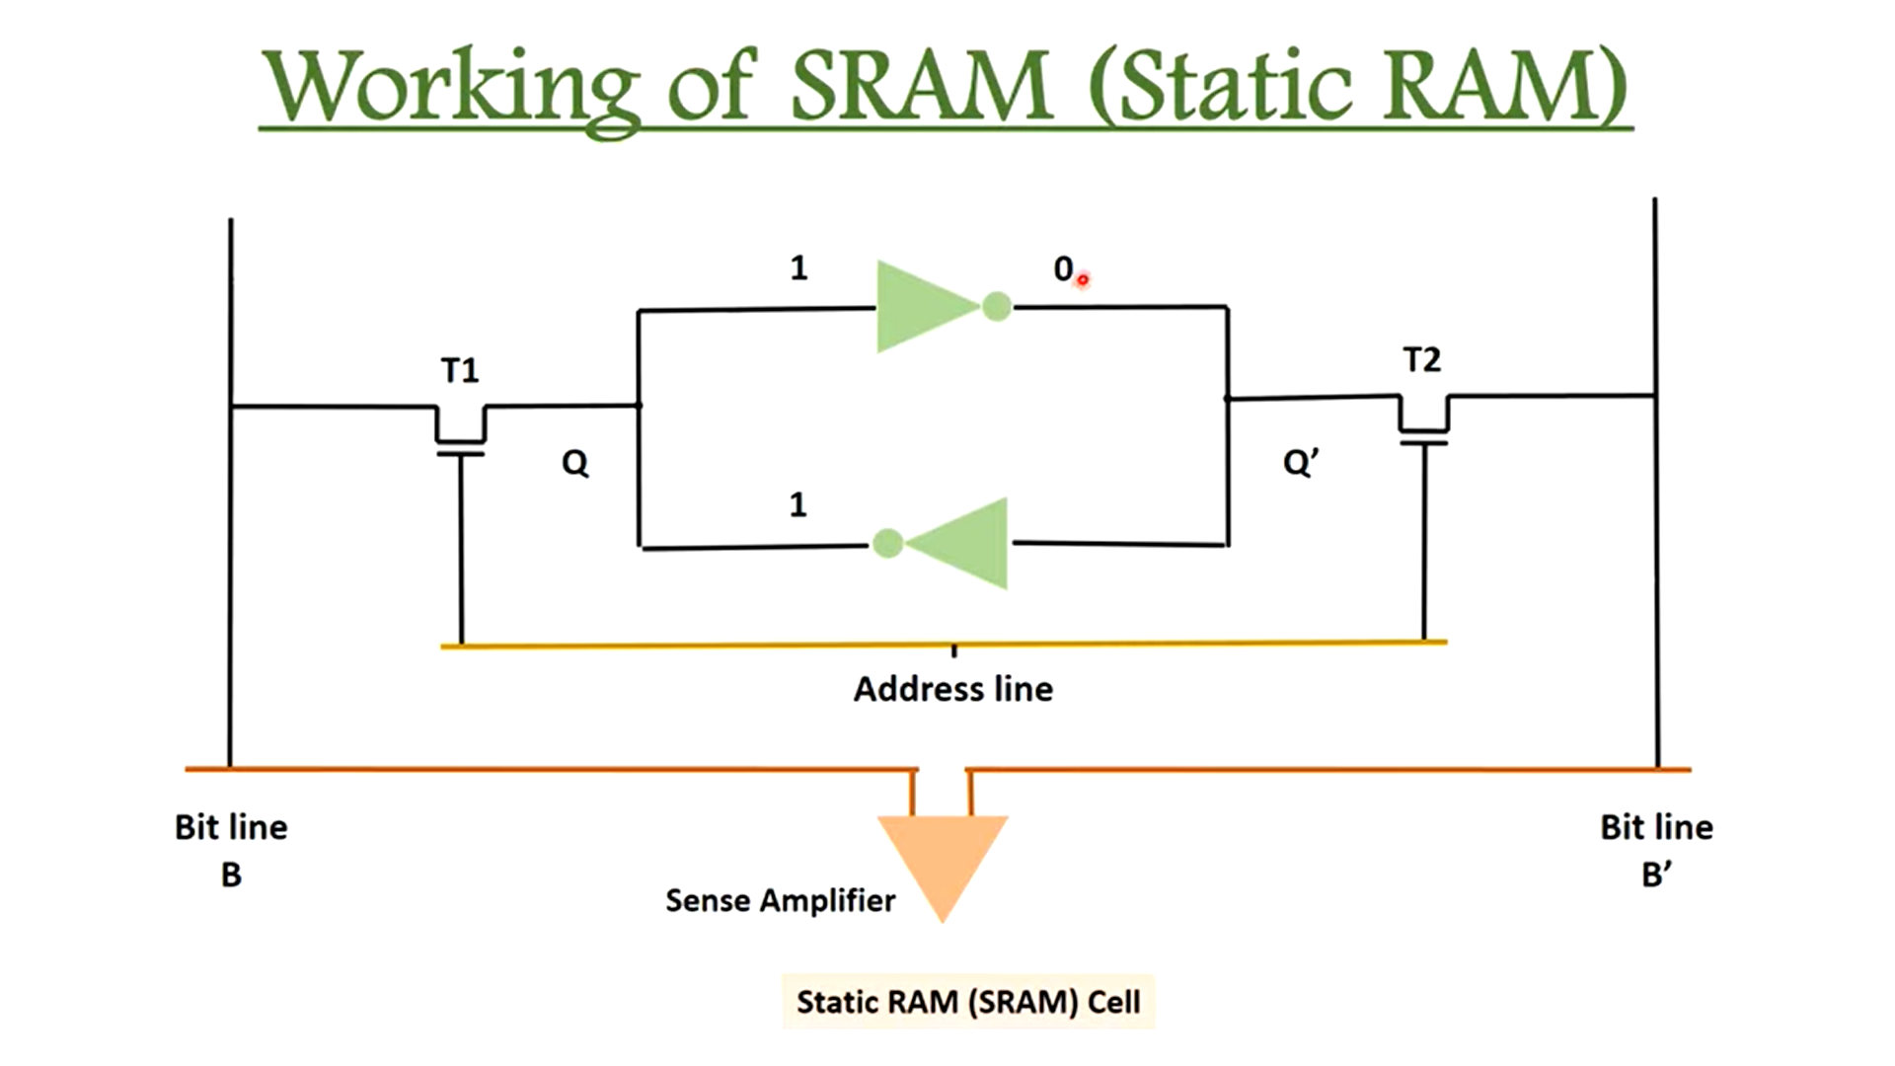

Slide 18
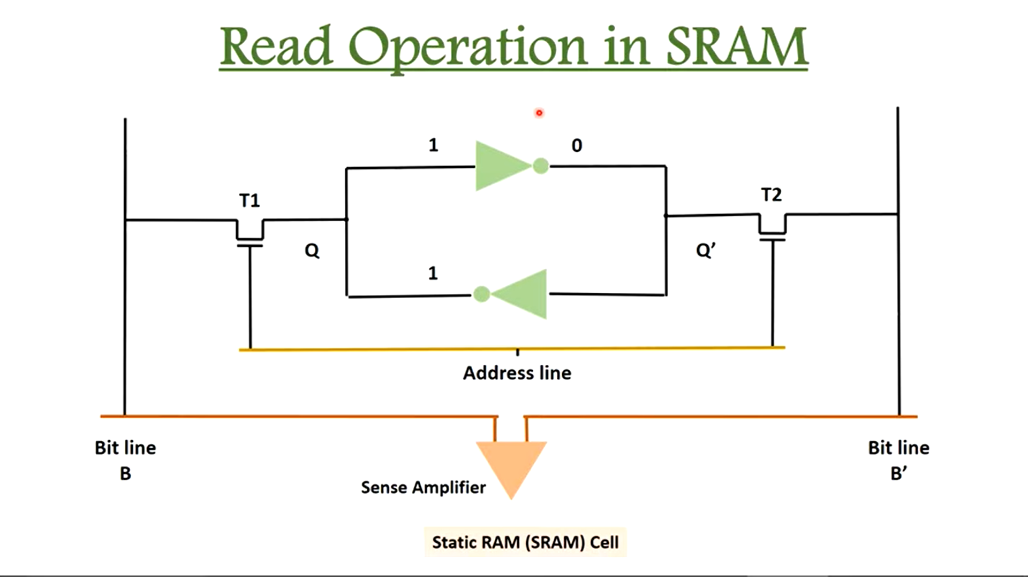

Slide 19
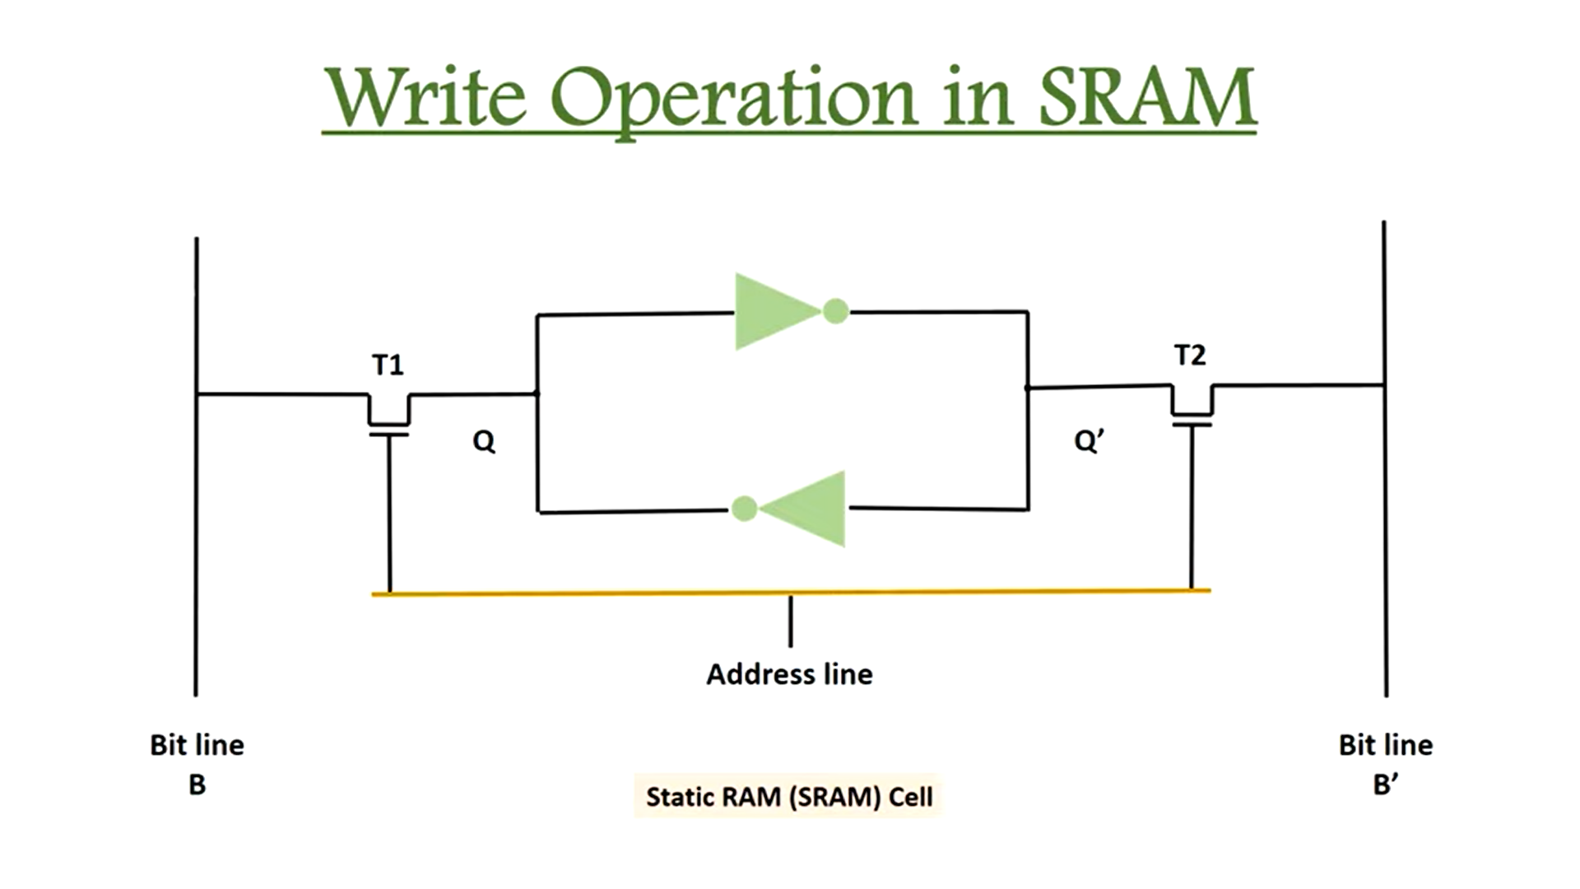

Slide 20
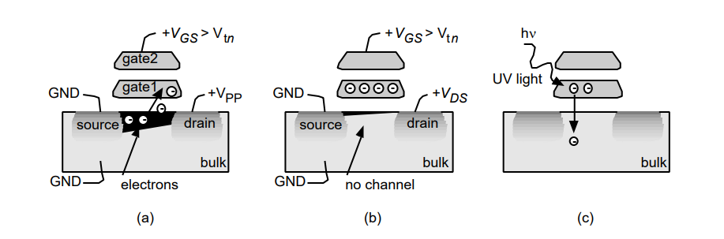
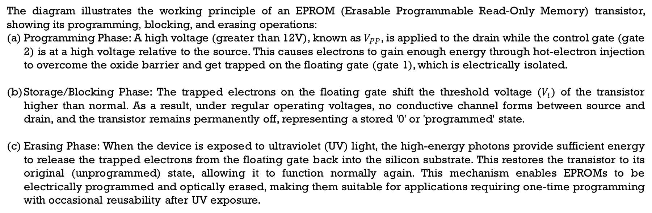
EPROM Technology
The diagram illustrates the working principle of an EPROM (Erasable Programmable Read-Only Memory) transistor, showing its programming, blocking, and erasing operations:
Programming Phase: A high voltage (greater than 12V), known as $V_{PP}$, is applied to the drain while the control gate (gate 2) is at a high voltage relative to the source. This causes electrons to gain enough energy through hot-electron injection to overcome the oxide barrier and get trapped on the floating gate (gate 1), which is electrically isolated.
Storage/Blocking Phase: The trapped electrons on the floating gate shift the threshold voltage ($V_{t}$) of the transistor higher than normal. As a result, under regular operating voltages, no conductive channel forms between source and drain, and the transistor remains permanently off, representing a stored '0' or 'programmed' state.
Erasing Phase: When the device is exposed to ultraviolet (UV) light, the high-energy photons provide sufficient energy to release the trapped electrons from the floating gate back into the silicon substrate. This restores the transistor to its original (unprogrammed) state, allowing it to function normally again. This mechanism enables EPROMs to be electrically programmed and optically erased, making them suitable for applications requiring one-time programming with occasional reusability after UV exposure.

Slide 21
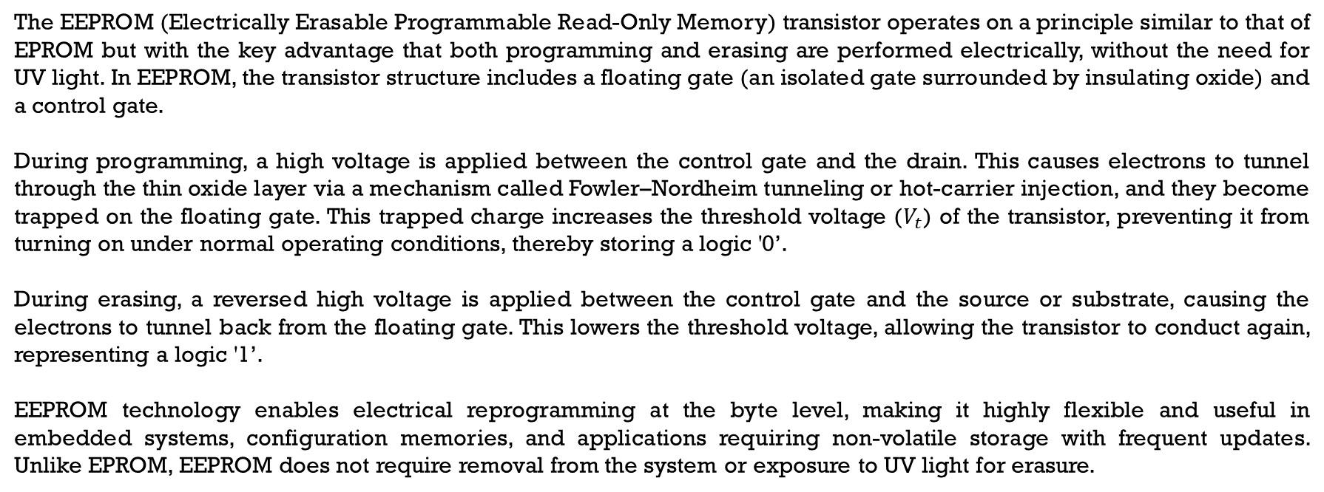
EEPROM Technology
The EEPROM (Electrically Erasable Programmable Read-Only Memory) transistor operates on a principle similar to that of EPROM but with the key advantage that both programming and erasing are performed electrically, without the need for UV light. In EEPROM, the transistor structure includes a floating gate (an isolated gate surrounded by insulating oxide) and a control gate.
During programming, a high voltage is applied between the control gate and the drain. This causes electrons to tunnel through the thin oxide layer via a mechanism called Fowler–Nordheim tunneling or hot-carrier injection, and they become trapped on the floating gate. This trapped charge increases the threshold voltage ($V_{t}$) of the transistor, preventing it from turning on under normal operating conditions, thereby storing a logic '0’.
During erasing, a reversed high voltage is applied between the control gate and the source or substrate, causing the electrons to tunnel back from the floating gate. This lowers the threshold voltage, allowing the transistor to conduct again, representing a logic '1’.
EEPROM technology enables electrical reprogramming at the byte level, making it highly flexible and useful in embedded systems, configuration memories, and applications requiring non-volatile storage with frequent updates. Unlike EPROM, EEPROM does not require removal from the system or exposure to UV light for erasure.
Application-Specific Integrated Circuit and Field Programmable Gate Array Design
******

Slide 22
EEPROM
An EEPROM cell is approximately 2.5 times larger than an EPROM cell because it contains two transistors.
One of the transistors is similar to that of an EPROM transistor in that it contains a floating gate, but the insulating oxide layers surrounding the floating gate are very much thinner.
The second transistor can be used to erase the cell electrically, and EEPROM devices can typically be erased and reprogrammed on a word-by-word basis.

Slide 23
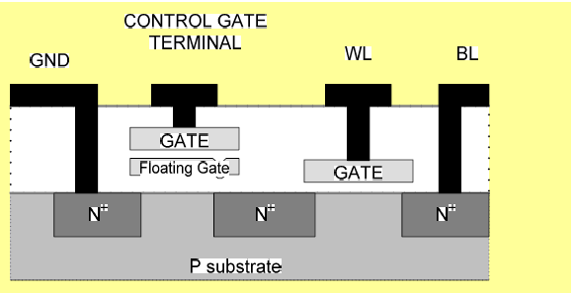
EEPROM

Slide 24
Programmable Logic Devices (PLDs)
Programmable Logic Devices (PLDs) are digital circuits that can be programmed to perform specific logic functions, offering flexibility over fixed-function logic devices.
They are broadly classified into Simple PLDs (SPLDs) such as PROM, PAL, and PLA; Complex PLDs (CPLDs), which integrate multiple SPLDs; and Field Programmable Gate Arrays (FPGAs), which contain thousands of configurable logic blocks and interconnects suitable for complex designs.
PLDs use different architectures, typically involving arrays of AND-OR gates in SPLDs or configurable logic blocks and routing matrices in FPGAs.
They are programmed using various technologies such as fuses, antifuses (one-time programmable), EEPROM and Flash (electrically erasable), and SRAM (volatile and reconfigurable).
Application-Specific Integrated Circuit and Field Programmable Gate Array Design
******

Slide 25
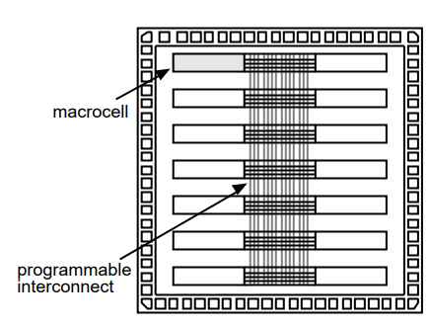
Programmable Logic Devices (PLDs)
A programmable logic device (PLD) consists of
No customized mask layers or logic cells
Fast design turnaround
A single large block of programmable interconnect
A matrix of logic macrocells that usually consist of programmable array logic followed by a flip-flop or latch

Slide 26
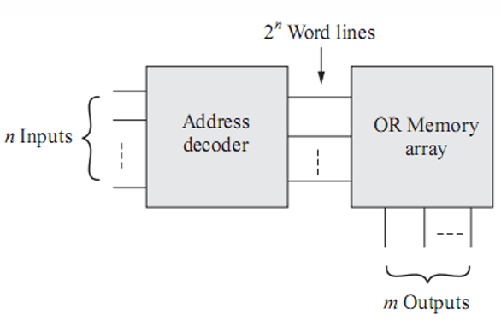
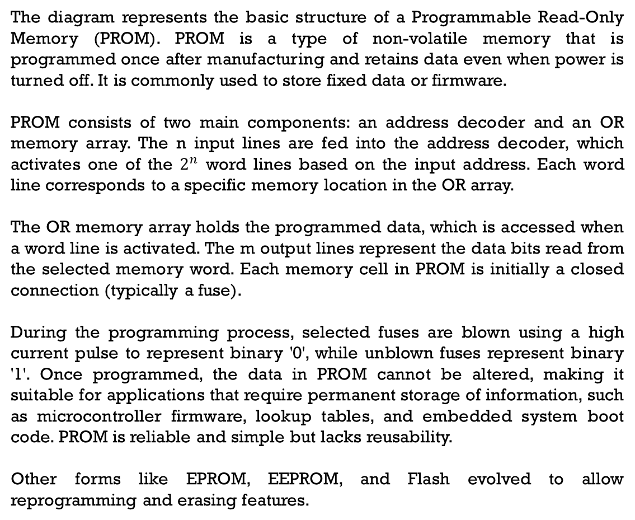
1. Programmable Read-Only Memory [PROM]
The diagram represents the basic structure of a Programmable Read-Only Memory (PROM). PROM is a type of non-volatile memory that is programmed once after manufacturing and retains data even when power is turned off. It is commonly used to store fixed data or firmware.
PROM consists of two main components: an address decoder and an OR memory array. The n input lines are fed into the address decoder, which activates one of the $2^{n}$ word lines based on the input address. Each word line corresponds to a specific memory location in the OR array.
The OR memory array holds the programmed data, which is accessed when a word line is activated. The m output lines represent the data bits read from the selected memory word. Each memory cell in PROM is initially a closed connection (typically a fuse).
During the programming process, selected fuses are blown using a high current pulse to represent binary '0', while unblown fuses represent binary '1'. Once programmed, the data in PROM cannot be altered, making it suitable for applications that require permanent storage of information, such as microcontroller firmware, lookup tables, and embedded system boot code. PROM is reliable and simple but lacks reusability.
Other forms like EPROM, EEPROM, and Flash evolved to allow reprogramming and erasing features.

Slide 27
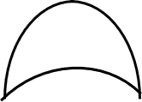
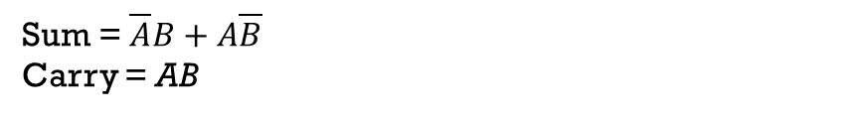
Half-Adder using PROM
Truth Table:
A | B | Sum | Carry
0 | 0 | 0 | 0
0 | 1 | 1 | 0
1 | 0 | 1 | 0
1 | 1 | 0 | 1
A
00
01
×
2x4
Decoder
10
×
B
×
11
OR
OR
Sum = $\overline{A}B+A\overline{B}$
Carry = AB
Carry
Sum
Fig: Implementation
Application-Specific Integrated Circuit and Field Programmable Gate Array Design
******

Slide 28
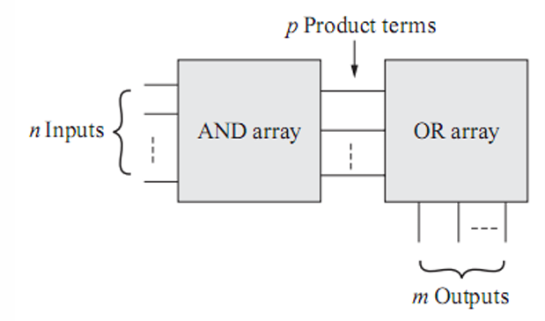
2. Programmable Array Logic [PAL]
The diagram shows the basic architecture of a Programmable Array Logic (PAL) device, which is a type of Simple Programmable Logic Device (SPLD). PAL is used to implement combinational logic functions in digital circuits and offers a balance between flexibility and speed.
A PAL consists of two main components: an AND array and an OR array. The n input lines are connected to a programmable AND array, which generates multiple product terms (p) by logically combining the inputs and their complements. The configuration of the AND array is programmable, allowing designers to select specific input combinations that correspond to desired logic conditions.
These product terms are then fed into a fixed OR array, which sums (logically ORs) selected product terms to produce the m output functions.
Since only the AND array is programmable and the OR array is fixed, PALs offer less flexibility than PLAs (Programmable Logic Arrays) but are faster and simpler to manufacture and configure.
PAL devices are commonly used for implementing sum-of-products expressions, address decoding, and custom logic functions in small to medium-scale digital systems. They are programmable only once (OTP) or reprogrammable depending on the technology used (e.g., fuse or EEPROM).
Application-Specific Integrated Circuit and Field Programmable Gate Array Design

Slide 29
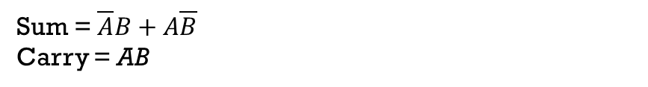
Half-Adder using PAL
Note: AND gate is programmable represent as “×” and OR gate is fixed represent as “ ”
Fig: Implementation
A
B
Truth Table:
A | B | Sum | Carry
0 | 0 | 0 | 0
0 | 1 | 1 | 0
1 | 0 | 1 | 0
1 | 1 | 0 | 1
×
×
A
N
D
×
×
A
N
D
×
×
A
N
D
OR
OR
Sum = $\overline{A}B+A\overline{B}$
Carry = AB
Carry
Sum

Slide 30
3. Programmable Logic Array [PLA]
A Programmable Logic Array (PLA) is a type of programmable logic device used to implement combinational logic circuits in a flexible and structured way. It consists of two programmable arrays: an AND array and an OR array, both of which can be configured by the user.
The n inputs to the PLA are first fed into the programmable AND array, where various combinations of input literals (both true and complemented forms) are logically ANDed to generate multiple product terms (p).
These product terms are then passed to the programmable OR array, where selected combinations of product terms are ORed together to form the desired m output functions. The key feature that distinguishes PLA from PAL is that both the AND and OR arrays are programmable, offering more flexibility in implementing complex logic functions.
However, this flexibility comes at the cost of increased area, delay, and design complexity compared to PALs.
PLAs are particularly useful in applications where multiple logic functions share common terms, as they allow optimal resource sharing and logic minimization. They are typically used in small-scale digital designs, state machines, and function generators where custom logic implementation is required.
Application-Specific Integrated Circuit and Field Programmable Gate Array Design
******

Slide 31
Half-Adder using PLA
Note: AND gate and OR gate both are programmable represent as “×”
Fig: Implementation
A
B
Truth Table:
A | B | Sum | Carry
0 | 0 | 0 | 0
0 | 1 | 1 | 0
1 | 0 | 1 | 0
1 | 1 | 0 | 1
×
×
×
A
N
D
×
×
×
A
N
D
×
×
×
A
N
D
OR
OR
Sum = $\overline{A}B+A\overline{B}$
Carry = AB
Carry
Sum

Slide 32
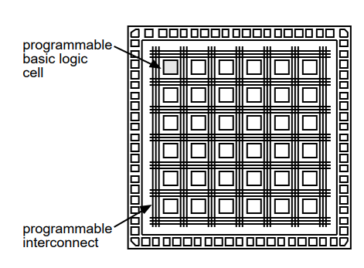
Field-Programmable Gate Arrays
A field-programmable gate array (FPGA) or complex PLD consists of
None of the mask layers are customized
A method for programming the basic logic cells and the interconnect
The core is a regular array of programmable basic logic cells that can implement combinational as well as sequential logic (flip-flops)
A matrix of programmable interconnect surrounds the basic logic cells
Programmable I/O cells surround the core
Design turnaround is a few hours

Slide 33
Two ICs that might or might not be considered as ASICs are, a controller chip for a PC and a chip for a modem. Both of these examples are specific to an application (shades of an ASIC) but are sold to many different system vendors (shades of a standard part). ASICs such as these are sometimes called application- specific standard products ( ASSPs ).

Slide 34
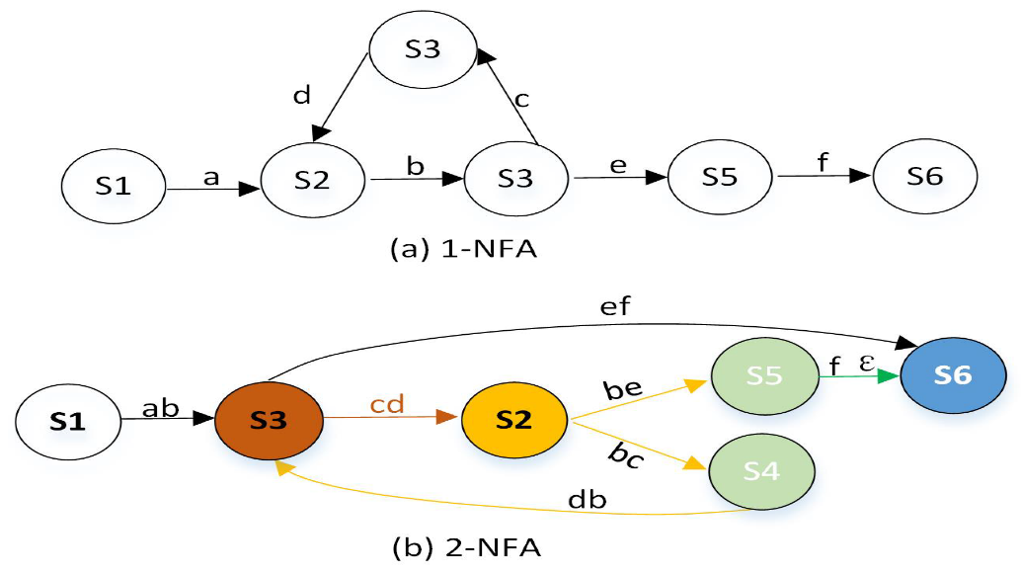
Vertex Concepts
Programmable ASICs—such as FPGAs (Field-Programmable Gate Arrays) and PLDs (Programmable Logic Devices)—are integrated circuits that can be configured or reconfigured after manufacturing to perform specific digital logic tasks. They consist of arrays of logic blocks and interconnects that are programmed to implement custom circuits In the context of programmable ASICs or FPGA design, “vertex” doesn’t refer to geometry in silicon fabrication—it’s often used in two key ways:
State Machines or Graph Models: In FPGA designs involving finite state machines (FSMs), each "state" can be depicted as a node or vertex. The transitions between states represent edges, which map neatly to hardware logic implementations.
Vertex Processing in Graphics Pipelines: Some futuristic FPGA-based GPU designs include dedicated vertex processors—hardware blocks that transform 3D coordinates and apply lighting to vertices in a graphics pipeline, optimized for parallel processing
A flow diagram showing vertex transitions

