Slide 1


Department of ECE
ASIC & FPGA Design
23ec2230F
Topic:
Programmable ASIC Logic Cells:

Slide 2
Actel Architecture
SESSION INTRODUCTION
The ACT 1 Series of field programmable gate arrays
(FPGAs) offers a variety of package, speed, and application
combinations. Devices are implemented in silicon gate,
1-micron two-level metal CMOS, and they employ Actel’s
PLICE® antifuse technology. The unique architecture offers
gate array flexibility, high performance, and instant
turnaround through user programming. Device utilization is
typically 95 to 100 percent of available logic modules.

Slide 3
ACT 1 devices also provide system designers with unique
on-chip diagnostic probe capabilities, allowing convenient
testing and debugging. Additional features include an on-chip
clock driver with a hardwired distribution network. The
network provides efficient clock distribution with minimum
skew.
The user-definable I/Os are capable of driving at both TTL
and CMOS drive levels. Available packages include plastic
and ceramic J-leaded chip carriers, ceramic and plastic quad
flatpacks, and ceramic pin grid array

Slide 4
Features
• 5V and 3.3V Families fully compatible with JEDEC
specifications
• Up to 2000 Gate Array Gates (6000 PLD equivalent gates)
• Replaces up to 50 TTL Packages
• Replaces up to twenty 20-Pin PAL® Packages
• Design Library with over 250 Macro Functions
• Gate Array Architecture Allows Completely Automatic
Place and Route
• Up to 547 Programmable Logic Modules
• Up to 273 Flip-Flops
• Data Rates to 75 MHz
• Two In-Circuit Diagnostic Probe Pins Support Speed
Analysis to 25 MHz
• Built-In High Speed Clock Distribution Network
• I/O Drive to 10 mA (5 V), 6 mA (3.3 V)
• Nonvolatile, User Programmable
• Fabricated in 1.0 micron CMOS technology

Slide 5
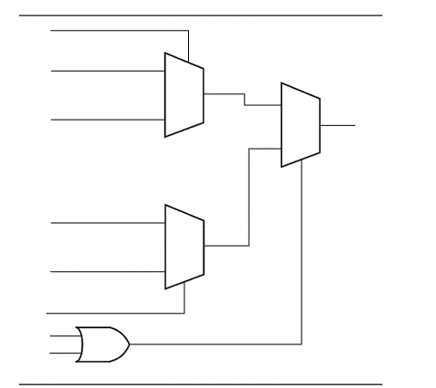
ACT 1 Logic Module

Slide 6
Features
Logic Module Inputs / Outputs: 8 inputs, 1 output per logic module.
• ACT 1010 = ~1,200 gates (≈ 3,000 PLD)
• ACT 1020 = ~2,000 gates (≈ 6,000 PLD)
Antifuses Count ACT 1010 has about 112,000 antifuses;
ACT 1020 has about 186,000 antifuses.
I/O Pins / I/O Buffer Features • I/O pins are programmable: input, output, three-state
Performance / Speed • System level performance: up to ~40 MHz for some applications (depending on part / temperature / supply etc.)

Slide 7
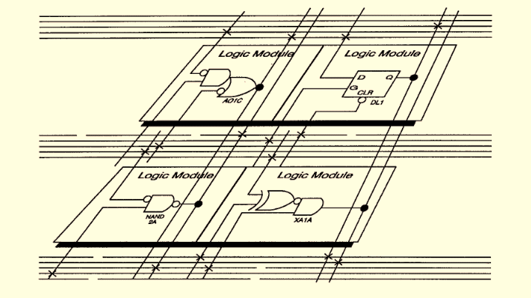
Partial View of an ACT 1 Device

Slide 8
ACT 3 Family
Features
• Up to 10,000 Gate Array Equivalent Gates (up to 25,000
equivalent PLD Gates)
• Highly Predictable Performance with 100% Automatic Place-
and-Route
• As Low as 9.0 ns Clock-to-Output Times (–1 Speed Grade)
• Up to 186 MHz On-Chip Performance (–1 Speed Grade)
• Up to 228 User-Programmable I/O Pins
• Four Fast, Low-Skew Clock Networks

Slide 9
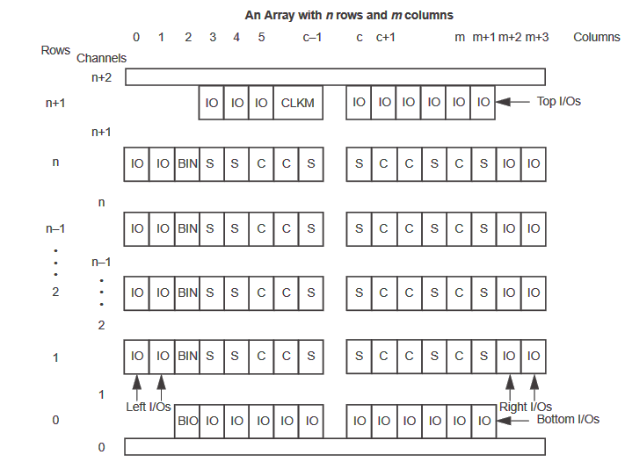
Generalized Floor Plan of ACT 3 Device

Slide 10
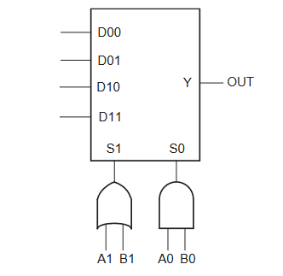
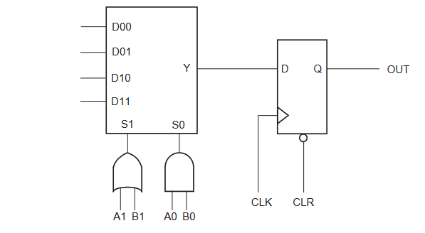
C-Module Diagram
S-Module Diagram

Slide 11
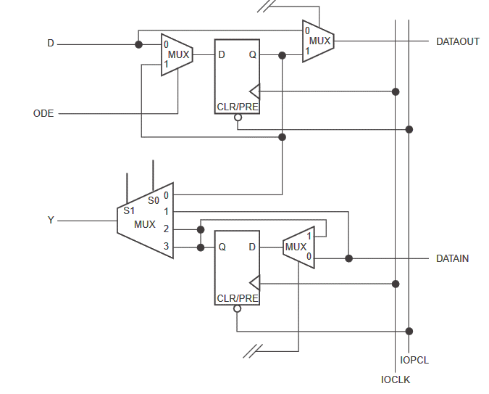
Functional Diagram for I/O Module

Slide 12
SUMMARY
ACT-1 Architecture: ACT-1 was one of Actel's earlier FPGA architectures. It provided basic programmable logic elements and I/O blocks. While it had limited capabilities compared to modern FPGAs, it was instrumental in enabling configurable logic for various applications.
ACT-2 Architecture: ACT-2 represented an advancement over ACT-1 with improved logic capacity, routing, and I/O capabilities. It was used in a wide range of applications, including telecommunications, aerospace, and industrial control systems.
ACT-3 Architecture: ACT-3 was the next evolution in Actel's FPGA architectures, offering even greater capacity, speed, and functionality. It was suitable for more complex designs and high-performance applications.

Slide 13
TERMINAL QUESTIONS
Explain the key improvement in ACT-2 architecture compared to ACT-1?
Describe the ACT FPGA architecture had the highest logic capacity and performance?

Slide 14
Topic:
Xilinx – XC3000

Slide 15
SESSION INTRODUCTION
The Xilinx XC3000 series, specifically known as the XC3000A, was a family of Field-Programmable Gate Arrays (FPGAs) developed by Xilinx. These FPGAs were introduced in the late 1980s and early 1990s and played a significant role in the early development and popularization of FPGA technology.
The XC3000 series was one of the pioneering families of FPGAs, and it contributed to the growth and acceptance of FPGA technology in the electronics industry.
These FPGAs were known for their re configurability, allowing users to implement custom digital logic functions by configuring the internal programmable logic cells and interconnections.
The XC3000 series offered a range of logic densities, making them suitable for a variety of applications, from small-scale to medium-scale designs.

Slide 16
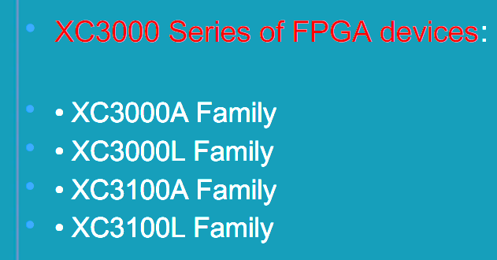
FPGA Routing Architecture
These FPGAs provided flexibility in terms of input and output (I/O) configurations, making them adaptable to different interface requirements.

Slide 17
XC3000 Family
XC3000 Family The basic XC3000 family forms the cornerstone for the rest of the XC3000 class of devices. The basic XC3000 family offers five different device densities with guaranteed toggle rates from 70 to 125 MHz. XC3000A Family
The XC3000A is an enhanced version of the basic XC3000 family, featuring additional interconnect resources and other user-friendly enhancements. The ease-of-use of the XC3000A family makes it the obvious choice for all new designs that do not require the speed of the XC3100 or the 3-V operation of the XC3000L.
XC3000L Family The XC3000L is identical in architecture and features to the XC3000A family, but operates at a nominal supply voltage of 3.3 V.
The XC3000L is the right solution for battery-operated and low-power applications. XC3100 Family The XC3100 is a performance-optimized relative of the basic XC3000 family. While both families are bitstream and footprint compatible, the XC3100 family extends toggle rates to 270 MHz and in-system performance to 80 MHz.
The XC3100 family also offers one additional array size, the XC3195. The XC3100 is best suited for designs that require the highest clock speed or the shortest net delays. XC3100A Family The XC3100A combines the enhanced feature set of the XC3000A with the performance of the XC3100. It offers the highest functionality, speed and capacity of all XC3000 families.

Slide 18
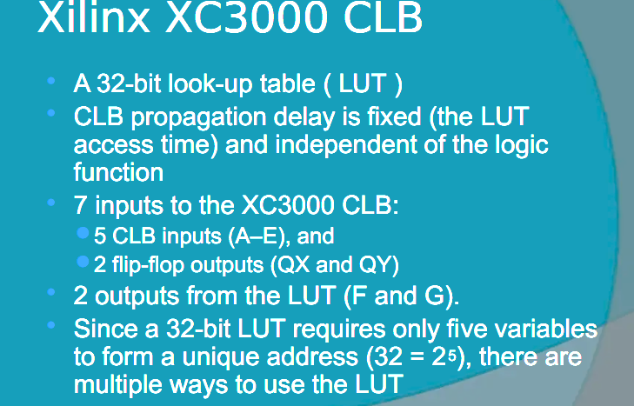
SESSION DESCRIPTION (Cont..)
It's important to note that the XC3000 series is now considered obsolete, and Xilinx has long since moved on to newer generations of FPGA families with increased capabilities, higher performance, and more advanced features.

Slide 19
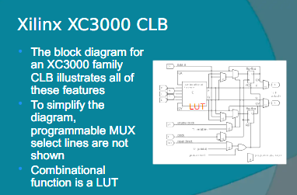
The XC3000 series marked an important milestone in the history of FPGA technology, serving as a precursor to more advanced FPGA families like the Virtex, Spartan, and Zynq series.

Slide 20
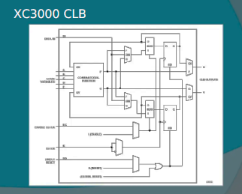
the Xilinx XC3000 series of FPGAs was an early and influential family of programmable logic devices that contributed to the development of FPGA technology. While they are no longer in production and have been succeeded by more advanced FPGA families, they hold historical significance in the field of digital design and reconfigurable hardware.

Slide 21
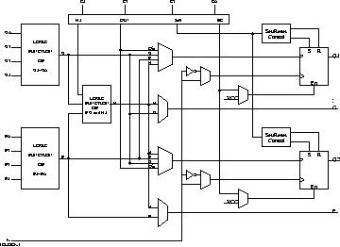
XC 4000
3 LUTs and 2 Flip-flops in a two stage arrangement
2 Outputs: Can be registered or combinational
External signals can also be registered
More of internal signals are available for connections
Can implement any two independent functions of four variables or any single function of five variables
XC4000 CLB

Slide 22
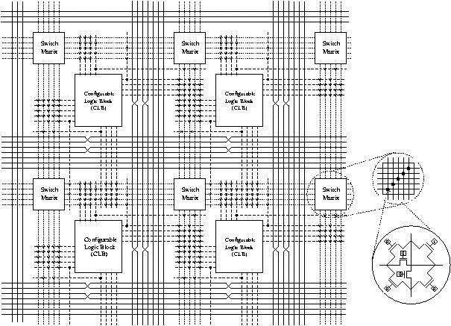
XC4000
XC4000 Routing Architecture

Slide 23
XC4000 Routing Architecture
Wire segments
Single length lines
Spans single CLB
Connects adjacent CLBs
Used to connect signals that do not have critical timing requirements
Double length lines
Spans two CLBs
Uses half as much switch as a single length connection
Long lines
Low skew; Used for signals such as clock
Relatively rare resource
Switch Matrix
Every line is connected to lines on the other three direction
Each connection requires six transistors

Slide 24
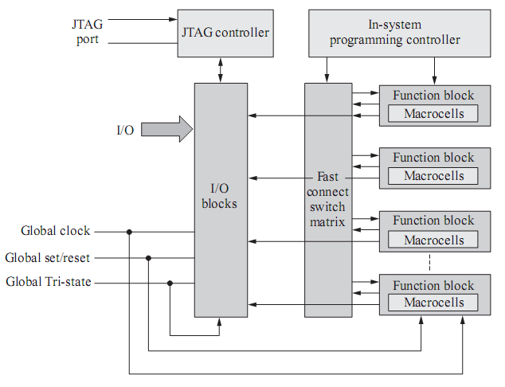
Xilinx XC9500 CPLD

Slide 25
SUMMARY
The Xilinx XC3000 series of FPGAs had a significant impact on the early development of FPGA technology. While they are no longer in production and have been replaced by more advanced FPGA families, they remain historically important in the field of digital design and reconfigurable hardware

Slide 26
TERMINAL QUESTIONS
What was a key feature of the Xilinx XC3000 series FPGAs?
Which of the following best describes the current status of the Xilinx XC3000 series
What role did the XC3000 series play in the history of FPGA technology?

Slide 27
Topic:
Altera – FLEX 8000/10000

Slide 28
SESSION INTRODUCTION
Features
Devices are fabricated on advanced processes and operate with
a 3.3- or 5.0-V supply voltage (see Table 3)
– In-circuit reconfigurability (ICR) via external Configuration
EPROM, intelligent controller, or JTAG port
– ClockLock and ClockBoost options for reduced clock
delay/skew and clock multiplication
– Built-in low-skew clock distribution trees
– 100 % functional testing of all devices; test vectors or scan chains
are not required

Slide 29
Altera’s FLEX 10K devices are the industry’s first embedded PLDs. Based
on reconfigurable CMOS SRAM elements, the Flexible Logic Element
MatriX (FLEX) architecture incorporates all features necessary to
implement common gate array megafunctions. With up to 250,000 gates,
the FLEX 10K family provides the density, speed, and features to integrate
entire systems, including multiple 32-bit buses, into a single device.
FLEX 10K devices are configurable, and they are 100% tested prior to
shipment. As a result, the designer is not required to generate test vectors
for fault coverage purposes. Instead, the designer can focus on simulation
and design verification. In addition, the designer does not need to manage
inventories of different gate array designs; FLEX 10K devices can be
configured on the board for the specific functionality required

Slide 30
The FLEX 10K architecture is similar to that of embedded gate arrays, the
fastest-growing segment of the gate array market. As with standard gate
arrays, embedded gate arrays implement general logic in a conventional
“sea-of-gates” architecture. In addition, embedded gate arrays have
dedicated die areas for implementing large, specialized functions. By
embedding functions in silicon, embedded gate arrays provide reduced
die area and increased speed compared to standard gate arrays. However,
embedded megafunctions typically cannot be customized, limiting the
designer’s options. In contrast, FLEX 10K devices are programmable,
providing the designer with full control over embedded megafunctions
and general logic while facilitating iterative design changes during
debugging.
Each FLEX 10K device contains an embedded array and a logic array. The
embedded array is used to implement a variety of memory functions or
complex logic functions, such as digital signal processing (DSP),
microcontroller, wide-data-path manipulation, and data-transformation
functions. The logic array performs the same function as the sea-of-gates
in the gate array: it is used to implement general logic, such as counters,
adders, state machines, and multiplexers. The combination of embedded
and logic arrays provides the high performance and high density of
embedded gate arrays, enabling designers to implement an entire system
on a single device.

Slide 31
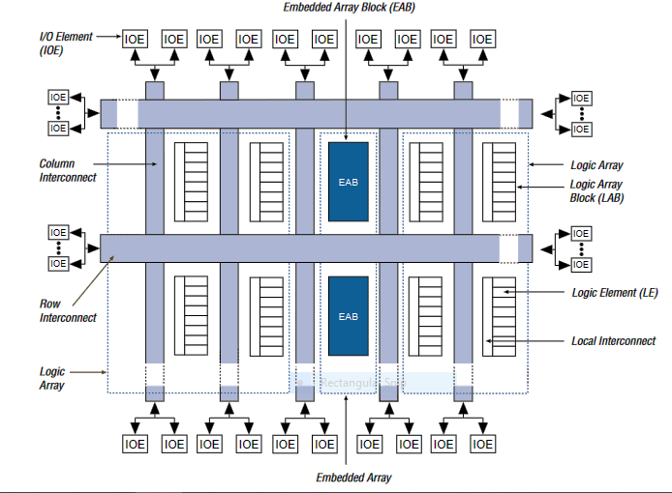
FLEX 10K Device Block Diagram

Slide 32
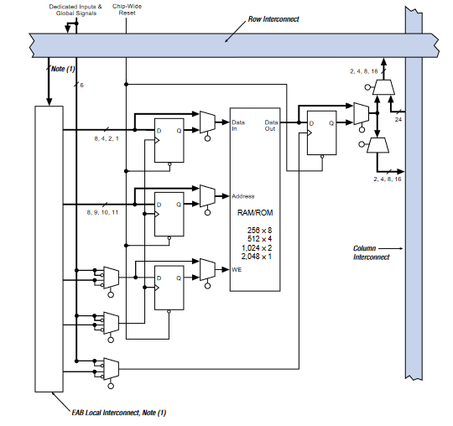
FLEX 10K Embedded Array Block

Slide 33
SUMMARY
The Altera FLEX 8000/10000 series refers to a family of programmable logic devices (PLDs) developed by Altera Corporation, which is now a part of Intel Corporation. These PLDs were widely used for various applications that required flexible and customizable digital logic functions
The Altera FLEX 8000/10000 series of FPGAs played a significant role in the history of programmable logic devices. Their flexibility and programmability made them valuable in a wide range of applications. However, given the rapid advancement in FPGA technology, it's advisable to consider newer FPGA families for contemporary projects, and you should check with the manufacturer for the latest information and support regarding these older devices.

Slide 34
TERMINAL QUESTIONS
Explain the software tool is commonly used for designing and programming Altera FLEX 8000/10000 series FPGAs?
Describe the Altera FLEX 8000/10000 series of FPGAs
What is the most likely status of the Altera FLEX 8000/10000 series as of 2023? Explain

Slide 35
Topic:
Altera Series- MAX 5000/7000

Slide 36
SESSION INTRODUCTION
MAX 7000 devices use CMOS EEPROM cells to implement logic functions. The user-configurable MAX 7000 architecture accommodates a variety of independent combinatorial and sequential logic functions. The devices can be reprogrammed for quick and efficient iterations during design development and debug cycles, and can be programmed and erased up to 100 times

Slide 37
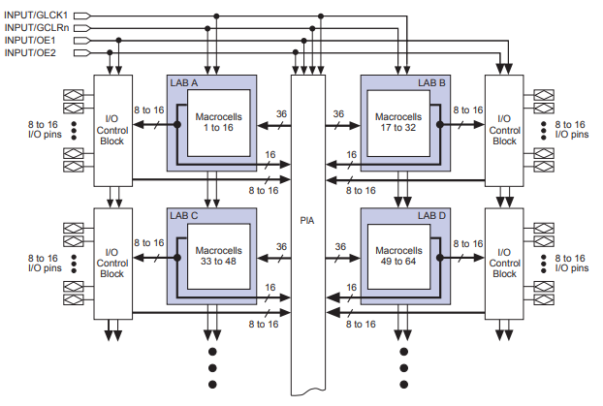
SESSION DESCRIPTION

Slide 38
SUMMARY
The MAX 7000 family of high-density, high-performance PLDs is based on Altera’s second-generation MAX architecture. Fabricated with advanced CMOS technology, the EEPROM-based MAX 7000 family provides 600 to 5,000 usable gates, ISP, pin-to-pin delays as fast as 5 ns, and counter speeds of up to 175.4 MHz. MAX 7000S devices in the -5, -6, -7, and -10 speed grades as well as MAX 7000 and MAX 7000E devices in -5, -6, -7, -10P, and -12P speed grades comply with the PCI Special Interest Group (PCI SIG) PCI Local Bus Specification.

Slide 39
Topic:
AMDs – CPLD (Mach 1 to 5)

Slide 40
SESSION INTRODUCTION
The MACH 1,2,3,4 & 5 families from Lattice/Vantis offer high-performance, low cost Complex Programmable Logic Devices (CPLDs), addressing the growing need for speed in networking, telecommunications and computing. MACH 1,2,3,4 & 5 devices are available in speeds as fast as 5.0-ns tPD and in densities ranging from 32 to 128 macrocells. The overall beneﬁts for users include guaranteed high performance for entry-to-mid-level logic needs at a low cost.

Slide 41
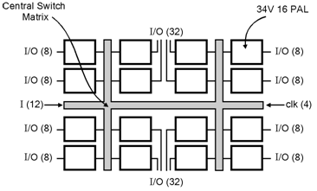
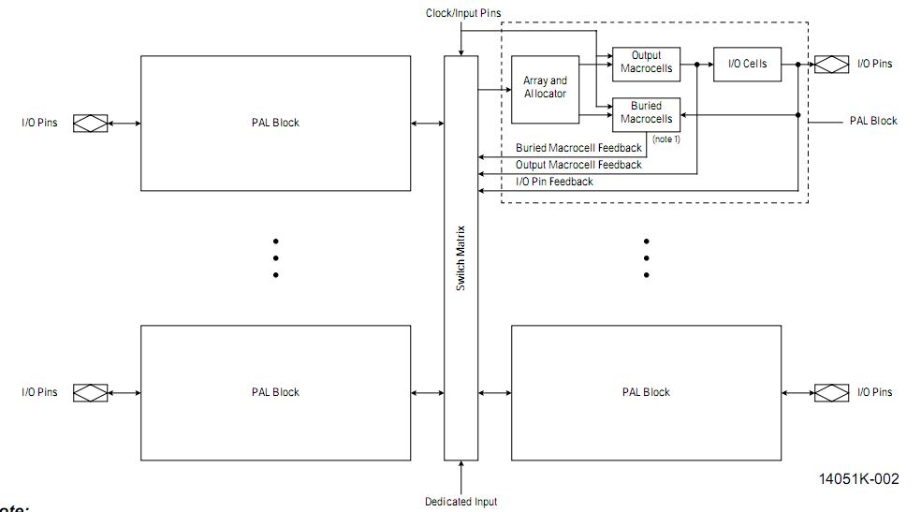
SESSION DESCRIPTION
MACH 1 devices

Slide 42
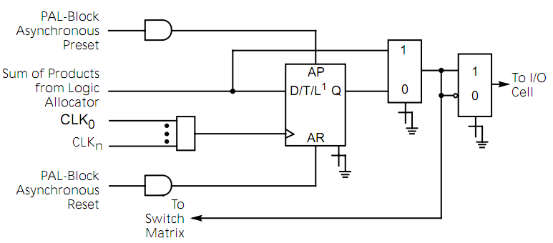
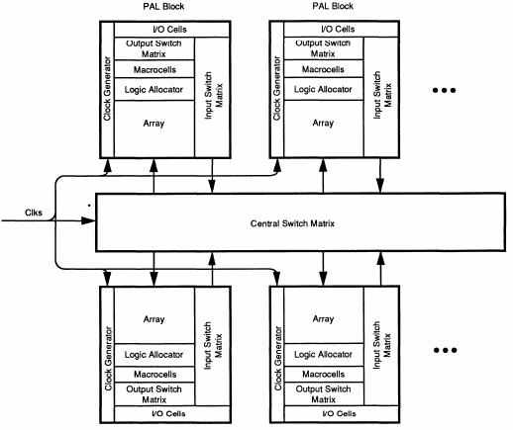
SESSION DESCRIPTION (Cont..)
MACH 2 devices
MACH 3 Block Diagram

Slide 43
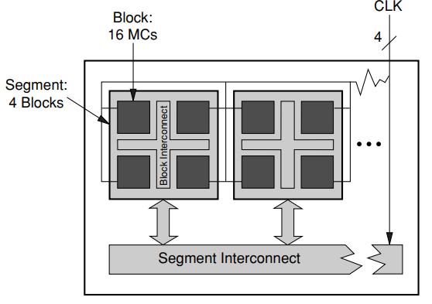
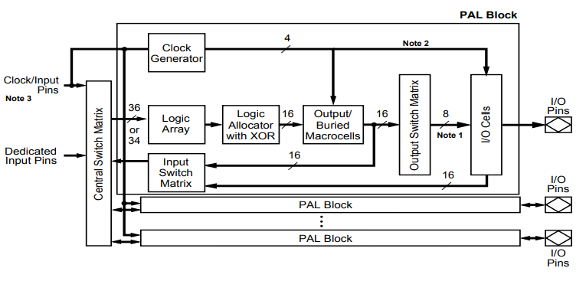
SESSION DESCRIPTION (Cont..)
MACH 4 Block Diagram
MACH 5 Block Diagram

Slide 44
SUMMARY
Advanced Micro Devices (AMD) offers CPLDs with five sub families called Mach 1 to 5
Mach devices uses EEPROM technology
Mach devices are small in size, high speed and low power devices
Each Mach devices has multiple PAL blocks
Mach 1 and Mach 2 consists 22V16 PALs
Mach 3 and Mach 4 consists 34V16 PALs
Mach 5 consists 34VPALs with enhanced speed

Slide 45
TERMINAL QUESTIONS
1. Sketch the Mach I/O Cell
2. Sketch the MACH Product Term Clusters and the Logic Allocator

Slide 46
Topic:
Cypress FLASH 370 Device technology

Slide 47
SESSION INTRODUCTION
The FLASH370 family of CMOS CPLDs provides a range of high-density programmable logic solutions with unparalleled performance. Each member of the family is designed with Cypress’s state-of-the-art Flash technology. All of the devices are electrically erasable and reprogrammable, simplifying product inventory and reducing costs. The FLASH370 family is designed to bring the flexibility, ease of use and performance of the 22V10 to high-density CPLDs. The architecture is based on a number of logic blocks that are connected by a Programmable Interconnect Matrix (PIM). Each logic block features its own product term array, product term allocator array, and 16 macrocells. The PIM distributes signals from one logic block to another as well as all inputs from pins. The family features a wide variety of densities and pin counts to choose from. At each density there are two packaging options to choose from—one that is I/O intensive and another that is register intensive.

Slide 48
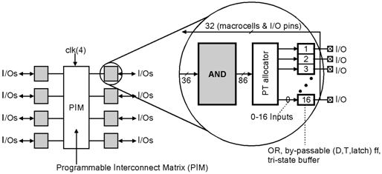
SESSION DESCRIPTION
FLASH370

Slide 49
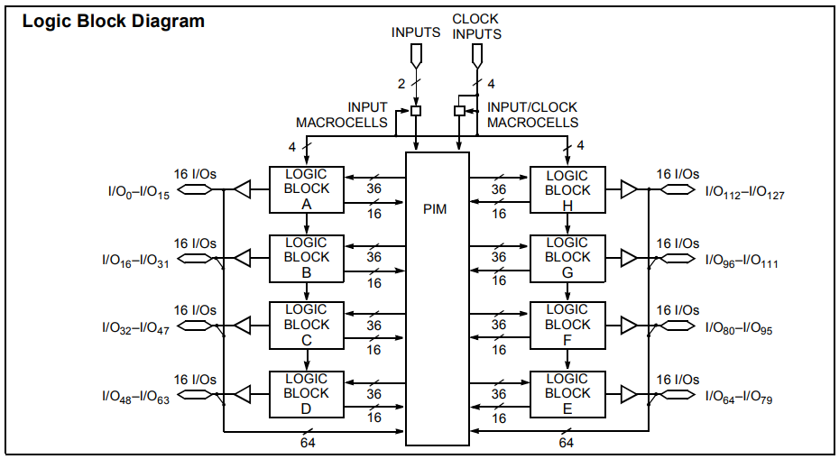
SESSION DESCRIPTION (Cont..)

Slide 50
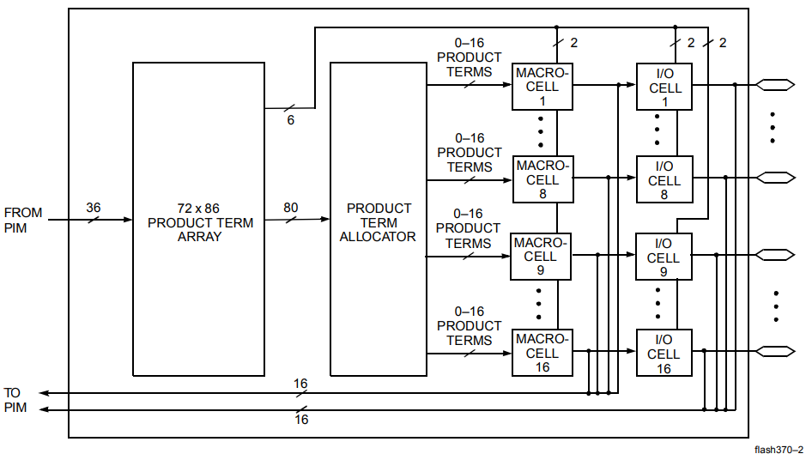
SESSION DESCRIPTION (Cont..)

Slide 51
SUMMARY
Stated another way, the FLASH370 features: • no fanout delays • no expander delays • no dedicated vs. I/O pin delays • no additional delay through PIM • no penalty for using 0–16 product terms • no added delay for steering product terms • no added delay for sharing product terms • no routing delays • no output bypass delays The simple timing model of the FLASH370 family eliminates unexpected performance penalties.

Slide 52
TERMINAL QUESTIONS
1. Define Allocator
2. Explain Product Term Array

Slide 53
Topic:
I/O Cells AND Xilinx I/O Block.

Slide 54
SESSION INTRODUCTION
The I/O cell architecture is similar to that of embedded gate arrays, the fastest-growing segment of the gate array market. As with standard gate arrays, embedded gate arrays implement general logic in a conventional “sea-of-gates” architecture. In addition, embedded gate arrays have dedicated die areas for implementing large, specialized functions. By embedding functions in silicon, embedded gate arrays provide reduced die area and increased speed compared to standard gate arrays. However, embedded mega functions typically cannot be customized, limiting the designer’s options. In contrast, I/O cell devices are programmable, providing the designer with full control over embedded mega functions and general logic while facilitating iterative design changes during debugging.

Slide 55
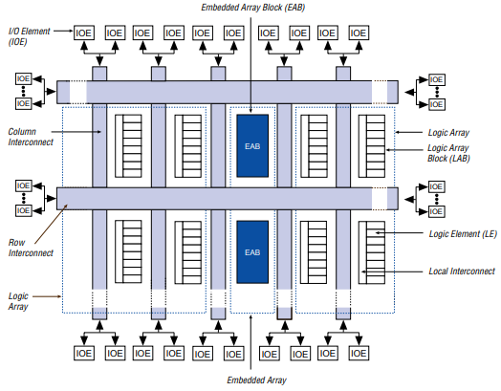
SESSION DESCRIPTION

Slide 56
Topic:
FPGA Partitioning, Floor planning, Placement, Routing.

Slide 57
Partitioning:
An MCM may contain as many as 100 chips. In turn, each chip can accommodate a certain number of transistors.
The first assignment herein is to partition the given circuit into subcircuits.
The partitioning should warrant fabrication of each subcircuits on a single chip.
Simultaneously, the number of subcircuits should be equivalent to or less than the number of chips that the MCM can sustain.
Please note that the MCM designs require performance driven approach. This requirement necessitates consideration of the power and timing constraints in the partitioning step.
These requirements shall be in addition to the traditional I/O constraints and area constraints for chip sites.
Placement:
The placement step is concerned with mapping the chips to the chip sites on the MCM substrate.
Placement, of course affects not only the thermal characteristics of an MCM but also routing efficiency, which translates directly into manufacturability and cost.
The number of components involved with the chip placement is much less as compared to the IC placement phase.
However, timing and power constraints in MCM placement problem makes it a significantly different problem compared to the IC placement.

Slide 58
FPGA Architecture --- segmented
Notes:
Segmented Interconnect

Slide 59
Routing:
After the chips have been placed on the chip sites, the next phase of the MCM physical design is to connect these chips specified by the net list.
The objective of minimizing routing area in IC design is no longer valid in MCM routing environment. Instead, the objective of the MCM routing is to minimize the number of layers, as the cooling requirement and therefore the cost of an MCM depends on the number of layers used.
Because of the long interconnect wires involved in MCM design, crosstalk and skin effect become important considerations which are not of much concern in IC layout
In particular, in MCM-D, skin effect of the interconnect becomes more severe. The parasitic effects also degrade the performance if not accounted for in routing of MCMs

Slide 60
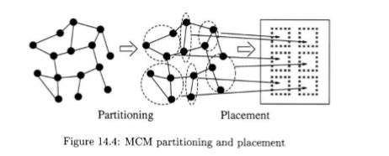

Slide 61
Classification of MCM Routing Algorithms
There are four distinguished approaches for general (non-programmable) MCM routing problems:
Maze Routing
Multiple Stage Routing
Topological Routing
Integrated Pin Distribution and Routing
Maze Routing
This method is conceptually simple to implement, it suffers from several problems.
Finally, three dimensional maze routing requires long computational time and large memory space
First, the quality of the maze routing solution is very much sensitive to the ordering of the nets being routed, and there is no effective algorithm for determining a good net ordering in general
2. Multiple Stage Routing
In this approach, the MCM routing problem is decomposed into several subproblems.
The close positioning of chips and high pin congestion around the chips require separation of pins before routing can be attempted.
Pins on the chip layer are first redistributed evenly with sufficient spacing between them so that the connections between the pins of the nets can be made without violating the design rules.

Slide 62
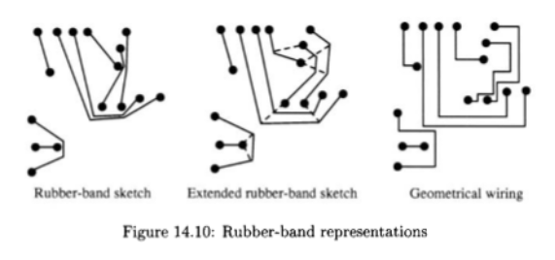
2. Multiple Stage Routing Stages:-
2.a Pin Redistribution Problem
2.b Layer Assignment
2.c Detailed Routing
2.d Topological Routing
2.a Pin Redistribution Problem :-
minimize the total number of pin redistribution layers.
minimize the total number of signal distribution layers.
minimize the cross-talks.
minimize the maximum signal delay.
maximize the number of nets that can routed in planar fashion
Topological Routing

Slide 63
SUMMARY
FPGA partitioning and routing are fundamental steps in the design process that significantly impact the success of FPGA-based projects. Proper partitioning and efficient routing are essential for achieving the desired performance, power efficiency, and functionality of the FPGA design. Careful planning, optimization, and the use of appropriate tools are key to meeting the design goals while addressing the challenges associated with FPGA partitioning and routing.

Slide 64
TERMINAL QUESTIONS
Explain the how to partition an FPGA design?
Describe the In FPGA design, what does routing refer to?

Slide 65
THANK YOU
Team – ASIC & FPGA Design

