Slide 1


Department of ECE
VLSI DESIGN
21EC2211
Topic:
NMOS inverter Design and analysis
Session - 1

Slide 2



AIM OF THE SESSION
To nurture students with Concepts of design rules for wires, transistors and contacts.
INSTRUCTIONAL OBJECTIVES
This Session is designed to:
Describe the working principle of CMOS Inverter
Demonstrate the electrical behavior of Inverter with pull up resistive and depletion loads.
Describe the Voltage Transfer Characteristic.
LEARNING OUTCOMES
At the end of this session, you should be able to:
Define the properties of CMOS Inverter
Calculation of VOH and VOL
Design the network/circuit using CMOS Inverters.

Slide 3
SESSION INTRODUCTION
“NMOS inverter Design and analysis”
The session starts with the introduction of the Inverter, as the nucleus of all digital designs.
Once its operation and properties are clearly understood, designing MOS Inverter with various pull up Resistive & Depletion Load is greatly simplified.
The electrical behavior of these complex circuits can be almost completely derived by extrapolating the results obtained for inverters.

Slide 4
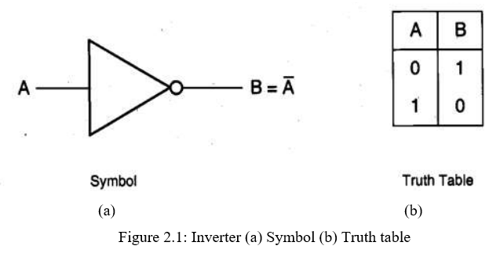
SESSION DESCRIPTION
Introduction:
The inverter is the most fundamental logic gate that performs a Boolean operation on a single input variable.
The logic symbol and the truth table of the ideal inverter are given in figure 2.1.
In MOS inverter circuits, both the input variable A and the output variable B are represented by node voltages, referenced to the ground potential. Using positive logic convention, the Boolean (or logic) value of "1" can be represented by a high voltage of VDD, and the Boolean (or logic) value of "0" can be represented by a low voltage of 0.

Slide 5
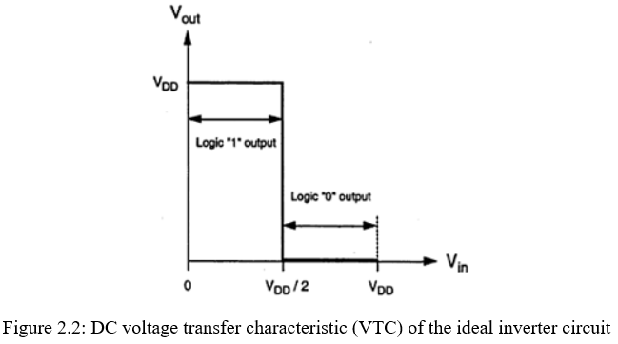
SESSION DESCRIPTION
Introduction:
The DC voltage transfer characteristic (VTC) of the ideal inverter circuit is shown in below figure 2.2.
The voltage, Vth is called the inverter threshold voltage.
Note that for any input voltage between 0 and Vth = VDD/2, the output voltage is equal to VDD (logic “1”).
The output switches from VDD to 0 when the input is equal to Vth.
For any input voltage between Vth and VDD, the output voltage assumes a value of 0 (logic "0").
Thus, an input voltage 0 < Vin< Vth is interpreted by this ideal inverter as a logic "0" while an input voltage Vth <Vin < VDD is interpreted as a logic "1".

Slide 6
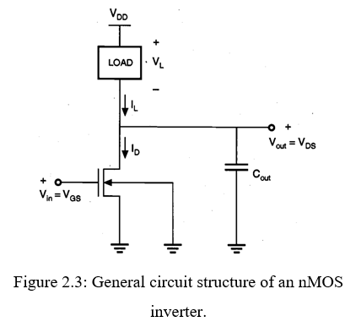
SESSION DESCRIPTION
Introduction:
An inverter circuit is a very important circuit for producing a complete range of logic circuits.
This is needed for restoring logic levels,
- for NAND and NOR gates, and
- for sequential and memory circuits of various forms.
Figure 2.3 shows the generalized circuit structure of an nMOS inverter.
The input voltage of the inverter circuit is also the gate-to-source voltage of the nMOS transistor (Vin = VGs), while the output voltage of the circuit is equal to the drain-to-source voltage (Vout = VDS).
The source and the substrate terminals of the nMOS transistor, also called the driver transistor, are connected to ground potential; hence, the source-to-substrate voltage is VSB = 0.

Slide 7
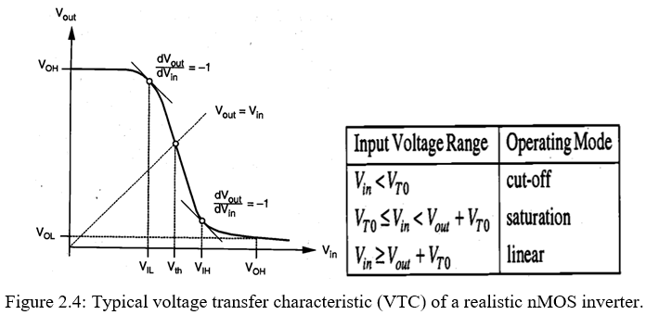

SESSION DESCRIPTION
Voltage Transfer Characteristic (VTC)
Applying Kirchhoff s Current Law (KCL) to this simple circuit, we see that the load current is always equal to the nMOS drain current.
The voltage transfer characteristic describing V as a function of Vin under DC conditions can then be found by analytically solving (2.1) for various input voltage values. The typical VTC of a realistic nMOS inverter is shown in Figure 2.4.

Slide 8
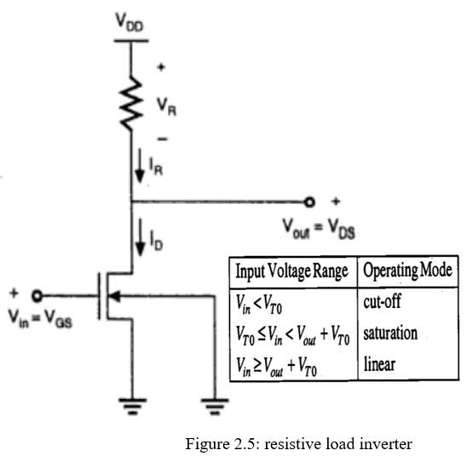
SESSION DESCRIPTION
Resistive Load:
The basic structure of a resistive load inverter is shown in the figure 2.5.
Circuit Operation:
When the input of the driver transistor is less than threshold voltage VTH (Vin <VTH), driver transistor is in the cut – off region and does not conduct any current.
So, the voltage drop across the load resistor is ZERO and output voltage is equal to the VDD.
Now, when the input voltage increases further, driver transistor will start conducting the non-zero current and nMOS goes in saturation region.
The various operating regions of the driver transistor and the corresponding input-output conditions are listed in the following table.

Slide 9
SESSION DESCRIPTION
ALTERMTIVE FORMS OF PULL –UP :
Generally, the inverter circuit will have a depletion mode pull-up transistor as its load. But there are also other configurations. Let us consider four such arrangements.
(i) Load resistance R_{L}
(ii) nMOS depletion mode transistor pull-up
(iii) nMOS enhancement mode pull-up
(iv) Complementary transistor pull-up (CMOS)

Slide 10
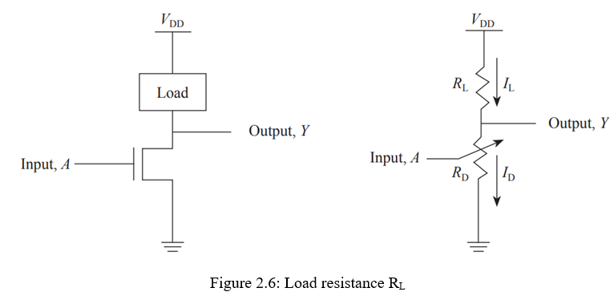

SESSION DESCRIPTION
Load resistance R_{L}:
This arrangement consists of a load resistor as a pull-up as shown in the figure 2.6 below.
It consists of an nMOS transistor connected between the output node and the ground, and is controlled by the input voltage applied at its gate terminal.
A load is connected between the power supply (VDD) and the output terminal.
We now analyze the output voltage levels for logic ‘0’ and logic ‘1’. Let us consider the load as a resistor of value R_{L}; and let the resistance of the driver nMOS transistor be R_{D}.

Slide 11


SESSION DESCRIPTION
Load resistance R_{L}:
Calculation of V_{OH} and V_{OL}
The output voltage is expressed as follows:
For maximum VOL, we consider only the positive sign in Eqn (2.3). Therefore, the equation is rewritten as follows:

Slide 12



SESSION DESCRIPTION
Load resistance R_{L}:
Calculation of V_{IL} and V_{IH}
By definition, V_{IL} and V_{IH} are input voltages such that
At V_{IL}, the nMOS transistor is in its saturation region as VDS > VGS – Vtn. Therefore, we have the following equation:
At V_{IH}, the nMOS transistor is in the linear region. Therefore, we have the following equation

Slide 13
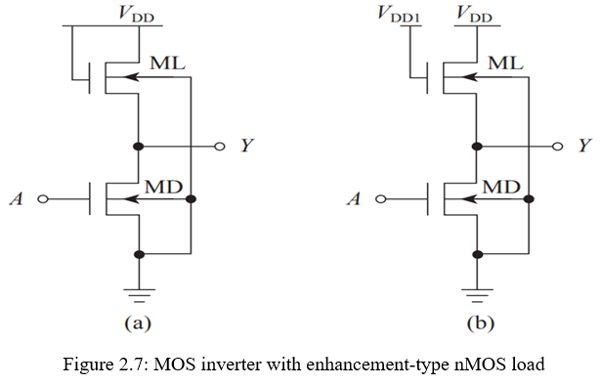
SESSION DESCRIPTION
nMOS enhancement mode pull-up
The disadvantage of a resistive inverter is that it requires a large area on silicon in order to implement the resistive load.
Therefore, as an alternative to resistive load, it is possible to design a MOS inverter with an enhancement-type nMOS transistor acting as a load, as shown in Fig. 2.7.
The load nMOS transistor ML can operate both in the saturation region and in the linear region, as explained in following: In Fig. 2.7(a), ML operates in the saturation region as its gate and drain are shorted together and tied to the power supply, VDD. On the other hand, in Fig. 2.7(b), ML operates in the linear region depending on the bias voltage VDD1.

Slide 14
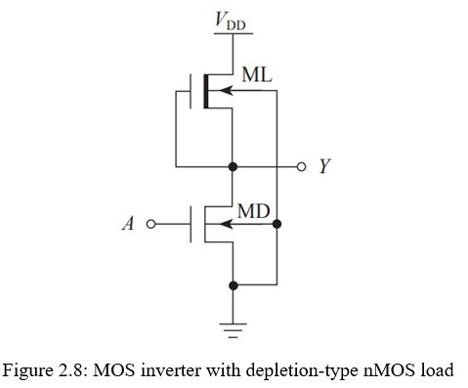
SESSION DESCRIPTION
nMOS depletion mode transistor pull-up
It is also possible to design an MOS inverter with a depletion-type nMOS transistor acting as load, as shown in Fig. 2.8.
The depletion-type nMOS transistor has a built-in channel region. Therefore, with zero gate voltage, the nMOS is ON, whereas for large gate voltage, the channel region gets depleted and the nMOS transistor becomes OFF.
In Fig. 2.8, we see that ML is always ON as its gate is shorted to the source terminal.
In this type of circuit, when the input is at logic low, the driver nMOS transistor MD is OFF, and the output is at logic high through the load transistor ML. On the other hand, when the input is at logic high, the driver nMOS transistor becomes ON, and the output is connected to the ground through MD.

Slide 15
ACTIVITIES/ CASE STUDIES/ IMPORTANT FACTS RELATED TO THE SESSION
Activities:
Design a network of Pull-Up to Pull-Down of an n-MOS inverter driven by another n-MOS inverter.
Articles:
a. T. F. Knight and A. Krymm, "A self-terminating low-voltage swing CMOS output driver," in IEEE Journal of Solid-State Circuits, vol. 23, no. 2, pp. 457-464, April 1988, doi: 10.1109/4.1007.
b. T. J. Gabara and S. C. Knauer, "Digitally adjustable resistors in CMOS for high-performance applications," in IEEE Journal of Solid-State Circuits, vol. 27, no. 8, pp. 1176-1185, Aug. 1992, doi: 10.1109/4.148326.
Case Studies:
a. CMOS Inverter: DC Analysis
(https://www.egr.msu.edu/classes/ece410/mason/files/Ch7.pdf)
b. THE CMOS INVERTER (http://bwrcs.eecs.berkeley.edu/Classes/icdesign/ee141_f01/Notes/chapter5.pdf)

Slide 16
EXAMPLES
These are found in mobile devices, digital cameras, home computers, cell phones, routers, network servers, modems & virtually each other electronic device that needs logic functions.
CMOS inverters are the most frequently used flexible MOSFET inverters that are used in designing integrated circuits like CD4069UB CMOS hex inverter, CD4069UBE, CD40106BE, etc. They function through very little power loss & high speed. These inverters are used for generating data in small electronic circuits.

Slide 17
SUMMARY
The CMOS Inverter is introduced in this session with different Resistive & Depletion Load. The enhancement and depletion modes of nMOS are also described.

Slide 18
SELF-ASSESSMENT QUESTIONS
Why is Inverter considered as the nucleus of all digital designs?
Differentiate between nMOS enhancement mode transistor pull-up and depletion mode transistor pull-up.
3. What is the disadvantage of resistive load while implementing Inverter? Suggest any solution to this problem.
4. Why nMOS technology is preferred more than pMOS technology?

Slide 19
TERMINAL QUESTIONS
a. What are pull-ups? Write about the resistor pull-up and its usage.
b. Derive the expression for estimation of Pull-Up to Pull-Down ratio of an n-MOS
inverter driven by another n-MOS inverter.
c. Illustrate the typical voltage transfer characteristic (VTC) of a realistic nMOS inverter.

Slide 20
REFERENCES FOR FURTHER LEARNING OF THE SESSION
Text Books:
1.Douglas A. Pucknell& Kamran Eshraghian, Basic VLSI Design, PHI, 3rd Ed., 2011
2. Neil H.E. Weste, David Harris, Ayan Banerjee, CMOS VLSI Design, A Circuits and Systems Perspective, Pearson Education, 4th Ed., 2011
3. Sung-Mo Kang, Yusuf Leblebici, CMOS Digital Integrated Circuits Analysis and Design, Tata Mc-Graw-Hill, 3rd Ed., 2003
Reference Books:
1. Jab M. Rabaey, Anantha Chandra Kasan, Borivoje Nikolic, Digital Integrated Circuits - A Design Perspective, PHI, 2nd Ed., 2012
2. Michal John Sebastian Smith, Application-Specific Integrated Circuits, Pearson Education, 6th Ed., 2009
Sites and Web links:
1. https://www.egr.msu.edu/classes/ece410/mason/files/Ch7.pdf
2. http://bwrcs.eecs.berkeley.edu/Classes/icdesign/ee141_f01/Notes/chapter5.pdf
3. https://nptelvideos.com/video.php?id=1317

Slide 21
THANK YOU
Team – VLSI Design

