Slide 1


Department of ECE
VLSI DESIGN
21EC2211
Topic:
MOS inverter Design with various pull - up Enhancement Load
Session - 2

Slide 2



AIM OF THE SESSION
To nurture students with Concepts of design rules for wires, transistors and contacts.
INSTRUCTIONAL OBJECTIVES
This Session is designed to:
Describe the working principle of CMOS Inverter
Demonstrate the Voltage transfer characteristics of a CMOS Inverter
Describe the Operating regions of the CMOS Inverter
LEARNING OUTCOMES
At the end of this session, you should be able to:
Define the operating modes of CMOS Inverter
Define the operating regions of CMOS Inverter

Slide 3
SESSION INTRODUCTION
“MOS inverter Design with various pull - up Enhancement Load”
The session starts with the introduction of the CMOS Inverter.
The regions of operation and operating modes are clearly explained.

Slide 4
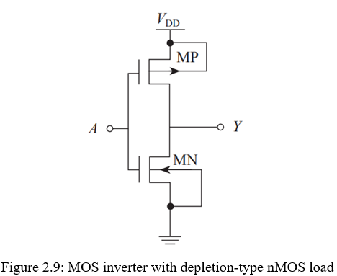
SESSION DESCRIPTION
CMOS Inverter:
The CMOS, or complementary MOS, inverter uses a pMOS transistor in the pull-up network, and nMOS transistor in the pull-down network, as illustrated in Fig. 2.9.
When the input is at logic low, the pMOS transistor is ON, and the nMOS transistor is OFF.
Therefore, the output is at logic high. On the other hand, when the input is at logic high, the pMOS transistor is OFF, and the nMOS transistor is ON, and hence the output is at logic low.
The advantage of a CMOS inverter is that as the nMOS and pMOS transistors functionally complement each other, they are never ON together; and hence, there is no direct path from VDD to the ground for static current to flow.

Slide 5
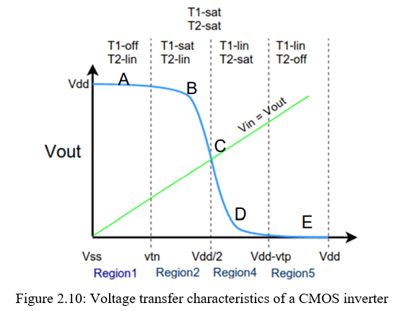
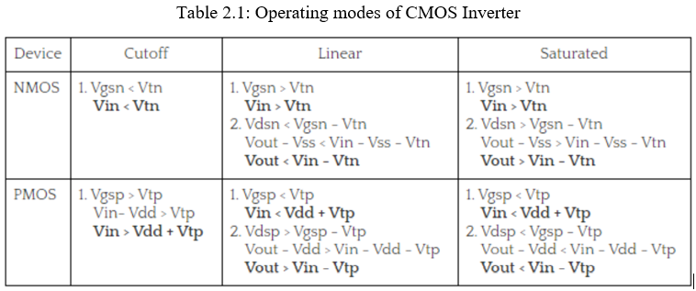
SESSION DESCRIPTION
Voltage Transfer Characteristics:
The VTC of a CMOS inverter are shown in Fig. 2.10. We see that the VTC curve is divided into five different parts, depending on the operating region of the nMOS and pMOS transistors.

Slide 6
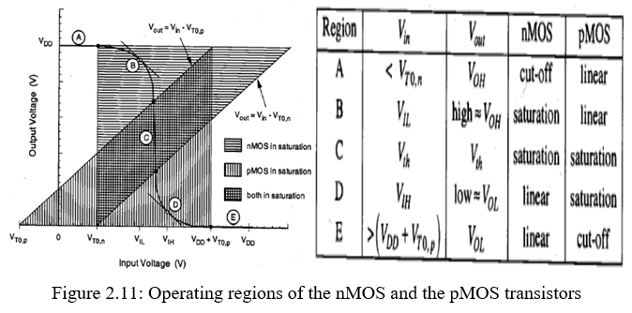
SESSION DESCRIPTION
Operating regions of the nMOS and pMOS transistors in CMOS Inverter:
Region-1
➢ In this region the input is in the range of (0,Vtn).
➢ Since the input voltage is less than Vtn, the NMOS is in cutoff region.
➢ No current flows from Vdd to Vss, The entire Vdd will appear at the Output terminal.
➢ NMOS is in cutoff as Vgs < Vtn
➢ PMOS is in linear as Vgsp < Vtp and Vdsp > Vgsp -Vtp.
➢ Zero current flows from supply voltage and the power dissipation is zero.

Slide 7
SESSION DESCRIPTION
Operating regions of the nMOS and pMOS transistors in CMOS Inverter:
Region-2
➢ In this region the input is in the range of (Vtn,Vdd/2). Since the input voltage is greater than Vtn the NMOS is conducting and it jumps to saturation as it has large Vds across it (Vout is high).
➢ PMOS still remains in the linear region.
➢ NMOS is in saturation as Vgs > Vtn and Vout >Vin - Vtn.
➢ PMOS is in linear region as Vdsp > Vgsp - Vtp.
➢ since both the transistors are conducting some amount of current flows from supply in this.

Slide 8
SESSION DESCRIPTION
Operating regions of the nMOS and pMOS transistors in CMOS Inverter:
Region-3
➢ In this region the input voltage is Vdd/2.
➢ At this point the output voltage is also Vdd/2 as one can see in figure.
➢ At this voltage both the NMOS and PMOS are in saturation and the output drops drastically
from Vdd to Vdd/2.
➢ At this point a large amount of current flows from the supply. Most of the power consumed in CMOS inverter is at this point.
➢ So care should be taken that the Input should not stay at Vdd/2 for more amount of time.
➢ NMOS is in saturation as Vgs > Vtn and Vout >Vin - Vtn.
➢ PMOS is in saturation as Vgsp < Vtp and Vdsp < Vgsp -Vtp.
➢ Large amount of current is drawn from supply and hence large power dissipation.

Slide 9
SESSION DESCRIPTION
Operating regions of the nMOS and pMOS transistors in CMOS Inverter:
Region-4
➢ In this region the input voltage is in the range of (Vdd/2 , Vdd-Vtp). Here the PMOS remains in saturation as Vout < Vin - Vtp and Vgsp < Vtp.
➢ But the NMOS moves from saturation to linear region since the drain to source voltage now is less than Vgsn-Vtn.
➢ NMOS is in linear as Vgs > Vtn and Vout < Vin - Vtn.
➢ PMOS is in saturation as Vgsp < Vtp and Vdsp < Vgsp -Vtp.
➢ A medium amount of current is drawn as NMOS is in linear region and power dissipation is low.

Slide 10
SESSION DESCRIPTION
Operating regions of the nMOS and pMOS transistors in CMOS Inverter:
Region-5
➢ In this region the input voltage is in the range of (Vdd-Vtp,Vdd).
➢ Here the PMOS moves from saturation to cutoff as the Vgsp is so high that Vgsp > Vtp.
➢ The NMOS still remains in linear as the drain to source voltage now is less than Vgsn-Vtn.
➢ NMOS is in linear as Vgs > Vtn and Vout < Vin - Vtn.
➢ PMOS is in cutoff as Vgsp > Vtp.
➢ Zero current flows from the supply and so the power dissipation is zero.

Slide 11
ACTIVITIES/ CASE STUDIES/ IMPORTANT FACTS RELATED TO THE SESSION
Activities:
Design an enhancement type of complementary metal-oxide semiconductor (CMOS) transistors for three-valued logic circuit.
Articles:
a. Y. Yasuda, Y. Tokuda, S. Zaima, K. Pak, T. Nakamura and A. Yoshida, "Realization of quaternary logic circuits by n-channel MOS devices," in IEEE Journal of Solid-State Circuits, vol. 21, no. 1, pp. 162-168, Feb. 1986, doi: 10.1109/JSSC.1986.1052493.
b. Terman, Lewis M. "MOSFET memory circuits." Proceedings of the IEEE 59, no. 7 (1971): 1044-1058. (https://www.ee.bgu.ac.il/~kushnero/ternary/Using%20CMOS%20gates/Depletion-Enhancement%20CMOS%20Low%20Power%20Three-Valued%20Logic.pdf)
Case Studies:
a. NMOS Inverter with Enhancement Load (http://www.ece.mcgill.ca/~grober4/SPICE/SPICE_Decks/1st_Edition/chapter13/Chapter%2013%20MOS%20Digital%20Ccts%20web%20version.html)
b. Analytical transient response and propagation delay evaluation of the CMOS inverter for short-channel devices (https://www.researchgate.net/publication/2977672_Analytical_transient_response_and_propagation_delay_evaluation_of_the_CMOS_inverter_for_short-channel_devices)

Slide 12
EXAMPLES
These are found in mobile devices, digital cameras, home computers, cell phones, routers, network servers, modems & virtually each other electronic device that needs logic functions.
CMOS inverters are the most frequently used flexible MOSFET inverters that are used in designing integrated circuits like CD4069UB CMOS hex inverter, CD4069UBE, CD40106BE, etc. They function through very little power loss & high speed. These inverters are used for generating data in small electronic circuits.

Slide 13
SUMMARY
MOS inverter with depletion-type nMOS load is discussed in this session. The VTC for CMOS Inverter with various operating modes and regions are also explained.

Slide 14
SELF-ASSESSMENT QUESTIONS
Draw transfer characteristics of CMOS inverter.
Summarize the properties of static CMOS inverter.
3. What is the condition, at which the CMOS inverter becomes saturated?
Define Threshold voltage.

Slide 15
TERMINAL QUESTIONS
a. Derive the expression for transfer characteristics of CMOS Inverter
b. With reference to the Operating regions of the nMOS and the pMOS transistors, illustrate the working principle of CMOS Inverter.

Slide 16
REFERENCES FOR FURTHER LEARNING OF THE SESSION
Text Books:
1.Douglas A. Pucknell& Kamran Eshraghian, Basic VLSI Design, PHI, 3rd Ed., 2011
2. Neil H.E. Weste, David Harris, Ayan Banerjee, CMOS VLSI Design, A Circuits and Systems Perspective, Pearson Education, 4th Ed., 2011
3. Sung-Mo Kang, Yusuf Leblebici, CMOS Digital Integrated Circuits Analysis and Design, Tata Mc-Graw-Hill, 3rd Ed., 2003
Reference Books:
1. Jab M. Rabaey, Anantha Chandra Kasan, Borivoje Nikolic, Digital Integrated Circuits - A Design Perspective, PHI, 2nd Ed., 2012
2. Michal John Sebastian Smith, Application-Specific Integrated Circuits, Pearson Education, 6th Ed., 2009
Sites and Web links:
1. https://www.egr.msu.edu/classes/ece410/mason/files/Ch7.pdf
2. http://bwrcs.eecs.berkeley.edu/Classes/icdesign/ee141_f01/Notes/chapter5.pdf
3. https://nptelvideos.com/video.php?id=1317

Slide 17
THANK YOU
Team – VLSI Design

