Slide 1


Department of ECE
VLSI DESIGN
21EC2211
Topic:
CMOS Inverter- Static and Dynamic characteristics
Session - 3

Slide 2



AIM OF THE SESSION
To nurture students with Concepts of design rules for wires, transistors and contacts.
INSTRUCTIONAL OBJECTIVES
This Session is designed to:
Describe the different types of power dissipation in CMOS Inverter.
Demonstrate the static and dynamic power dissipation of a CMOS Inverter.
Describe the Area consideration in CMOS Inverter w.r.t power dissipation.
LEARNING OUTCOMES
At the end of this session, you should be able to:
Define the different types of power dissipation in the CMOS Inverter.
Determine the static and dynamic power dissipation.

Slide 3
SESSION INTRODUCTION
“CMOS Inverter- Static and Dynamic characteristics”
The session starts with the DC characteristics of CMOS inverter followed by its Dynamic characteristics.
The power and area considerations are explained in this session.

Slide 4
SESSION DESCRIPTION
POWER AND AREA CONSIDERATIONS:
We can identify two other issues that play significant roles in inverter design: power consumption and the chip area occupied by the inverter circuit.
About one million logic gates can be accommodated on a very large scale integrated (VLSI) chip using 0.5 μm MOS technology, and the circuit density is expected to increase even further in future-generation chips.
Since each gate on the chip dissipates power and thus generates heat, the removal of this thermal energy, i.e., cooling of the chip, becomes an essential and usually very expensive task.
It is very important to reduce the amount of power dissipated by the circuit in both DC and dynamic operation.

Slide 5

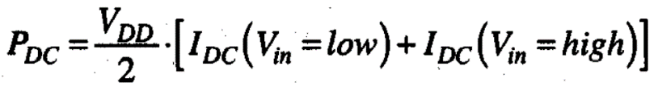
SESSION DESCRIPTION
DC power dissipation of an inverter circuit:
The DC power dissipation of an inverter circuit can be calculated as the product of its power supply voltage and the amount of current drawn from the power supply during steady state.
Notice that the DC current drawn by the inverter circuit may vary depending on the input and output voltage levels.
Assuming that the input voltage level corresponds to logic "0” during 50% of the operation time and to logic " 1 " during the other 50%, the overall DC power consumption of the circuit can be estimated as follows:

Slide 6
SESSION DESCRIPTION
Dynamic power dissipation of an inverter circuit:
In a CMOS inverter, the dynamic power dissipation occurs when the load capacitor is charged and discharged.
When the load capacitor is charged, it takes some energy from the power supply; part of this energy is stored in the load capacitor and the remainder is dissipated across the pMOS transistor.
Next, during the discharge of the load capacitor, the stored energy is discharged through the nMOS transistor.
Dynamic power dissipation has maximum contribution in the total power dissipation.

Slide 7
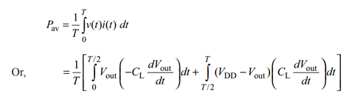
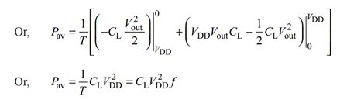
SESSION DESCRIPTION
Dynamic power dissipation of an inverter circuit:
The average energy dissipated over one switching cycle is calculated as follows:

Slide 8

SESSION DESCRIPTION
Dynamic power dissipation of an inverter circuit:
If the circuit switching frequency is f, then the dynamic power dissipation is determined as follows:
where α (0 < α < 1) is the activity factor.

Slide 9
SESSION DESCRIPTION
Area Considerations:
To reduce the chip area occupied by the inverter circuit, it is necessary to reduce the area of the MOS transistors used in the circuit.
As a practical measure, we use the gate area of the MOS transistor, i.e., the product of W and L.
Thus, an MOS transistor has minimum area when both of the gate (channel) dimensions are made as small as possible within the constraints of the particular technology.
It follows that the ratio of the gate width to gate length (W/L) should also be as close to unity as possible, in order to achieve minimum transistor area.

Slide 10
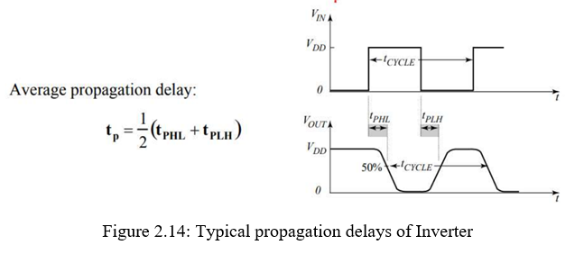
SESSION DESCRIPTION
Delays:
Inverter propagation delay: time delay between input and output signals
Typical propagation delays: < 100 ps Propagation delay denoted as tp

Slide 11
ACTIVITIES/ CASE STUDIES/ IMPORTANT FACTS RELATED TO THE SESSION
Activities:
Design any circuits using CMOS inverter considering low power dissipation.
Articles:
a. R. X. Gu and M. I. Elmasry, "Power dissipation analysis and optimization of deep submicron CMOS digital circuits," in IEEE Journal of Solid-State Circuits, vol. 31, no. 5, pp. 707-713, May 1996, doi: 10.1109/4.509853.
Case Studies:
a. CMOS Power Dissipation and Trends (https://www.ece.ucdavis.edu/~ramirtha/EEC216/W08/lecture1_updated.pdf)
b. CMOS inverter propagation delay. (http://www.ece.sunysb.edu/~oe/Leon/ESE314F12/Lab09.pdf)

Slide 12
EXAMPLES
Most portable systems, such as cellular communication devices and laptop and palmtop computers, operate from a limited power supply, and the extension of battery-based operation time is a significant design goal.

Slide 13
SUMMARY
The DC characteristics of CMOS inverter followed by its Dynamic characteristics are described in this session. The power and area considerations are explained.

Slide 14
SELF-ASSESSMENT QUESTIONS
How is the static power dissipation is almost zero in CMOS Inverter?
List out the sources of static and dynamic power consumption.
3. Write the expression for the average propagation delay of CMOS Inverter.

Slide 15
TERMINAL QUESTIONS
a. Derive the expression for dynamic power dissipation in CMOS Inverter.
b. Briefly explain the requirements to reduce the area of the MOS transistors used in the circuit.

Slide 16
REFERENCES FOR FURTHER LEARNING OF THE SESSION
Text Books:
1.Douglas A. Pucknell& Kamran Eshraghian, Basic VLSI Design, PHI, 3rd Ed., 2011
2. Neil H.E. Weste, David Harris, Ayan Banerjee, CMOS VLSI Design, A Circuits and Systems Perspective, Pearson Education, 4th Ed., 2011
3. Sung-Mo Kang, Yusuf Leblebici, CMOS Digital Integrated Circuits Analysis and Design, Tata Mc-Graw-Hill, 3rd Ed., 2003
Reference Books:
1. Jab M. Rabaey, Anantha Chandra Kasan, Borivoje Nikolic, Digital Integrated Circuits - A Design Perspective, PHI, 2nd Ed., 2012
2. Michal John Sebastian Smith, Application-Specific Integrated Circuits, Pearson Education, 6th Ed., 2009
Sites and Web links:
https://archive.nptel.ac.in/courses/106/105/106105034/

Slide 17
THANK YOU
Team – VLSI Design

