Slide 1


Department of ECE
VLSI DESIGN
21EC2211
Topic:
NMOS and CMOS Logic circuits design
Session - 4

Slide 2



AIM OF THE SESSION
To nurture students with Concepts of design rules for wires, transistors and contacts.
INSTRUCTIONAL OBJECTIVES
This Session is designed to:
Describe the static and dynamic characteristics of various combinational MOS logic circuits.
Basic principles used in the design and analysis of MOS inverters in can be directly applied to combinational logic circuits as well.
LEARNING OUTCOMES
At the end of this session, you should be able to:
Understand static and dynamic characteristics of various combinational MOS logic circuits.
Analyze basic principles used in the design and analysis of MOS inverters.

Slide 3
SESSION INTRODUCTION
“NMOS and CMOS Logic circuits design”
The session starts with the introduction of the NMOS and CMOS logic circuit, we will examine the static and dynamic characteristics of various combinational MOS logic circuits.
It will be seen that many of the basic principles used in the design and analysis of MOS inverters in can be directly applied to combinational logic circuits as well.

Slide 4
SESSION DESCRIPTION
INTRODUCTION:
Combinational logic circuits, or gates, which perform Boolean operations on multiple input variables and determine the outputs as Boolean functions of the inputs, are the basic building blocks of all digital systems.
In this lecture, we will examine the static and dynamic characteristics of various combinational MOS logic circuits. It will be seen that many of the basic principles used in the design and analysis of MOS inverters can be directly applied to combinational logic circuits as well.
All input variables are represented by node voltages, referenced to the ground potential. Using positive logic convention, the Boolean (or logic) value of " 1 " can be represented by a high voltage of V_{DD}, and the Boolean (or logic) value of "0" can be represented by a low voltage of 0.
The output node is loaded with a capacitance CL, which represents the combined parasitic device capacitances in the circuit and the interconnect capacitance components seen by the output node. This output load capacitance certainly plays a very significant role in the dynamic operation of the logic gate.

Slide 5
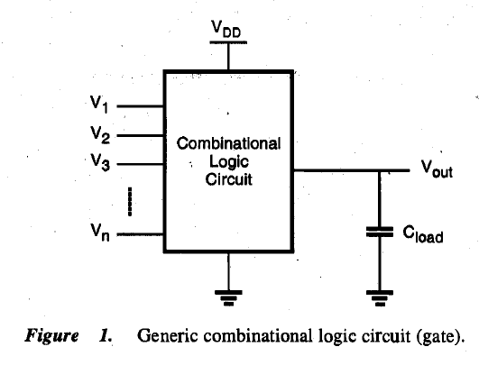
SESSION DESCRIPTION
As in the simple inverter case, the voltage transfer characteristic (VTC) of a combinational logic gate provides valuable information on the DC operating performance of the circuit. Critical voltage points such as V_{OL} or V_{th} are considered to be important design parameters for combinational logic circuits.

Slide 6
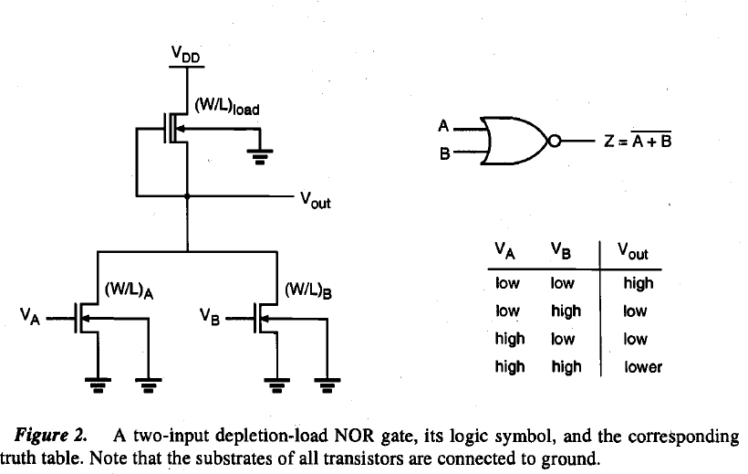
SESSION DESCRIPTION
MOS Logic Circuits with Depletion nMOS Loads
The DC analysis of the circuit can be simplified significantly by considering the structural similarities between this circuit and the simple nMOS depletion-load inverter. In the following, the calculation of output low and output high voltages will be examined.

Slide 7

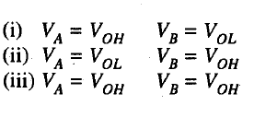
SESSION DESCRIPTION
Calculation of V_{OH}
When both input voltages VA and VB are lower than the corresponding driver threshold voltage, the driver transistors are turned off and conduct no drain current. Consequently, the load device, which operates in the linear region, also has zero drain current. In linear region, current equation becomes-
Calculation of V_{OL}
To calculate the output low voltage V_{OL}, we must consider three different cases, i.e., three different input voltage combinations, which produce a conducting path from the output node to the ground. These cases are-

Slide 8
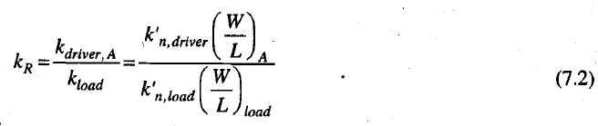
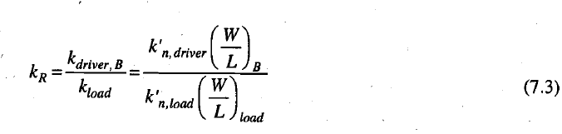
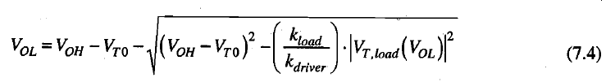
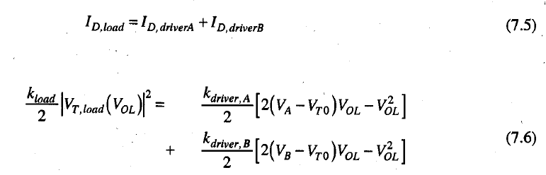
SESSION DESCRIPTION

Slide 9
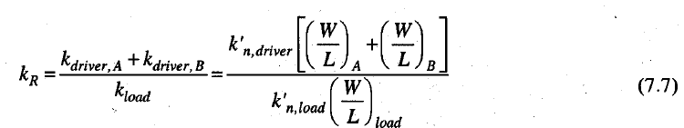
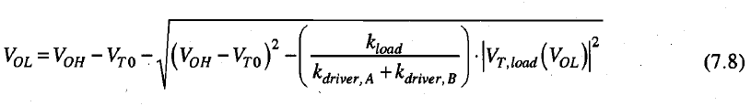
SESSION DESCRIPTION
Generalized NOR Structure with Multiple Inputs:
At this point, we can expand our analysis to generalized n-input NOR gates, which consist of n parallel driver transistors, as shown in Fig. 3. Note that the combined current ID in this circuit is supplied by the driver transistors which are turned on, i.e., transistors which have gate voltages higher than the threshold voltage V_{T0}.

Slide 10
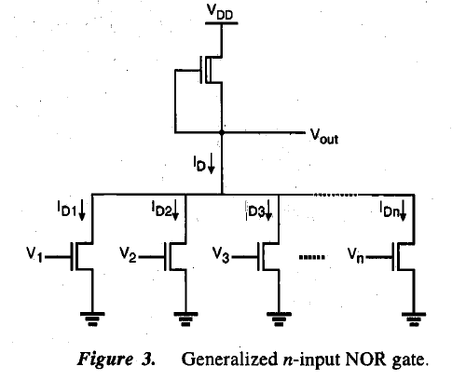
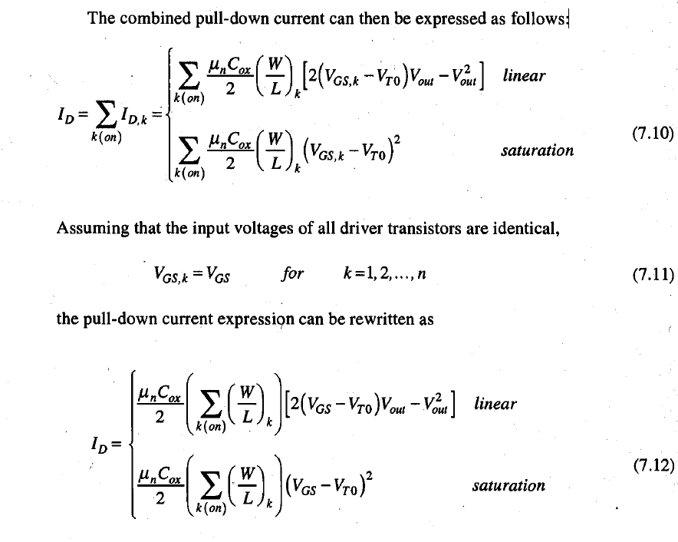
SESSION DESCRIPTION

Slide 11
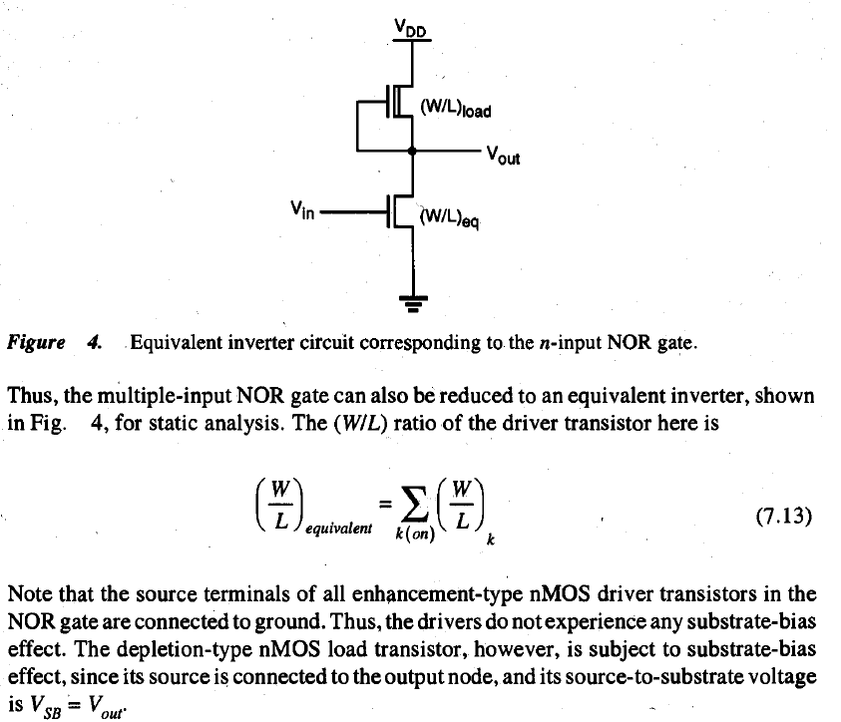
SESSION DESCRIPTION

Slide 12
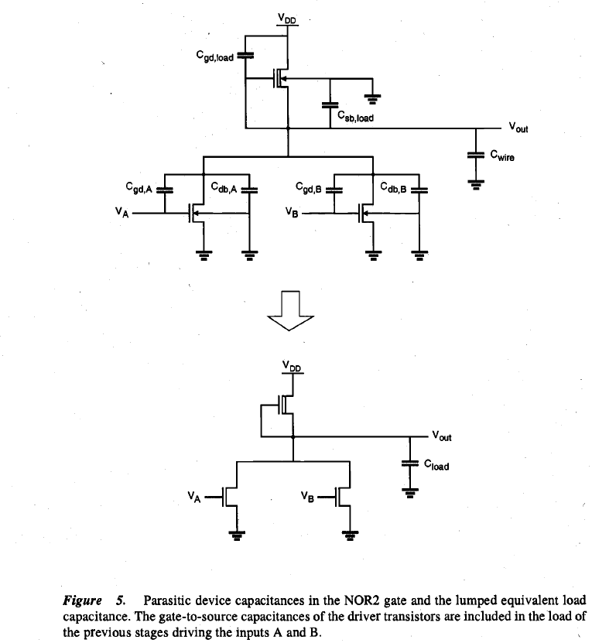
SESSION DESCRIPTION
Transient Analysis of NOR Gate:
Figure 5 shows the two-input NOR (NOR2) gate with all of its relevant parasitic device capacitances. As in the inverter case, we can combine the capacitances seen in Fig. 5 into one lumped capacitance, connected between the output node and the ground. The value of this combined load capacitance, C_{Load}, can be found as-

Slide 13
ACTIVITIES/ CASE STUDIES/ IMPORTANT FACTS RELATED TO THE SESSION
Activities:
Discuss the static and dynamic characteristics of MOS logic circuits with depletion nMOS loads..
Articles:
LOGIC CIRCUITS AND CMOS
https://courses.engr.illinois.edu/ece110/sp2021/content/courseNotes/files/?logicAndCMOS
Case Studies:
DESIGNING COMBINATIONAL LOGIC GATES IN CMOS
http://bwrcs.eecs.berkeley.edu/Classes/icdesign/ee141_f01/Notes/chapter6.pdf

Slide 14
EXAMPLES
Most portable systems, such as cellular communication devices and laptop and palmtop computers, operate from a limited power supply, and the extension of battery-based operation time is a significant design goal.

Slide 15
SUMMARY
Discus the static and dynamic characteristics of MOS logic circuits with depletion nMOS loads for two and multiple inputs NOR gate. Calculate V_{OH} and V_{OL} for both the cases.

Slide 16
SELF-ASSESSMENT QUESTIONS
1. Define threshold voltage? Drive the V_{t} equation for MOS transistor.
2. Find V_{OH} and V_{OL} for resistive load inverter.
3. Explain about capacitance associated with mos logic circuit with depletion nMOS loads. .

Slide 17
TERMINAL QUESTIONS
1. Find the static and dynamic characteristics of MOS logic circuits with depletion nMOS loads for two and multiple inputs NAND gate.

Slide 18
REFERENCES FOR FURTHER LEARNING OF THE SESSION
Text Books:
1.Douglas A. Pucknell& Kamran Eshraghian, Basic VLSI Design, PHI, 3rd Ed., 2011
2. Neil H.E. Weste, David Harris, Ayan Banerjee, CMOS VLSI Design, A Circuits and Systems Perspective, Pearson Education, 4th Ed., 2011
3. Sung-Mo Kang, Yusuf Leblebici, CMOS Digital Integrated Circuits Analysis and Design, Tata Mc-Graw-Hill, 3rd Ed., 2003
Reference Books:
1. Jab M. Rabaey, Anantha Chandra Kasan, Borivoje Nikolic, Digital Integrated Circuits - A Design Perspective, PHI, 2nd Ed., 2012
2. Michal John Sebastian Smith, Application-Specific Integrated Circuits, Pearson Education, 6th Ed., 2009
Sites and Web links:
https://archive.nptel.ac.in/courses/106/105/106105034/

Slide 19
THANK YOU
Team – VLSI Design

