Slide 1


Department of ECE
VLSI DESIGN
21EC2211
Topic:
Pass Transistor and Transmission Gate based logics
Session - 5

Slide 2



AIM OF THE SESSION
To nurture students with Concepts of design rules for wires, transistors and contacts.
INSTRUCTIONAL OBJECTIVES
This Session is designed to:
1. Introduction of Pass Transistor and Transmission Gate.
2. A popular and widely-used alternative to complementary CMOS is pass-transistor logic, which attempts to reduce the number of transistors required to implement logic by allowing the primary inputs to drive gate terminals as well as source/drain terminals.
LEARNING OUTCOMES
At the end of this session, you should be able to:
1. Understand the basic of Pass Transistor and Transmission Gate.
2. Reduce the number of transistors required to implement logic gates

Slide 3
SESSION INTRODUCTION
“Pass Transistor and Transmission Gate based logics”
The session starts with the introduction of Pass Transistor and Transmission Gate.
A popular and widely-used alternative to complementary CMOS is pass-transistor logic, which attempts to reduce the number of transistors required to implement logic by allowing the primary inputs to drive gate terminals as well as source/drain terminals.

Slide 4
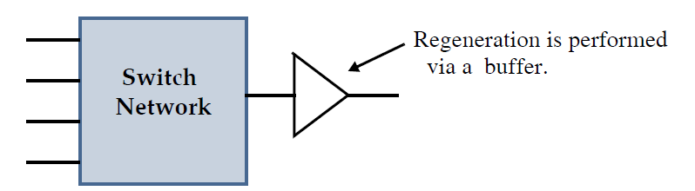
SESSION DESCRIPTION
INTRODUCTION:
Pass-Transistor Logic:
A popular and widely-used alternative to complementary CMOS is pass-transistor logic, which attempts to reduce the number of transistors required to implement logic by allowing the primary inputs to drive gate terminals as well as source/drain terminals. This is in contrast to logic families that we have studied so far, which only allow primary inputs to drive the gate terminals of MOSFETS.
An alternative to implementing complex logic is to realize it using a logic network of pass transistors (switches).

Slide 5
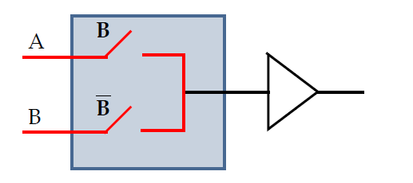
SESSION DESCRIPTION
We have already observed a series connection of two switches implements AND while a parallel connection implements OR.
B is not redundant; it ensures a low impedance path exists when B is low.
Pass Gate Logic Advantage:
Fast and simple.
Complex gates can be implemented using minimum number of transistors, which also
reduces parasitics.
Static and dynamic performance depends on a switch with low parasitic resistance and
capacitance.

Slide 6
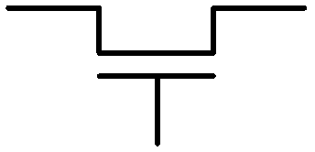
Switch Logic - Pass Transistors
Use n-transistor as “switches”
“Threshold problem”
IN: ^{V}DD
OUT: ^{V}DD^{-V}tn
Transistor switches off when Vgs < Vt
VDD input -> VDD-Vt output
A:
^{V}DD
Special gate needed to “restore” values

Slide 7
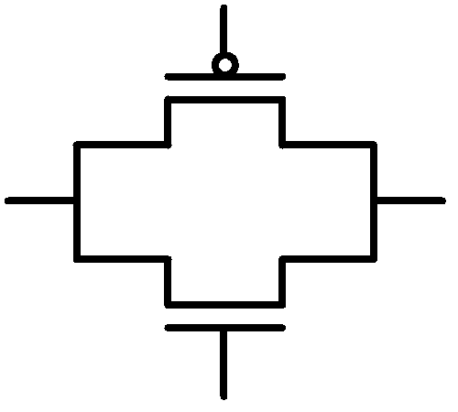

Switch Logic - Transmission Gates
Complementary transistors - n and p
No threshold problem
Cost: extra transistor, extra control input
Not a perfect conductor!
A’
A’
A
A

Slide 8
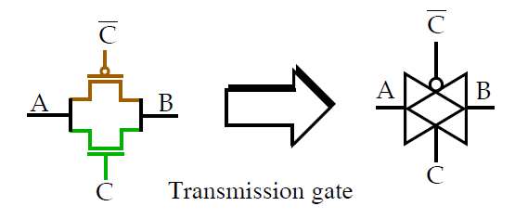
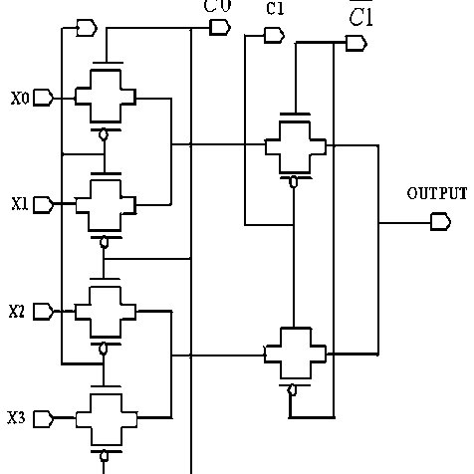
SESSION DESCRIPTION
Therefore, pass gate networks are often constructed from bi-directional transmission gates.
Both transistors are important:

Slide 9
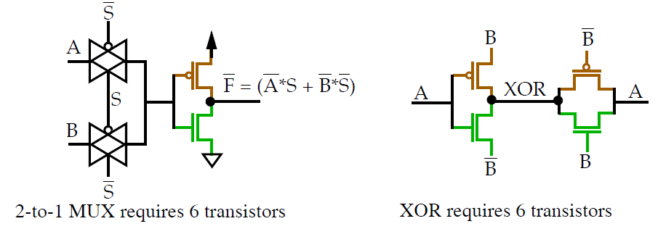
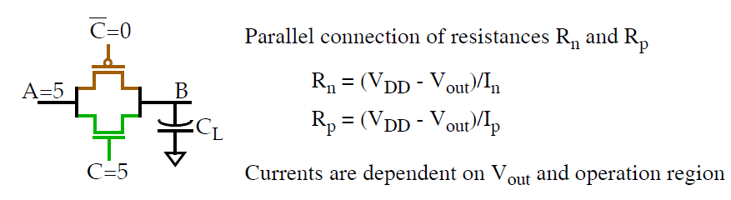
SESSION DESCRIPTION
Design Issues
Resistance:

Slide 10
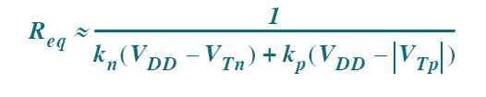
SESSION DESCRIPTION
During the low-to-high transition, the pass transistors pass through several operation modes.
As V_{GS} is always equal to V_{DS}, the NMOS is either in saturation or off.
The V_{GS} of the PMOS is V_{DD}, and the device changes from saturation to linear.
􀂁 V_{out} < |V_{Tn}|: NMOS and PMOS saturated.
􀂁 |V_{Tp}| < V_{out} < V_{DD} - V_{Tn}: NMOS saturated, PMOS linear.
􀂁 V_{DD} -V_{Tn} < V_{out}: NMOS cut off, PMOS linear.
It is important to incorporate the body effect when computing Ip and In. The expression for the resistance of a pass gate without the body effect.

Slide 11
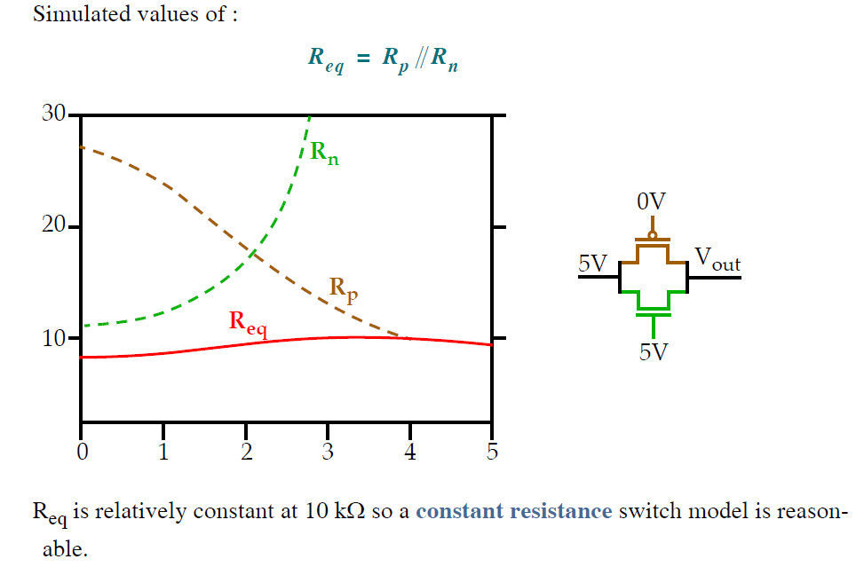
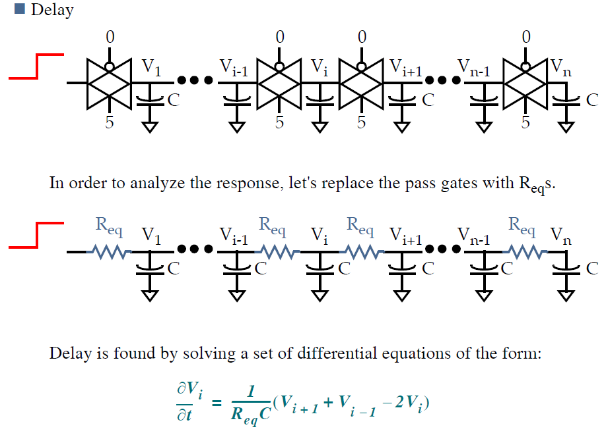
SESSION DESCRIPTION

Slide 12
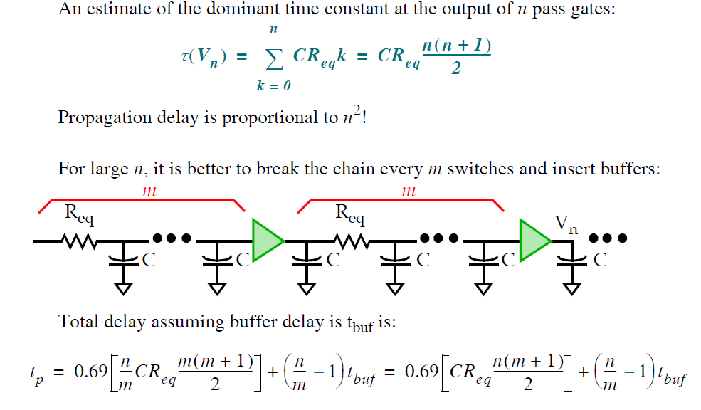
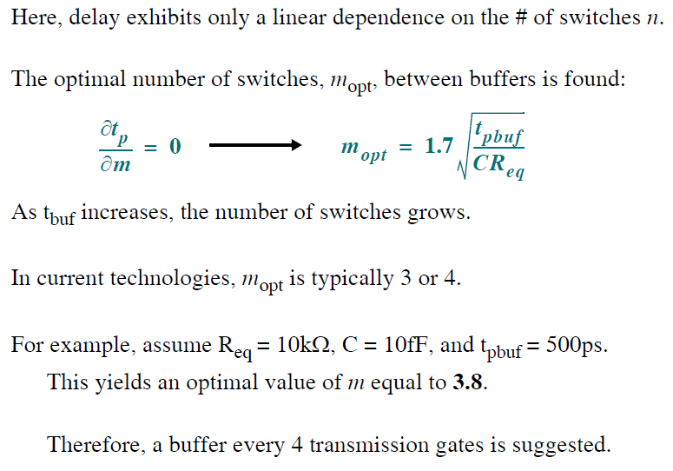
SESSION DESCRIPTION

Slide 13
SESSION DESCRIPTION
􀂄 Transistor sizing
Pass gate logic family is a member of the ratio less logic class.
The dc characteristics are not affected by the sizes.
Performance, to the first order, is not impacted by changing the W/L.
Increasing the size reduces the resistance, but this is offset by the increase in diffusion
capacitance.
Therefore, minimum sized devices should ALWAYS be used, unless the chain drives a significant external load capacitance. In this case, ordering transistors from largest to smallest in the pass gate chain will help reduce delay.
This is analogous to the argument given earlier for logic gate transistors close to the output.

Slide 14
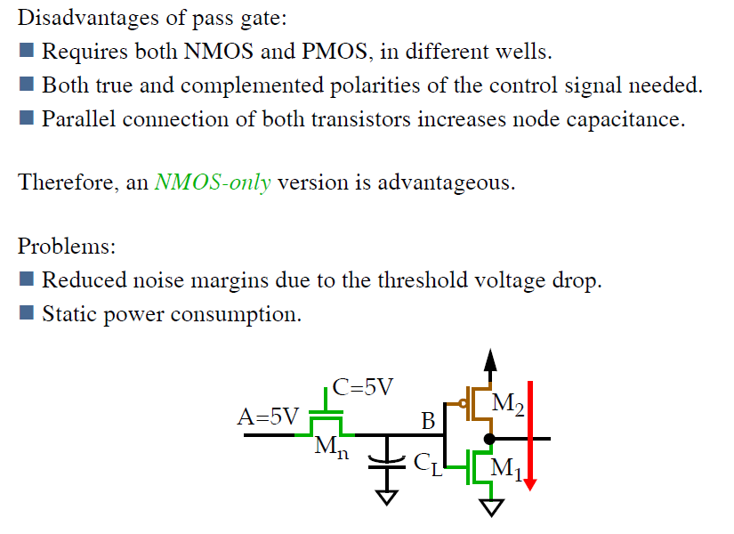
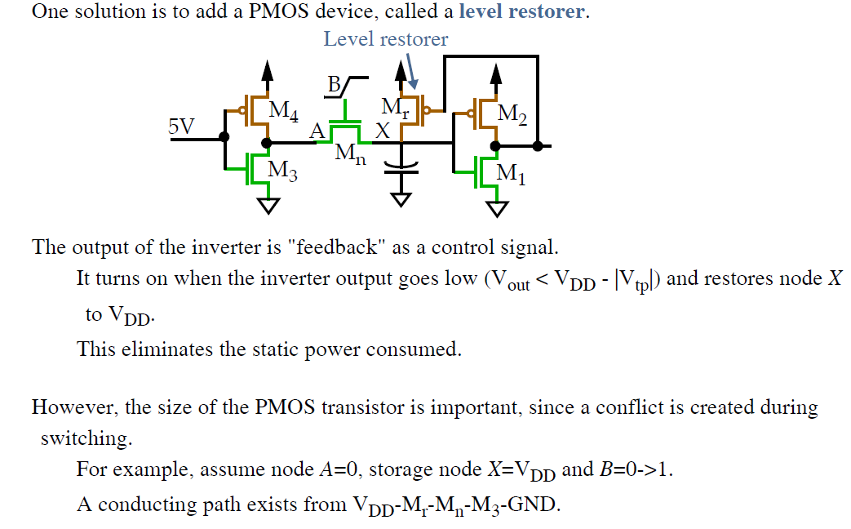
SESSION DESCRIPTION

Slide 15
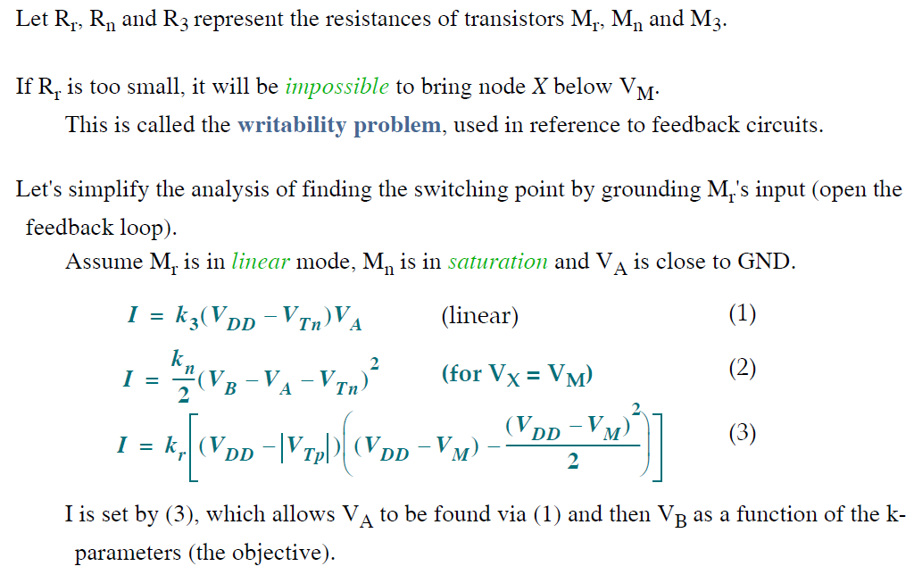
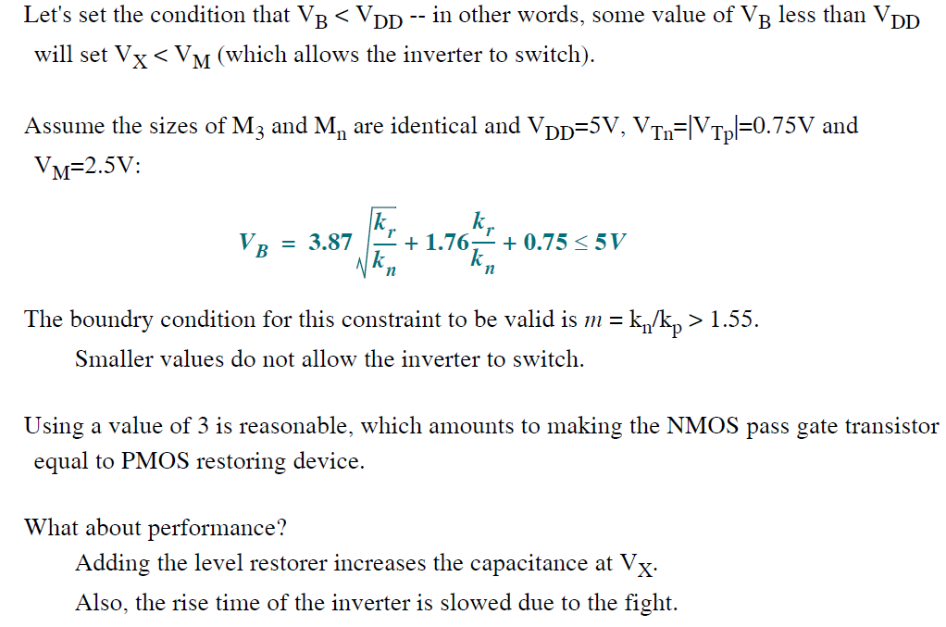
SESSION DESCRIPTION

Slide 16
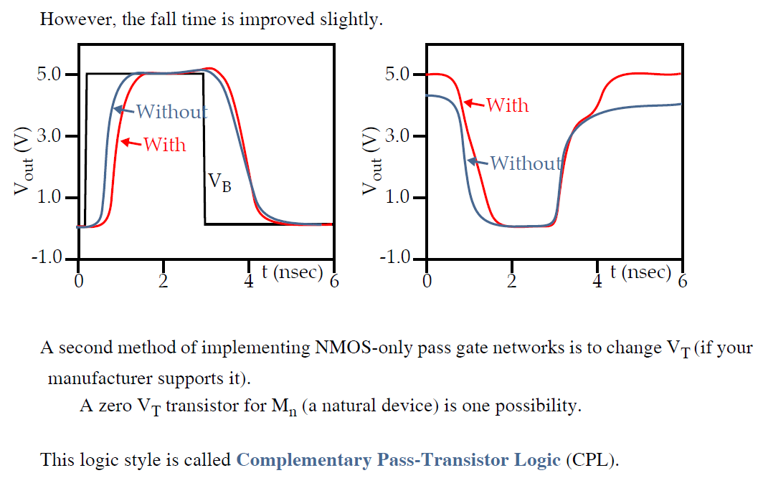
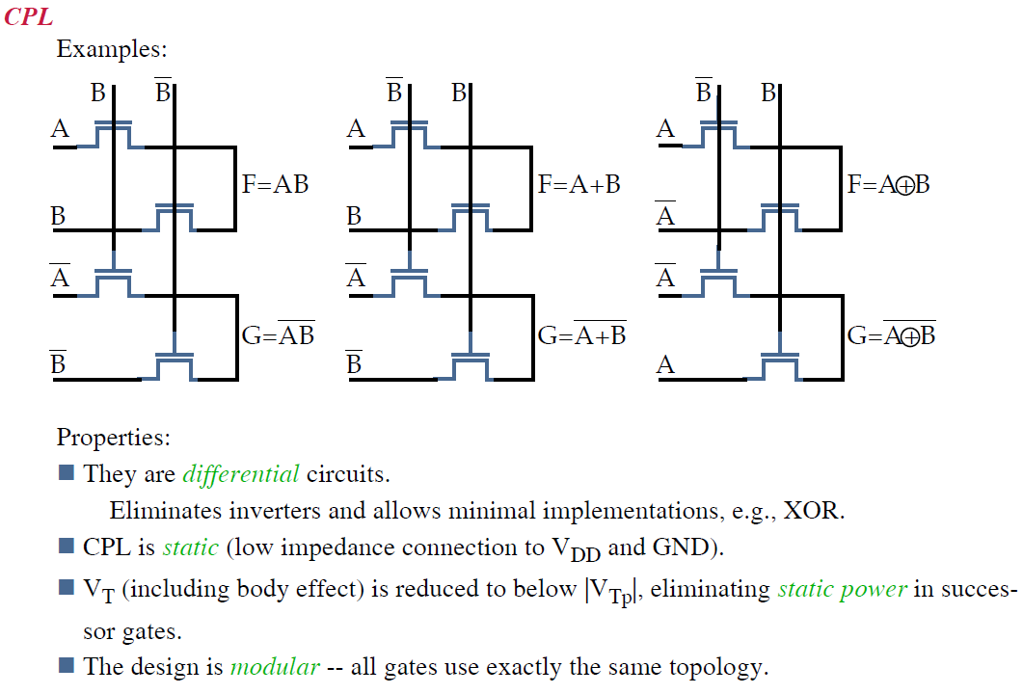
SESSION DESCRIPTION

Slide 17
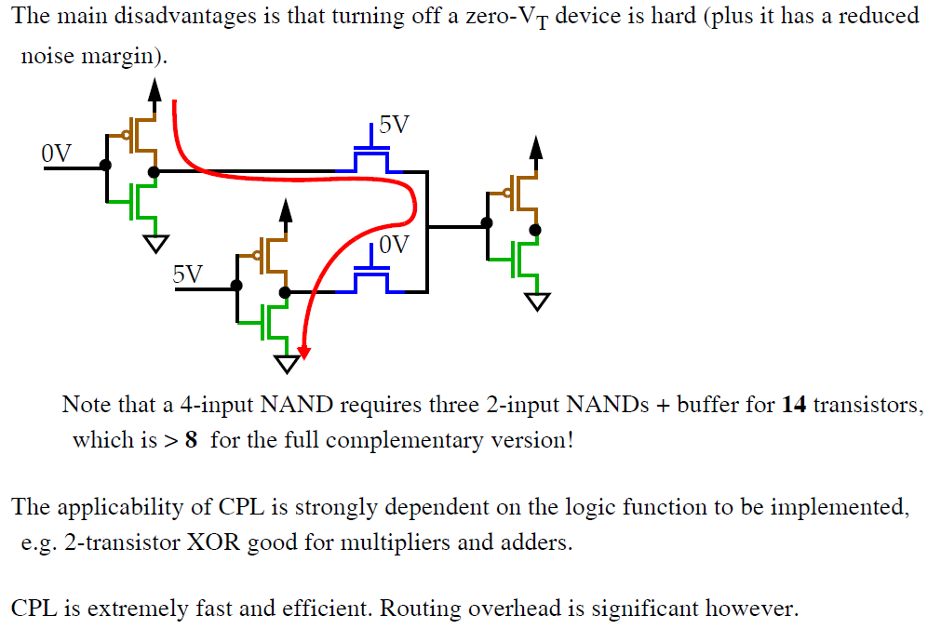
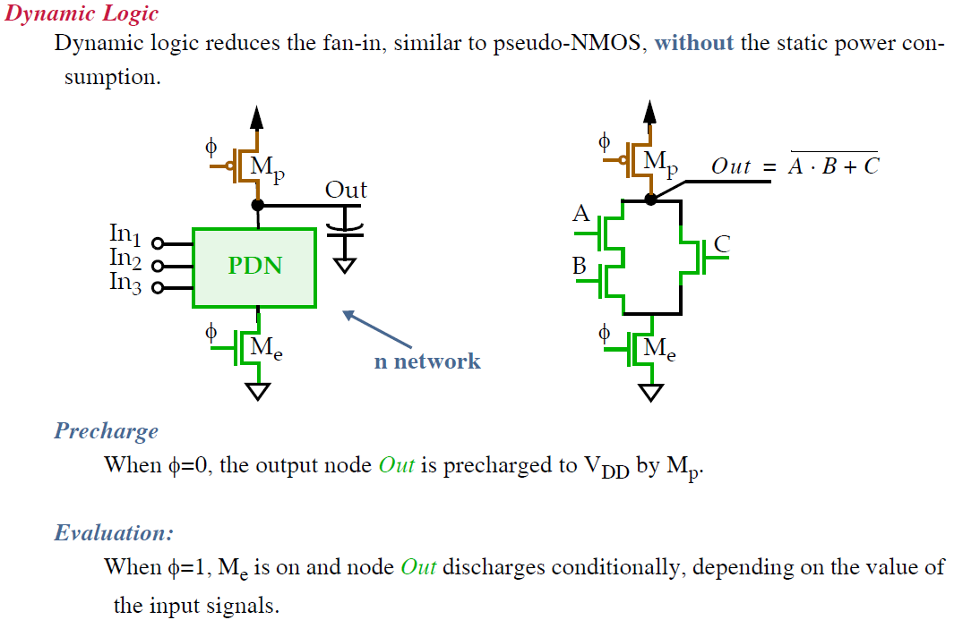
SESSION DESCRIPTION

Slide 18
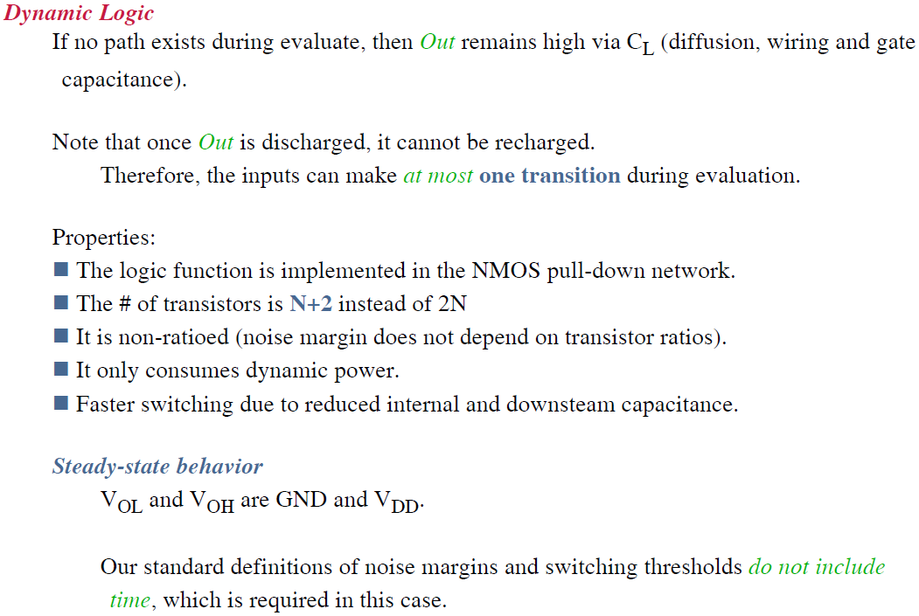
SESSION DESCRIPTION

Slide 19
ACTIVITIES/ CASE STUDIES/ IMPORTANT FACTS RELATED TO THE SESSION
Activities:
Discuss the basic of Pass Transistor and Transmission Gate based logics.
Articles:
LOGIC CIRCUITS AND CMOS
https://courses.engr.illinois.edu/ece110/sp2021/content/courseNotes/files/?logicAndCMOS
Case Studies:
DESIGNING COMBINATIONAL LOGIC GATES IN CMOS
http://bwrcs.eecs.berkeley.edu/Classes/icdesign/ee141_f01/Notes/chapter6.pdf

Slide 20
EXAMPLES
Most portable systems, such as cellular communication devices and laptop and palmtop computers, operate from a limited power supply, and the extension of battery-based operation time is a significant design goal.

Slide 21
SUMMARY
Pass-transistor logic is good for certain classes of circuits (MUX/adders). Dynamic logic gives fast and small circuits but complicates the design process and restricts the minimum clock rate.

Slide 22
SELF-ASSESSMENT QUESTIONS
1. Explain the requirement and operation of pass transistors and transmission gates.
2. Describe Switch Logic and pass transistor.

Slide 23
TERMINAL QUESTIONS
1. Draw the minimum CMOS transistor network that implements the functionality of Boolean equation F= ((A+B) C + D)'. You can assume both the original and complemented versions of each literal are available as gate inputs.

Slide 24
REFERENCES FOR FURTHER LEARNING OF THE SESSION
Text Books:
1.Douglas A. Pucknell& Kamran Eshraghian, Basic VLSI Design, PHI, 3rd Ed., 2011
2. Neil H.E. Weste, David Harris, Ayan Banerjee, CMOS VLSI Design, A Circuits and Systems Perspective, Pearson Education, 4th Ed., 2011
3. Sung-Mo Kang, Yusuf Leblebici, CMOS Digital Integrated Circuits Analysis and Design, Tata Mc-Graw-Hill, 3rd Ed., 2003
Reference Books:
1. Jab M. Rabaey, Anantha Chandra Kasan, Borivoje Nikolic, Digital Integrated Circuits - A Design Perspective, PHI, 2nd Ed., 2012
2. Michal John Sebastian Smith, Application-Specific Integrated Circuits, Pearson Education, 6th Ed., 2009
Sites and Web links:
https://archive.nptel.ac.in/courses/106/105/106105034/

Slide 25
THANK YOU
Team – VLSI Design

