Slide 1


Department of ECE
VLSI DESIGN
21EC2211
Topic:
CMOS Fault Models
Session - 3

Slide 2



AIM OF THE SESSION
To familiarize students with CMOS Fault Modles
INSTRUCTIONAL OBJECTIVES
This Session is designed to:
Describe about Logical fault models.
Describe about Single stuck at fault.
Describe about Test stuck at fault.
LEARNING OUTCOMES
At the end of this session, you should be able to:
Describe about Logical fault models.
Describe about Single stuck at fault.
Describe about Test stuck at fault.

Slide 3
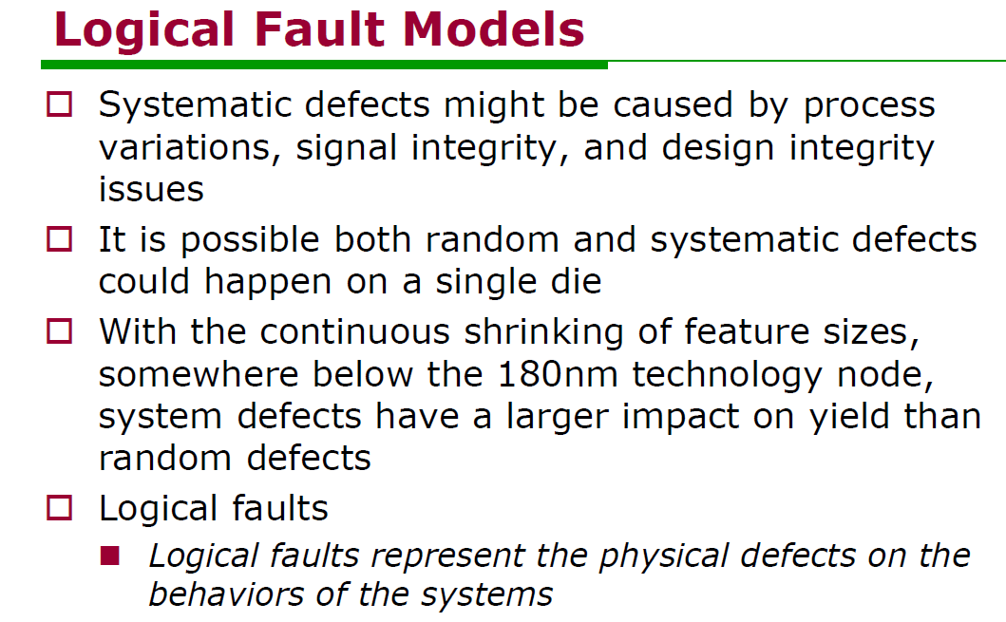
SESSION INTRODUCTION

Slide 4
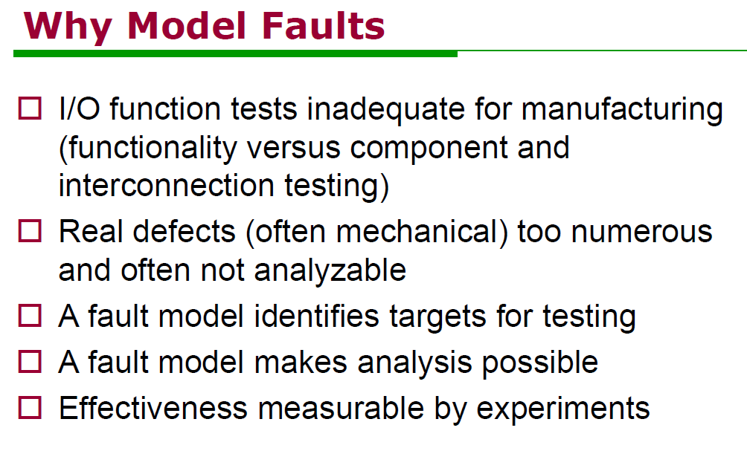
SESSION DESCRIPTION

Slide 5
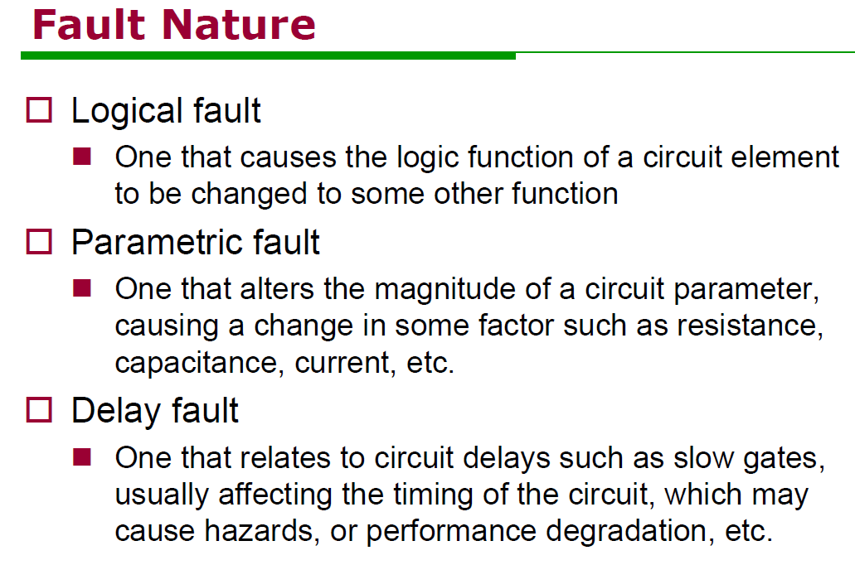
SESSION DESCRIPTION

Slide 6
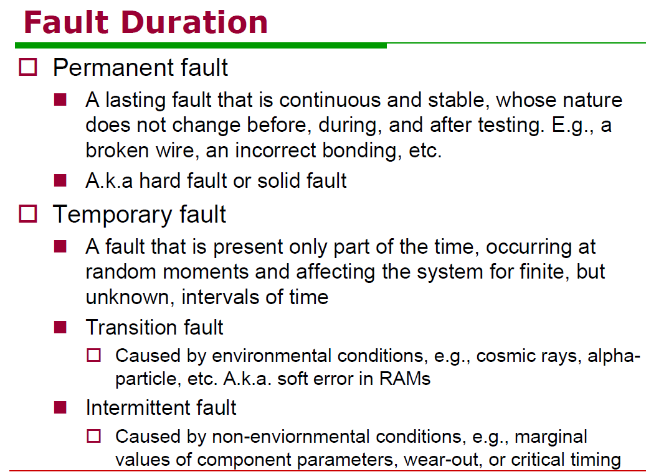
SESSION DESCRIPTION

Slide 7
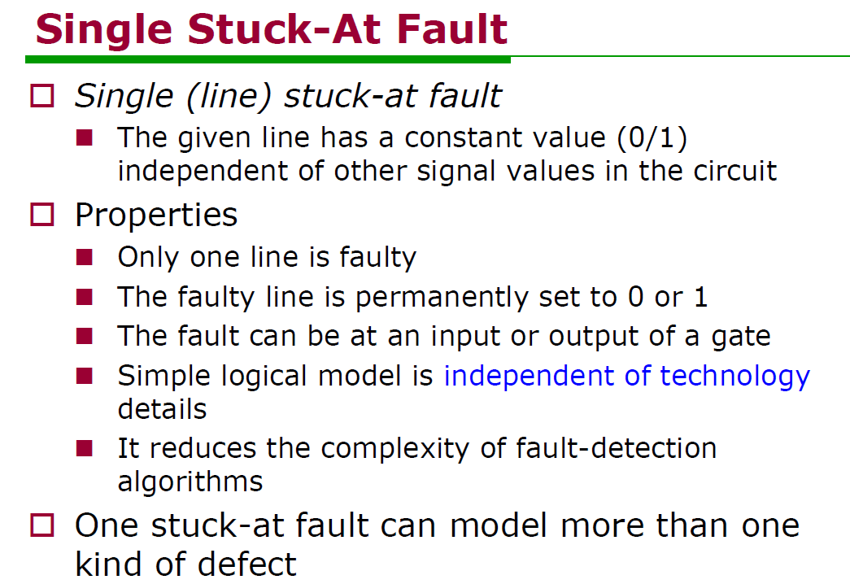
SESSION DESCRIPTION

Slide 8
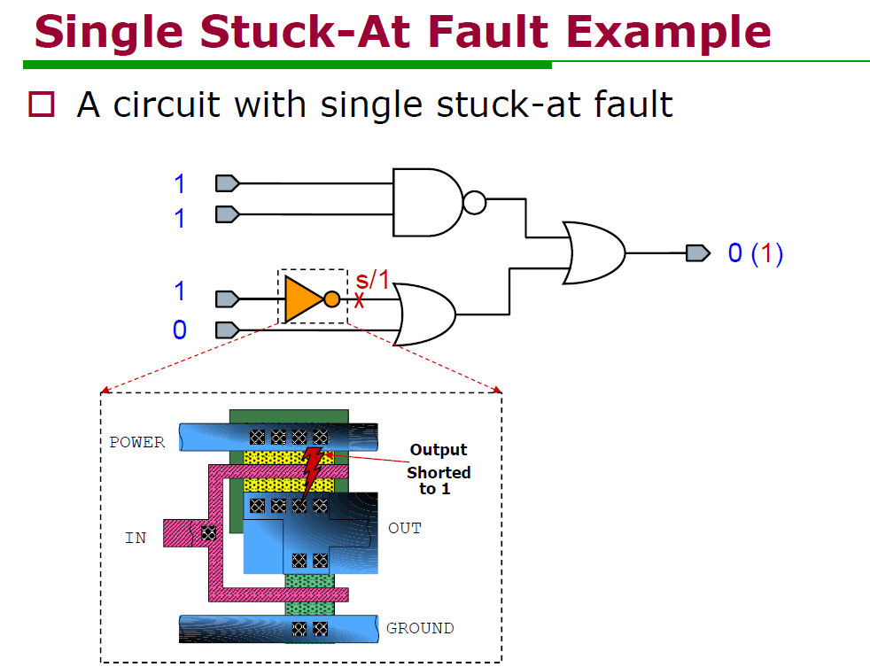
SESSION DESCRIPTION

Slide 9
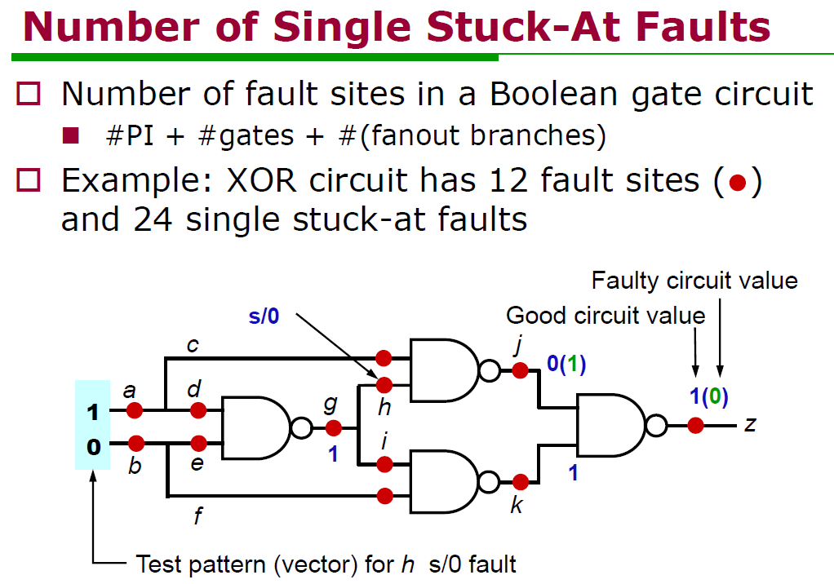
SESSION DESCRIPTION

Slide 10
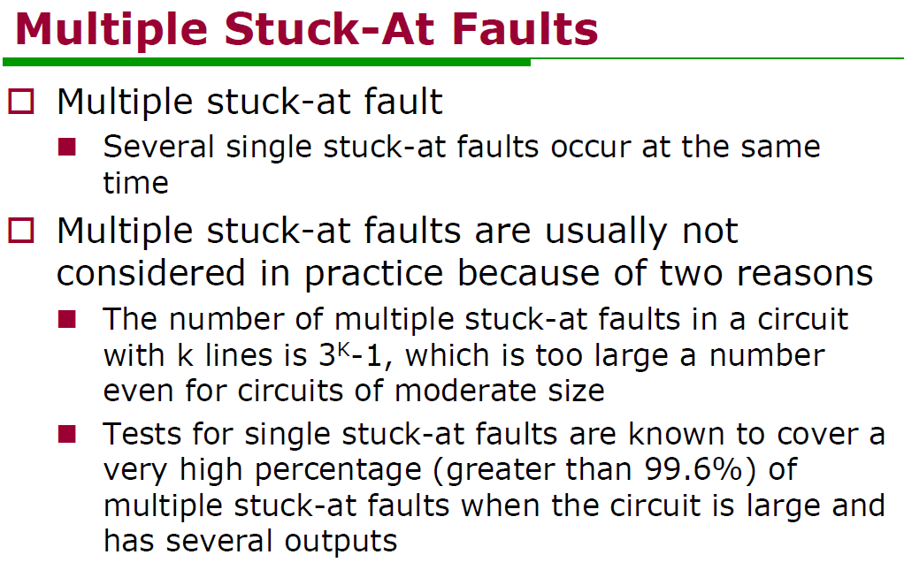
SESSION DESCRIPTION

Slide 11
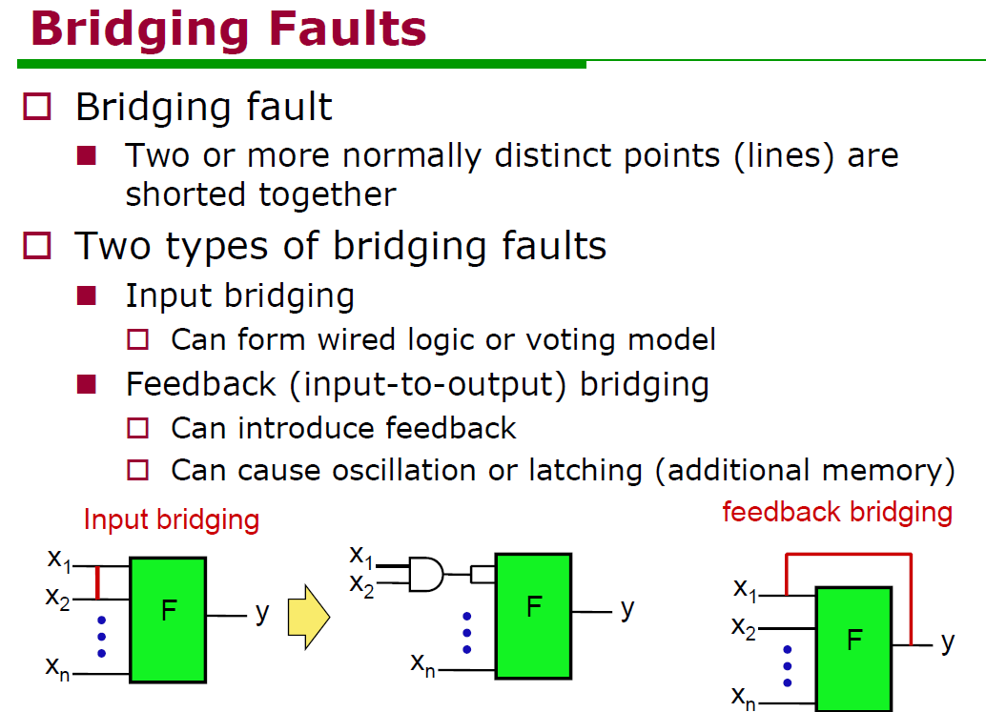
SESSION DESCRIPTION

Slide 12
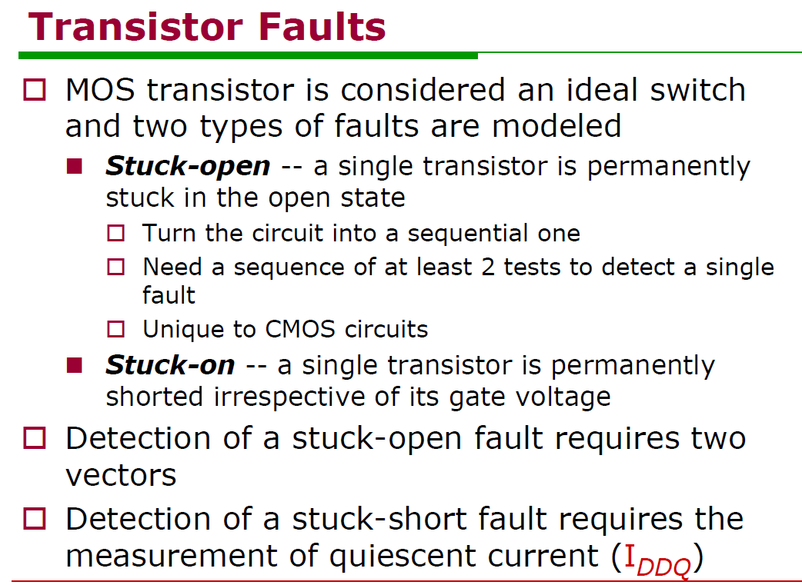
SESSION DESCRIPTION

Slide 13
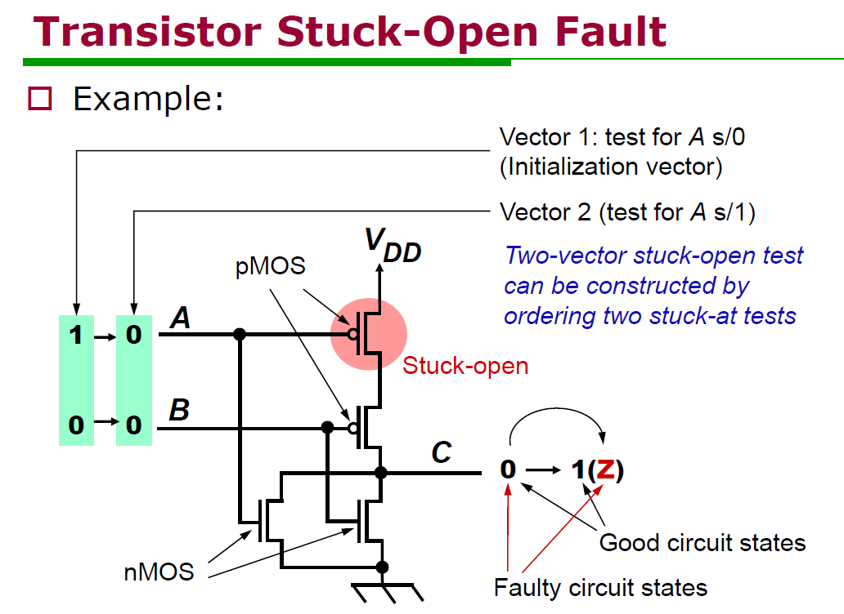
SESSION DESCRIPTION

Slide 14
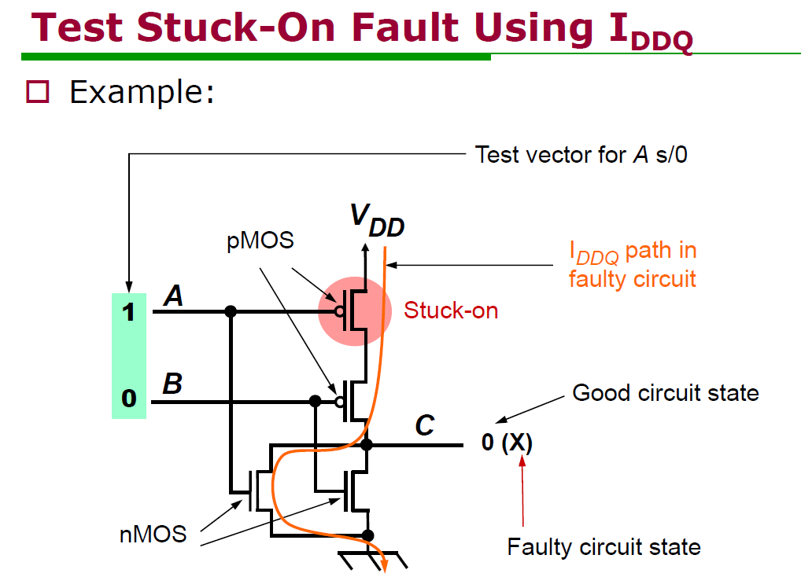
SESSION DESCRIPTION

Slide 15
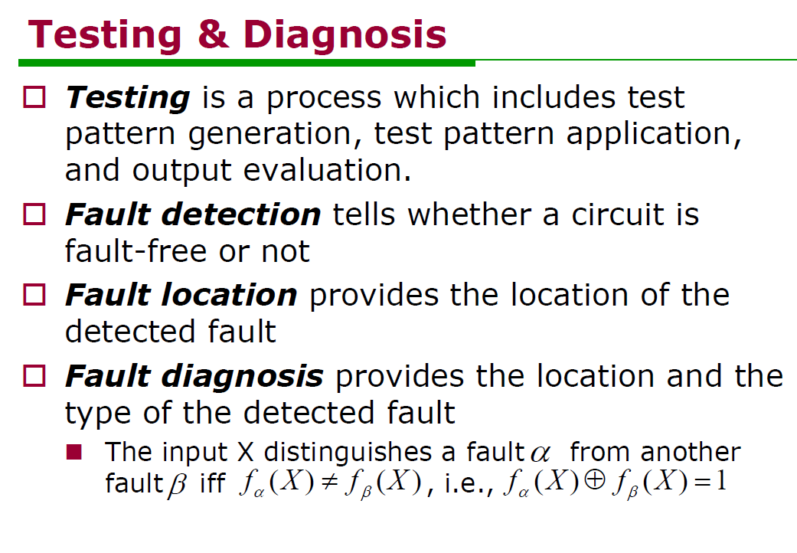
SESSION DESCRIPTION

Slide 16
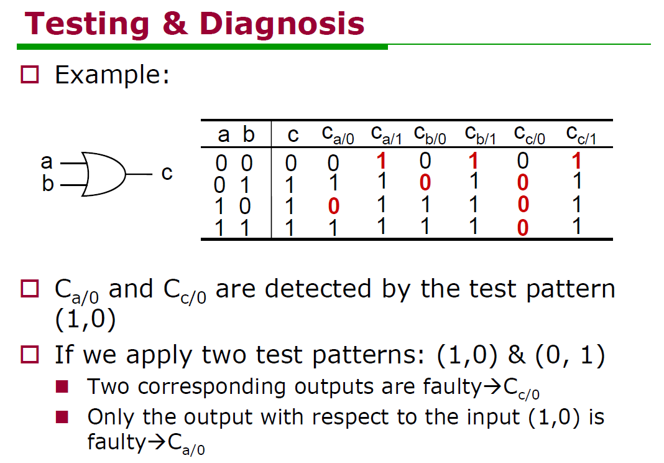
SESSION DESCRIPTION

Slide 17
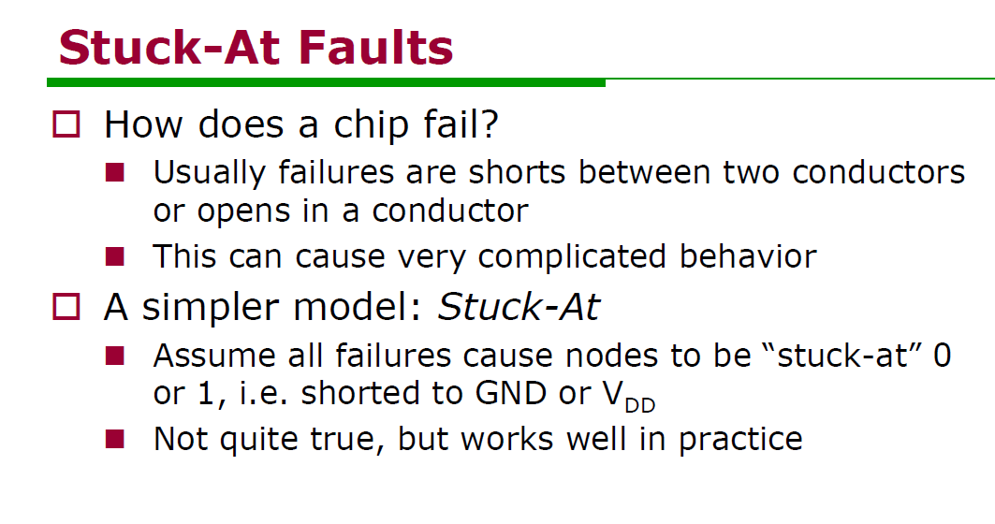
SESSION DESCRIPTION

Slide 18
SUMMARY
About brief description of CMOS Fault model is taken out in this ppt.

Slide 19
SELF-ASSESSMENT QUESTIONS
Describe about Logical fault models.
2.Describe about Single stuck at fault.
3.Describe about Test stuck at fault.

Slide 20
TERMINAL QUESTIONS
Describe about Logical fault models.
Describe about Single stuck at fault.
Describe about Test stuck at fault.

Slide 21
REFERENCES FOR FURTHER LEARNING OF THE SESSION
Text Books:
1.Douglas A. Pucknell& Kamran Eshraghian, Basic VLSI Design, PHI, 3rd Ed., 2011
2. Neil H.E. Weste, David Harris, Ayan Banerjee, CMOS VLSI Design, A Circuits and Systems Perspective, Pearson Education, 4th Ed., 2011
3. Sung-Mo Kang, Yusuf Leblebici, CMOS Digital Integrated Circuits Analysis and Design, Tata Mc-Graw-Hill, 3rd Ed., 2003
Reference Books:
1. Jab M. Rabaey, Anantha Chandra Kasan, Borivoje Nikolic, Digital Integrated Circuits - A Design Perspective, PHI, 2nd Ed., 2012
2. Michal John Sebastian Smith, Application-Specific Integrated Circuits, Pearson Education, 6th Ed., 2009
Sites and Web links:
1. https://www.egr.msu.edu/classes/ece410/mason/files/Ch7.pdf
2. http://bwrcs.eecs.berkeley.edu/Classes/icdesign/ee141_f01/Notes/chapter5.pdf
3. https://nptelvideos.com/video.php?id=1317

Slide 22
THANK YOU
Team – VLSI Design

