Slide 1


Department of ECE
VLSI DESIGN
21EC2211
Topic:
Testing of Combinational logics,
&Testing of sequential logics,
Session – 4 &5

Slide 2



AIM OF THE SESSION
To familiarize students with combinational and sequential circuits.
INSTRUCTIONAL OBJECTIVES
This Session is designed to:
Define combinational logic circuits with relevant examples.
Define sequential logic circuits with relevant examples.
LEARNING OUTCOMES
At the end of this session, you should be able to:
Define combinational logic circuits with relevant examples.
Define sequential logic circuits with relevant examples.

Slide 3
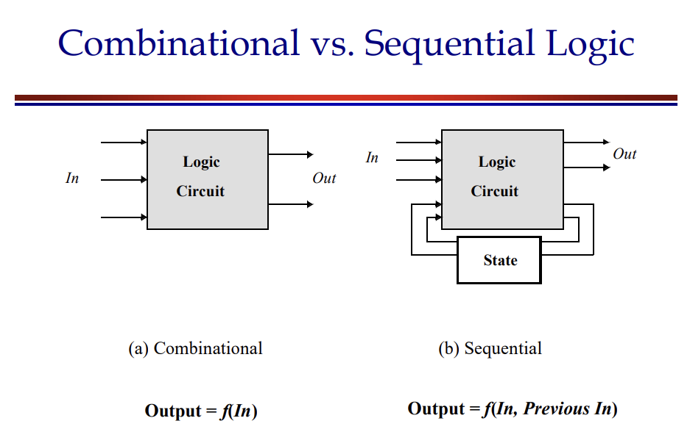
SESSION INTRODUCTION

Slide 4
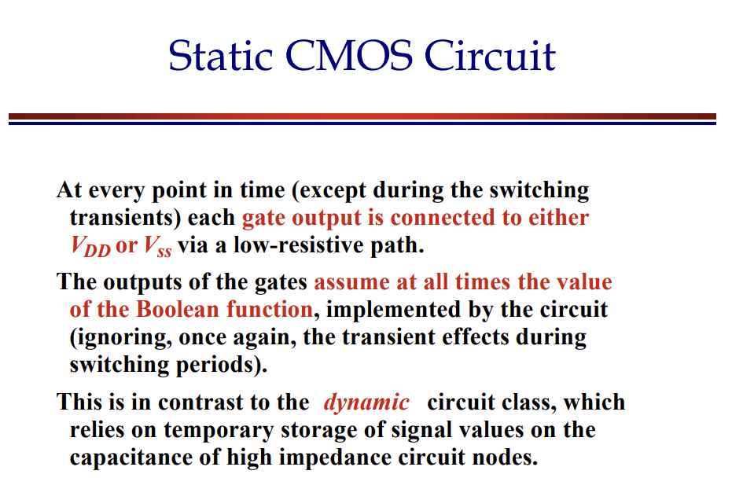
SESSION INTRODUCTION

Slide 5
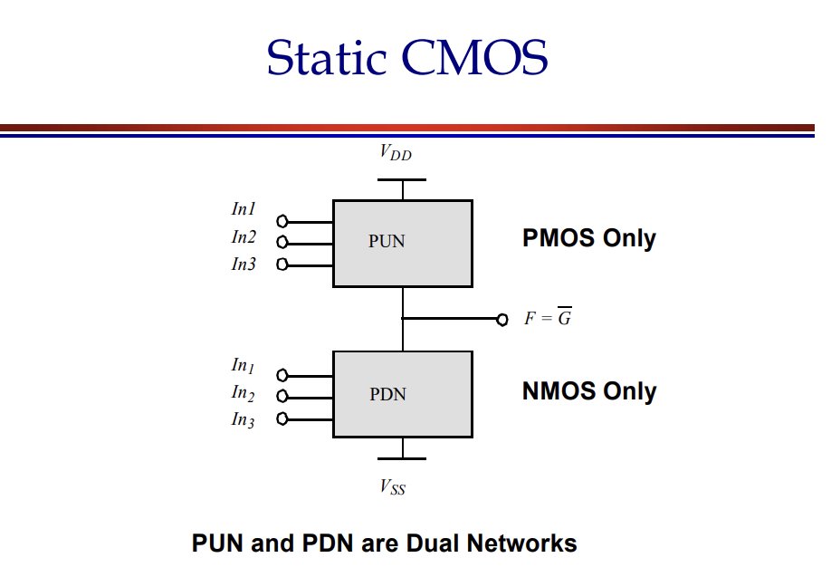
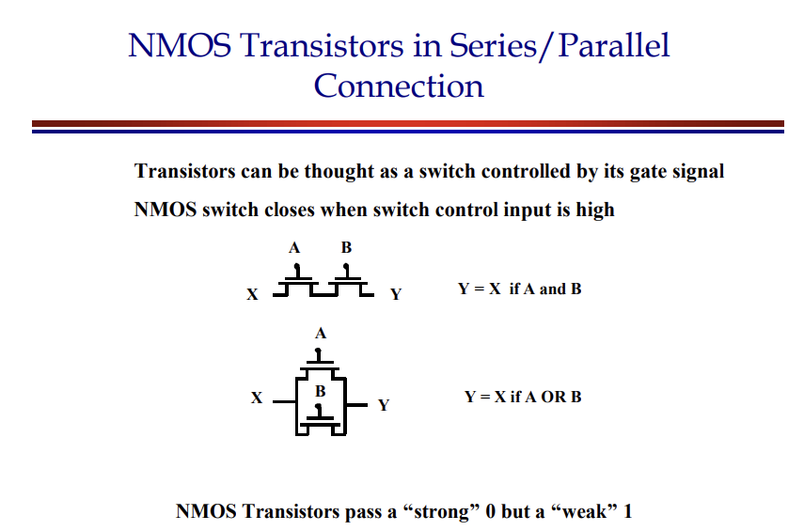
SESSION INTRODUCTION

Slide 6
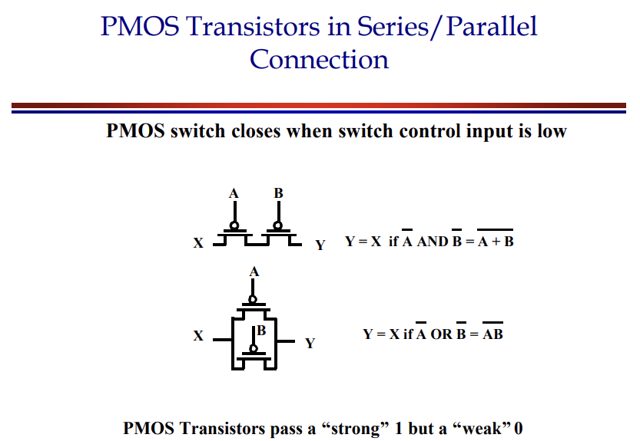
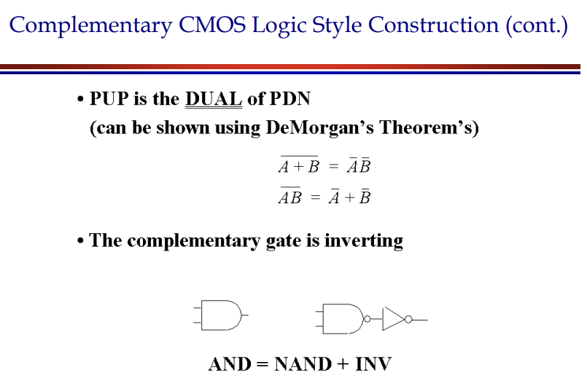
SESSION INTRODUCTION

Slide 7
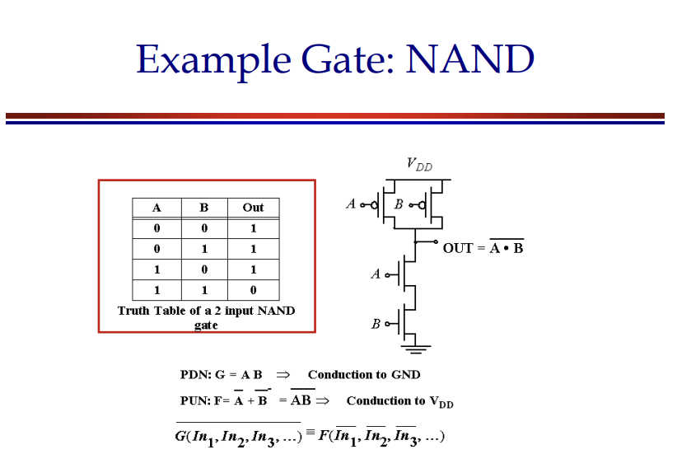
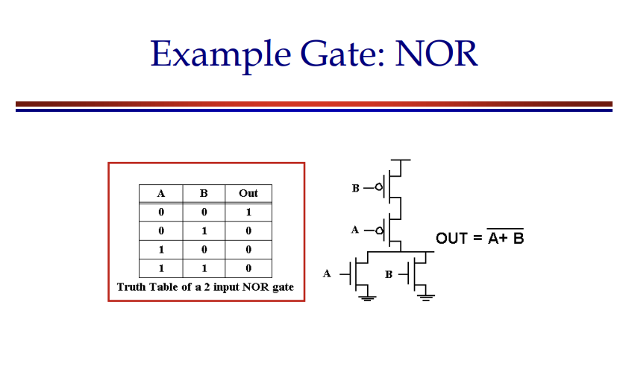
SESSION INTRODUCTION

Slide 8
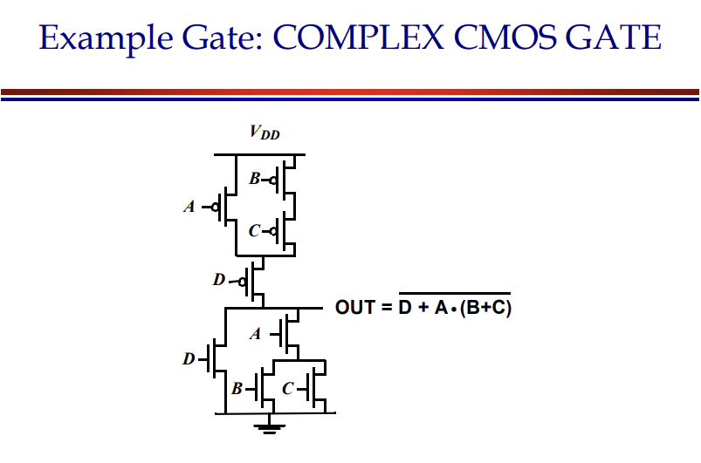
SESSION INTRODUCTION

Slide 9
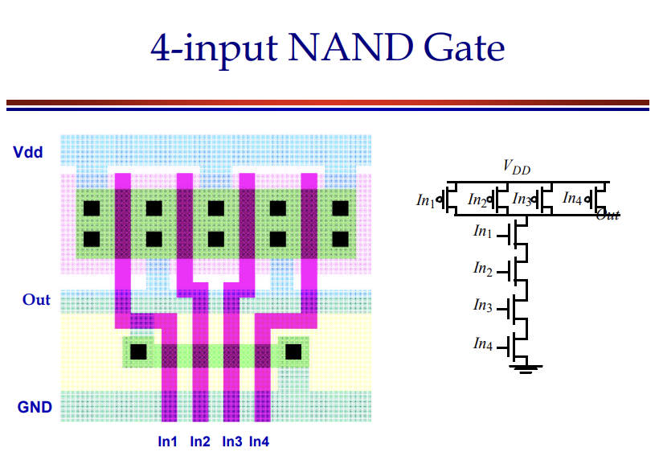
SESSION INTRODUCTION

Slide 10
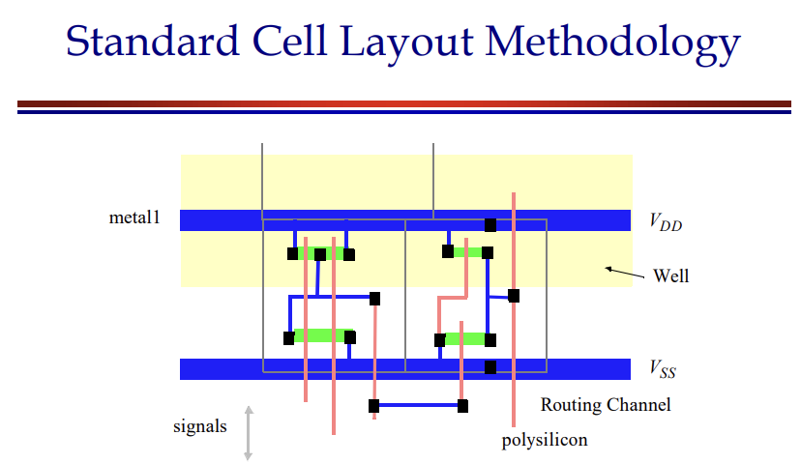
SESSION INTRODUCTION

Slide 11
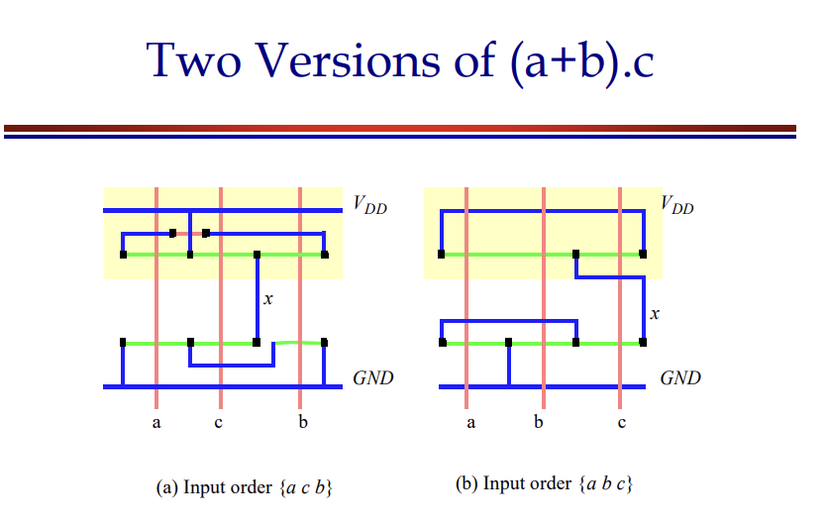
SESSION INTRODUCTION

Slide 12
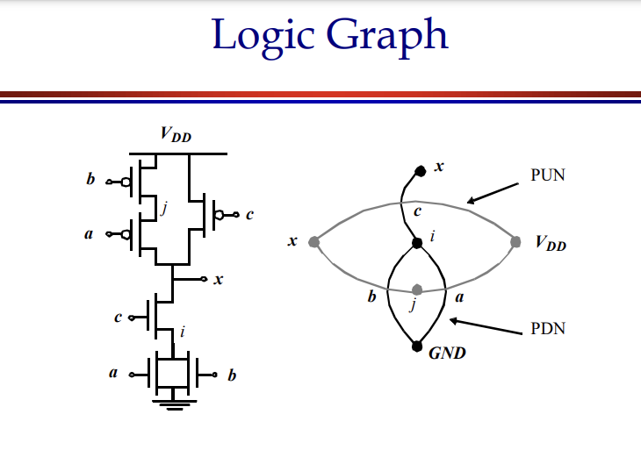
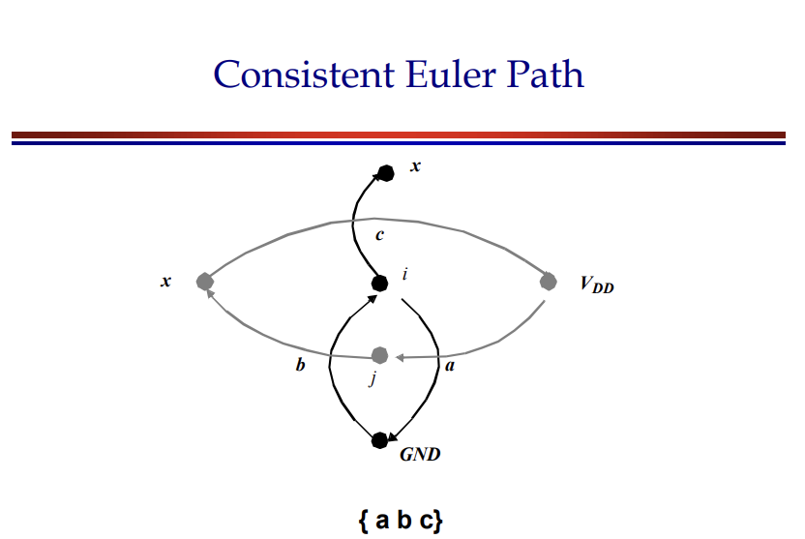
SESSION INTRODUCTION

Slide 13
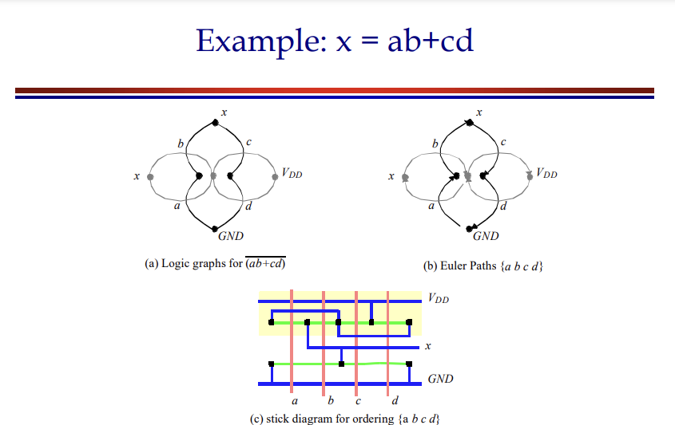
SESSION INTRODUCTION

Slide 14
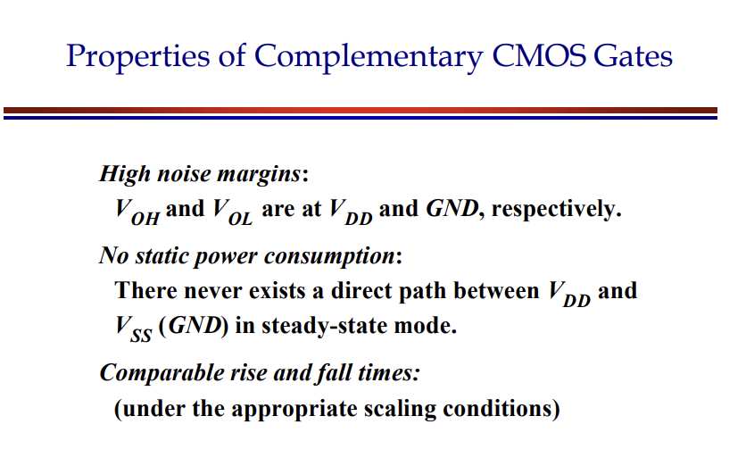
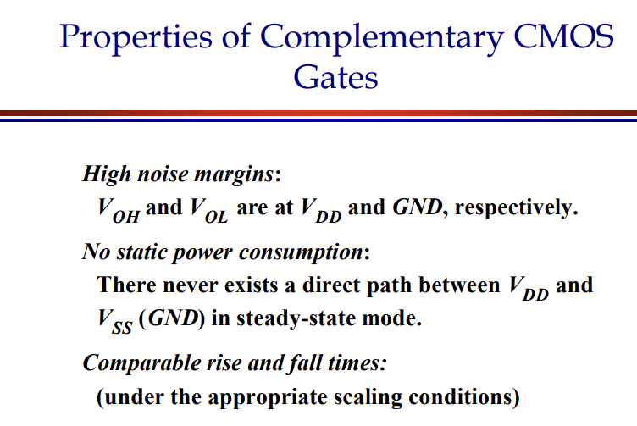
SESSION INTRODUCTION

Slide 15
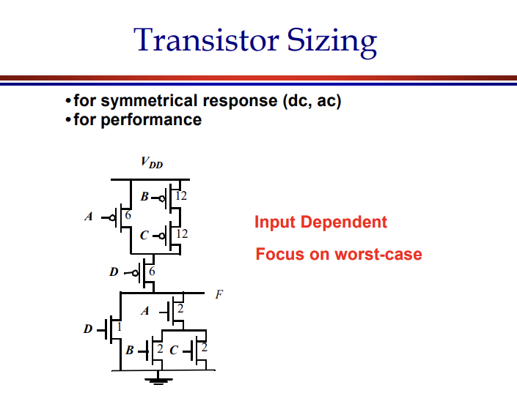
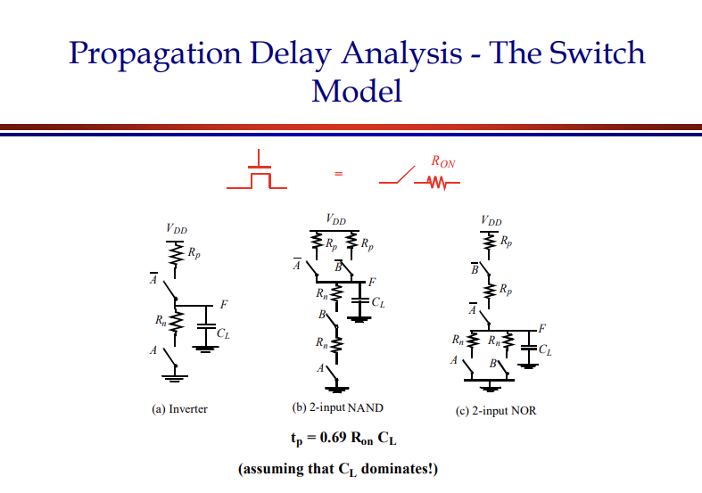
SESSION INTRODUCTION

Slide 16
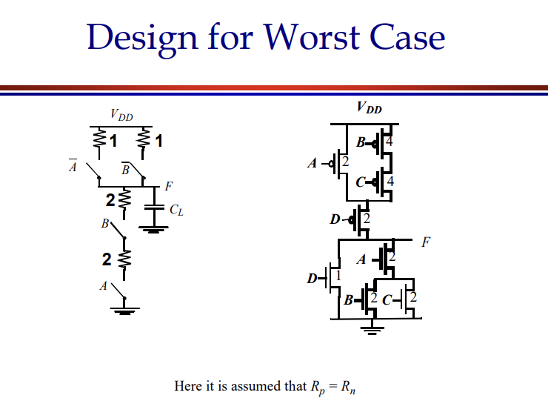
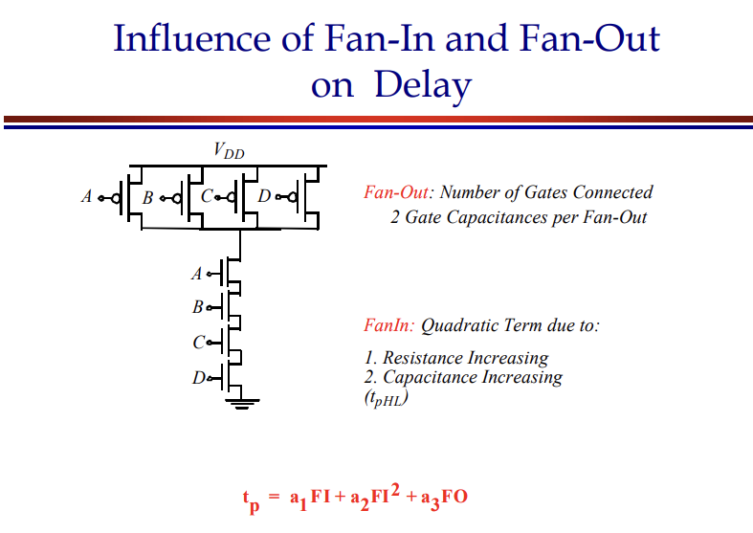
SESSION INTRODUCTION

Slide 17
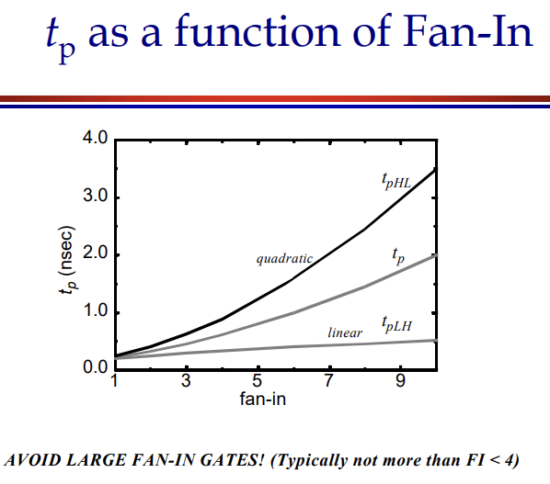
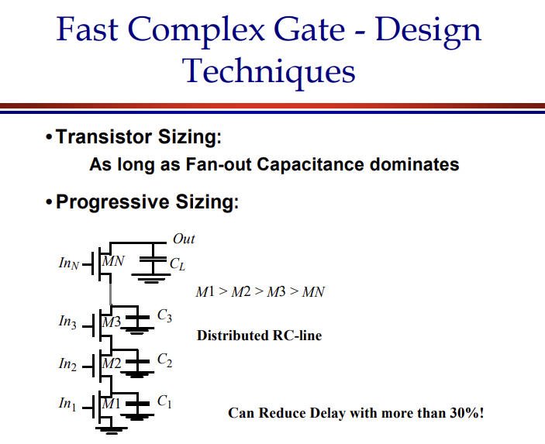
SESSION INTRODUCTION

Slide 18
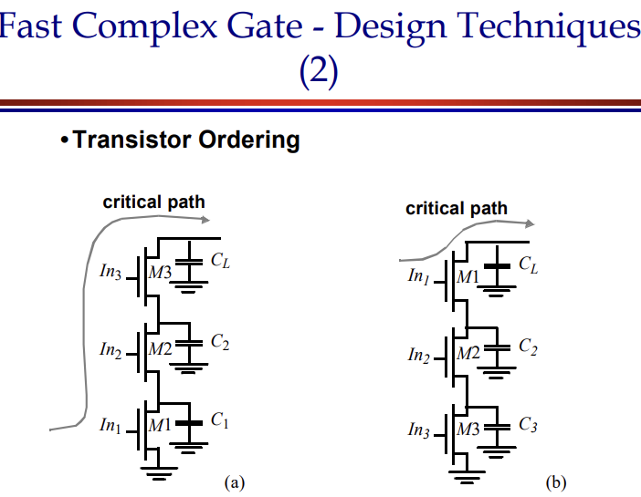
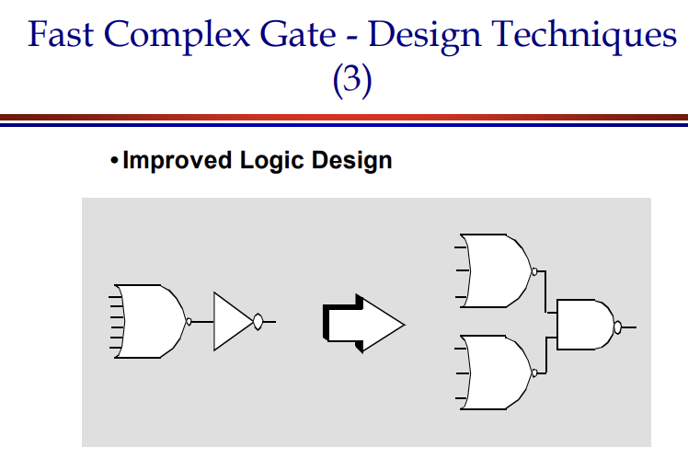
SESSION INTRODUCTION

Slide 19
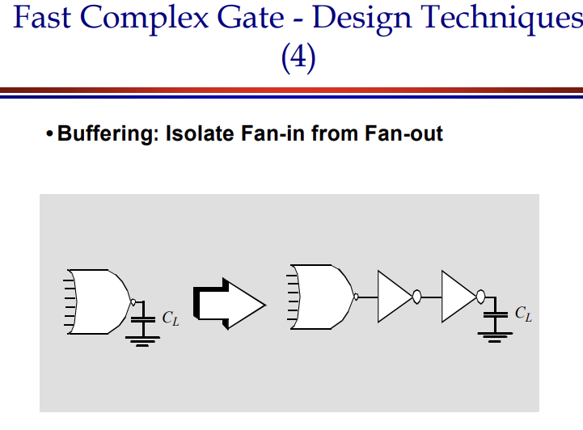
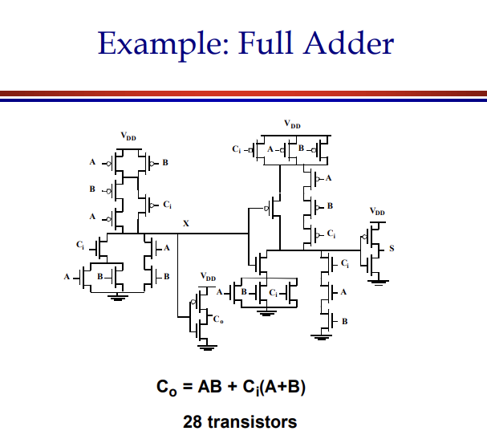
SESSION INTRODUCTION

Slide 20
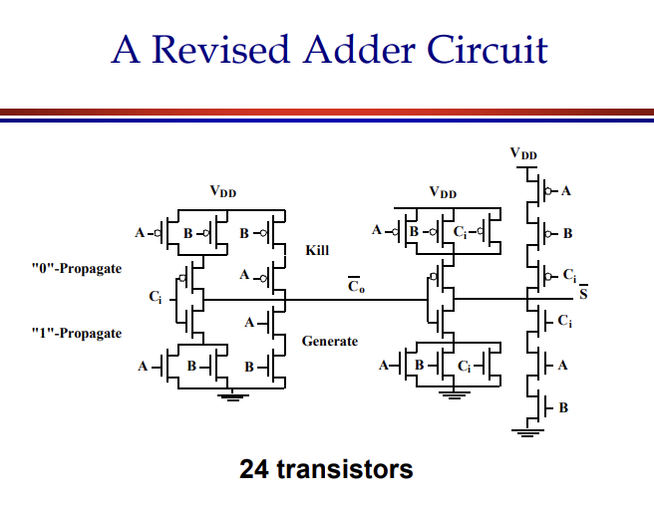
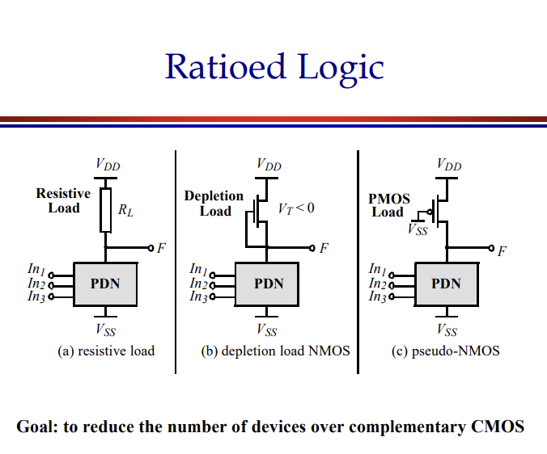
SESSION INTRODUCTION

Slide 21
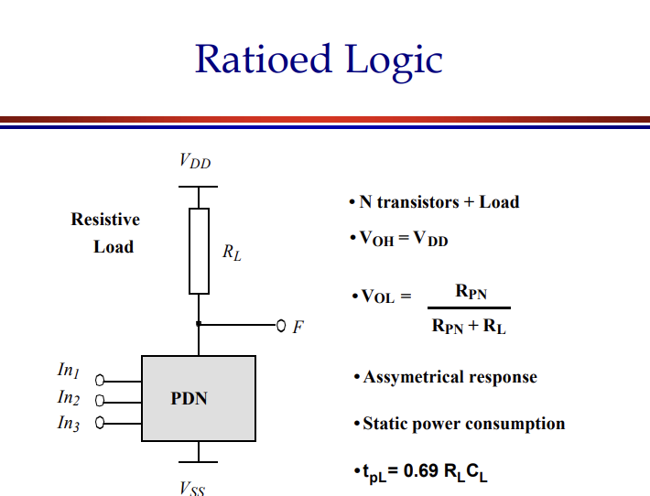
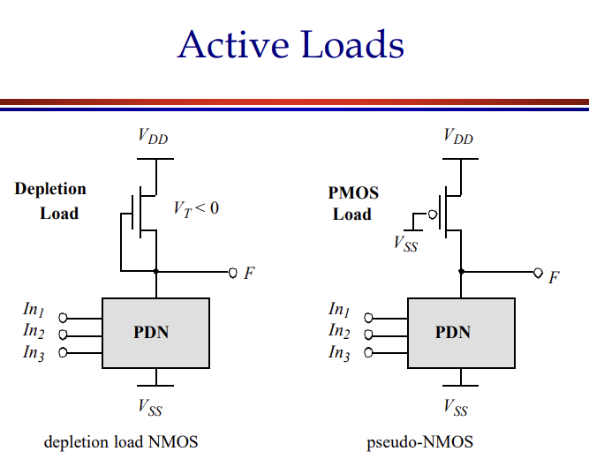
SESSION INTRODUCTION

Slide 22
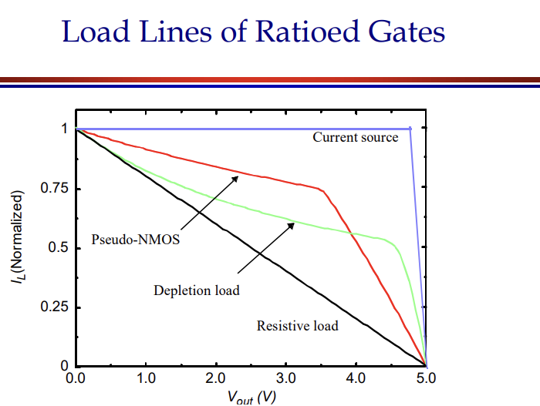
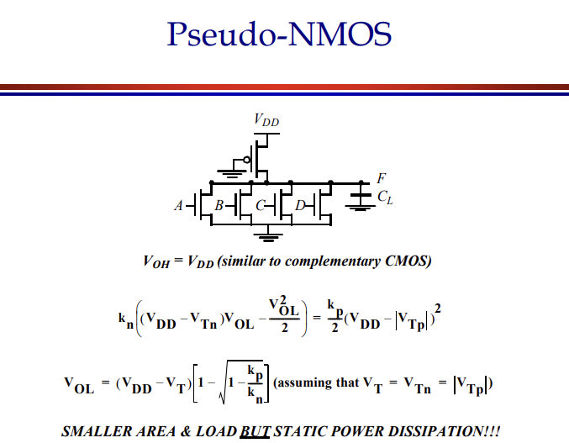
SESSION INTRODUCTION

Slide 23
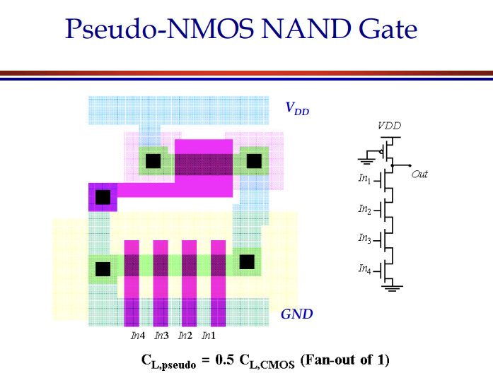
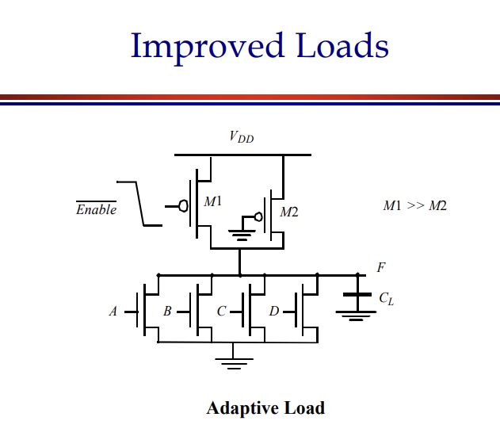
SESSION INTRODUCTION

Slide 24
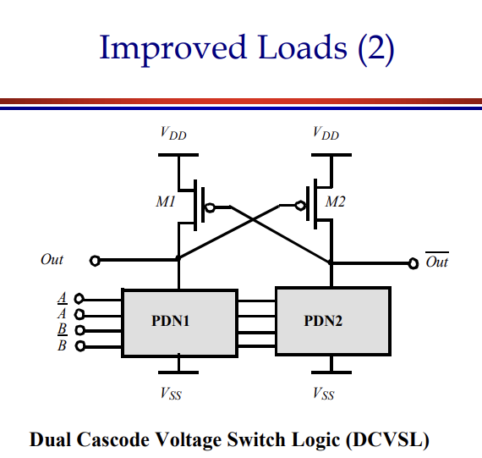
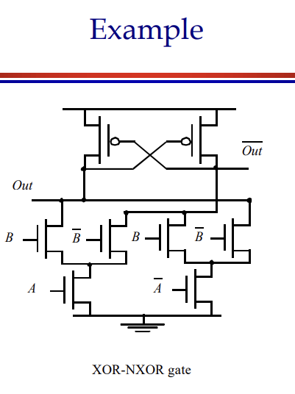
SESSION INTRODUCTION

Slide 25
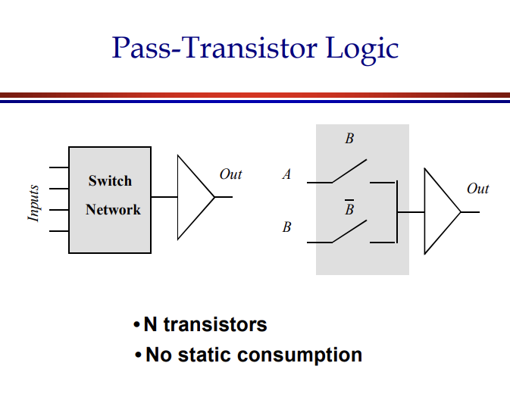
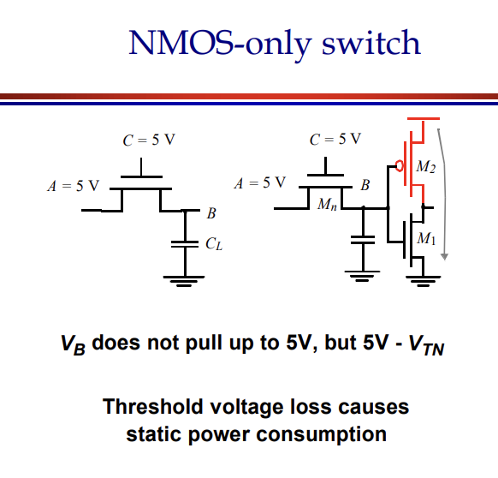
SESSION INTRODUCTION

Slide 26
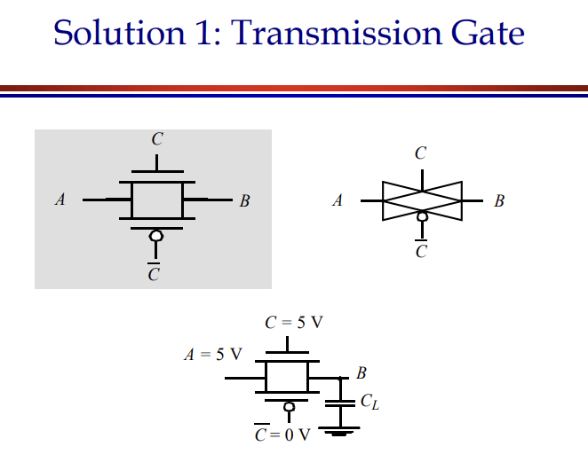
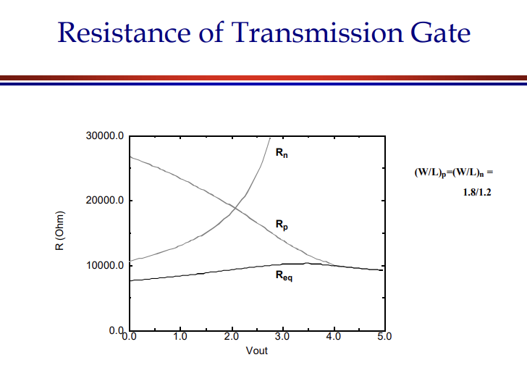
SESSION INTRODUCTION

Slide 27
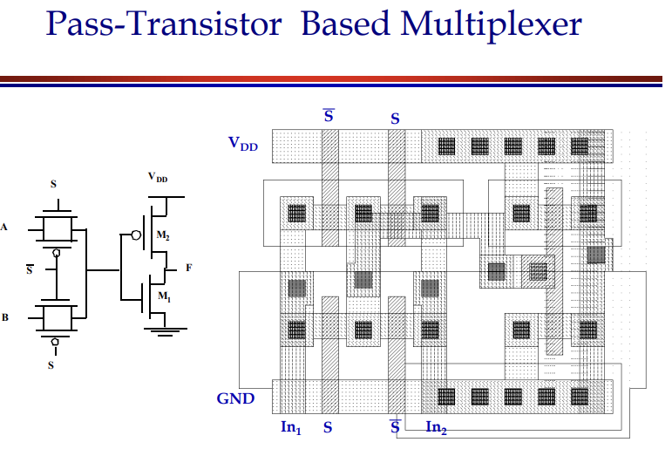
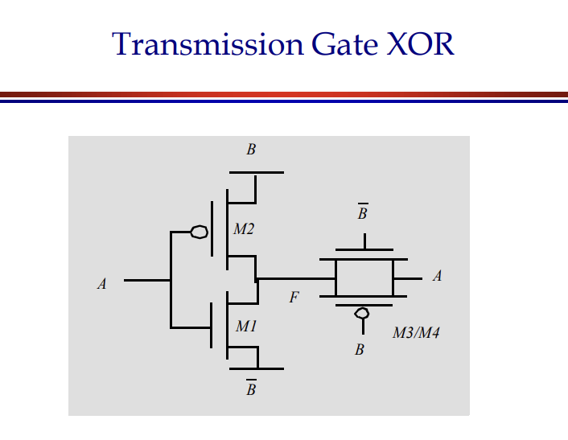
SESSION INTRODUCTION

Slide 28
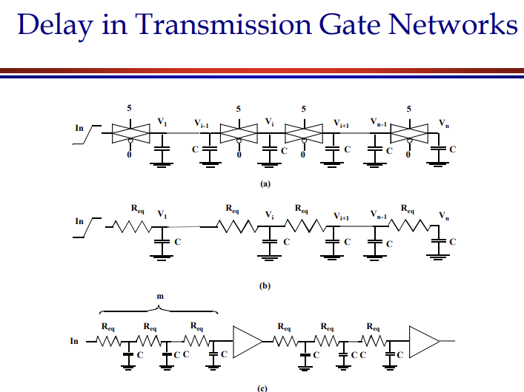
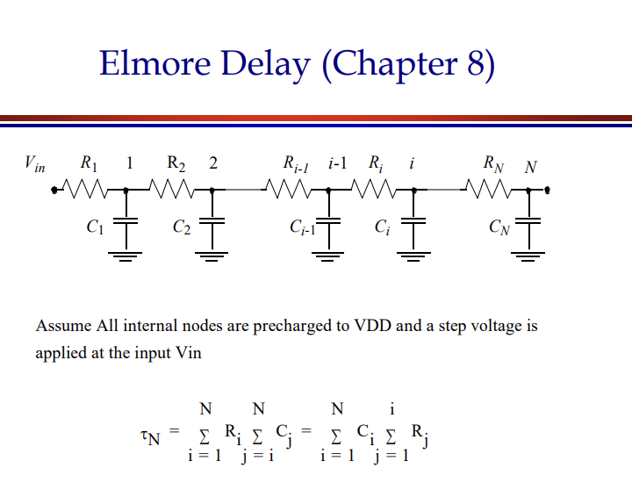
SESSION INTRODUCTION

Slide 29
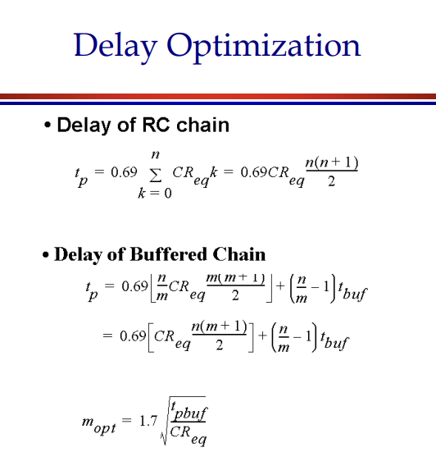
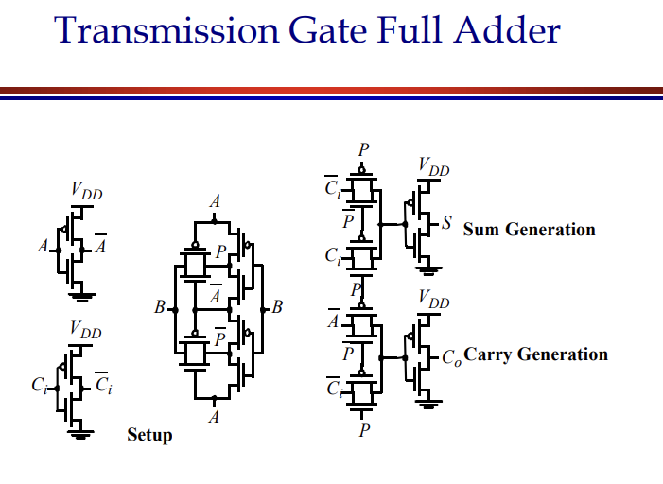
SESSION INTRODUCTION

Slide 30
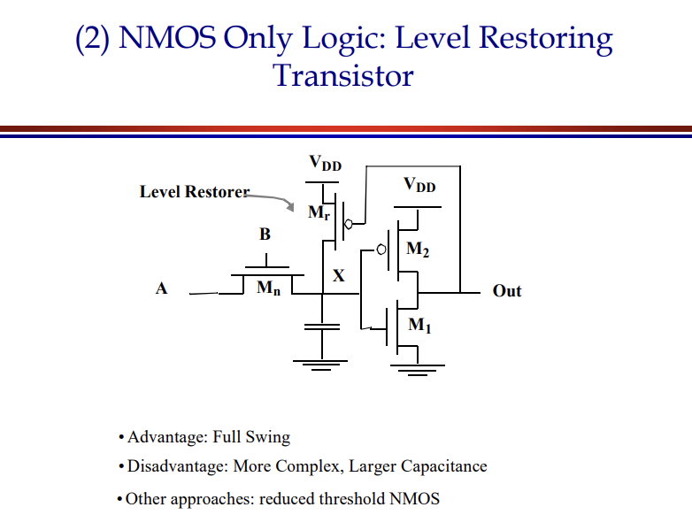
SESSION INTRODUCTION

Slide 31
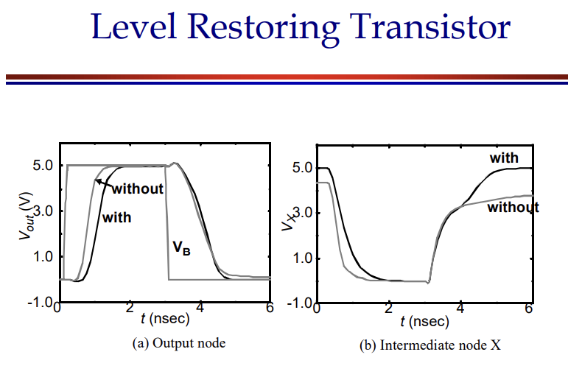
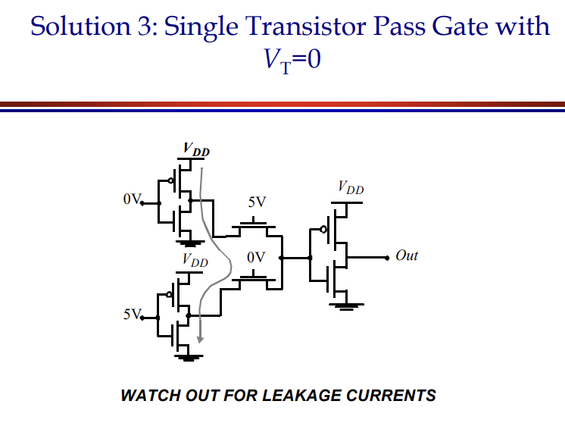
SESSION INTRODUCTION

Slide 32


SESSION INTRODUCTION

Slide 33


SESSION INTRODUCTION

Slide 34


SESSION INTRODUCTION

Slide 35


SESSION INTRODUCTION

Slide 36


SESSION INTRODUCTION

Slide 37


SESSION INTRODUCTION

Slide 38


SESSION INTRODUCTION

Slide 39


SESSION INTRODUCTION

Slide 40
SUMMARY
About brief description of Testing combinational and sequential logic circuits is taken out in this ppt.

Slide 41
SELF-ASSESSMENT QUESTIONS
Define combinational logic circuits with relevant examples.
2.Define sequential logic circuits with relevant examples.

Slide 42
TERMINAL QUESTIONS
Define combinational logic circuits with relevant examples.
Define sequential logic circuits with relevant examples.

Slide 43
REFERENCES FOR FURTHER LEARNING OF THE SESSION
Text Books:
1.Douglas A. Pucknell& Kamran Eshraghian, Basic VLSI Design, PHI, 3rd Ed., 2011
2. Neil H.E. Weste, David Harris, Ayan Banerjee, CMOS VLSI Design, A Circuits and Systems Perspective, Pearson Education, 4th Ed., 2011
3. Sung-Mo Kang, Yusuf Leblebici, CMOS Digital Integrated Circuits Analysis and Design, Tata Mc-Graw-Hill, 3rd Ed., 2003
Reference Books:
1. Jab M. Rabaey, Anantha Chandra Kasan, Borivoje Nikolic, Digital Integrated Circuits - A Design Perspective, PHI, 2nd Ed., 2012
2. Michal John Sebastian Smith, Application-Specific Integrated Circuits, Pearson Education, 6th Ed., 2009
Sites and Web links:
1. https://www.egr.msu.edu/classes/ece410/mason/files/Ch7.pdf
2. http://bwrcs.eecs.berkeley.edu/Classes/icdesign/ee141_f01/Notes/chapter5.pdf
3. https://nptelvideos.com/video.php?id=1317

Slide 44
THANK YOU
Team – VLSI Design

