Slide 1


Department of ECE
VLSI DESIGN
21EC2211
Topic:
Scan design techniques
Session - 6

Slide 2



AIM OF THE SESSION
To familiarize students with the scan design techniques
INSTRUCTIONAL OBJECTIVES
This Session is designed to:
Describe about Scan Design techniques .
Describe about Scan path.
Describe about Boundary Scan Test.
LEARNING OUTCOMES
At the end of this session, you should be able to:
Describe about Scan Design techniques .
Describe about Scan path.
Describe about Boundary Scan Test.

Slide 3
SESSION INTRODUCTION
Scan Design Techniques
The set of design for testability guidelines presented above is a set of ad hoc methods to design random logic in respect with testability requirements. The scan design techniques are a set of structured approaches to design (for testability) the sequential circuits.
The major difficulty in testing sequential circuits is determining the internal state of the circuit. Scan design techniques are directed at improving the controllability and observability of the internal states of a sequential circuit. By this the problem of testing a sequential circuit is reduced to that of testing a combinational circuit, since the internal states of the circuit are under control.

Slide 4
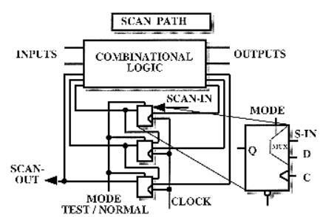
SESSION DESCRIPTION
Scan Path
The goal of the scan path technique is to reconfigure a sequential circuit, for the purpose of testing, into a combinational circuit. Since a sequential circuit is based on a combinational circuit and some storage elements, the technique of scan path consists in connecting together all the storage elements to form a long serial shift register. Thus the internal state of the circuit can be observed and controlled by shifting (scanning) out the contents of the storage elements. The shift register is then called a scan path.
The storage elements can either be D, J-K, or R-S types of flip-flops, but simple latches cannot be used in scan path. However, the structure of storage elements is slightly different than classical ones. Generally the selection of the input source is achieved using a multiplexer on the data input controlled by an external mode signal. This multiplexer is integrated into the D-flip-flop, in our case; the D-flip-flop is then called MD-flip-flop (multiplexed-flip-flop).

Slide 5
SESSION DESCRIPTION
The sequential circuit containing a scan path has two modes of operation : a normal mode and a test mode which configure the storage elements in the scan path.
In the normal mode, the storage elements are connected to the combinational circuit, in the loops of the global sequential circuit, which is considered then as a finite state machine.
In the test mode, the loops are broken and the storage elements are connected together as a serial shift register (scan path), receiving the same clock signal. The input of the scan path is called scan-in and the output scan-out. Several scan paths can be implemented in one same complex circuit if it is necessary, though having several scan-in inputs and scan-out outputs.
A large sequential circuit can be partitioned into sub-circuits, containing combinational sub-circuits, associated with one scan path each. Efficiency of the test pattern generation for a combinational sub-circuit is greatly improved by partitioning, since its depth is reduced.
Before applying test patterns, the shift register itself has to be verified by shifting in all ones i.e. 111...11, or zeros i.e. 000...00, and comparing.

Slide 6
SESSION DESCRIPTION
The method of testing a circuit with the scan path is as follows:
Set test mode signal, flip-flops accept data from input scan-in
Verify the scan path by shifting in and out test data
Set the shift register to an initial state
Apply a test pattern to the primary inputs of the circuit
Set normal mode, the circuit settles and can monitor the primary outputs of the circuit
Activate the circuit clock for one cycle
Return to test mode
Scan out the contents of the registers, simultaneously scan in the next pattern

Slide 7
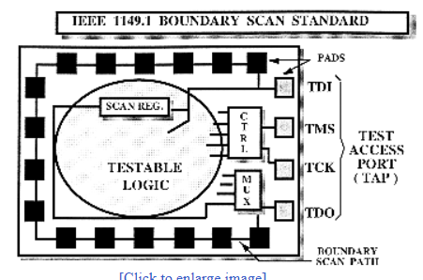
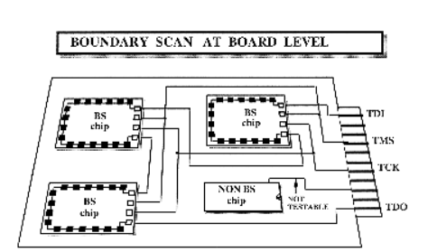
SESSION DESCRIPTION
Boundary Scan Test (BST)
Boundary Scan Test (BST) is a technique involving scan path and self-testing techniques to resolve the problem of testing boards carrying VLSI integrated circuits and/or surface mounted devices (SMD).
Printed circuit boards (PCB) are becoming very dense and complex, especially with SMD circuits, that most test equipment cannot guarantee a good fault coverage.
BST consists in placing a scan path (shift register) adjacent to each component pin and to interconnect the cells in order to form a chain around the border of the circuit. The BST circuits contained on one board are then connected together to form a single path through the board.
The boundary scan path is provided with serial input and output pads and appropriate clock pads which make it possible to :
Test the interconnections between the various chip
Deliver test data to the chips on board for self-testing
Test the chips themselves with internal self-test

Slide 8
SESSION DESCRIPTION
The advantages of Boundary scan techniques are as follows :
No need for complex testers in PCB testing
Test engineers work is simplified and more efficient
Time to spend on test pattern generation and application is reduced
Fault coverage is greatly increased.
BS Techniques are grouped by the IEEE Standard Organization in a "standard test access port and boundary scan architecture", namely IEEE P1149.1-1990. The Joint Test Action Group (JTAG), formed basically in 1986 at Philips, is an international committee composed of IC manufacturers who have set the technical development of the IEEE P1149 standard and promoted its use by all sectors of electronics industry.
The IEEE 1149 is a family of overall testability bus standards, defined by the Joint Test Action Group (JTAG), formed basically in 1986 at Philips. JTAG is an international committee composed of European and American IC manufacturers. The "standard Test Access Port and Boundary Scan architecture", namely IEEE P1149.1 accepted by the IEEE standard committee in February1990, is the first one of this family. Several other ongoing standards are developed and suggested as drafts to the technical committee of the IEEE 1149 standard in order to promote their use by all sectors of electronics industry.

Slide 9
SUMMARY
About brief description of Scan Design Techniques is taken out in this ppt.

Slide 10
SELF-ASSESSMENT QUESTIONS
Describe about Scan Design techniques?
Describe about Scan path?
3 Describe about Boundary Scan Test?

Slide 11
TERMINAL QUESTIONS
Describe the basics and types of BIST.
Demonstrate the Architecture and Working of the BIST.
Describe the Issues of design, advantages and dis-advantages of BIST?.

Slide 12
REFERENCES FOR FURTHER LEARNING OF THE SESSION
Text Books:
1.Douglas A. Pucknell& Kamran Eshraghian, Basic VLSI Design, PHI, 3rd Ed., 2011
2. Neil H.E. Weste, David Harris, Ayan Banerjee, CMOS VLSI Design, A Circuits and Systems Perspective, Pearson Education, 4th Ed., 2011
3. Sung-Mo Kang, Yusuf Leblebici, CMOS Digital Integrated Circuits Analysis and Design, Tata Mc-Graw-Hill, 3rd Ed., 2003
Reference Books:
1. Jab M. Rabaey, Anantha Chandra Kasan, Borivoje Nikolic, Digital Integrated Circuits - A Design Perspective, PHI, 2nd Ed., 2012
2. Michal John Sebastian Smith, Application-Specific Integrated Circuits, Pearson Education, 6th Ed., 2009
Sites and Web links:
1. https://www.egr.msu.edu/classes/ece410/mason/files/Ch7.pdf
2. http://bwrcs.eecs.berkeley.edu/Classes/icdesign/ee141_f01/Notes/chapter5.pdf
3. https://nptelvideos.com/video.php?id=1317

Slide 13
THANK YOU
Team – VLSI Design

