Slide 1


Department of ECE
VLSI DESIGN
21EC2211
Topic:
BIST Techniques
Session - 7

Slide 2



AIM OF THE SESSION
To familiarize students with the basic concept BIST Techniques
INSTRUCTIONAL OBJECTIVES
This Session is designed to:
Describe the basics and types of BIST.
Demonstrate the Architecture and Working of the BIST.
Describe the Issues of design, advantages and dis-advantages of BIST?.
LEARNING OUTCOMES
At the end of this session, you should be able to:
Define basics and types of the BIST.
Define the Architecture and Working of the BIST.
Illustrate the Issues of design, advantages and dis-advantages of BIST.

Slide 3
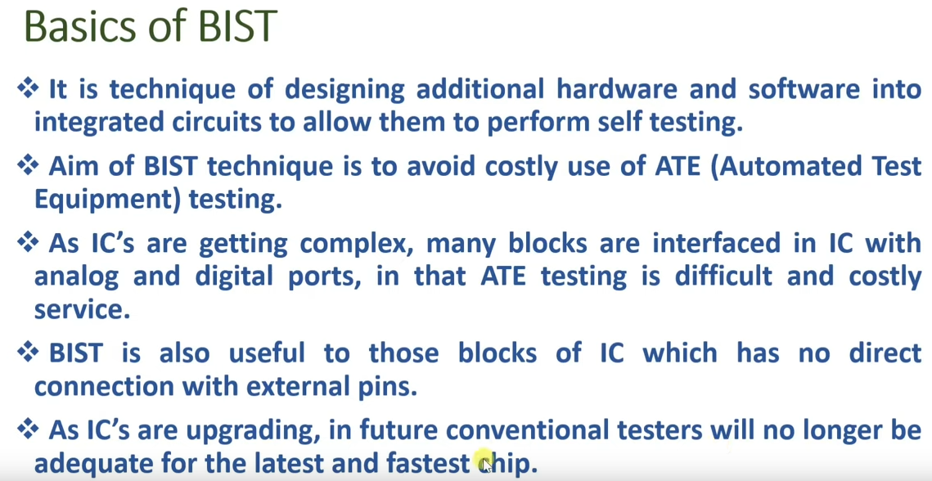
SESSION INTRODUCTION

Slide 4
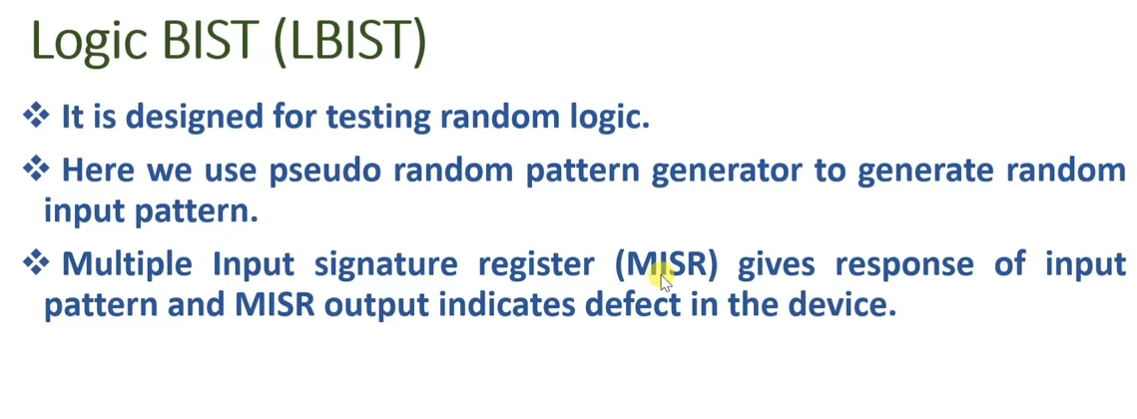
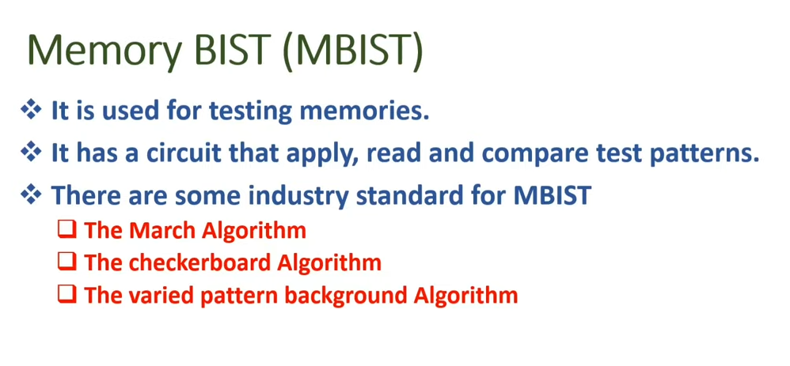
SESSION DESCRIPTION

Slide 5
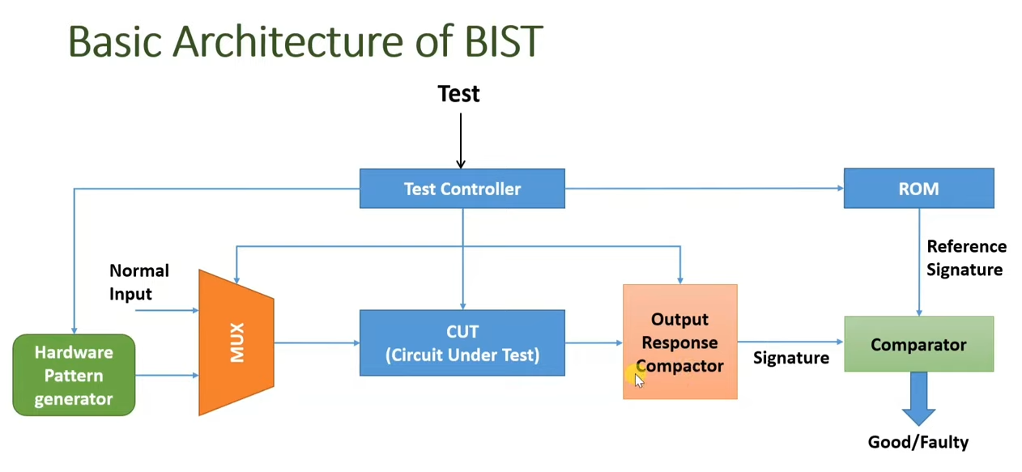
SESSION DESCRIPTION

Slide 6
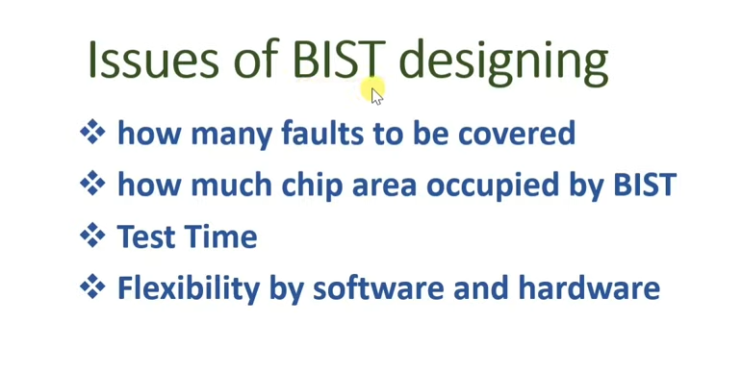
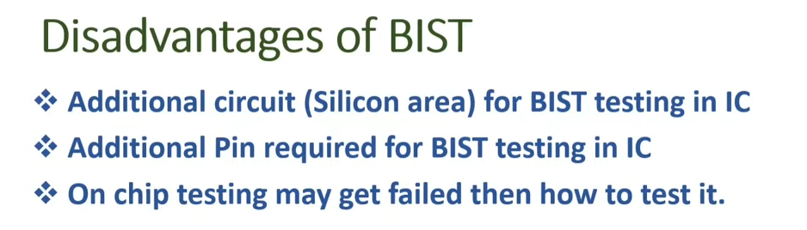
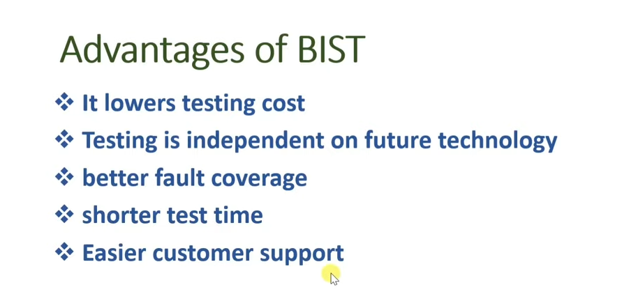
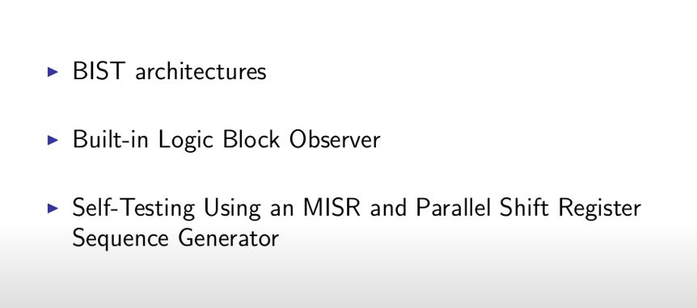
SESSION DESCRIPTION

Slide 7
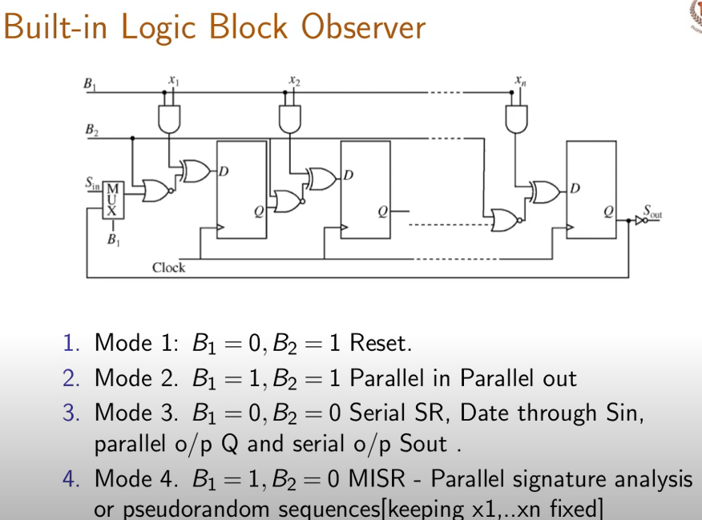
SESSION DESCRIPTION

Slide 8
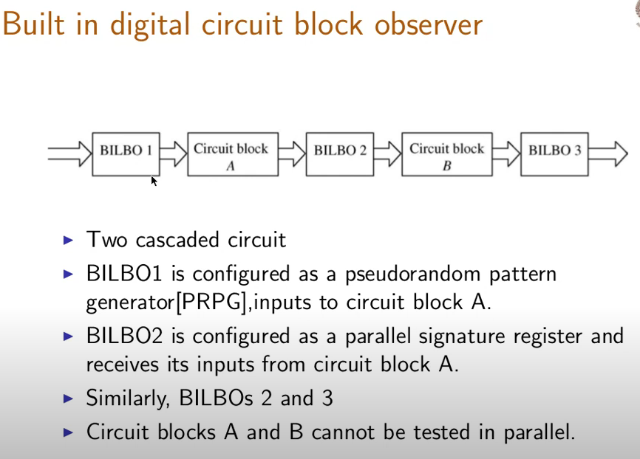
SESSION DESCRIPTION

Slide 9
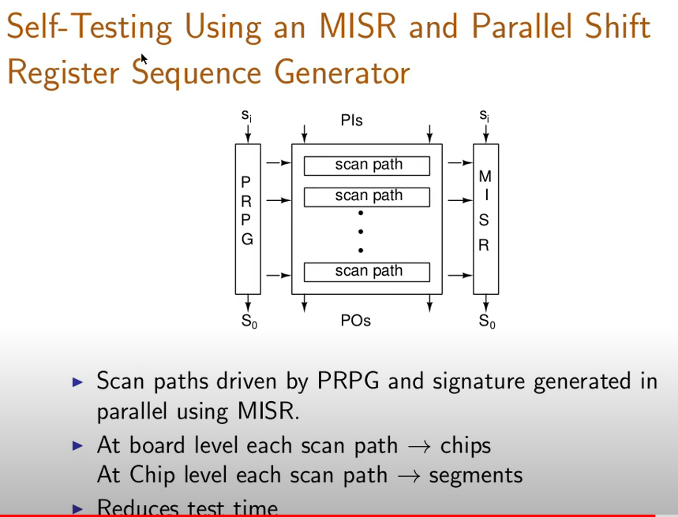
SESSION DESCRIPTION

Slide 10
SUMMARY
About brief description of BIST is taken out in this ppt.

Slide 11
SELF-ASSESSMENT QUESTIONS
What are the types BIST?
State the advantages and disadvantages of the BIST?
3. Define Architecture and working principle of the BIST?
4.State the issues of designing in the BIST?

Slide 12
TERMINAL QUESTIONS
Describe the basics and types of BIST.
Demonstrate the Architecture and Working of the BIST.
Describe the Issues of design, advantages and dis-advantages of BIST?.

Slide 13
REFERENCES FOR FURTHER LEARNING OF THE SESSION
Text Books:
1.Douglas A. Pucknell& Kamran Eshraghian, Basic VLSI Design, PHI, 3rd Ed., 2011
2. Neil H.E. Weste, David Harris, Ayan Banerjee, CMOS VLSI Design, A Circuits and Systems Perspective, Pearson Education, 4th Ed., 2011
3. Sung-Mo Kang, Yusuf Leblebici, CMOS Digital Integrated Circuits Analysis and Design, Tata Mc-Graw-Hill, 3rd Ed., 2003
Reference Books:
1. Jab M. Rabaey, Anantha Chandra Kasan, Borivoje Nikolic, Digital Integrated Circuits - A Design Perspective, PHI, 2nd Ed., 2012
2. Michal John Sebastian Smith, Application-Specific Integrated Circuits, Pearson Education, 6th Ed., 2009
Sites and Web links:
1. https://www.egr.msu.edu/classes/ece410/mason/files/Ch7.pdf
2. http://bwrcs.eecs.berkeley.edu/Classes/icdesign/ee141_f01/Notes/chapter5.pdf
3. https://nptelvideos.com/video.php?id=1317

Slide 14
THANK YOU
Team – VLSI Design

