Slide 1


Department of ECE
VLSI DESIGN
21EC2211
Topic:
Sheet Resistance RS, Area Capacitance and Delay calculations.
Session – 1&2

Slide 2



AIM OF THE SESSION
To familiarize students with combinational and sequential circuits.
INSTRUCTIONAL OBJECTIVES
This Session is designed to:
1.Discuss about the logics implemented in gate level design and explain the switch logic implementation for a four way multiplexer.
2.Describe about the methods for driving large capacitive loads.
3.Describe about the choice of fan – in and fan – out selection in gate level design.
LEARNING OUTCOMES
At the end of this session, you should be able to:
1.Discuss about the logics implemented in gate level design and explain the switch logic implementation for a four way multiplexer.
2.Describe about the methods for driving large capacitive loads.
3.Describe about the choice of fan – in and fan – out selection in gate level design.

Slide 3
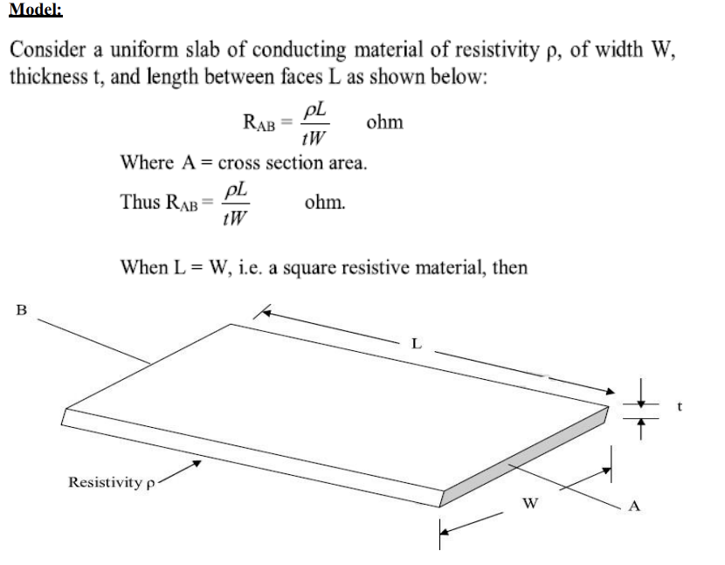
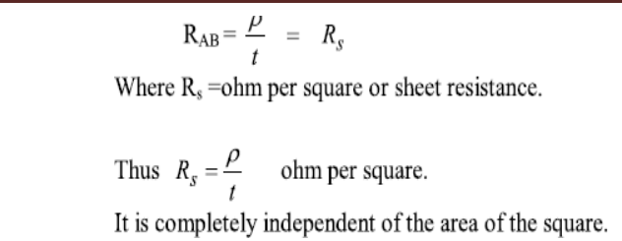
SESSION INTRODUCTION
Sheet Resistance Rs and its concepts to MOS The sheet resistance is a measure of resistance of thin films that have a uniform thickness. It is commonly used to characterize materials made by semiconductor doping, metal deposition, resistive paste printing, and glass coating. Example of these processes are: doped semiconductor regions (eg: silicon or polysilicon) and resistors.

Slide 4
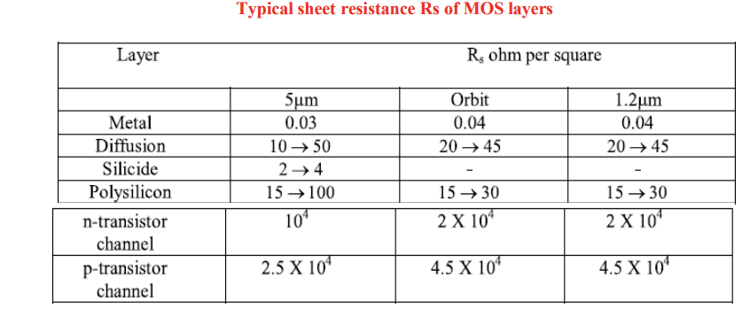
SESSION INTRODUCTION

Slide 5
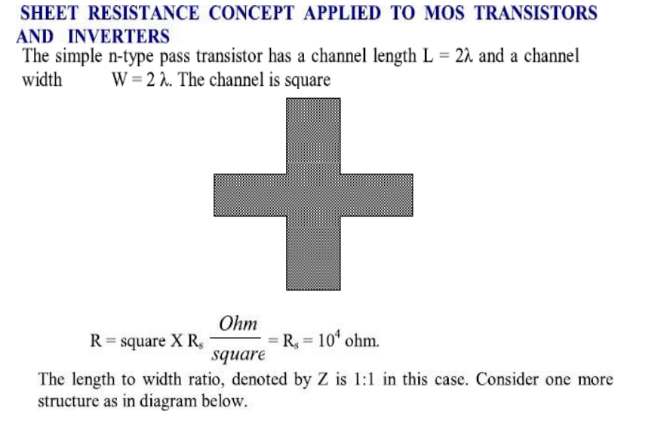
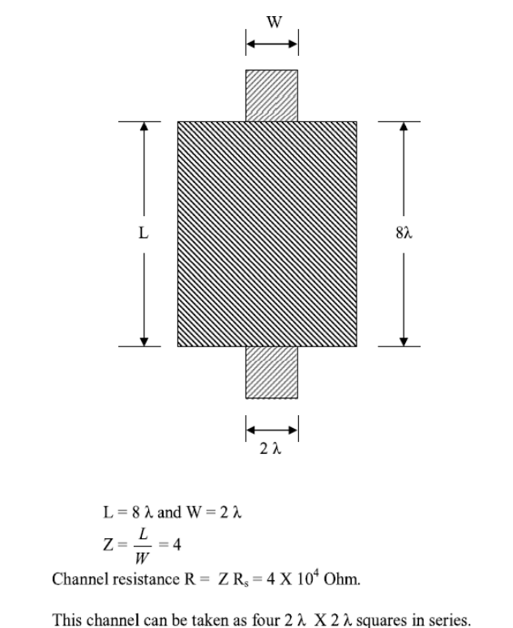
SESSION INTRODUCTION

Slide 6
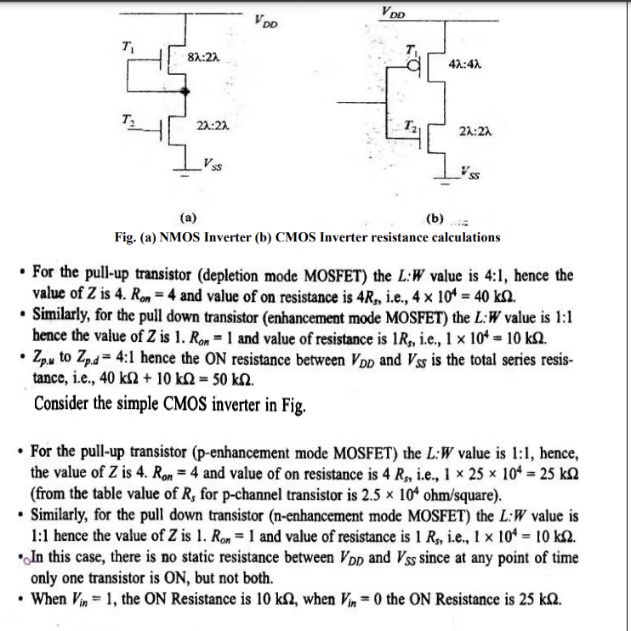

SESSION INTRODUCTION

Slide 7
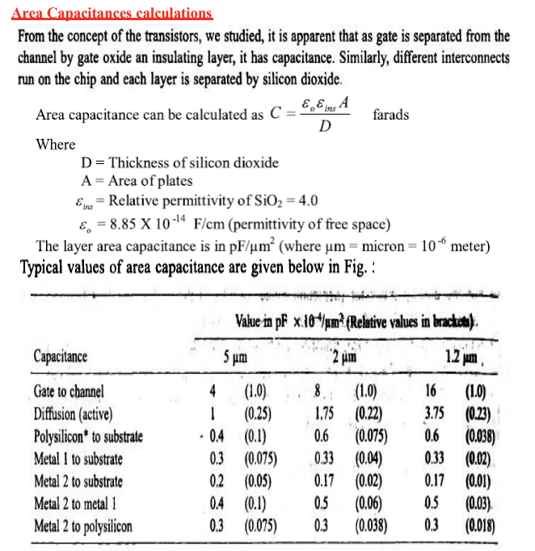
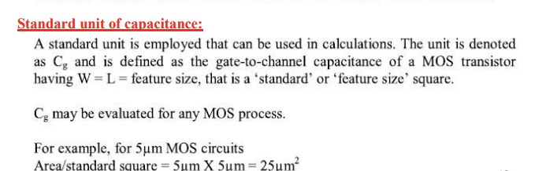
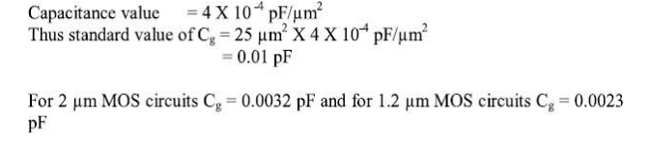
SESSION INTRODUCTION

Slide 8
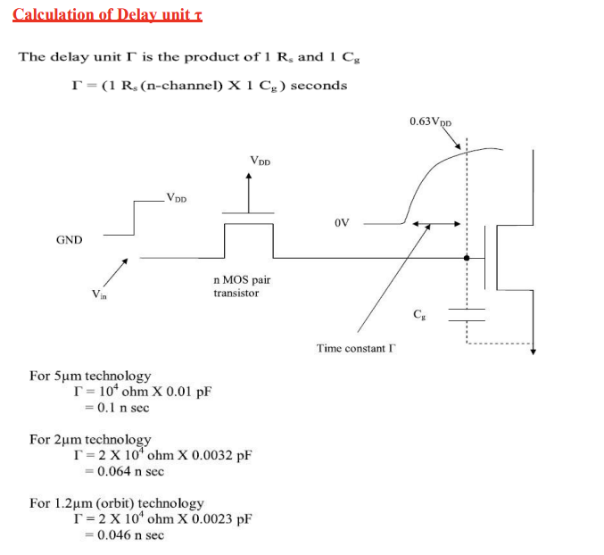
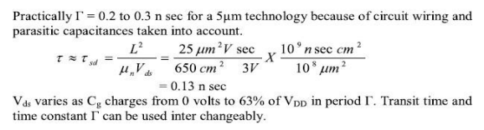
SESSION INTRODUCTION

Slide 9
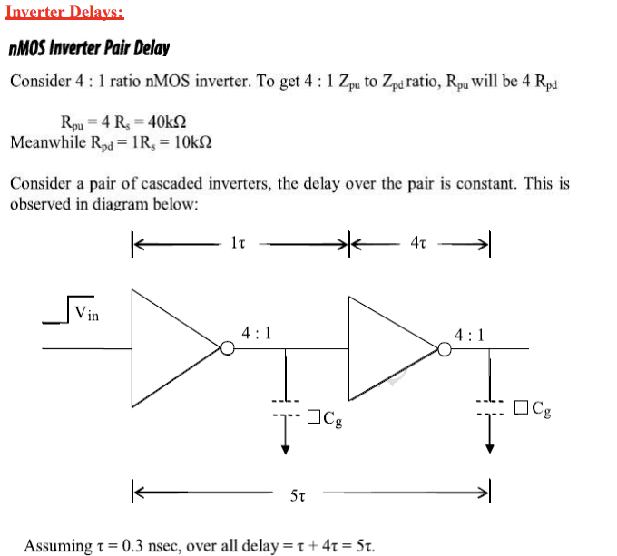
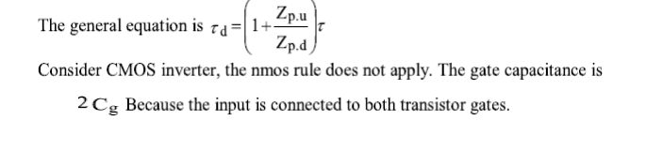
SESSION INTRODUCTION

Slide 10
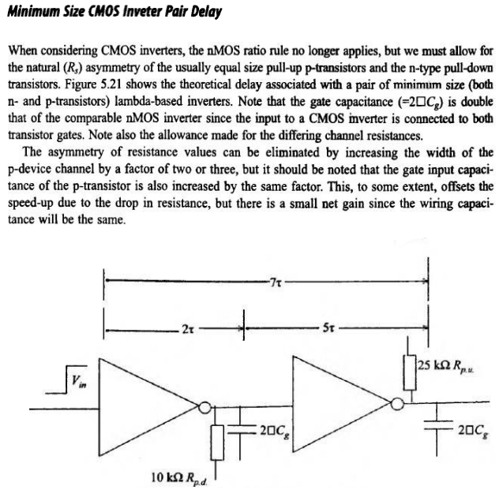
SESSION INTRODUCTION

Slide 11
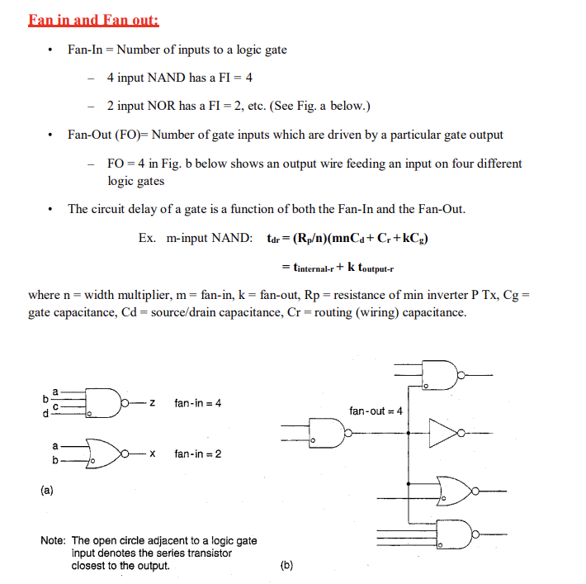
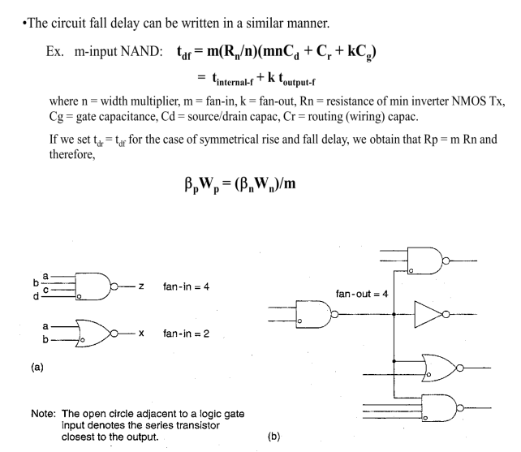
SESSION INTRODUCTION

Slide 12
SUMMARY
About brief description of sheet resistance, area of capacitance and delay calculation is taken out in this ppt.

Slide 13
SELF-ASSESSMENT QUESTIONS
Define combinational logic circuits with relevant examples.
2.Define sequential logic circuits with relevant examples.

Slide 14
TERMINAL QUESTIONS
Define combinational logic circuits with relevant examples.
Define sequential logic circuits with relevant examples.

Slide 15
REFERENCES FOR FURTHER LEARNING OF THE SESSION
Text Books:
1.Douglas A. Pucknell& Kamran Eshraghian, Basic VLSI Design, PHI, 3rd Ed., 2011
2. Neil H.E. Weste, David Harris, Ayan Banerjee, CMOS VLSI Design, A Circuits and Systems Perspective, Pearson Education, 4th Ed., 2011
3. Sung-Mo Kang, Yusuf Leblebici, CMOS Digital Integrated Circuits Analysis and Design, Tata Mc-Graw-Hill, 3rd Ed., 2003
Reference Books:
1. Jab M. Rabaey, Anantha Chandra Kasan, Borivoje Nikolic, Digital Integrated Circuits - A Design Perspective, PHI, 2nd Ed., 2012
2. Michal John Sebastian Smith, Application-Specific Integrated Circuits, Pearson Education, 6th Ed., 2009
Sites and Web links:
1. https://www.egr.msu.edu/classes/ece410/mason/files/Ch7.pdf
2. http://bwrcs.eecs.berkeley.edu/Classes/icdesign/ee141_f01/Notes/chapter5.pdf
3. https://nptelvideos.com/video.php?id=1317

Slide 16
THANK YOU
Team – VLSI Design

