Slide 1


Department of ECE
VLSI Design
22EC2211A
Topic:
Full Custom Flow and Evolution of CAD Tools in VLSI
Session - 40

Slide 2



AIM OF THE SESSION
To familiarize students with the VLSI full custom design and evolution of CAD for VLSI
INSTRUCTIONAL OBJECTIVES
This Session is designed to:
Demonstrate the heirarchical flow of full custom design.
Describe the limitations of VLSI full custom design
Sketch the evolution process of CAD.
LEARNING OUTCOMES
At the end of this session, you should be able to:
Demonstrate the heirarchical flow of full custom design.
Describe the limitations of VLSI full custom design
Sketch the evolution process of CAD.

Slide 3
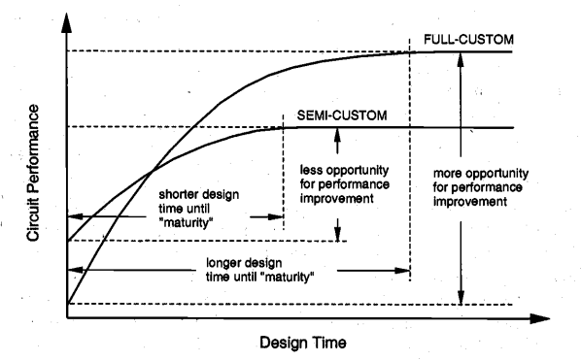
Relative Merits of VLSI Design Styles
Inherent flexibility of adjusting almost every aspect of circuit design allows far more opportunity for circuit performance improvement during the design cycle.
The final product typically has a high level of performance (e.g. high processing speed, low power dissipation) and the silicon area is relatively small because of better area utilization.

Slide 4
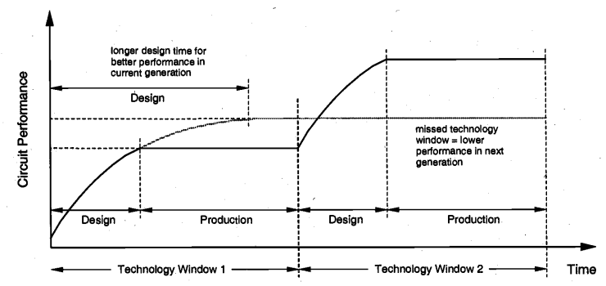
Progressive Performance Improvement in VLSI
In order to make the best use of the current technology, the chip development time has to be short enough to allow the maturing of chip manufacturing and timely delivery of the product to customers. This may require that the level of logic integration and chip performance fall short of the level achievable with the current processing technology,

Slide 5
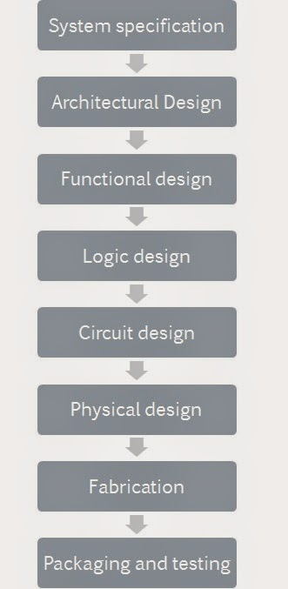
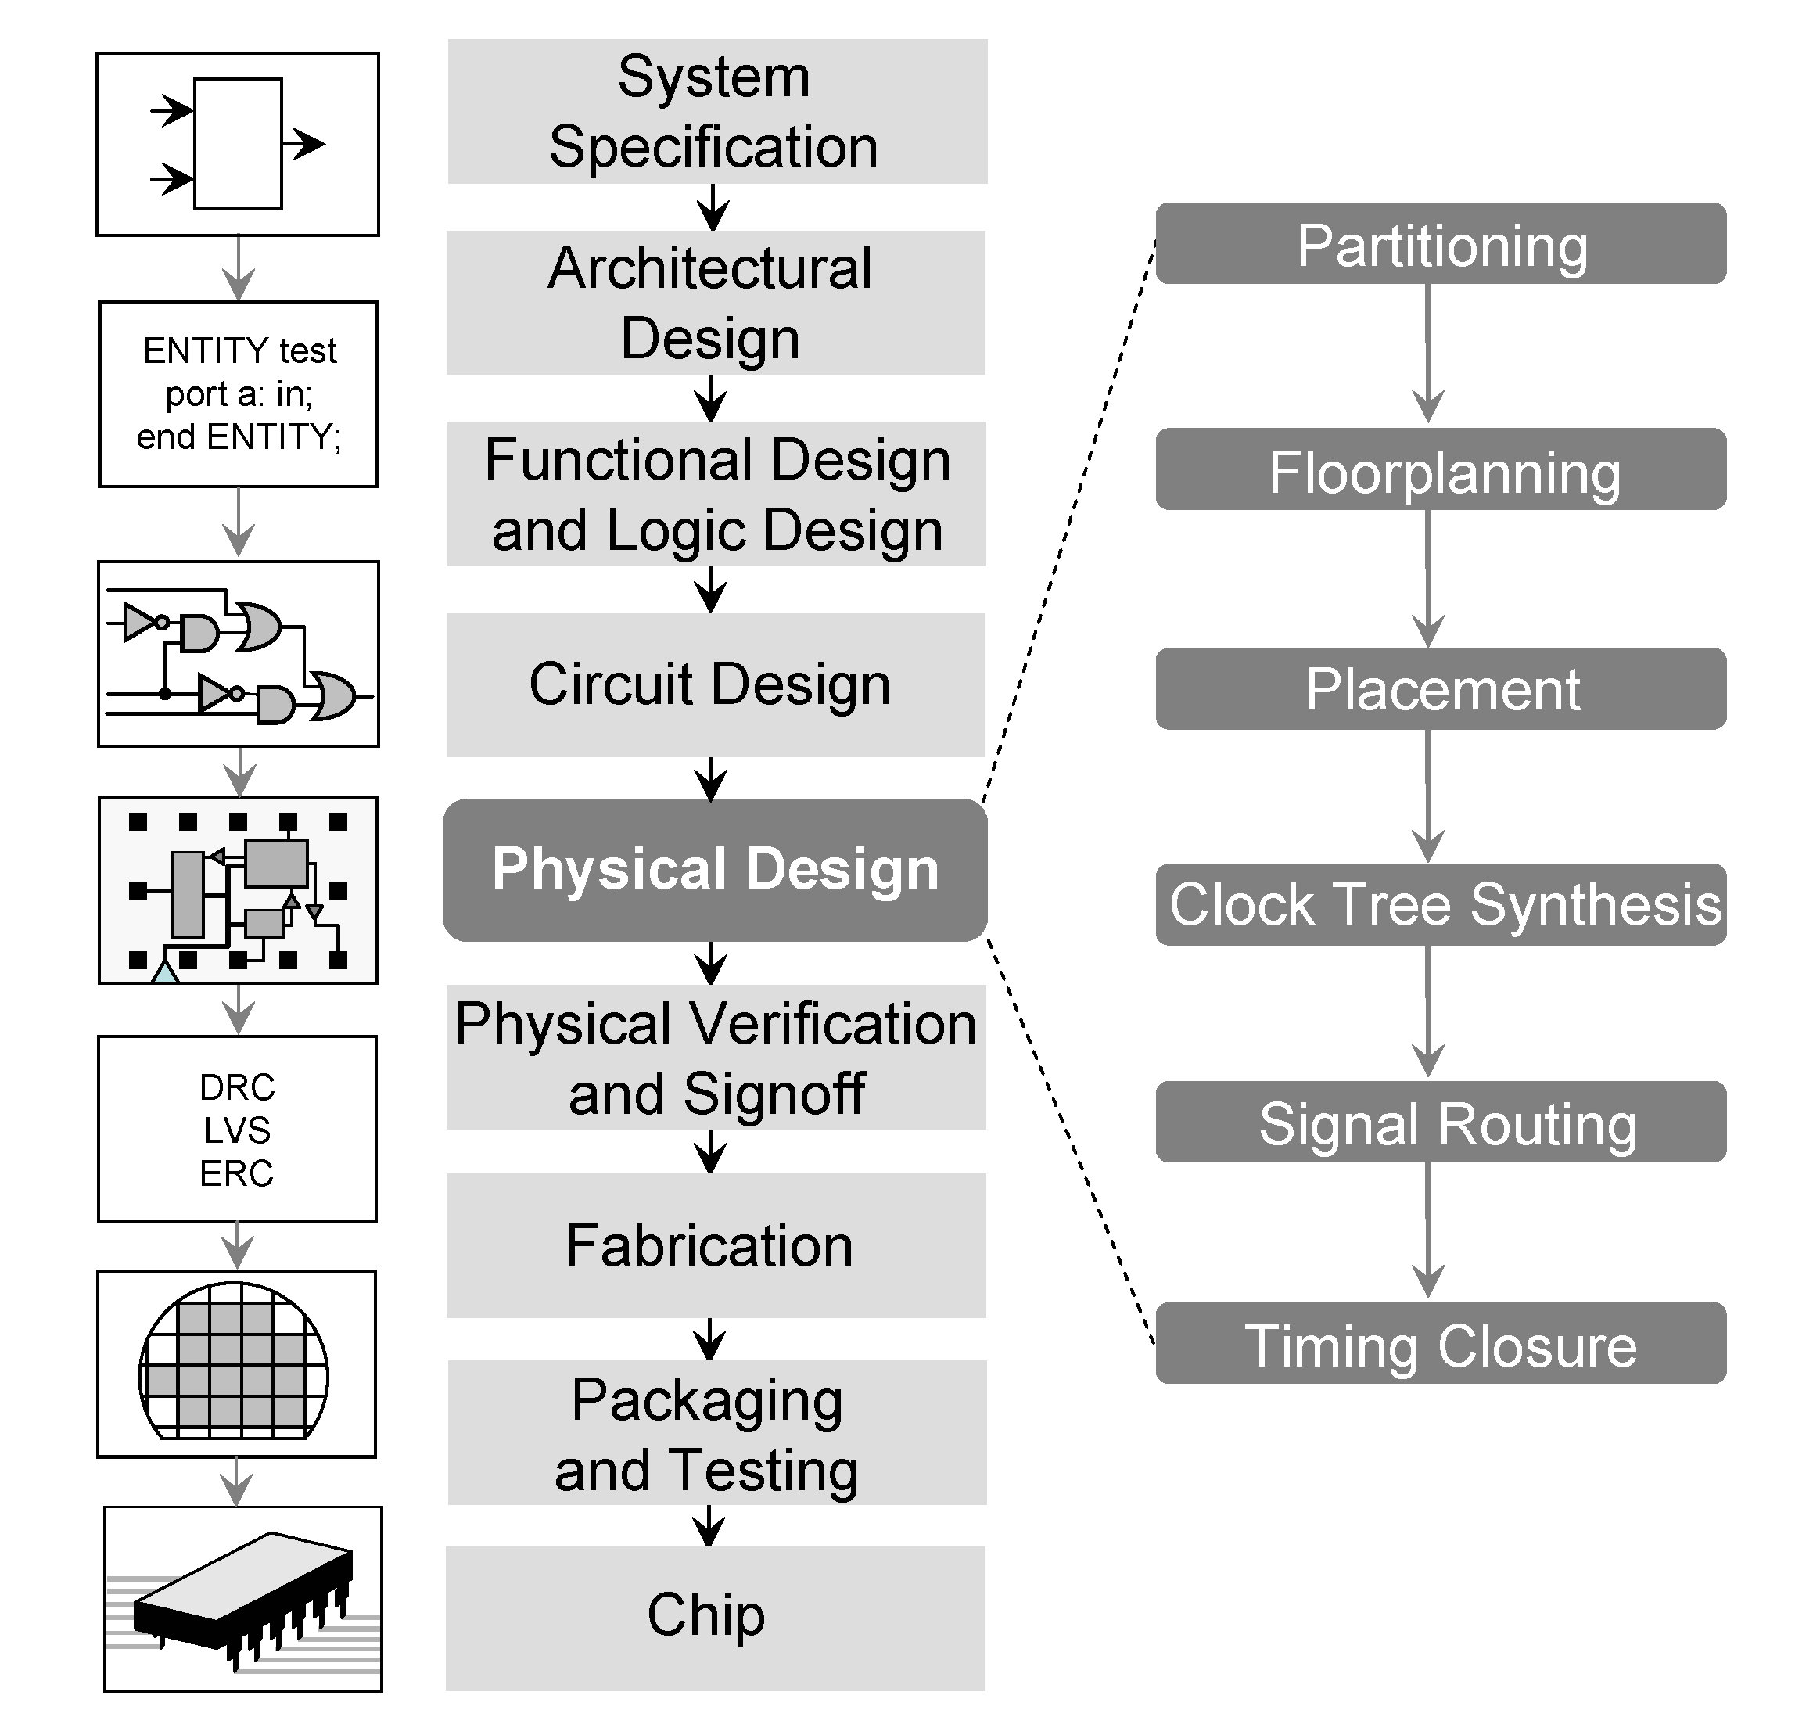
VLSI CAD System Design Flow (ASIC)

Slide 6
VLSI Design Hierarchy: System Specifications
1. System Specification:
System specification is a high level representation of the system. The factors to be considered in this process include: performance, functionality, and physical dimensions
As an example, the initial design specs of a one-bit binary full adder circuit are listed below:
Technology: 0.8 µm twin-well CMOS Propagation delay of “sum” and “carry_out” signals < 1.2 ns (worst case) Transition times of “sum” and “carry_out” signals <1.2 ns (worst case) Circuit area < 1500 µm^2 Dynamic power dissipation (at VDD=5 V and fmax=20 MHz) < 1 mW

Slide 7
Architectural and Behavioral Design
2. Architectural Design:
The basic architecture of the system is designed in this step.
In this stage optimized scheduling, allocation and binding of resources is carried out.
3. Behavioral or Functional Design:
In this step, main functional units of the system are identified. This also identifies the interconnect requirements between the units.
The outcome of functional design is usually a timing diagram or other relationships between units
Formal verification done using Hardware Description Languages: Verilog, VHDL etc.

Slide 8
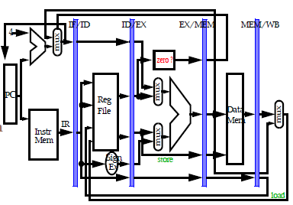
Logic Design
In this step the control flow, word widths, register allocation, arithmetic operations, and logic operations of the design that represent the functional design are derived and tested.
This description is called Register Transfer Level (RTL) description. RTL is expressed in a Hardware Description Language (HDL), such as VHDL or Verilog. This description can be used in simulation and verification.
After RTL, matching between RTL and functional design should be performed.
Logic Design
Register Transfer Level (RTL) Design

Slide 9
Circuit Design
The purpose of circuit design is to develop a circuit representation using all the functional blocks whose logic synthesis is complete.
The circuit design is usually expressed in a detailed circuit diagram. This diagram shows the circuit elements (cells, macros, gates, transistors) and interconnection between these elements. This representation is also called a net list.
Block B
Block A
Overall Circuit
Design
Block C
Logic synthesis of these blocks are complete

Slide 10
Physical Design
In this step the circuit representation (or net list) is converted into a geometric representation. This geometric representation of a circuit is called a layout.
The exact details of the layout also depend on design rules, which are guidelines based on the limitations of the fabrication process and the electrical properties of the fabrication materials.
In many cases, physical design can be completely or partially automated and layout can be generated directly from net list by Layout Synthesis tools.
After complete layout generation, matching between layout and circuit design should be met.
Partitioning
Floor Planning
Placement
Timing closure
Signal Routing
Clock tree synthesis

Slide 11
GDS II Generation
After layout and verification, the design is ready for fabrication. Since layout data is typically sent to fabrication on a tape, the event of release of data is called Tape Out.
GDS II Steps:
Add bond wire
in top module
Add dummy &
Slot blocking
layer
System specs.
Pin out and
area estimate
Interconnect top module blocks,
apply shields and guard rings
VLSI design flow
(up to logic design)
Layout
GDS II
Pin out and
area estimate
Add Decaps
and ESD
Foundry

Slide 12
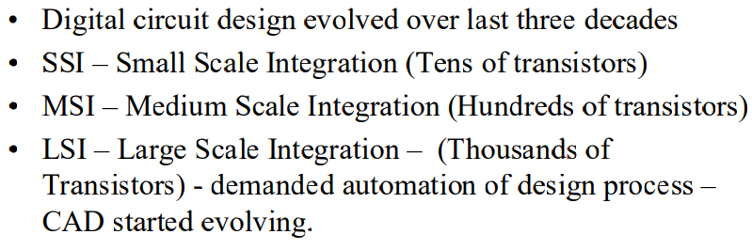
Evolution of CAD Tools

Slide 13
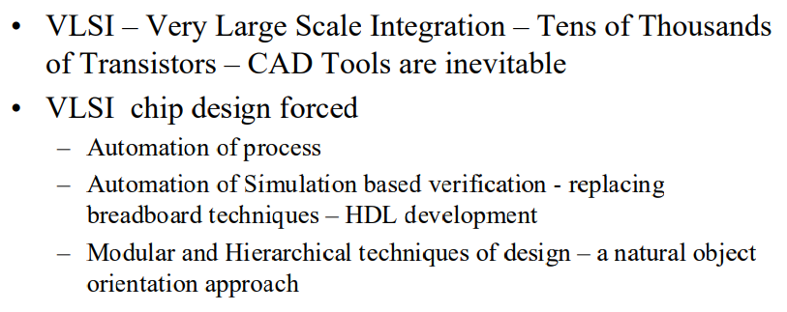
Evolution of CAD Tools

Slide 14
ACTIVITIES/ CASE STUDIES/ IMPORTANT FACTS RELATED TO THE SESSION
Activities:
"How has the evolution of CAD tools in VLSI impacted the design process and IC industry? Provide examples of key advancements and their influence on chip design, from manual processes to modern automated methodologies, showcasing the pivotal role of CAD tools in VLSI."

Slide 15
SUMMARY
This session summarizes the overview of VLSI full custom design flow and evolution of CAD for VLSI

Slide 16
SELF-ASSESSMENT QUESTIONS
1. What is a key characteristic of VLSI full custom design?
a) Relies extensively on pre-designed standard cells
b) Involves designing custom layout for every transistor
c) Utilizes only fixed, predefined layout templates
d) Primarily focuses on high-level behavioral descriptions
Which stage is involved in VLSI full custom design flow after logic design and before fabrication?
a) Physical design
b) RTL synthesis
c) Functional verification
d) Design validation
What is the primary advantage of VLSI full custom design over other methodologies?
a) Quick design iterations due to standard cell libraries
b) Reduced design effort as it utilizes fixed layouts
c) Higher performance and lower power consumption
d) Simplified design process with predefined modules

Slide 17
TERMINAL QUESTIONS
1. Describe the step-by-step process of the VLSI full custom design flow. How does it differ from other design methodologies like semi-custom or ASIC design?
2. Explain the role of each stage in the VLSI full custom design flow (such as specification, architectural design, logic design, physical design, and fabrication). How do these stages integrate to create a final VLSI product?
3. Discuss the evolution of CAD tools for VLSI design. How have these tools evolved over time, and what are the key advancements that have significantly impacted the design and manufacturing of VLSI circuits?
4. What are the major challenges faced in the full custom design flow for VLSI? How do CAD tools address these challenges, and what improvements are continually being made to streamline this process?
5. Considering the current technological advancements and trends in VLSI, how are CAD tools adapting to meet the demands of increasingly complex designs, smaller process nodes, and higher performance expectations? What methodologies or tools are being developed to aid VLSI designers in this context?

Slide 18
REFERENCES FOR FURTHER LEARNING OF THE SESSION
Text Books:
N. H. E. Weste and C. Harris - Principles of CMOS VLSI Design: A System Perspective, 3rd Edition, Pearson Education 2007
2. J. Rabaey, A. Chandrakasan and B. Nikolic, Digital Integrated Circuits: A Design Perspective, 2nd Edition, Prentice Hall 2004.
Reference Books:
Douglas A. Pucknell and Kamran Eshraghian - Basic VLSI design. Prentice-Hall, Inc., 1994.
2. Sung Mo Kang and Yusuf Leblebici- CMOS digital integrated circuits, MacGraw-Hill, 2003
Sites and Web links:
rajeev2007.github.io/VLSI/0072460539cmos.pdf
http://www.eecs.northwestern.edu/~haizhou/357/lec1.pdf
https://onlinecourses.nptel.ac.in/noc21_ee09/preview

Slide 19
THANK YOU
Team –VLSI Design (22EC2211A)

