Slide 1


Department of ECE
VLSI Design
22EC2211A
Topic:
Overview of VLSI Semi-Custom Design Flow
Session - 41

Slide 2



AIM OF THE SESSION
To familiarize students with the semicustom design flow of VLSI
INSTRUCTIONAL OBJECTIVES
This Session is designed to:
Demonstrate the design hierarchy of VLSI semicustom design flow.
Describe the process of RTL synthesis in digital VLSI flow.
Sketch the pros and cons of ASIC and FPGA flows.
LEARNING OUTCOMES
At the end of this session, you should be able to:
Demonstrate the design hierarchy of VLSI semicustom design flow.
Describe the process of RTL synthesis in digital VLSI flow.
Sketch the pros and cons of ASIC and FPGA flows.

Slide 3
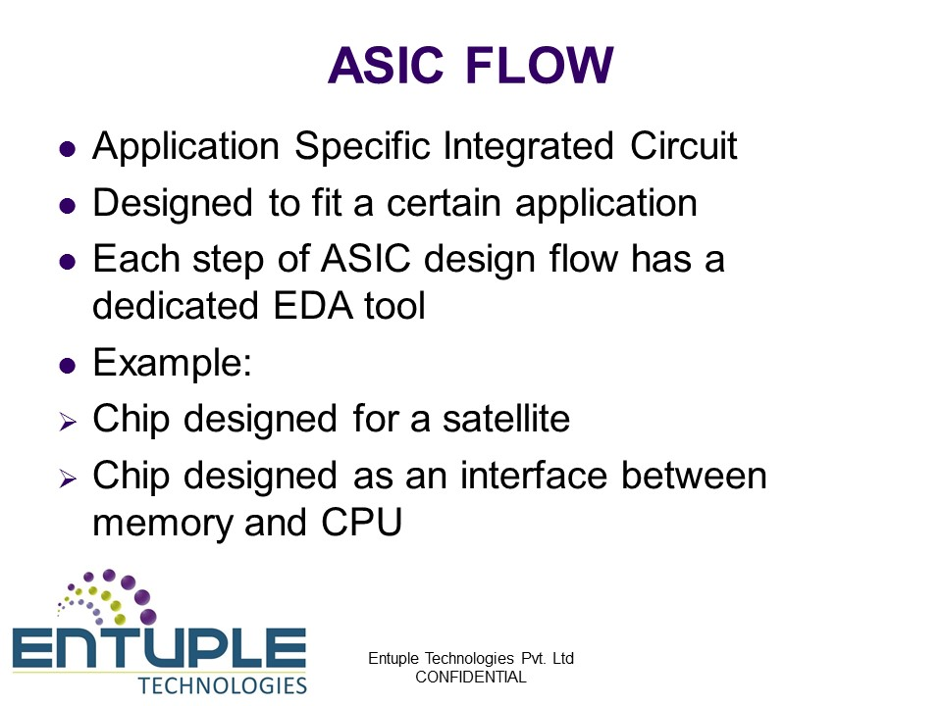
Semi-Custom Design Flow (ASIC Flow)

Slide 4
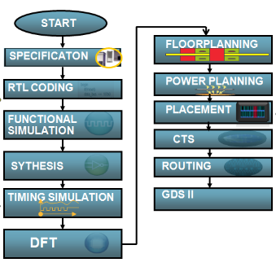
Semi-Custom Design Flow (ASIC Flow)

Slide 5
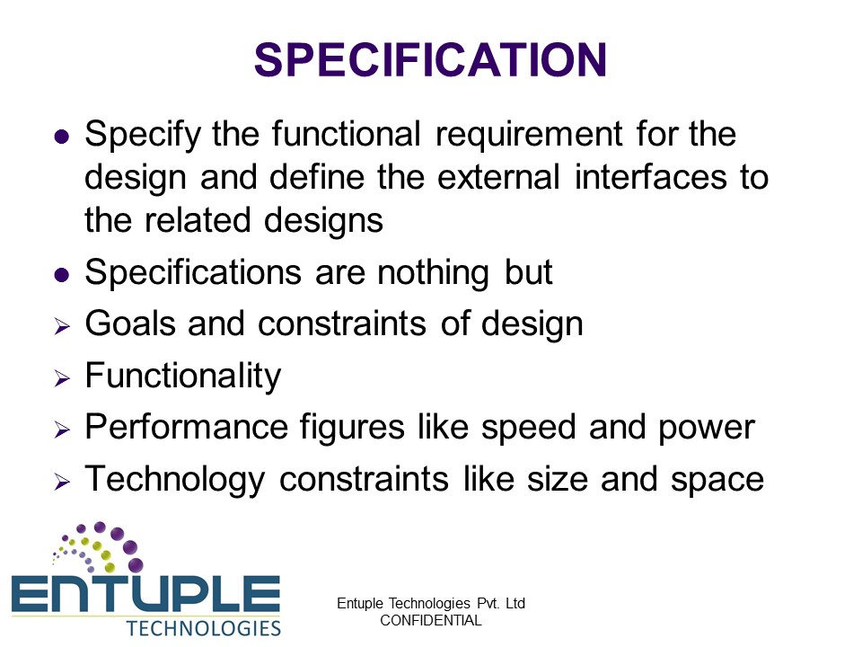
ASIC Flow

Slide 6
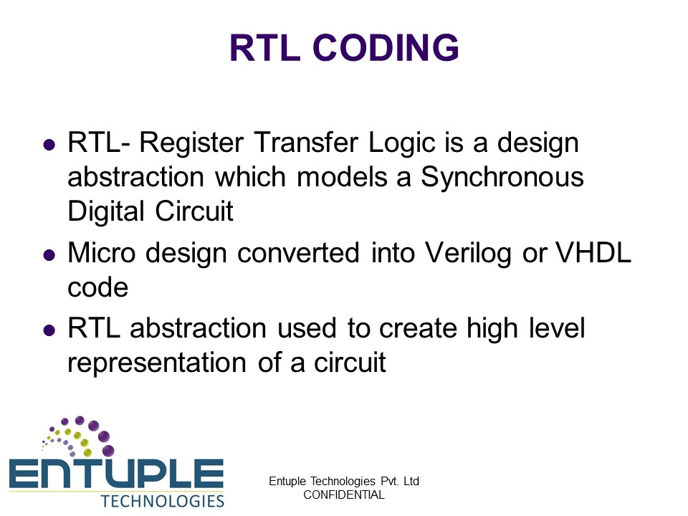
ASIC Flow

Slide 7
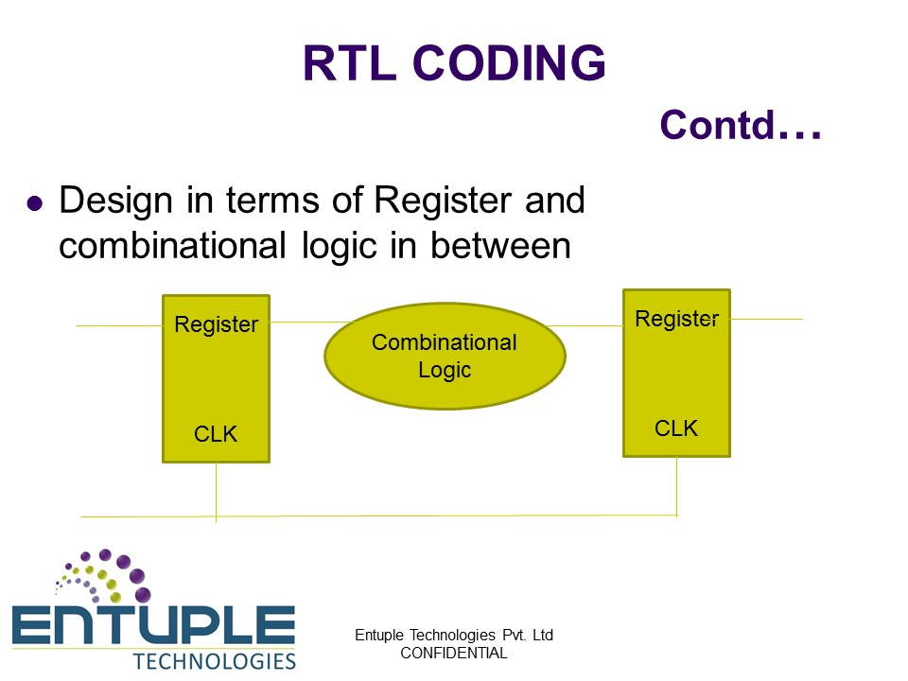
ASIC Flow

Slide 8
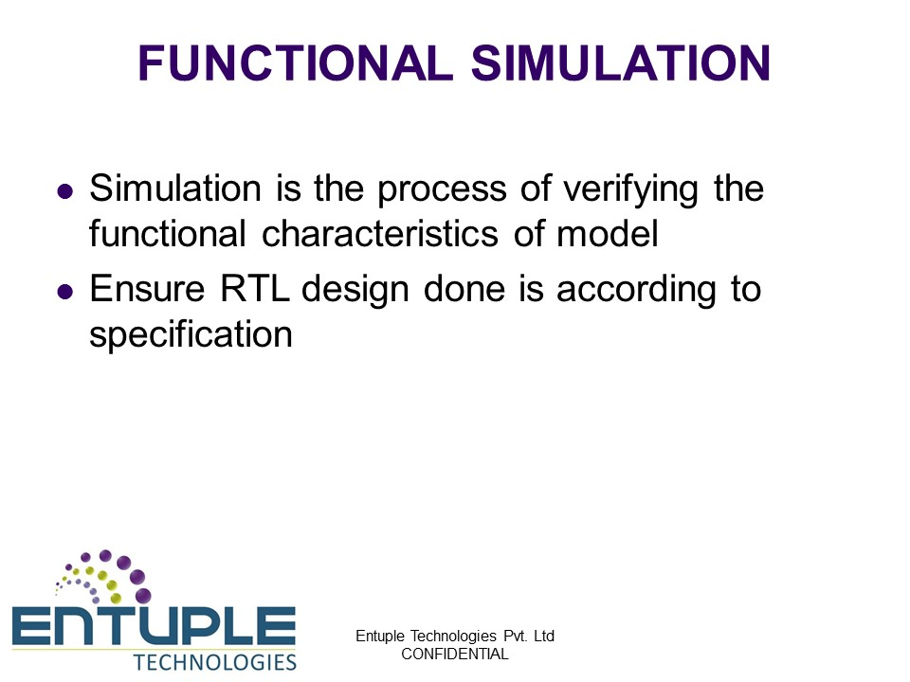
ASIC Flow

Slide 9
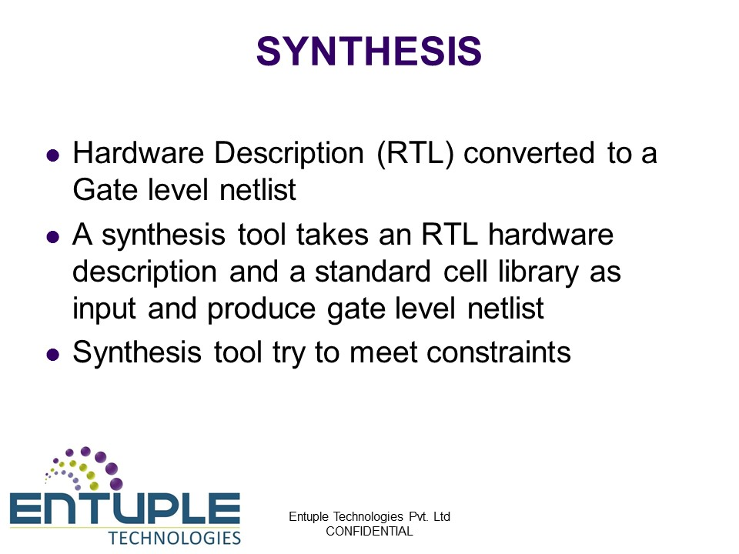
ASIC Flow

Slide 10
ASIC Flow
Introduction Synthesis
Definition: Converting HDL design to Gate level Netlist
Goal: Generate synthesized GLN and SDC for the specified logic design
Three Major steps included:
Translation
Mapping
Optimization

Slide 11
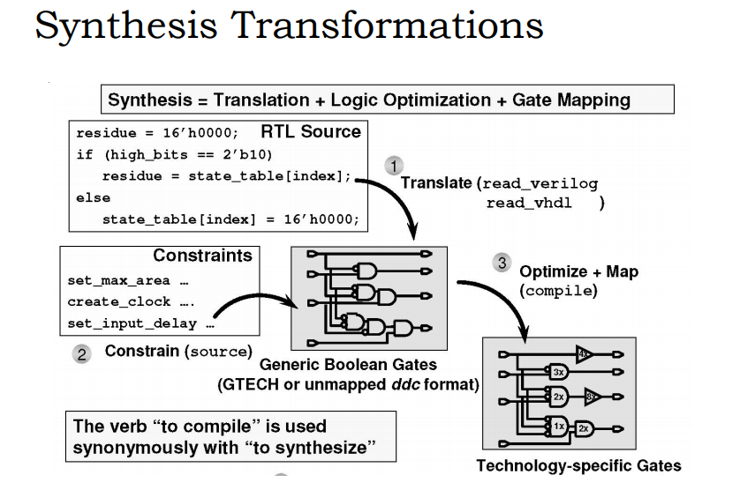
ASIC Flow
Three Major Steps in Synthesis

Slide 12
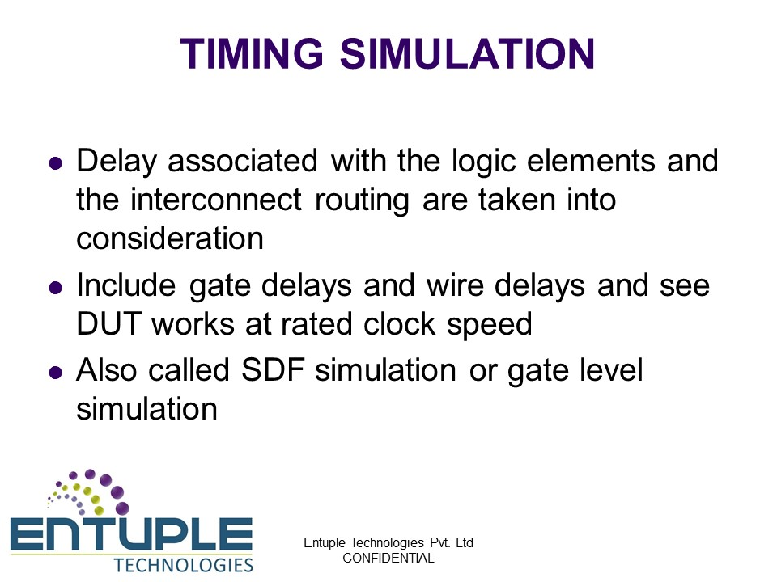
ASIC Flow

Slide 13
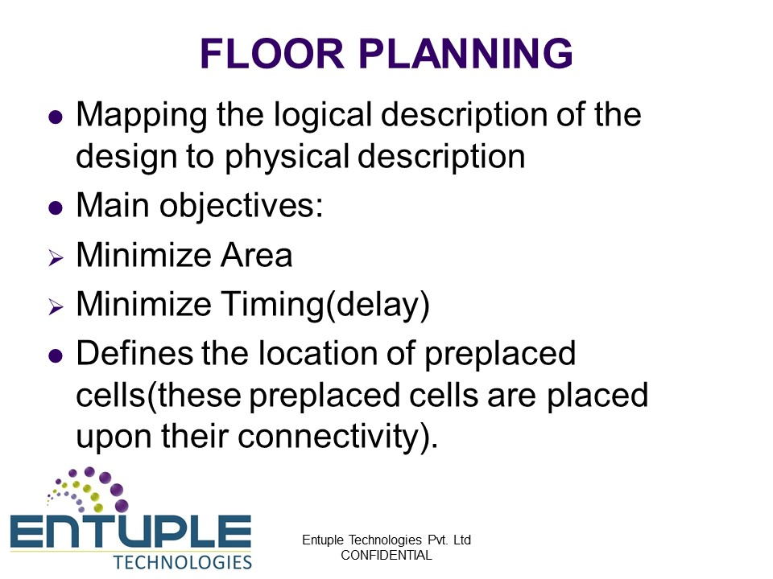
ASIC Flow

Slide 14

ASIC Flow

Slide 15
ASIC Flow

Slide 16

ASIC Flow

Slide 17
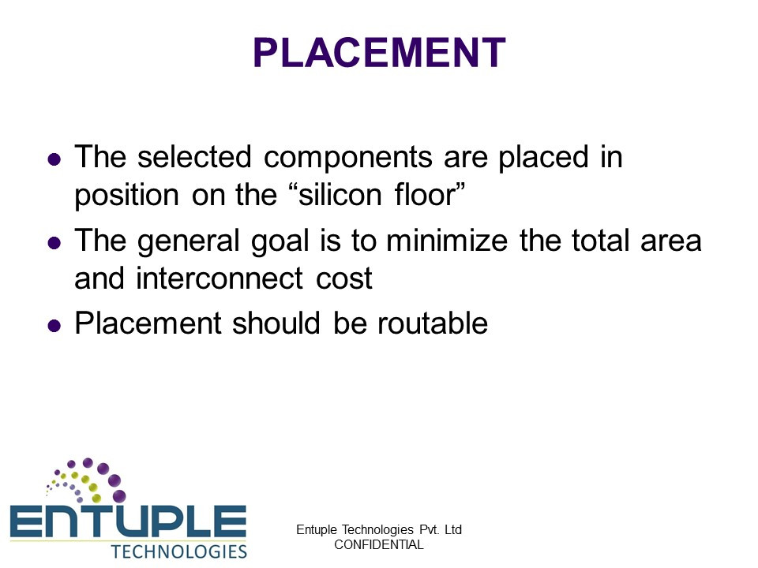
ASIC Flow

Slide 18
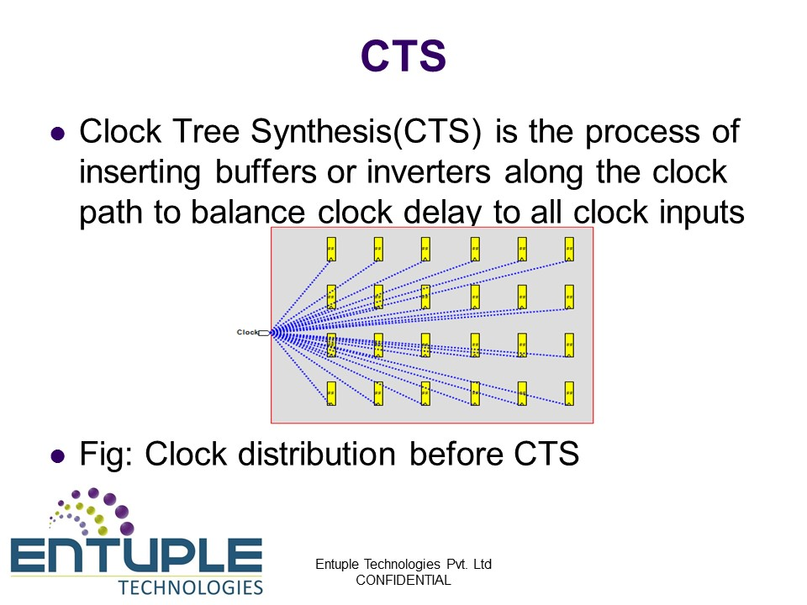
ASIC Flow

Slide 19
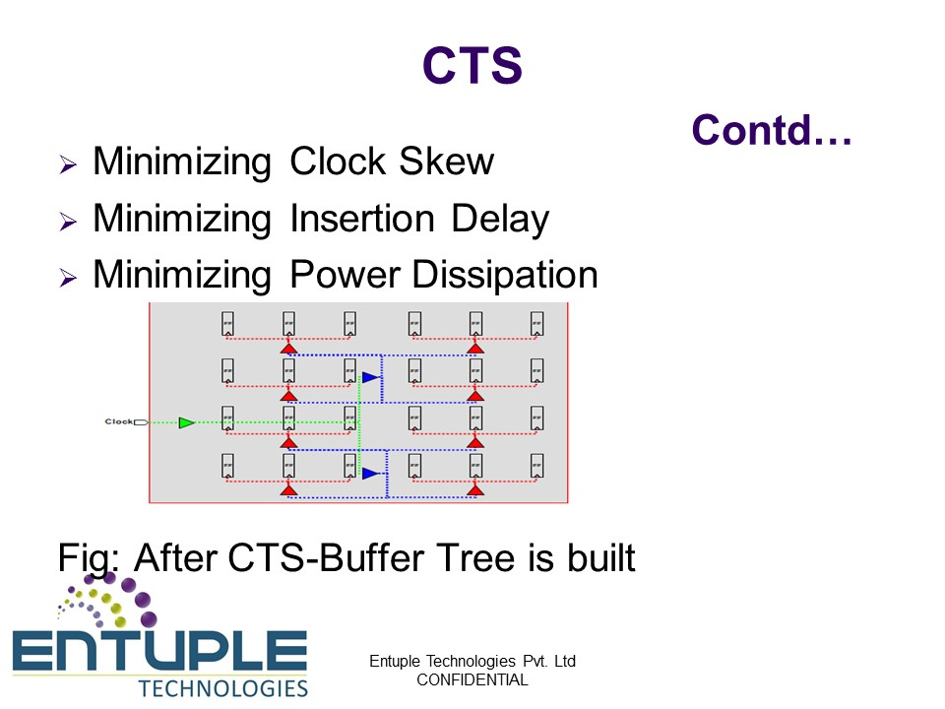
ASIC Flow

Slide 20
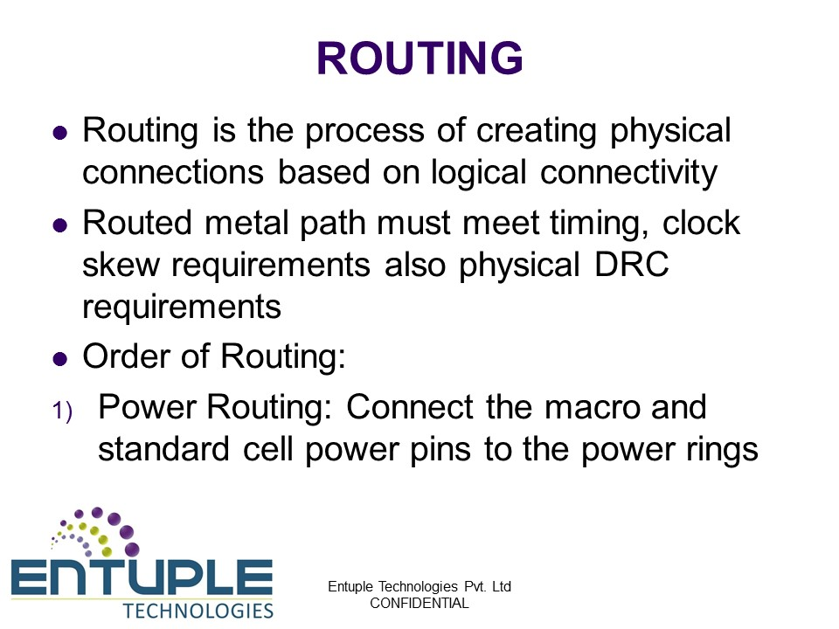
ASIC Flow

Slide 21
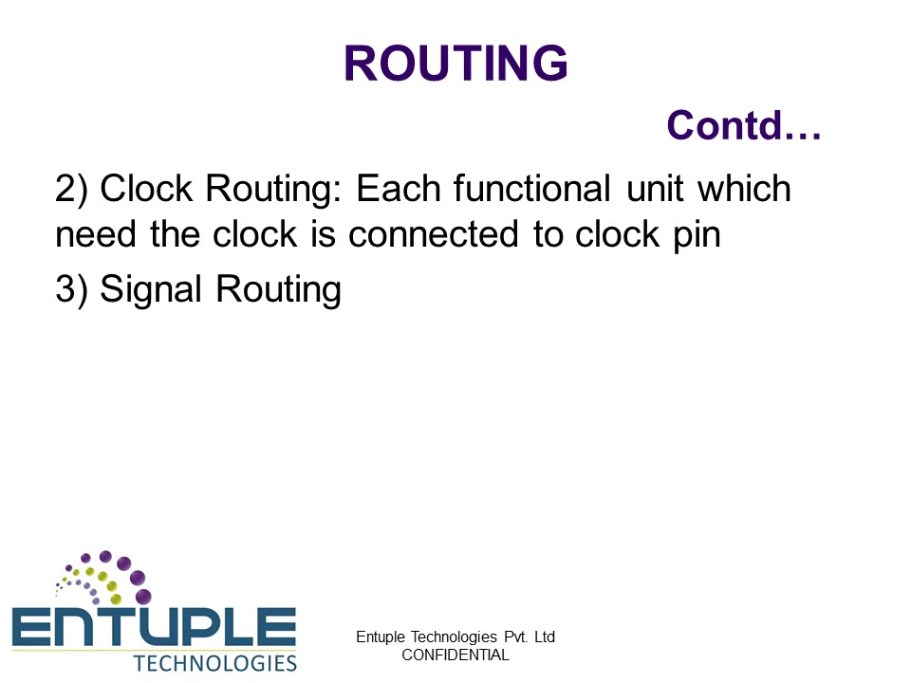
ASIC Flow

Slide 22
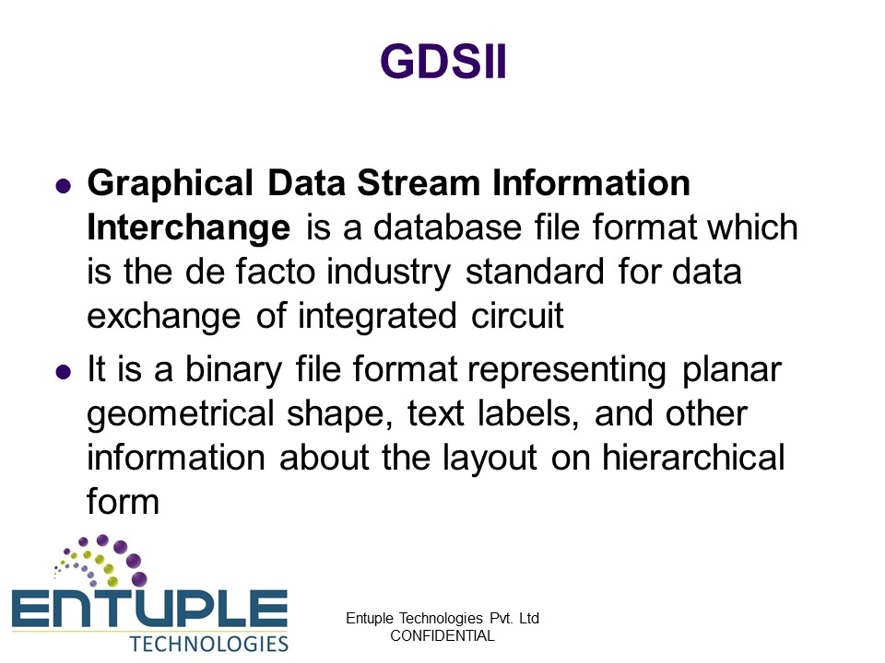
ASIC Flow

Slide 23
ACTIVITIES/ CASE STUDIES/ IMPORTANT FACTS RELATED TO THE SESSION
Activities:
"Analyzing the historical development of VLSI semi-custom design flow, discuss its impact on design efficiency and product outcomes. Illustrate the transition from fully custom to semi-custom design methodologies, highlighting the advantages, challenges, and key elements influencing the design process. Provide examples showcasing the successful application and significance of semi-custom design flow in the VLSI industry."

Slide 24
SUMMARY
This session summarizes the overview of VLSI semicustom design flow.

Slide 25
SELF-ASSESSMENT QUESTIONS
What defines VLSI semi-custom design flow?
a) Exclusively uses custom layout for each transistor
b) Incorporates both pre-designed cells and custom-designed blocks
c) Involves only standard cell-based design
d) Focuses solely on behavioral descriptions of the design
What is a significant characteristic of semi-custom design flow in VLSI?
a) Utilizes a fully custom-designed layout for every chip
b) Incorporates entirely standard cell libraries without customization
c) Mixes standard cells with partially custom-designed blocks
d) Relies only on fixed, unmodifiable pre-designed blocks
Which stage in the VLSI semi-custom design flow involves the integration of both pre-designed cells and custom-designed blocks?
a) Physical design
b) Logic synthesis
c) Floorplanning
d) Behavioral synthesis

Slide 26
TERMINAL QUESTIONS
1. Explain the fundamental principles of VLSI semi-custom design flow. How does it differ from full custom and ASIC design methodologies?
2. Discuss the stages involved in VLSI semi-custom design flow, including circuit partitioning, standard cell placement, routing, and verification. How do these stages contribute to the creation of semi-custom VLSI designs?
3. What are the key advantages and limitations of the semi-custom design approach in VLSI? How does it strike a balance between design flexibility and efficiency compared to other design methodologies?
4. Detail the role of standard cells and pre-designed logic modules in the semi-custom design flow. How do these components enhance design efficiency and reduce time-to-market for VLSI products?
5. Considering the current technological trends, how has the VLSI semi-custom design flow evolved to address the challenges of increasingly complex designs and shrinking process nodes? What new methodologies or tools have emerged to optimize the semi-custom design process in contemporary VLSI design?

Slide 27
REFERENCES FOR FURTHER LEARNING OF THE SESSION
Text Books:
N. H. E. Weste and C. Harris - Principles of CMOS VLSI Design: A System Perspective, 3rd Edition, Pearson Education 2007
2. J. Rabaey, A. Chandrakasan and B. Nikolic, Digital Integrated Circuits: A Design Perspective, 2nd Edition, Prentice Hall 2004.
Reference Books:
Douglas A. Pucknell and Kamran Eshraghian - Basic VLSI design. Prentice-Hall, Inc., 1994.
2. Sung Mo Kang and Yusuf Leblebici- CMOS digital integrated circuits, MacGraw-Hill, 2003
Sites and Web links:
rajeev2007.github.io/VLSI/0072460539cmos.pdf
http://www.eecs.northwestern.edu/~haizhou/357/lec1.pdf
https://onlinecourses.nptel.ac.in/noc21_ee09/preview

Slide 28
THANK YOU
Team –VLSI Design (22EC2211A)

