Slide 1
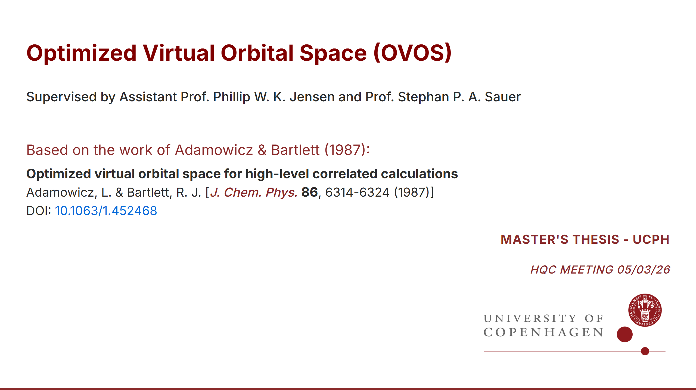
Notes:
Master's thesis on **Optimized Virtual Orbitals (OVO)** for quantum computing at UCPH. Implementation based on [L. Adamowicz & R. J. Bartlett (1987)](https://pubs.aip.org/aip/jcp/article/86/11/6314/93345/Optimized-virtual-orbital-space-for-high-level) - minimizes second-order correlation energy (MP2) using orbital rotations Outline 1. Motivation 2. Theoretical background 3. OVOS algorithm (reference) 4. Key equations 5. Implementation details 6. Numerical results 7. Limitations & future work 8. Summary

Slide 2
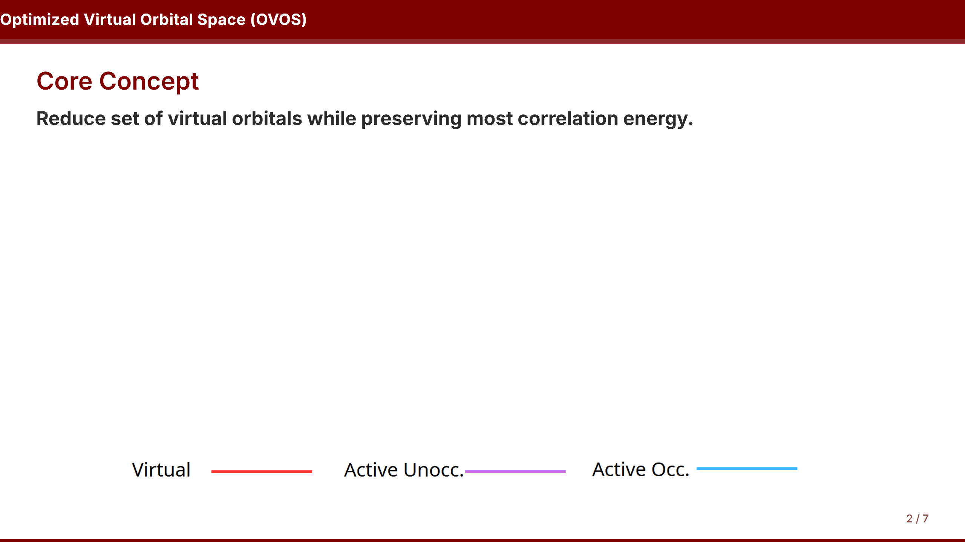

Slide 3
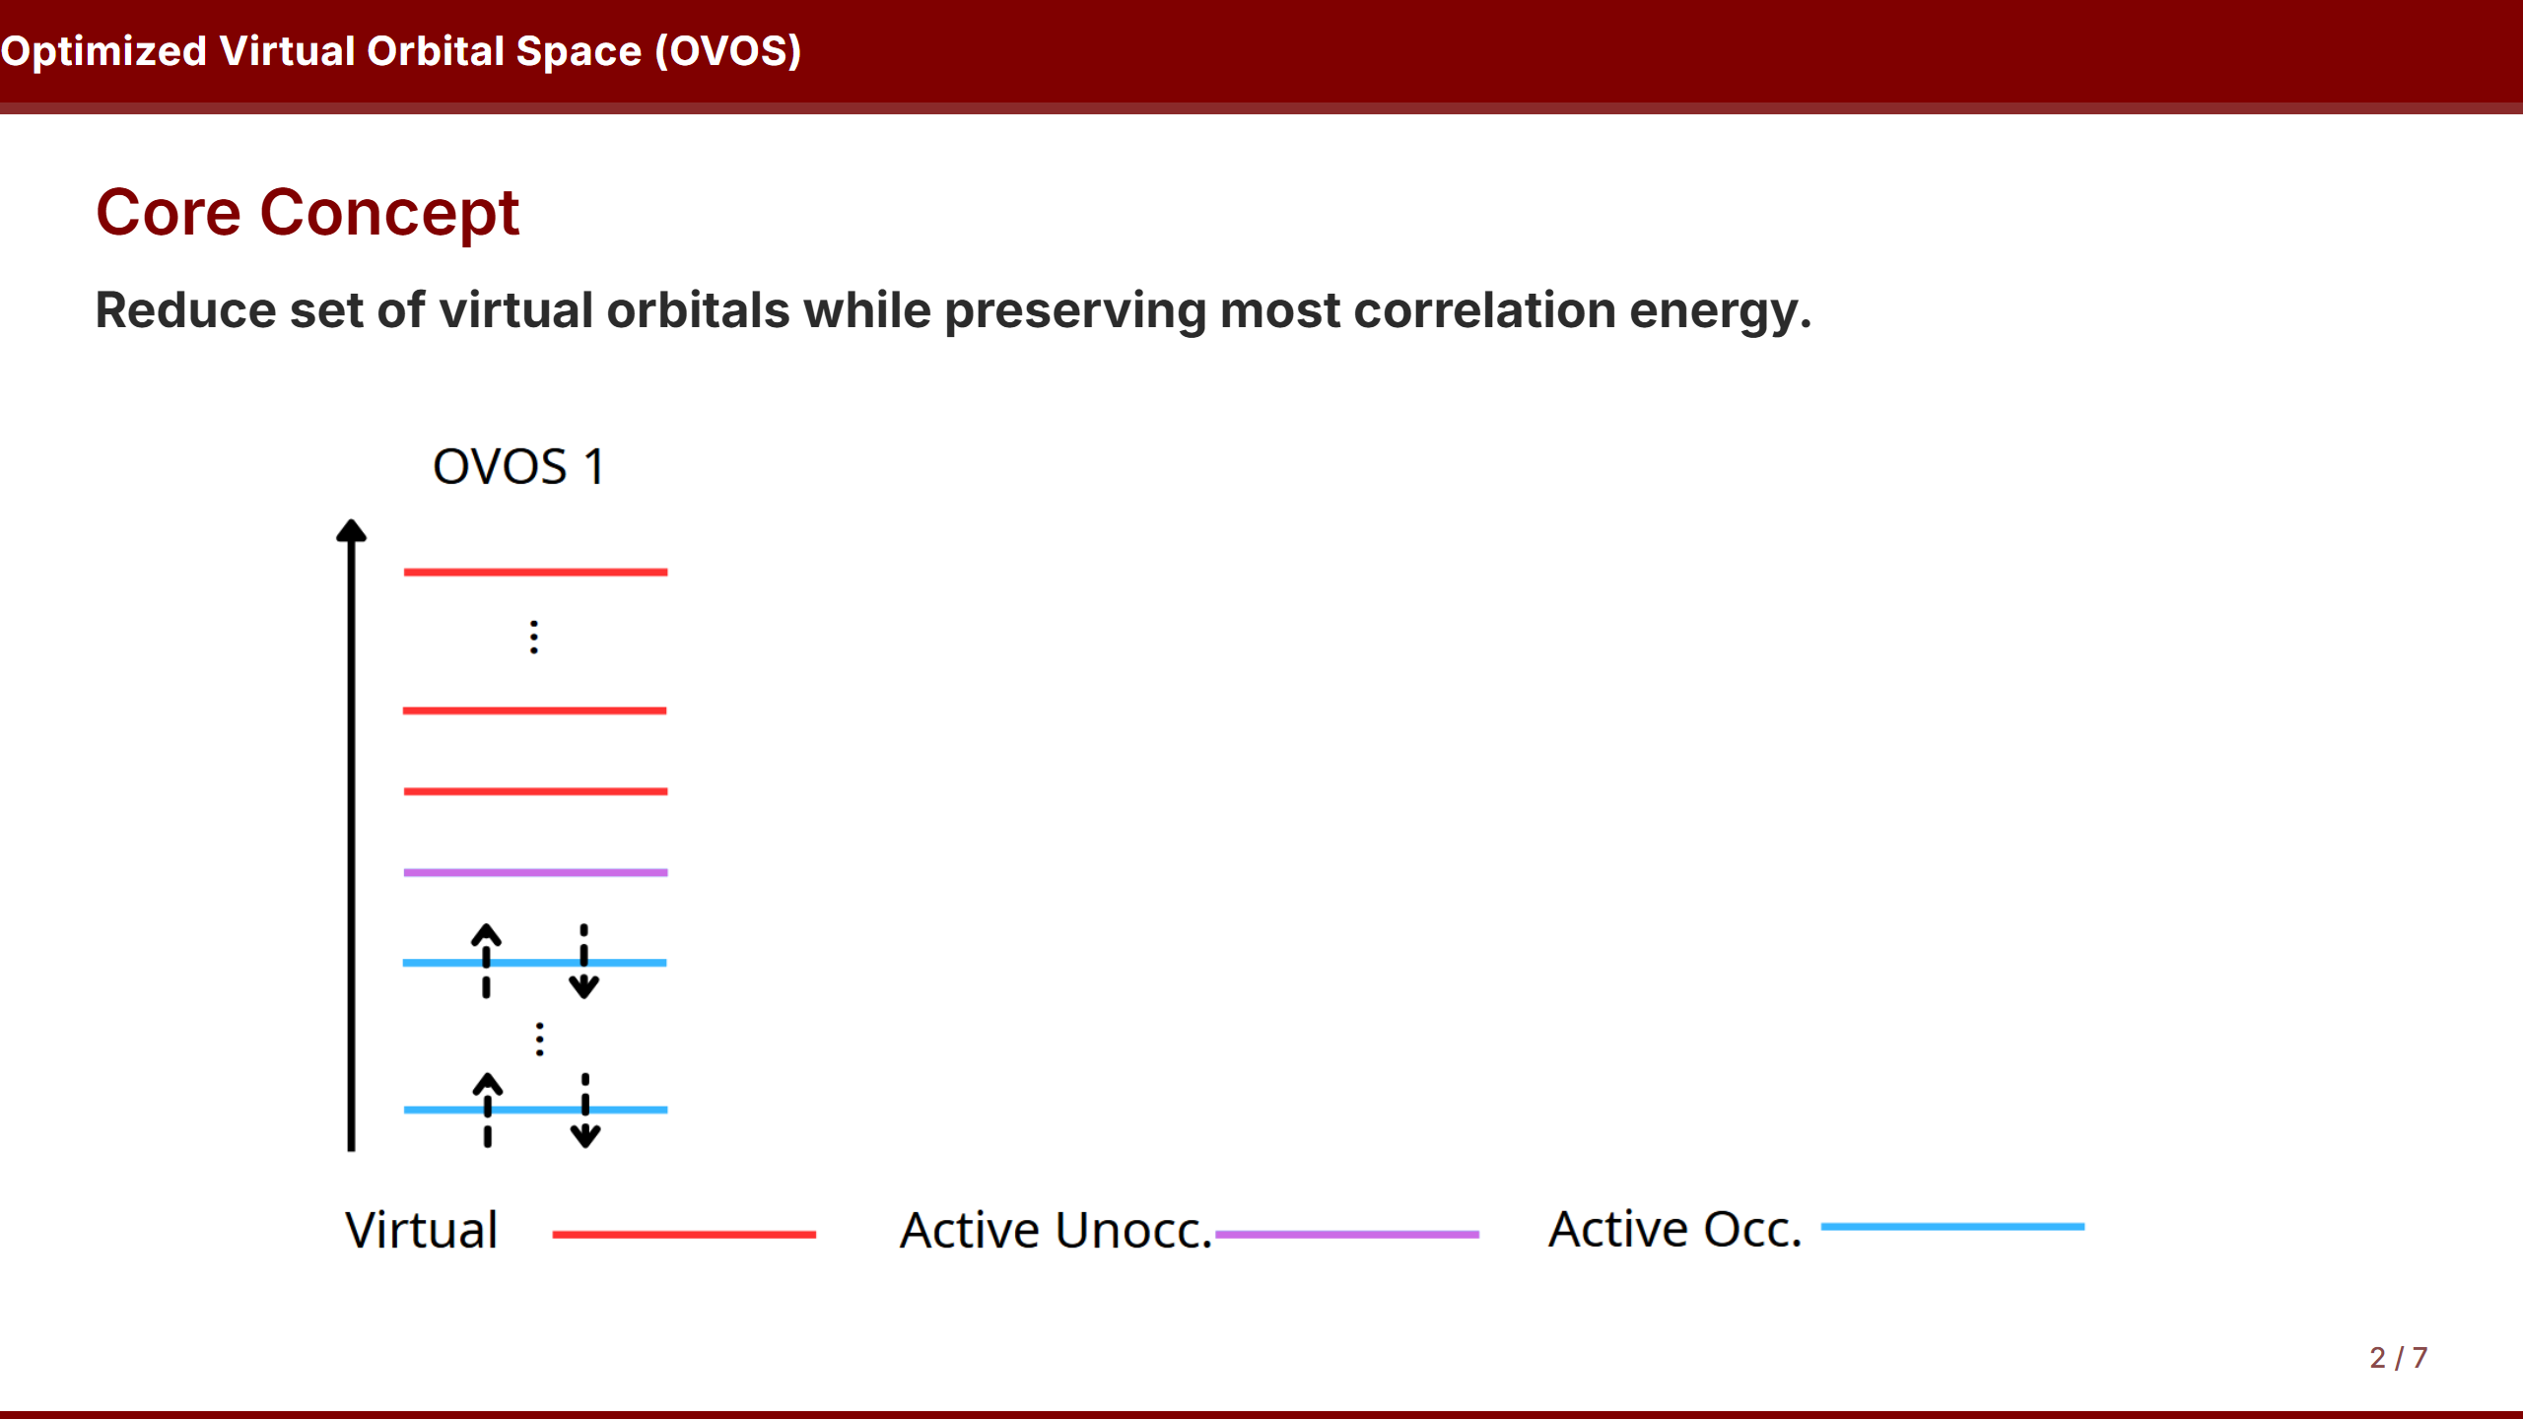

Slide 4
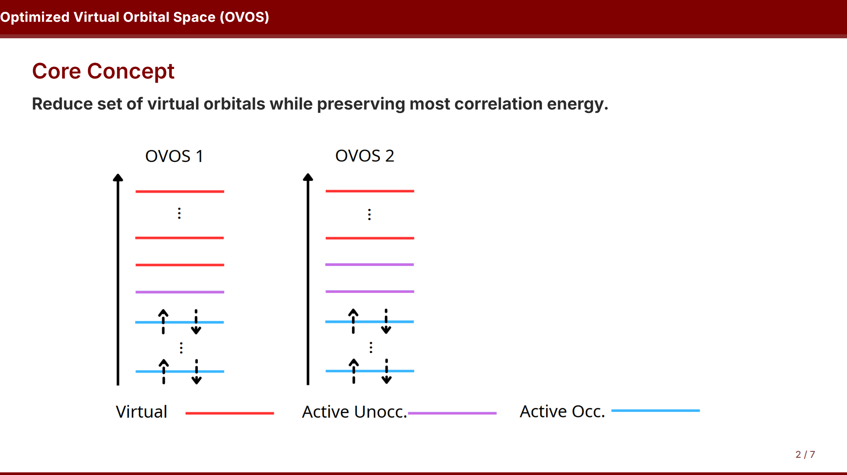

Slide 5
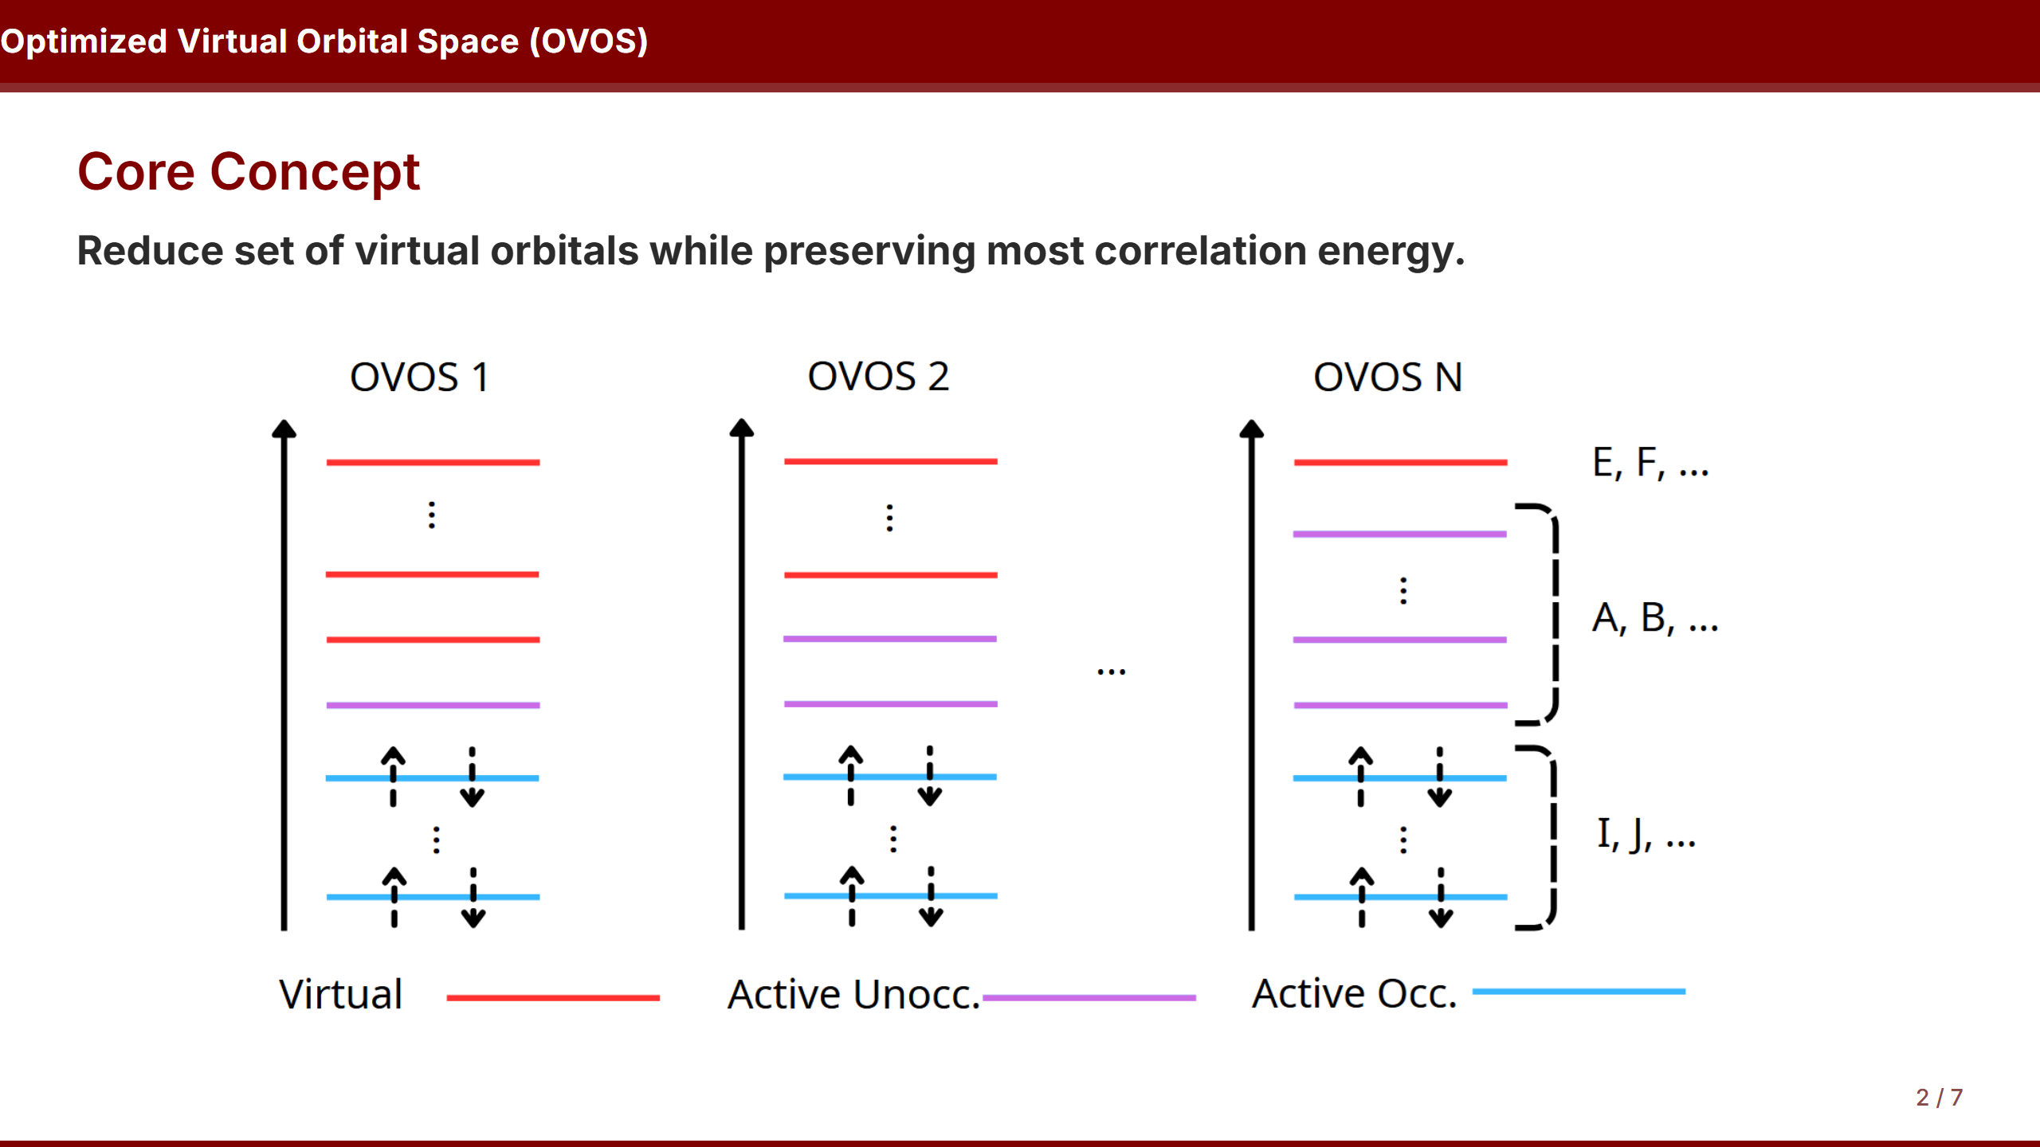

Slide 6
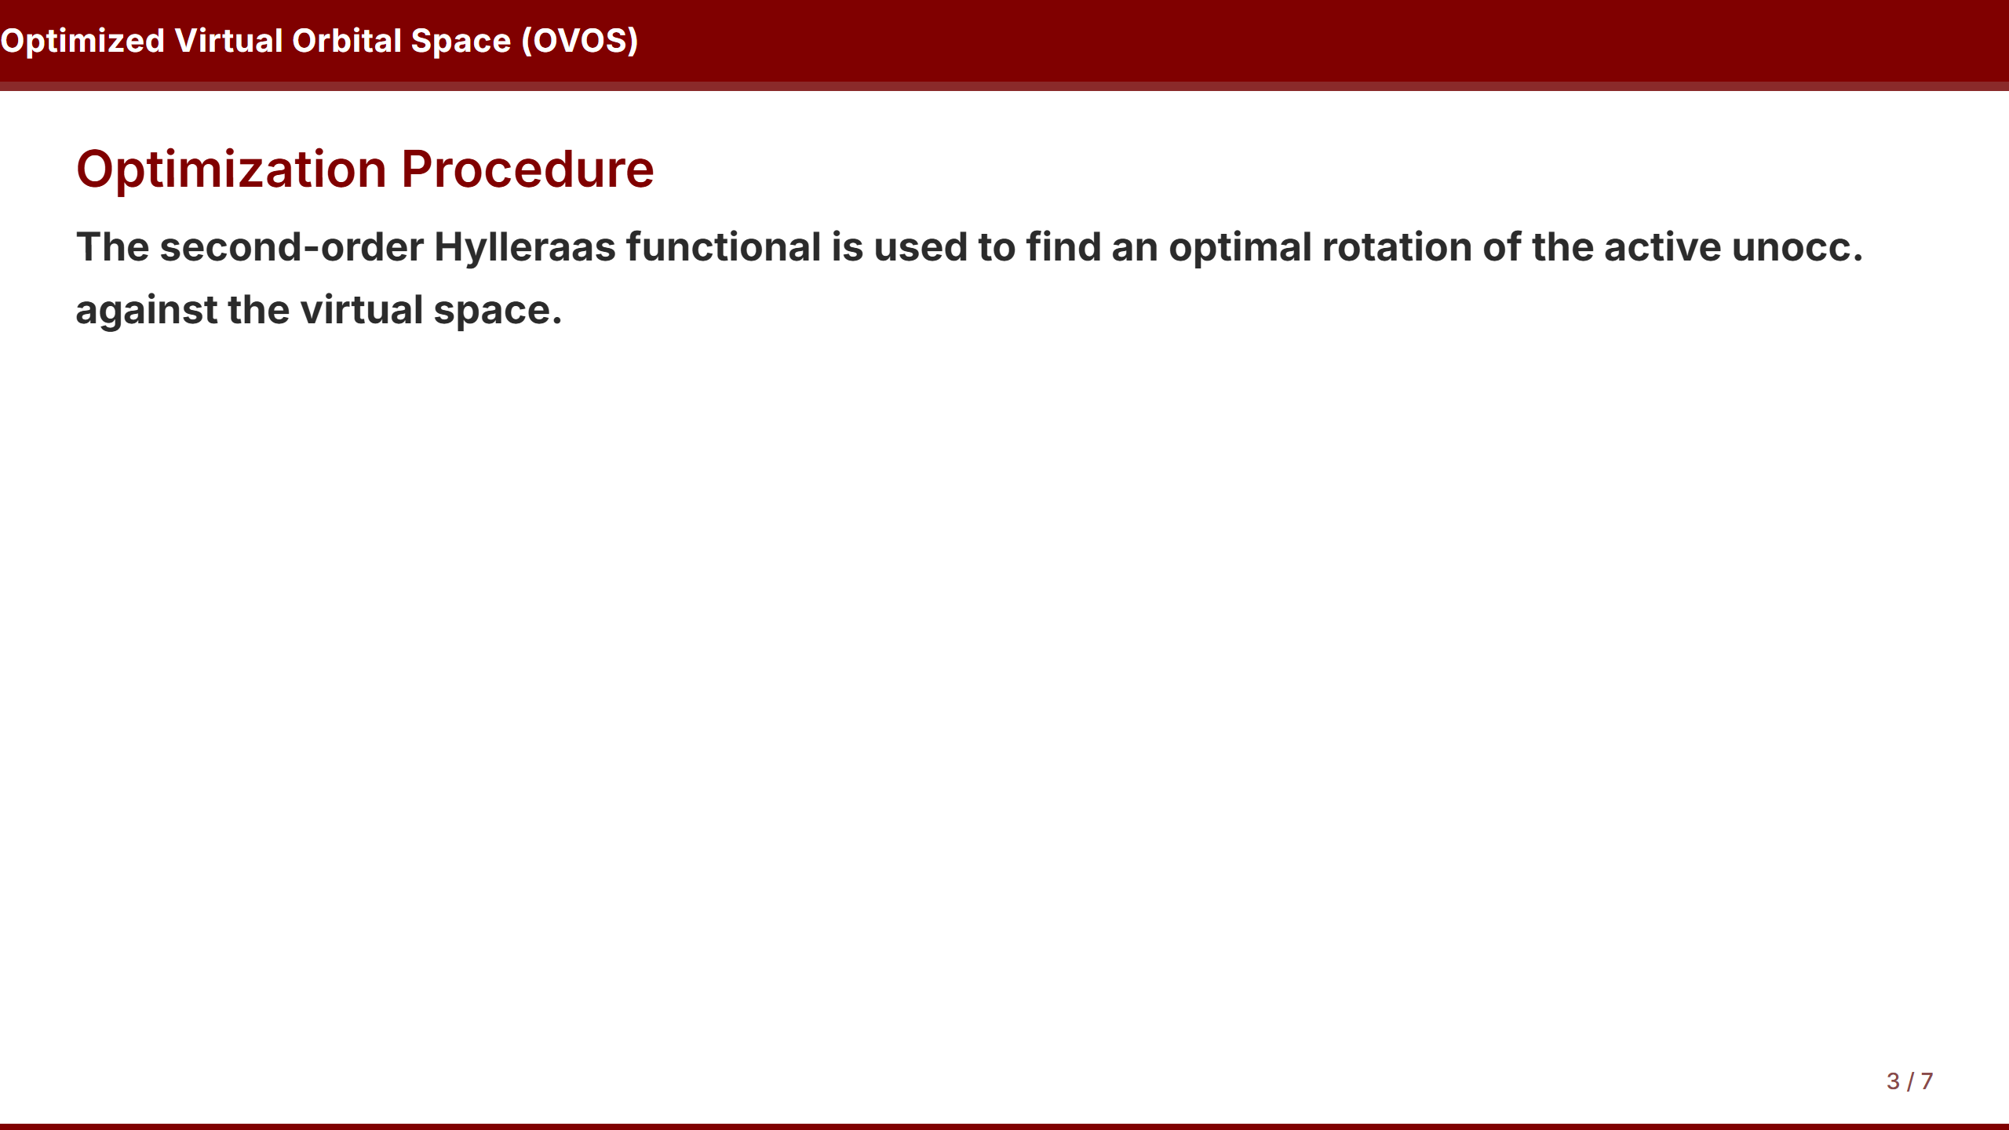

Slide 7
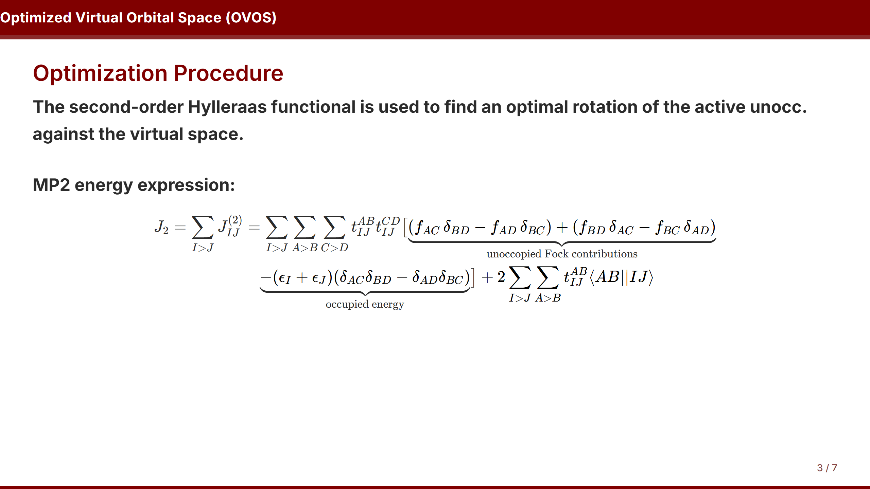

Slide 8
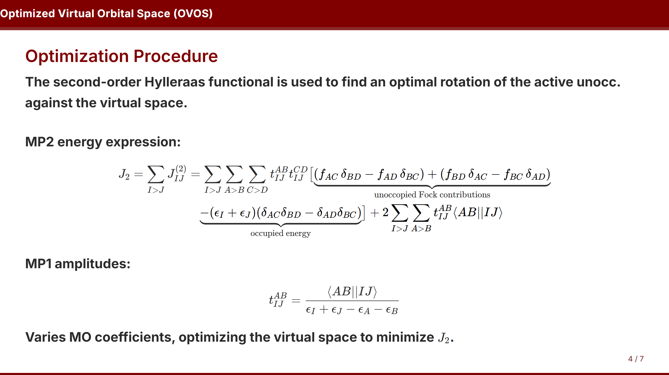

Slide 9
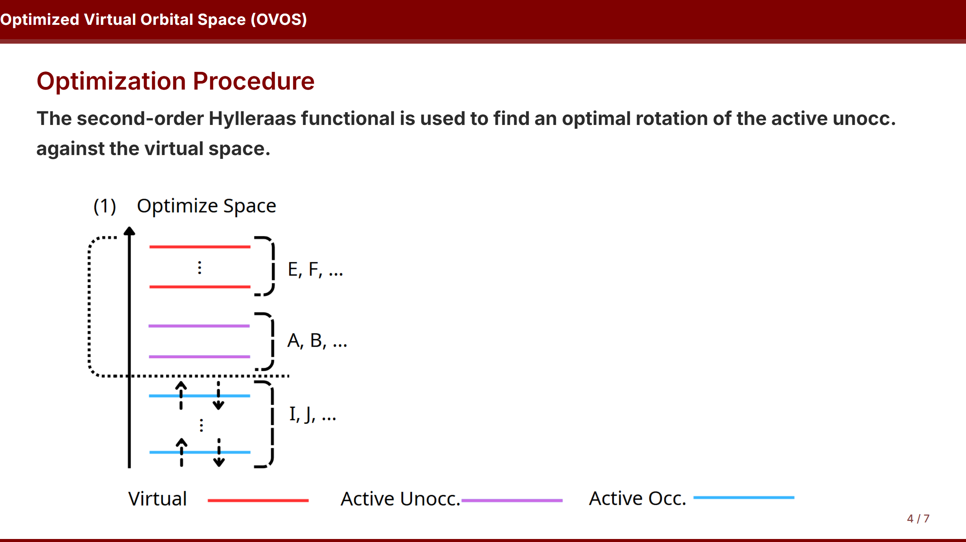

Slide 10
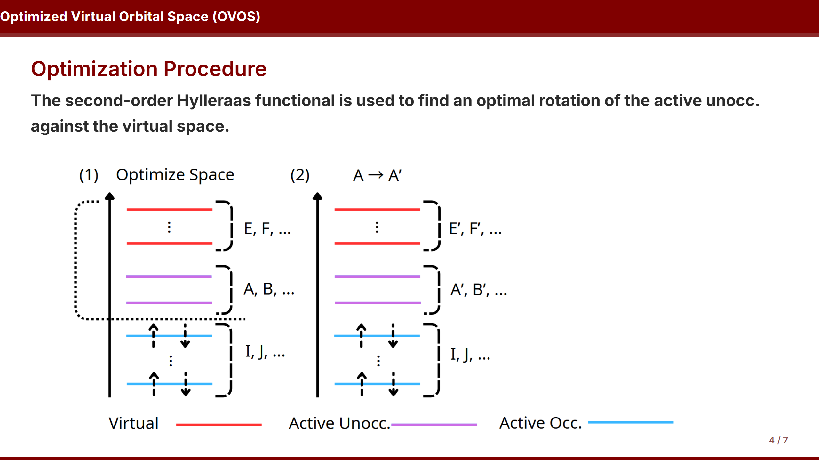

Slide 11
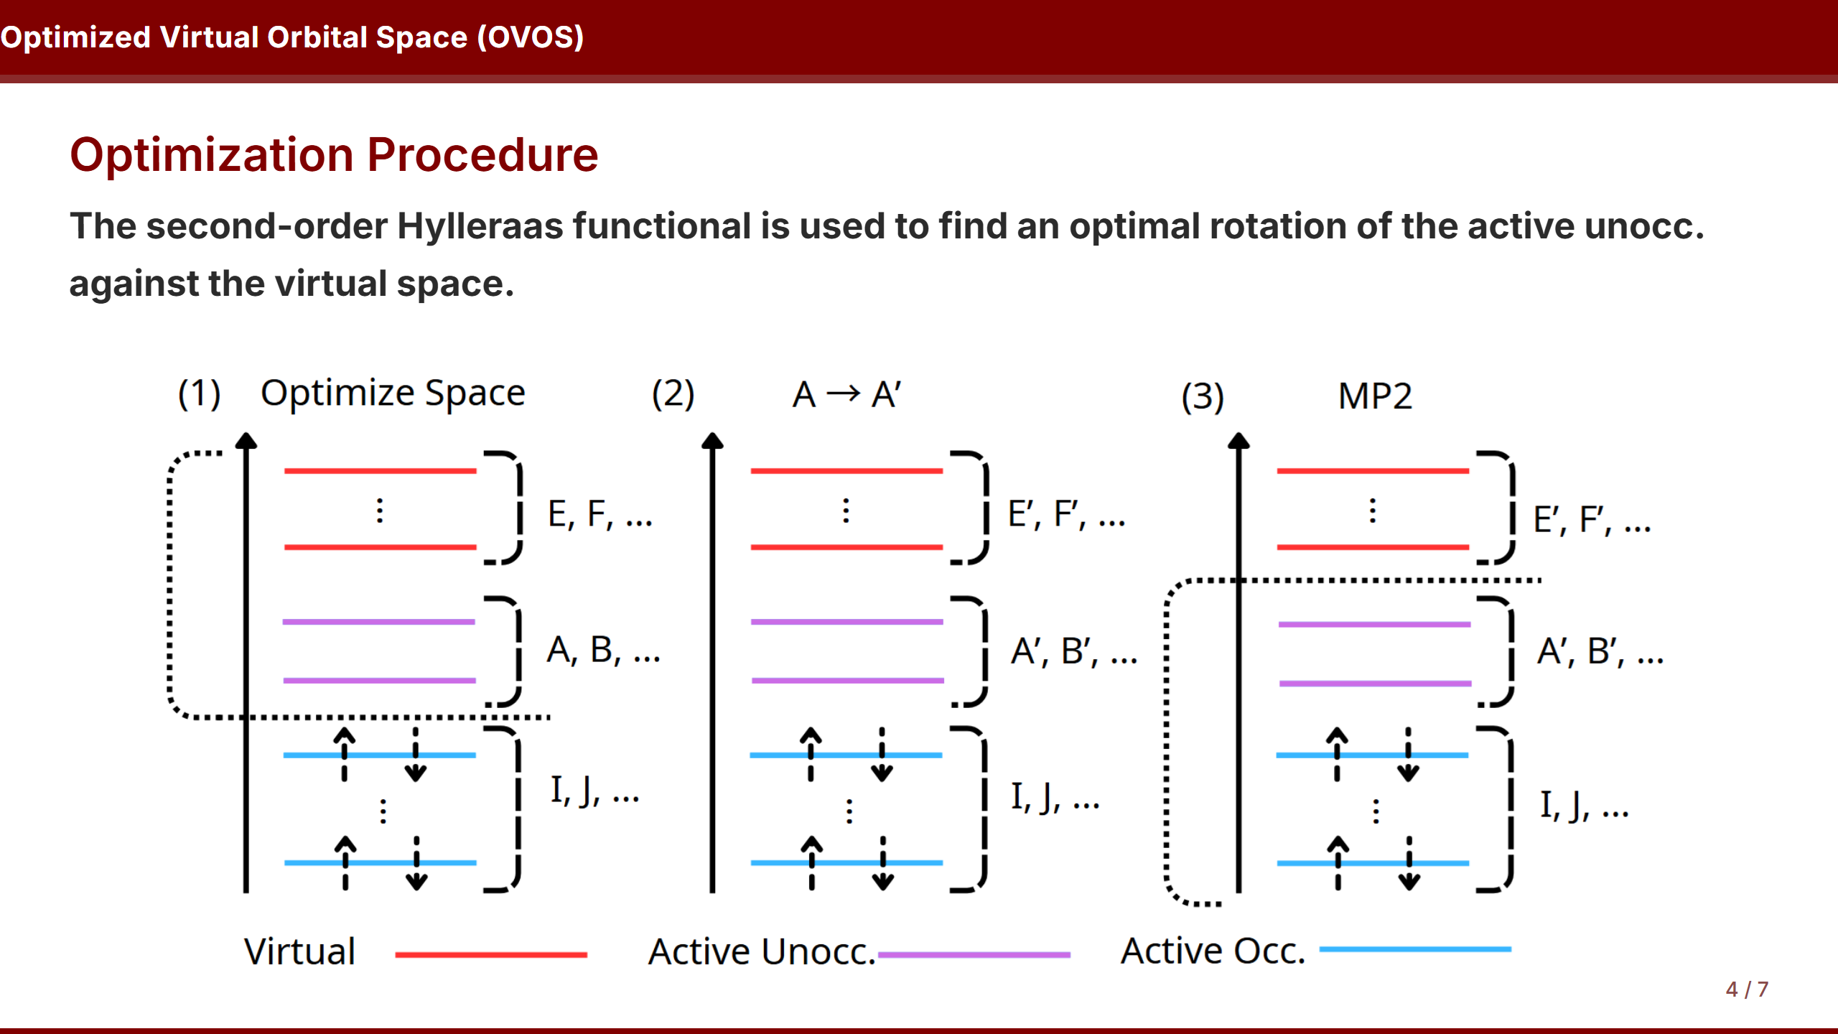

Slide 12
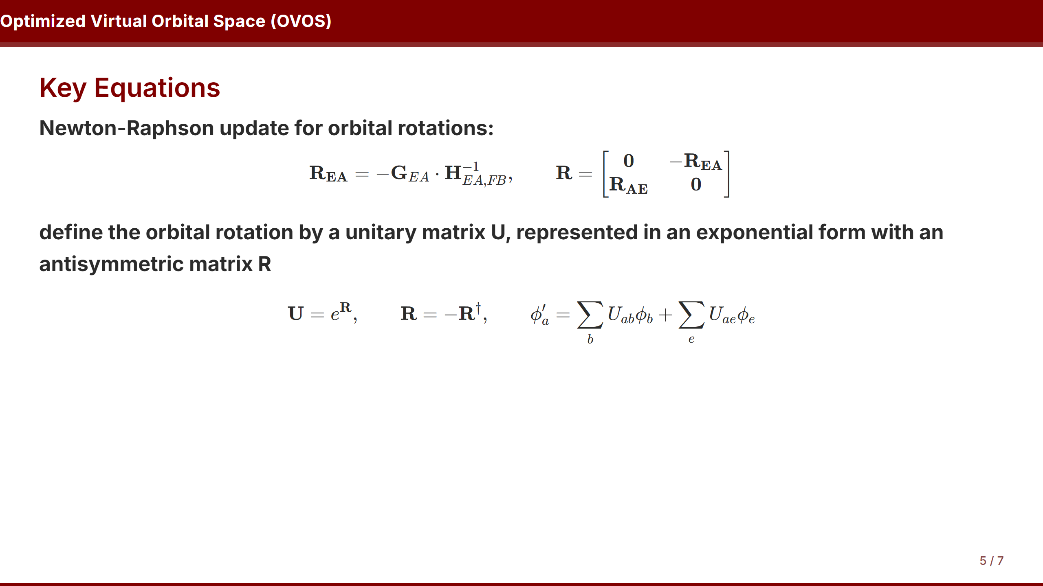

Slide 13
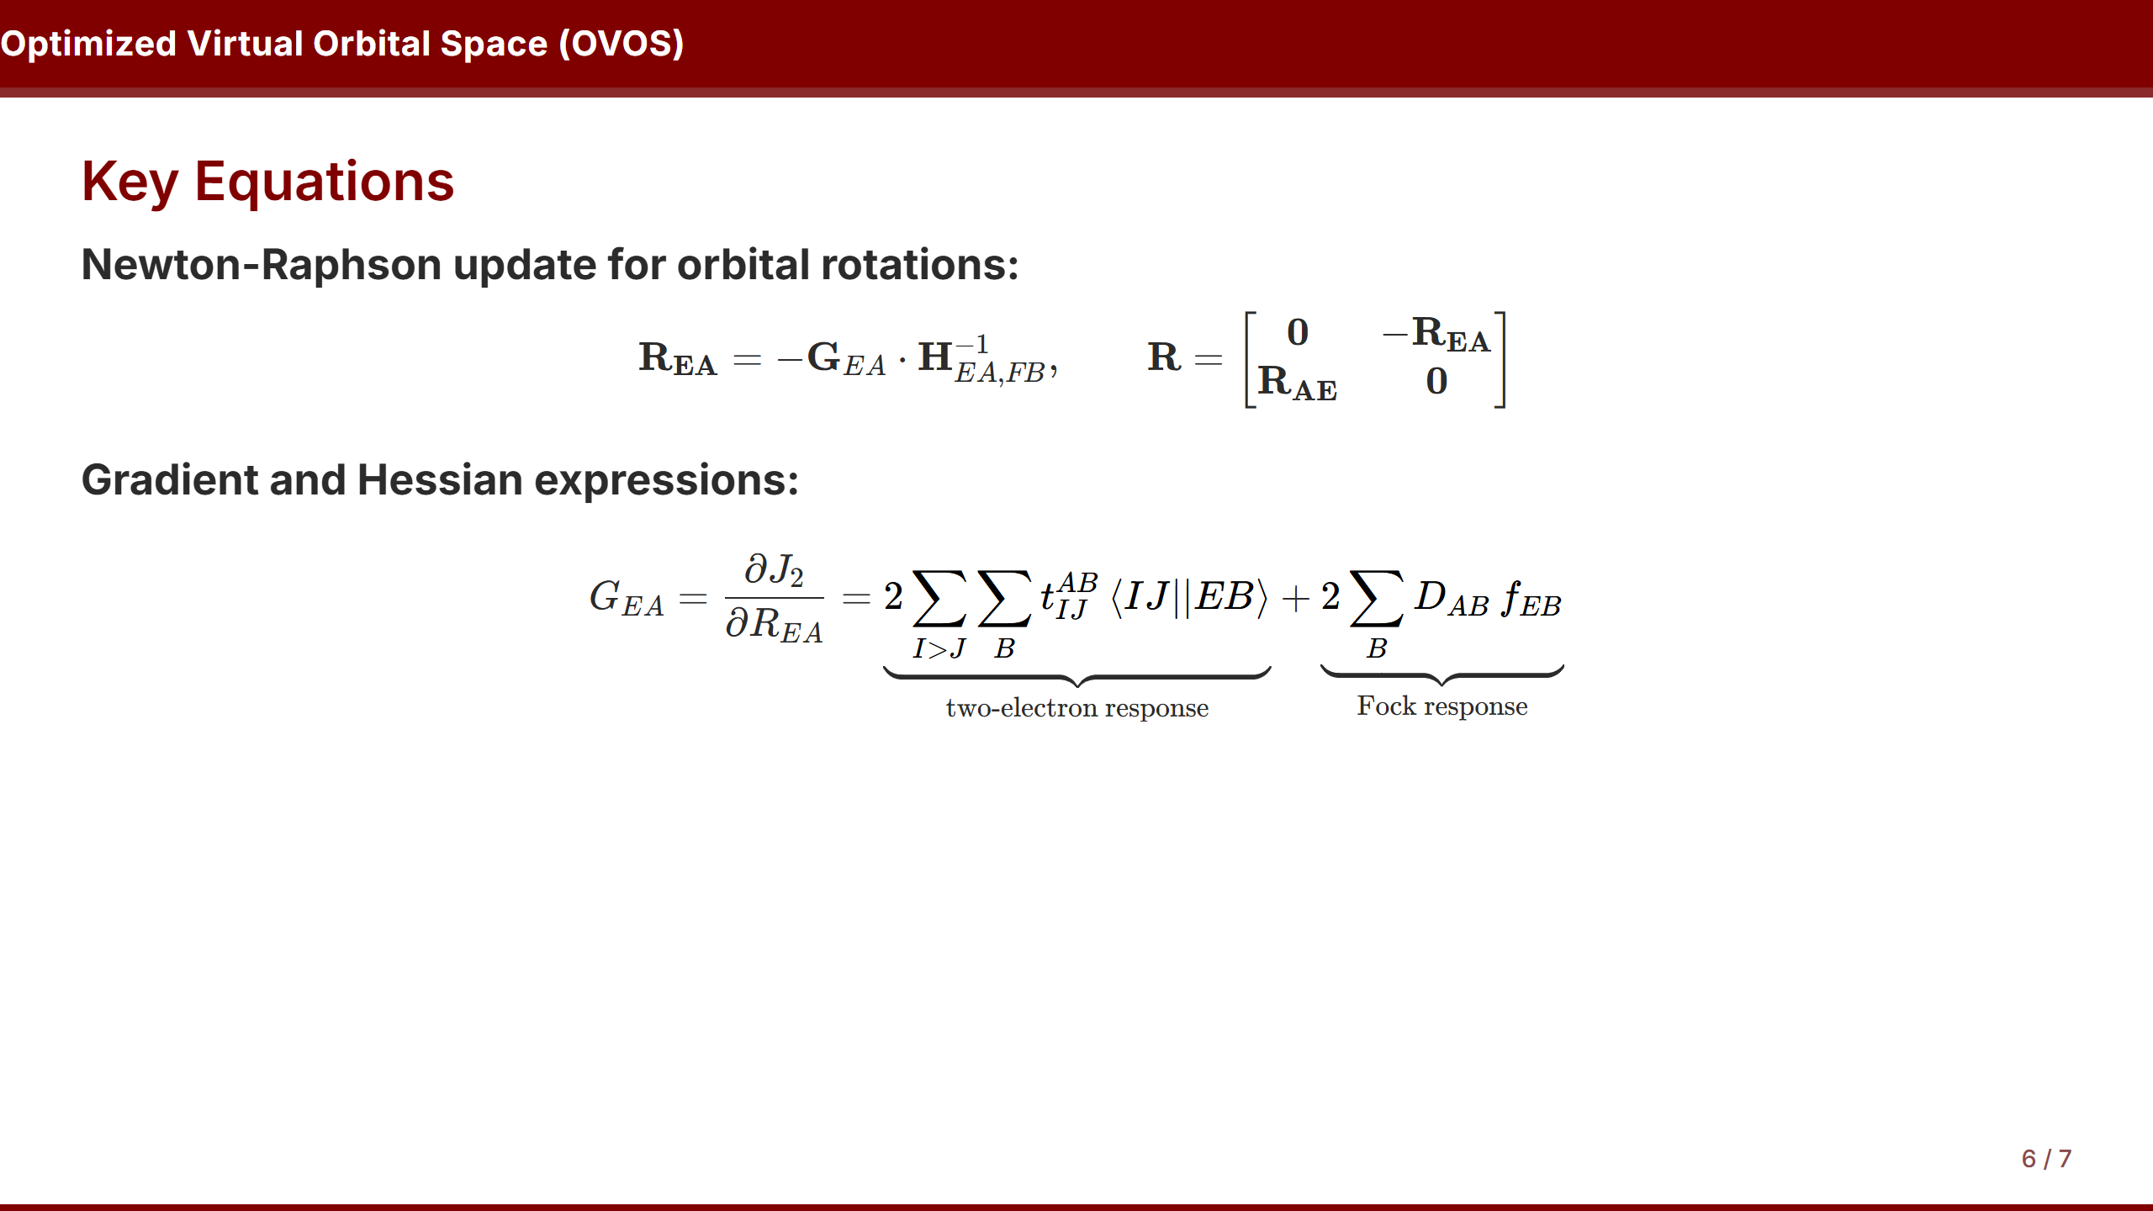

Slide 14
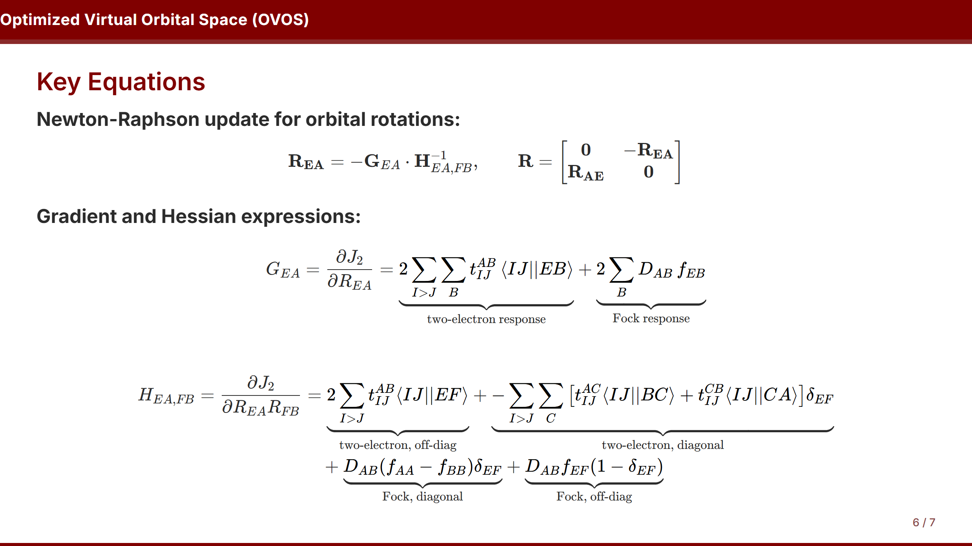

Slide 15
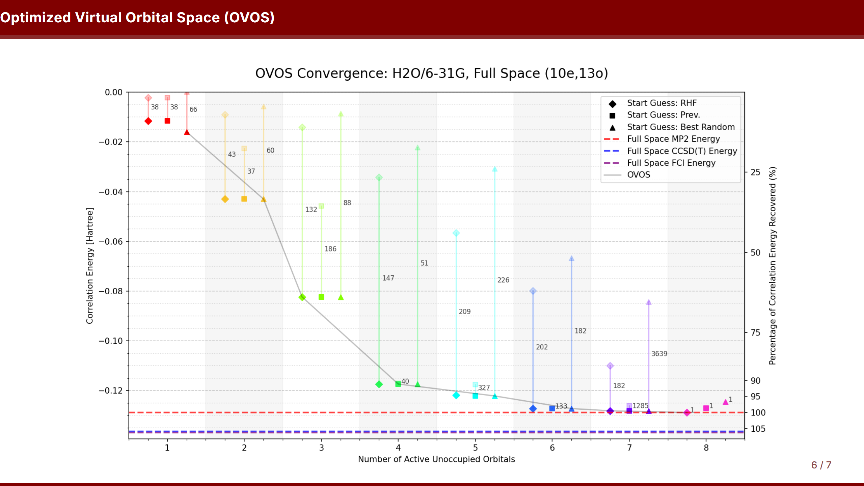

Slide 16
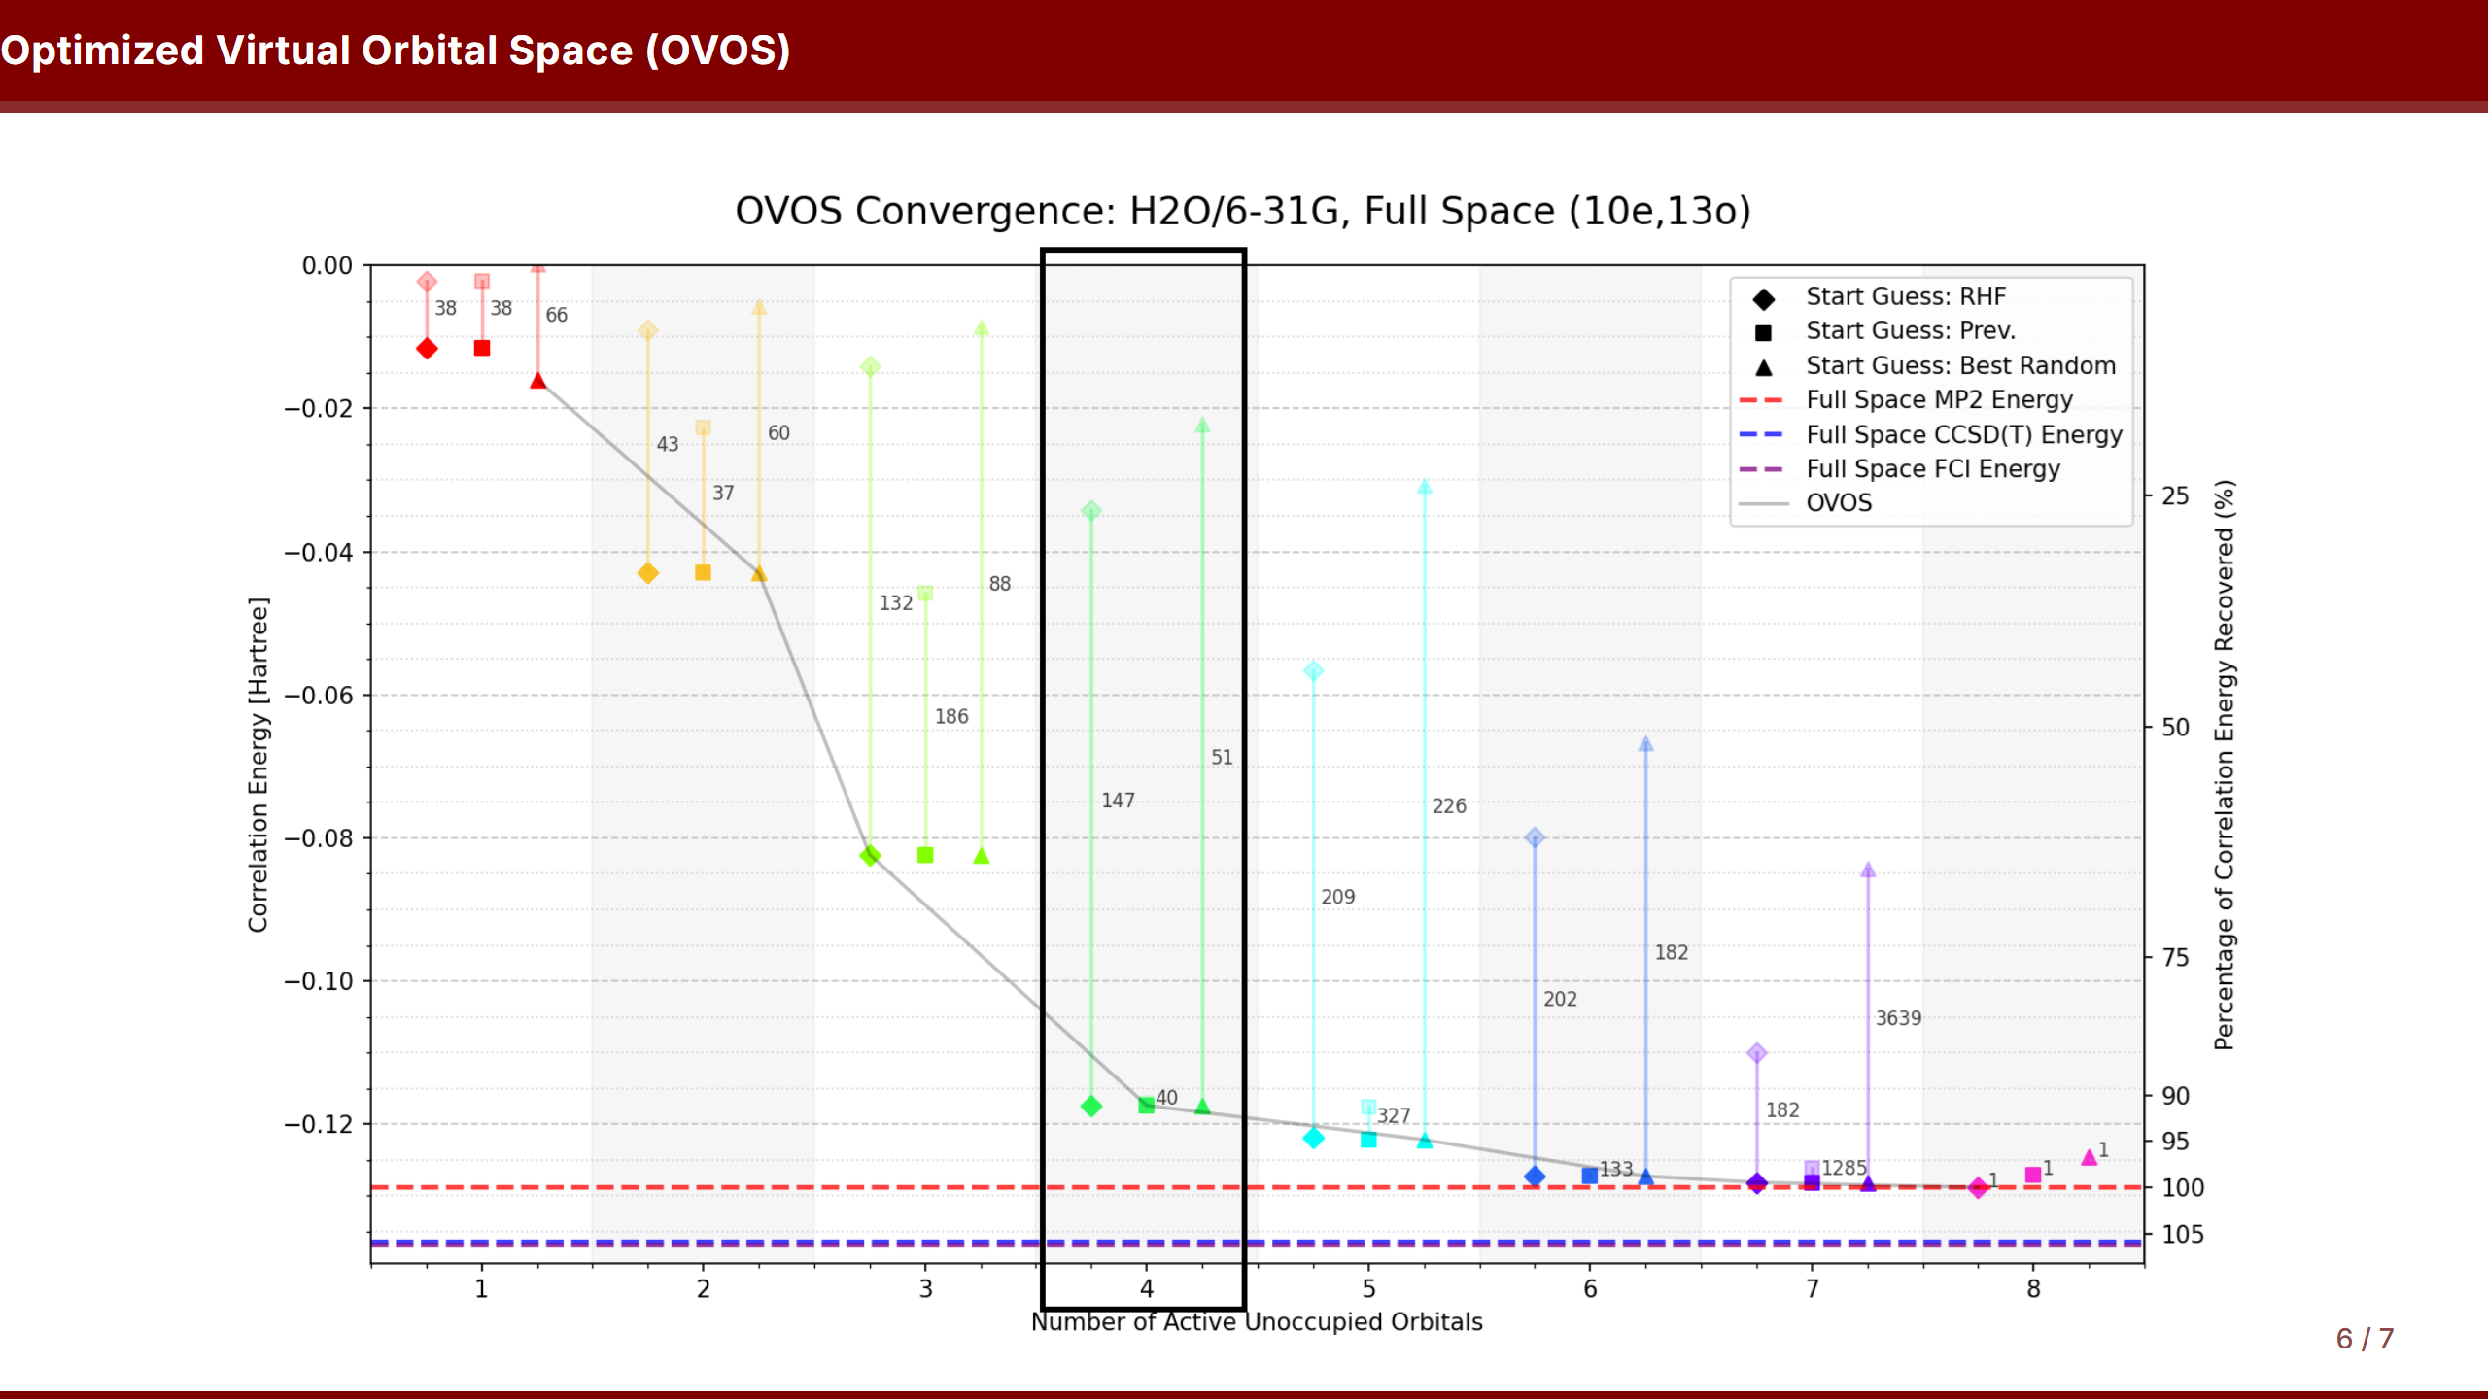

Slide 17
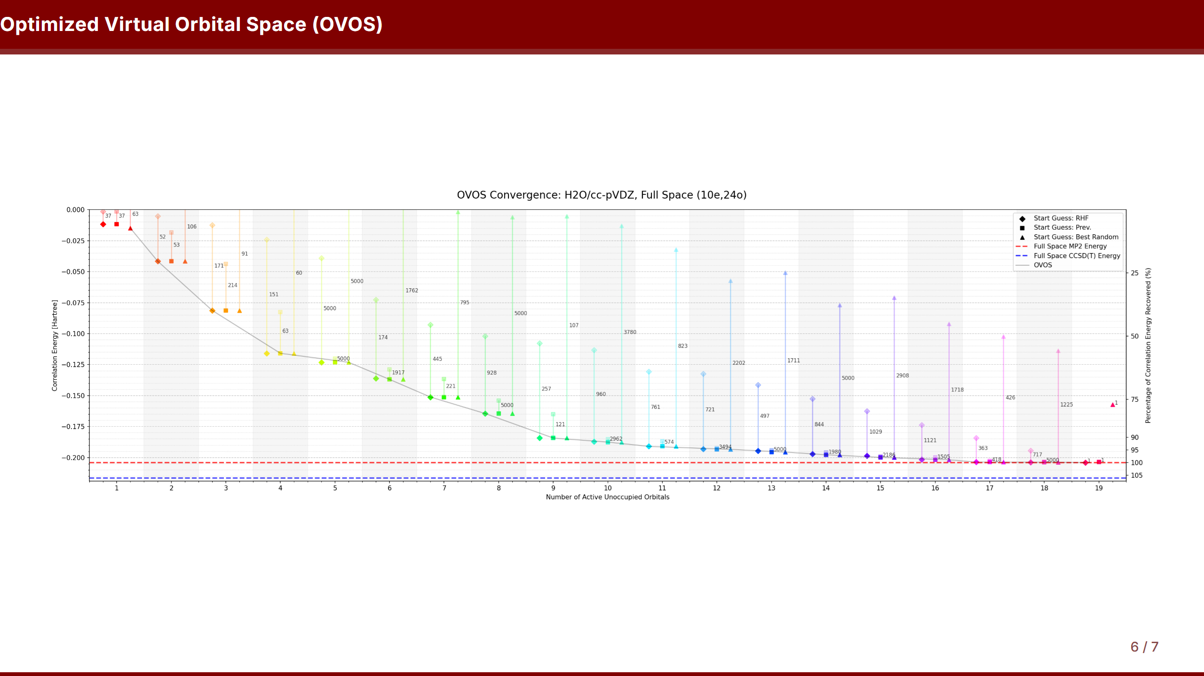

Slide 18
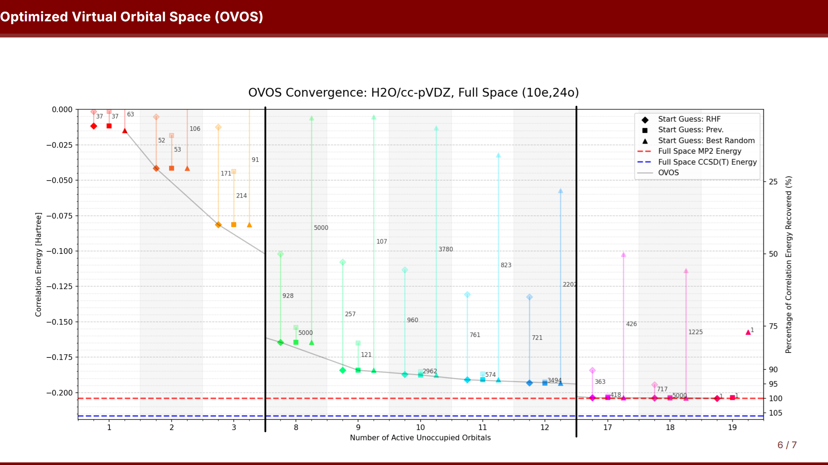

Slide 19
