Slide 1
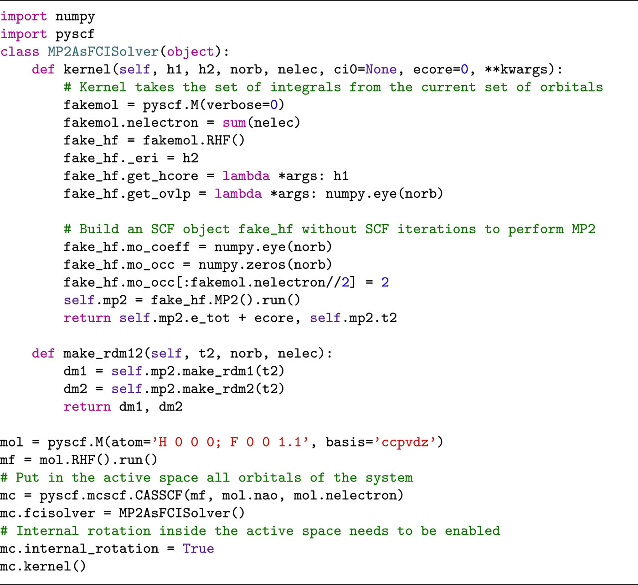
From: Recent developments in the PySCF program package
J. Chem. Phys. 153, 024109 (2020)
^{Date of Download: 3/13/2026}
Copyright © 2026 . All rights reserved.
Notes:
Figure Legend: Using the general CASSCF solver to implement an orbital-optimized MP2 method.

